Slide 1
Feature Extraction & Price Prediction for Mobile Phones
Internship Project
Company: NextHikes IT Solution
Presented by: Rahiluddin Asif Rohila

Slide 2
Introduction
Problem: Improve pricing strategy for mobile phones using data-driven methods.
Goal: Identify key features and build a predictive model.

Slide 3
Dataset Overview
Source file: Processed_Flipdata.xlsx
Rows: 541 | Columns: 18
Features include model, colour, ram, memory, battery, camera specs, processor, price.

Slide 4
Data Cleaning
Dropped empty columns
Filled missing values (categorical -> 'Unknown', numeric -> median)
Extracted numeric parts from RAM/memory/battery/camera columns.

Slide 5
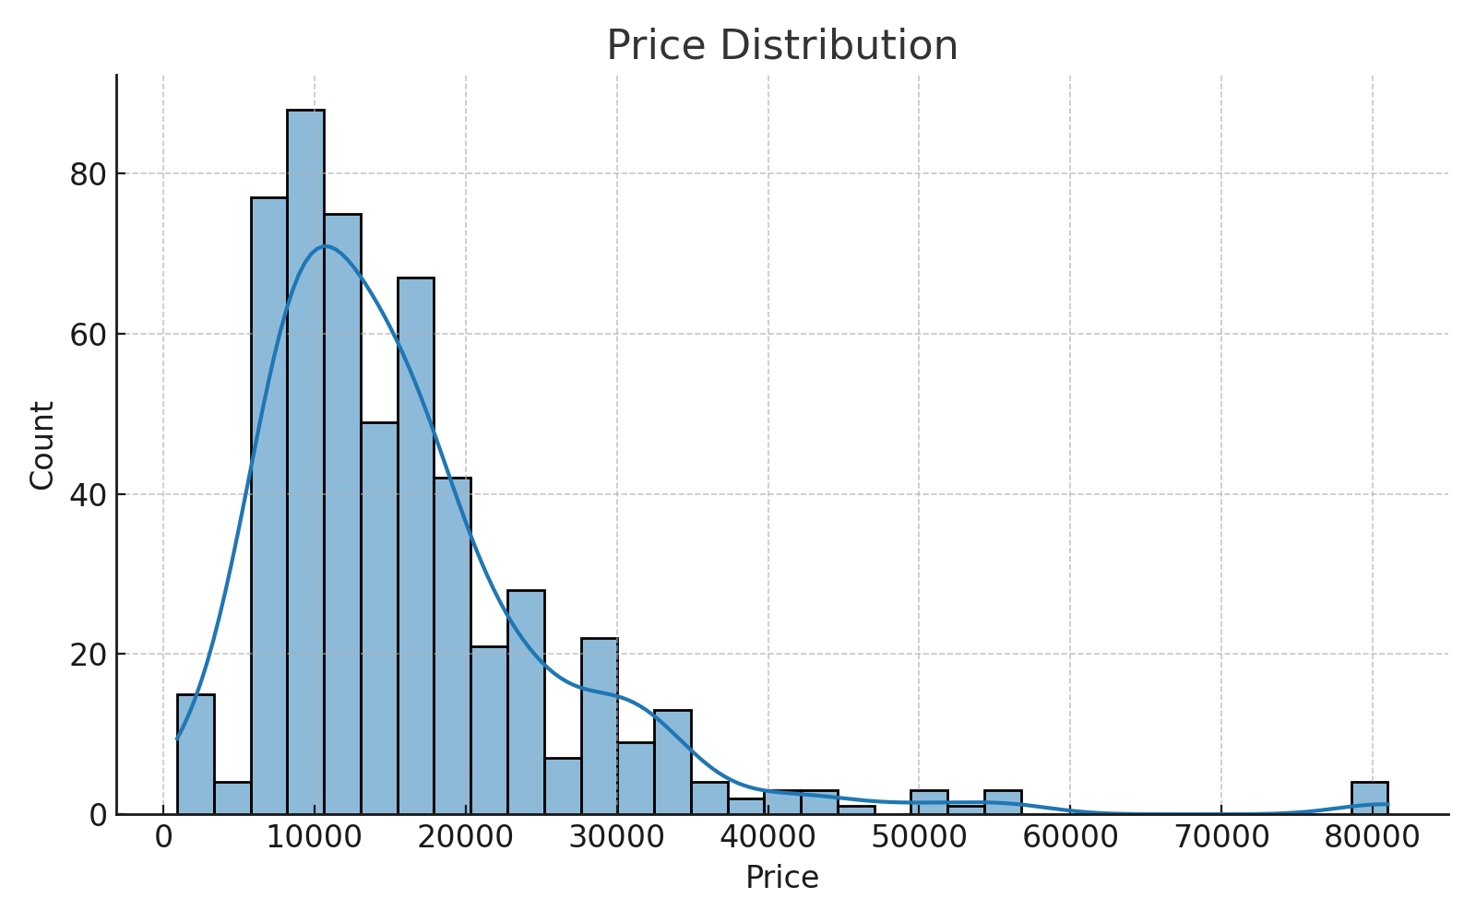
Exploratory Analysis
Price distribution, correlations, and outlier detection.

Slide 6
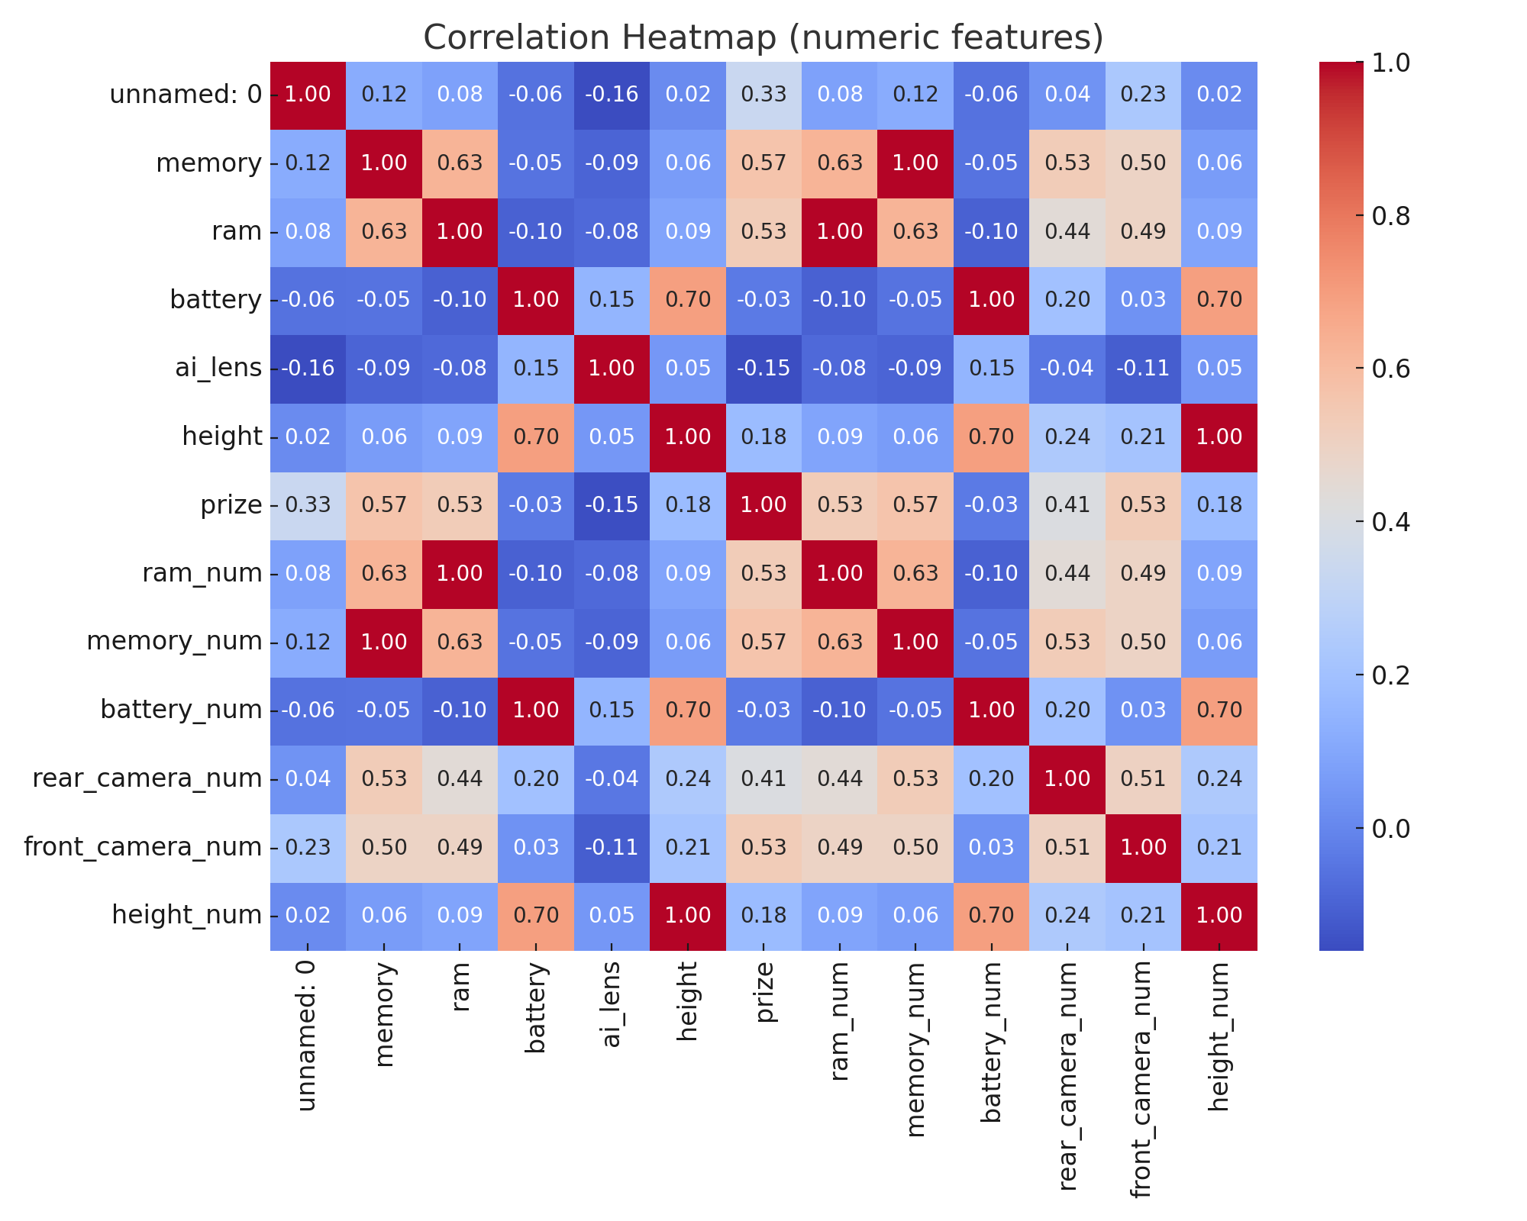
Correlation Analysis
Correlation among numeric features examined.

Slide 7
Feature Engineering
Engineered: ram_num, memory_num, battery_num, rear_camera_num, front_camera_num
Derived candidate features like price_per_unit where applicable.

Slide 8
Modeling Approach
Train/Test split (80/20)
Preprocessing: StandardScaler for numeric, OneHotEncoder for categorical
Model: RandomForestRegressor (n=150)

Slide 9
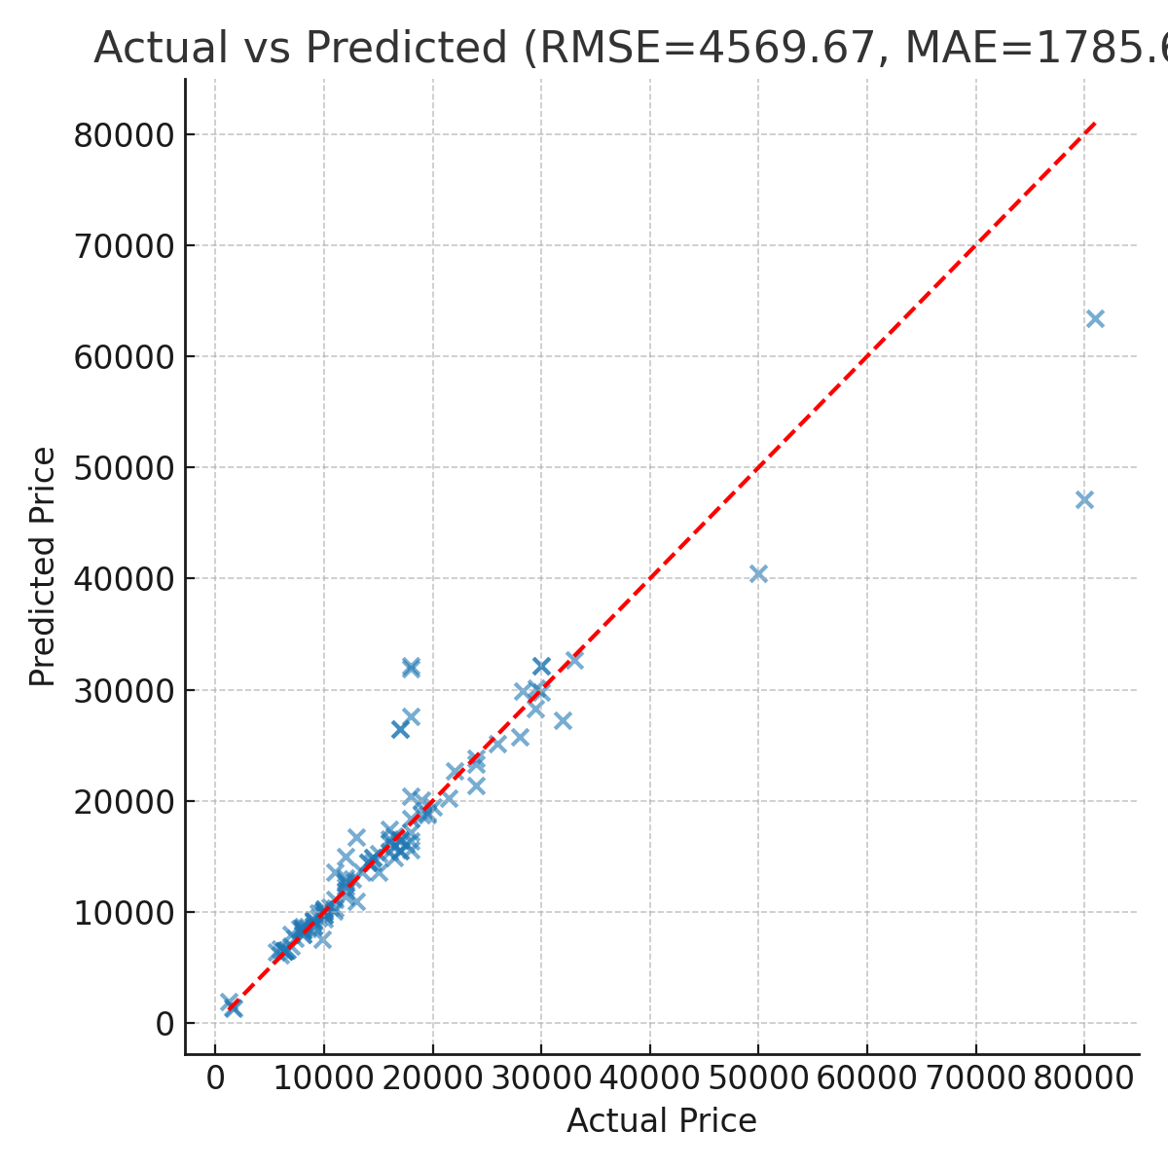
Model Evaluation
MAE: 1785.61
RMSE: 4569.67
R^2: 0.848

Slide 10
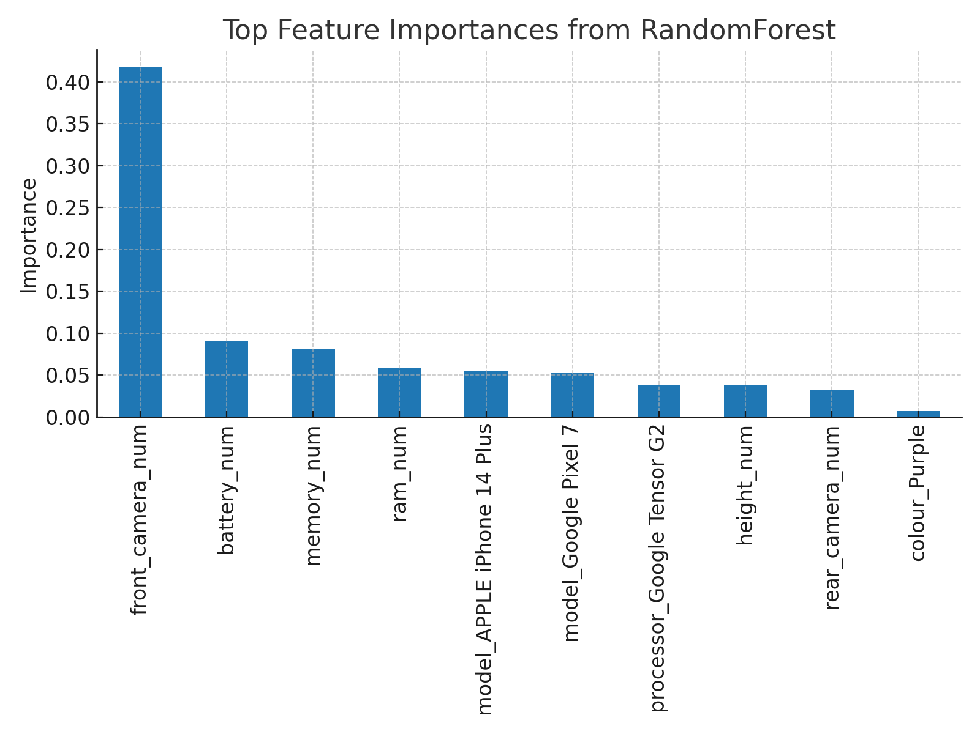
Feature Importance
Top features from model importance analysis.

Slide 11
Recommendations
Focus on high-impact features for pricing (see feature importance).
Use model for initial pricing suggestions and refine with business rules.

Slide 12
Next Steps
1) Hyperparameter tuning and cross-validation
2) Deploy model as API
3) Customer segmentation and targeted pricing

Slide 13
Conclusion
Project delivered a working model and insights for pricing.
Deliverables: code, cleaned data, model pickle, visualizations, presentation.

