Slide 1
Above the Clouds: Performance Analysis of Airline Operations
Team 3 -- eMarket Mavericks:
Bhargav Sukhavasi
Keerthi Kolli
Krishna Vamshi Nethi
Min Shi
Rahil Shah

Slide 2

Agenda
I. Project Introduction
II. Overview of Airline Industry
III. Assessment of Financial Performance of Top 4 Airlines
IV. Top 4 Airlines Revenue Analysis
V. Top 4 Airlines Operating Expenses Analysis
VI. Alliance and Partnerships
VII. Insights & Recommendation
VIII. Summary

Slide 3


I. Project Introduction
Problem Statement
Challenges in airline industry: Volatile fuel prices, fluctuating demand, and evolving consumer preferences.
Intense competition: Airlines must strategically manage operational costs and revenue streams to sustain profitability.
Making informed decisions is crucial: Assess the financial health and performance to understand industry dynamics.

Slide 4
Project Objective
Evaluate the overall financial and revenue health of the top 4 airlines during 2002-2023.
Investigate operating expenses to identify areas of shortness and opportunities for improvement for top 4 airlines.
Combining big events, alliances and partnerships to generate comprehensive context analysis of top 4.

Slide 5
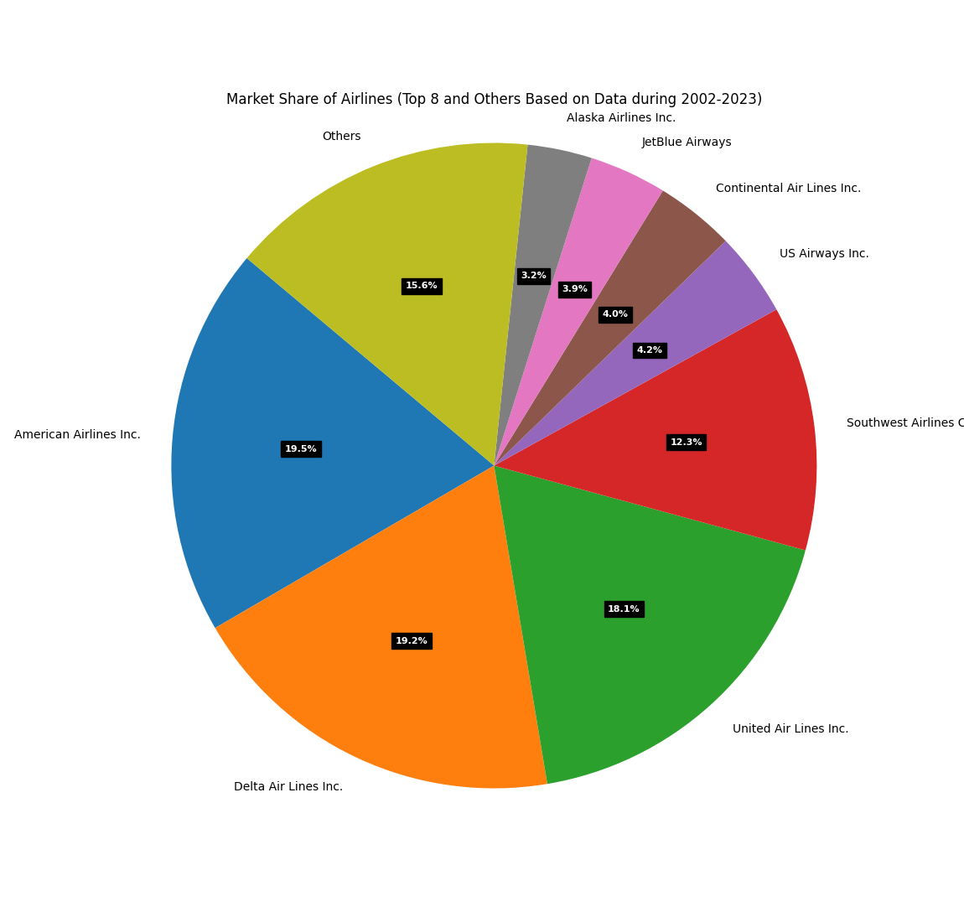
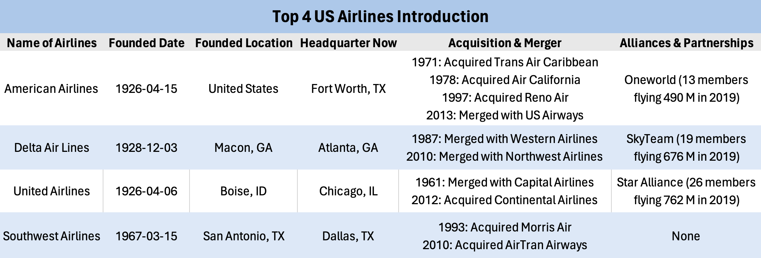
II. Overview of Airline Industry
American Airlines, Delta Air Lines, United Airlines, and Southwest Airlines are the undisputed leaders in the US market. The significant presence of other players with 30% market share include Regional Airlines, Budget Airlines and Legacy Carriers
The historical progression of mergers and acquisitions that led to the establishment of the four largest airlines in the U.S. They boast extensive route networks, large fleets, and brand recognition.
Each has a distinct niche: American focuses on a global network, Delta prioritizes customer service, United emphasizes efficiency, and Southwest is known for its low-cost model.

Slide 6
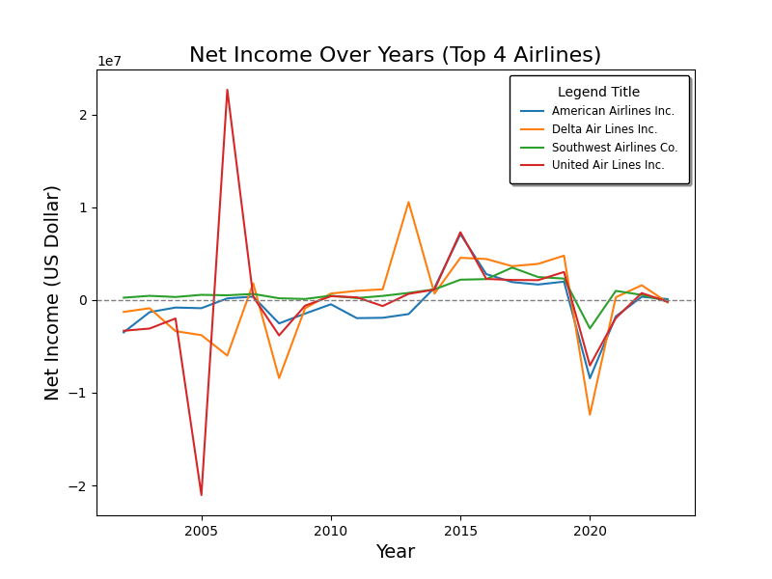
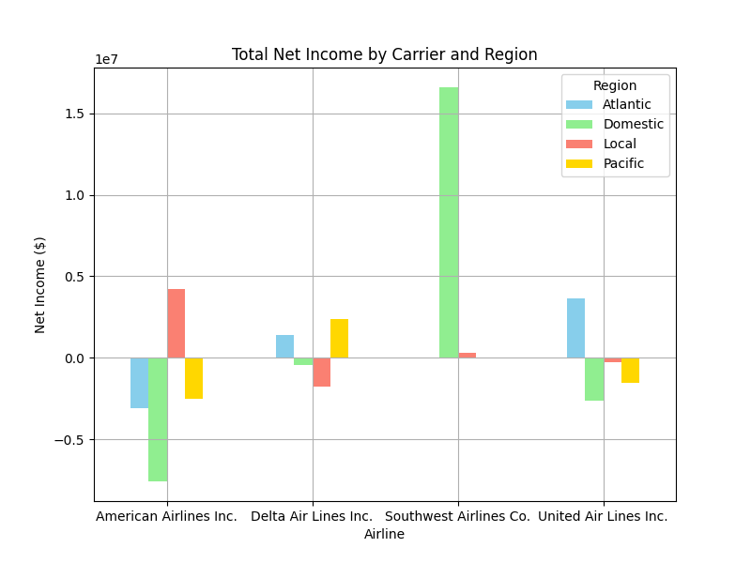
III. Assessment of Financial Performance of Top 4 Airlines
Net Income Over Years by Airline:
American Airlines' Financial Challenges: Negative net income till 2014.
Delta Air Lines' Strategic Shift: Positive net income since 2010 and a notable increase in 2013.
United Airlines' Volatility: significant loss in 2005 but recovered in 2006.
Southwest Airlines' Stability: the most stable net income trend among top 4.
Total Net Income by Airline and Region:
Southwest Airlines: focus on domestic routes and net income is the highest.
American Airlines: huge net loss, particularly in domestic operations.
Delta Airline: net loss in local flight and domestic operations.
United Airlines: earn the most from its across-Atlantic Ocean flights, but face losses in domestic, local, and Pacific operations.

Slide 7
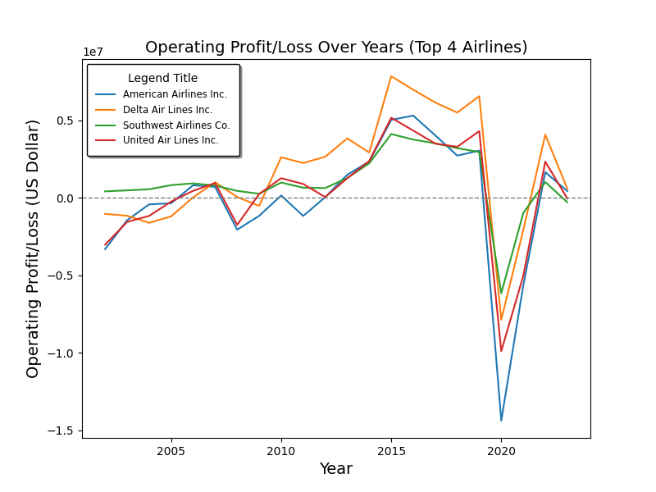
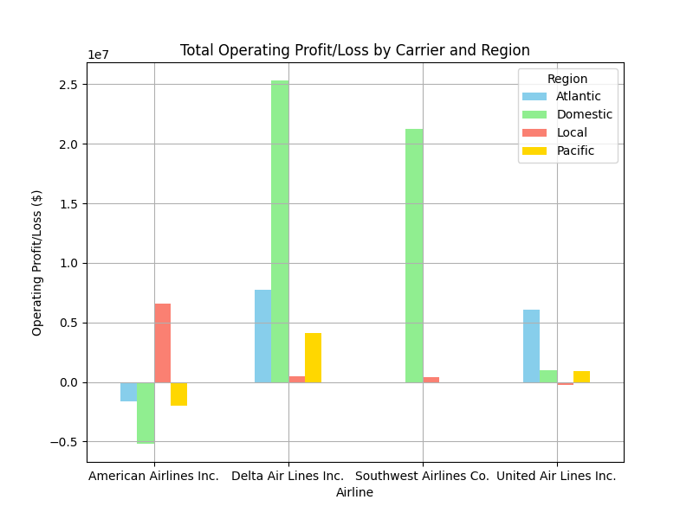
III. Assessment of Financial Performance of Top 4 Airlines
Operating Profit/Loss Over Years by Airline:
The trends for US top 4 airlines are similar.
Among the top 4 airlines, Delta Air Lines is the most profitable airline:
(1) Fuel Hedging (2) Fleet Modernization (3) Operational Excellence
(4) Customer Service and Brand Loyalty (5) Strategic Partnerships
(6) Cost Discipline (7) Economic Recovery Leverage
Total Operating Profit/Loss Income by Airline and Region:
Delta Airlines: earnings in all four regions, domestic operation most.
Southwest: 2nd place, operating solely in domestic and local markets.
United: 3rd place, the most substantial earnings from Atlantic routes.
American: least profitable, overall negative profit, especially in domestic operations.

Slide 8
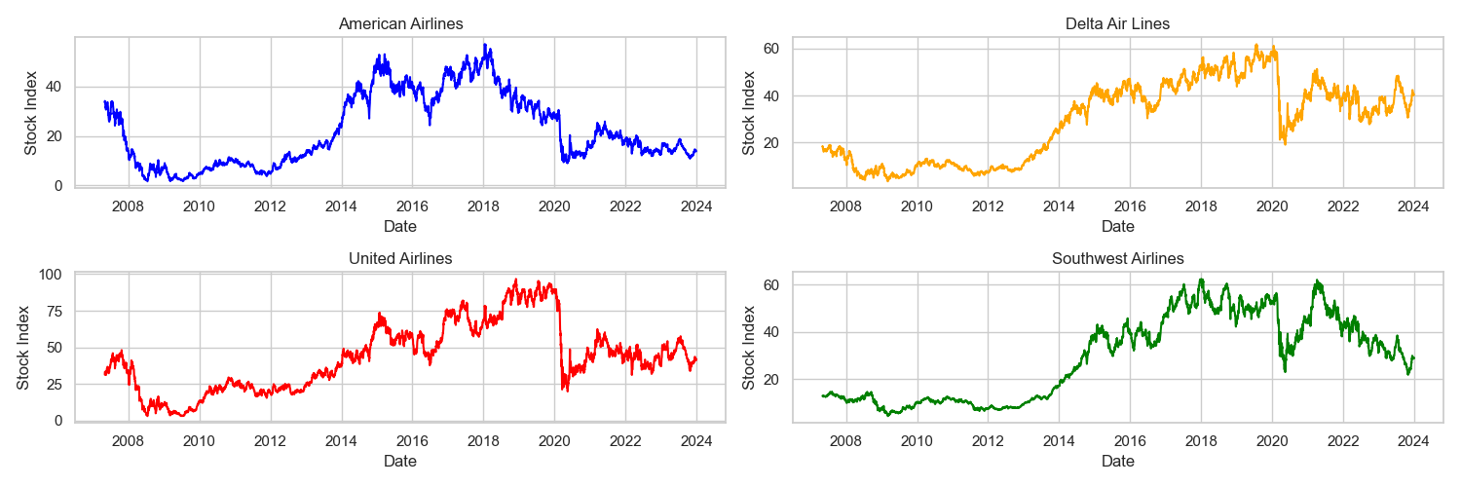
III. Assessment of Financial Performance of Top 4 Airlines
Top 4 US Airlines Stock Index (2007-2024)
Insights:
American’s stock data maintain low since 2019.
Delta’s stock data is the most robust one.
United Airline’s stock data is still during recovery.
Southwest’s stock data recovered to pre-pandemic level in 2021 but decreased a lot recently.

Slide 9
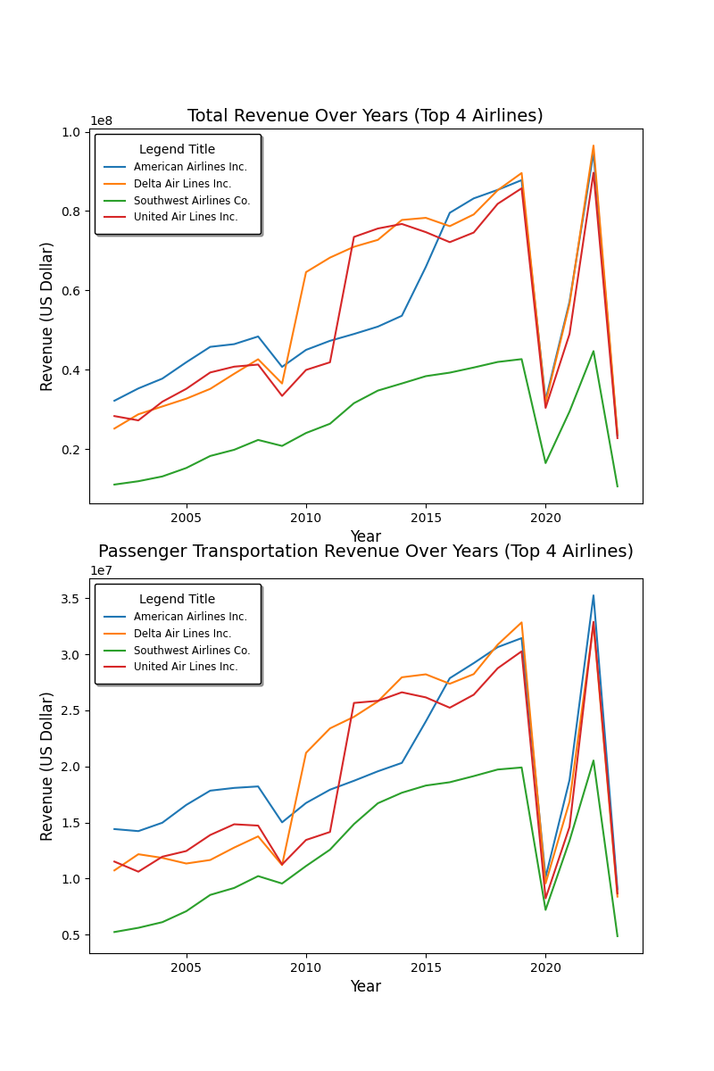
IV. Top 4 Airlines Revenue Analysis
Total revenue appears to be increasing over the years for all four major US airlines
Delta Airlines has the highest total revenue among the four airlines throughout the provided timeframe.
There were two major dips in total revenue coinciding with the 2008 financial crisis and the COVID-19 pandemic.
American Airlines experienced slower revenue growth compared to competitors from 2008 to 2013. Following their merger with US Airways, they implemented a turnaround strategy that improved their performance.

Slide 10
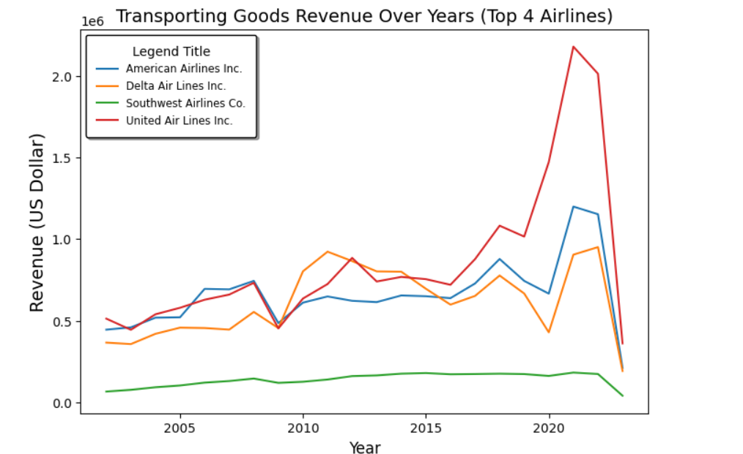
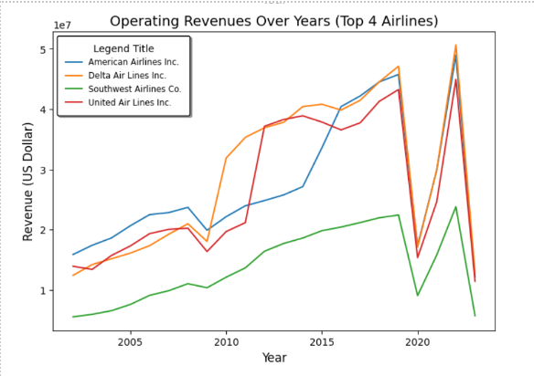
IV. Top 4 Airlines Revenue Analysis
With passenger demand plummeting, airlines needed alternative revenue streams. Cargo transportation boomed during the pandemic due to continued demand for goods
United Airlines' transportation goods revenue has grown significantly over the past few years in compared to others
Delta Airlines appears to have the highest operating revenue throughout the years shown in the chart, followed by American Airlines, United Airlines and Southwest Airlines.
Delta merged with Northwest Airlines in 2008 created a larger, more competitive airline with a wider route network and increased operational efficiency.

Slide 11
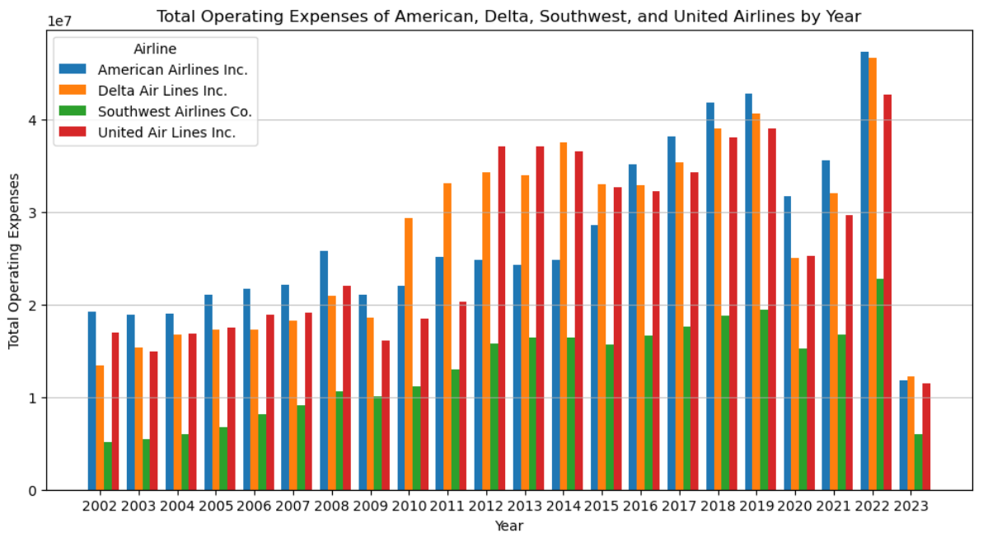
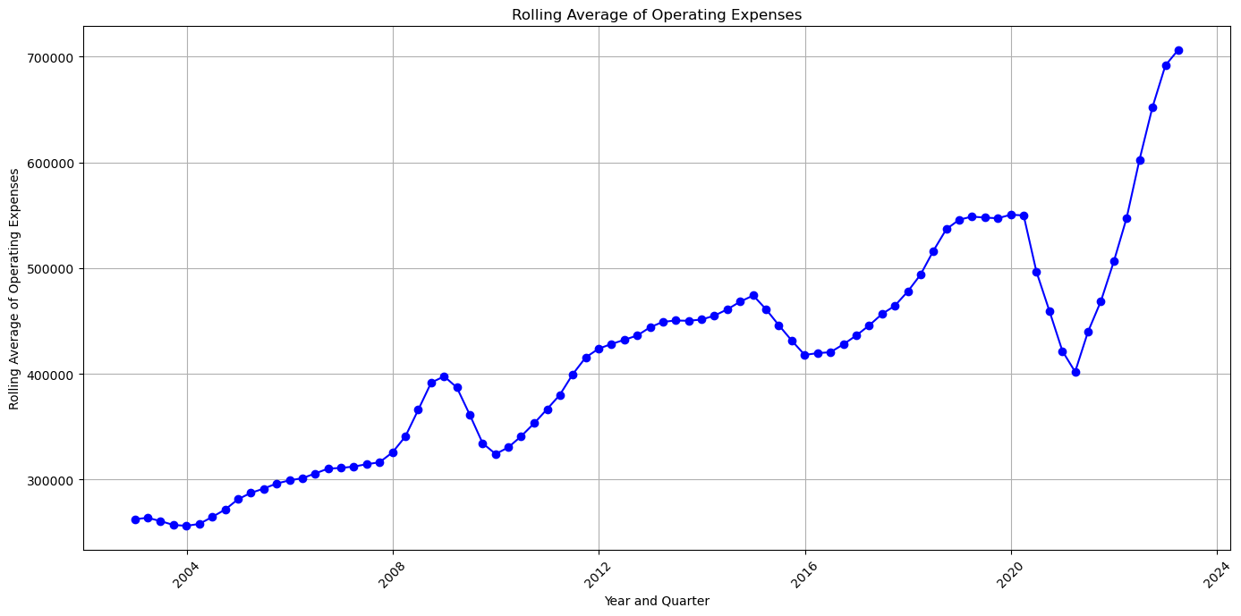
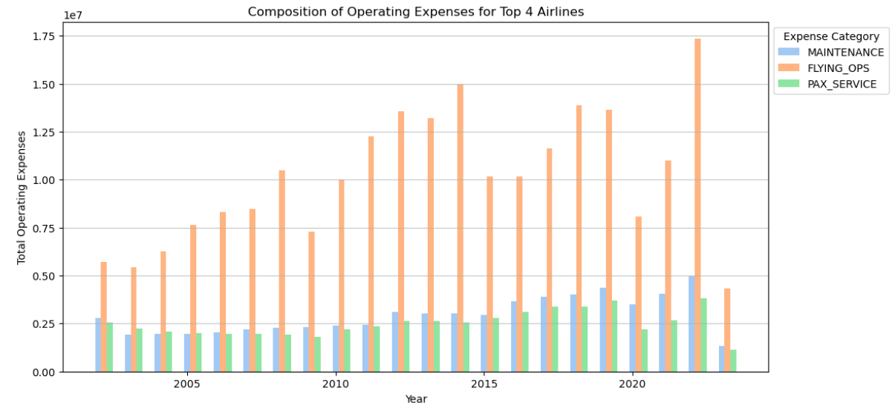
V. Top 4 Airlines Operating Expense Analysis

Slide 12
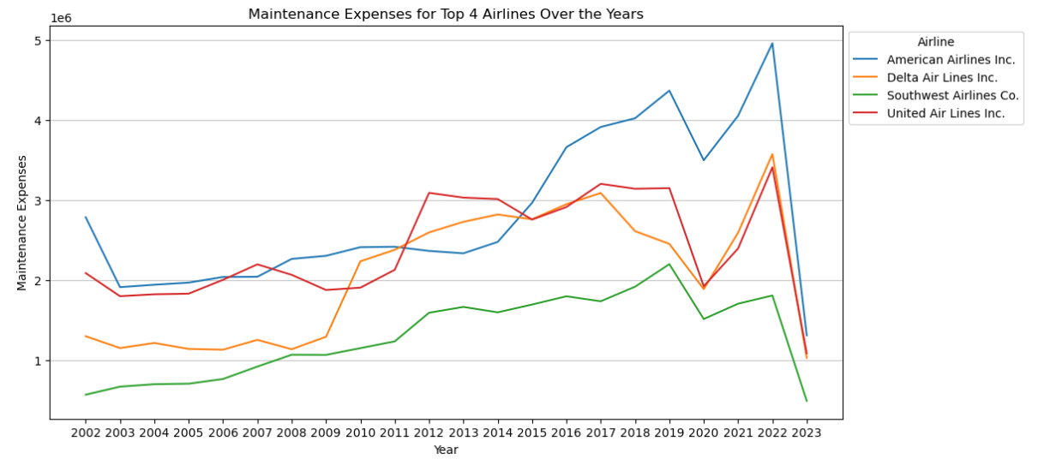
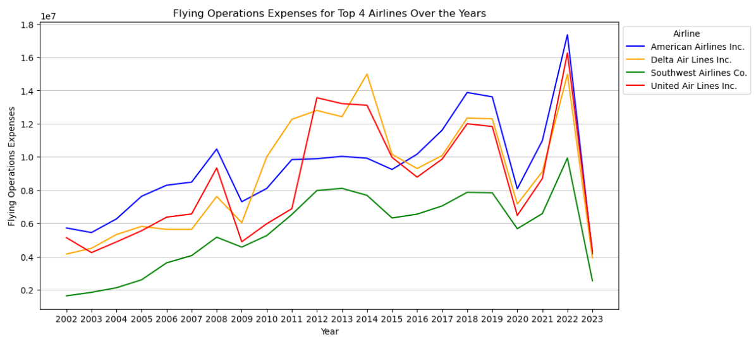
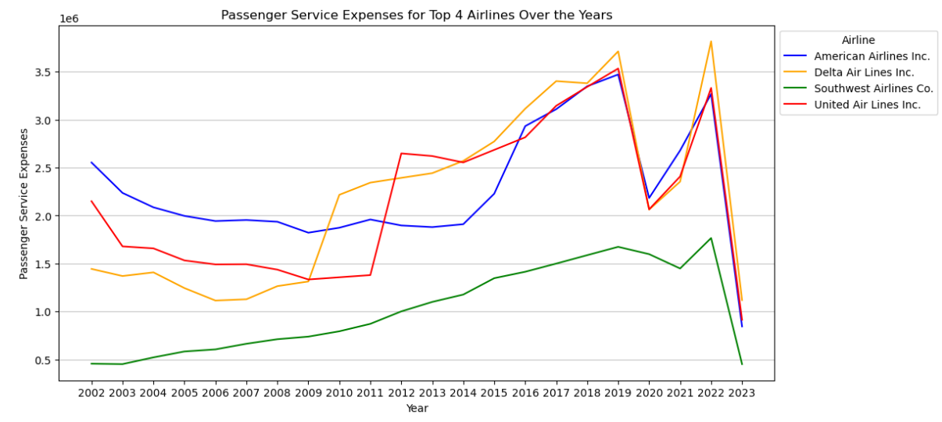
V. Top 4 Airlines Operating Expense Analysis

Slide 13
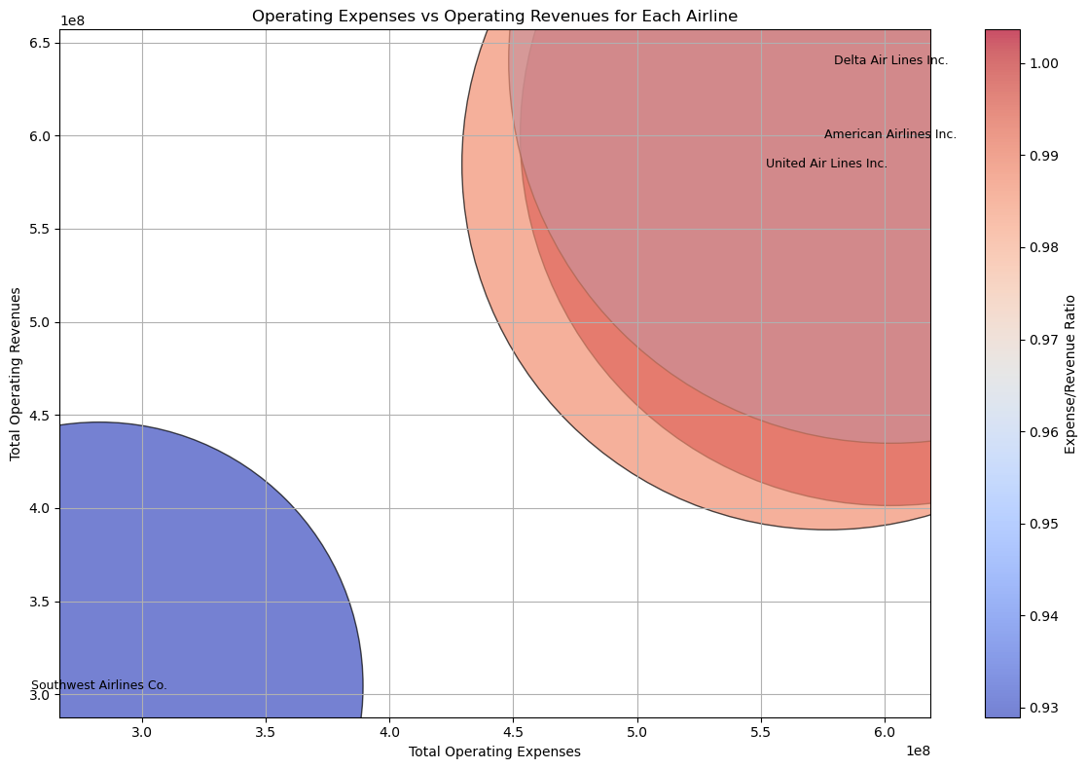
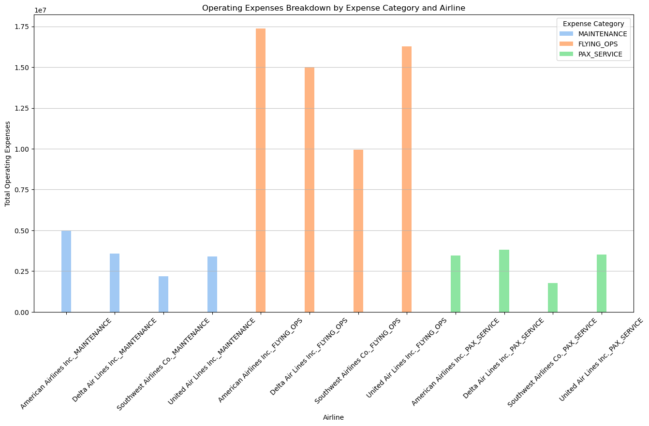
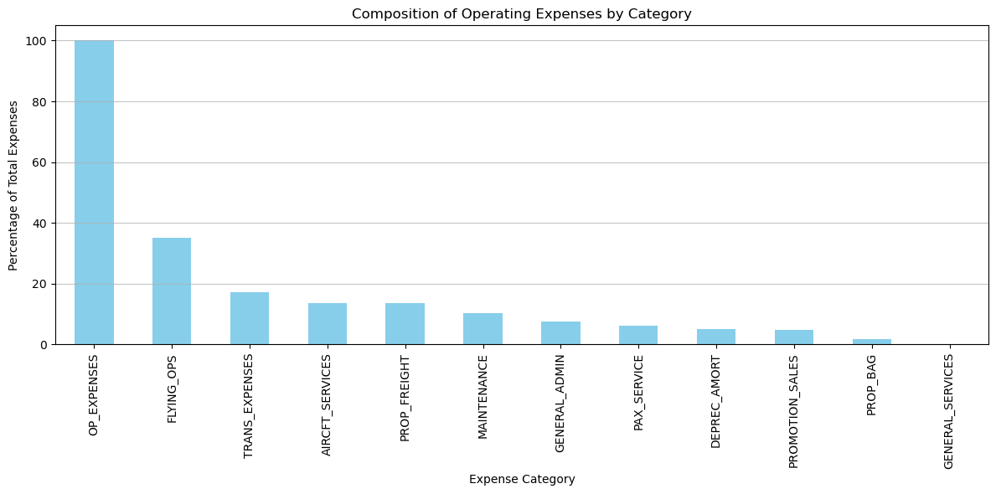
V. Top 4 Airlines Operating Expense Analysis

Slide 14
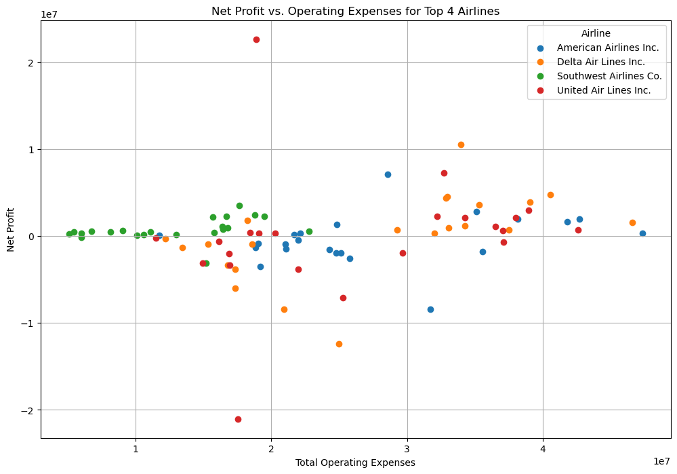
V. Top 4 Airlines Operating Expense Analysis
Insights:
Southwest Airlines demonstrates the highest profitability margin, with lower operating expenses relative to its net profit compared to the other airlines. This indicates Southwest's ability to generate more profit from its operations, possibly due to efficient cost management.
Delta Air Lines and American Airlines have similar net profit-to-operating expense ratios, suggesting comparable levels of operating efficiency. However, United Airlines lags behind, indicating potential inefficiencies or higher operating costs
.
Southwest's ability to achieve a higher net profit with lower operating expenses suggests effective cost management strategies. This could include efficient fleet management, route optimization, or other operational efficiencies.
United Airlines' lower net profit-to-operating expense ratio indicates a lower level of profitability relative to its operating costs compared to the other airlines. This may indicate challenges in managing costs or generating sufficient revenue to offset expenses.

Slide 15
VI. Alliance and Partnerships
Strategic Focus on Cargo – United Airlines has successfully leveraged partnerships with leading cargo carriers to expand their global reach and increase revenue.
Delta's Rise Through Alliances – Delta's membership in the SkyTeam alliance and joint ventures have been instrumental their impressive operating revenue growth.
The Importance of Mergers – The merger between Delta and Northwest gave them a dominant network and market share, playing a key role in their revenue growth.

Slide 16
VII. Insights
Southwest Airlines maintained the most stable financial performance among the top 4 airlines, attributed to its low-cost carrier model, focus on domestic routes, and strategic decisions around fuel hedging, fleet, and customer service.
Delta Air Lines implemented strategic initiatives like fuel hedging, fleet modernization, and revenue diversification that helped it emerge as the most profitable of the top 4 airlines between 2011-2019.
United Airlines experienced significant volatility in net income, partly due to its bankruptcy and restructuring in the early 2000s but was able to improve its financial performance through cost reductions and operational changes.
American Airlines struggled with high labor costs, operational inefficiencies, and a burdensome cost structure, but saw improvements after its merger with US Airways in 2013.
All airlines are highly sensitive to economic conditions, as seen during the 2008 financial crisis and the COVID-19 pandemic, which significantly impacted revenues

Slide 17
VIII. Summary
High fuel prices heavily impact airline profitability, necessitating strategic partnerships, route planning, pricing adjustments.
Southwest faced increased low-cost carrier competition post-2011, challenging dominance. Responded with enhanced customer service, route expansion, marketing innovation.
2005-2006 fuel price surge greatly impacted airline profits, highlighting vulnerability to fuel cost fluctuations.
Delta's revenue surged from 2010 driven by mergers, fleet optimization, revenue management strategies.
Strategic alliances like Delta's SkyTeam, United's cargo partnerships expanded global reach, boosted revenue.

