Slide 1
.
.
CMPE320: Data Science
Course Introduction
2026, Fall
Rahim Dehkharghani

Slide 2
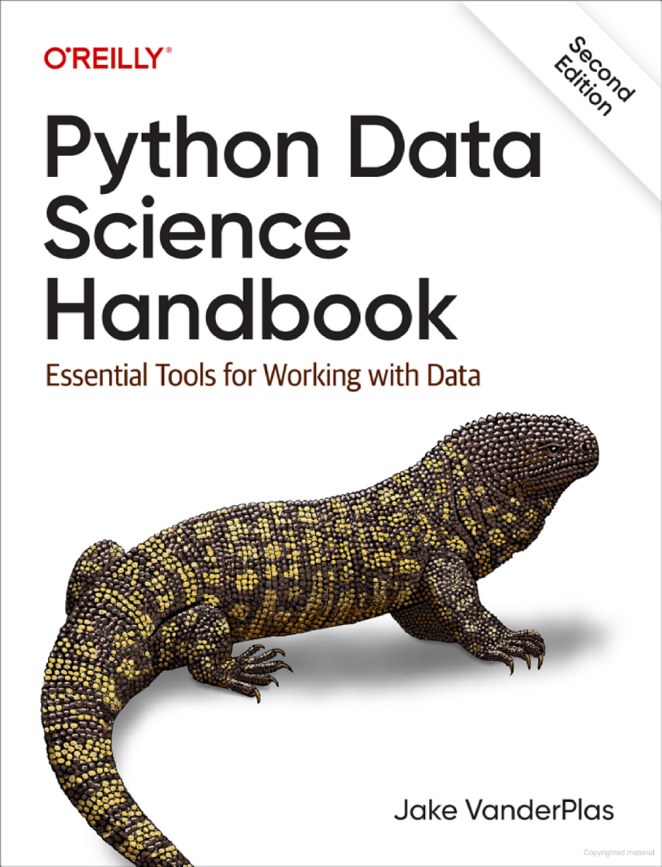
Reference Book
Python Data Science Handbook: Essential Tools for Working with Data
Python Data Science Handbook: Essential Tools for Working with Data 2nd Edition
, by Jake VanderPlas, 2023
Publisher: O'Reilly
Amazon.com rating: 4.2 out of 5

Slide 3
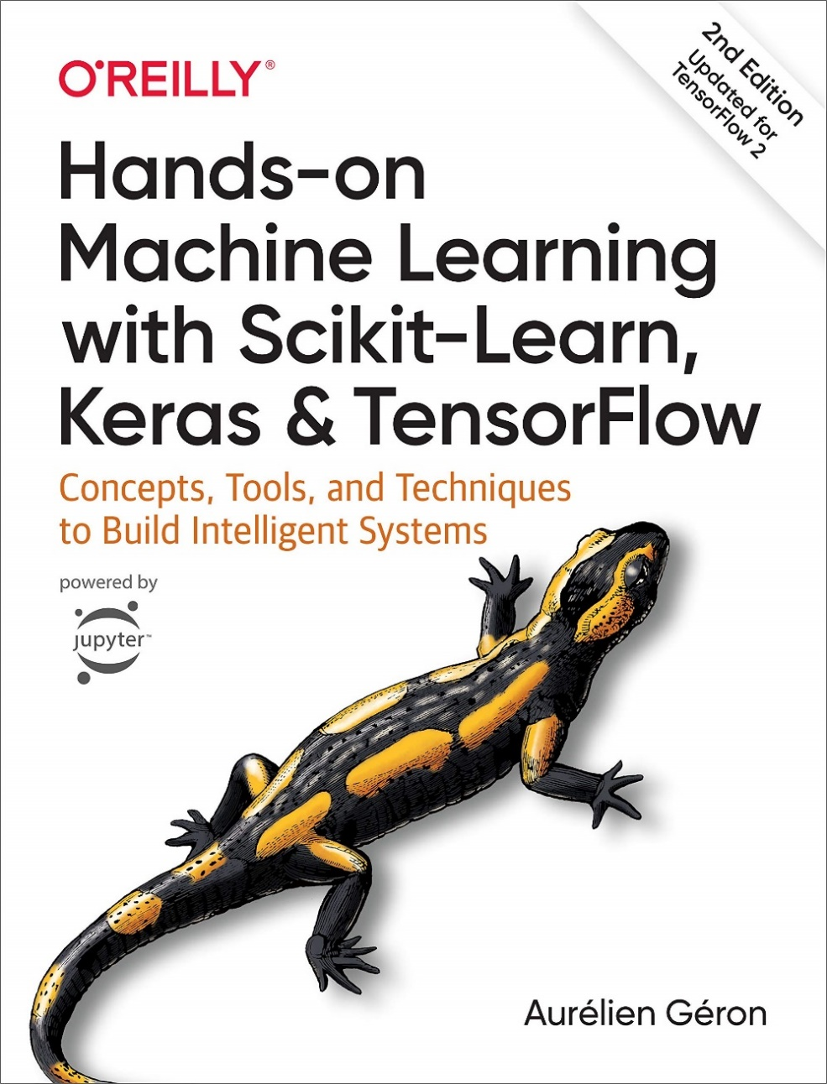
Reference Book
Hands-On Machine Learning with Scikit-Learn and TensorFlow: Concepts, Tools, and Techniques to Build Intelligent Systems, by Geron Aurelien, 2019
2nd edition,
Publisher: O'Reilly
Amazon.com rating: 4.8 out of 5

Slide 4
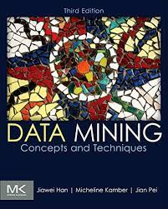
Reference Book
.
Data mining, techniques and concepts, Jiawei Han, Micheline Kamber, and Jian Pei, 3rd edition, Morgan Kaufmann, 2011
Amazon.com rating: 4.3 out of 5

Slide 5


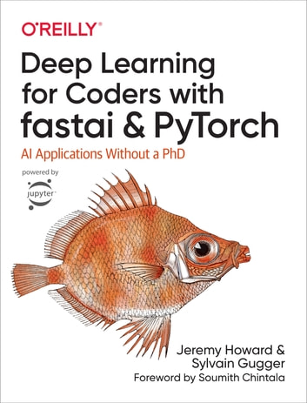
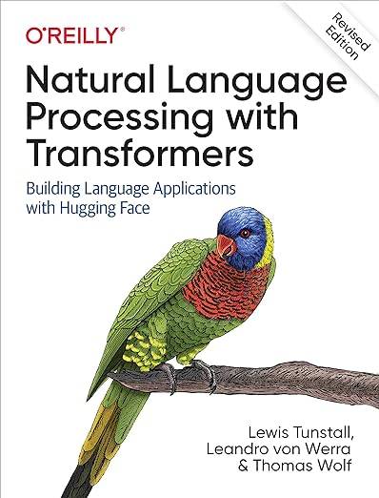
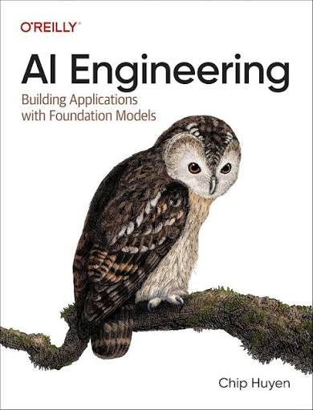
More Reference Book
İn this order

Slide 6
Syllabus
.
What is Data Mining (DM) and Data Science
Introduction to Python libraries (Numpy, Pandas, Matplotlib and Seaborn)
Know your data (data types, data dissimilarity measures, …)
Preprocessing of data (cleaning, Integration, Reduction, Transformation, Discretization)
Machine Learning
  Classification
  Regression
  Naïve Bayes and Text Classification
  Decision Trees
  SVM
  Clustering

Slide 7

Grading
Attendance is not mandatory but highly recommended.
Practical Homeworks | 10%
Midterm 1 | 30%
Midterm 2 | 40%
Atendance
 | 10%
Total | 100%

Slide 8
Contact info
Instructor: Rahim Dehkharghani
rahim.dehkharghani@khas.edu.tr, rahim.dehkharghani@gmail.com
Office hours: Reservation via email
Room: D208
Your emails will be answered as soon as possible.

Slide 9
Data Science/mining tools
Python (libraries such as numpy, pandas, Scikit-Learn, Keras …)
Rapid Miner
WEKA
Matlab
R programming language
…

Slide 10

IDE
Anaconda -> Jupyter lab (or notebook)
Pycharm
Visual Studio code
Google Colab
…
…

Slide 11

IDE
Download and install Anaconda
After running Anaconda, click on Jupyter notebook (or lab)
İt will appear on your browser
Start writing the code or opening an existing ipynb file
Homeworks should be uploaded as an ipynb file.

Slide 12
Prerequisites
Basics of Statistics and Probabilities
A high level programming language (Python)

Slide 13
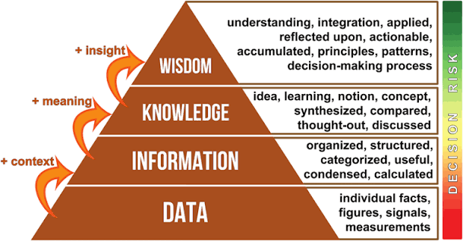
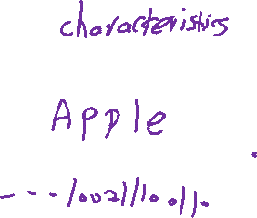
Knowledge triangle

Slide 14

Knowledge triangle
Level | Example | What happened?
Data | Ali: 45, 52, 48, 90 | Raw numbers with no interpretation
Information | “Ali's first three exam scores are around 50, but his fourth score is 90.” | We organize and give meaning to the data
Knowledge | “Ali performs poorly in the first three topics but performs very well in the fourth topic. He probably needs more practice in the first three topics.” | We identify a pattern and understand what it means
Wisdom | “Ali should spend more study time on the first three topics and continue using the study method that helped him achieve 90 on the fourth topic.” | We use knowledge to make a good decision/action

Slide 15
Data mining vs Data Science
Data Mining (1989 by Gregory Piatetsky Shapiro)
Data mining is the process of extracting and discovering patterns in large data sets involving methods at the intersection of machine learning, statistics, and database systems
Data Science (1974 by Peter Naur)
Data science is an interdisciplinary academic field that uses statistics, scientific computing, scientific methods, processing, scientific visualization, algorithms and systems to extract or extrapolate knowledge and insights from potentially noisy, structured, or unstructured data

Slide 16
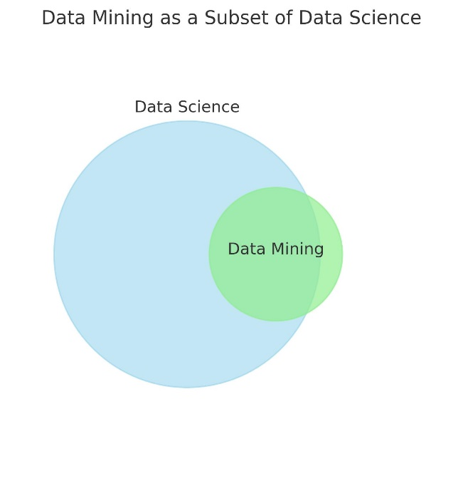

Data mining vs Data Science
Data Mining is a subset of Data Science.
  Data Science covers the whole pipeline (data collection → preprocessing → modeling → deployment → visualization).
  Data Mining is mainly about extracting patterns and knowledge from raw data, which is just one part of Data Science.
You can think of Data Mining as a specialized technique inside the larger
toolbox of Data Science.

Slide 17
Terminology
Aspect | Data Scientist | ML Engineer | AI Engineer
Goal | Analyze data & generate insights | Deploy and scale ML models | Build AI-powered applications
Focus | Statistics, ML, analytics | MLOps & production systems | LLMs, RAG, agents, multimodal AI
Typical Work | Data analysis, prediction | Training, deployment, monitoring | AI assistants, chatbots, copilots
Main Skills | Statistics, Python, SQL | Python, Docker, Kubernetes | Python, LLM APIs, AI frameworks
Output | Reports & predictive models | Production ML services | Intelligent AI applications
Common Employers | Finance, Healthcare, Retail | Tech companies | AI startups & Enterprise AI

Slide 18
Data Science-related fields
Machine
Learning
Pattern
Recognition
Statistics
Data Structures
Data Science
Visualization
Algorithm
Database
Technology
High-Performance
Computing

Slide 19
Applications of Data Science
Credit card fraud detection,
Customer behaviour estimation
Clustering/Classifying stars, diseases, web-pages, …
Categorization of people in social media
Cancer detection
Stock market price detection
Fake unemployment claim detection
…

Slide 20

Summary
Data science is an interdisciplinary academic field that extract knowledge from potentially noisy, structured, or unstructured data
Data science requires statistics, mathematics, algorithms, database technology and …
Data science is not machine learning (ML) but uses ML to extract knowledge from data.
We will use Python to implement the taught concepts on Google Colab or Jupyter Lab.
Choosing and solving a real-world problem from the scratch is expected in this course.
Data Mining is a subset of Data Science.

Slide 21


?
Contact : rahim.dehkharghani@khas.edu.tr

