Slide 1

Introduction to Python Columbia Biological Sciences

Slide 2
Course Page
https://github.com/rahim-hashim/Intro-Python-Biology

Slide 3
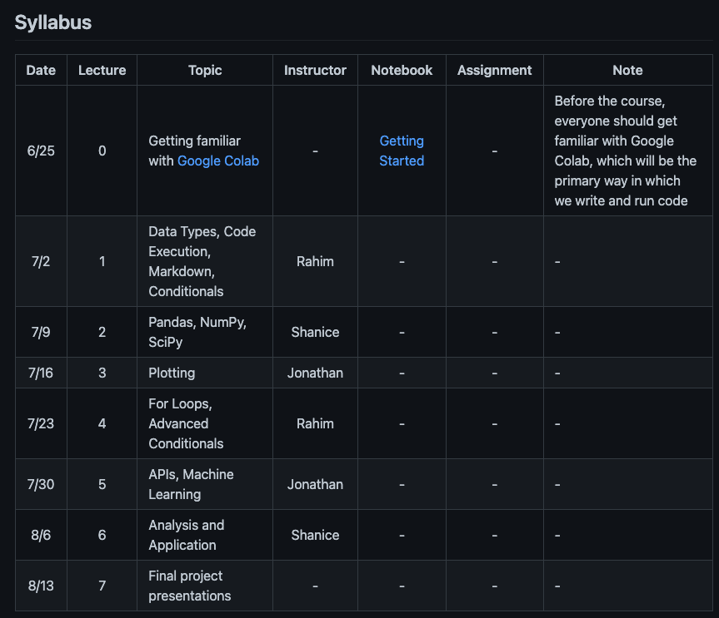
Course Page

Slide 4
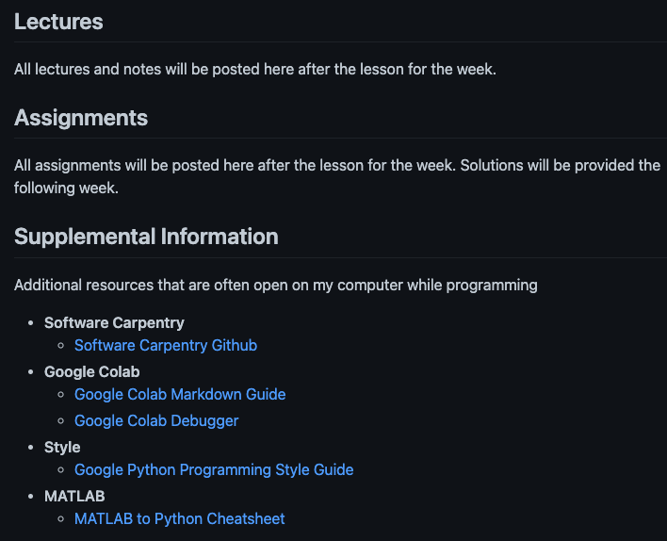
Course Page

Slide 5
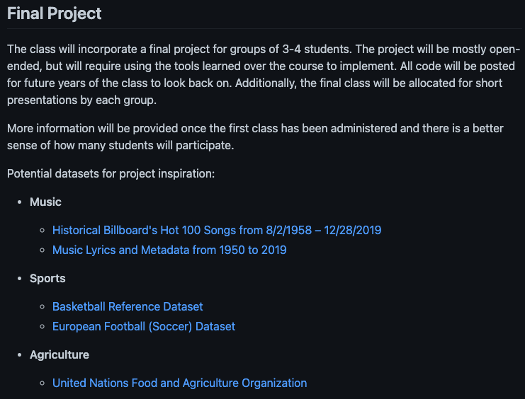
Course Page

Slide 6
Google Colab
https://colab.research.google.com

Slide 7
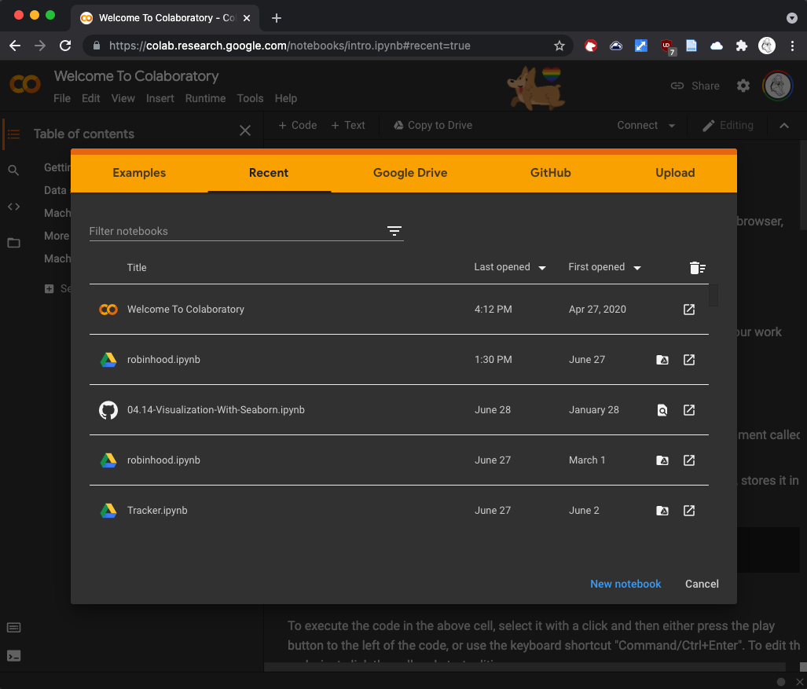
Google Colab

Slide 8
Markdown vs. Code
https://colab.research.google.com/notebooks/markdown_guide.ipynb

Slide 9


Slide 10
Expressions

Slide 11
Expressions
values

Slide 12
Expressions
values
operators

Slide 13
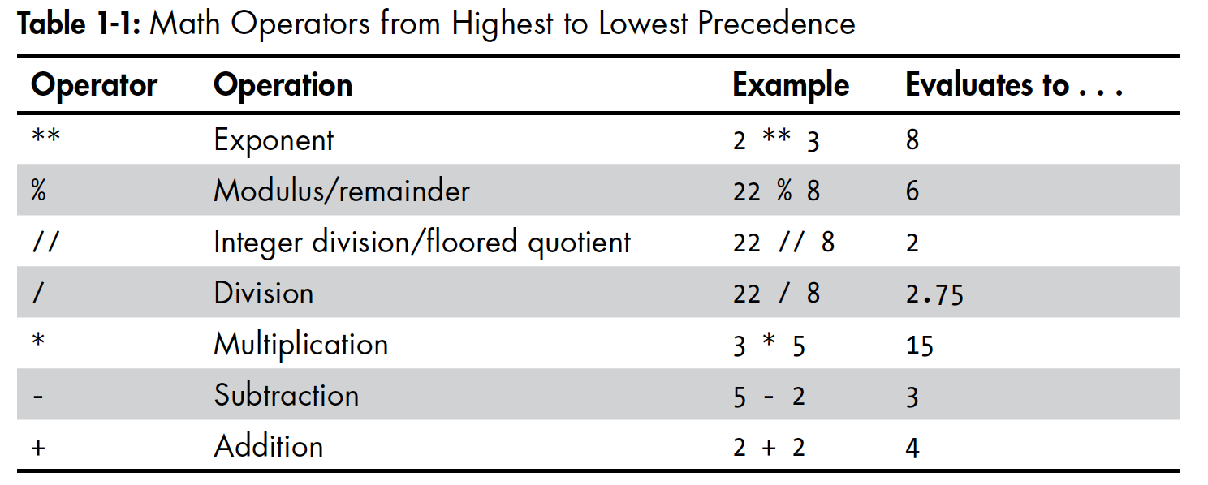
Math Operators

Slide 14

Expressions

Slide 15
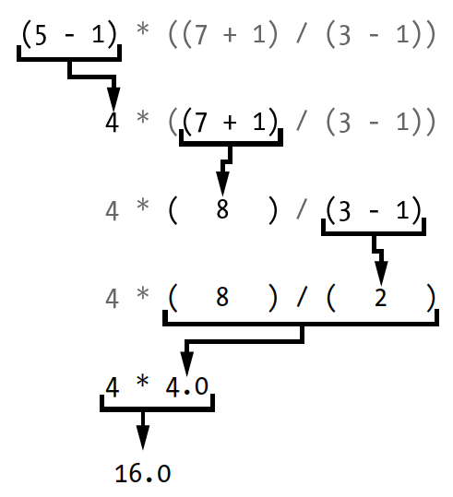
Expressions

Slide 16
Expressions

Slide 17
Expressions

Slide 18
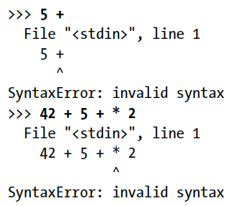
Expressions

Slide 19
Expressions

Slide 20
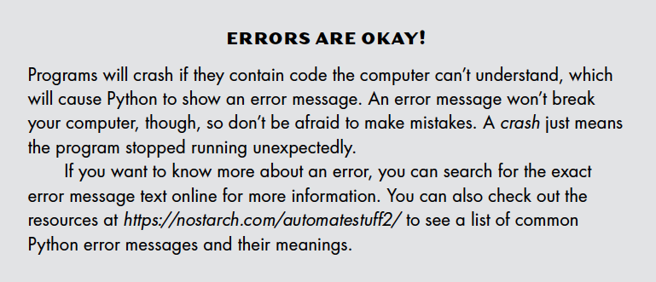
Expressions

Slide 21
Expressions
2 + 2

Slide 22
Expressions
2.0 + 2.0

Slide 23
Expressions
‘2’ + ’2’

Slide 24
Types
2 + 2
integer
2.0 + 2.0
float
‘2’ + ’2’
string

Slide 25
Types
2 + 2
integer
2.0 + 2.0
float
‘2’ + ’2’
string

Slide 26
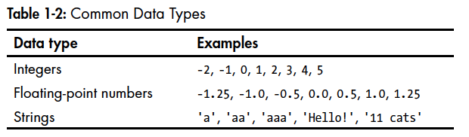
Types

Slide 27
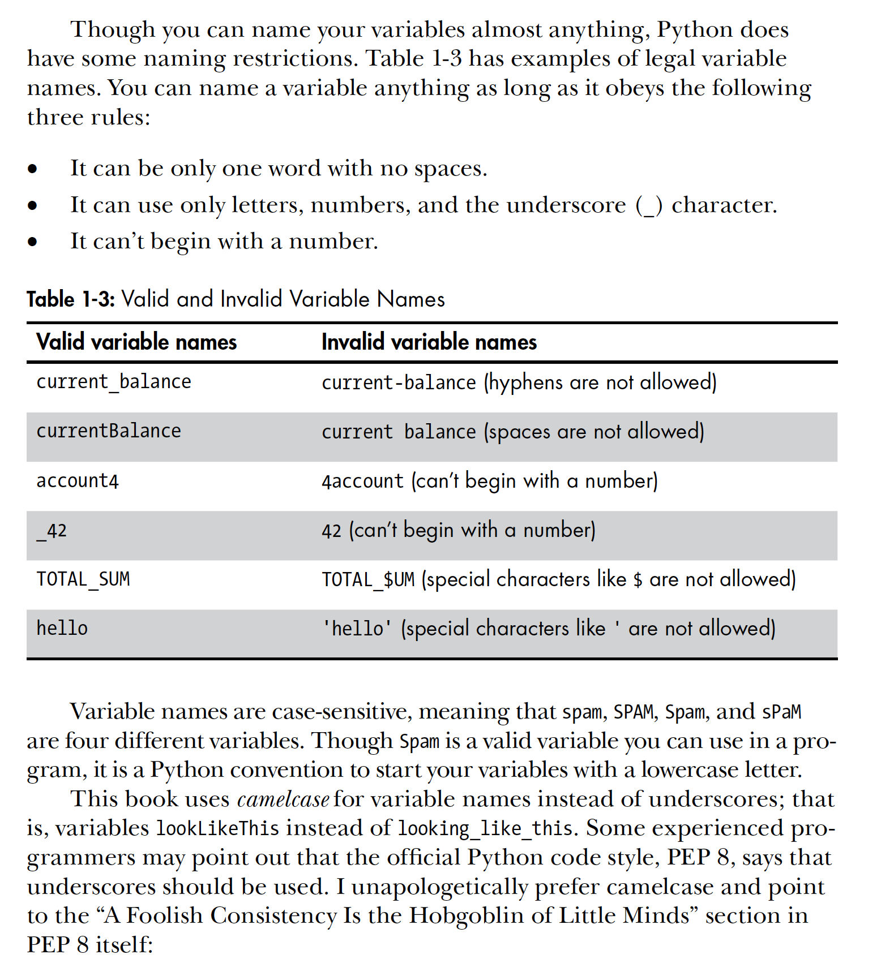
Variables

Slide 28
Math Operators

Slide 29
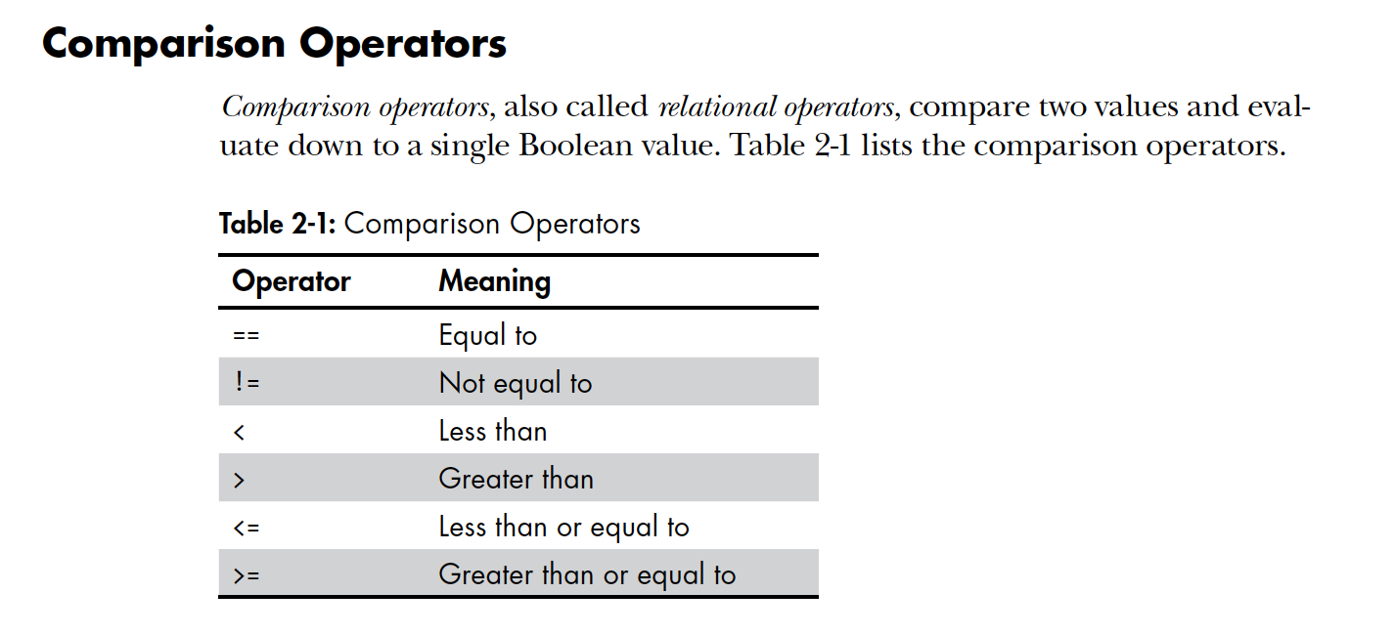
Comparison Operators

Slide 30
Operators

Slide 31
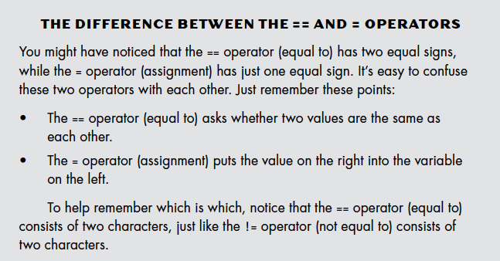
Comparison Operators

Slide 32
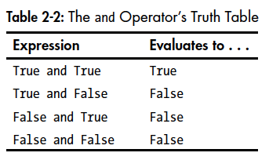
Boolean Operators

Slide 33
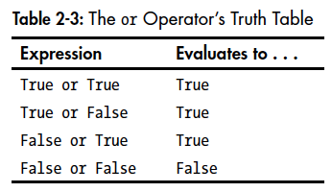
Boolean Operators

Slide 34
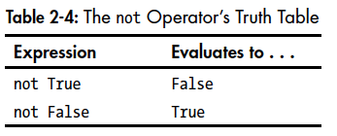
Boolean Operators

Slide 35
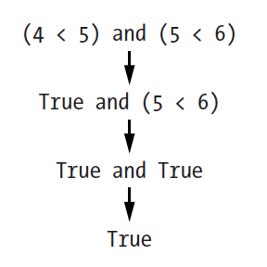
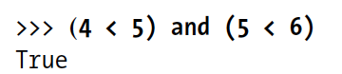
Boolean and Comparison Operators

Slide 36
Functions

Slide 37
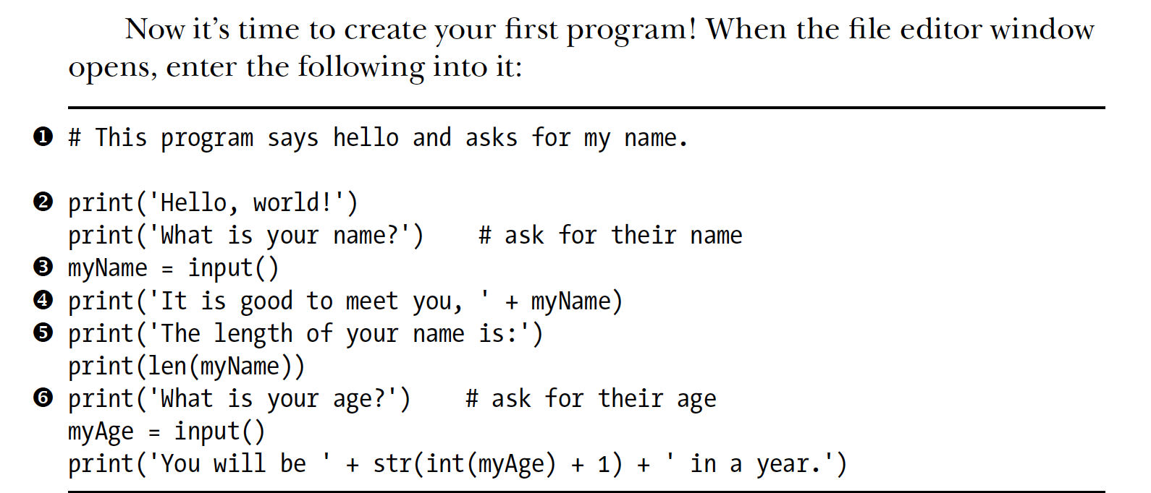
Functions print()

Slide 38
Functions print()
print(‘Rahim’)

Slide 39
Functions print()
name = ‘Rahim’
print(name)

Slide 40
Functions print()
name = ‘Rahim’
print(name, ‘is’, ‘cool’)

Slide 41
Functions input()

Slide 42
Functions len()

Slide 43
Lists

Slide 44
Lists
atom_name = ‘helium’

Slide 45
Lists
atom_name = ‘helium’
len(atom_name)

Slide 46
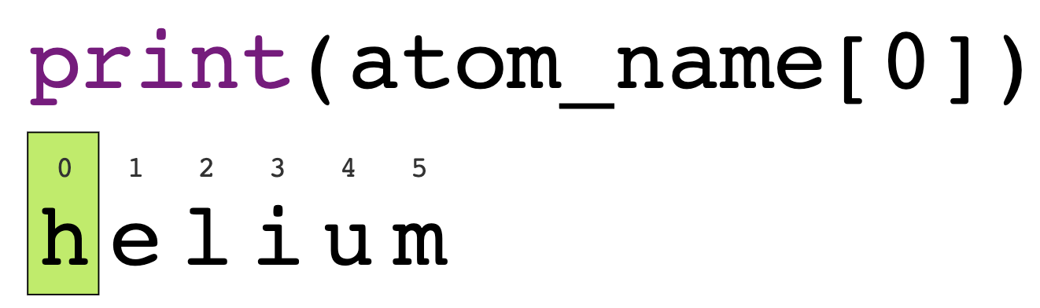
Lists

Slide 47
Lists

Slide 48
Lists
index

Slide 49
Lists
A list contains multiple values.
‘hello’
‘h’ ‘e’ ’l’ ‘l’ ’o’

Slide 50
Lists
A list contains multiple values.
len(‘hello’)

Slide 51
Lists
A list contains multiple values.
len(‘hello’)
5

Slide 52
Lists
A list contains multiple values.
len(12345)

Slide 53
Lists
A list contains multiple values.
len(12345)
TypeError

Slide 54
Lists
A list contains multiple values.
[ , ]

Slide 55
Lists
A list contains multiple values.
len([1,2,3,4,5])
5

Slide 56
Functions

Slide 57
Functions

Slide 58
Types
2 + 2
2.0 + 2.0
‘2’ + ’2’

Slide 59
Functions type()
number = 2.0
print(type(number))

Slide 60
Functions type()
number = 2.0
print(type(number))
<class ‘float’>

Slide 61
int(2.0) + int(2.0)
2 + 2
int(‘2’) + int(‘2’)
float(2) + float(2)
2.0 + 2.0
float(‘2’) + float(‘2’)
str(2) + str(2)
‘2’ + ’2’
str(2.0) + str(2.0)

Slide 62
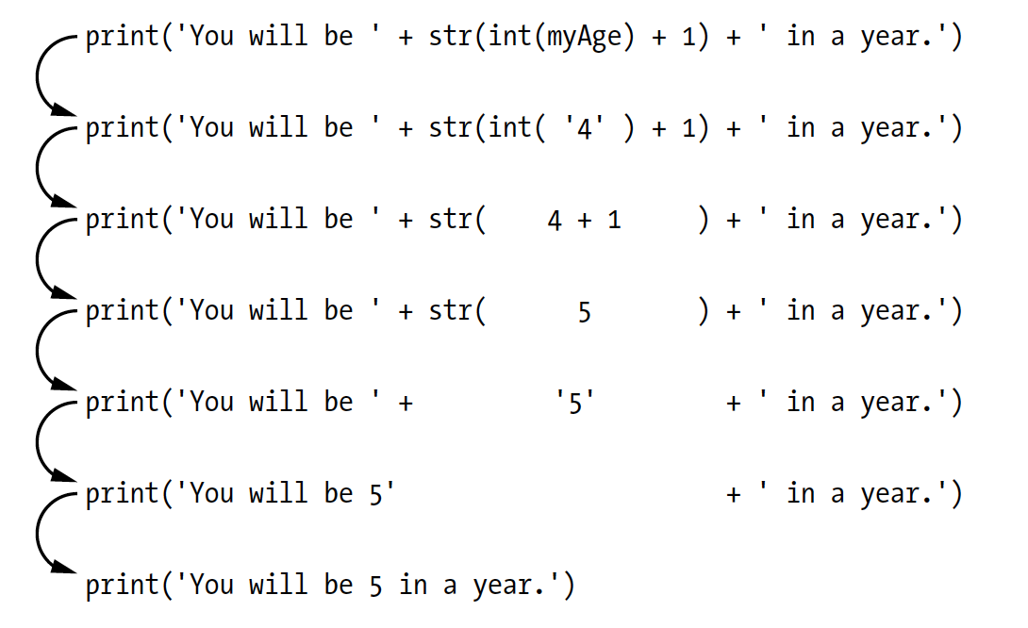
Functions

Slide 63
Functions

Slide 64
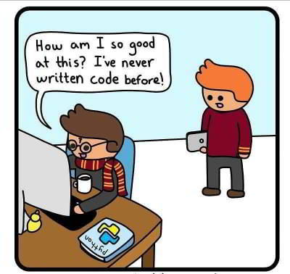

Slide 65
BREAK

Slide 66
BREAK
Write code that asks for the tip percentage and bill amount, and prints the tip amount and total bill including tip, using the functions input(), float(), and print().

Slide 67
Indexing

Slide 68
Slicing
atom_name[0]
‘h’
atom_name[0:3]

Slide 69
Slicing
print(atom_name[0:3])

Slide 70
Slicing
marvel_characters = [‘thor’, ‘vision’, ‘captain_america’, ‘iron_man’]
len(marvel_characters)

Slide 71
Slicing
marvel_characters = [‘thor’, ‘vision’, ‘captain_america’, ‘iron_man’]
len(marvel_characters)
marvel_characters[1:3]

Slide 72
Slicing
marvel_characters = [‘thor’, ‘vision’, ‘captain_america’, ‘iron_man’]
len(marvel_characters)
marvel_characters[-1]
marvel_characters[1:3]

Slide 73
Slicing
marvel_characters = [‘thor’, ‘vision’, ‘captain_america’, ‘iron_man’]
len(marvel_characters)
marvel_characters[-1]
marvel_characters[1:3]
marvel_characters[1][1]

Slide 74
Slicing
marvel_characters = [‘thor’, ‘vision’, ‘captain_america’, ‘iron_man’]
marvel_characters[:]
marvel_characters[5]

Slide 75
Concatenation
‘2’ + ’2’

Slide 76
Concatenation
‘2’ + ’2’
[1, ‘2’, 3] + [’4’, 5, ‘6’]

Slide 77
Concatenation
‘2’ + ’2’
[1, ‘2’, 3] + [’4’, 5, ‘6’]
today = [‘06-02-2021’]; tomorrow = [‘06-03-2021’]

Slide 78
Concatenation
‘2’ + ’2’
[1, ‘2’, 3] + [’4’, 5, ‘6’]
today = [‘06-02-2021’]; tomorrow = [‘06-03-2021’]
dates = [‘06-01-2021’] + today + tomorrow

Slide 79
Concatenation
‘2’ + ’2’
[1, ‘2’, 3] + [’4’, 5, ‘6’]
today = [‘06-02-2021’]; tomorrow = [‘06-03-2021’]
dates = [‘06-01-2021’] + [today] + [tomorrow]

Slide 80
Concatenation
dates = [‘06-01-2021’] + [today] + [tomorrow]
dates[1]

Slide 81
Concatenation
dates = [‘06-01-2021’] + [today] + [tomorrow]
dates[1]
[‘06-02-2021’]

Slide 82
Concatenation
dates = [‘06-01-2021’] + [today] + [tomorrow]
dates[1]
[‘06-02-2021’]
dates[1][1]

Slide 83
Concatenation
dates = [‘06-01-2021’] + [today] + [tomorrow]
dates[1]
[‘06-02-2021’]
dates[1][1]
IndexError

Slide 84
Concatenation
dates = [‘06-01-2021’] + [today + tomorrow]
dates[1]
dates[1][1]

Slide 85
Functions max(), min(), round()
number_list = [6.25, 8, 1.5, 15, 2, 5, 12, 3]

Slide 86
Functions max(), min(), sum(), round()
number_list = [6.25, 8, 1.5, 15, 2, 5, 12, 3]
max(number_list)
sum(number_list)
min (number_list)
round(number_list)

Slide 87
Functions max(), min(), sum(), round()
number_list = [6.25, 8, 1.5, 15, 2, 5, 12, 3]
max(number_list)
sum(number_list)
min (number_list)
round(number_list)

Slide 88
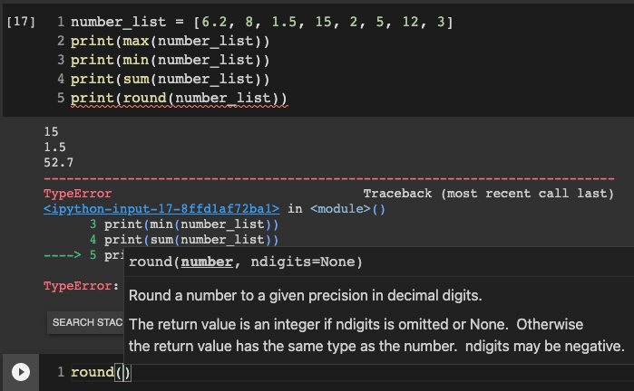

Slide 89
Functions max(), min(), sum(), round()
number_list = [6.25, 8, 1.5, 15, 2, 5, 12, 3]
round(number_list[0])

Slide 91
Functions max(), min(), sum(), round()
number_list = [6.25, 8, 1.5, 15, 2, 5, 12, 3]
round(number_list[0], 1)

Slide 92
Questions?

