Slide 1

Introduction to Python Columbia Biological Sciences

Slide 2
Course Page
https://github.com/rahim-hashim/Intro-Python-Biology

Slide 3
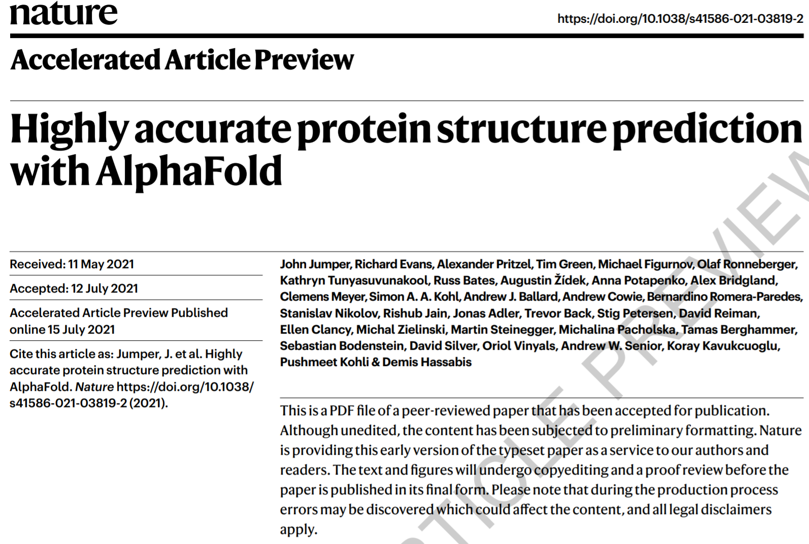

Slide 4
https://github.com/deepmind/alphafold

Slide 5
.ipynb

Slide 6
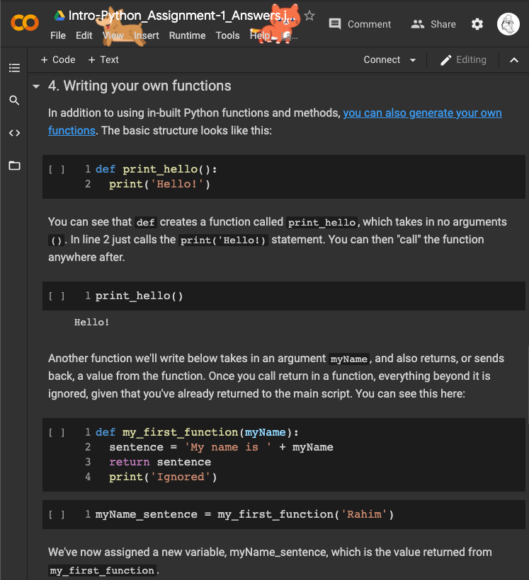
.ipynb

Slide 7
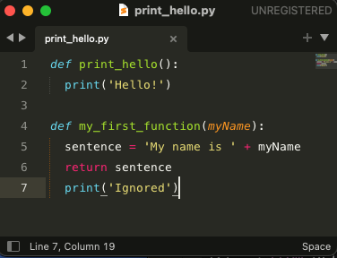
.ipynb
.py

Slide 8
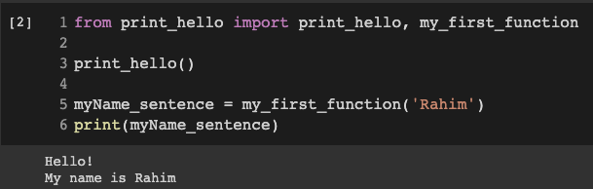
.ipynb
.py

Slide 9
Variable Scope
local variable

Slide 10
Variable Scope
local variable
global variable

Slide 11
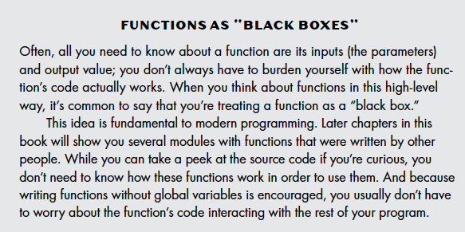
Variable Scope

Slide 12
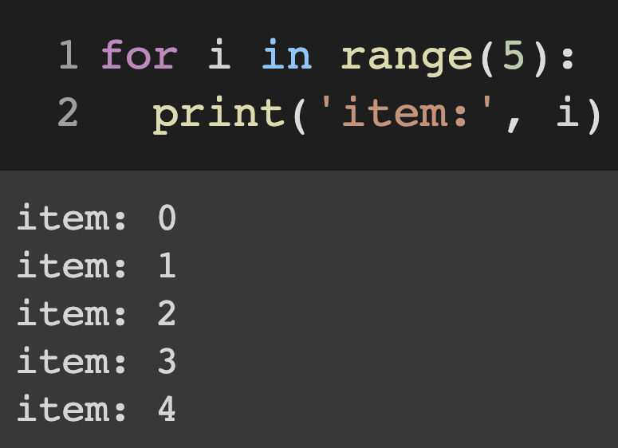
For Loops

Slide 13
For Loops
loop variable
loop condition
keyword

Slide 14
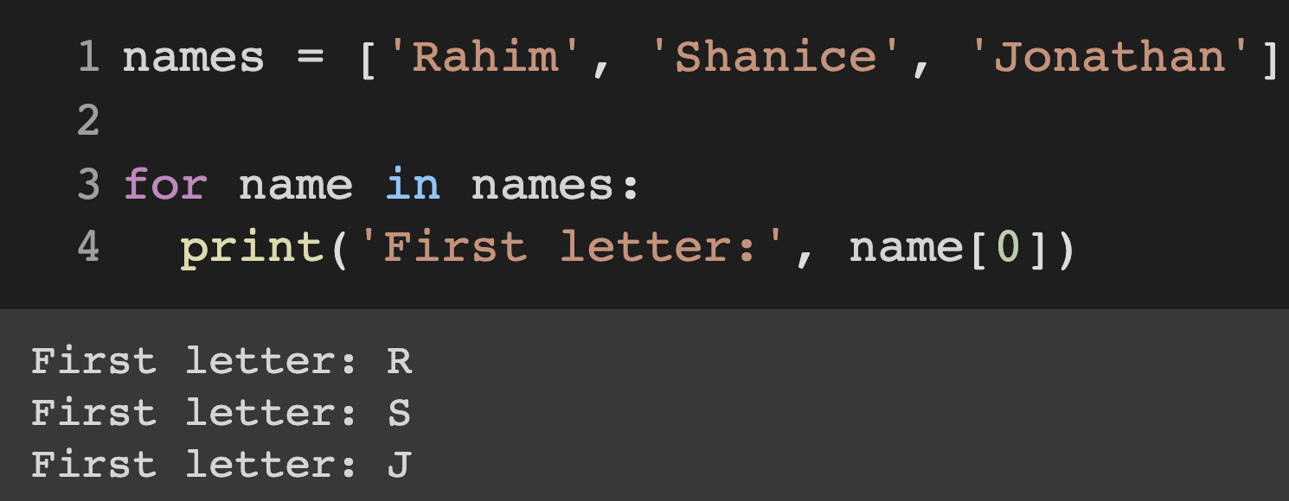
For Loops
loop variable
loop condition
keyword

Slide 15
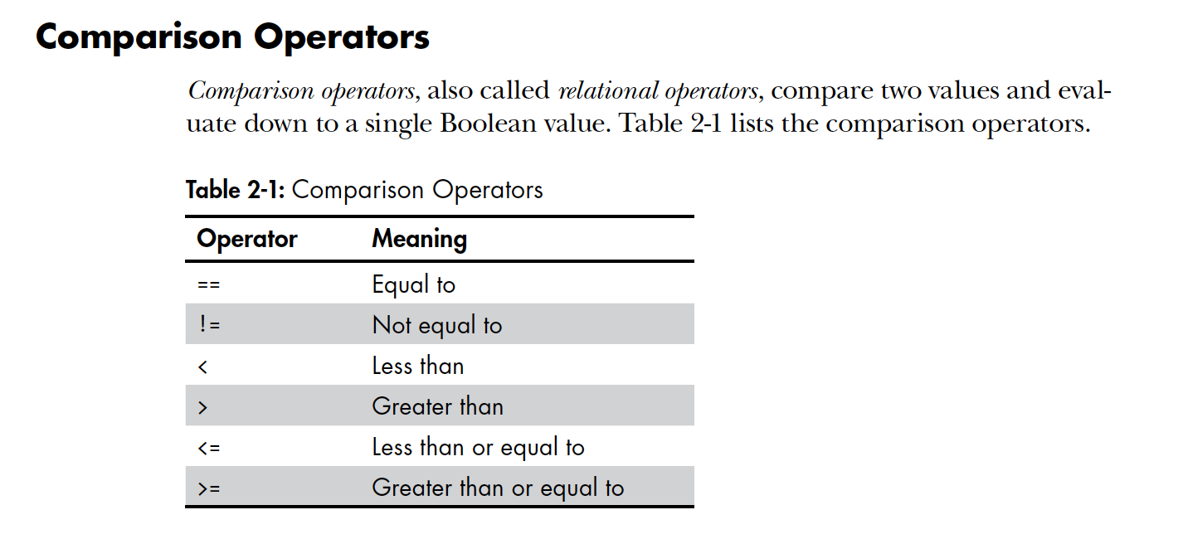
Comparison Operators

Slide 16
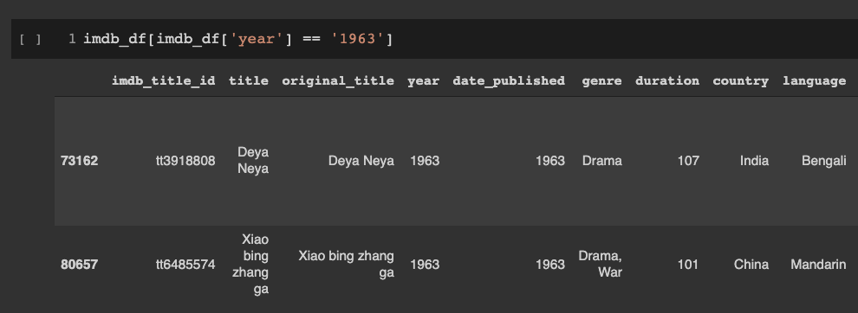
Pandas Filtering

Slide 17
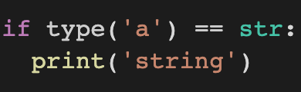
Conditionals
The most common type of flow control statement is the if statement.

Slide 18
Conditionals
The most common type of flow control statement is the if statement.
keyword
condition
block

Slide 19
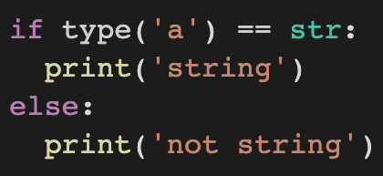
Conditionals
The most common type of flow control statement is the if statement.

Slide 20
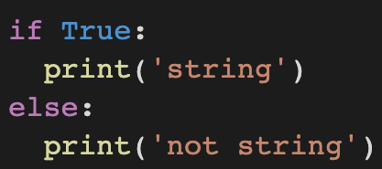
Conditionals
The most common type of flow control statement is the if statement.

Slide 21
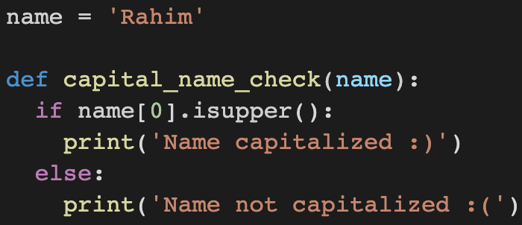
Conditionals

Slide 22
For Loop + Conditionals
Write a function that takes in a list, checks to see that the element is an ‘int’, and if so, prints whether it is even or odd.
Hint: use the % operation

Slide 23
For Loop + Conditionals
Write a function that takes in a list, checks to see that the element is an ‘int’, and if so, prints whether it is even or odd and large (>10) or small (<=10)

Slide 24
Dictionaries
Like a list, a dictionary is a mutable collection of many values. But unlike indexes for lists, indexes for dictionaries can use many different data types, not just integers. Indexes for dictionaries are called keys, and a key with its associated value is called a key-value pair.

Slide 25
List
brain_areas =
[‘hippocampus’, ‘amygdala’, ‘prefrontal_cortex’]
brain_areas[1] = ‘amygdala’

Slide 26
List
brain_areas =
[‘hippocampus’, ‘amygdala’, ‘prefrontal_cortex’]
brain_areas[1] = ‘amygdala’
Dictionaries
brain_areas[‘amygdala’] = ‘emotions’

Slide 27
Dictionaries
brain_areas[‘amygdala’] = ‘emotions’
brain_areas[‘hippocampus’] = ‘memory’
brain_areas[‘prefrontal_cortex’] = ‘decision_making’

Slide 28
Dictionaries
brain_areas = {
‘amygdala’: ‘emotions’,
‘hippocampus’: ‘memory’,
‘prefrontal_cortex’: ‘decision_making’
}

Slide 29
Nested Dictionaries
brain_areas = {
‘amygdala’: {‘function’: ‘emotions’, ‘location’: ‘limbic’},
‘hippocampus’: {‘function’: ‘memory’, ‘location’: ‘limbic’},
‘prefrontal_cortex’: {‘function’: ‘decision_making’ ‘location’: ‘cortex’}
}

