Slide 1

CSA15 | Cloud Computing and Big Data Analytics
CSA15 Cloud Computing and Big Data Analytics
Presenter Details
Student Name:RAHIMA BANU N
Register Number:192525009
Class / Section / Slot: B
Capstone Title: CareRoute Cloud Ambulance Dispatch Optimizer Using ETA and Severity Analytics
Selected SDG Goal(s):
SDG 3 – Good Health and Well-being
Cloud Platform / Tools:
Google Cloud Platform (GCP)
Google Maps Platform
Capstone Cloud Technical Presentation
Individual Student Presentation Deck
Presentation Focus
Present your capstone as a cloud-backed product. Explain the problem, architecture, service choices, evidence, and CO1 learning clearly.
Individual student submission template | Department of Computer Science and Engineering
CO1 AT3 | 01
Notes:
Open by naming the capstone problem and the cloud product objective. Keep the title slide uncluttered and clearly identify the individual presenter.

Slide 2
CSA15 | Cloud Computing and Big Data Analytics
Problem Context and Stakeholder Mapping
Our capstone begins with a real problem to solve
Problem Statement
Target Users
Ambulances are often dispatched without considering both patient severity and real-time traffic, causing delays in emergency care.
• Emergency dispatch centers
• Ambulance drivers
• Hospitals & emergency patients
SDG Fit
Product Boundary
SDG 3 – Good Health and Well-being
Improve emergency response and save lives through faster ambulance dispatch.
• ETA prediction using live traffic
• Patient severity prioritization
• Optimal ambulance assignment & route recommendation
Individual student submission template | Department of Computer Science and Engineering
CO1 AT3 | 02
Notes:
Do not start with technology. First make the need clear, then connect it to cloud-enabled scale, reach, or reliability.

Slide 3
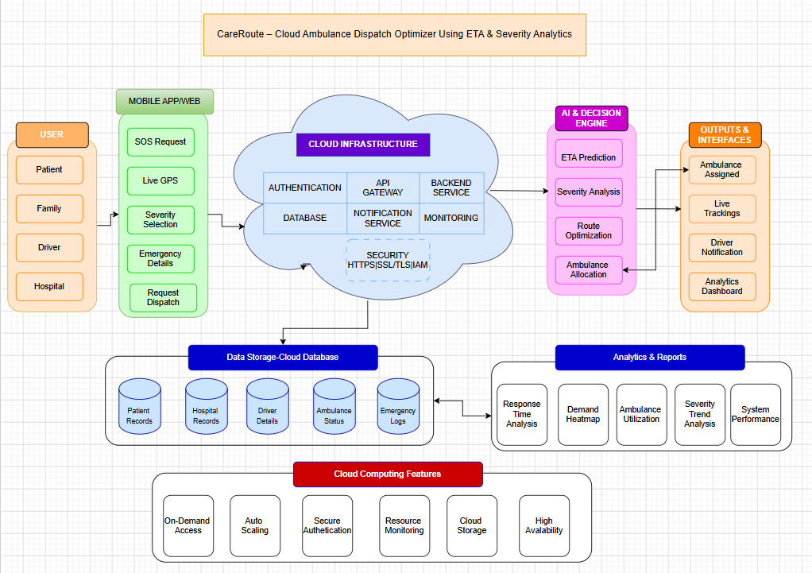
CSA15 | Cloud Computing and Big Data Analytics
Cloud Adoption Rationale and Concept Map
The problem needs cloud support to become a usable product
Cloud Definition
Cloud Concept Map
Cloud computing delivers computing resources (servers, storage, databases, and applications) over the internet, enabling scalable and on-demand services.
Cloud Characteristics
Elasticity: Auto-adjusts resources.
Scalability: Handles growing users.
Measured Service: Pay for actual usage.
Resource Pooling: Shared cloud resources.
Individual student submission template | Department of Computer Science and Engineering
CO1 AT3 | 03
Notes:
Students should explain the concept map as a reasoning artifact, not as decoration.

Slide 4
CSA15 | Cloud Computing and Big Data Analytics
Capstone Cloud Architecture
Our cloud architecture connects the user action to services
Scaling point
Hospital / Dispatcher / Ambulance App
Google Maps API + Firebase Auth
Analytics & Monitoring Dashboard
Cloud Firestore / Cloud Storage
Security boundary
Presentation Points
Analytics + Monitoring
User → API → Backend → Database
Google Maps API for ETA & routing
Google Cloud Platform (Cloud Run)
Cloud Firestore
Cloud Monitoring & Logging
Auto-scales during emergency demand
Individual student submission template | Department of Computer Science and Engineering
CO1 AT3 | 04
Notes:
Walk from user request to API, compute, data, storage, analytics, monitoring, and security boundary.

Slide 5
CSA15 | Cloud Computing and Big Data Analytics
Cloud Service Model Responsibility Matrix
Each service model defines what we control and what cloud manages
Service area
Model
Provider manages
Student team manages
Why this fits
SaaS
Hosting Platform
UI & User interface
Easy Deployment
Frontend hosting
PaaS
Runtime & Scaling
ETA & severity logic
Focus on Application
Backend/API
PaaS
Database service
Patient & ambulance data
Managed Database
Database
IaaS
Cloud Storage
Reports and documents
Secure Storage
Storage
PaaS
Monitoring Tools
Performance Tracking
Quick issue detection
Monitoring / logs
SaaS
Authentication Service
User roles & permissions
Secure access
Security / IAM
Individual student submission template | Department of Computer Science and Engineering
CO1 AT3 | 05
Notes:
Ask the student to defend provider responsibility and student responsibility for the selected service models.

Slide 6
CSA15 | Cloud Computing and Big Data Analytics
Data Flow and Analytics Pipeline
The product data moves from user activity to useful insight
Collect
Ingest
Store
Process
Visualize
Patient details, GPS location,
ambulance status
Google Maps API +
Firebase
Cloud Firestore
ETA & Severity
Analytics
Dispatcher Dashboard
Data Requirements
Analytics Requirement
Proof Required
Patient data, ambulance location, traffic data
ETA prediction, priority ranking, dispatch alerts
Sample dispatch result with ETA and severity score
Individual student submission template | Department of Computer Science and Engineering
CO1 AT3 | 06
Notes:
Big data analytics is optional, but a thoughtful data path is expected.

Slide 7
CSA15 | Cloud Computing and Big Data Analytics
Python / AI Module Integration
Python or AI adds intelligence where the product needs it
Python Role
Input and Output
ETA prediction & severity analysis
Input: Patient details, location, traffic data
Output: Priority score, ETA, best ambulance
Execution Point
Product Value
Cloud Run / Flask API
Faster and smarter ambulance dispatch
Individual student submission template | Department of Computer Science and Engineering
CO1 AT3 | 07
Notes:
If AI is not required, students can present a Python automation or analytics module instead.

Slide 8
CSA15 | Cloud Computing and Big Data Analytics
Security, Scalability, Privacy and Cost Design
Security, scale, privacy and cost shape the final design
Security
Privacy
Firebase Authentication & role-based access
Encrypted patient data & limited access
Scalability
Cost Awareness
Auto-scales during high emergency requests
Free-tier Firebase & pay-as-you-use GCP
Individual student submission template | Department of Computer Science and Engineering
CO1 AT3 | 08
Notes:
This slide is where students show engineering judgment instead of simply listing services.

Slide 9
CSA15 | Cloud Computing and Big Data Analytics
Implementation Stack and Deployment Evidence
Our implementation stack shows how the design will be built
Mobile / Web Layer
Cloud Services
React Web Application
GCP, Firebase, Google Maps API
Evidence
Version Control
GitHub repository, API test, deployment URL
GitHub (commits & branches)
Individual student submission template | Department of Computer Science and Engineering
CO1 AT3 | 09
Notes:
Evidence should be specific and inspectable, not a generic list of tools.

Slide 10
CSA15 | Cloud Computing and Big Data Analytics
Demo Storyboard and User Journey
A complete user journey proves the product flow
Scene 1
Scene 2
Scene 3
User action -> system response -> cloud component touched
Patient severity calculated → Backend processes data
Google Maps API estimates ETA
Scene 4
Scene 5
Scene 6
Nearest ambulance selected
Hospital & ambulance receive notification
Patient picked up → Dashboard updated
Individual student submission template | Department of Computer Science and Engineering
CO1 AT3 | 10
Notes:
A storyboard helps the faculty see whether the cloud architecture is connected to actual use.

Slide 11
CSA15 | Cloud Computing and Big Data Analytics
Evaluation Readiness Checklist
Our evidence confirms that the presentation is ready
Cloud ecosystem and service model explained
Elasticity and scalability decisions are visible
✅
✅
REST/SOAP/API role connected to capstone
✅
✅
GitHub and cloud evidence are inspectable
Architecture has compute, data, storage, security, monitoring
References and integrity statement are included
✅
✅
Evaluator Focus
CO1 is verified through cloud design reasoning, service choices, evidence, and individual explanation.
Individual student submission template | Department of Computer Science and Engineering
CO1 AT3 | 11
Notes:
Students can use this as the self-check slide before presenting the conclusion.

Slide 12
CSA15 | Cloud Computing and Big Data Analytics
Conclusion, Limitations and Future Scope
We close with learning, limitations and next steps
Learning Outcome
Limitations
Applied cloud computing for real-time ambulance dispatch.
Depends on internet connectivity and live traffic accuracy.
Future Improvement
Integrity Statement
AI-based ambulance demand prediction and IoT ambulance tracking.
Developed using Google Cloud, Firebase, Google Maps API, Python, and React. AI assistance (ChatGPT) was used only for guidance and content refinement.
Individual student submission template | Department of Computer Science and Engineering
CO1 AT3 | 12
Notes:
The ending should synthesize learning, not just say thank you.

