Slide 1

TECHNICAL PRESENTATION
MOTION BLUR IN IMAGE ACQUISITION
ITA0521-COMPUTER VISION
Dr T M USHA
RAHIMA BANU N
192525009
B TECH AI&ML

Slide 2
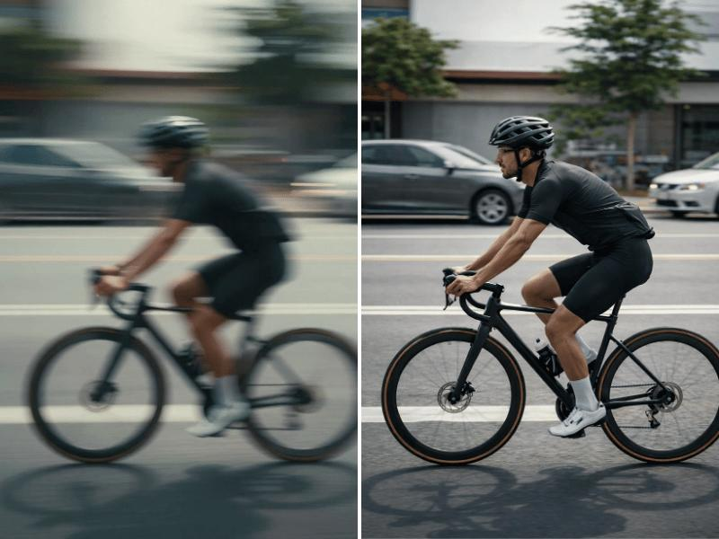

INTRODUCTION TO MOTION BLUR
Definition: Motion blur is an image distortion that occurs when an object or camera moves while the camera sensor is collecting light to form an image.
Key points
A moving object may appear stretched, smeared or unclear.
The blur occurs because the object's position changes during exposure.
Stationary objects can remain sharp while moving objects appear blurred.
Camera movement can blur the entire scene.
Motion blur can reduce the quality of images used by computer vision systems.

Slide 3
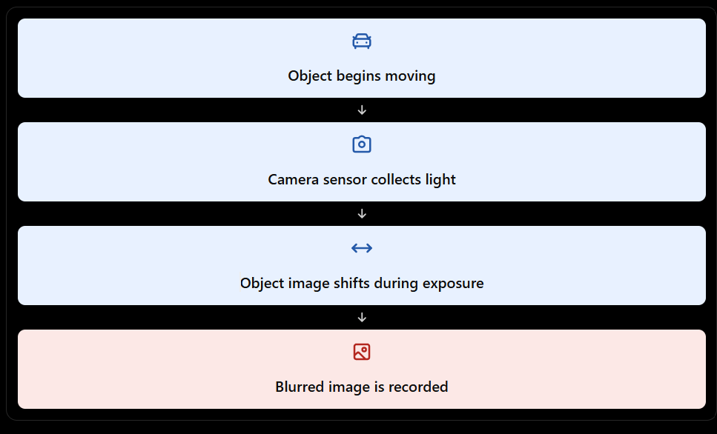
CAUSES OF MOTION BLUR
Object Movement: Fast-moving objects change position during image capture, causing blur.
Long Exposure Time: The camera sensor collects light for a longer duration, increasing blur.
Camera Shake: Camera movement during capture can blur the entire scene.
Relative Motion: Movement between the camera and object affects image sharpness.
Low Lighting Conditions: Cameras may use longer exposure times in low light, increasing motion blur.

Slide 4
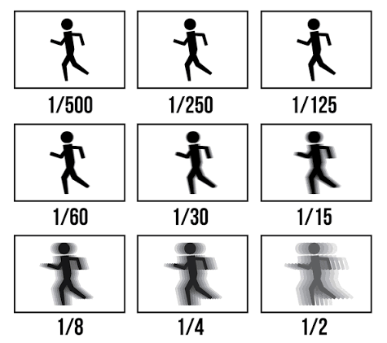
Problem 1: Scenario Analysis
ROLE OF EXPOSURE TIME AND SHUTTER SPEED
Exposure Time: The duration for which the camera sensor collects light.
Short Exposure (1/1000 s): Freezes fast-moving objects and reduces blur.
Medium Exposure (1/125 s): Suitable for capturing moderate movement with less blur.
Long Exposure (1/30 s): Increases the chance of blur when objects are moving.
Effect on Image Quality: Shorter exposure improves sharpness but allows less light into the camera.
Example: A moving car captured at 1/1000 s appears sharper than the same car captured at 1/30 s.

Slide 5

MATHEMATICAL RELATIONSHIP OF MOTION BLUR
Motion blur depends on object speed and exposure time.
Formula: Blur Length = Speed × Exposure Time
L = Blur length (pixels)
v = Object speed (pixels/ms)
t = Exposure time (ms)
Example:
If an object moves at 5 pixels/ms for 4 ms:
Blur Length = 5 × 4 = 20 pixels
Result: Longer exposure time generally produces greater motion blur.

Slide 6
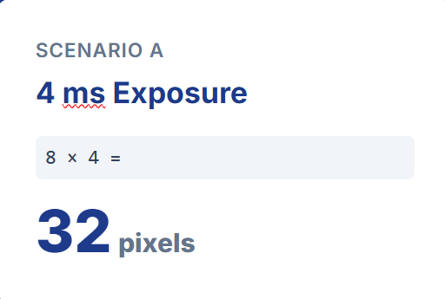
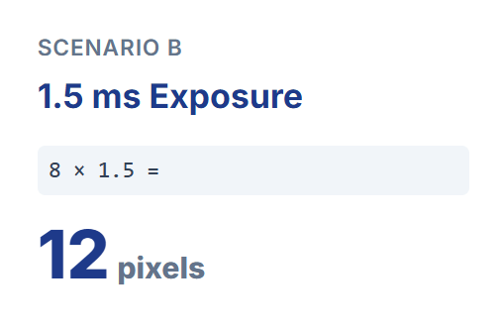
Problem 2: Numerical Solution
NUMERICAL ANALYSIS
Given Object Speed: 8 pixels/ms
Conclusion: The blur length is 32 pixels at 4 ms and 12 pixels at 1.5 ms. Shorter exposure time results in less motion blur.

Slide 7
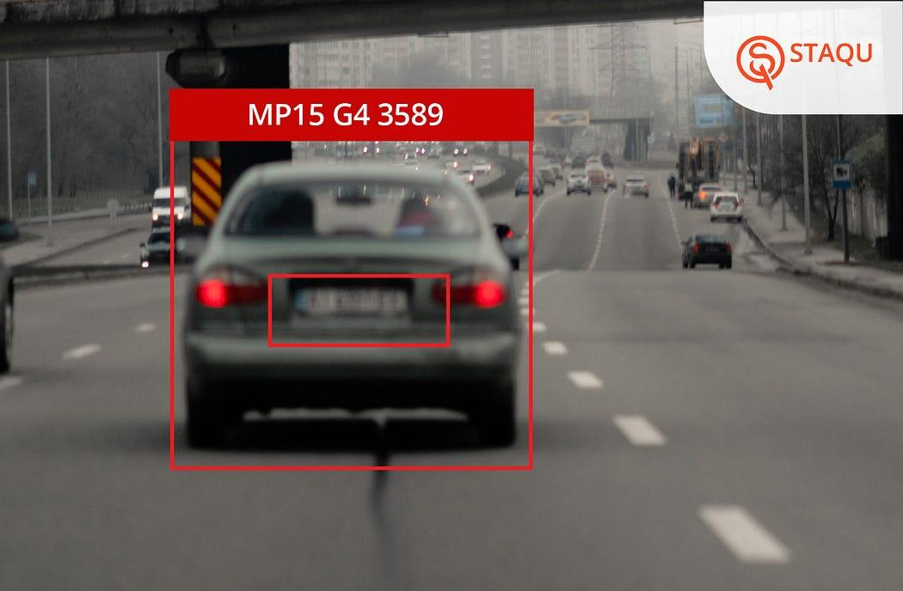
APPLICATIONS OF MOTION BLUR
Traffic Monitoring: Helps identify challenges in vehicle detection and number-plate recognition.
Sports Analysis: Affects tracking of fast-moving players and balls.
Robotics: Can reduce accuracy when detecting and locating moving objects.
Security Surveillance: May make faces and other important details difficult to recognize.
Industrial Inspection: Can affect the detection of defects in products moving along conveyor belts.
Autonomous Vehicles: Clear images help cameras detect pedestrians, vehicles and road signs reliably

Slide 8
CONCLUSION
Motion blur occurs when an object or camera moves during exposure.
Object speed, relative motion and exposure time determine the amount of blur.
Shorter exposure times can reduce blur and improve image sharpness.
Motion blur is an important consideration in traffic monitoring, robotics, surveillance and other computer vision applications.
Understanding the relationship between speed and exposure helps us capture and process clearer images.

Slide 9
THANK YOU

