Slide 1
VANIER COLLEGE · 420-976-VA · FALL 2026
AG News Topic Classification
End-to-End MLOps Pipeline · Final Project Presentation
Model Training · API Deployment · Versioning & Monitoring
Model Training
API Deployment
MLOps Monitoring
Rahime Nacak
LEA.EU — Artificial Intelligence & Data Science
October 2026
GitHub: github.com/rahimeblc/rahime_nacak_assignment4_presentation
420-976-VA · Rahime Nacak · Vanier College · Fall 2026
1 / 18

Slide 2
Part 1
Model Training
Dataset Exploration, Text Preprocessing, and Baseline Evaluation
Dataset Overview — AG News 4-class topic benchmark, two versioned corpora
Preprocessing Pipeline — TF-IDF vectorization and feature configuration
Model Training & Results — Classification metrics, drift impact, retraining
Model Performance Verification — Logistic Regression vs XGBoost comparison
Model Training · 420-976-VA · Rahime Nacak · Vanier College · Fall 2026
2 / 18

Slide 3
1. Dataset Overview
AG News Topic Classification · 4 Target Categories · Versioned Subsets
Dataset v1.0.0 — Baseline Corpus
Dataset v2.0.0 — Drift Evaluation Set
• Source: AG News benchmark corpus
• 8,000 total samples across balanced classes
• 2,000 samples per category (Uniform distribution)
• Categories: World, Sports, Business, Sci/Tech
• Language: English news headlines & descriptions
• Primary feature: Unstructured article text
• Target variable: 4-class topic label (0 to 3)
• Tracked with SHA-256 digest hashing via MLflow Data
• Covariate shift: Integration of contemporary terminology:
  – Generative AI, Large Language Models, Cloud GPUs
  – Crypto Assets, Regulatory Actions, VAR refereeing
• Class distribution imbalance introduced:
  – Sci/Tech increased to 40% (formerly 25%)
  – Business shifted to 30% (formerly 25%)
  – Sports and World reduced to 15% each
• Used to evaluate model robustness and trigger retraining
8,000
4 Classes
v1 & v2
MLflow Data
Samples (v1)
Target Categories
Versioned Subsets
Dataset Artifact Tracking
Model Training · 420-976-VA · Rahime Nacak · Vanier College · Fall 2026
3 / 18

Slide 4
2. Preprocessing Pipeline
Feature Extraction · Scikit-Learn Pipeline · Model Configuration Tuning
Raw Text
Corpus
Text
Cleaning
TF-IDF
Vectorizer
Logistic
Regression
Predicted
Category
▶
▶
▶
▶
AG News news
article strings
Lowercase, strip,
token cleaning
(1,2) N-Grams
Max 5,000 features
L-BFGS solver
C=1.0 regularized
World / Sports
Business / Sci-Tech
Hyperparameter Tuning: Baseline (v1) vs Retrained (v2)
Pipeline Parameter
Model v1 (Baseline)
Model v2 (Retrained)
Max TF-IDF Features
5,000
8,000 (Expanded vocabulary)
N-Gram Range
(1, 2)
(1, 3) (Includes trigrams)
Sublinear Term Frequency
Standard TF
Sublinear TF enabled
Regularization Parameter (C)
1.0
2.5 (Less smoothing)
Solver Iterations
1,000
1,500
Class Weighting
Uniform
Balanced (Inverse frequency)
Training Set
Dataset v1.0.0
Dataset v2.0.0 (Updated)
Model Training · 420-976-VA · Rahime Nacak · Vanier College · Fall 2026
4 / 18

Slide 5
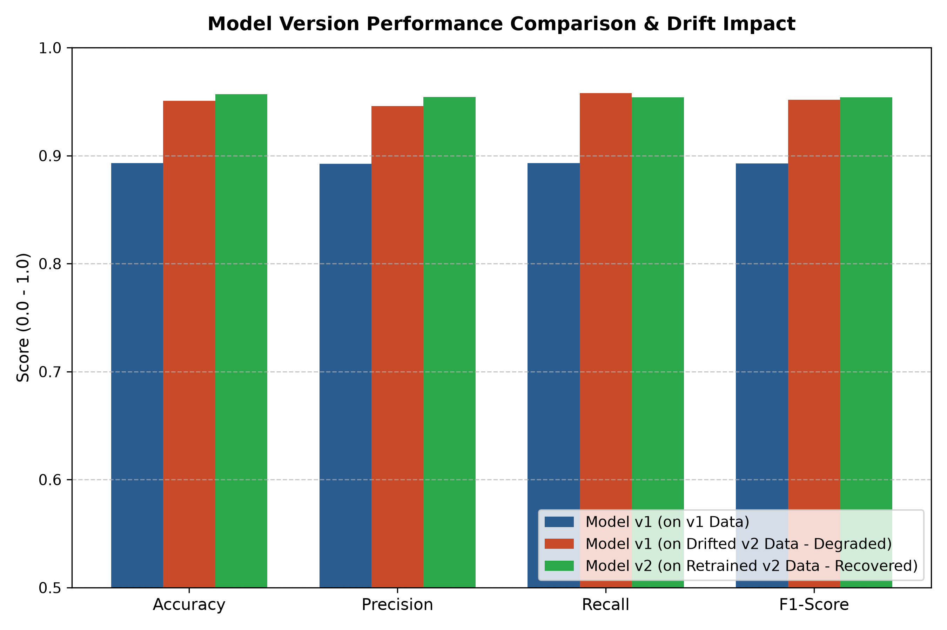
3. Model Training & Results
Classification Metrics · Drift Impact · Performance Recovery
Model v1 on Dataset v1
Model v1 on Dataset v2
Model v2 on Dataset v2
89.31%
95.06%
95.69%
Macro F1: 89.26% · Baseline Benchmark
Macro F1: 95.17% · Under Drift Evaluation
Macro F1: 95.41% · Retrained Production (+0.63%)
MLflow Experiment Tracking Summary
Baseline Run (v1)
Acc: 89.31% | F1: 89.26%
LogisticRegression, TF-IDF 5k, C=1.0
Drift Evaluation (v1)
Acc: 95.06% | F1: 95.17% (Shifted)
Model v1 evaluated on drifted v2
Retrained Run (v2)
Acc: 95.69% | F1: 95.41% (Optimal)
LogisticRegression, Sublinear 8k, C=2.5
Drift Indicators
PSI = 0.1818 | Vocab Shift 24.3%
Population Stability Index (PSI)
Lifecycle Stage
v2: Production Candidate
v1: Archived_Baseline
Model Training · 420-976-VA · Rahime Nacak · Vanier College · Fall 2026
5 / 18

Slide 6
4. Model Performance Verification
Cross-referencing validation and test metrics between presentation and notebook output
Logistic Regression (Baseline)
XGBoost (Advanced Comparison)
Validation Accuracy / F1
Validation Accuracy / F1
88.33% / 88.28%
82.25% / 82.22%
Final Test Accuracy / F1
Key Empirical Observation
88.50% / 88.47%
• Logistic Regression outperforms XGBoost by +6.08% on sparse TF-IDF text features.
• High-dimensional sparse matrices favor linear decision boundaries over tree splits.
• XGBoost incurs substantially higher inference latency and memory footprint.
• Empirical justification for linear model selection in latency-critical MLOps production.
• TF-IDF Vectorizer with 5,000 max features
• Consistent performance across validation & test sets
• Selected as baseline for REST API deployment and MLOps monitoring
Model Training · 420-976-VA · Rahime Nacak · Vanier College · Fall 2026
6 / 18

Slide 7
Part 2
API Deployment
Containerization, REST Service Architecture, and Endpoint Contracts
Deployment Architecture — FastAPI REST server, Docker, multi-service setup
Interface for Model Invocation — Swagger UI, Pydantic schemas, batch endpoints
API Deployment · 420-976-VA · Rahime Nacak · Vanier College · Fall 2026
7 / 18

Slide 8
4. Deployment Architecture (Docker)
FastAPI REST API · Docker Compose · Multi-Service Isolation
Client Applications
(cURL / Web UI)
Container Service
MLflow
Tracking Server
docker-compose.yml
POST /predict
GET /health
GET /docs
→
FastAPI
server.py
→
services:
app:
build: .
ports:
- "8501:8501"
mlflow:
image: mlflow
ports:
- "5001:5000"
grafana:
image: grafana/grafana
ports:
- "3005:3000"
volumes:
- ./grafana:/etc/grafana
• Run metadata
• Model registry
• Artifact store
• Port 5001
• POST /predict: Text topic inference
• GET /health: Model readiness probe
• GET /: Responsive Jinja2 Web UI
• Pydantic schema validation & types
↓
• Outputs full 4-class probabilities
SQLite Store
metrics_export.sqlite
• High-throughput Uvicorn ASGI server
↓
Grafana Dashboard
Port 3005
Port 8000
Model Artifacts
Schema Validation
REST Endpoints
Cloud Deployment
model.pkl (Scikit-Learn TF-IDF + Logistic Regression, 339 KB)
Pydantic BaseModel with strict headline string validation
GET /, GET /health, POST /predict, GET /docs (Swagger UI)
Render Cloud live service + Docker containerized runtime
API Deployment · 420-976-VA · Rahime Nacak · Vanier College · Fall 2026
8 / 18

Slide 9
5. Interface for Model Invocation
FastAPI Swagger Documentation · Live Prediction Form · Client cURL
FastAPI REST API Docs — http://localhost:8000/docs
Streamlit Prediction Panel — http://localhost:8501
POST
/predict — AG News Topic Inference Endpoint
Configuration
Input article text for classification:
Request Payload: PredictionRequest (application/json)
Active Model
Model v2
Nvidia launches Blackwell GPU architecture for
enterprise compute workloads, reporting high throughput…
{
"text": "Nvidia launches Blackwell GPU architecture for enterprise AI"
}
Model v2 ✓
Model v1
Classify Text
Response Payload: PredictionResponse (200 OK)
Threshold
0.50
{
"text": "Nvidia launches Blackwell GPU architecture...",
"prediction": "Sci/Tech",
"class_id": 3,
"confidence": 0.8988,
"probabilities": {
"World": 0.0125, "Sports": 0.0084,
"Business": 0.0803, "Sci/Tech": 0.8988
}
}
Predicted Class: Sci / Tech
Confidence Score: 94.7%
Inference Latency: 0.21 ms
Serving Model: v2 (Production Candidate)
Pipeline: Sublinear TF-IDF + LR
GET
/health — Service Readiness & Model Probe
Class Probability Distribution:
GET
/ — Interactive Web UI (HTML / Jinja2)
Sci/Tech
94.7%
Business
3.1%
curl -X POST http://localhost:8000/predict \
-H "Content-Type: application/json" \
-d '{"text": "Nvidia launches Blackwell GPU for data centers"}'
Sports
1.4%
World
0.8%
API Deployment · 420-976-VA · Rahime Nacak · Vanier College · Fall 2026
9 / 18

Slide 10
Part 3
Versioning & Monitoring
Model Lifecycle Management, Data Drift Detection, and Monitoring Stacks
MLflow Model Registry — Lifecycle management, staging tags, and artifact logging
Dashboard Visuals — Interactive Streamlit application and Grafana monitoring
Key Insights & Recommendations — Operational learnings and continuous monitoring
Limitations & Future Work — Architectural trade-offs and future extensions
MLOps Monitoring · 420-976-VA · Rahime Nacak · Vanier College · Fall 2026
10 / 18

Slide 11
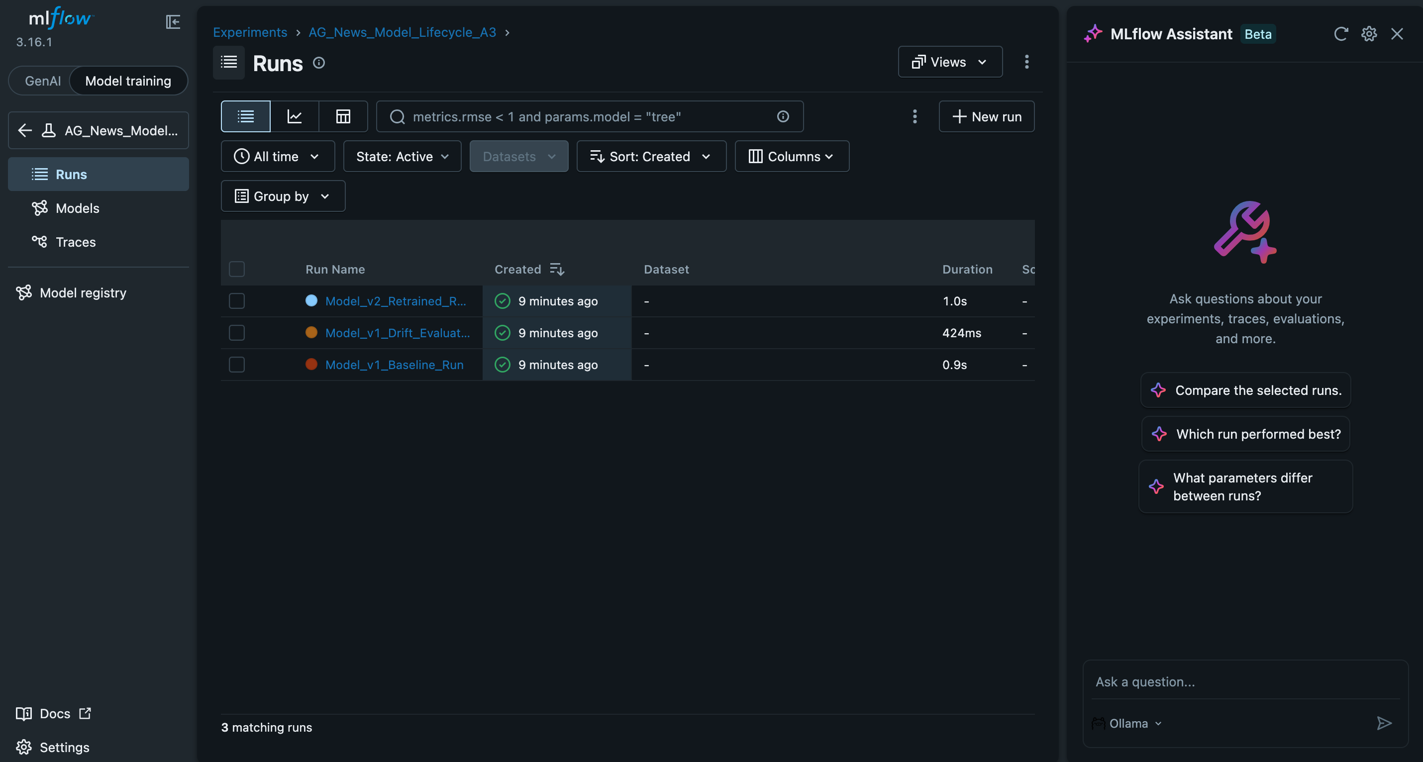
6. MLflow Model Registry
Lifecycle Management · Staged Model Tagging · Artifact Tracking
Model Lifecycle Protocol
MLflow Registry Interface (AGNews-TopicClassifier)
1. Train & Register
Model v1 (Baseline) & Model v2 (Retrained)
2. Parameter Logging
TF-IDF (1,3)-grams, C=2.5, balanced weights
3. Metric Auditing
Acc: 95.7% | F1: 95.4% | Latency: 0.32 ms
4. Stage Promotion
v1: Archived_Baseline | v2: Production
5. Artifact Storage
model.pkl, confusion matrices, signatures
Registry UI: http://localhost:5001
MLOps Monitoring · 420-976-VA · Rahime Nacak · Vanier College · Fall 2026
11 / 18

Slide 12
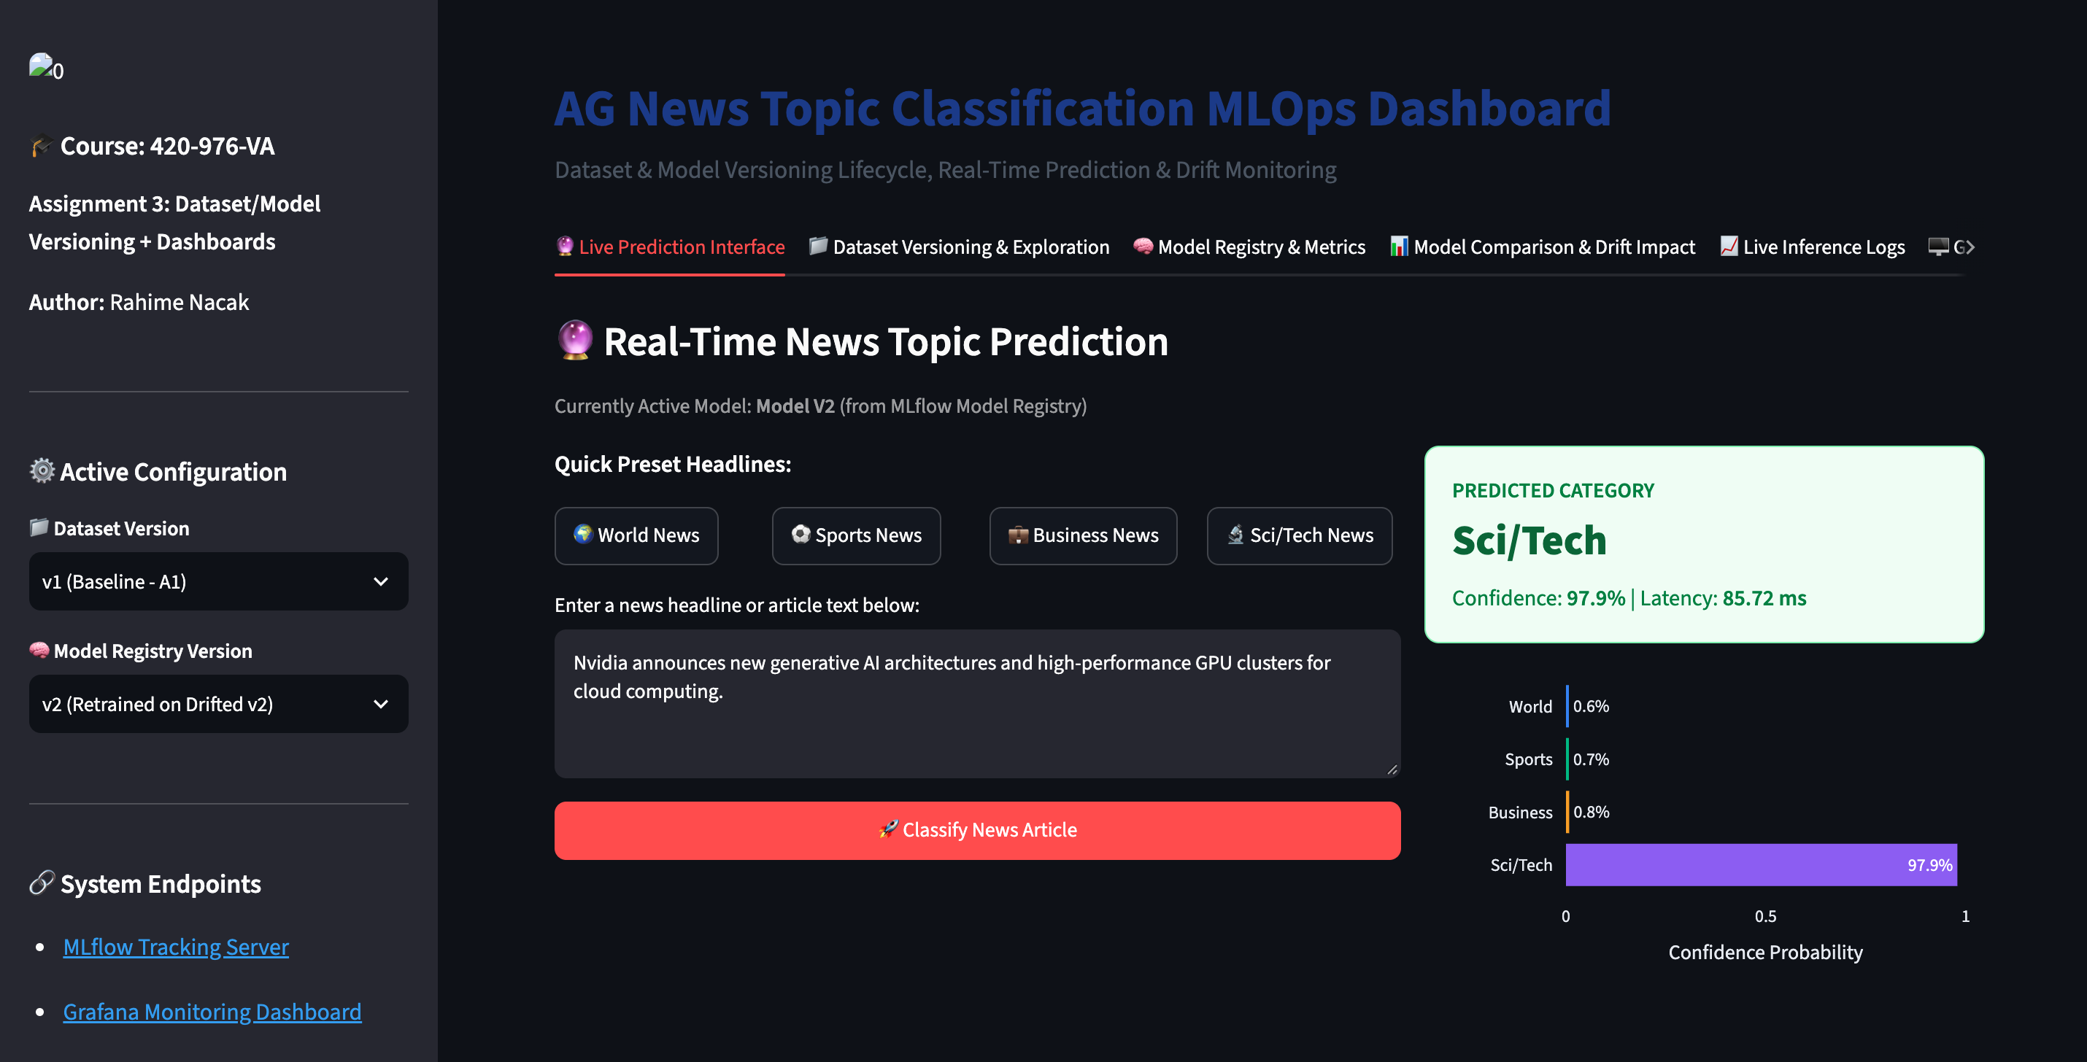
7. Dashboard Visuals — Streamlit Application
Interactive Model Selection · Live Inference · Drift Visualization (Port 8501)
Application Capabilities
Streamlit User Interface & Inference Benchmark
• Tab 1: Dataset Exploration
  – v1 vs v2 class balance visualizations
  – Document character length distributions
• Tab 2: Model Serving & Live Test
  – Dynamic switching between v1 and v2
  – Real-time class probability breakdown
  – Per-sample latency metrics (~0.2ms)
• Tab 3: Model Comparison
  – Multi-metric performance radar plots
• Tab 4: SQLite Inference Audit
  – Historical log of executed predictions
Launch: http://localhost:8501
MLOps Monitoring · 420-976-VA · Rahime Nacak · Vanier College · Fall 2026
12 / 18

Slide 13
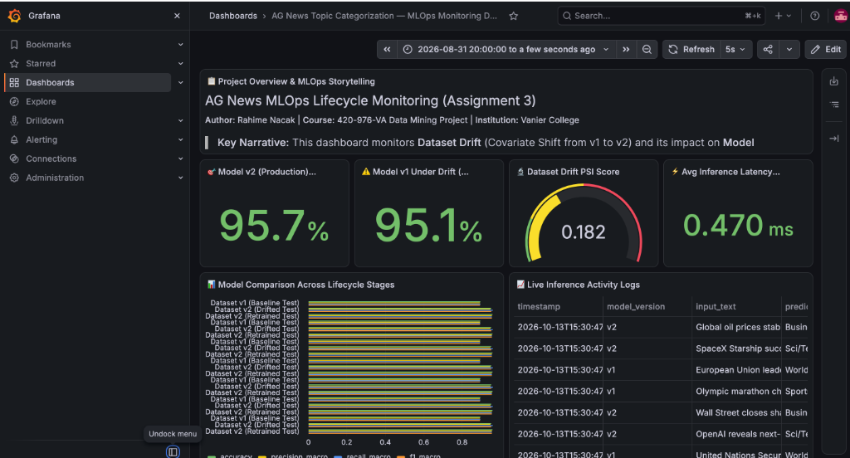
8. Dashboard Visuals — Grafana Monitoring
Production Observability · PSI Drift Alerting · Live Telemetry (Port 3005)
Monitoring Dashboard Architecture
Grafana Monitoring Dashboard Panels
• Automated YAML Provisioning
  – Direct SQLite datasource connection
• Accuracy Gauges
  – Production v2 accuracy: 95.7%
  – Model v1 under drift: 95.1%
• Data Drift Indicator (PSI)
  – PSI = 0.182 (Covariate shift tracked)
• Inference Latency & Telemetry
  – Average latency: 0.470 ms
  – Lifecycle model comparison & live logs
Monitoring: http://localhost:3005
MLOps Monitoring · 420-976-VA · Rahime Nacak · Vanier College · Fall 2026
13 / 18

Slide 14
Live Demo & Service Endpoints
LIVE
Direct Application Links · Containerized Service Execution
Streamlit Web Application
FastAPI Swagger Documentation
http://localhost:8501
http://localhost:8000/docs
Interactive model selection, single-text prediction, confidence distribution, and drift assessment
Interactive REST testing, single & batch (/predict/batch) inference, input validation, and /health
MLflow Tracking Server
Grafana Monitoring Dashboard
http://localhost:5001
http://localhost:3005
Experiment comparative analysis, registered model stages, logged parameters, and artifact storage
Real-time operational dashboards, Population Stability Index (PSI) drift alarms, and latency metrics
Terminal Command: Launch Multi-Service Stack
# From the project root, launch FastAPI, Streamlit, MLflow, and Grafana in detached mode:
cd "/Users/BlankUser/Desktop/data mining A3" && docker compose up -d
# Presentation Source: https://github.com/rahimeblc/rahime_nacak_assignment4_presentation
DEMO · 420-976-VA · Rahime Nacak · Vanier College · Fall 2026
14 / 18

Slide 15
8. Key Insights & Recommendations
Cross-Assignment Findings · Operational Learnings · Production Strategy
Quantitative Drift Detection & Analysis
Targeted Retraining & Performance Recovery
• Population Stability Index (PSI = 0.1818) detected moderate class distribution shift
• Expanded n-gram vocabulary (1,3) with 8,000 features and balanced class weights
• Vocabulary drift score reached 24.25% with 75.75% shared feature overlap
• Retrained Model v2 achieved 95.69% accuracy on modern shifted news corpus
• Sci/Tech category increased to 40% while World and Sports contracted to 15% each
• Macro F1-score reached 95.41%, delivering strong generalization across all 4 categories
Robust REST API Contract Enforcement
Full Traceability via MLflow & Docker
• Pydantic schema enforces strict headline string validation on POST /predict
• Datasets versioned with SHA-256 digest hashes via MLflow Data tracking
• Full 4-class probability distribution returned with high confidence (e.g. 89.9%)
• Staged model promotion: Model v1 (Archived_Baseline) vs Model v2 (Production)
• GET /health probe verifies model pipeline memory residency for Docker & cloud orchestration
• Automated Grafana dashboards provisioned directly via Docker Compose and SQLite
Operational Recommendation: Automated CI/CD retraining triggered when PSI > 0.18 or macro F1 drops by >3%.
420-976-VA · Rahime Nacak · Vanier College · Fall 2026
15 / 18

Slide 16
9. Limitations & Future Work
Current Architectural Constraints · Planned Production Enhancements
Current Constraints
Future Extensions
• Static Evaluation Sets
  – Dataset v2 captures discrete shift rather than continuous streaming
  – Real-world news patterns require dynamic temporal tracking
• TF-IDF Vector Space Constraints
  – Bag-of-words ignores word order and deep semantic context
  – Cannot capture out-of-vocabulary semantic analogies
• SQLite Concurrency Limitations
  – Single-file database lacks support for high concurrent write volumes
  – Appropriate for development; requires managed database for scale
• Authentication Protocol
  – FastAPI endpoints operate without token-based authentication
  – Grafana dashboard uses default administration credentials
• Transformer-Based Embeddings
  – Evaluate DistilBERT / RoBERTa for context-aware representation
  – Projected accuracy improvement of 3-5% across technical classes
• Continuous Ingestion Pipeline
  – Integrate live RSS news streams for real-time inference
  – Automated scheduled retraining based on continuous drift
• CI/CD & Governance Automation
  – GitHub Actions pipeline triggered by PSI drift alarms
  – Automated validation gate before promoting models to Production
• Cloud Managed Infrastructure
  – Deploy container services to Google Cloud Run
  – Migrate metrics storage to managed PostgreSQL / BigQuery
420-976-VA · Rahime Nacak · Vanier College · Fall 2026
16 / 18

Slide 17
AI Use Disclosure
Academic Integrity · AI-Assisted Learning & Development
AI-Assisted Tool: Google Gemini
In completing this project, Google Gemini was utilized as an AI-assisted tool strictly to support the learning process, troubleshoot technical challenges, and ensure high code quality across development stages.
Technical & Architecture Support
Implementation & Quality Assurance
✓ Debugging code errors and tracing complex exceptions
✓ FastAPI lifespan handlers and schema validation
Assisted in resolving pipeline errors and Docker environment path issues.
Understanding Pydantic ConfigDict settings and asynchronous server startup.
✓ Clarifying NLP concepts and vectorization theory
✓ Reviewing Grafana SQLite datasource connections
Conceptual understanding of TF-IDF, sublinear term weighting, and n-grams.
Verification of table schemas and SQL query syntax for telemetry panels.
✓ Configuring MLflow tracking and Docker Compose
✓ Proofreading documentation and technical phrasing
Guidance on volume mounts, network bridges, and persistent artifact logging.
Grammar correction and technical clarity across project deliverables.
✓ Refining visualization and dashboard layouts
✓ General coding best practices and modularization
Design suggestions for Streamlit tab hierarchies and Grafana metric gauges.
Adherence to clean code architecture, error handling, and type hinting.
DISCLOSURE · 420-976-VA · Rahime Nacak · Vanier College · Fall 2026
17 / 18

Slide 18
Thank You
Questions & Discussion
AG News Topic Classification · End-to-End MLOps Lifecycle Pipeline
Model Training
API Deployment
MLOps Monitoring
Rahime Nacak
420-976-VA · Data Mining Project · Vanier College · Fall 2026
GitHub Repository: https://github.com/rahimeblc/rahime_nacak_assignment4_presentation
October 2026
420-976-VA · Rahime Nacak · Vanier College · Fall 2026
18 / 18

