Slide 1
KAFKA
SARFARAAZ ASLAM
1

Slide 2

Sommaire
Messaging
Synchrone et Asynchrone
Point to Point
Publish Subscribe
MOM
Solution:Kafka
Principe
Use Case
Notre Offre
Demo
2
Notes:
2

Slide 3
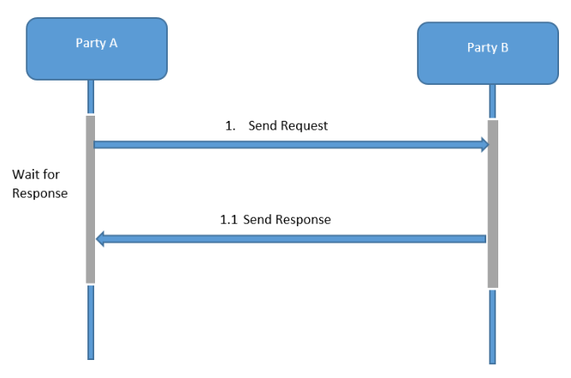
Message Synchrone

Slide 4
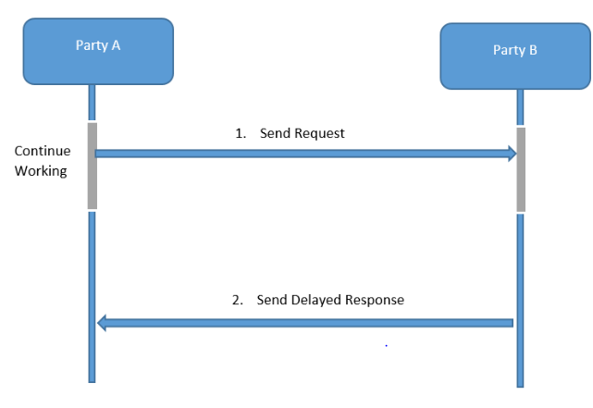
Message Asynchrone

Slide 5
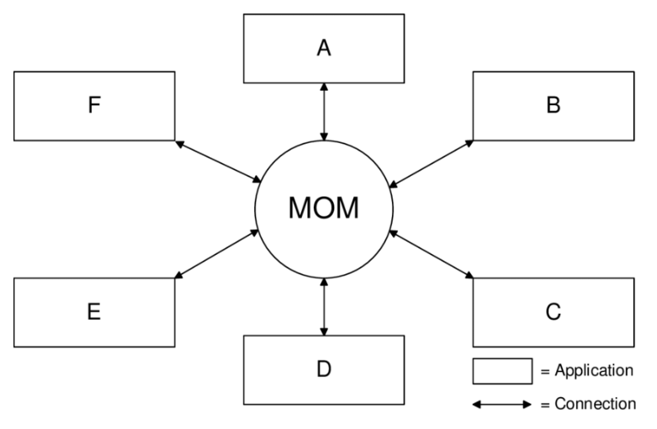
MOM

Slide 6

Messaging
Point to Point
Publish Subscribe

Slide 7
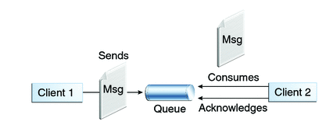
Point to Point

Slide 8
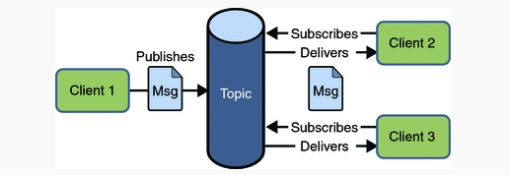
Publish Subscribe

Slide 9
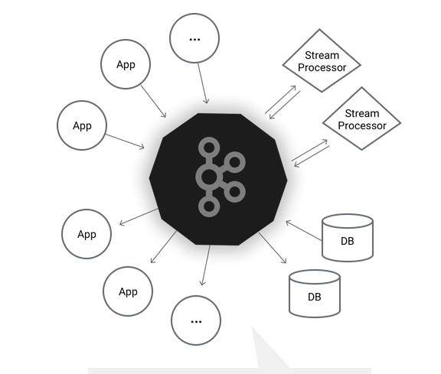
Solution KAFKA
Historique
2009
LinkedIn
Apache
Plateforme
Streaming distribuée
Echange centralisée
Messaging
NAS
Publish-subscribe

Slide 10
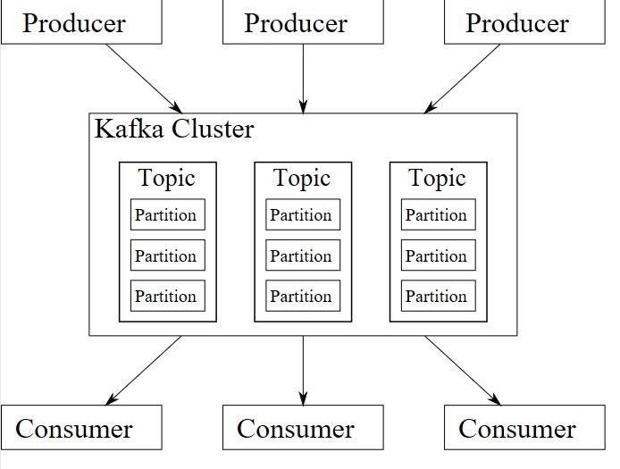
Principe
« Don’t fear file system »
Message
Producer
Consumer
Topic
Broker
Cluster
Partition

Slide 11
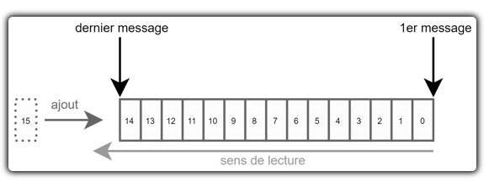
Log
Unité fondamental
Clé/Valeur
Byte arrays
Offset

Slide 12
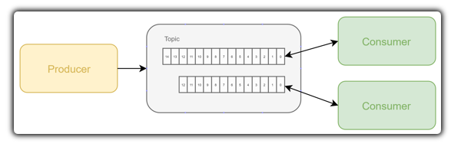
Producer

Slide 13
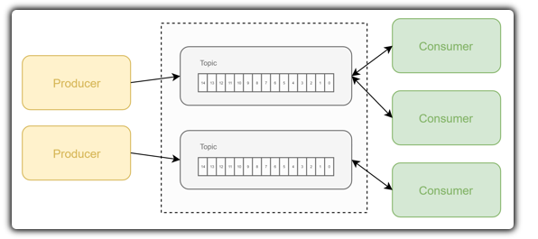
Topics

Slide 14
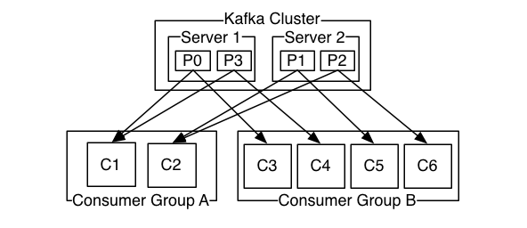
Consumer

Slide 15
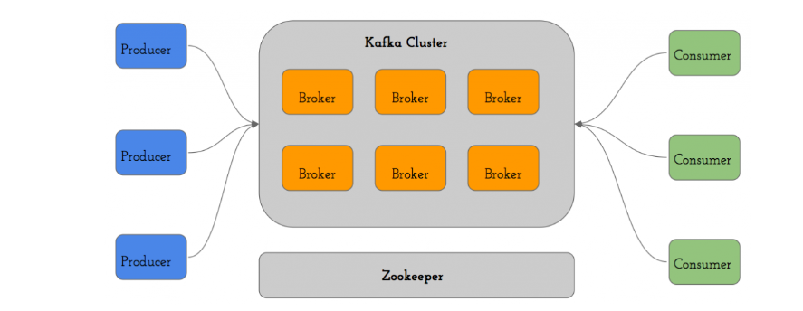
Architecture

Slide 16

Use cases
use cases
Messaging
Analytics
Parcours de navigation
Metrics
Big Data
Log Aggregation

Slide 17
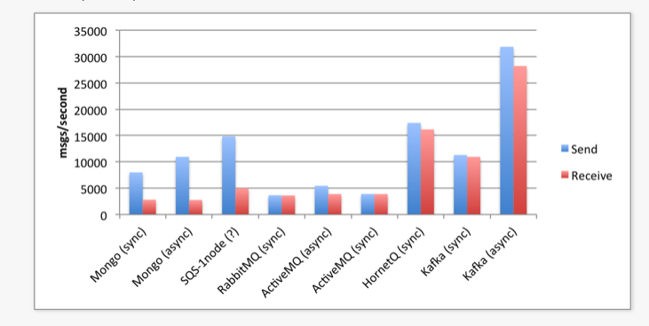
Comparatif

Slide 18
Notre offre
Choix Technologique
Spring: 5
Spring-Kafka: 2.2

Slide 19
Design
Cluster
Producer Lib
Consumer Lib
Push
Pull
Application.properties
Application.properties

Slide 20

Demo

