Slide 1
« KAFKA »
Sarfaraaz ASLAM
1

Slide 2

Sommaire
Messaging
Point to Point
Publish Subscribe
Solution:Kafka
Principe
Use Case
Notre Offre
Demo
2
Notes:
2

Slide 3

Messaging
Point to Point
Publish Subscribe

Slide 4
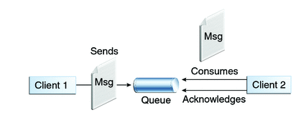
Point to Point

Slide 5
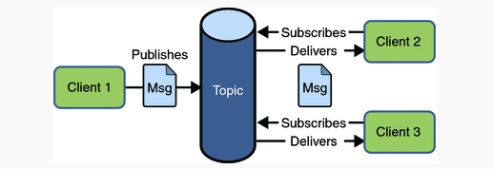
Publish Subscribe

Slide 6
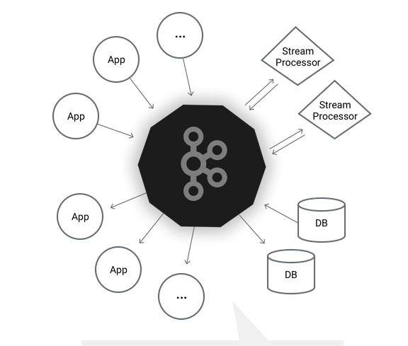
Solution KAFKA
Historique
2009
LinkedIn
Plateforme
Streaming distribuée
Echange centralisée
Messaging
NAS
Publish-subscribe

Slide 7
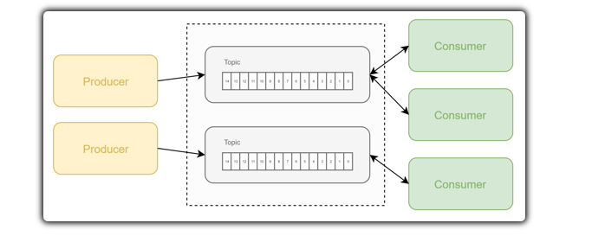
Principe

Slide 8
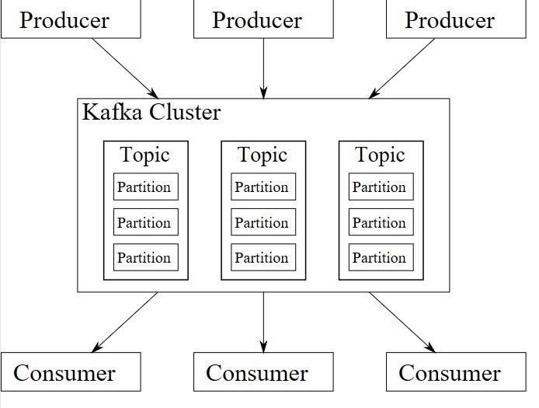
Principe
Message
Producer
Consumer
Topic
Broker
Cluster
Partition

Slide 9
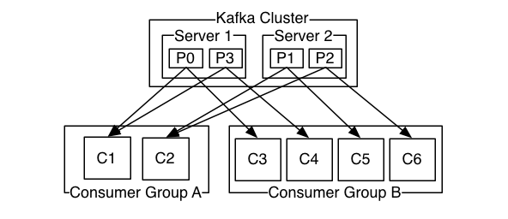
Consumer

Slide 10

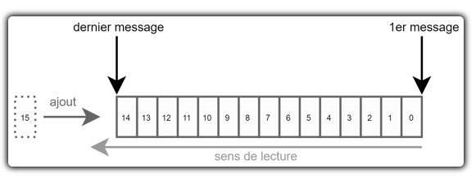
Message
Unité fondamental
Clé/Valeur
Byte arrays
Offset

Slide 11
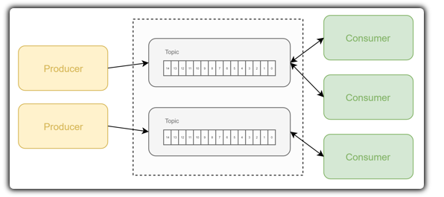
Topics

Slide 12
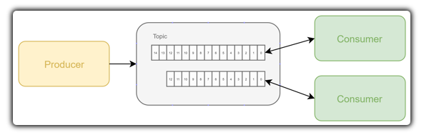
Partition

Slide 13
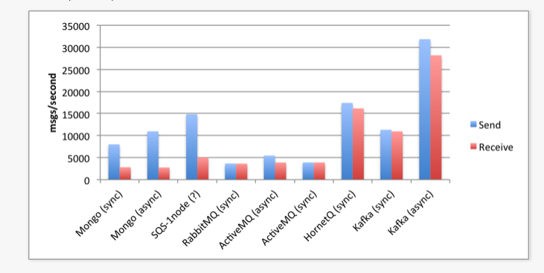
Comparatif

Slide 14
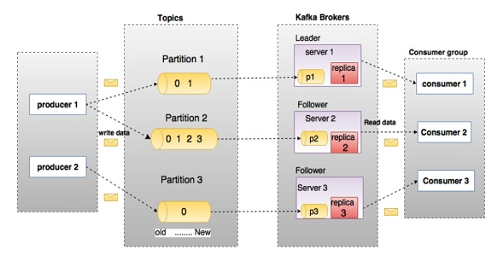
Architecture

Slide 15
Use cases
use cases
Messaging
Parcours de navigation
Metrics
Log Aggregation

Slide 16
Notre offre
Choix Technologique
Spring: 5
Spring-Kafka: 2.2

Slide 17
Design
Cluster
Producer Lib
Consumer Lib
Push
Pull
Application.properties
Application.properties

Slide 18

Demo

