Slide 1
NC STATE UNIVERSITY
WolfBox
Your work, remembered.
A persistent coding tutor and course companion
Hacktoberfest Hack Day Raleigh
October 31, 2026
01
Notes:
15 seconds. WolfBox is a persistent coding tutor and course companion. Most tutoring conversations restart without the student’s history. WolfBox keeps the work, so both the tutor and the TA can pick up where the student left off.
Sources: WolfBox repository, commit 1036db1 (pulled October 31, 2026). SPEC.md; README.md. Screenshots, where used, are bundled native macOS demo fixtures with synthetic student records and fake Gemma responses. These images illustrate the interface, not a live production session. Theme reference: NC State University Brand, https://brand.ncsu.edu/designing-for-nc-state/color/ (Wolfpack Red #CC0000, Wolfpack Black #000000, Wolfpack White #FFFFFF).

Slide 2
The missing context
The same bug.
Another explanation
from scratch.
A tutor needs the student’s earlier attempts.
A TA needs the story before office hours begin.
WolfBox keeps runs, code snapshots, and recurring mistake patterns.
02
Notes:
15 seconds. A failing test is only the latest symptom. The useful context is what the student already tried and whether the same mistake appeared earlier. Students repeat that explanation in every tutoring session and at office hours. WolfBox keeps that history with the student.
Sources: WolfBox repository, commit 1036db1 (pulled October 31, 2026). SPEC.md; README.md. Screenshots, where used, are bundled native macOS demo fixtures with synthetic student records and fake Gemma responses. These images illustrate the interface, not a live production session. Theme reference: NC State University Brand, https://brand.ncsu.edu/designing-for-nc-state/color/ (Wolfpack Red #CC0000, Wolfpack Black #000000, Wolfpack White #FFFFFF).

Slide 3
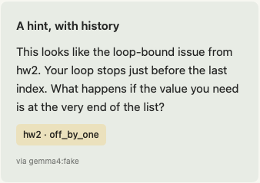
Hints that remember earlier attempts
Every run adds context
Run the assignment’s tests.
Keep the submitted code and results.
Use past mistakes to guide the next hint.
Same code, different history
Seeded Alex and fresh Sam form the core demo.
Native macOS demo fixture
03
Notes:
25 seconds. Submit buggy hw4 code as Alex, whose box has three weeks of synthetic history. Tests run in the box. The hint can connect the last-index failure to an earlier hw2 loop-bound error. Then run the same code as fresh student Sam. Sam has no earlier attempt to cite. The intended contrast demonstrates why persistent state matters. The screenshot is a fixture, and this slide does not claim a live model evaluation.
Sources: WolfBox repository, commit 1036db1 (pulled October 31, 2026). SPEC.md §5 LEARN and §6; README.md Demo flow; apple/README.md Learn; apple/screenshots/learn.png. Screenshots, where used, are bundled native macOS demo fixtures with synthetic student records and fake Gemma responses. These images illustrate the interface, not a live production session. Theme reference: NC State University Brand, https://brand.ncsu.edu/designing-for-nc-state/color/ (Wolfpack Red #CC0000, Wolfpack Black #000000, Wolfpack White #FFFFFF).

Slide 4
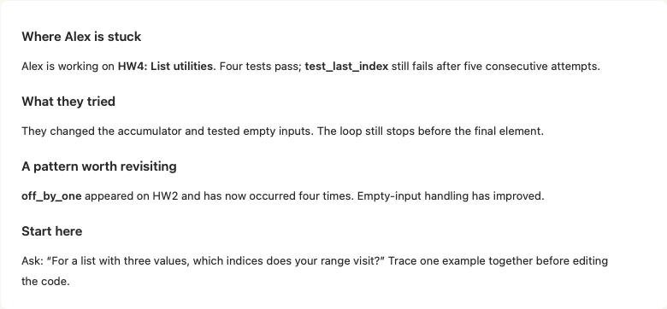
A clearer handoff to the TA
A nudge when progress stalls
Cropped native macOS demo fixture
04
Notes:
20 seconds. Repeated failures trigger a nudge and a draft message the student can review. The TA view summarizes the failing test, earlier attempts, and recurring mistakes, then suggests a starting question. The native app uses macOS sharing for a reviewed message. It does not claim delivery to an office-hours queue.
Sources: WolfBox repository, commit 1036db1 (pulled October 31, 2026). SPEC.md §5 HELP; apple/README.md Learn and TA; apple/screenshots/ta.png. Screenshots, where used, are bundled native macOS demo fixtures with synthetic student records and fake Gemma responses. These images illustrate the interface, not a live production session. Theme reference: NC State University Brand, https://brand.ncsu.edu/designing-for-nc-state/color/ (Wolfpack Red #CC0000, Wolfpack Black #000000, Wolfpack White #FFFFFF).

Slide 5
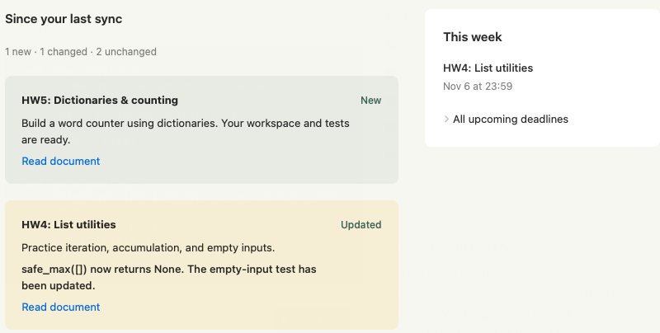
Course changes stay with the work
New material
and changed specs
Summaries and deadlines
remain in the course library.
Canvas import now supports instructions, links, and due dates.
Sample course shown. Canvas imports do not create test workspaces automatically.
05
Notes:
20 seconds. The sample course sync can summarize new material, explain a changed spec, extract deadlines, and prepare tested assignment workspaces. The updated repository also includes real Canvas REST imports through a course picker. Canvas imports bring published instructions, links, and due dates, but do not automatically create executable workspaces. The screenshot shows the sample course flow.
Sources: WolfBox repository, commit 1036db1 (pulled October 31, 2026). SPEC.md §5 SYNC; README.md Canvas assignments; apple/README.md Course; apple/screenshots/course.png. Screenshots, where used, are bundled native macOS demo fixtures with synthetic student records and fake Gemma responses. These images illustrate the interface, not a live production session. Theme reference: NC State University Brand, https://brand.ncsu.edu/designing-for-nc-state/color/ (Wolfpack Red #CC0000, Wolfpack Black #000000, Wolfpack White #FFFFFF).

Slide 6
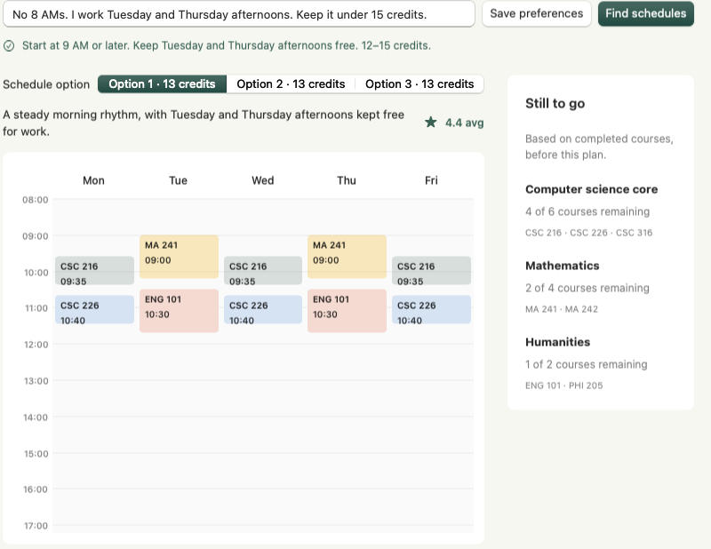
Schedules built from actual constraints
“No 8 AMs.
I work Tuesday and
Thursday afternoons.”
Gemma parses the preferences.
The solver checks section conflicts.
The app shows remaining requirements.
Sample catalog and transcript shown
06
Notes:
20 seconds. A student writes preferences such as no 8 AMs or keeping Tuesday and Thursday afternoons free. Gemma parses the preferences and explains results. A deterministic solver selects up to three schedules from catalog sections. The default demo uses sample data. An optional NC State refresh can use public sections, but prerequisite interpretation is limited and official registration must confirm eligibility. Degree requirements and the example transcript remain synthetic.
Sources: WolfBox repository, commit 1036db1 (pulled October 31, 2026). SPEC.md §5 PLAN; README.md Registration planner: public NC State schedules; apple/README.md Plan; apple/screenshots/plan.png. Screenshots, where used, are bundled native macOS demo fixtures with synthetic student records and fake Gemma responses. These images illustrate the interface, not a live production session. Theme reference: NC State University Brand, https://brand.ncsu.edu/designing-for-nc-state/color/ (Wolfpack Red #CC0000, Wolfpack Black #000000, Wolfpack White #FFFFFF).

Slide 7
The next Canvas deadline, on the desk
5 min
Course
Assignment
Upcoming due date
Canvas refresh interval
A Mac sends the next eligible assignment to the UNO Q over USB.
New companion code in the latest repository update. Hardware not verified here.
07
Notes:
15 seconds. The latest pulled commit adds a separate Canvas LED companion for the Arduino UNO Q. A Mac script reads active student courses and sends the next eligible unsubmitted assignment over USB. It refreshes every five minutes. Past-due and undated assignments are excluded. The board returns to a waiting state if the connection disappears and marks old data after prolonged transient Canvas failures. The code is present in the repository. Hardware operation was not verified for this presentation.
Sources: WolfBox repository, commit 1036db1 (pulled October 31, 2026). CanvasLink/README.txt; CanvasLink/canvas_link.py; CanvasLink/CanvasDisplay/CanvasDisplay.ino; commit 1036db1. Screenshots, where used, are bundled native macOS demo fixtures with synthetic student records and fake Gemma responses. These images illustrate the interface, not a live production session. Theme reference: NC State University Brand, https://brand.ncsu.edu/designing-for-nc-state/color/ (Wolfpack Red #CC0000, Wolfpack Black #000000, Wolfpack White #FFFFFF).

Slide 8
Persistent state belongs to the student
Browser or native macOS client
FastAPI orchestrator
Routes requests to each student’s box
Student’s persistent box
Runs, snapshots, mistake profile,
course documents, and plan
Gemma backend options
Gemini API or local Ollama
Fake backend for repeatable demos
Local boxes support the demo. Maritime deployment still needs provider verification.
08
Notes:
20 seconds. The browser and SwiftUI client call a FastAPI orchestrator. The orchestrator routes to a student’s box, which owns run history, code snapshots, the mistake profile, course documents, and planning state. Local processes provide the demo backend. Maritime is the target provider, with deployment details still requiring verification. Gemma has Gemini and local Ollama backend options. The default development configuration uses fake model responses.
Sources: WolfBox repository, commit 1036db1 (pulled October 31, 2026). README.md Architecture, Online Gemma mode, Offline mode, Maritime deployment; IMPLEMENTATION.md §7. Screenshots, where used, are bundled native macOS demo fixtures with synthetic student records and fake Gemma responses. These images illustrate the interface, not a live production session. Theme reference: NC State University Brand, https://brand.ncsu.edu/designing-for-nc-state/color/ (Wolfpack Red #CC0000, Wolfpack Black #000000, Wolfpack White #FFFFFF).

Slide 9
The three-minute walkthrough
01
Same code, different student history
Alex compared with fresh student Sam
02
The office-hours handoff
A nudge and a concise account of prior attempts
03
An updated course and a workable schedule
Sync the sample course, then solve from preferences
09
Notes:
20 seconds. The actual demo can use this sequence. Start with seeded Alex and fresh Sam to show the memory difference. Move to the TA handoff, publish and sync a sample course update, then solve a schedule. Show the Arduino companion if configured, otherwise identify it as added code. The exact timing is a presenter plan, not a measured runtime.
Sources: WolfBox repository, commit 1036db1 (pulled October 31, 2026). SPEC.md §6; README.md Demo flow; CanvasLink/README.txt. Screenshots, where used, are bundled native macOS demo fixtures with synthetic student records and fake Gemma responses. These images illustrate the interface, not a live production session. Theme reference: NC State University Brand, https://brand.ncsu.edu/designing-for-nc-state/color/ (Wolfpack Red #CC0000, Wolfpack Black #000000, Wolfpack White #FFFFFF).

Slide 10
Prototype today, pilot next
Current prototype
Before a student pilot
Test execution with saved history
Tutor and TA workflows
Course sync and schedule solver
Web and native macOS clients
Verify live model behavior
and Maritime deployment
Validate account access and privacy
Measure student and TA usefulness
WolfBox keeps the history that makes the next conversation useful.
10
Notes:
10 seconds. WolfBox’s current evidence is a local prototype with native app fixtures and a documented fake-Gemma local integration check. The newer repository adds Canvas imports, an optional public course catalog, and the UNO Q companion. The next step is to validate live model and provider behavior, strengthen authentication and privacy, and test whether students and TAs find the persistent history useful. No production readiness, proven learning outcome, or verified per-student cost is claimed.
Sources: WolfBox repository, commit 1036db1 (pulled October 31, 2026). README.md; SPEC.md Goals and non-goals; apple/VERIFICATION.md; CanvasLink/README.txt. Screenshots, where used, are bundled native macOS demo fixtures with synthetic student records and fake Gemma responses. These images illustrate the interface, not a live production session. Theme reference: NC State University Brand, https://brand.ncsu.edu/designing-for-nc-state/color/ (Wolfpack Red #CC0000, Wolfpack Black #000000, Wolfpack White #FFFFFF).

