Slide 1
HUMAN VALUES TEXT CLASSIFICATION ON SRI SATHYA SAI BABA DISCOURSES USING MACHINE LEARNING
Venkata Nihar Tatavarti
MSC Data Science Final Thesis Presentation

Slide 2
Agenda
Introduction / Background
Literature Review
Problem Statement
Methodology
Results & Discussion
Conclusion & Future work

Slide 3
Introduction / Background
Introduction
Assigning specific text labels according to sentiment or content of the text, this process is known as Text Classification. There has been no interest in Text Classification based on one individual’s literature according to the text labels definitions defined by that individual. Human Emotions stem from Human psyche guided by Human Values, which act as the core of Human Existence. This research is focused at finding the workflow and right classifier to classify discourses of Sri Sathya Sai Baba across two human values namely, love and right conduct, being true to the definitions of the human values as defined by Baba during His lifetime
Significance
The importance of this research work is high as there has been no interest in Text Classification based on one individual’s literature according to the text labels definitions defined by that individual. The techniques and work flow can be extended to a corpus of a specific individual for custom text classification where a generic text classification does not yield right results.
Motivation
Bhagawan Sri Sathya Sai Baba has been an influential figure in my life through His teachings and the foundation of those teachings are the Five Human Values, namely TRUTH, RIGHT CONDUCT, PEACE, LOVE and NON-VOILENCE. A complete harmony can only be achieved by adhering to all five human values. .

Slide 4
Literature Review
Although there is no work to classify text based on one individual’s literature according to the text labels definitions defined by that individual, several pieces of research is carried out on text classification, dimensionality reduction techniques on principal component analysis, Uniform Manifold Approximation and Projection, encoding and using machine learning algorithms in text classification
Special Mention
Kowsari, Kamran and Jafari Meimandi, Kiana and Heidarysafa, Mojtaba and Mendu, Sanjana and Barnes, Laura E. and Brown, Donald E. (2019) Text Classification Algorithms: A Survey, Special Issue "Machine Learning on Scientific Data and Information" 23 April 2019
T. Mikolov, E. Grave, P. Bojanowski, C. Puhrsch, A. Joulin. Advances in Pre-Training Distributed Word @inproceedings{mikolov2018advances, title={Advances in Pre-Training Distributed Word Representations}, author={Mikolov, Tomas and Grave, Edouard and Bojanowski, Piotr and Puhrsch, Christian and Joulin, Armand}, booktitle={Proceedings of the International Conference on Language Resources and Evaluation (LREC 2018)}, year={2018} }

Slide 5
Problem Statement
Problem Statement
To explore and identify the workflow combining natural language processing techniques and machine learning techniques, which can identify the human value the text, is referring to with accuracy more than 70%.
Definition
This research will solely base on definitions of Human Value as defined by Sri Sathya Sai Baba. To give a general idea, Baba defined five human values. Love as per Baba is ‘Love is the primordial urge and the basis of creation. Love is God. This love assumes many different forms in the phenomenal world and gives a variety of experiences to individuals. While the forms of love keep changing based on one’s relationship, the Principle of Love remains unchanged’. Right Conduct is ‘Doing work with love is Righteousness’. Peace, Nonviolence and Truth are the remaining three, which are classified as ‘Other’ for the purpose of research. Peace is ‘Calmness, endurance, purity, Self-discipline, self-respect’. Truth is ‘Truth relates to unchanging reality’ and Nonviolence is ‘One should lead a life of moderation and balance. Anything done beyond limits is violence.’
Objective
This aim of the research is to find the workflow and right classifier to accurately classify discourses of Sri Sathya Sai Baba across two human values namely; love and right conduct, being true to the definitions of the human values as defined by Baba during His lifetime

Slide 6
Methodology
High Level Approach
Data capture & analysis
Data Collection
Data Preparation
Feature Extraction
Apply basic natural language processing techniques
Create required matrix / vectors
Modelling
Split Train and Test
Apply machine learning algorithms
Exploratory Data Analysis
Apply word embedding natural language processing techniques
Dimensionality Reduction
Dimensionality reduction techniques on optimum machine learning algorithms
Apply machine learning algorithms
Evaluation
Evaluate results
Hyper parameter tuning
Hyper parameter tuning
Classify optimum process flow to address the Problem
Preprocessing

Slide 7
Methodology
Bag of Words
Process Flow
TF-IDF Word Level
TF-IDF ngram Level
TF-IDF Character Level
Stemming
Corpus
Change sentence to lower case
Tokenize into words
Remove stop words
Lemmatization
Pre-trained word embedding
Modelling (Training and Testing Algorithms)
Modelling (Training and Testing Algorithms)
Dimensionality Reduction on Optimum classifiers through Vectors / Matrix
POS filtering & Bi-grams
Word2Vec CBOW Word Averaging
Word2Vec
TF-IDF
Doc2Vec
100D
Doc2Vec
300D
DeepIR

Slide 8
Results & Discussion
Utility functions to train model, predict the labels on validation dataset and populate F1-score is created in Python. Similar function for confusion matrix and accuracy predictions is created to help as supporting data during modelling. In this paper, F1-score is presented in tabular format.
f1-score (Stemming) | Bag of Words | TF-IDF – Word Embedding | TF-IDF – n gram Embedding | TF-IDF – Character Embedding | Pre-trained word embedding vector | Word2Vec TF-IDF embedding vectorizer | Word2Vec CBOW Word Averaging | Doc2Vec Paragraph Embeddings 100 Dimensions | Doc2Vec Paragraph Embeddings 300 Dimensions
Naive Bayes - Gaussian |  |  |  |  |  | 41% | 63% | 49% | 60%
Naive Bayes - MultinomialNB | 67% | 57% | 60% | 50% | 33%
Logistic regression | 74% | 74% | 64% | 76% | 40% | 41% | 70% | 61% | 63%
SVM linear | 48% | 43% | 43% | 43% | 49% | 60% | 39% | 67% | 64%
SVM rbf | 57% | 44% | 44% | 44% | 45% | 60% | 39% | 67% | 64%
Random Forest | 80% | 69% | 64% | 73% | 57% | 58% | 70% | 64% | 66%
Extreme Gradient Boosting | 78% | 83% | 64% | 81% | 57% | 49% | 68% | 65% | 67%
k-nearest neighbors | 62% | 66% | 60% | 65% | 51% | 46% | 58% | 61% | 62%
Rocchio classification | 53% | 71% | 69% | 69% | 46% | 42% | 63% | 49% | 66%
Gradient Boosting Classifier | 82% | 80% | 66% | 81% | 48% | 58% | 67% | 64% | 64%
Meta Bagging Decision Trees | 84% | 84% | 66% | 82% | 44% | 53% | 51% | 52% | 61%
Meta Bagging-K Nearest | 61% | 66% | 54% | 54% | 47%
Ada Boost Classifier | 74% | 74% | 67% | 54% | 50% | 61% | 41% | 62% | 64%

Slide 9
Results & Discussion
f1-score (Lemmatization) | Bag of Words | TF-IDF – Word Embedding | TF-IDF – n gram Embedding | TF-IDF – Character Embedding | Pre-trained word embedding vector | Word2Vec TF-IDF embedding vectorizer | Word2Vec CBOW Word Averaging | Doc2Vec Paragraph Embeddings 100 Dimensions | Doc2Vec Paragraph Embeddings 300 Dimensions
Naive Bayes - Gaussian |  |  |  |  |  | 63% | 68% | 57% | 59%
Naive Bayes - MultinomialNB | 75% | 47% | 56% | 44% | 33%
Logistic regression | 78% | 78% | 64% | 75% | 39% | 44% | 77% | 62% | 65%
SVM linear | 49% | 42% | 42% | 42% | 44% | 53% | 47% | 62% | 64%
SVM rbf | 49% | 42% | 42% | 42% | 44% | 53% | 47% | 62% | 64%
Random Forest | 77% | 75% | 66% | 80% | 53% | 49% | 76% | 66% | 66%
Extreme Gradient Boosting | 81% | 75% | 58% | 83% | 39% | 49% | 84% | 63% | 65%
k-nearest neighbors | 64% | 63% | 64% | 60% | 44% | 47% | 65% | 60% | 66%
Rocchio classification | 51% | 73% | 67% | 71% | 45% | 44% | 70% | 46% | 66%
Gradient Boosting Classifier | 76% | 80% | 58% | 83% | 45% | 49% | 82% | 60% | 60%
Meta Bagging Decision Trees | 81% | 80% | 73% | 81% | 44% | 24% | 74% | 57% | 53%
Meta Bagging-K Nearest | 49% | 60% | 45% | 61% | 38%
Ada Boost Classifier | 70% | 40% | 67% | 78% | 44% | 66% | 44% | 62% | 58%
Soft Voting Classifier - (DecisionTreeClassifier, RandomForestClassifier, GradientBoostingClassifier, XGBClassifier) |  |  |  |  |  |  | 69%

Slide 10
Results & Discussion
Dimensionality reduction technique PCA and UMAP were applied on Word2Vec CBOW Word Averaging train and test data. The results were far from encouraging.
f1-score (Lemmatization) Word2Vec CBOW Word Averaging | PCA | UMAP
Naive Bayes - Gaussian | 40.00% | 32.59%
Naive Bayes - MultinomialNB | 40.00% | 27.41%
SVM linear | 40.00% | 32.59%
SVM rbf | 40.00% | 32.59%
Random Forest | 25.19% | 32.59%
Extreme Gradient Boosting | 42.96% | 29.63%
k-nearest neighbors | 53.33% | 39.26%
Rocchio classification | 62.96% | 32.59%
Gradient Boosting Classifier | 34.07% | 58.52%
Meta Bagging Decision Trees | 34.81% | 32.59%
Ada Boost Classifier | 48.89% | 60.74%

Slide 11
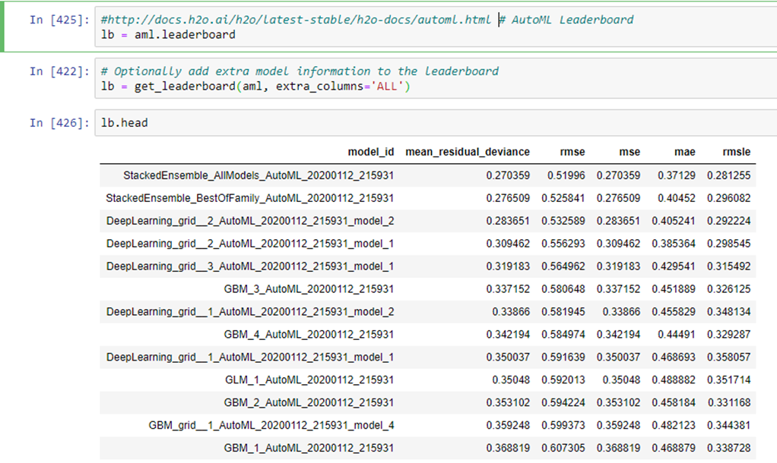
Results & Discussion
H20 Auto ML is used to look at Deep learning grids which are fully-connected multi-layer artificial neural network.

Slide 12
Results & Discussion
After viewing the results, the threshold of f1-score greater than 80% is considered. The optimum results are from Extreme Gradient Boosting, Gradient Boosting Classifier and Meta Bagging Decision Trees algorithms.
Word Form Normalization | NLP Technique | Machin Learning | f1-score
Lemmatization | Word2Vec CBOW Word Averaging | Extreme Gradient Boosting | 84.33%
Stemming | Bag of Words | Meta Bagging Decision Trees | 84.26%
Stemming | TF-IDF – Word Embedding | Meta Bagging Decision Trees | 84.26%
Stemming | TF-IDF – Word Embedding | Extreme Gradient Boosting | 83.33%
Lemmatization | TF-IDF – Character Embedding | Extreme Gradient Boosting | 83.33%
Lemmatization | TF-IDF – Character Embedding | Gradient Boosting Classifier | 83.33%
Stemming | Bag of Words | Gradient Boosting Classifier | 82.41%
Stemming | TF-IDF – Character Embedding | Meta Bagging Decision Trees | 82.41%
Lemmatization | Word2Vec CBOW Word Averaging | Gradient Boosting Classifier | 81.69%
Stemming | TF-IDF – Character Embedding | Extreme Gradient Boosting | 81.48%
Lemmatization | TF-IDF – Character Embedding | Meta Bagging Decision Trees | 81.48%
Stemming | TF-IDF – Character Embedding | Gradient Boosting Classifier | 80.56%
Lemmatization | Bag of Words | Extreme Gradient Boosting | 80.56%
Lemmatization | Bag of Words | Meta Bagging Decision Trees | 80.56%

Slide 13
Conclusion
Corpus
Extreme Gradient Boosting and Meta Bagging Decision Trees have produced better results with the data sets of Word2Vec CBOW, Bag of words and TF-IDF word level Embeddings.
Clean Data
(punctuations, apostrophes, lower case)
The optimal process flow from cleaning data to modelling is proposed to conclude the research.
Word Tokenize & Remove stop words
Stemming
Lemmatization
Bag of Words
TF-IDF Character Level
TF-IDF Word Level
Bag of Words
TF-IDF Character Level
Word2Vec CBOW Word Averaging
Extreme Gradient Boosting
Gradient Boosting Classifier
Meta Bagging Decision Trees
Extreme Gradient Boosting
Gradient Boosting Classifier
Meta Bagging Decision Trees

Slide 14
Future Work
This research was limited to classifying text across two human values.
There is abundant scope to explore text classification under all of five human values as defined by Orator.
Deep learning techniques, Bidirectional Encoder Representations from Transformers (BERT) can be explored towards multi text classification of human values and further improve f1-score accuracy.

Slide 15
Thank You

