Slide 1
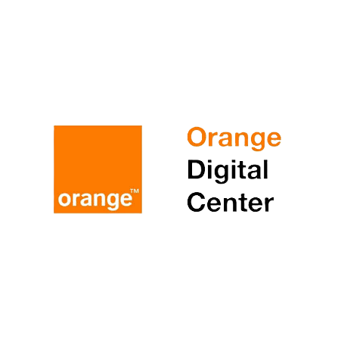


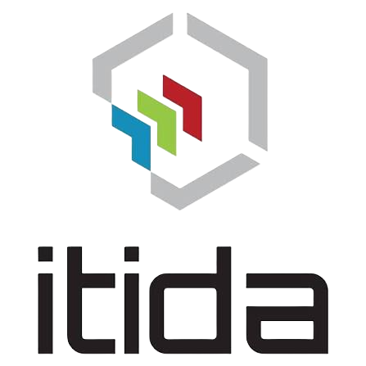

OsteoGuard AI
Evidence-grounded clinical decision support for osteoarthritis
Team The Innovators
Youssef Elbasiouny · Ibrahim Ahmed · Ali Sherif
AI Clinical Decision Support Hackathon
Notes:
Good morning. We are The Innovators, and this is OsteoGuard AI - a clinical decision-support system for osteoarthritis that answers only from official guidelines, and cites every claim to its exact page. [30 seconds. For the 5-minute hackathon format, present slides 2, 5, 6, 7, 8, then go straight to the live demo.]

Slide 2








Osteoarthritis is Egypt
The most common joint disease in Egypt
8.5%
1 in 12
The driver is obesity
of adults have osteoarthritis
≈ 6 million Egyptian adults
39.8%
WHO community study, rural Egypt
Egypt “100 Million Health” initiative screening, 2019
of Egyptian adults are obese measured by the Ministry’s own 100 Million Health screening of 49.7 million adults (2019). Around 50% among women.
10.9%
8.1%
+44% by 2035. Global knee-OA prevalence is projected to rise sharply as populations age and obesity grows, Egypt is on that curve.
of women affected vs 6.1% of men
knee OA — over half of all rheumatic disease seen
women carry almost double the burden
the single most common rheumatic diagnosis
Sources: WHO-ILAR COPCORD osteoarthritis study, rural Egypt · Egypt “100 Million Health” initiative screening, 2019 · Global Burden of Disease 2021 knee-OA projections to 2035
OsteoGuard AI · The Innovators
2
Notes:
One in twelve Egyptian adults lives with osteoarthritis - about six million people, women nearly twice as often as men. And the main modifiable driver, obesity, affects 40% of our adults by the Ministry’s own 100 Million Health screening. This burden is not going down; it is projected to rise over 40% by 2035. [60 seconds]

Slide 3



The evidence exists
Why guideline knowledge fails at the point of care
The answers are buried in hundreds of pages
NICE NG226 and the ACR/AF 2019 guideline hold the evidence for every osteoarthritis decision.
A clinician in a crowded clinic has minutes, not hours
High patient volumes leave no time to verify a recommendation, a dose ceiling, or a referral threshold against the source.
Generic AI chatbots hallucinate in medicine is dangerous
A fluent, confident, wrong answer is worse than no answer. Clinical AI must prove where every claim comes from.
Our question: can AI answer from the guidelines without hallucination?
OsteoGuard AI · The Innovators
3
Notes:
The evidence to manage these six million patients already exists - NICE and ACR guidelines. The problem is access at the point of care: hundreds of pages, minutes per patient. And the obvious shortcut, a generic chatbot, hallucinates - which in medicine is dangerous. So our question was: can AI answer from the guidelines, and ONLY the guidelines? [45 seconds]

Slide 4

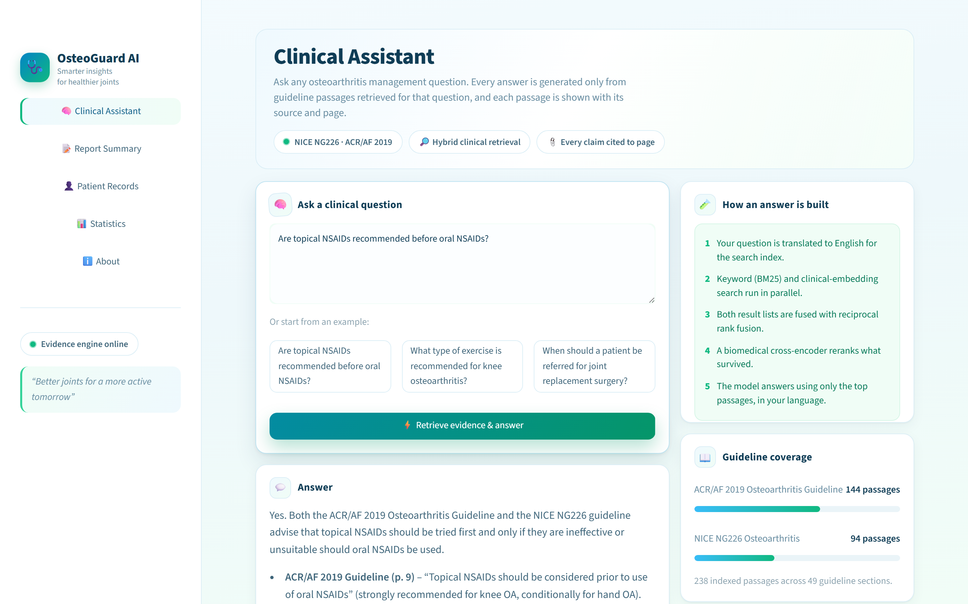

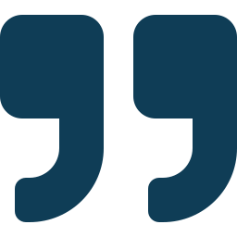

OsteoGuard AI is a bilingual guideline assistant
Live product
Ask in Arabic or English
The question is translated for search; the answer comes back in the language it was asked in.
Answers only from retrieved guideline text
The model never answers from its own memory — out-of-scope questions are refused.
Every claim cited to document + page
Each source expands to the exact guideline passage behind the claim.
Calibrated confidence
“Are topical NSAIDs recommended before oral NSAIDs?” — answered live, quoting ACR/AF 2019 p.9 and NICE NG226 p.12–13
The % shown tracks measured precision — not a raw model score.
OsteoGuard AI · The Innovators
4
Notes:
This is OsteoGuard. A clinician asks in Arabic or English; the system retrieves the relevant guideline passages, answers strictly from them, and cites each claim to document and page. What you see here is a real, live answer - the system quotes ACR page 9 word for word. [45 seconds]

Slide 5





Data ingestion
Page numbers and section titles survive every step, so citations are possible at all
1
2
3
4
5
Official sources
Parse & clean
Chunk + metadata
238 passages · 49 sections
Local vector store
NICE NG226 and ACR/AF 2019 — the two reference guidelines for OA management
PyMuPDF extraction; repeated headers, footers and boilerplate stripped
Guideline text split into passages, each tagged with section title and page
Embedded with PubMedBERT — a biomedical model, not a generic one
ChromaDB on disk — the whole index runs offline on one machine
Traceability is built in at ingestion. Because every passage keeps its page number and section, every answer can point back to the exact place in the official document.
OsteoGuard AI · The Innovators
5
Notes:
We started from the official PDFs. PyMuPDF parses them, boilerplate is stripped, and the text is chunked into 238 passages - each one keeping its section title and page number. That metadata is the foundation: citations are only possible because traceability is preserved from the first step. Embeddings are PubMedBERT - a biomedical model - stored in a local ChromaDB. [50 seconds]

Slide 6
Retrieval
Hybrid retrieval fused and reranked; runs 100% locally on CPU
Keyword search (BM25)
Clinical question
with clinical abbreviation expansion: TENS, PRP, CMC, PEMF …
Reciprocal rank fusion
MedCPT reranker
Arabic or English → translated to English for the index
both result lists merged into one candidate pool
a biomedical cross-encoder trained on PubMed picks the winners based on semantic relevance
Semantic search
PubMedBERT embeddings in ChromaDB — meaning, not just words
Output: the top 5 guideline passages, each with document, section, page — and a confidence % calibrated against measured precision.
Sovereignty by design. Embeddings, index and reranker all run locally — retrieval works with no internet and no data leaving the machine.
OsteoGuard AI · The Innovators
6
Notes:
When a question arrives, two searches run in parallel: BM25 keyword search - expanded so clinical abbreviations like TENS match their full terms - and semantic search over PubMedBERT embeddings. The two lists are fused, then a biomedical cross-encoder, MedCPT, reranks the pool and picks the top five passages. Everything you just heard runs locally on one CPU. [50 seconds]

Slide 7

Hallucination prevention
The property that makes clinical AI usable at all
1 · Grounded-only generation
2 · Page-level citations
The model answers strictly over retrieved passages. Asked about antihypertensives, it replies: “the osteoarthritis guidelines you provided do not contain information on this” — it refuses rather than guesses.
Every claim carries its document and page, and each source expands to the exact passage — the judge can check us in seconds.
3 · Verbatim-quote verification
4 · No inference in summaries
A red-flag warning must quote the report word-for-word, and the quote is checked against the source text. A flag whose evidence is not literally present is discarded — the model cannot invent an emergency.
Anything a report does not state returns “Not stated in the report” — never a plausible guess. Doses, dates and units are reproduced exactly as written.
If it cannot prove it, it does not say it.
OsteoGuard AI · The Innovators
7
Notes:
This is the most important slide. Four defences. One: the model can only speak from retrieved passages - ask it about blood pressure and it refuses, live. Two: every claim is cited to a page you can open. Three: safety warnings must quote the report verbatim, and we verify the quote actually exists in the text - so the system cannot invent an emergency. Four: report summaries are forbidden from inferring - missing information comes back as "not stated". The principle: if it cannot prove it, it does not say it. [70 seconds]

Slide 8
Measured, not claimed
Evaluated on a 100-query clinical test set with per-query ground truth
87.6%
Precision@3 = 92.0%
Precision@1 = 96.0%
88.2% calibrated confidence — the reported number now tracks what we actually measured.
Speed / accuracy presets
Mode | Precision@5 | Latency
accurate | 87.6% | ~14 s
balanced | 84.4% | ~6 s
fast | 82.8% | ~4 s
Same engine, tunable per deployment — a busy clinic can trade 3 points of precision for a 3× faster answer.
OsteoGuard AI · The Innovators
8
Notes:
We do not ask you to trust adjectives. On a 50-question clinical test set with ground truth, retrieval precision at 5 is 87.6%, up from a 78% baseline - and the confidence figure the clinician sees is calibrated, so 88% displayed means 88% measured. The engine also has three presets, so a busy clinic can choose speed over the last few points of precision. [50 seconds]

Slide 9


Problems we have hit
The journey from a 78% prototype to a system we can defend
Precision stuck in the 70s
Root cause: a web-search reranker judging clinical text. Replaced with the MedCPT biomedical cross-encoder and fixed an over-aggressive section filter → 87.6% precision, 88.2% confidence.
Gemini replies were slow — and its SDK reached end-of-life
Migrated generation to Groq (gpt-oss-120B). Generation now takes under one second; total latency is dominated by our own local reranker, which we control.
1 in 6 outputs degenerated into invisible filler characters
Measured it, built detection, and resample automatically — residual failure rate now under 1%.
Every failure became a measurement, then a fix — nothing here is hidden.
OsteoGuard AI · The Innovators
9
Notes:
Four honest problems. Our precision was stuck in the seventies - the culprit was a generic web reranker judging medical text; a biomedical reranker fixed it. Gemini was slow and its SDK was end-of-life, so we moved generation to Groq - sub-second now. During that migration our testing caught a smaller model translating the Arabic for osteoarthritis as "bone fractures" - we rejected it; we test before we trust. And when one in six outputs degenerated into invisible characters, we measured it and built automatic detection and retry. [60 seconds]

Slide 10
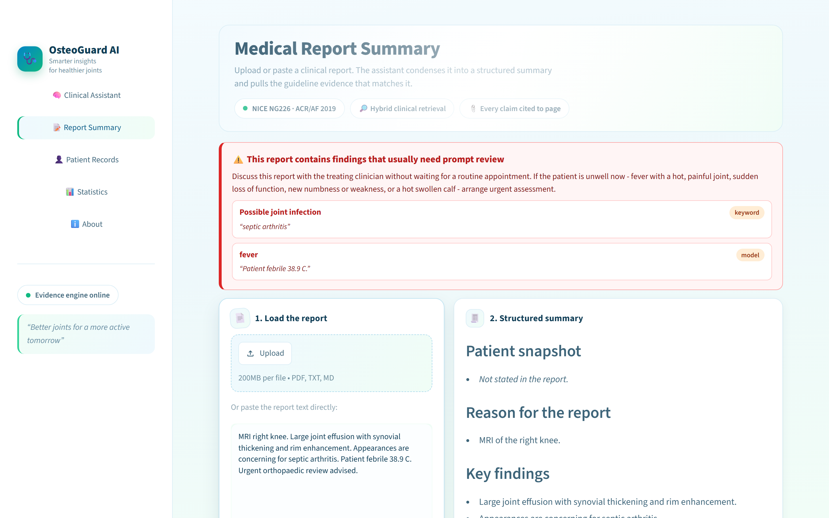

Beyond Q&A
All captured live from the running product
Arabic, end to end
RTL interface, Arabic questions, Arabic summaries — doses and drug names kept exactly as written.
OCR for phone scans
A CamScanner photo of a paper MRI report is read locally — 252 words recovered in our live test.
Local patient records
Assessments saved to a file on the clinic’s machine. No cloud, no account, nothing uploaded.
Exercise video links
Guideline-first exercise answers come with joint-matched video searches to show the patient.
Report summarizer + red-flag screen. A scanned or pasted report is summarised under fixed headings — and a septic-arthritis report triggers the warning banner, with the verbatim evidence quoted.
OsteoGuard AI · The Innovators
10
Notes:
Around the assistant we built a working clinical workflow. On screen: a real septic-arthritis report - the system summarised it AND raised the red banner, quoting the exact words that triggered it. On the right: full Arabic support including Arabic summaries, OCR that reads phone-scanned paper reports locally, patient records stored only on the clinic machine, and exercise video recommendations to hand the patient. [55 seconds]

Slide 11

Built for Egypt’s health system
Designed to fit the Ministry’s priorities, not just a demo bench
Arabic-first
Data sovereignty
The first guideline assistant your clinicians can use in their own language — questions, answers and report summaries.
Retrieval and records run locally; no patient identifier needs to leave the clinic. Fits national data-protection requirements.
Aligned with 100 Million Health
A platform, not a single app
Targets the obesity–osteoarthritis link the initiative itself measured — 40% of adults — with guideline-backed weight and exercise advice.
Next: index the Egyptian knee-OA clinical practice guideline (2025), extend to diabetes and hypertension, integrate with EMRs.
Cost to run: one machine + a commodity LLM API — no GPUs, no severs & no patient-data cloud contracts.
OsteoGuard AI · The Innovators
11
Notes:
Why this matters for Egypt specifically. It is Arabic-first. It is sovereign - patient data stays in the clinic. It directly targets the obesity-osteoarthritis link that the 100 Million Health initiative itself documented. And it is a platform: the same pipeline can index the 2025 Egyptian knee-OA guideline next, then diabetes, then hypertension. It runs on one ordinary machine per clinic. [50 seconds]

Slide 12

Evidence. Cited. In Arabic.
OsteoGuard AI — guideline answers Egyptian clinicians can verify in one click.
Github Repository
Now — a live demonstration
Team The Innovators Youssef Elbasiouny · Ibrahim Ahmed · Ali Sherif
Thank you — شكراً
Notes:
We close where we started: six million Egyptians with osteoarthritis deserve answers their clinicians can verify. OsteoGuard gives evidence, cited, in Arabic. Let us show you live. [20 seconds, then switch to the app]

