Slide 1




Intelligent Support Ticket Classification with Retrieval-Augmented Generation (RAG)
Team Members:
Rahiq Khaled 2. Tasneem Khaled
3.Aya Elsaid 4.Radwa Ahmed
5. Aya abdelshafy

Slide 2

Project Overview
Client
↓
Ticket
↓
Azure ML Classifier
↓
Predicted Labels
↓
SBERT Embedding
↓
Azure AI Search
↓
Retrieve Similar Tickets
↓
Qwen2.5-7B-Instruct.
↓
Generated Response
This project aims to automate customer support using Artificial Intelligence.
The system:
Classifies incoming support tickets.
Predicts the ticket's type, queue, and priority.
Retrieves similar historical tickets using semantic search.
Generates context-aware responses using Retrieval-Augmented Generation (RAG).
Provides a web application for customers and administrators.

Slide 3







Project objectives
Develop an intelligent AI-powered customer support system that automates ticket processing from submission to response generation.
Preprocess customer support data
Train ticket classification models
Build a RAG pipeline
Deploy using Azure ML
Integrate Azure AI Search
Develop FastAPI backend
Build client & admin web interfaces

Slide 4
Dataset
Content:
28,587 support tickets
16 original features
2 languages (English & German)
4 ticket types
10 support queues
3 priority levels
Note
Only English tickets were retained for model training.

Slide 5
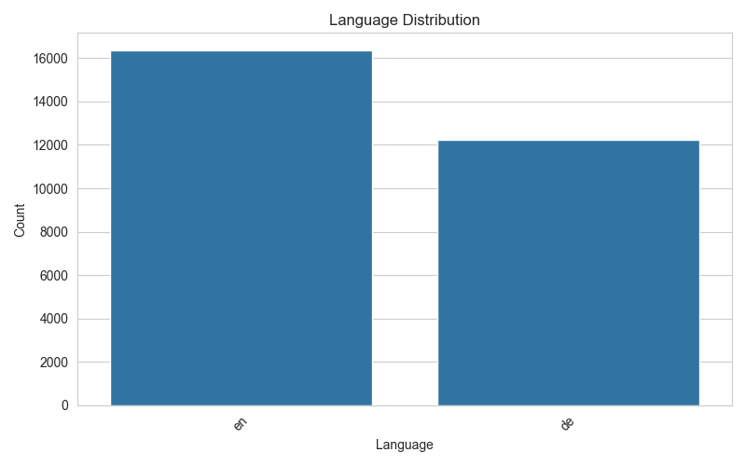
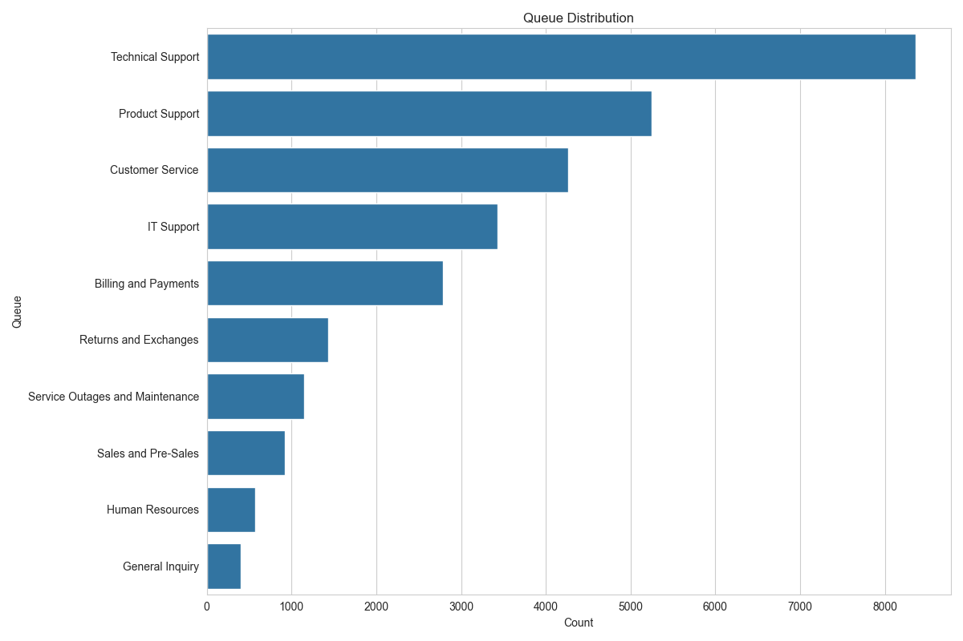
Figures: EDA raw

Slide 6
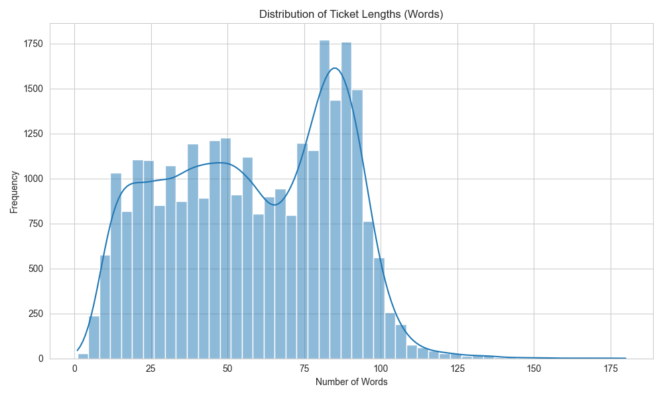
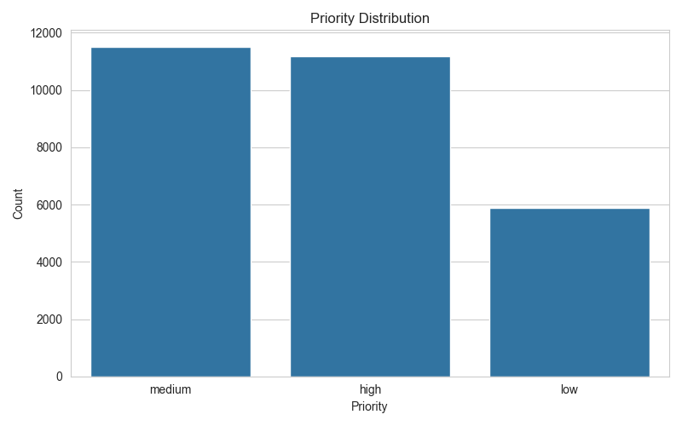
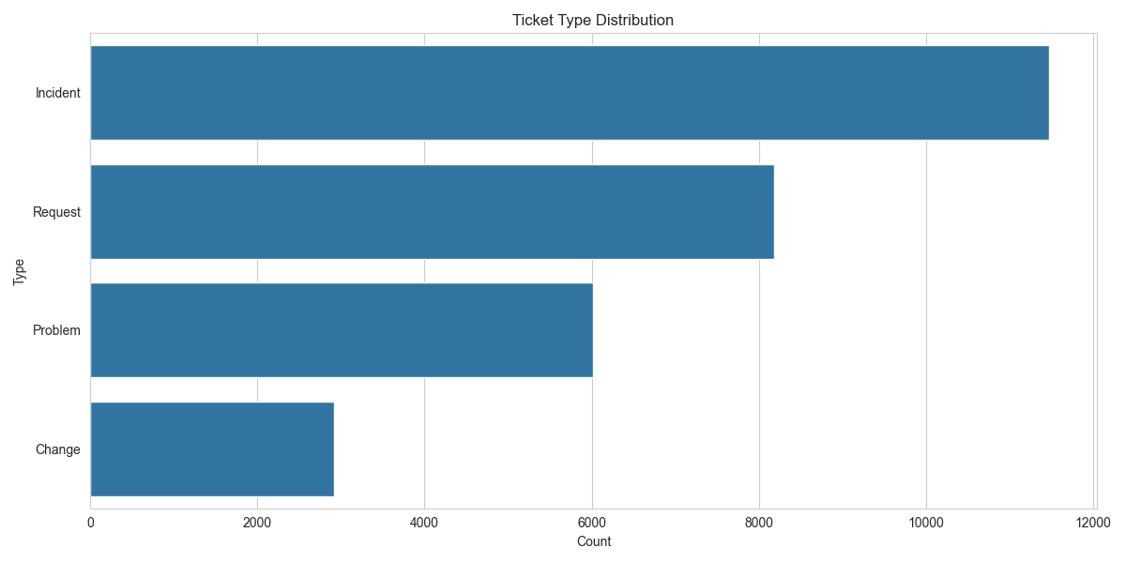
Figures: EDA raw

Slide 7
Data Cleaning and Preprocessing
Raw Dataset
↓
Filter English Tickets
↓
Handle Missing Values
↓
Remove Sparse Features
↓
Normalize Text
↓
Create Combined Text
↓
Near-Duplicate Removal
↓
Train / Validation / Test Split
-Removed Tag5–Tag8
-approximately 13% missing values in subjects
-Missing subjects were replaced with empty strings because the body already contained sufficient information.
-Missing answers were replaced with empty strings since answers were not used as input features.
-Created combined text
-Added text length features
-English tickets retained: 16,338
-German tickets removed: 12,249
-Near-Duplicate Removal to 10,893
Split | Size
Training | 7625
Validation | 1634
Testing | 1634

Slide 8
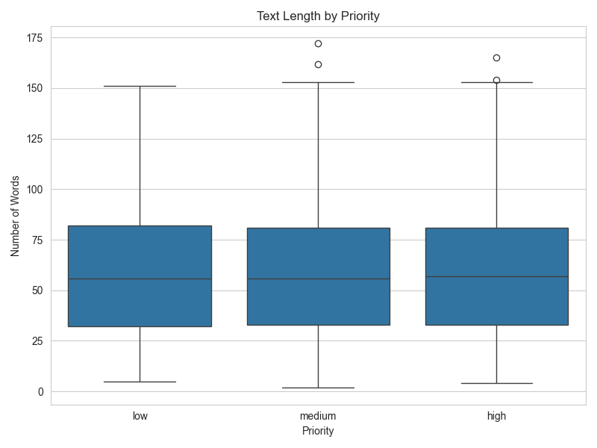
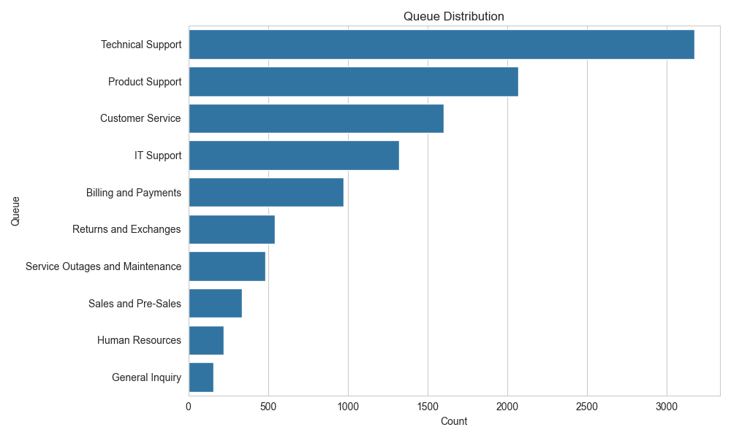
Figures: EDA processed

Slide 9
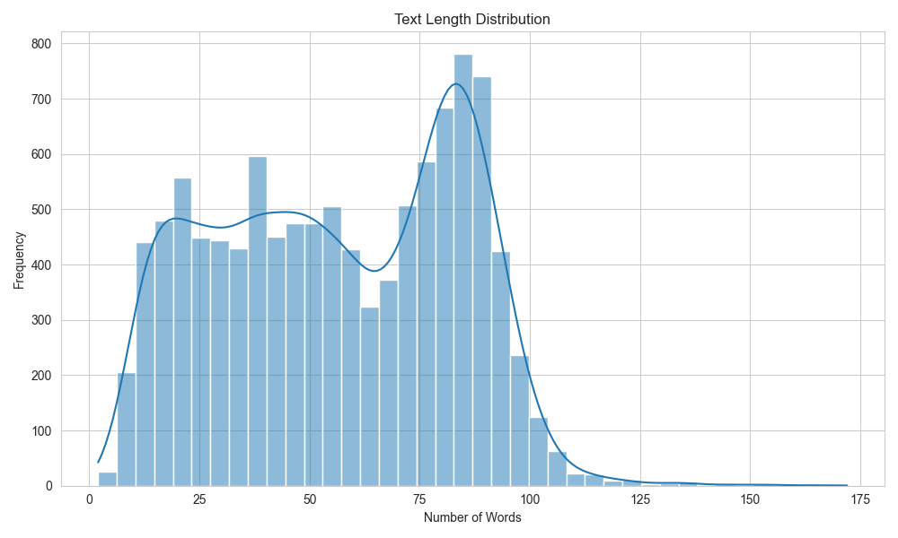
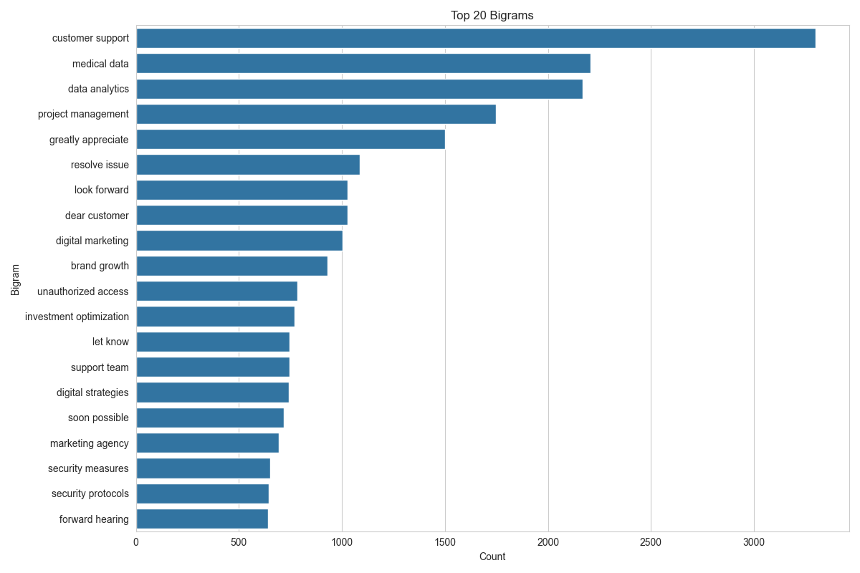
Figures: EDA processed

Slide 10
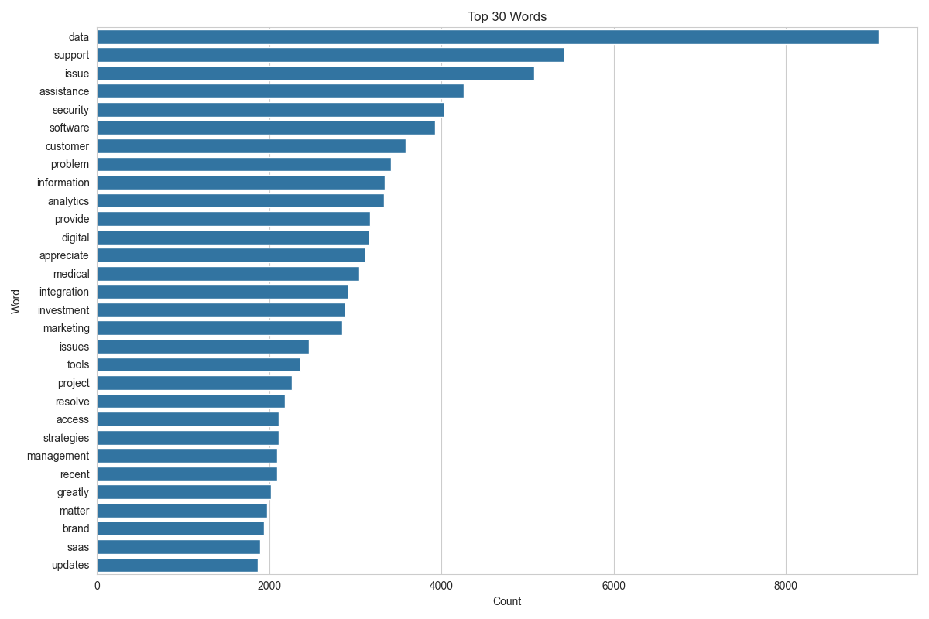
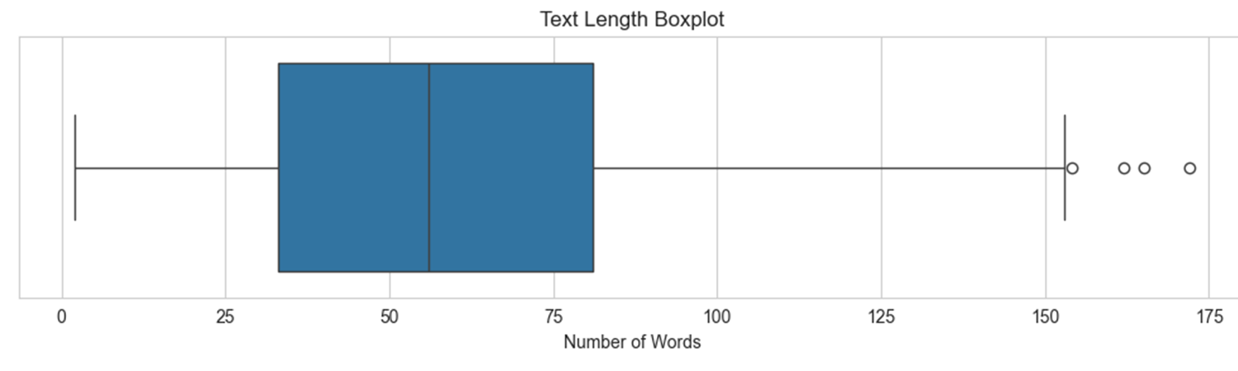
Figures: EDA processed

Slide 11
Feature Engineering
SBERT
all-MiniLM-L6-v2
384-dimensional embeddings
TF-IDF
30,000 features
Unigrams, Bigrams, Trigrams
Note
Removed 5,445 semantic duplicates (33.3%) before splitting, and leakage analysis confirmed 0% train–test overlap above the chosen similarity threshold.

Slide 12

The objective of this milestone was to develop and evaluate different approaches for automatic support ticket classification. Three approaches were investigated:
Traditional Machine Learning using TF-IDF features.
Transformer-based classification using DistilBERT.
Retrieval-Augmented Generation (RAG) using semantic retrieval and similarity-based voting.
The three approaches were compared on the tasks of predicting the ticket Type, Queue, and Priority to identify the most effective solution for the customer support domain.

Slide 13
Model Development
Traditional ML
Hyperparameters:
Results:
Parameter | Value
Feature Representation | TF-IDF
Maximum Features | 30,000
Grid Search | Yes
Cross Validation | 3-fold
Evaluation Metric | Weighted F1
Task | Best Model | Accuracy | F1-score
Type | LinearSVC | 82.5% | 82.25%
Queue | LinearSVC | 47.98% | 47.70%
Priority | LinearSVC | 52.94% | 52.69%
TF-IDF
Logistic Regression
Naïve Bayes
LinearSVC
↓
Best: LinearSVC

Slide 14
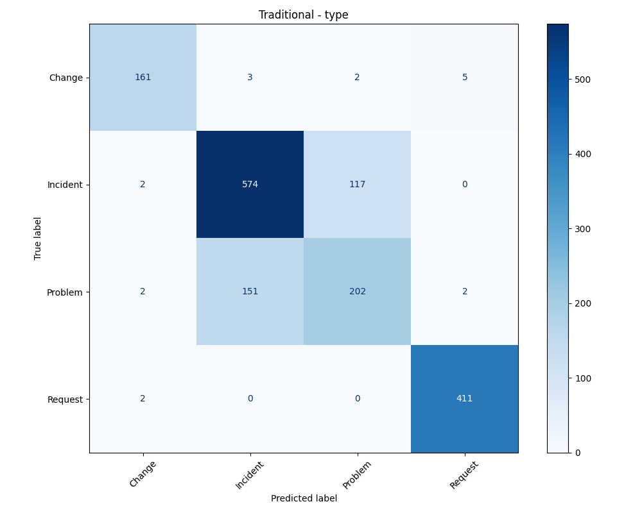
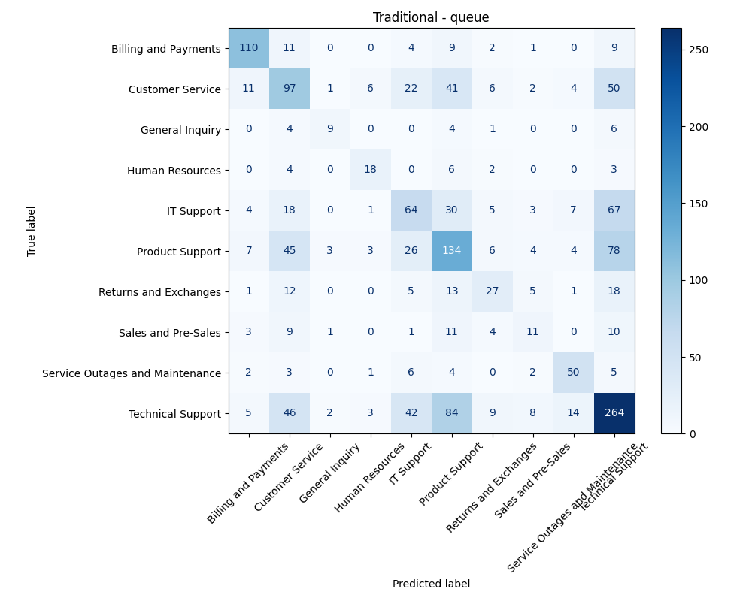
TF-IDF Confusion Matrix

Slide 15
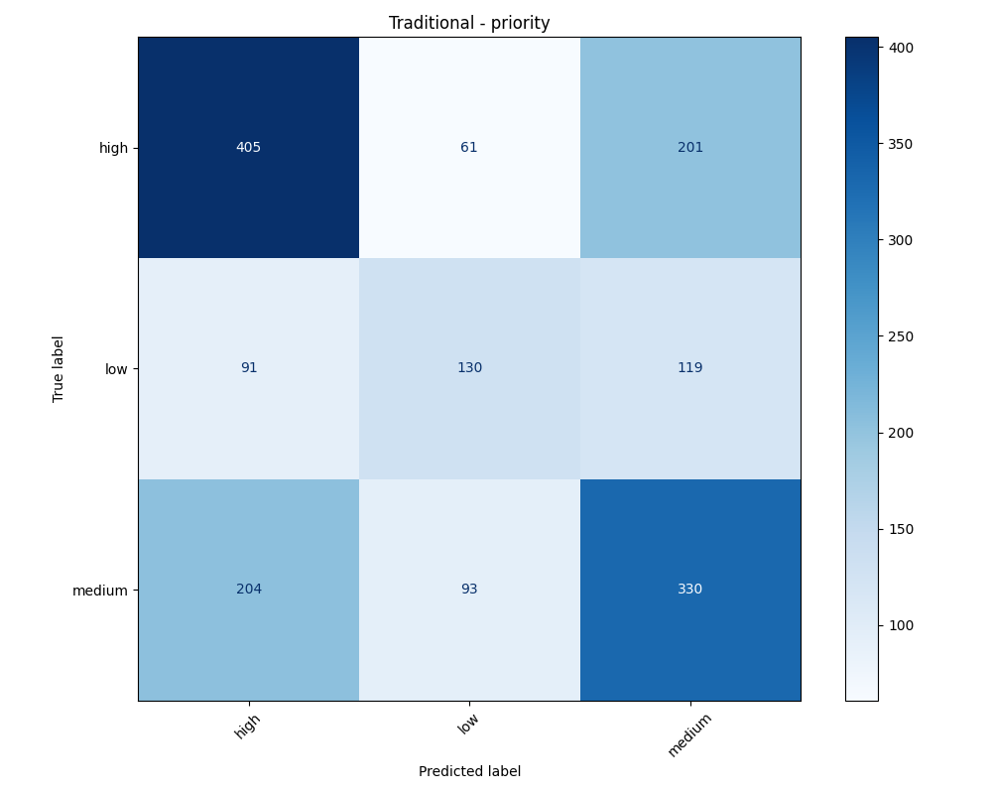
TF-IDF Confusion Matrix

Slide 16
Model Development
DistlBERT Transformer
Training Configuration
Results
Parameter | Value
Model | DistilBERT-base-uncased
Maximum Length | 128
Batch Size | 8
Learning Rate | 2×10⁻⁵
Maximum Epochs | 10
Early Stopping | Patience = 2
Task | Accuracy | F1-score
Type | 83.90% | 83.52%
Queue | 46.14% | 44.86%
Priority | 52.94% | 52.39%

Slide 17

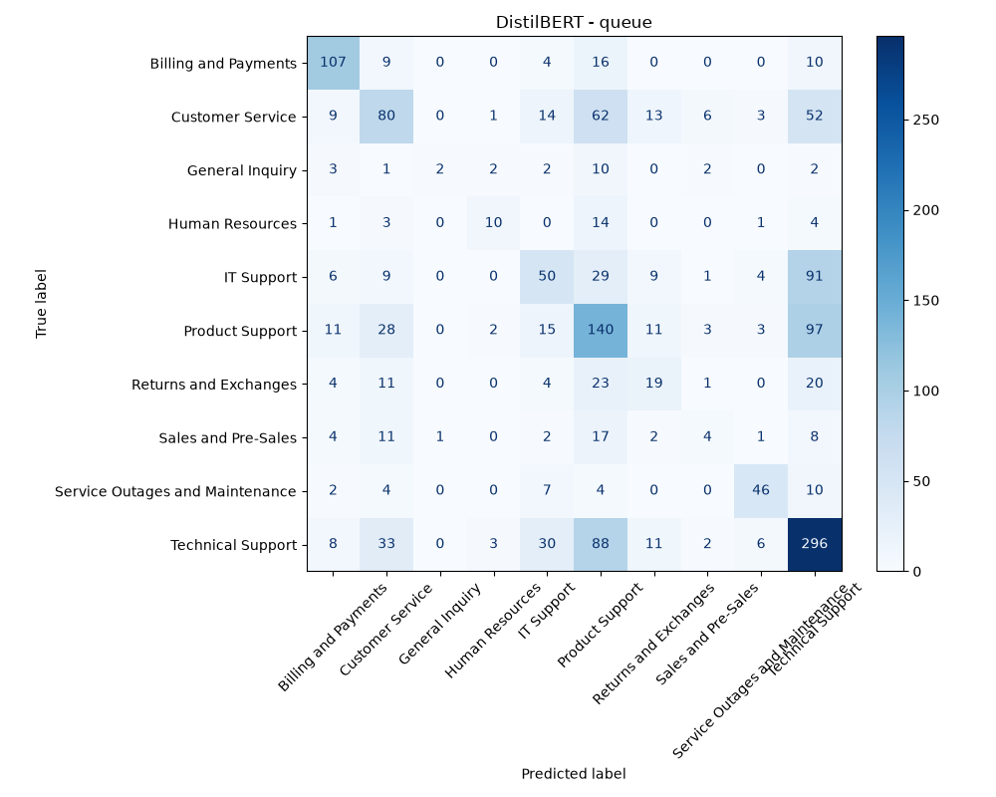
DistlBERT Confusion Matrix

Slide 18
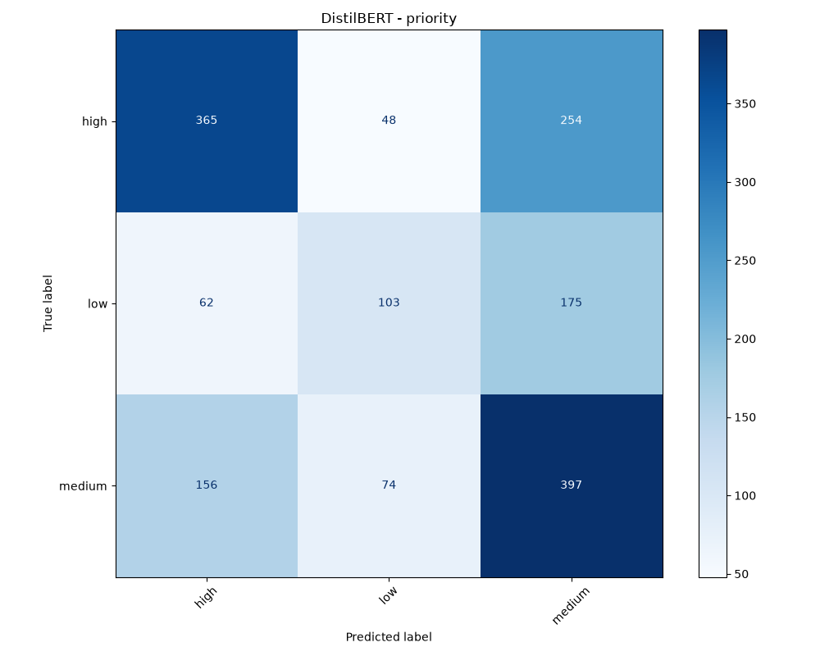
DistlBERT Confusion Matrix

Slide 19
Model Development
RAG
Results
Sentence-BERT embeddings
FAISS IndexFlatIP
Cosine similarity
Similarity threshold filtering
Weighted majority voting
Task | Accuracy
Type | 79.31%
Queue | 41.98%
Priority | 51.65%
Average BLEU Score
0.2106

Slide 20
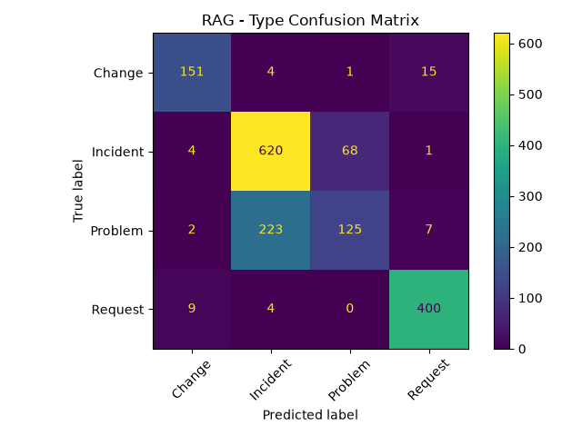
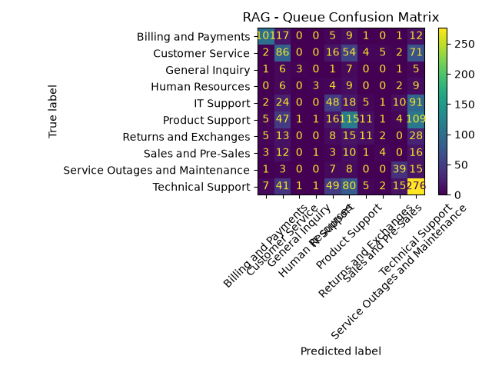
RAG Confusion Matrix

Slide 21
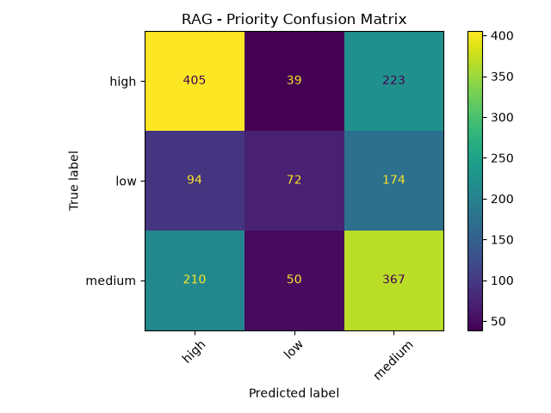
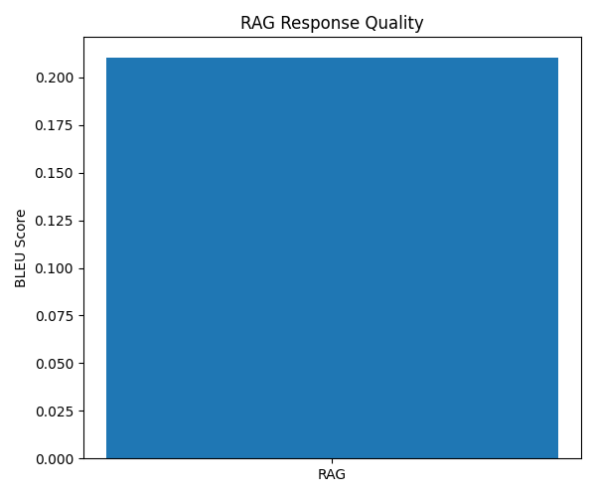
RAG Confusion Matrix

Slide 22
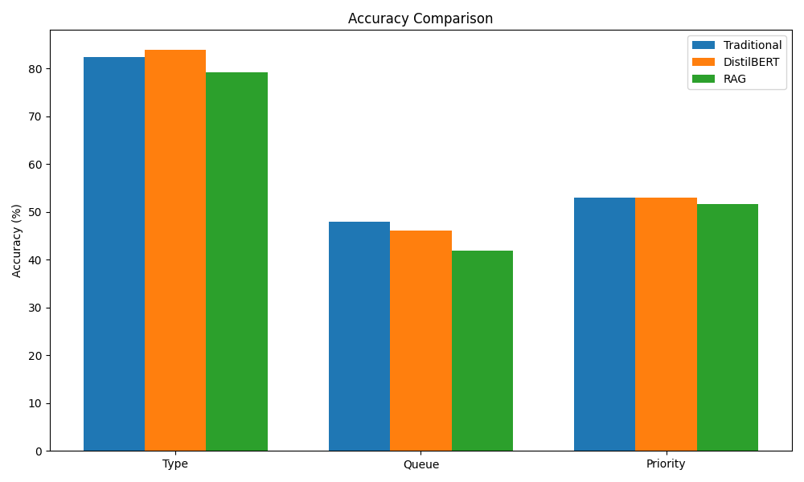
Comparison

Slide 23

Comparison

Slide 24

Comparison

Slide 25
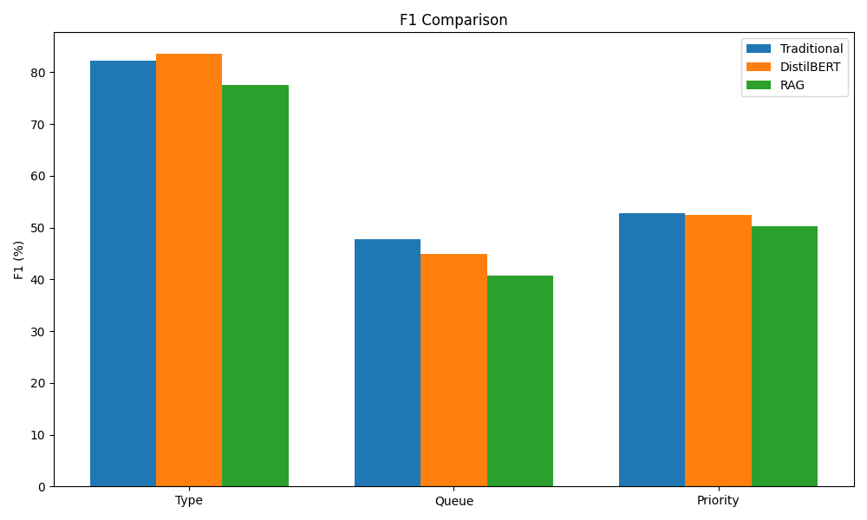
Comparison

Slide 26
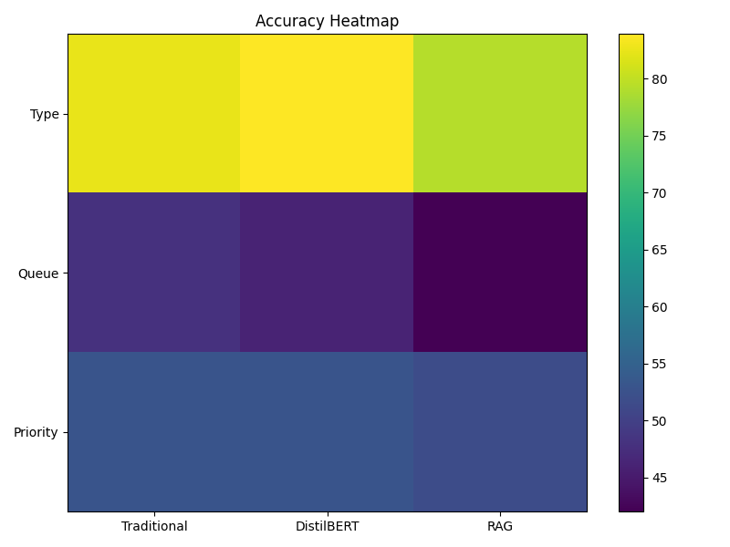
Comparison

Slide 27
Comparison
Why Traditional Machine Learning Performed Best:
Following duplicate removal, LinearSVC combined with TF-IDF achieved the highest performance for Queue and Priority prediction.
This outcome can be explained by the characteristics of the dataset.
Many ticket categories are distinguished primarily by explicit keywords such as refund, billing, login, server, and outage.
TF-IDF emphasizes these discriminative terms directly, allowing LinearSVC to learn effective decision boundaries with relatively limited training data.
DistilBERT Performance
DistilBERT achieved the highest accuracy for predicting ticket Type because this task benefits more from contextual semantic understanding.
However, transformer models require larger datasets to fully exploit their representational power. After removing near-duplicate tickets, only approximately 7,600 training samples remained, limiting the potential advantages of fine-tuning.

Slide 28
Comparison
Role of RAG
The Retrieval-Augmented Generation pipeline achieved the lowest classification accuracy because similarity-based voting over a small number of retrieved examples is fundamentally different from supervised learning.
Nevertheless, RAG serves a different purpose within the overall system.
Its primary contribution is generating context-aware customer responses by incorporating similar historical support cases, rather than maximizing classification accuracy.
Consequently, RAG remains an essential component of the complete support ticket system despite its lower classification metrics.

Slide 29

System Architecture
System Integration & Deployment
Client
│
▼
Frontend
│
▼
FastAPI Backend
|
├ ────────► Azure ML
│ │
│ ▼
│ Type / Queue / Priority
│
├────────► Azure AI Search
│ │
│ ▼
│ Similar Tickets
│
├────────► Qwen
│ │
│ ▼
│ AI Response
│
▼
SQLite Database
│
▼
Admin Dashboard

Slide 30

User Workflow
Use a numbered flow:
User logs in.
Submits a ticket.
Azure ML predicts Type, Queue, and Priority.
Azure AI Search retrieves similar tickets.
Qwen generates an AI response.
Ticket is stored in the database.
User can provide feedback or reopen the ticket.
Administrators monitor and resolve reopened or failed cases.

Slide 31
Backend Development
The backend was implemented using FastAPI, providing RESTful APIs for communication between the frontend, database, and AI services.
Module | Purpose
Authentication | User login/signup using JWT
Ticket API | Ticket submission and retrieval
Azure ML Service | Ticket classification
Azure AI Search | Similar ticket retrieval
Qwen Service | AI response generation
Database Layer | Store users, tickets, responses, logs and feedback
Admin API | Ticket management and monitoring

Slide 32
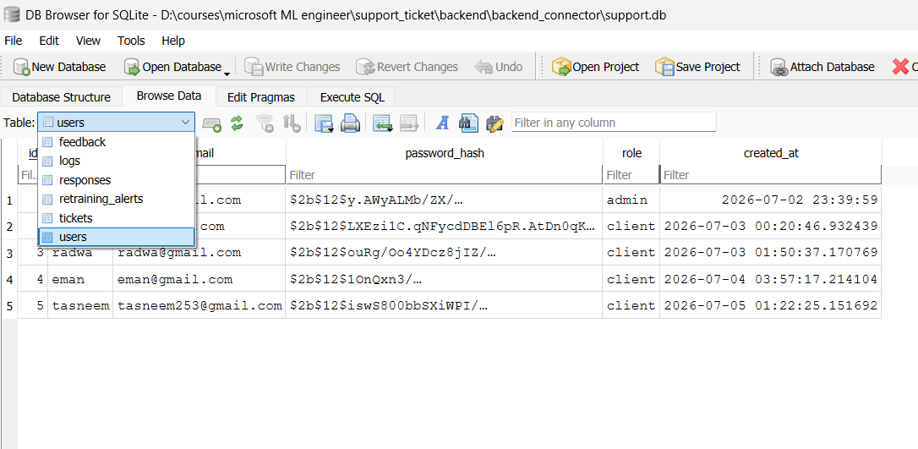
Database
SQLite was selected for data persistence due to its simplicity and suitability
Authentication The application supports secure authentication using JWT tokens.
Features include:
User registration
User login
Admin login
Password hashing
Role-based authorization

Slide 33
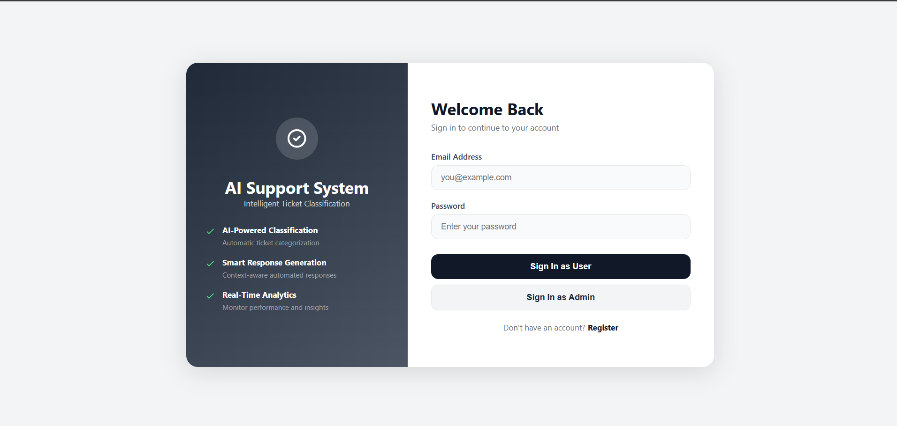
Login/sign up

Slide 34
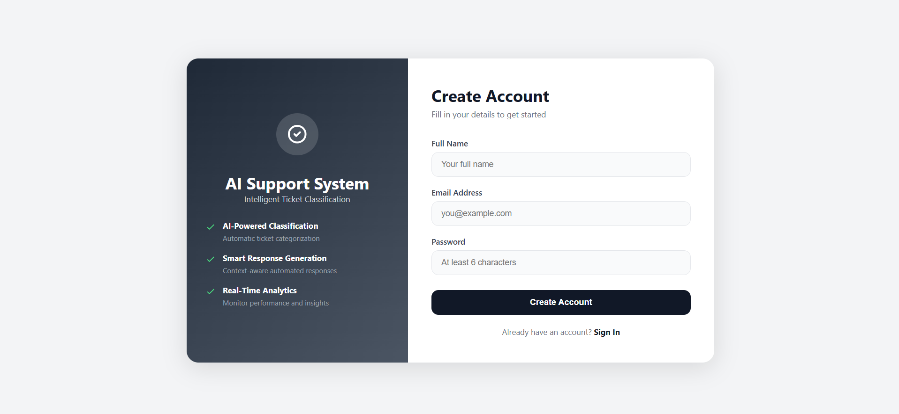
Login/sign up

Slide 35
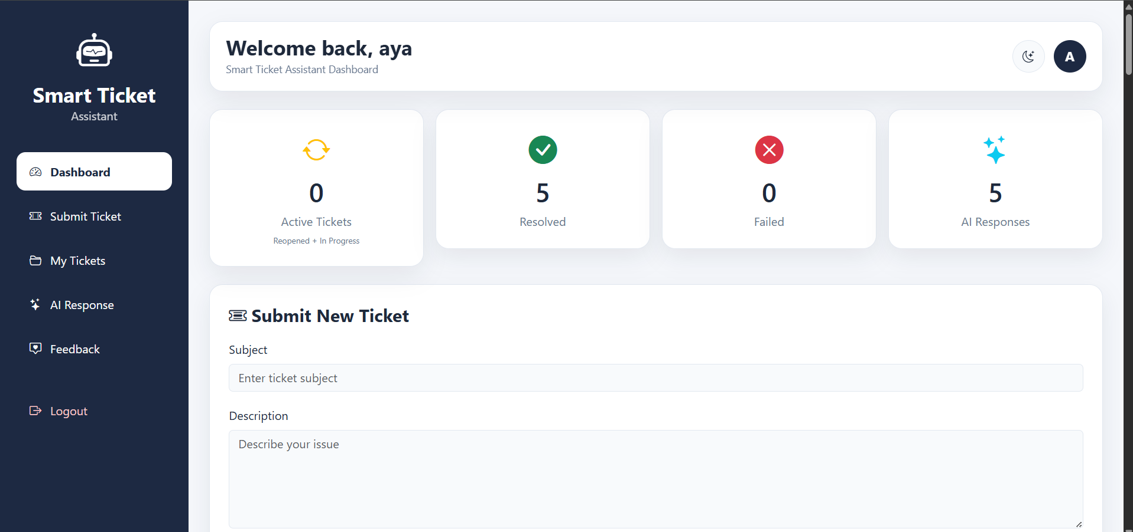
Client dashboard

Slide 36
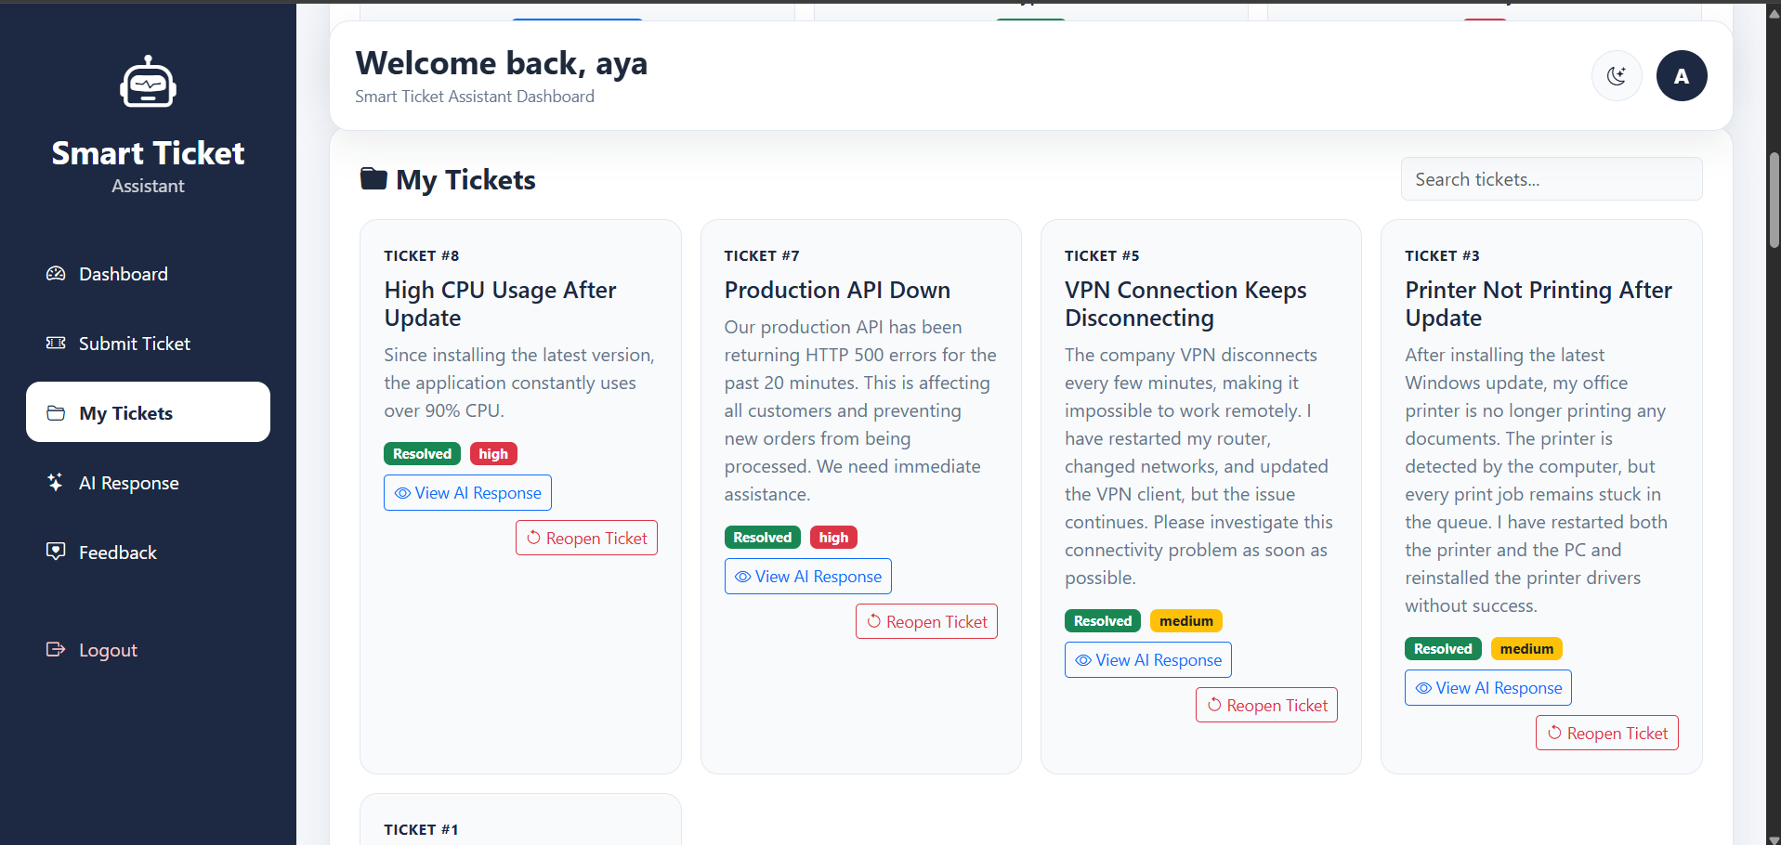
Client dashboard

Slide 37
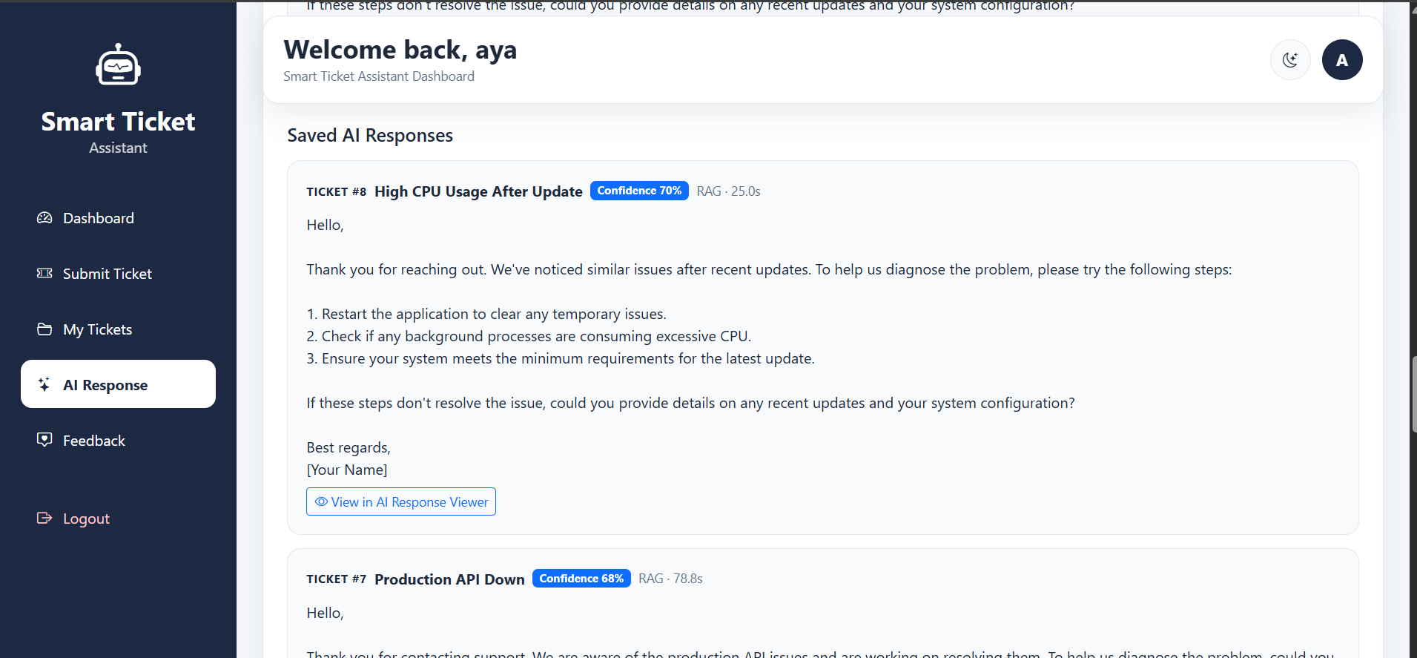
Client dashboard

Slide 38
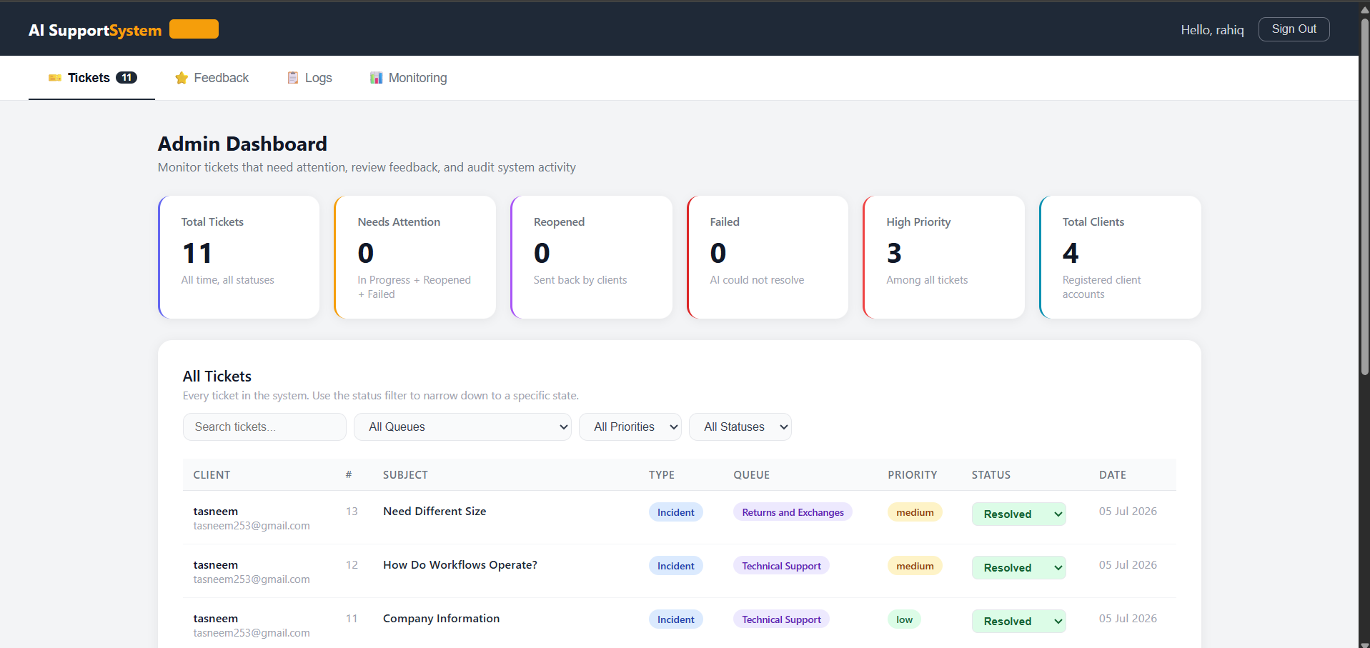
Admin dashboard

Slide 39
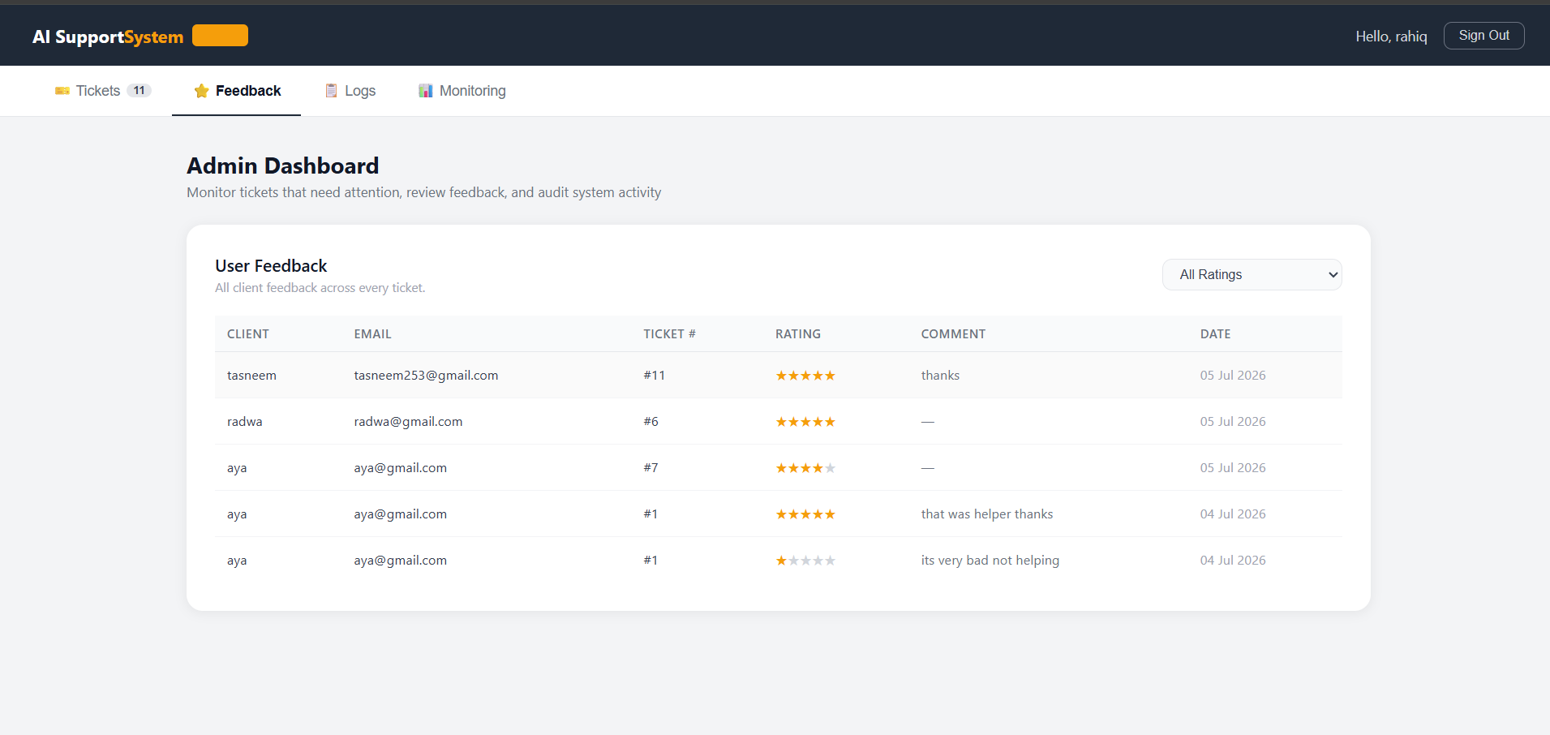
Admin dashboard

Slide 40
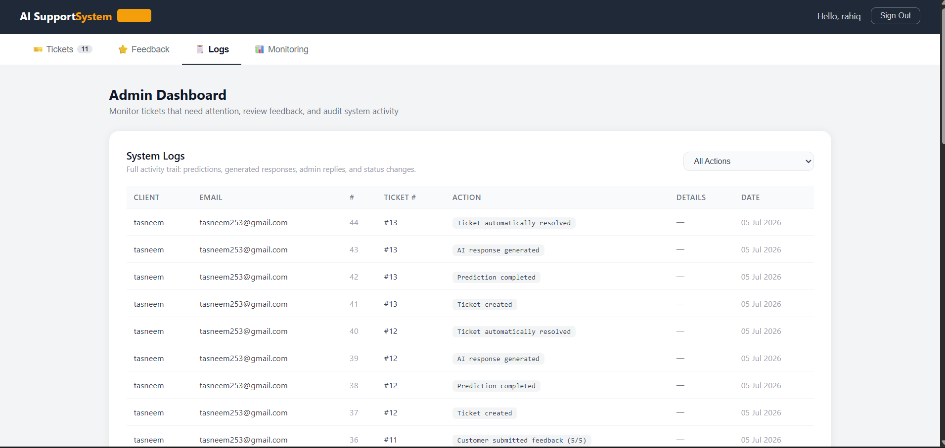
Admin dashboard

Slide 41

MLOps
Model Training
│
▼
MLflow
(Log Parameters & Metrics)
│
▼
Deployed Model
│
▼
Monitoring System
│
▼
Retraining Checks
│
▼
Administrator Alerts

Slide 42
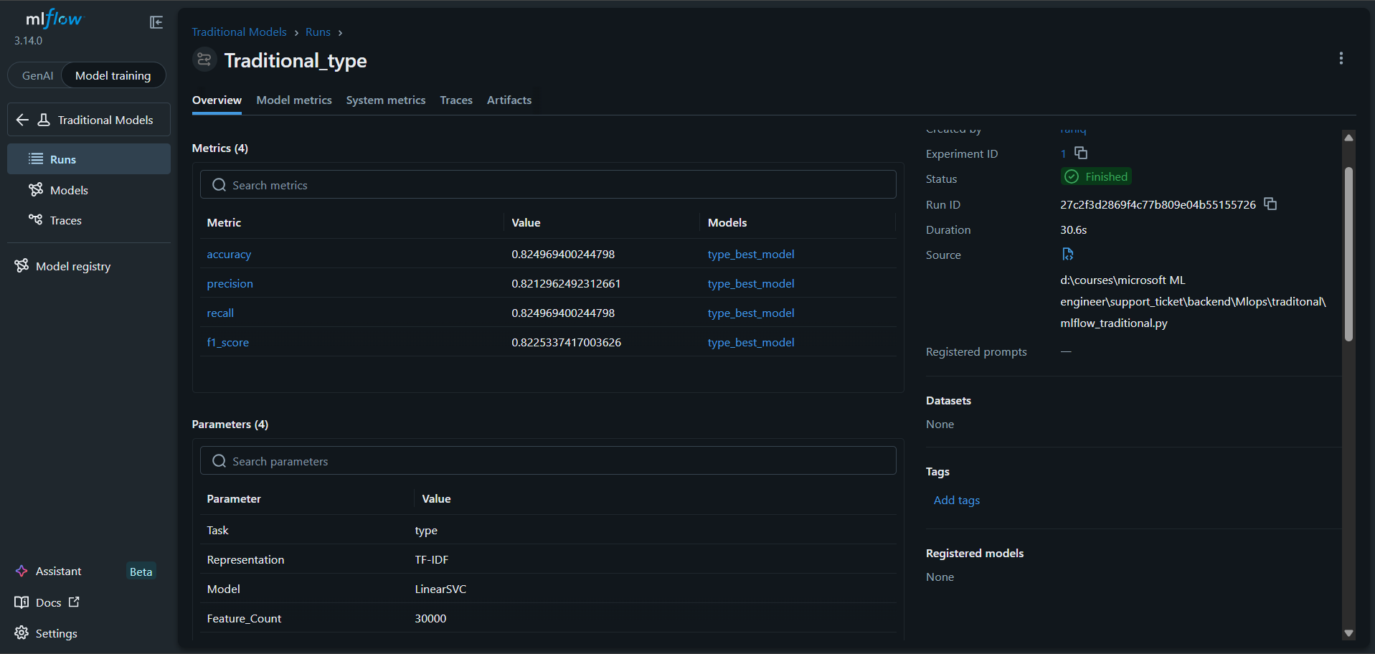
MLOps Experiments
One of the examples rest in report

Slide 43
MLOps Monitoring
The MLOps pipeline enables continuous monitoring of the deployed AI system and automatically recommends retraining when significant performance degradation is detected.
Monitoring Check | Purpose
⭐ Feedback Rating | Customer satisfaction
🎯 Confidence Score | Prediction reliability
🔄 Reopened Tickets | Human intervention
❌ Failed Tickets | AI failures
📈 Ticket Volume | Distribution changes
🆕 New Categories | Emerging ticket types
System Status
✅ OK
⚠️ Warning
🔴 Retraining Recommended

Slide 44
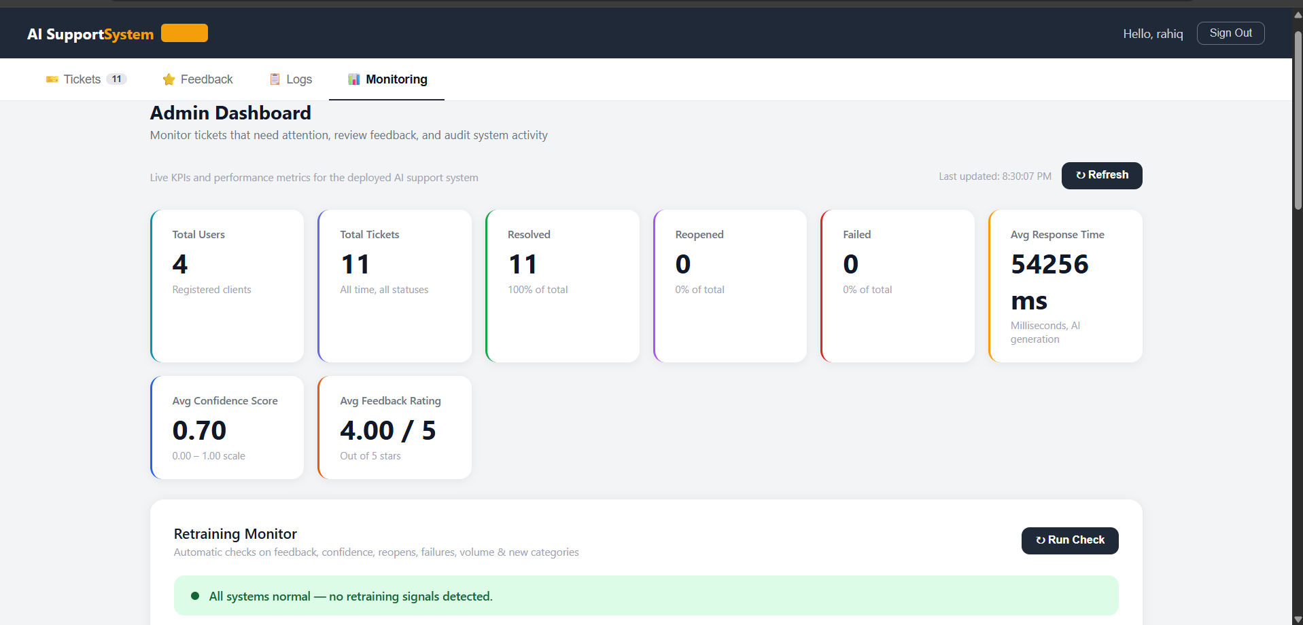
MLOps Monitoring

Slide 45
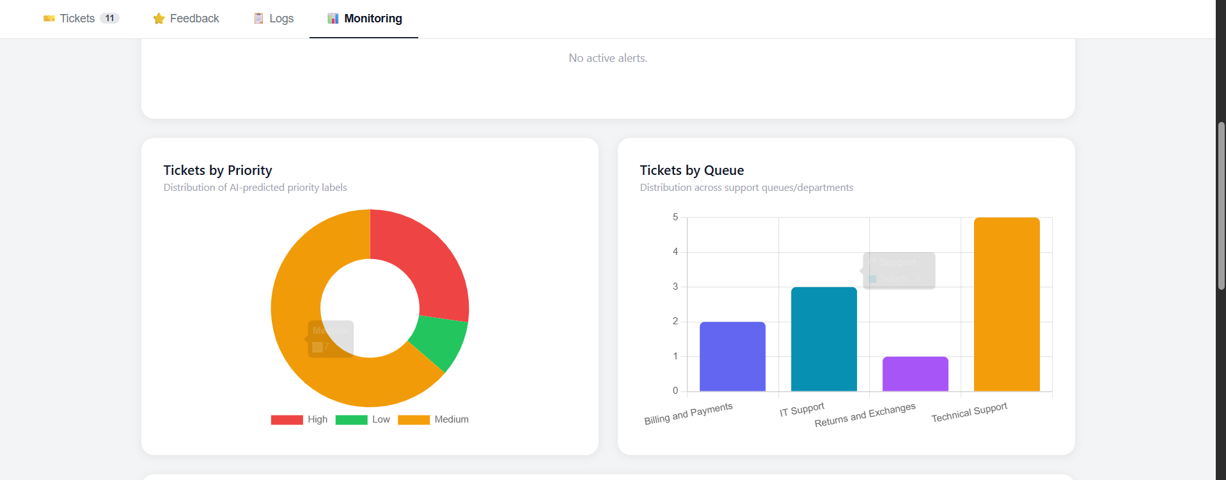
MLOps Monitoring

Slide 46
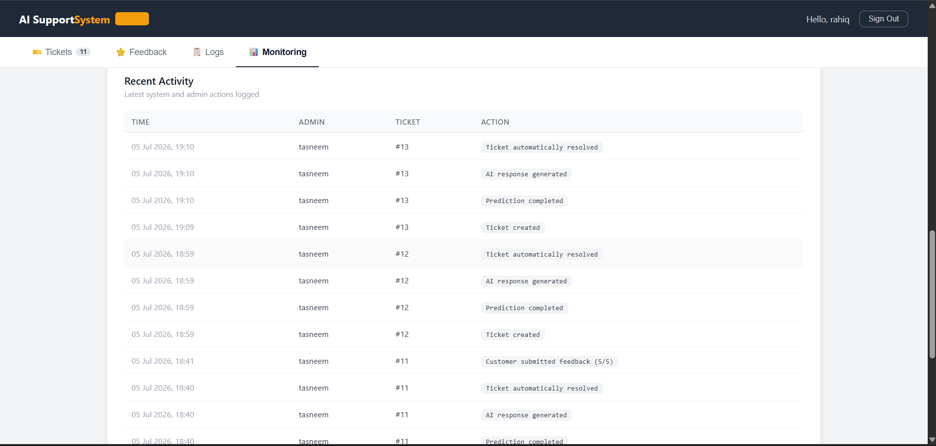
MLOps Monitoring

Slide 47




Future Of Work
Although the proposed system successfully automates support ticket classification and response generation, several improvements can further enhance its capabilities and scalability
Train the classification models on larger and more diverse datasets
Add multilingual support
Enable continuous automated retraining using new data and feedback.
Replace SQLite with a scalable cloud database

Slide 48
Final Conclusion
-Built an end-to-end AI-powered customer support system.
-Compared Traditional ML, DistilBERT, and RAG for ticket classification.
-Integrated Azure Machine Learning, Azure AI Search, FastAPI, and SQLite into a deployable application.
- Implemented MLOps with MLflow, monitoring, and retraining recommendations.
-Delivered an intelligent platform that automates ticket classification, semantic retrieval, AI-assisted response generation, and administrative management.
This project demonstrates that combining machine learning, Retrieval-Augmented Generation, cloud deployment, and MLOps can significantly improve the efficiency, scalability, and quality of modern customer support systems.

Slide 49
Thank You
So Much
Presentation - 2026

