Slide 1
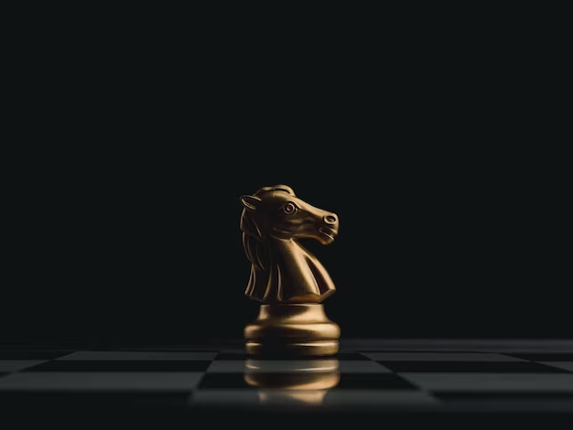
The Knight’s Tour
A Discrete Mathematics
Group Project.

Slide 2

INTRODUCTION
The Knight’s Tour problem is a classic puzzle of finding a sequence of moves for a single knight on a chessboard such that it visits every square on the board exactly one time.

Slide 3
EXISTENCE
For a knight’s tour (open/closed), ∀m, ∀n ∈ Z+, if m≤n, then it exists, unless:
m = 1 or 2 or, m = 3 and n = 3, 5, or 6 or, m = 4 and n = 4
For a closed knight’s tour, Schwenk proved that for a m x n board with m≤n, it is always possible, unless:
m = 1 or 2, or, m = 3 and n = 3, 5, or 6, or, m = 4 and n = 4.

Slide 4
HISTORY
The solution to the Knight’s Tour problem was known in India as early as the 9th century AD in the guise of exemplary skill in composing 32-syllable verses in Sanskrit.
In 18th century, famous physicist Leonard Euler looked at this problem as a mathematical puzzle and from there on many mathematicians began finding solutions to this puzzle.

Slide 5
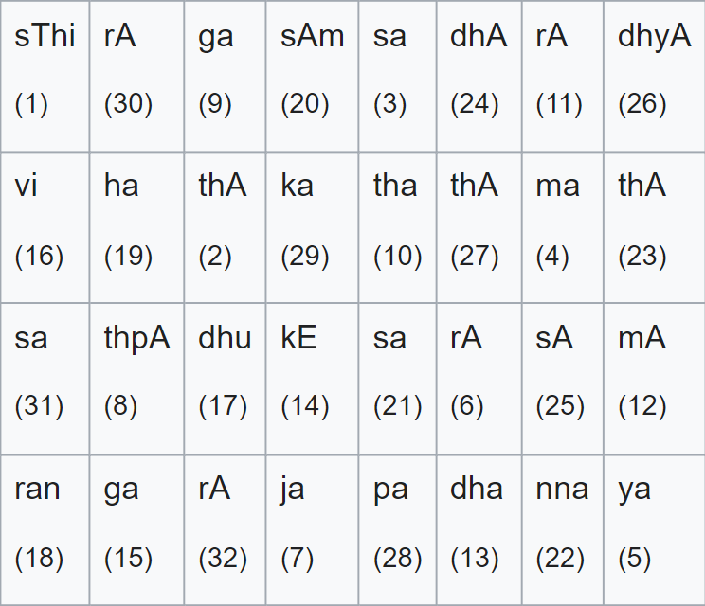
HISTORY
The 20th verse that can be obtained by performing Knight's tour on the above verse is as follows:
sThi thA sa ma ya rA ja thpA
ga tha rA mA dha kE ga vi |
dhu ran ha sAm sa nna thA dhA
sA dhyA thA pa ka rA sa rA ||

Slide 6
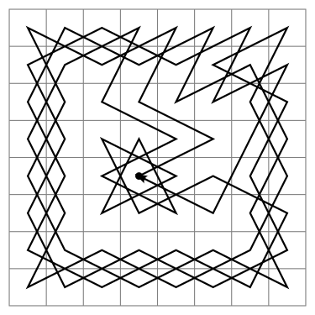
SOLUTIONS TO THE PUZZLE
BRUTE FORCE APPROACH
This solution involves systematically exploring all possible moves of the knight on the checkerboard. So basically, it generates all tours one by one and checks whether they are knight’s tour or not.
This a Closed (circular) solution for The Knight’s Tour Problem.

Slide 7
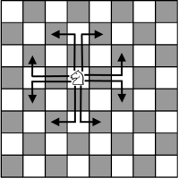
SOLUTIONS TO THE PUZZLE
BACKTRACKING APPROACH
This algorithm works by exploring all possible moves for the knight, starting from a given square, and backtracking to try different moves if it reaches a dead end.
Ways a Knight can move on the board.

Slide 8
SOLUTIONS TO THE PUZZLE
NEURAL NETWORK APPROACH
In this approach, every knight’s legal move is represented in terms of a neuron signal, with output value and state value. When this network runs, each neuron changes its state and output based on its neighbors’ state and outputs according to some predefined transition rules.

Slide 9
OUR APPROACH
In our project, we’ve combined two algorithms, one of which was proposed by H.C. Warnsdorff which is popularly known as the Warnsdorff Algorithm and the Backtracking Algorithm. This strategy has the knight choose squares with the fewest available moves and avoiding the ones already visited.
This approach applies the concept of Hamiltonian Path from graph theory which is why we chose this algorithm to find the solution for this puzzle.

Slide 10
Demonstration of a Knight’s Tour on a 8 x 8 chess board.

Slide 11
CODE
We were able to apply the Warnsdorff’s Algorithm in our code successfully.
The snip of the code the solves the given puzzle is presented on the next slide.

Slide 12
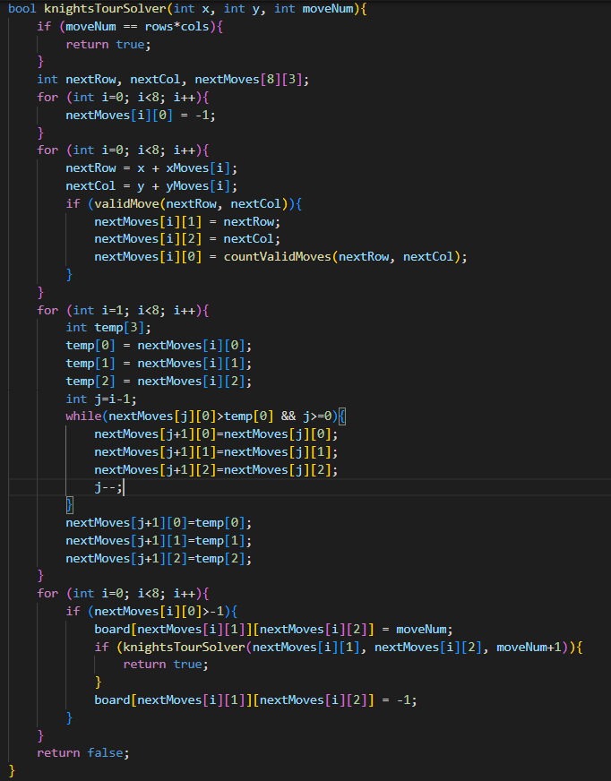

Slide 13
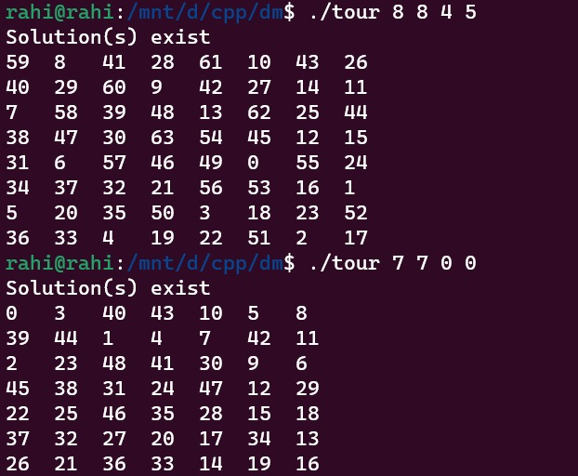
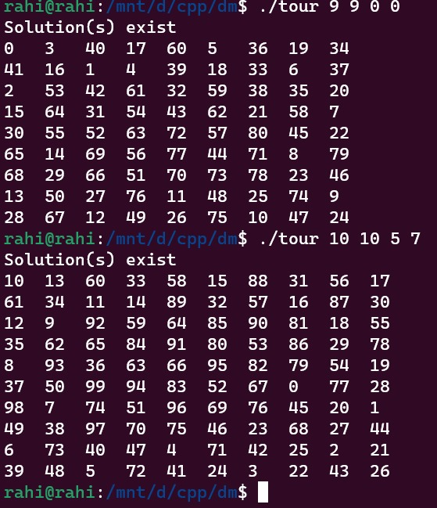
Test Cases

Slide 14
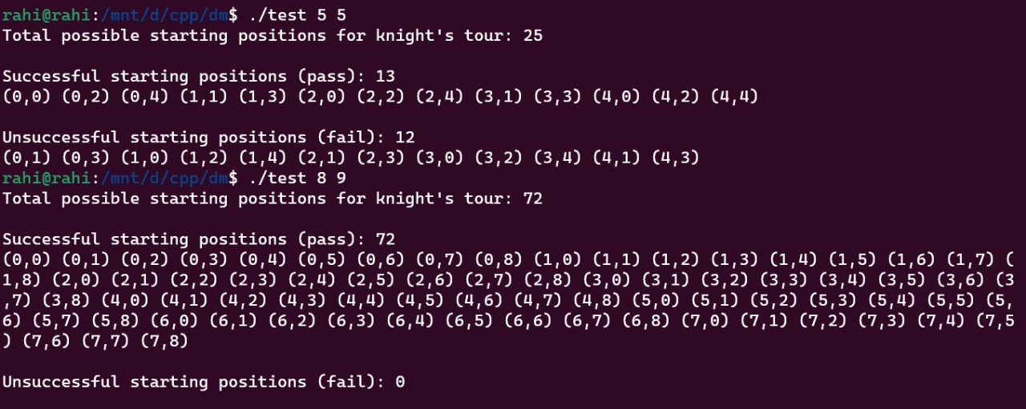

Slide 15
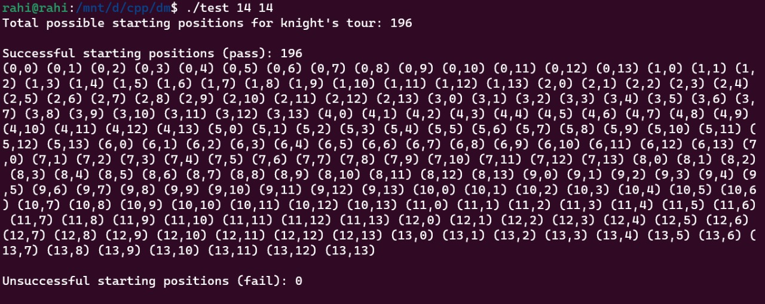

Slide 16
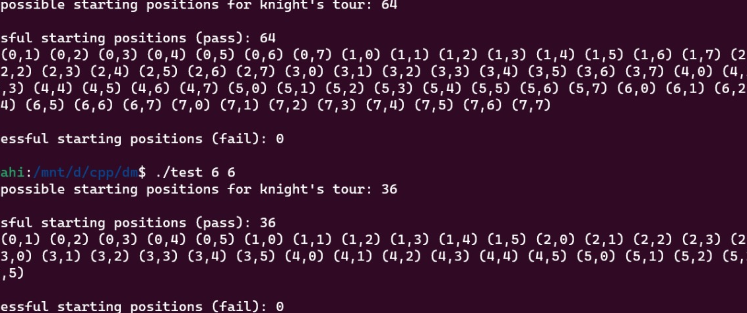

Slide 17
THANK YOU

