Slide 1
CSE556: Natural Language Processing
Project Final-Evaluation
Mental Health Counselling Summarization
Himanshu Raj 2022216
Ishita 2022224
Ritika Thakur 2022408

Slide 2
Introduction
Rising mental health awareness has increased demand for effective counselling services.
Counselling dialogues are complex: Include emotional expressions, therapeutic interventions, and reflective insights.
Summarizing these conversations is challenging due to the need to preserve context and subtlety.
Objective: Summarize counselling conversations effectively.
Motivation:
Help professionals quickly understand core content.
Reduce cognitive load.
Enhance documentation and analysis efficiency.

Slide 3
Related Works
Dialogue summarization is complex due to:
Frequent topic shifts, role-specific utterances, and non-informative fillers.
Domain-specific approaches are emerging to tackle these challenges.
Srivastava et al. (2022):
Use mental health knowledge to filter irrelevant content.
Focus on clinically meaningful, therapeutic utterances.
Other studies consider discourse structure, speaker roles, and context embeddings.
Most models (e.g., T5) treat all utterances equally, ignoring emotional nuances.
Our contribution
Incorporate emotional salience to guide content selection and summary generation.

Slide 4
Methodology
Method 1
Two-stage process:
Emotion Tagging:
Use a pre-trained emotion recognition model.
Assign emotion tags to each utterance.
Emotion-Conditioned Summarization:
Fine-tune T5/Pegasus on emotion-annotated data.
Model learns to associate emotional cues with text.
Goal:
Generate summaries that are factually accurate and emotionally aware.
Enhance relevance, coherence, and human-like quality.
Method 2
Multi-dataset fine-tuning approach:
Fine-tune T5 on GoEmotions → understand emotional context.
Fine-tune T5 on DialogSum → learn conversational summarization.
Final fine-tuning on MEMO dataset for domain-specific performance.
Low-Rank Adaptation (LoRA):
Used for efficient training on large datasets.
Additional LoRA layer added during MEMO fine-tuning for adaptation.
Goal:
Build a summarization model that captures emotional subtext in dialogues.
Enhance expressive, emotionally-aware summaries with efficient training.

Slide 5
DialogSum
13,460 dialogues wsith human-written summaries & topics.
Covers everyday life dialogues (e.g., shopping, work, school, travel).
Includes various speakers: friends, customers, service providers, etc.
Datasets
MEMO Dataset
12,900 utterances from 212 counselling conversations.
Each utterance includes:
Subtopic (e.g., symptoms, reflecting), speaker type, ID, and emotion (empty).
Contains utterances, summaries, primary & secondary topics.
Helps identify fillers via subtopics like "inactive" or "patient discovery".
GoEmotions (Google AI)
58,009 Reddit comments labeled with emotions.
27 emotion categories:
12 positive, 11 negative, 4 ambiguous, 1 neutral.
Emotion labels include: joy, fear, curiosity, sadness, gratitude, etc.
Designed for fine-grained emotional analysis.

Slide 6
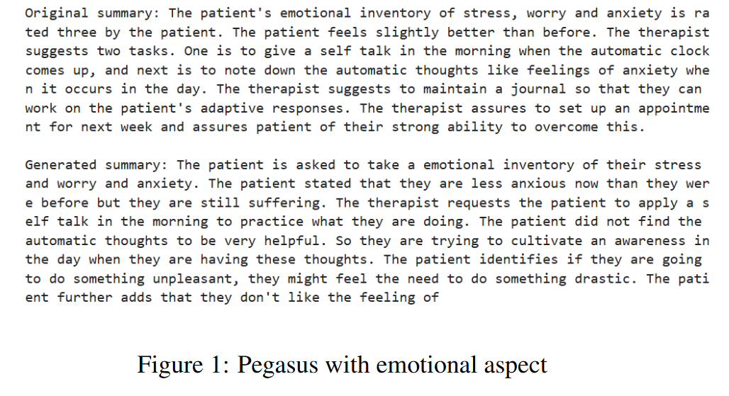
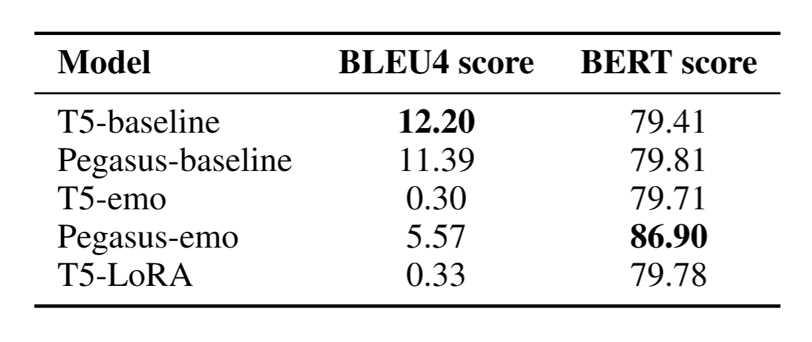
Results
Generated Summaries

Slide 7
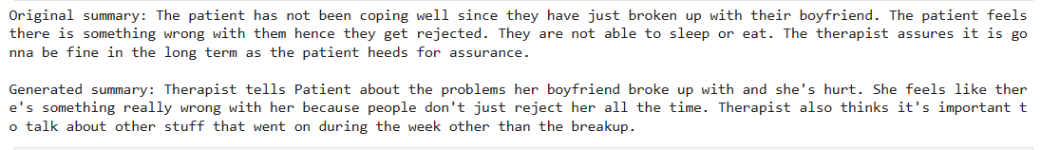
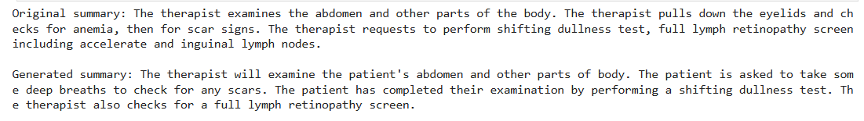
Generated Summaries
LoRA with emotional aspects
T5 with emotional aspects

Slide 8
Insights & Future Directions
Emotion Integration Challenges: Incorporating emotion tags into models like T5 and Pegasus presented challenges; T5-emo showed reduced BLEU4 scores, indicating that naive integration can disrupt summarization capabilities.​
Model Performance: Pegasus-emo demonstrated improved BERTScore, suggesting better semantic alignment with reference summaries.​
LoRA Fine-Tuning: T5-LoRA did not show significant improvements, highlighting potential limitations in this fine-tuning approach for the specific application.​
Data Annotation Gaps: The absence of pre-annotated emotion labels in the MEMO dataset necessitated the use of external emotion recognition models, introducing potential inaccuracies.​
Future Work:
Focus on advanced emotion integration techniques, enhancing datasets with emotion annotations, exploring different model architectures, developing real-world applications, and addressing ethical considerations in AI-driven mental health tools.​

