Slide 1
Computer Graphics
Final Project Evaluation
Surface Reconstruction using non parallel curve networks
Asa Singh Himanshu Raj
2022113 2022216

Slide 2
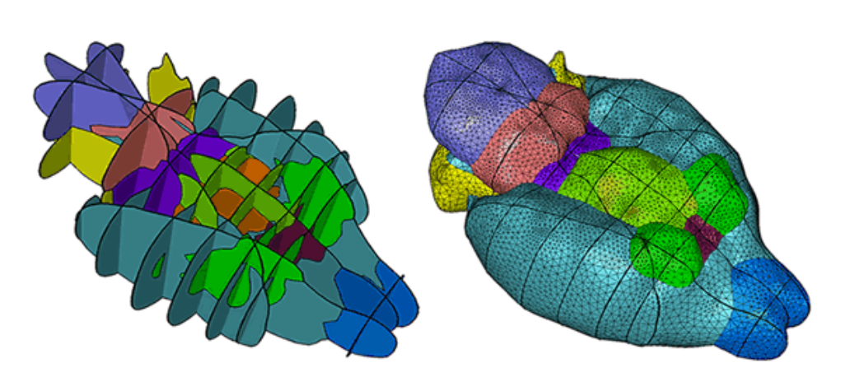
Introduction
This project develops an algorithm for constructing 3D surface networks from curve segments on non-parallel planes, extending beyond traditional methods focused on closed curves on parallel sections.
It enables detailed surface reconstruction for applications in biomedical modeling and computational geometry, handling complex object segmentation like muscle, bone, and tissue layers.
The approach ensures a closed 3D surface network that captures both the exterior boundaries and internal segmentation of the object.
Image from
https://www.cs.wustl.edu/~taoju/
research/eg_paper_final.pdf

Slide 3
Literature Review
Surface reconstruction from cross-sectional data is a critical area in geometry processing and medical imaging. Boissonnat and Memari laid the groundwork for reconstructing surfaces from closed curves, primarily focusing on parallel cross-sections. Their methods effectively address simple geometries but do not account for the complexities introduced by non-parallel, multi-labelled curve networks, which are essential for accurately modelling anatomical structures.
Reconstructing surfaces from non-parallel curves presents challenges in ensuring closedness and continuous interpolation between segments. The referenced paper proposes an advanced approach using polyhedral decomposition and a divide-and-conquer strategy, providing a robust solution to these challenges. This method divides the input space into manageable cells, allowing for the construction of closed surfaces within each cell, thus maintaining continuity across non-parallel planes and effectively managing multi-label structures.

Slide 4
Methodology
Computing convex cells: Space is divided into regions, converted to CGAL polyhedra to identify unique elementary cells.
Axis - Aligned Planes: Cuboidal polyhedra have axis-aligned planes computed using bounding boxes and contour plane alignment.
Contour projections on plane: Contours are projected onto the plane, creating 2D vertices for surface construction.
Mesh construction: Delaunay Triangulation creates surface meshes from contours, forming a complete 3D mesh.

Slide 5
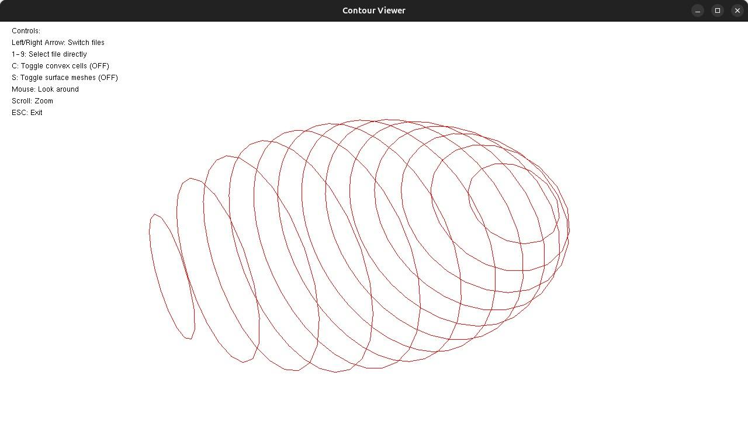
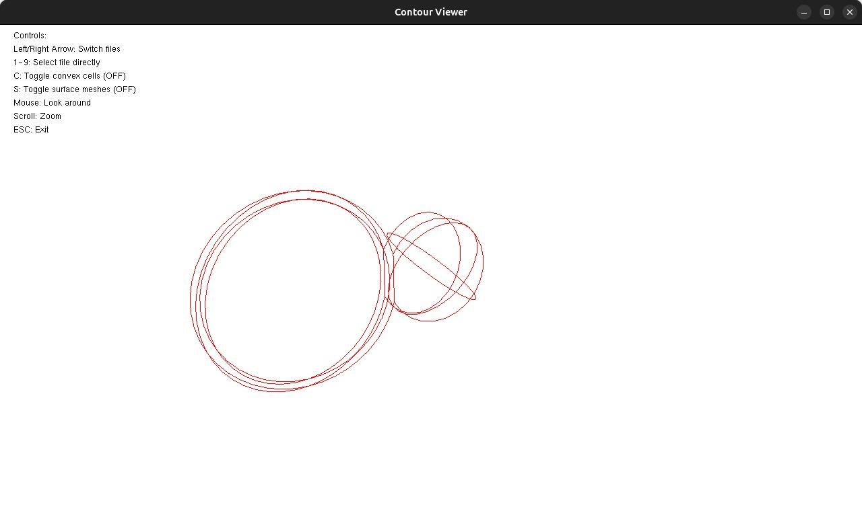
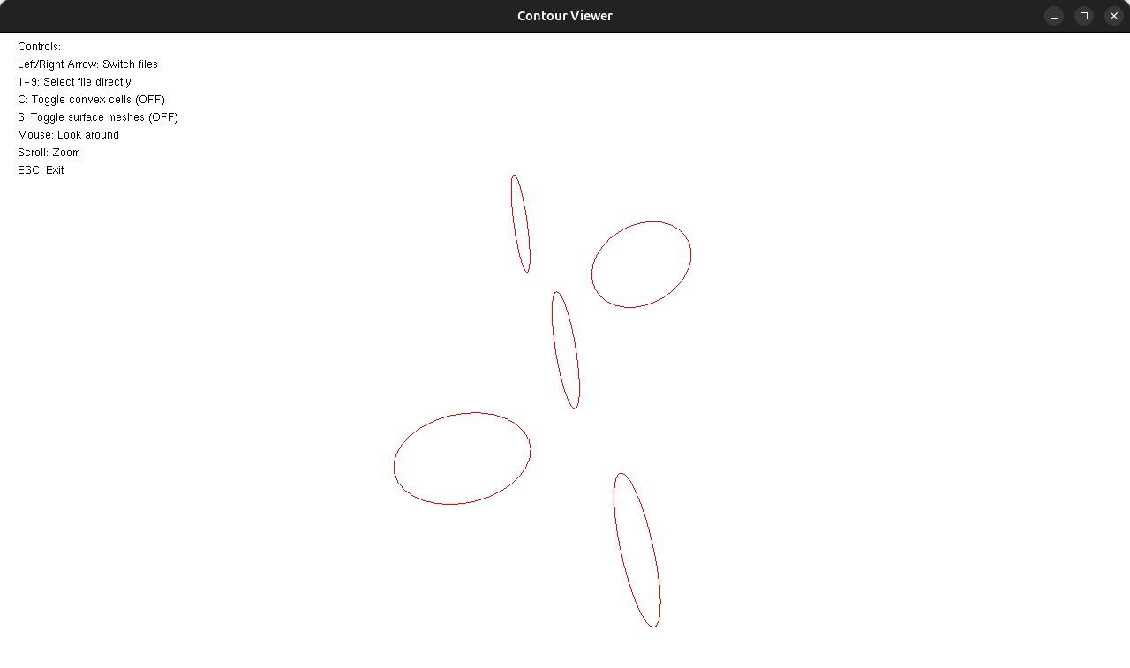
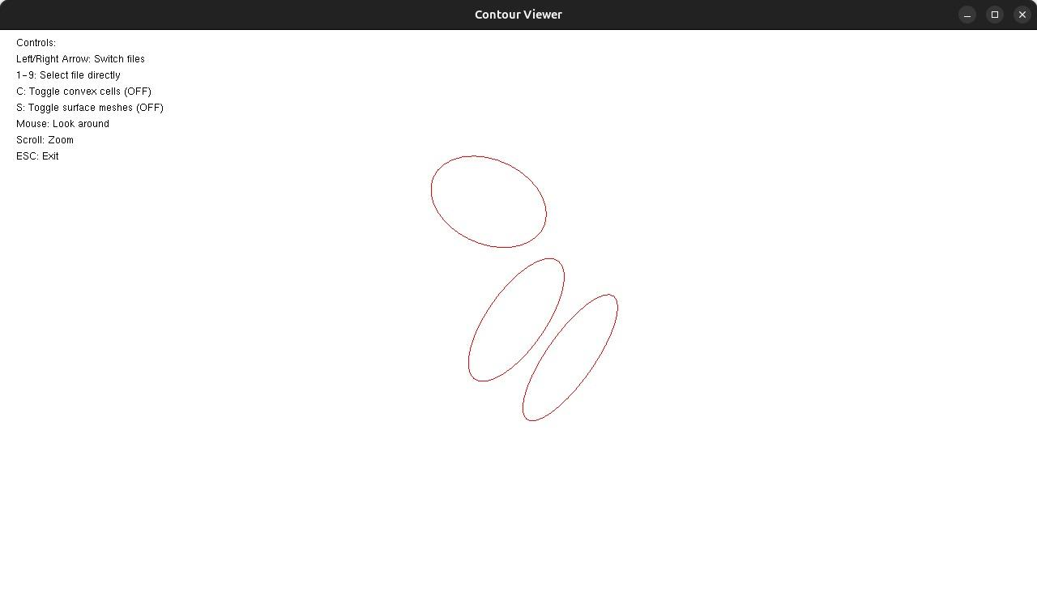

Slide 6
Computing convex cells
The space is divided into smaller regions using predefined contour planes and a bounding box. These partitions are stored as Nef polyhedra along with their associated plane indices for later processing.
Each region is checked against others to determine if it overlaps or shares the same vertices with any other region. Non-overlapping and unique regions are identified as elementary cells.
The Nef polyhedra representing each region are converted into CGAL polyhedra for comparison and geometric operations. This allows efficient handling and visualization of the partitions.

Slide 7
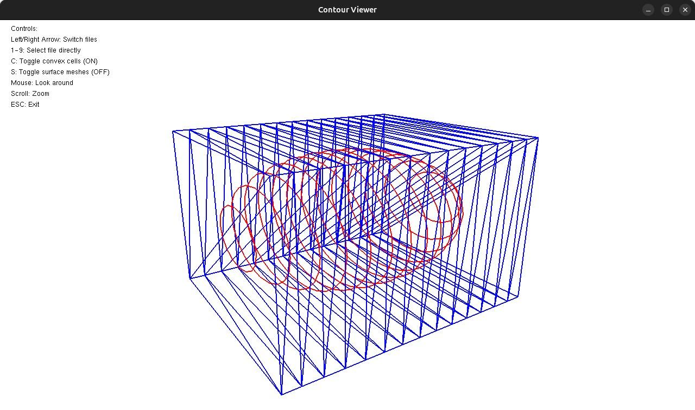
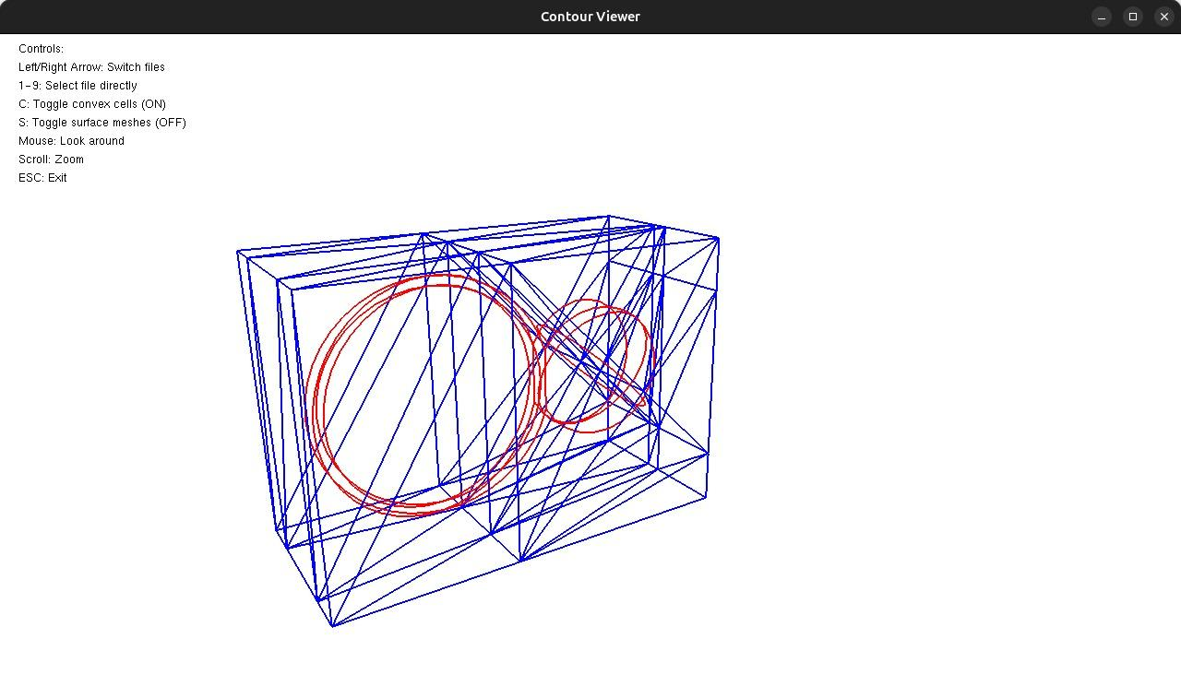
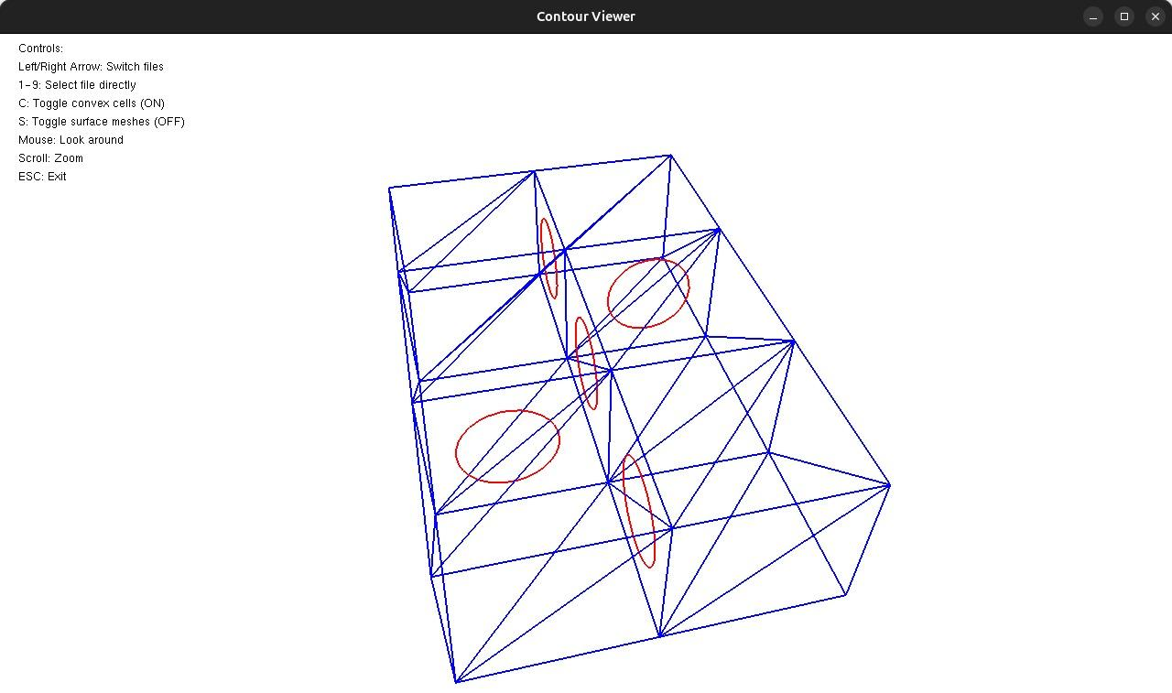
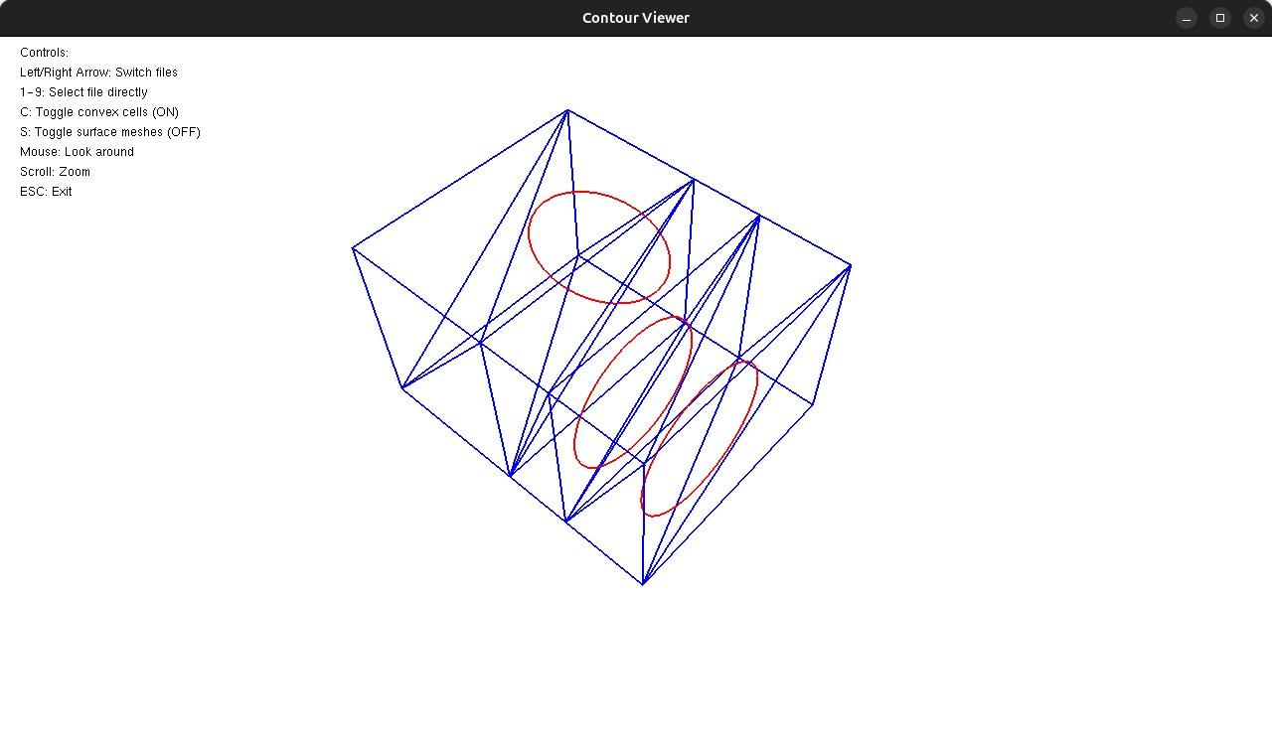

Slide 8
Axis-Aligned Planes
The resultant polyhedrons generated during the processing phase are generally cuboidal or close to cuboidal in shape. To facilitate further analysis and processing, axis-aligned planes are constructed for these 3D cells. These planes are defined such that each one corresponds to a pair of parallel faces of the polyhedron. The selection of the appropriate axis-aligned plane is guided by the associated contour planes.
The chosen axis-aligned plane is either parallel to the contour plane or determined to be the most horizontal among all contour planes associated with the polyhedron. This ensures consistency and alignment with the geometric characteristics of the cell.
To compute the axis-aligned planes, we enclose each polyhedron within its bounding box. The bounding box defines the extent of the polyhedron along the x, y, and z axes. By averaging the coordinates across these axes, we establish the optimal positions for the planes.

Slide 9
Contour projections on plane
Once the axis-aligned plane for a given cell is determined, the next step is to project the vertices of the associated contours orthogonally onto this plane. This process involves transforming the 3D contour geometry into a 2D representation on the axis-aligned plane.
The projection ensures that the contours are accurately represented on the selected plane while preserving their geometric fidelity. Each contour projection becomes a critical input for subsequent surface construction. By aligning these projections on a common plane, we simplify the process of creating connections between them.
The result of this projection step is a set of 2D contour vertices on the axis-aligned plane. These vertices provide the foundation for defining the geometry of surfaces that link the contours, enabling the reconstruction of the cell's internal structure.

Slide 10
Mesh construction
To create surfaces that connect the vertices of two or more contours within each cell, Delaunay Triangulation is employed. This triangulation technique is particularly suitable for this purpose due to its ability to create well-shaped and non-degenerate triangles. Delaunay Triangulation ensures that the resultant mesh is both geometrically robust and visually coherent.
The process begins by applying Delaunay Triangulation to the set of projected vertices on each axis-aligned plane. This generates a surface mesh that seamlessly connects the contours within the cell. If multiple contour levels are present, the triangulation process is repeated to create surfaces between adjacent levels.
Finally, all the generated surfaces are stitched together to form a complete mesh representation of the polyhedron. The resulting mesh not only captures the 3D structure of the cell but also provides a high-quality approximation that is suitable for visualization, analysis, and further processing.

Slide 11
