Slide 1
On Strategies To Improve Software Defect Prediction
Rahul Krishna
PhD Scholar
Dept. Computer Science

Slide 2
Overview
Motivation
Research Questions
Background
Data Sets
Experimental Setup
Experimental Results

Slide 3
Motivation

Slide 4
Why Defect Prediction?
Boehm and Papaccio^{[1]} comment that early detection helps reduce cost incurred to fix at a later stage “by a factor of upto 200”
IEEE Metrics 2002 concluded that “Finding and fixing bugs after delivery is usually 100 times more expensive that do so at the requirements and design phase”^{[2]}
Shull et al.^{[2]} claim that, “About 40-50% of the user programs enter use with nontrivial defects”
In the agile world, code bases are more developed than tested
The takeaway– Find Bugs Early!
[1] B. W. Boehm and P. N. Papaccio, “Understanding and controlling software costs,” IEEE Trans. Softw. Eng., vol. 14, no. 10, pp. 1462–1477, Oct.
1988.
[2] F. Shull, V. Basili, B. Boehm, A. W. Brown, P. Costa, M. Lindvall, D. Port, I. Rus, R. Tesoriero, and M. Zelkowitz, “What we have learned about
fighting defects,” in Software Metrics, 2002. Proceedings. Eighth IEEE Symp. on. IEEE,pp. 249–258.

Slide 5
Easier said than done..
No oracles or closed form mathematical models.
Expert opinion is would take too long.
There way too much data
Github has over 9 million users and 21.1 million repositories.
Develop efficient code analysis measures
Use Machine Learning tools
Algorithms are too generic, needs optimization
But real world data is skewed
“80% of the defects lie in only 20% of the modules”
Not enough defective samples in a project to learn meaningful patterns

Slide 6
Research Questions
RQ1: Can techniques such as SMOTE be used to preprocess data to improve prediction accuracy?
RQ2: Does Tuning a data miner improve it’s prediction accuracy?
RQ3: Can tuning be performed in conjunction with SMOTE to further improve the prediction accuracy?
RQ4: Is SMOTE limited only to defect prediction?

Slide 7
Background

Slide 8
Defect Prediction
Models are hard to obtain, to complex, and not aren’t reliable.
Different regions of the same data have different properties^{[1]}
A plausible solution:
Use Case Based Reasoning
Learn from past data and reflect at new data
They’re pretty neat
Can work with partial data (useful at early stages)^{[2]}
Can work with sparse samples^{[3]}
Rather robust
[1] T. Menzies, A. Butcher, D. Cok, A. Marcus, L. Layman, F. Shull, B. Turhan, and T. Zimmermann, “Local versus global lessons for defect
prediction and effort estimation,” Software Engineering, IEEE Transactions on, vol. 39, no. 6, pp. 822 – 834, June 2013.
[2] F. Walkerden and R. Jeffery, “An empirical study of analogy based software effort estimation,” Empirical software engineering, vol. 4, no. 2, pp.
135–158, 1999.
[3] I. Myrtveit, E. Stensrud, and M. Shepperd, “Reliability and validity in comparative studies of software prediction models,” Software
Engineering, IEEE Transactions on, vol. 31, no. 5, pp. 380–391, May 2005.

Slide 9
Defect Prediction
Lessmann et al.^{[1]} compared 21 different learners for software defect prediction.
They found Random Forest to be the Best and CART to be Worst
That’s strange!
They’re both tree based learners
One is deterministic, other is random
But they surely can’t be on opposite ends of spectrum. Can they?
It’s probably the data
It’s always the data
Maybe the predictors need to be calibrated
[1] S. Lessmann, B. Baesens, C. Mues, and S. Pietsch, “Benchmarking classification models for software defect prediction: A proposed framework
and novel findings,” Software Engineering, IEEE Transactions on, vol. 34, no. 4, pp. 485–496, July 2008

Slide 10
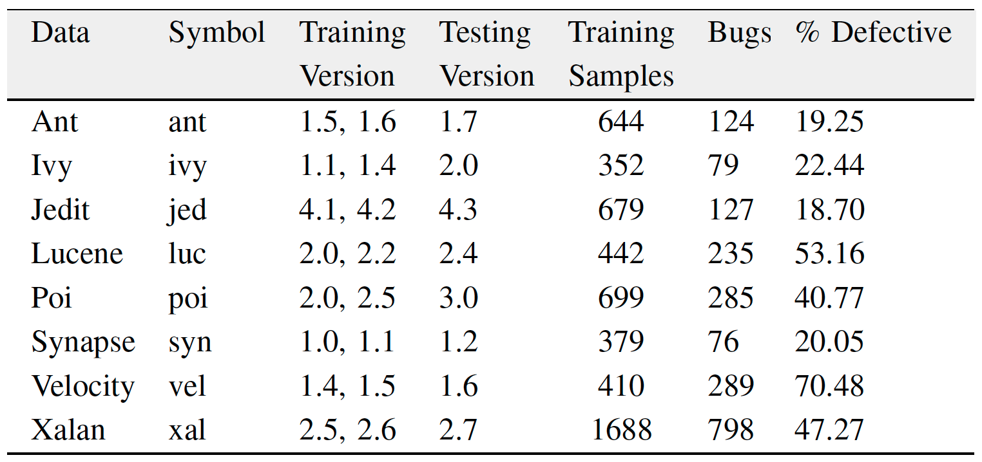
Class Imbalance in Data

Slide 11
Class Imbalance in Data
Too many samples of non-defective modules
Trees constructed by CART and RF would be severely biased
Use SMOTE^{[1]} to preprocess training data
Upsample minority class by creating “synthetic” samples
Downsample majority class by randomly discarding samples
My criterion (My infallible Engineering judgment)
At least 50 samples from minority class
At most 100 samples from majority class

Slide 12
Parameter Tuning
SMOTE preprocess training data
Tuning calibrates the predictor
Automate calibration using metaheuristics
Differential Evolution is popular and a simple optimizer
Use training data to learn the best parameters for the predictor
Test data must not be revealed
Only datasets with 3 or more historic versions are used
Last version is used for test, all other are used for training

Slide 13
Differential Evolution (in a nutshell)
Randomly choose attributes
Pick any two attributes and create a new attribute by interpolation
If the new attribute performs better than the old one discard the old one
If not discard the new one
Repeat 2-4

Slide 14
Datasets

Slide 15
Datasets
8 Defect Prediction Datasets:
Ant
Ivy
Jedit
Lucene
Poi
Synapse
Velocity
Xalan
1 Bugzilla dataset (Thanks Chris!)

Slide 16
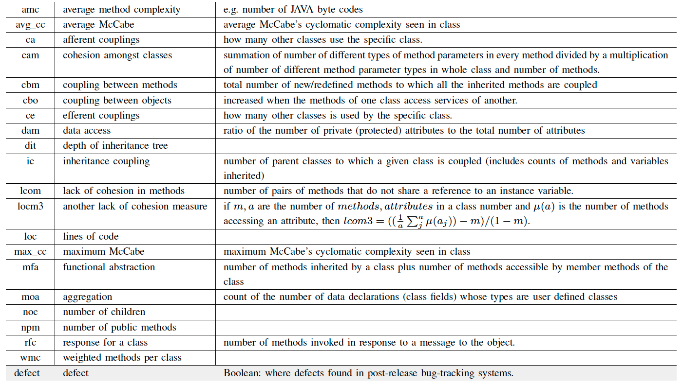
The Metrics

Slide 17
Experimental Setup

Slide 18
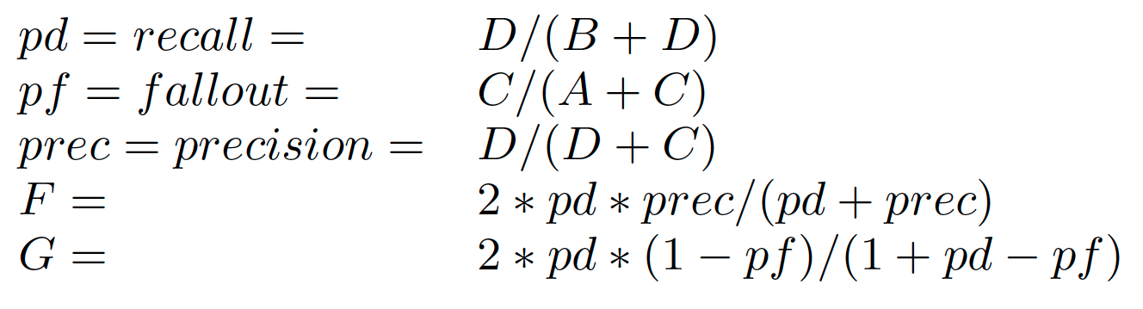
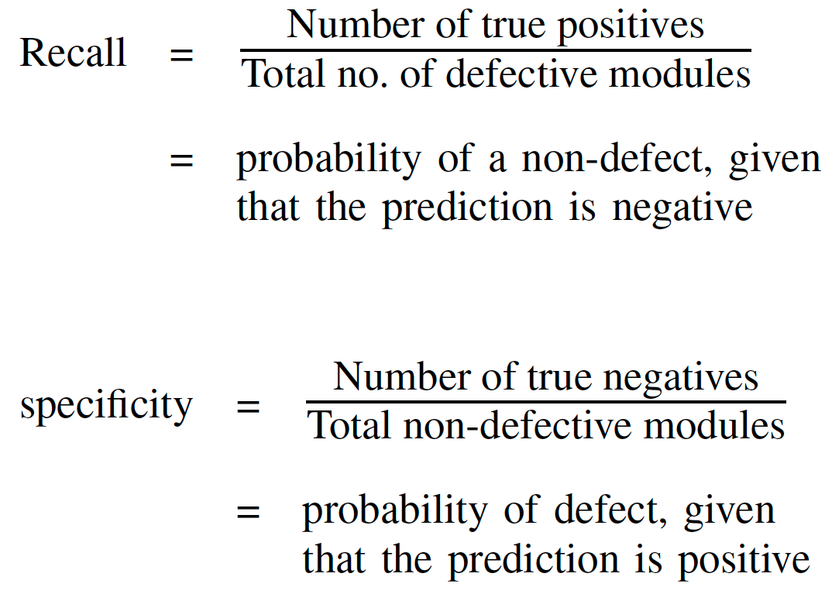
Statistical Measures
Let A,B,C,D denote True negative, False Negative, False Positive, True Positive
The standard measures:
F,G measure both defects and non-defects at once. Recall and specificity only measure one.
G is especially useful, it is the harmonic mean between recall and specificity.
G is lower than both recall and fallout.
High G implies both Recall and sensitivity are high. Which is good!

Slide 19
Experimental RESULTS

Slide 20
Defect Dataset
RQ1:Can techniques such as SMOTE be used to preprocess data to improve prediction accuracy?
RF was better than CART in 6 out of the 8 datasets.
SMOTE helped improve the performance in 4 out of those 6 datasets.
RQ2: Does Tuning a data miner improve it’s prediction accuracy?
Not always, just tuning didn’t help
RQ3: Can tuning be performed in conjunction with SMOTE to further improve the prediction accuracy?
Yes. In 6 out the 8 datasets, SMOTE+Tuning surely helps

Slide 21
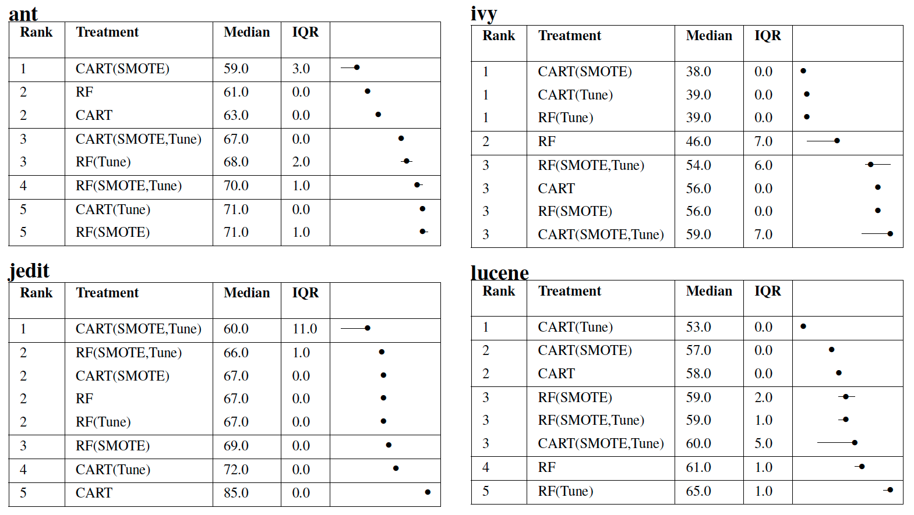

Slide 22
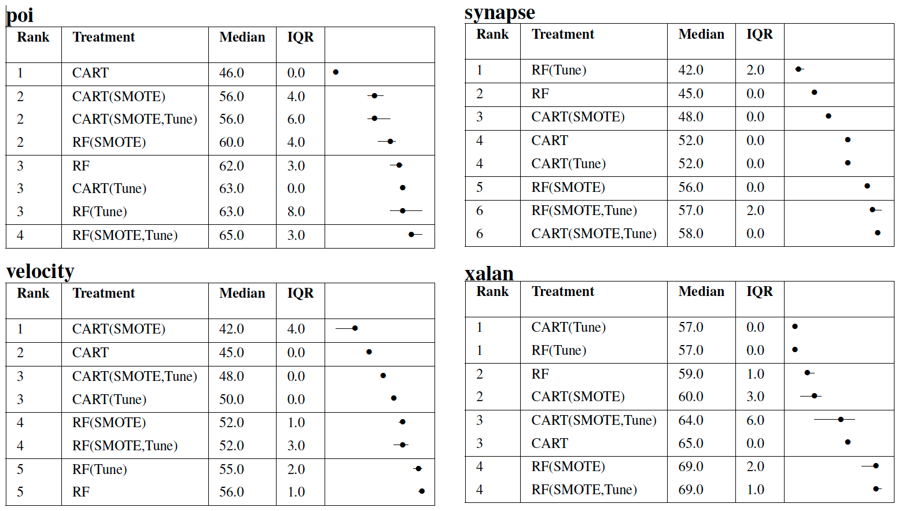

Slide 23
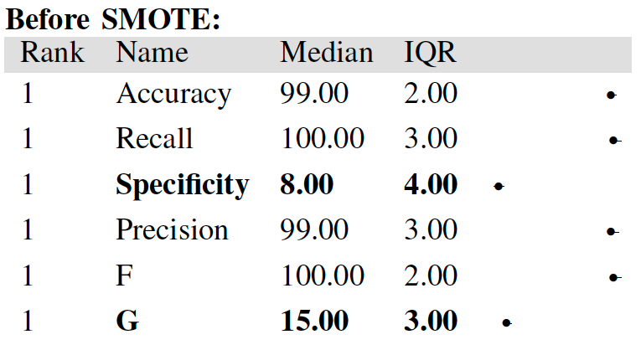
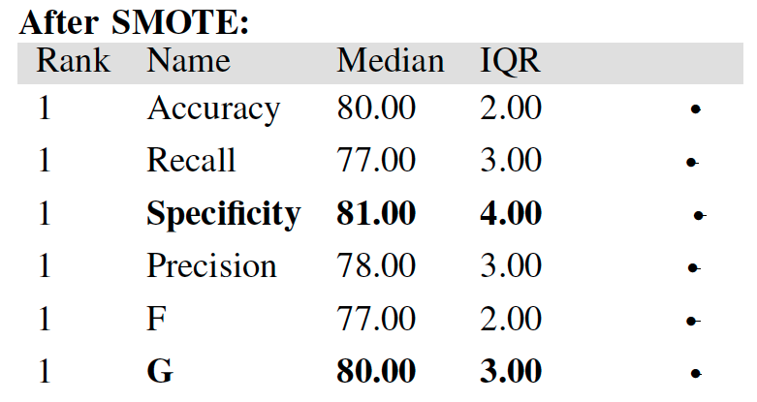
Security Flaws Dataset

Slide 24
Conclusion
Defect Data Set
SMOTEing is beneficial
Tuning alone is not too useful
The combination of both works even better.
Security Flaw Dataset
Improves sensitivity by 10 times
In summary:
Always reflect over the data
Calibrate your predictor before use

