Slide 1


SOFTWARE TESTING Project
Mohamed Abdelaty Ahmed Saif Abdelfattah Moawed Magda Abdeltawab Rahma Ibrahim

Slide 2


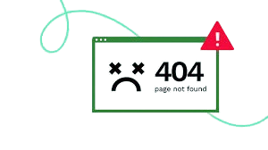
Why Quality Control is Essential
In 1996, a bug in the Ariane 5’s guidance system caused a $370 million rocket to explode
n 2012, a bug in Knight Capital Group’s trading software caused a series of unintended trades, costing the company $460 million in under an hour..
Between 2005 and 2010, Toyota recalled over 400,000 Prius vehicles due to a software glitch in the braking system, which delayed brake response.
The cause?
Errors and Bugs

Slide 3


Lessons Learned: Importance of Quality Control
Investing in Quality Prevents Costly Failures
Robust Testing Mitigates Financial Risk
Proactive Quality Assurance Enhances Safety
Early Testing Saves Time and Money

Slide 4


Competitor Analysis
Major e-commerce platforms like Amazon and AliBaba set high standards for user experience, functionality, and reliability. Their success is largely attributed to their robust quality control processes, seamless user interfaces, and efficient customer service.

Slide 5

Because of all the previous factors, we decided to conduct testing on NopCommerce website

Slide 6
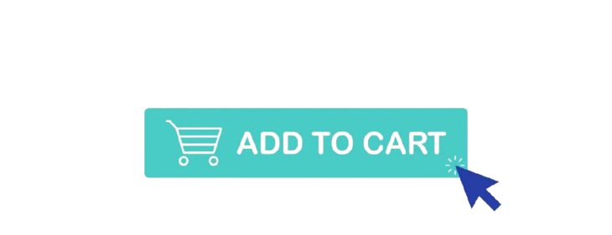


What is NopCommerce?
NopCommerce is an open-source e-commerce platform built on ASP.NET, designed to create and manage online stores with ease.
It offers a wide range of features, including Login Registration, Wishlist, add to cart, and customizable themes, making it suitable for businesses of all sizes.

Slide 7
Software Test Process
Plan
Design
Execution
Defect Report
Closure

Slide 8
Software Test Plan
introduction
Objectives
Scope
Test approach
Software Test Plan
Test Deliverables
Test Environment
Entry and exit Criteria
Schedule

Slide 9
introduction
Objectives
Scpe
This test plan aims to validate the functionality, usability, and stability of the key features on the nopCommerce demo website.
The features to be tested include Register, Login, Currencies, Search, Hover Categories, Home Sliders, Follow Us, and Wishlist.
Testing will cover both functional and non-functional aspects to ensure an optimal user experience.
To verify that the core functionalities of nopCommerce (e.g., Register, Login) work as expected.
To assess the usability and accessibility of the navigation and layout features.
To confirm that each feature operates consistently across various devices and browsers
Functionality testing for each specified feature.
UI/UX verification for user interface elements, ensuring usability.
Accessibility testing for interactive elements

Slide 10
Approach
Deliverables
Environment
Functional Testing: Test each feature independently to ensure it works as expected.
UI/UX Testing: Check that the layout and design elements are intuitive and accessible.
Regression Testing: Retest all features after any code changes or updates
Test cases for each feature (including positive and negative scenarios).
Test summary reports and defect logs.
Browsers: Chrome, Firefox, Safari, Edge
Devices: Desktop (Windows 11)
Test Data:
Registration: Sample user data (e.g., emails, passwords).
Currencies: Different currencies to check price changes.
Wishlist: List of test items to add to the wishlist

Slide 11
SOFTWARE TEST Schedule
Week 1 | Prepare test cases for Register, Login, Currencies
Week 2 | Testing Search, Hover Categories, Home Sliders features
Week 3 | Testing Follow Us, Wishlist, and run regression tests features
Week 4 | Review reports, Re-test, finalize test report.

Slide 12
Entry and exit criteria
Entry Criteria: All specified features are available on the website; test data is prepared.
Exit Criteria: All critical and high-priority test cases are executed, and critical defects are resolved

Slide 13
Register
Home Slider Home Category
Tested Features
Login
Wishlist
Search
Currencies Follow Us

Slide 14
Test Design
Equivalence Partitioning
Boundary Value Analysis
Decision Table Testing
Testing Techniques
Exploratory Testing

Slide 15
Test Execution Process
Step 1
01
Set up the test environment based on the specifications in the test plan.
Ensure that all necessary tools, resources, and test data are available.

Slide 16
Step 2
02
Execute the test cases sequentially according to the test plan.
Document the actual results, noting any discrepancies between expected and actual outcomes.

Slide 17
Step 3
03
Log any defects or issues identified during testing into a defect tracking system.
Provide clear and detailed descriptions of the defects to facilitate debugging.

Slide 18
Defect Reporting Process
Identification: During testing, any discrepancies or bugs discovered are logged as defects.
Documentation:
Defect ID: Assign a unique identifier for tracking.
Summary: Provide a concise description of the issue.
Environment: Specify the testing environment details (e.g., browser, OS).
Steps to Reproduce: List clear instructions to replicate the defect.
Expected vs. Actual Results: Outline what should have happened versus what occurred.
Severity and Priority Assignment: Classify the defect based on its impact and urgency for resolution.

Slide 19
Closure Process
Verification: Confirm that the defect fix meets acceptance criteria through retesting.
Retesting: Execute test cases to ensure the defect is resolved without introducing new issues.
Documentation: Update defect reports with verification results and any observations.
Closure: Officially close the defect in the tracking system once verified.
Communication: Inform stakeholders about the defect closure and any relevant implications.

Slide 20
Thank You!
Any Questions?

