Slide 1
Travelling salesman problem

Slide 2
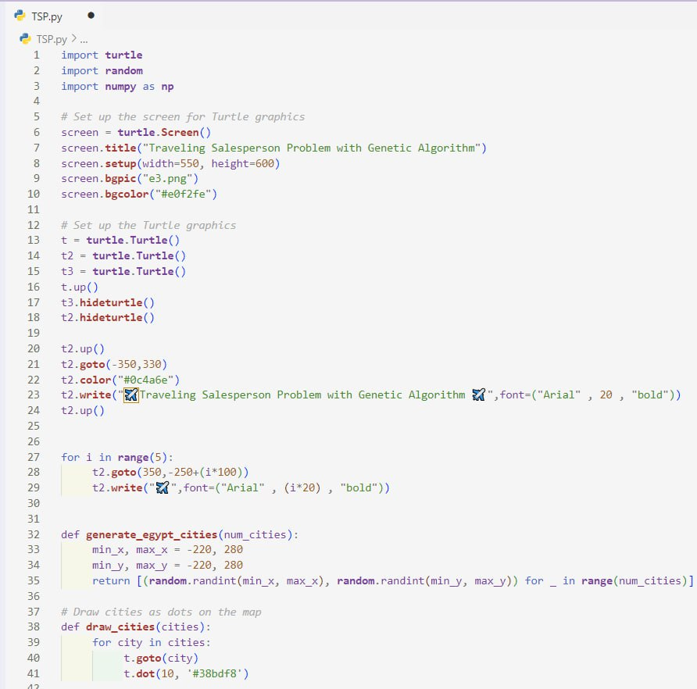
Code:

Slide 3
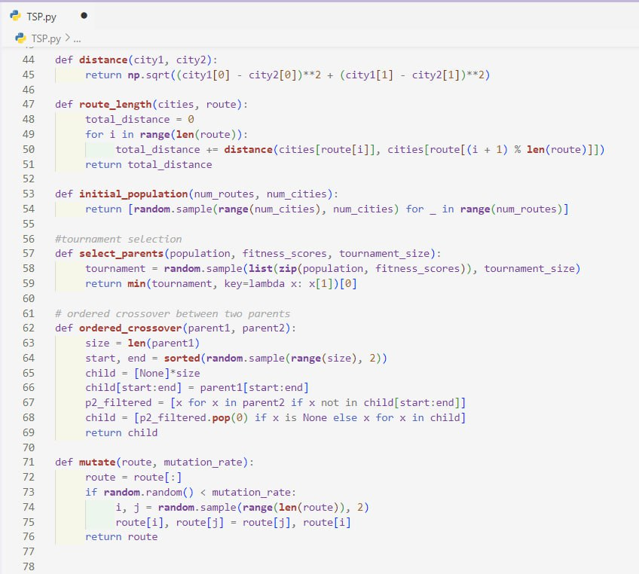
Code:

Slide 4
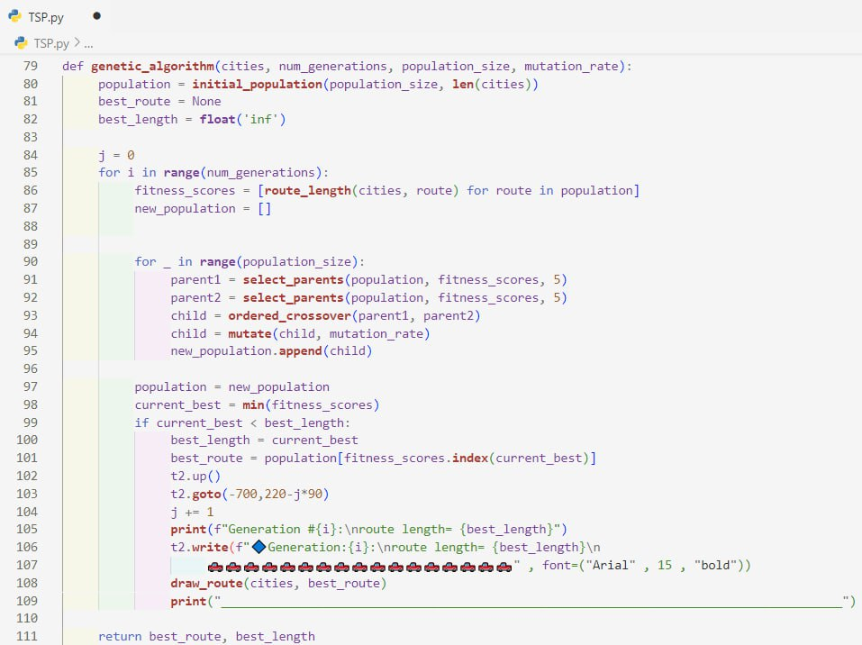
Code:

Slide 5
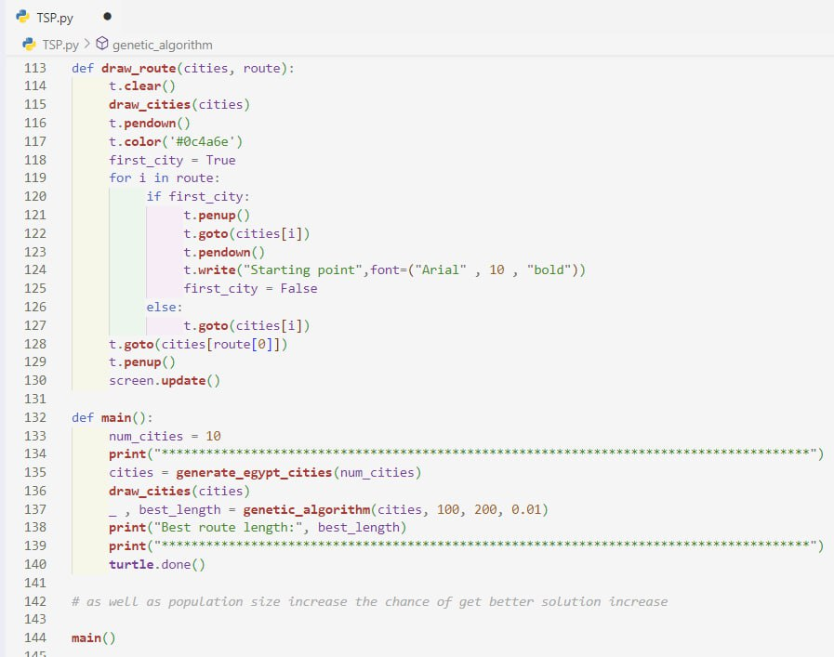
Code:

Slide 6
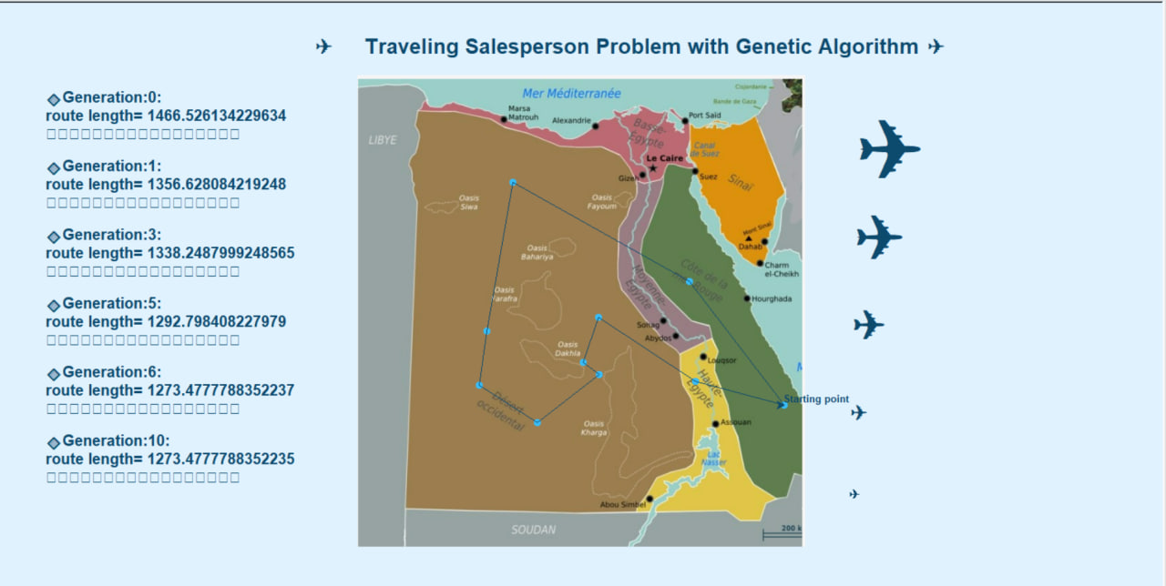
Output:

Slide 7
Thanks!

