Slide 1



Challenge Selected:
LUNAR SURFACE OPERATIONS: REAL-TIME COLLABORATION
Team Name: Champions
Team member names:
Ms. Amna Salim Rashid Al Kaabi
Ms. Sheikha Hassan Khamis Mohammed Al Zaabi
Ms. Rahma Fahad Mohammed Al Mamari
Ms. Khaloud Hamed Rashid Al Maamari
Ms. Rahaf Mohammed Ali Al Khazimi

Slide 2

Challenge:
Create an application to allow NASA flight controllers and the broader scientific community to collaborate and compare notes on lunar mission data as it is collected.
Solution:
Space-Logger is Mobile cum Web Application which assist the crew member can individually record their exploration on the planet space. Simultaneously many members can save their log information which include text, image, video.
Gain:
Secure Data communication
Supports multiple user to interact at the same time
Supports different type of data
Console log can be view based on the topic of interest.
Deletion of message can be possible only by owner of the console log.
Real-time console log information is vital for review by the experts and helpful for post mission investigation or scientific research.
Data:
The following are the sample data references used in this project
https://history.nasa.gov/afj/ap13fj/08day3-problem.html
https://history.nasa.gov/afj/ap11fj/01launch.html
https://history.nasa.gov/afj/ap13fj/pics/accident-log.png

Slide 3
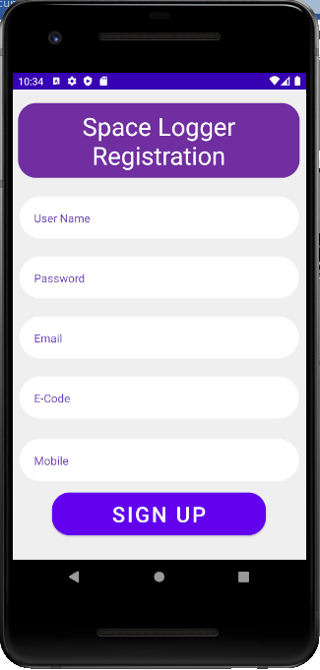
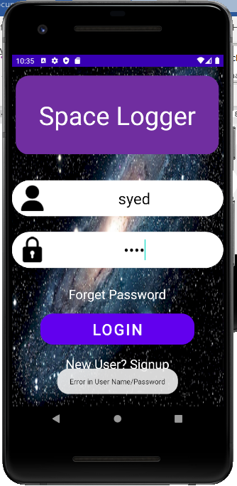
Sign Up screen
Login screen
Mobile
Design

Slide 4
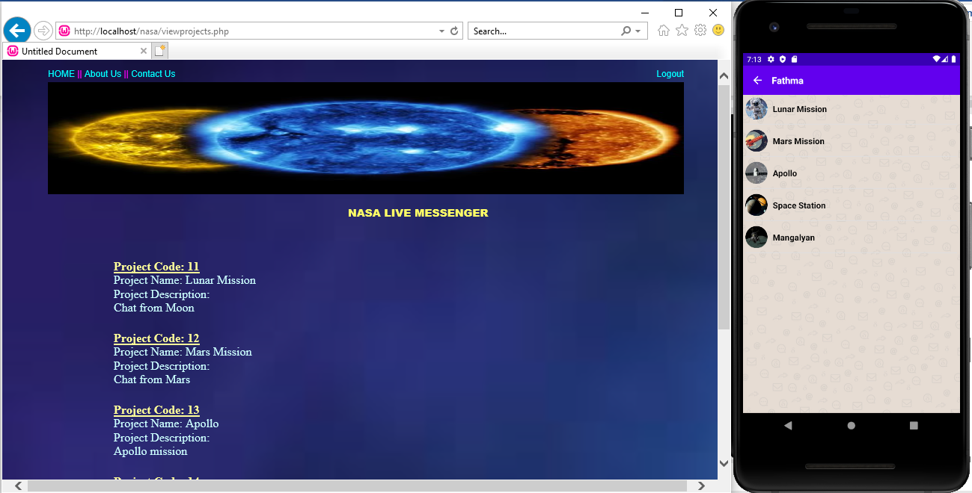
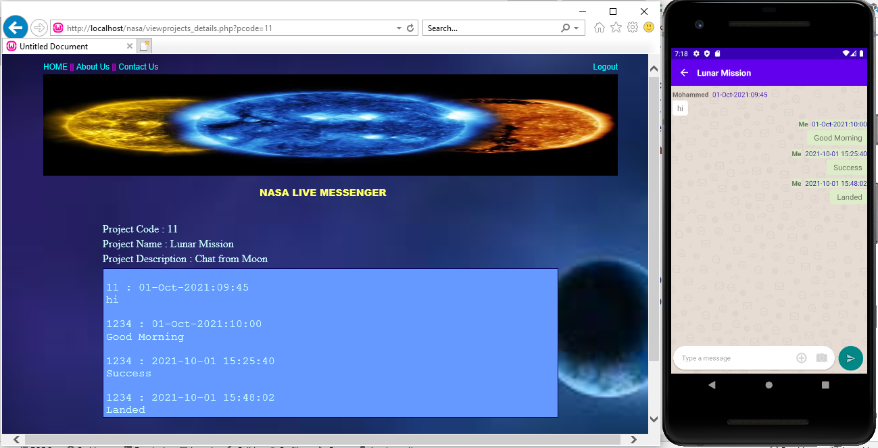
List of projects screen
Message list screen

Slide 5
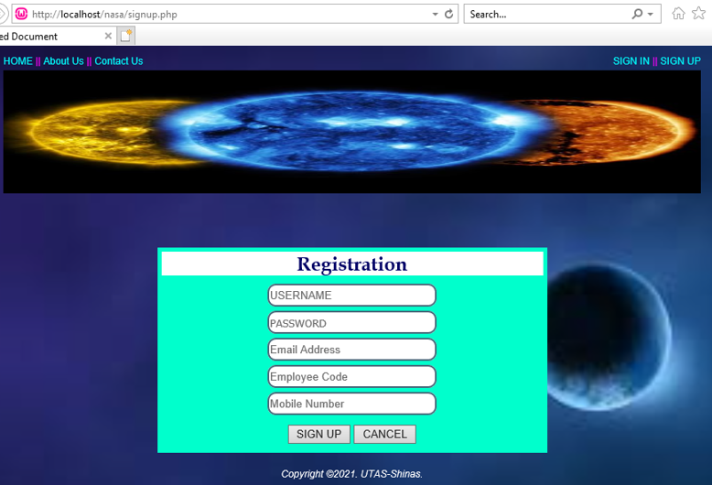
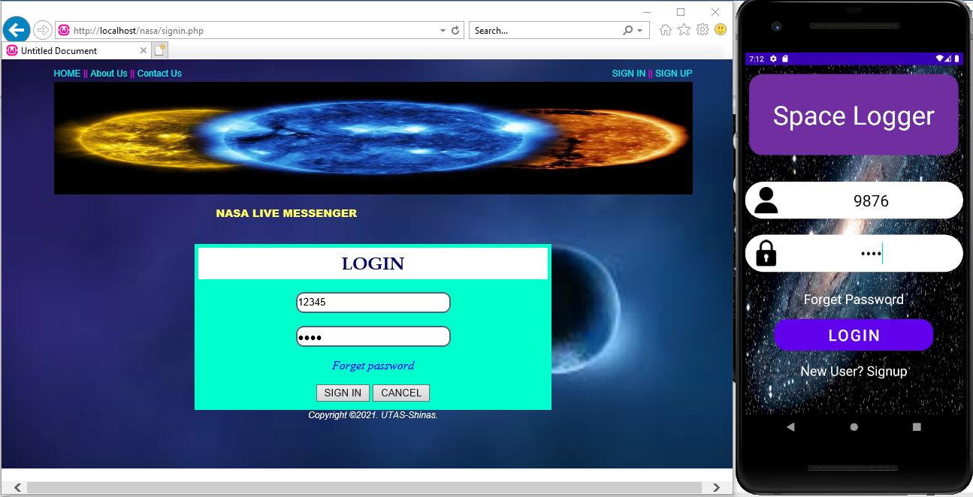
Registration
Login
Website
Design

Slide 6
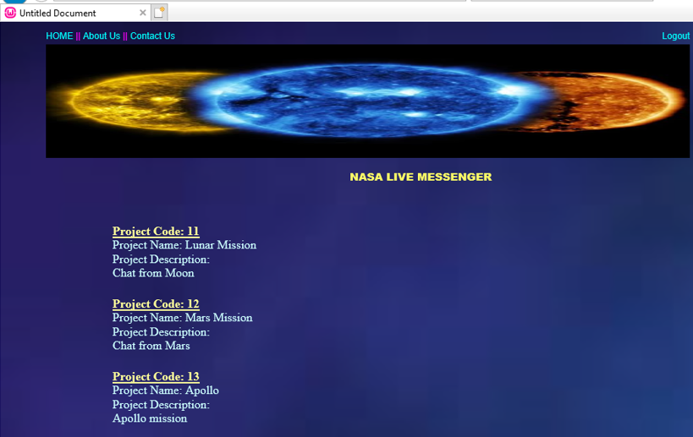
List of Running Projects
Console Log

Slide 7


Future Enhancements
Improve the GUI interface
User can send different size of file
Security features
Console Log Authorization
Well organized searching and listing

