Slide 1

Data-driven Predictive maintenance
Data Mining
Rahma Dawud
Gessesse Dagmawi Sahleslassie

Slide 2
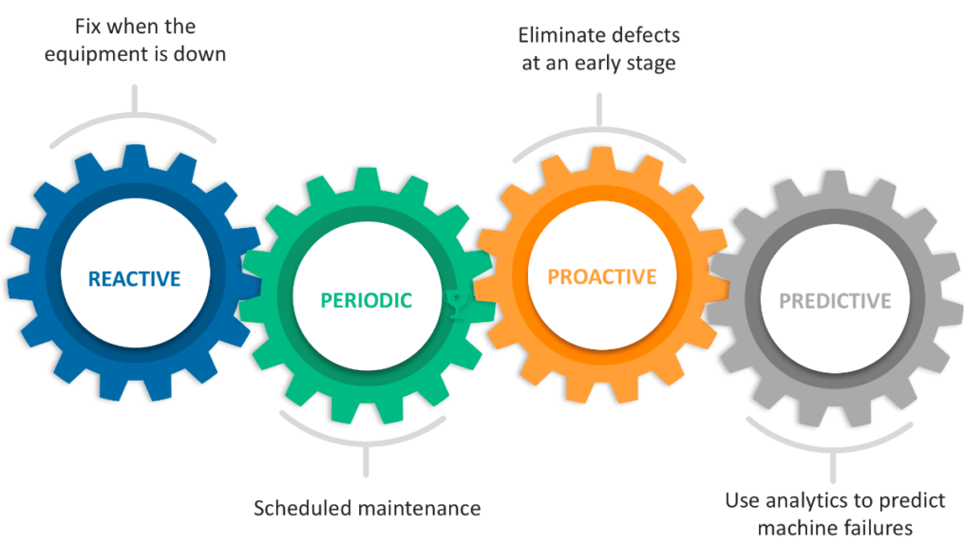
Maintenance management
Reactive maintenance:
Simple
Very high down time and cost of intervention
Safety concern
Preventive (Periodic) maintenance
Failures are usually prevented
Unnecessary corrective actions
Inefficient use of resources
Predictive maintenance
Enables timely pre-failure interventions
Increases productivity
Allows optimal planning of service interventions and spare part handling
Complexity and efficiency
Fig. 1 Types od maintenance
source: https://leanbi.ch/blog/predictive-maintenance-wie-starten/

Slide 3

Goal
Develop a machine learning model to predict the probability that a machine will fail due to a certain component within a specified time (48 hours)

Slide 4

About The Data
Four data sources
Telemetry data: Sensor data of voltage, rotation, pressure, vibration
Error :Errors encountered by the machines while in operating condition (5 types)
Maintenance: Historical maintenance records (4 components)
Machine: Machine information (model, type, age)
Failures: Each record represents replacement of a component due to failure
Microsoft Azure dataset
100 Machines
Hourly time series data for 1 year
876,100 records
https://www.kaggle.com/datasets/arnabbiswas1/microsoft-azure-predictive-maintenance

Slide 5
Steps to prediction
Exploratory data analysis (EDA)
Identify patterns, trends, and relationships among the variables in the data.
Feature engineering
Bringing the different data sources together to create features that best describe a machines' health condition
Lag features for long- and short-term dependencies
Rolling aggregate measures (mean, standard deviation)
Days since last replacement
Modeling
Multi class classification problem
4 component failures + No failure
A time window of 48 hrs
Select a suitable ML algorithm
Class imbalance problem
Evaluation
Find the appropriate metric
Recall (Sensitivity, True positive rate) is a good performance measure)

Slide 6

Exploratory Data Analysis

Slide 7
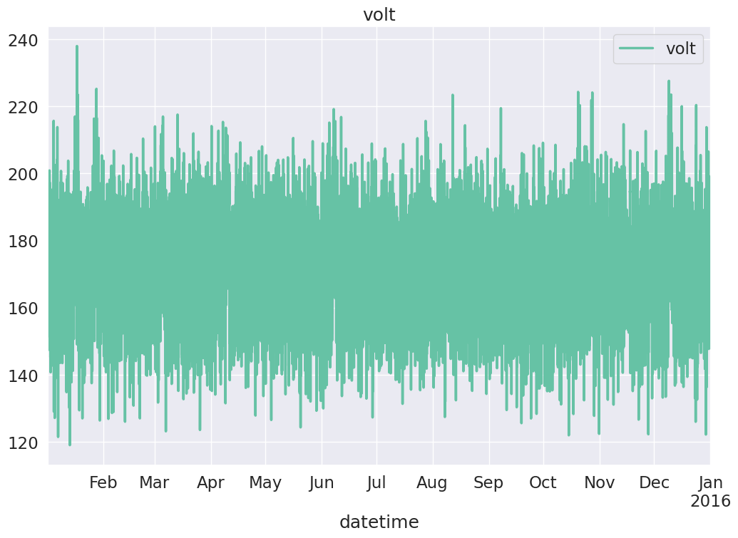
telemetry data
Telemetry data ranges from: 2015-01-01 06:00:00 to 2016-01-01 06:00:00
Total number of telemetry records: 876100
voltage, rotation, pressure, vibration
Fig. 2 Time series plot for machine id 1

Slide 8
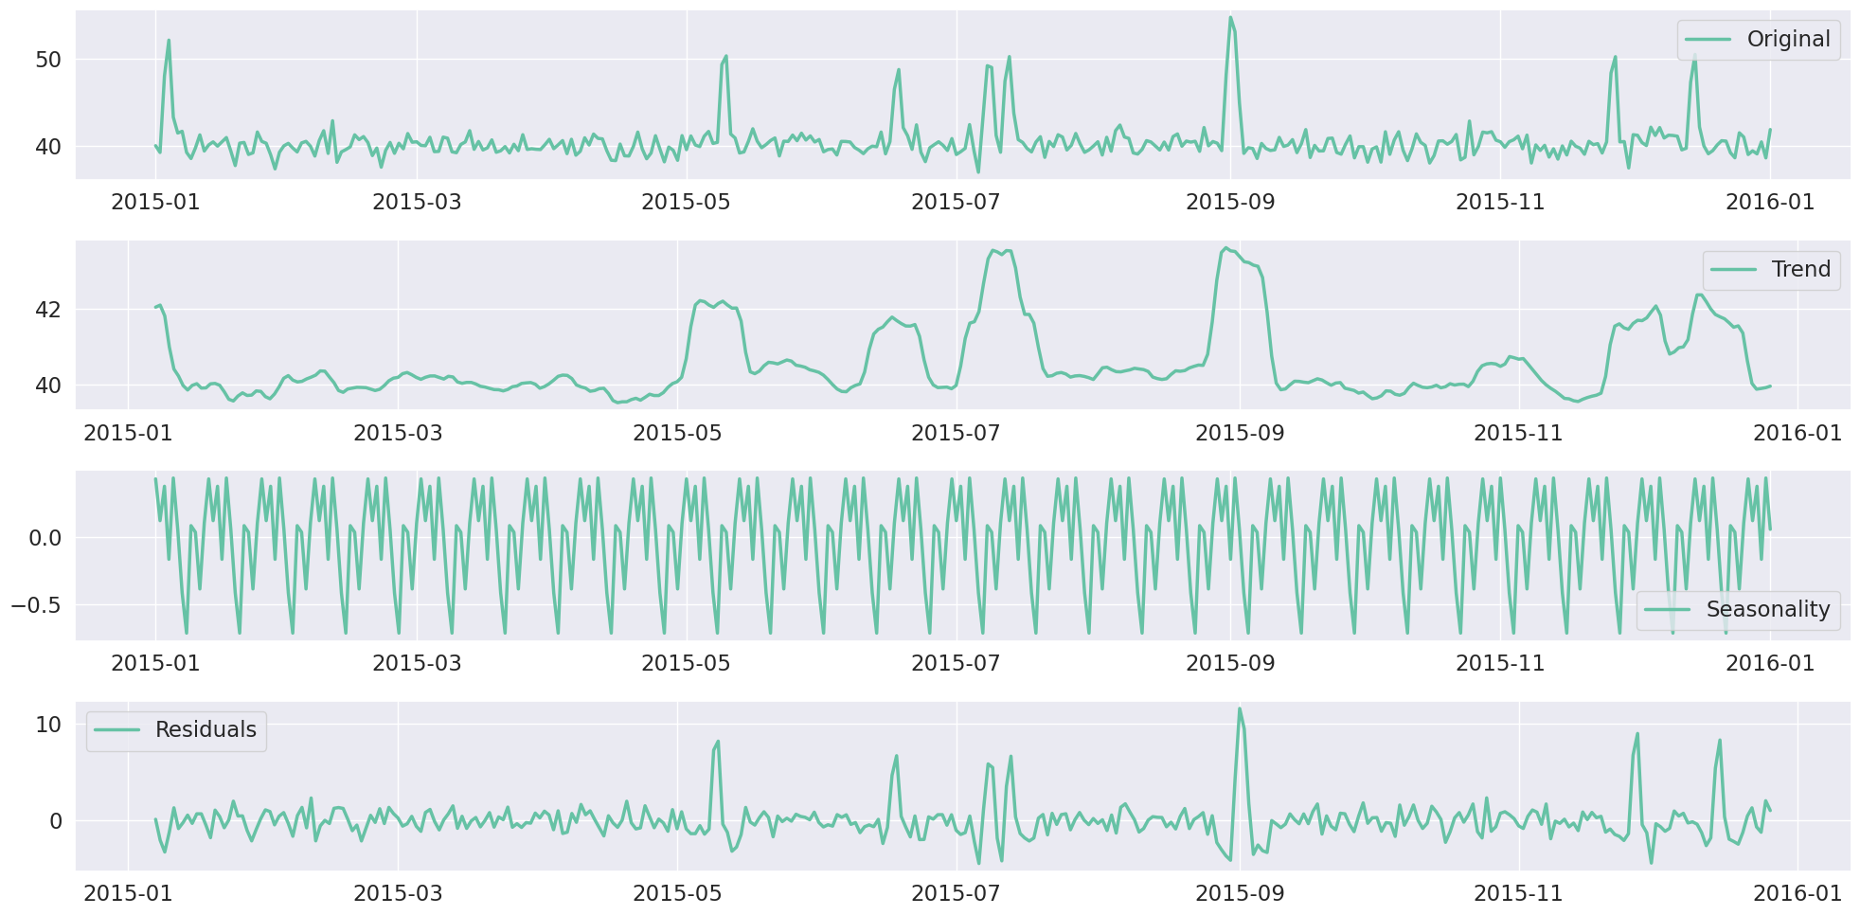
telemetry data: Timeseries decomposition
First 30 days
Observation
Peaks in the trend
Seasonality
Fig. 3 Timeseries decomposition of vibration

Slide 9
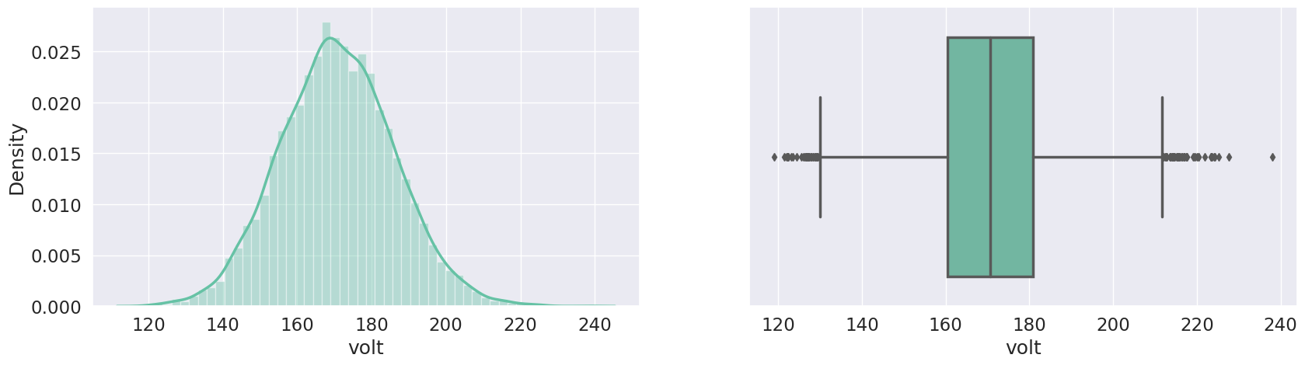
telemetry data: Distribution
Observation
No Missing values
No duplicates
There are a few spikes may be due to sensor malfunction
All telemetry variables have a normal distribution
There are a few outliers
Fig. 4 Histogram and box plot for voltage

Slide 10
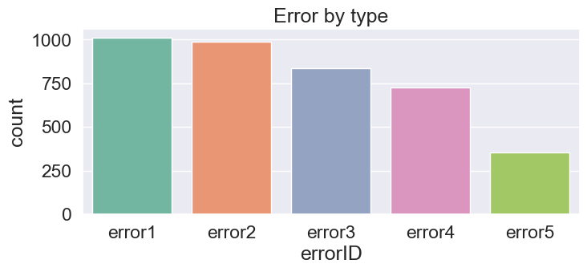
Error data
Observation
Error1 and error2 are the most common errors
Error5 is the least common
Fig. 5 Distribution of Error Types

Slide 11
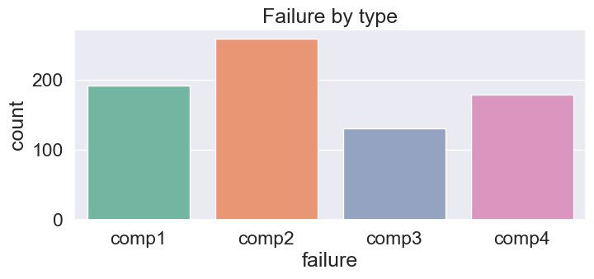
Failures DATA
Observation
Component 2 is the most frequently
Component 3 seems relatively stable
Fig. 6 Distribution of component failures

Slide 12
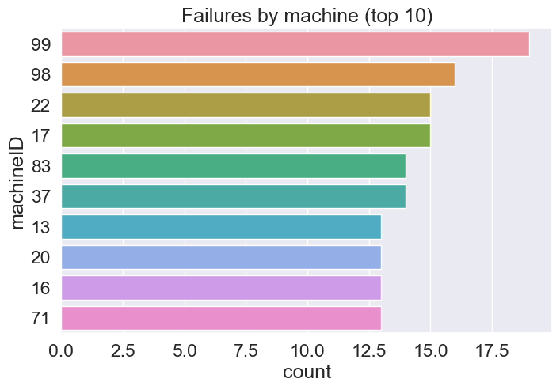
EXPLORTORY DATA ANALYSIS FAILURES DATA
Observation
Machine ID 99 with the most failure
Fig. 7 Top 10 machines with the most failures

Slide 13
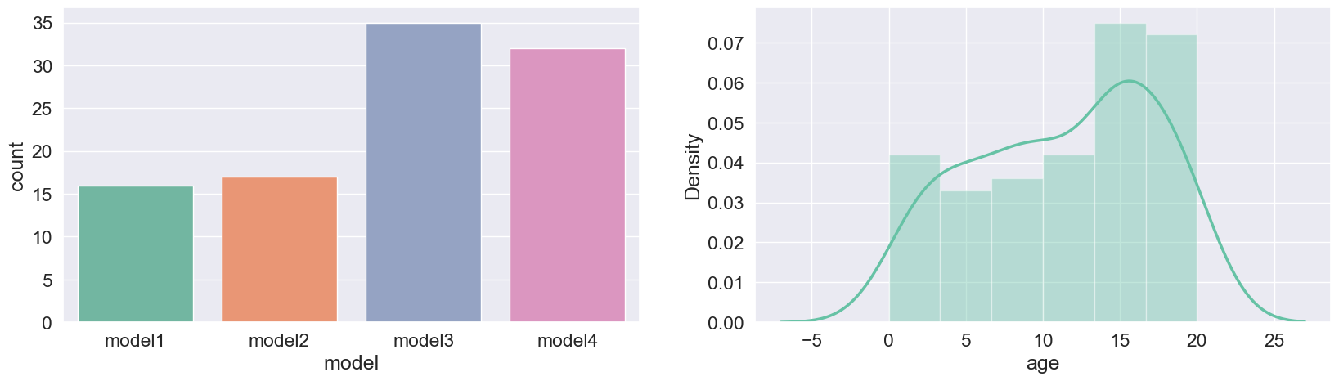
Machines metaData
Machine ID 99 with the most failure
Fig. 8 Machines model and age
Observation
More than 60 percent of the machines are of model 3 and 4
The age ranges from 0 to 20 years.

Slide 14

Feature engineering
create features that best describe a machines' health condition

Slide 15
LAG FEATURES FROM TELEMETRY
Create features using rolling mean and standard deviation
Selected window sizes for each of the telemetry variables
Short term dependencies: 4 hours
Long term dependencies: 48 hours

Slide 16
LAG FEATURES FROM ERRORS
Errors table
Errors are categorical
Count the number of errors of each type in a lagging window (48 hours)
datetime | Error
01.04.15 08:00 | error1
05.04.15 12:00 | error4
06.04.15 12:00 | error1
datetime | error1_48h_sum | error2_48h_sum | error3_48h_sum | error4_48h_sum | error5_48h_sum
01.04.15 06:00 | 0 | 0 | 0 | 0 | 0
02.04.15 07:00 | 0 | 0 | 0 | 0 | 0
03.04.15 08:00 | 1 | 0 | 0 | 0 | 0
04.04.15 09:00 | 1 | 0 | 0 | 0 | 0
05.04.15 10:00 | 1 | 0 | 0 | 0 | 0
06.04.15 11:00 | 1 | 0 | 0 | 0 | 0
07.04.15 12:00 | 2 | 0 | 0 | 1 | 0
08.04.15 13:00 | 2 | 0 | 0 | 1 | 0
09.04.15 14:00 | 2 | 0 | 0 | 1 | 0
10.04.15 15:00 | 2 | 0 | 0 | 1 | 0

Slide 17
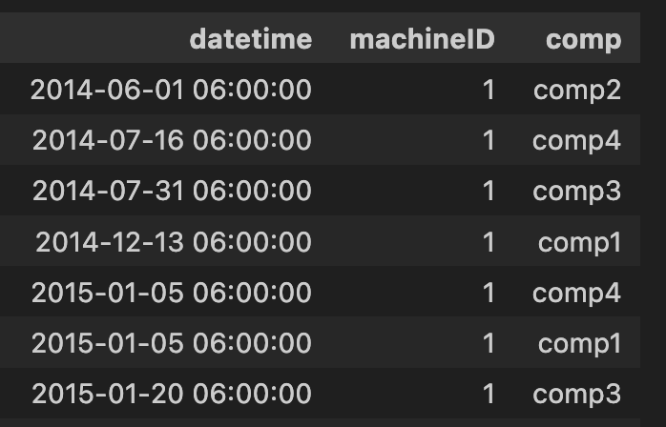
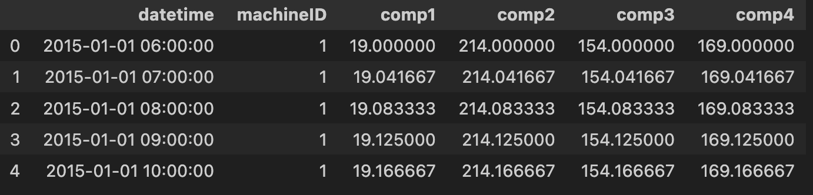
LAG FEATURES Maintenance
Maintainance table
Number of days since Last component replacement

Slide 18

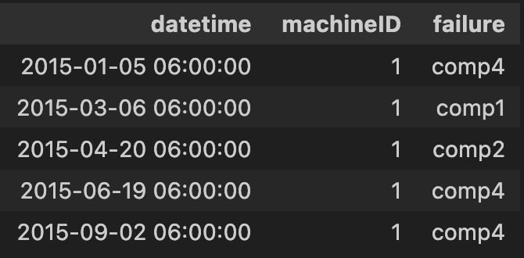
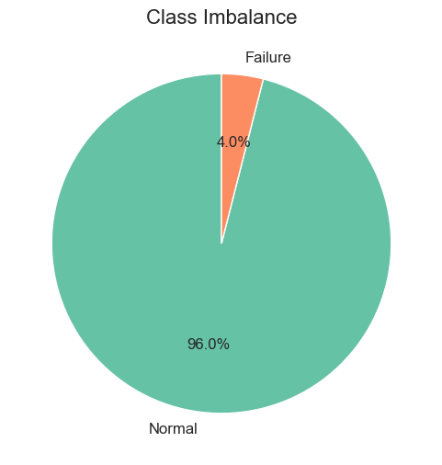
Target variable Construction
Failure data
Create a multi-class label with a 48h window
Possible classes
Normal, comp1, comp2, comp3, comp4
Fig. 11 Distribution of failures

Slide 19

Modeling anD EVALUATION
A multi-class classifier

Slide 20

Modelling and Evaluation
A multi-class classification problem
Dealing with class imbalance
Selecting the right algorithm
Selecting the right metrics
Hyperparameter optimization

