Slide 1

Exploratory Data Analysis
G2M Case Study
Name : XYZ Firm
Location: US
Team: Data Sciences
Date: 15-March-2021

Slide 2

Agenda
Executive Summary
Problem Statement
Approach
EDA
Recommendations

Slide 3
Overview–G2M(cab industry) case study
XYZ is a private firm in US. Due to remarkable growth in the Cab Industry in last few years and multiple key players in the market, it is planning for an investment in Cab industry.
Problem Statement :
We want to assist XYZ firm in identifying the right company for making investment.
Approach :
The analysis has been divided into the following steps:
1. Data Understanding
2. Forecasting profit
3. Recommendations

Slide 4
Data Understanding
- Four data sets were merged into a single file (master data).
- Timeframe of the data: 2016-01-08 to 2018-01-02
- Total data points: 359,392
Data Set :
1. Cab_Data.xlsx :
This file includes details of transaction for 2 cab companies.
: 2. Customer_ID.csv
This is a mapping table that contains a unique identifier which links the customer’s demographic details.
: 3. Transaction_ID.csv
This is a mapping table that contains transaction to customer mapping and payment mode.
4. City.csv :
This file contains list of US cities, their population and number of cab users.
City.csv
Cab_Data.xlsx.
Master_data.csv
Transaction_ID.csv
Customer_ID.csv

Slide 5
Data Understanding
Number of Rows and Columns
Derived Features
Capacity | Number of Column | Number of Rows | Data File Name
19.2+ MB | 7 | 359392 | Cab_Data.xlsx
1.5+ MB | 4 | 49171 | Customer_ID.csv
10.1+ MB | 3 | 440093 | Transaction_ID.csv
608.0+ bytes | 3 | 20 | City.csv
48.3+ MB | 18 | 359392 | Master_data.csv
File Name | Feature
Cab_Data.xlsx | Profit
 | Number of Travel
 | Year
 | Month
 | Day

Slide 6
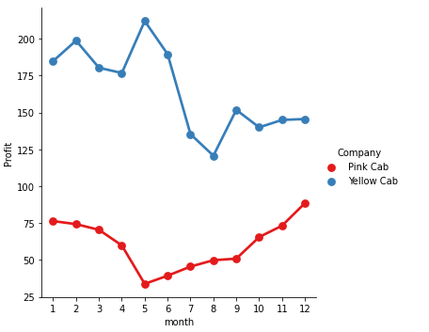
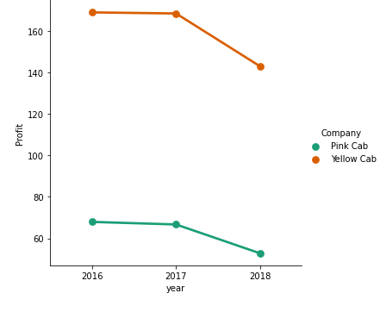
Profit Analysis
Monthly Profit for Both Cabs
Yearly Profit for Both Cabs
- Yellow cab achieved the highest profit on May, where pink the lowest.
- In 2017 both cabs achieved high profit.

Slide 7
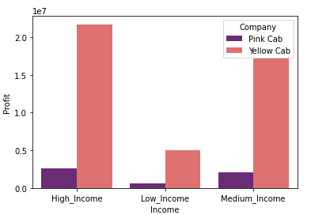
Profit Analysis Based on Customers’s Income
The highest profit come from customers those have high and medium income.
Most of customers prefer the yellow cab than the pink one.

Slide 8
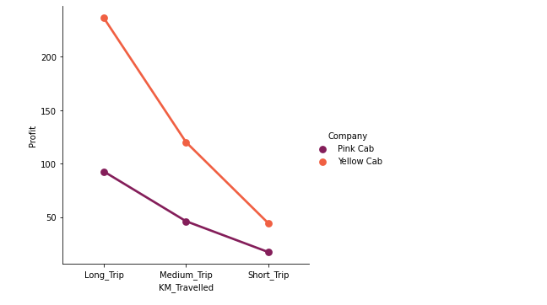
Average of Profit Based on 'KM_Travelled'
- The yellow cab profit in average is more than the double profit of pink.

Slide 9
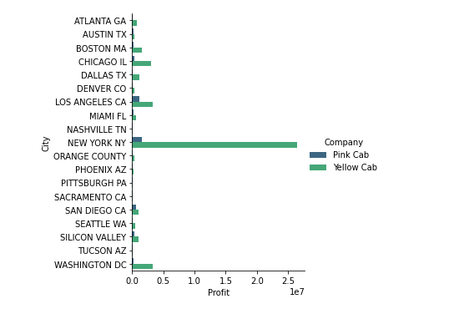
Profit by City
- Yellow cab has high profit in ‘NEW YORK NY’ city

Slide 10
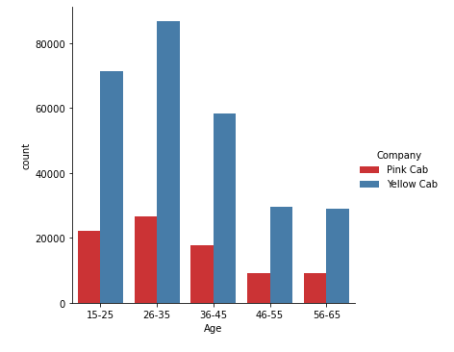
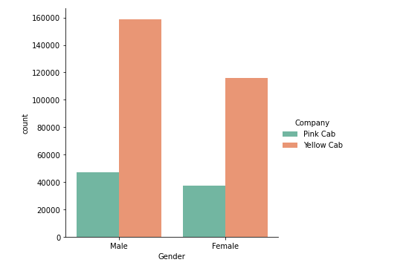
Age and Gender Analysis
- All ages prefer the yellow cab than the pink one.
- The yellow cab is extremely liked by both genders.

Slide 11
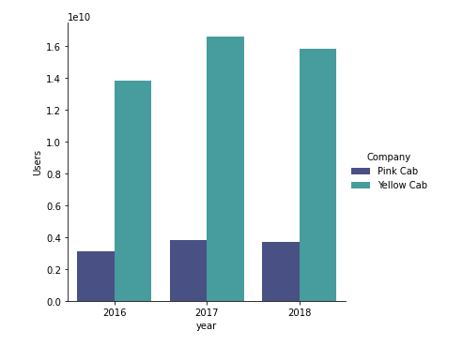
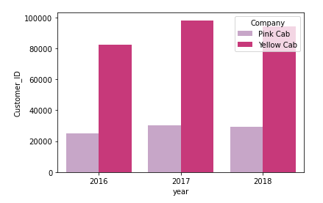
Users and Customers Covered by Company
- This is the number of users covered by yellow and pink cab during the three years.
- This is the number of customers covered by yellow and pink cab during the three years.

Slide 12
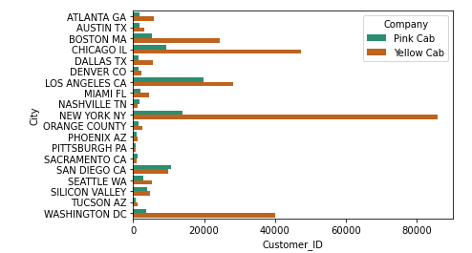
Customers Covered by Company in each City
- NEW YORK NY, CHICAGO IL and WASHINGTON DC have a bigger number of customers and they prefer a yellow cab.

Slide 13
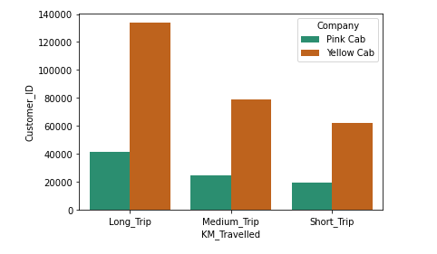
Number of Customers Based on Trip Distance
- Yellow cab has more customers than a pink cab on all trips.

Slide 14
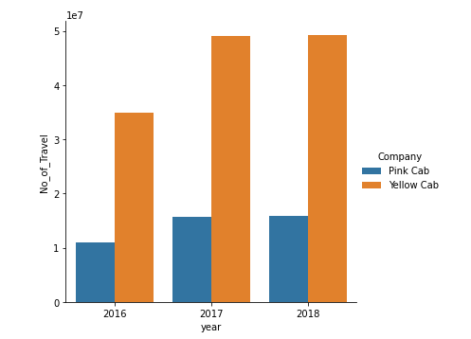
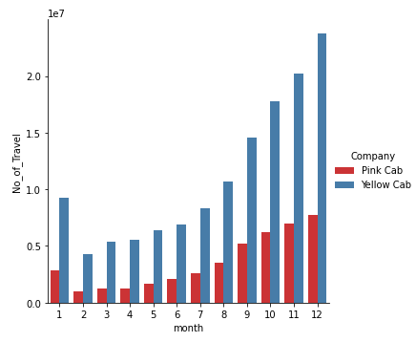
Number of Travels Analysis
Both pink and yellow cabs have been linearly increasing in the number of travels from February to December.
The number of travels for the yellow cab is extremely three times the number of travels for the pink cab.
This is the number of travels covered by yellow and pink cab during the three years.

Slide 15
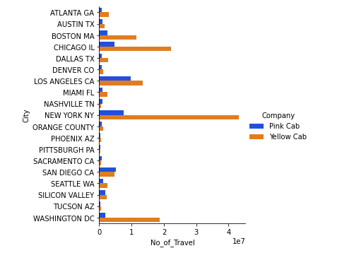
Number of Travels for Both Cabs by City
Yellow cab has more travels than the pink one in all cities.

Slide 16
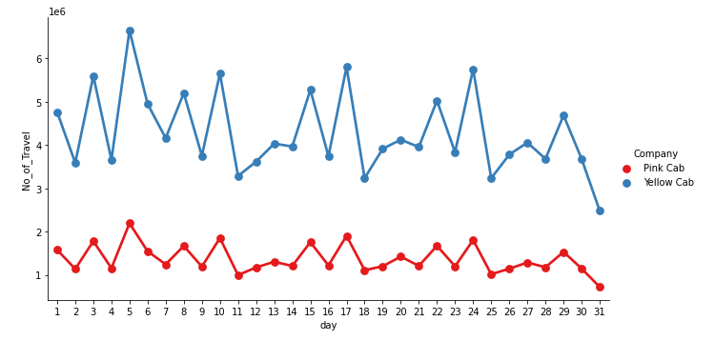
Seasonality in the Number of Travels
The peak number of travels on the beginning of the month, middle of the month and the end.

Slide 17
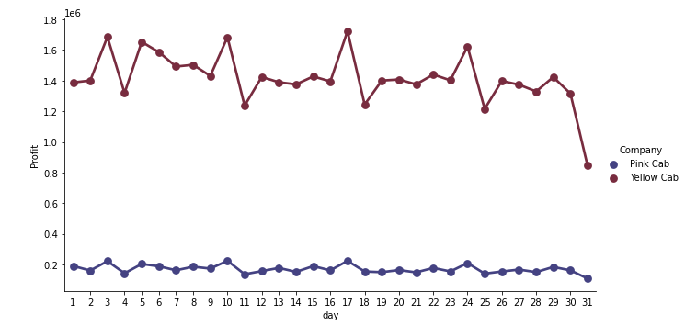
Seasonality in the Profit
The peak profit occur with in four time of the month (3rd, 10th, 17th and 24th) for both cabs.

Slide 18
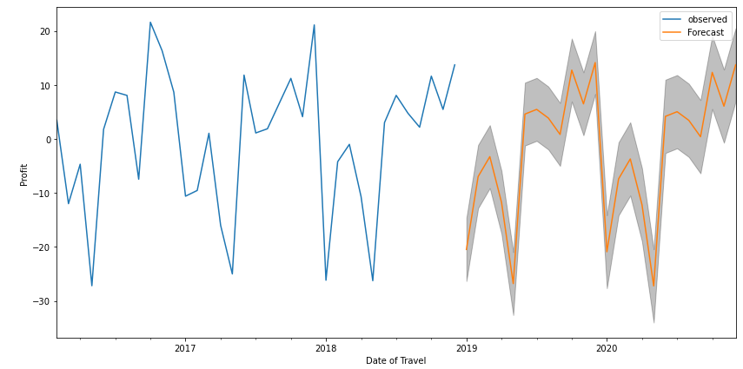
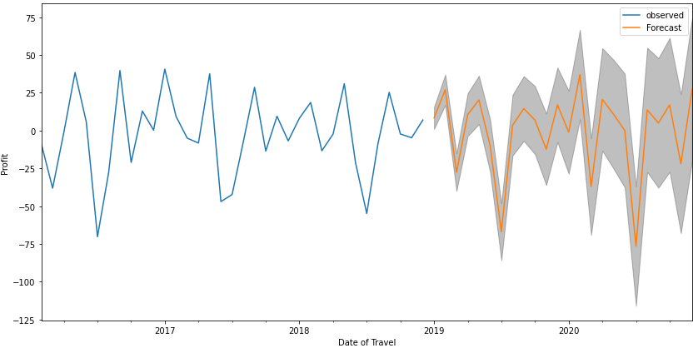
Profit Forecasting for Two Years (2019, 2020)
Pink Cab
Yellow Cab

Slide 19
Recommendations
After evaluation of both cabs the yellow one was found better than the pink one, below are some points the comparison depended on:
1. Users Number : The users number of yellow cab is greater than that for pink cab.
2. Customers Covered by Company : The Customers number of yellow cab is greater than that for pink cab.
3. Number of Travels : The yellow cab has more travels than the pink cab.
4. Age of Customers : All ages prefer the yellow cab than the pink one.
5. Gender of Customers : The yellow cab is extremely liked by both genders.
6. Average Profit per KM: The yellow cab profit in average is more than the double profit of pink.
7. Profit per Income : The high and medium income users prefer the yellow cab.
8. Profit Forecasting : After forecasting the profit loss the pink cab got less loss than yellow one.
Depending on the above comparison we found that the yellow cab is better than the pink cab.

Slide 20
Thank You

