Slide 1
HEAPSORT
Prepared By
Shahla Farzana (SHF)

Slide 2
Special Types of Trees
Def: Full binary tree = a binary tree in which each node is either a leaf or has degree exactly 2.
Def: Complete binary tree = a binary tree in which all leaves are on the same level and all internal nodes have degree 2.
4
1
3
2
16
9
10
14
8
7
12
Full binary tree
4
1
3
2
16
9
10
Complete binary tree

Slide 3
Definitions
Height of a node = the number of edges on the longest simple path from the node down to a leaf
Level of a node = the length of a path from the root to the node
Height of tree = height of root node
4
Height of root = 3
1
3
Height of (2)= 1
2
16
9
10
Level of (10)= 2
14
8

Slide 4
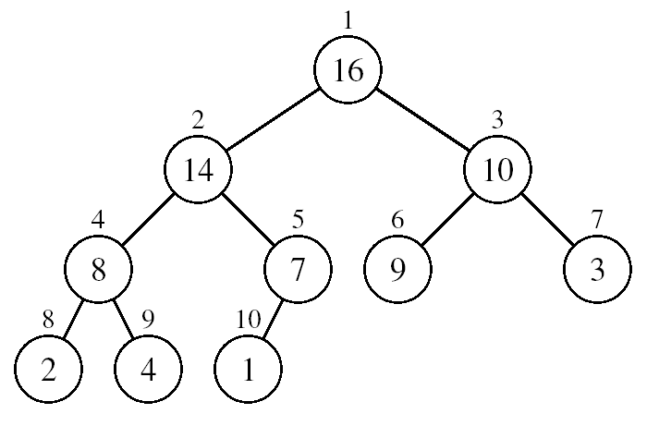
Useful Properties

Slide 5
The Heap Data Structure
Def: A heap is a nearly complete binary tree with the following two properties:
Structural property: all levels are full, except possibly the last one, which is filled from left to right
Order (heap) property: for any node x
Parent(x) ≥ x
From the heap property, it follows that:
“The root is the maximum
element of the heap!”
8
7
4
5
2
Heap
A heap is a binary tree that is filled in order

Slide 6
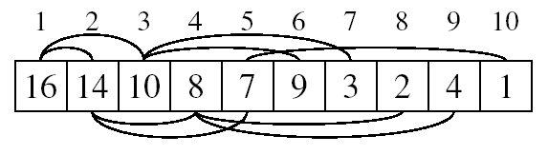
Array Representation of Heaps
A heap can be stored as an array A.
Root of tree is A[1]
Left child of A[i] = A[2i]
Right child of A[i] = A[2i + 1]
Parent of A[i] = A[ ⎣i/2⎦ ]
Heapsize[A] ≤ length[A]
The elements in the subarray A[(⎣n/2⎦+1) .. n] are leaves

Slide 7
Heap Types
Max-heaps (largest element at root), have the max-heap property:
for all nodes i, excluding the root:
A[PARENT(i)] ≥ A[i]
Min-heaps (smallest element at root), have the min-heap property:
for all nodes i, excluding the root:
A[PARENT(i)] ≤ A[i]

Slide 8
Operations on Heaps
Maintain/Restore the max-heap property
MAX-HEAPIFY
Create a max-heap from an unordered array
BUILD-MAX-HEAP
Sort an array in place
HEAPSORT
Priority queues

Slide 9
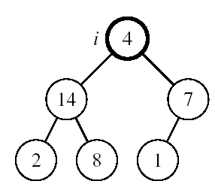
Maintaining the Heap Property
Suppose a node is smaller than a child
Left and Right subtrees of i are max-heaps
To eliminate the violation:
Exchange with larger child
Move down the tree
Continue until node is not smaller than children

Slide 10
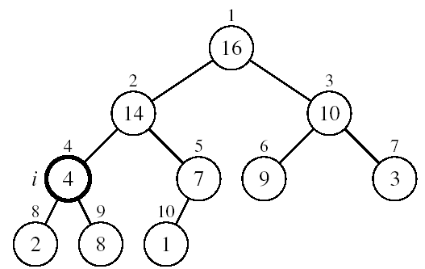
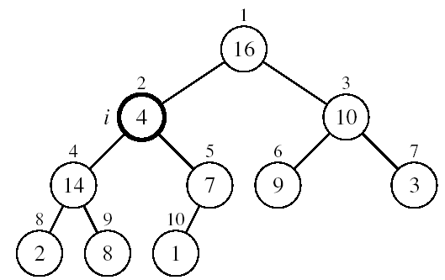
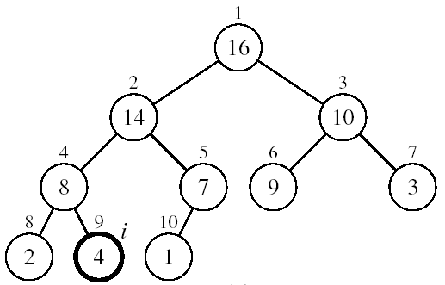
Example
MAX-HEAPIFY(A, 2, 10)
A[2] ↔ A[4]
A[2] violates the heap property
A[4] violates the heap property
A[4] ↔ A[9]
Heap property restored

Slide 11
Maintaining the Heap Property
Alg: MAX-HEAPIFY(A, i, n)
l ← LEFT(i)
r ← RIGHT(i)
if l ≤ n and A[l] > A[i]
then largest ←l
else largest ←i
if r ≤ n and A[r] > A[largest]
then largest ←r
if largest ≠ i
then exchange A[i] ↔ A[largest]
MAX-HEAPIFY(A, largest, n)
Assumptions:
Left and Right subtrees of i are max-heaps
A[i] may be smaller than its children

Slide 12
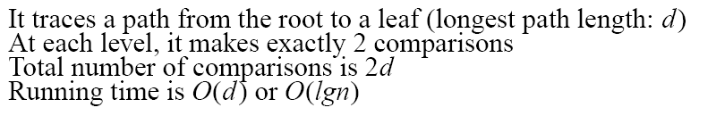
MAX-HEAPIFY Running Time
Intuitively:
Running time of MAX-HEAPIFY is O(lgn)
Can be written in terms of the height of the heap, as being O(h)
Since the height of the heap is ⎣lgn⎦
-
h
-
-
-
2h
O(h)

Slide 13
Building a Heap
Convert an array A[1 … n] into a max-heap (n = length[A])
The elements in the subarray A[(⎣n/2⎦+1) .. n] are leaves
Apply MAX-HEAPIFY on elements between 1 and ⎣n/2⎦
Alg: BUILD-MAX-HEAP(A)
n = length[A]
for i ← ⎣n/2⎦ downto 1
do MAX-HEAPIFY(A, i, n)
1
4
2
3
1
3
4
5
6
7
2
16
9
10
8
9
10
14
8
7
A:
4 | 1 | 3 | 2 | 16 | 9 | 10 | 14 | 8 | 7

Slide 14
Example: A
4 | 1 | 3 | 2 | 16 | 9 | 10 | 14 | 8 | 7
i = 5
i = 4
i = 3
1
1
1
4
4
4
2
3
2
3
2
3
1
3
1
3
1
3
4
5
6
7
4
5
6
7
4
5
6
7
2
16
9
10
2
16
9
10
14
16
9
10
8
9
10
8
9
10
8
9
10
14
8
7
14
8
7
2
8
7
i = 2
i = 1
1
1
1
4
4
16
2
3
2
3
2
3
1
10
16
10
14
10
4
5
6
7
4
5
6
7
4
5
6
7
14
16
9
3
14
7
9
3
8
7
9
3
8
9
10
8
9
10
8
9
10
2
8
7
2
8
1
2
4
1

Slide 15
Running Time of BUILD MAX HEAP
Alg: BUILD-MAX-HEAP(A)
n = length[A]
for i ← ⎣n/2⎦ downto 1
do MAX-HEAPIFY(A, i, n)
O(n)
O(lgn)
⇒ Running time: O(nlgn)
This is not an asymptotically tight upper bound
Running time of BUILD-MAX-HEAP= O(n)

Slide 16
Alg: HEAPSORT(A)
BUILD-MAX-HEAP(A)
for i ← length[A] downto 2
do exchange A[1] ↔ A[i]
MAX-HEAPIFY(A, 1, i - 1)
O(n)
n-1 times
O(lgn)

