Slide 1
Trello Timeline
Each slide in this PowerPoint shows a snapshot of when tasks were marked as complete on Trello. The notes reveal the time each change was made (a change could refer to a new task added or the completion of tasks).
Note that some tasks may not have been reported on Trello.
Notes:
By Mohammed Aminoor Rhaman

Slide 2
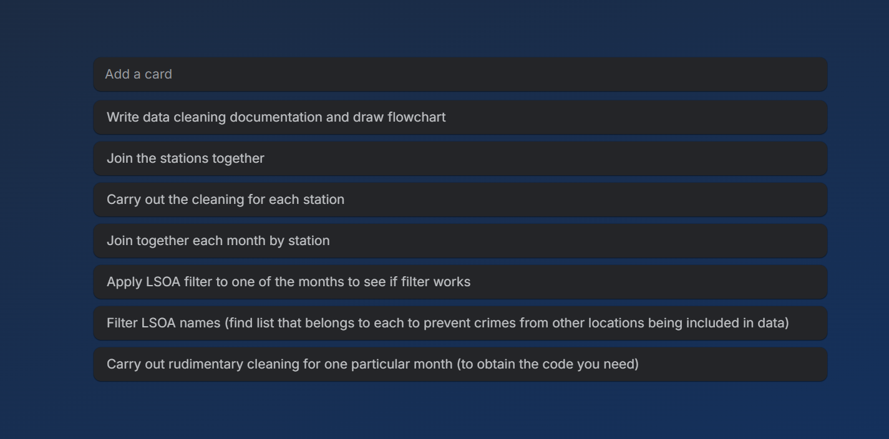
Notes:
Trello created 6/11/25, 2:07PM

Slide 3
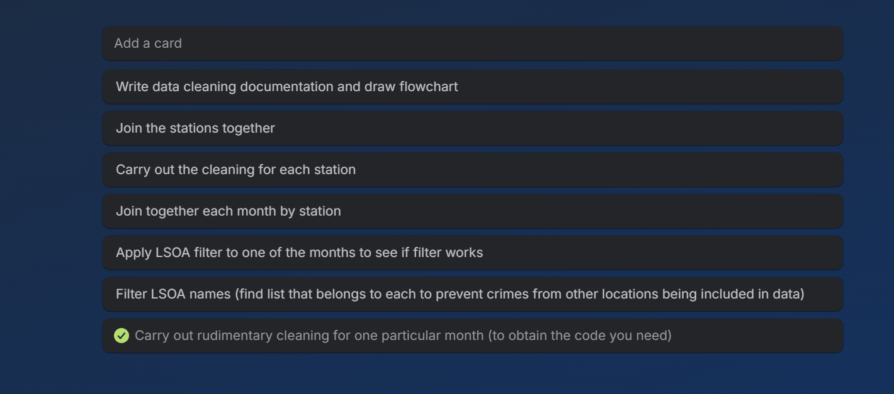
Notes:
7/11/25, 10:16AM

Slide 4
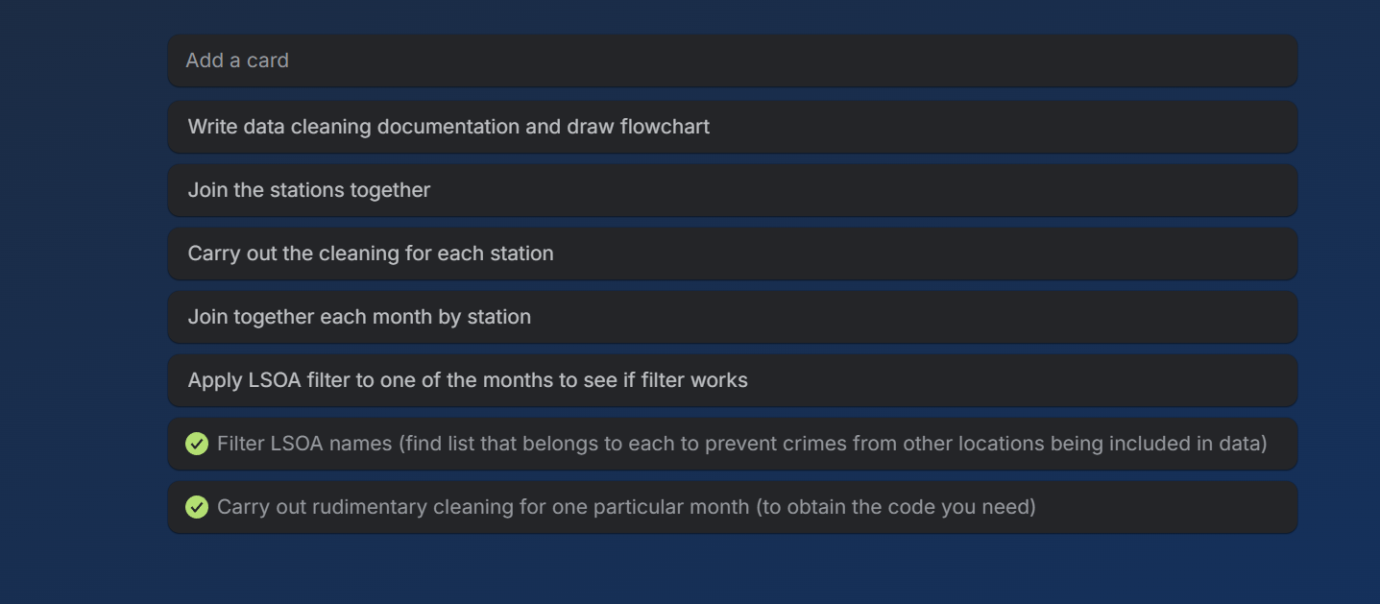
Notes:
‎07 ‎November ‎2025, ‏‎11:20:20

Slide 5
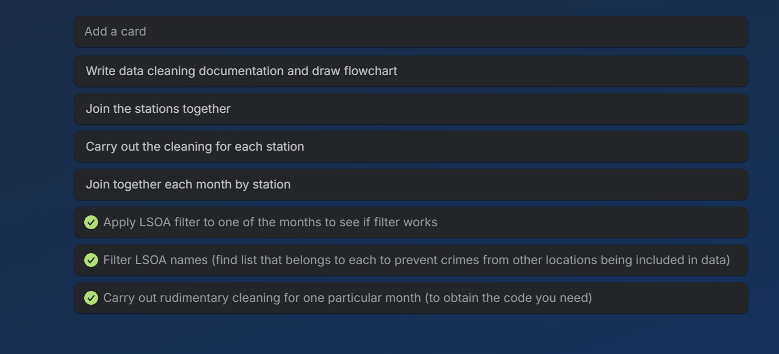
Notes:
‎07 ‎November ‎2025, ‏‎11:39:33

Slide 6
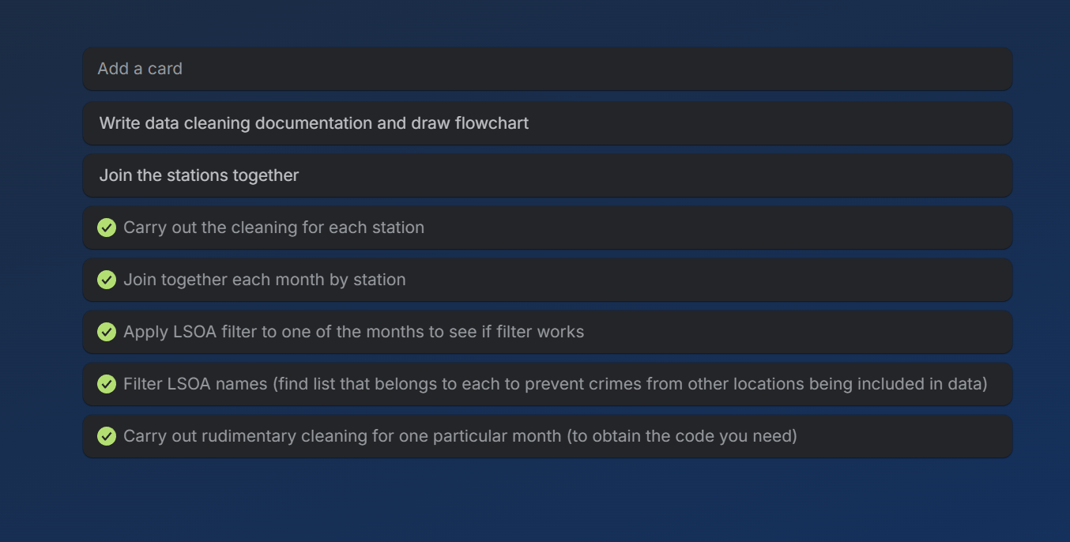
Notes:
‎07 ‎November ‎2025, ‏‎15:14:26

Slide 7
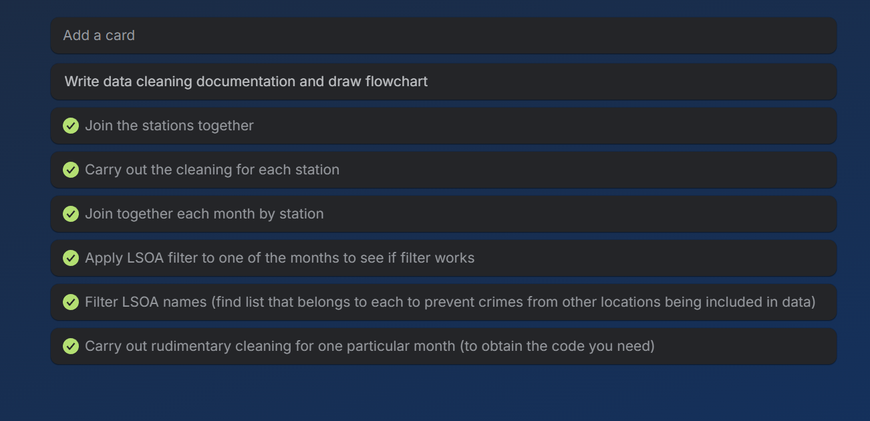
Notes:
‎07 ‎November ‎2025, ‏‎15:28:04

Slide 8
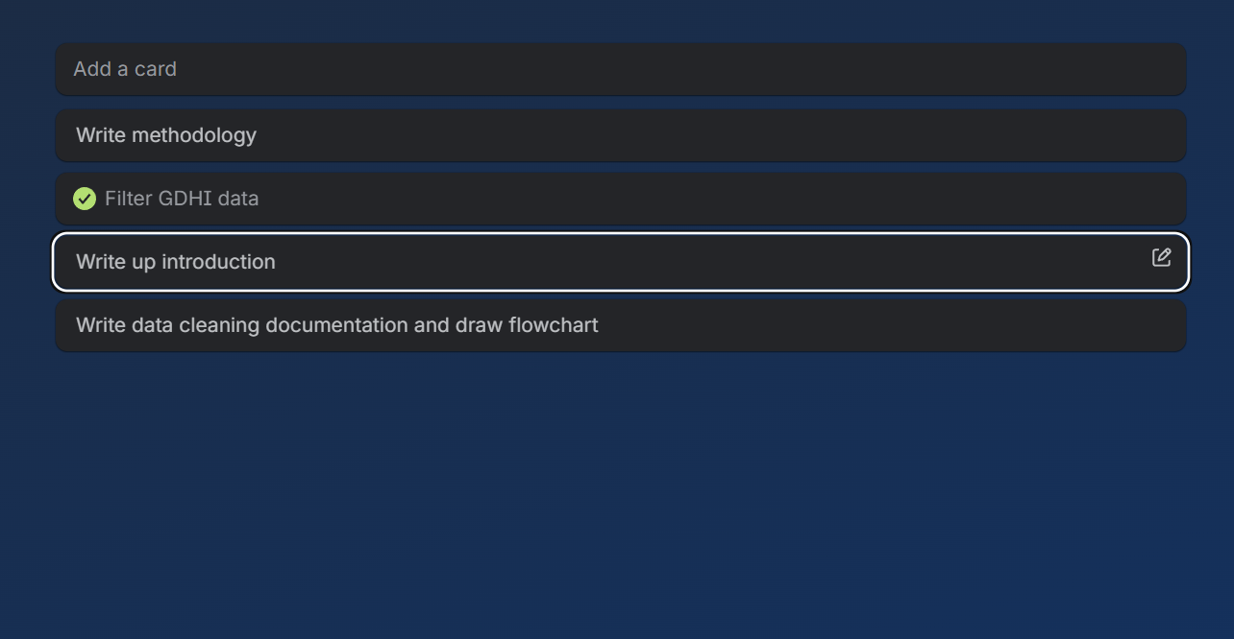
Notes:
‎08 ‎November ‎2025, ‏‎19:54:34

Slide 9
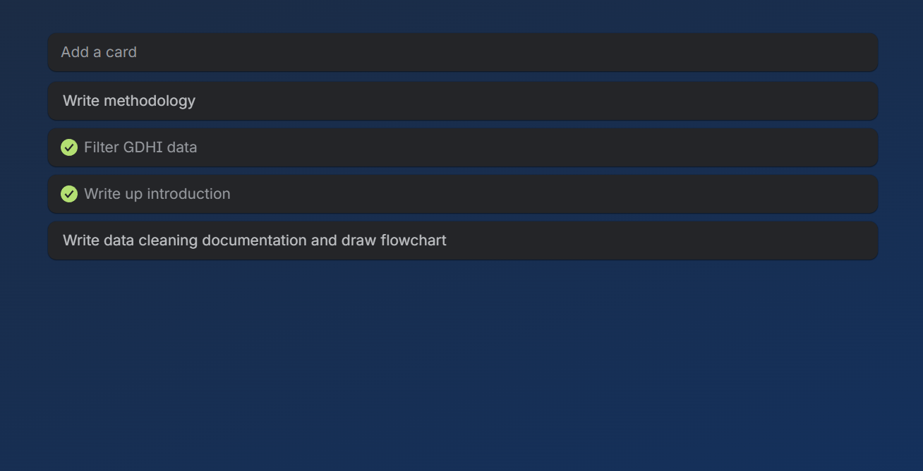
Notes:
‎09 ‎November ‎2025, ‏‎09:54:51

Slide 10
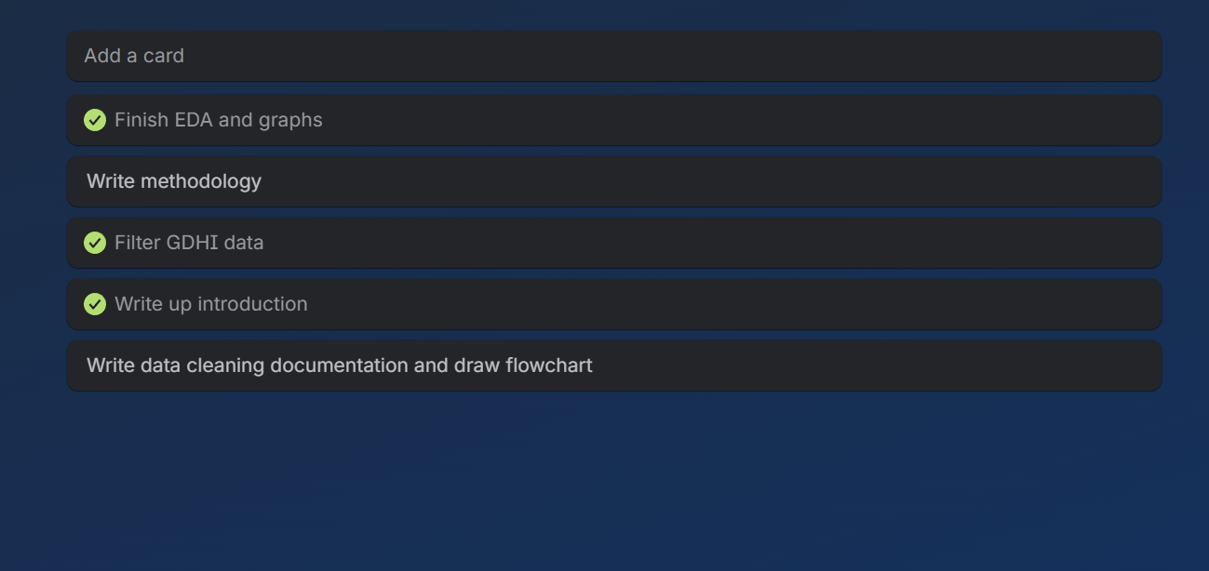
Notes:
‎10 ‎November ‎2025, ‏‎03:19:39

Slide 11
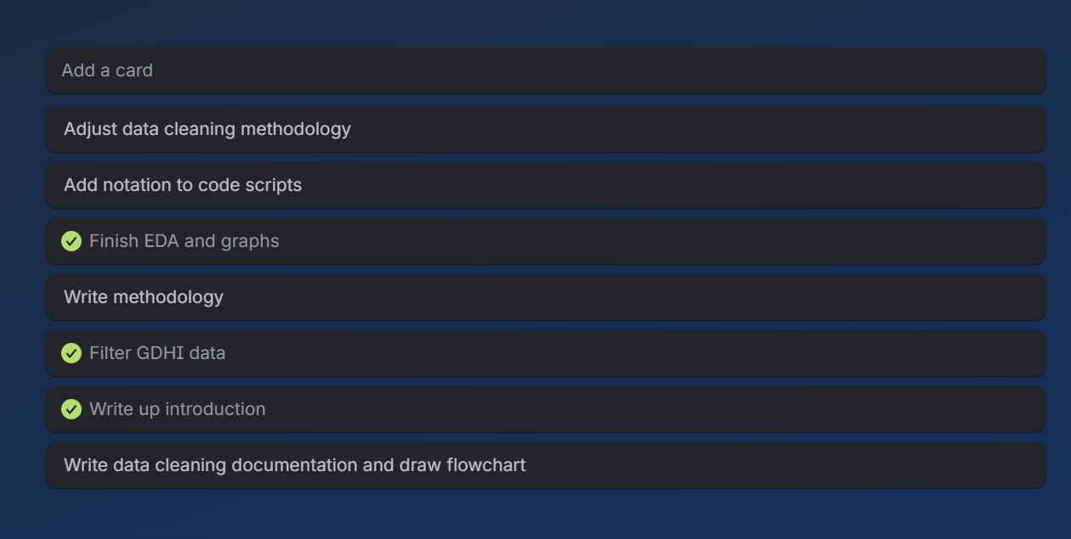
Notes:
‎10 ‎November ‎2025, ‏‎03:20:31

Slide 12
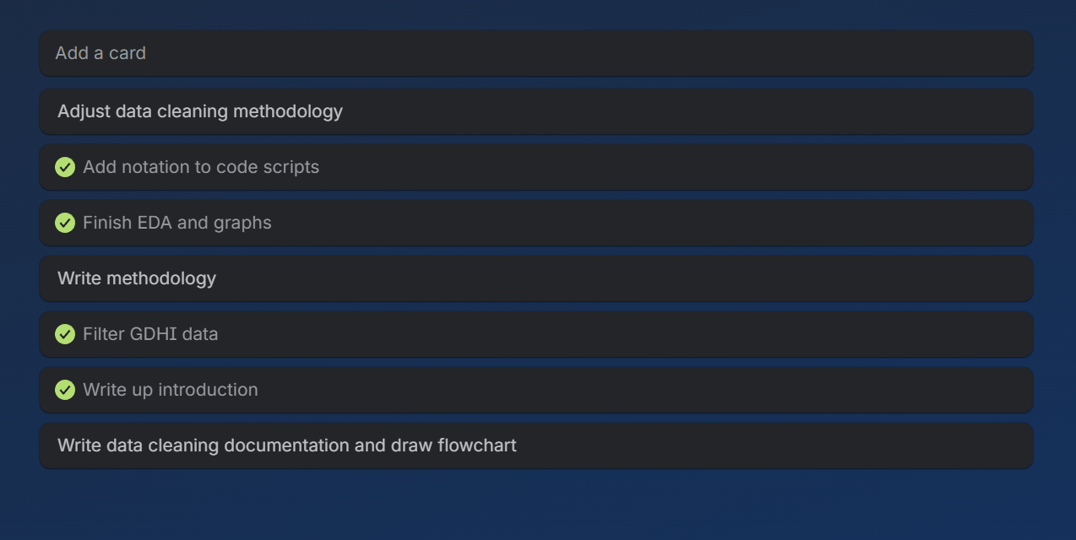
Notes:
‎10 ‎November ‎2025, ‏‎14:14:02

Slide 13
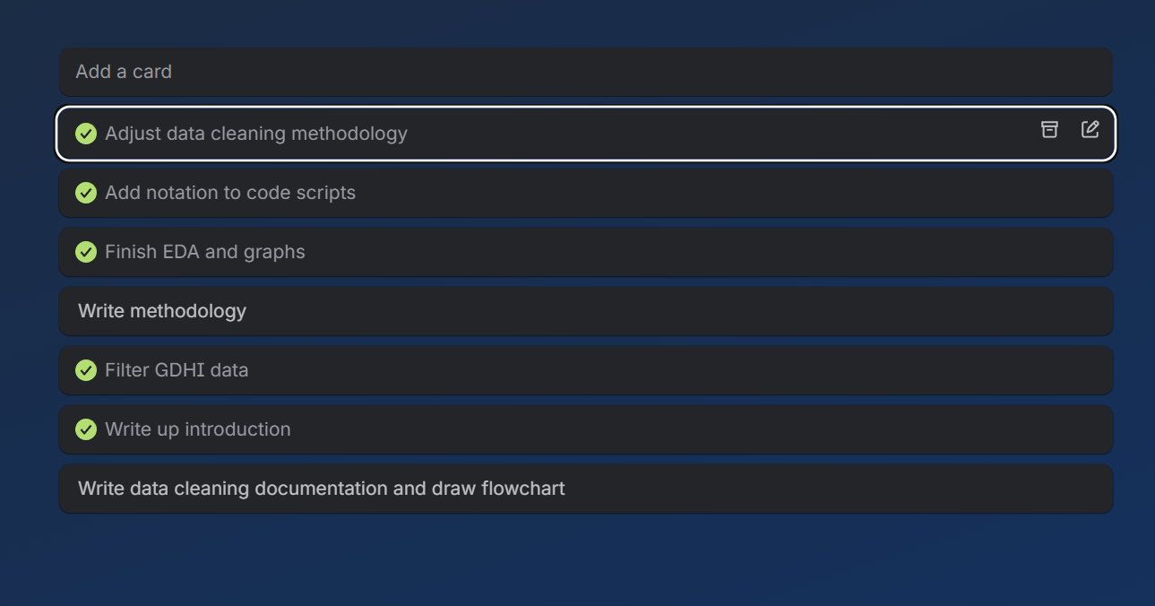
Notes:
‎10 ‎November ‎2025, ‏‎14:15:31

Slide 14
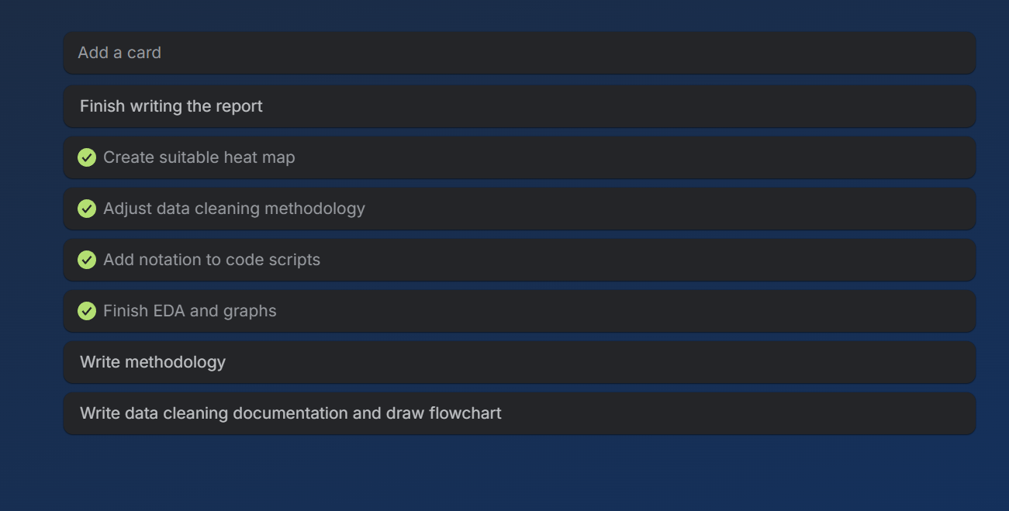
Notes:
‎10 ‎November ‎2025, ‏‎18:02:43

Slide 15
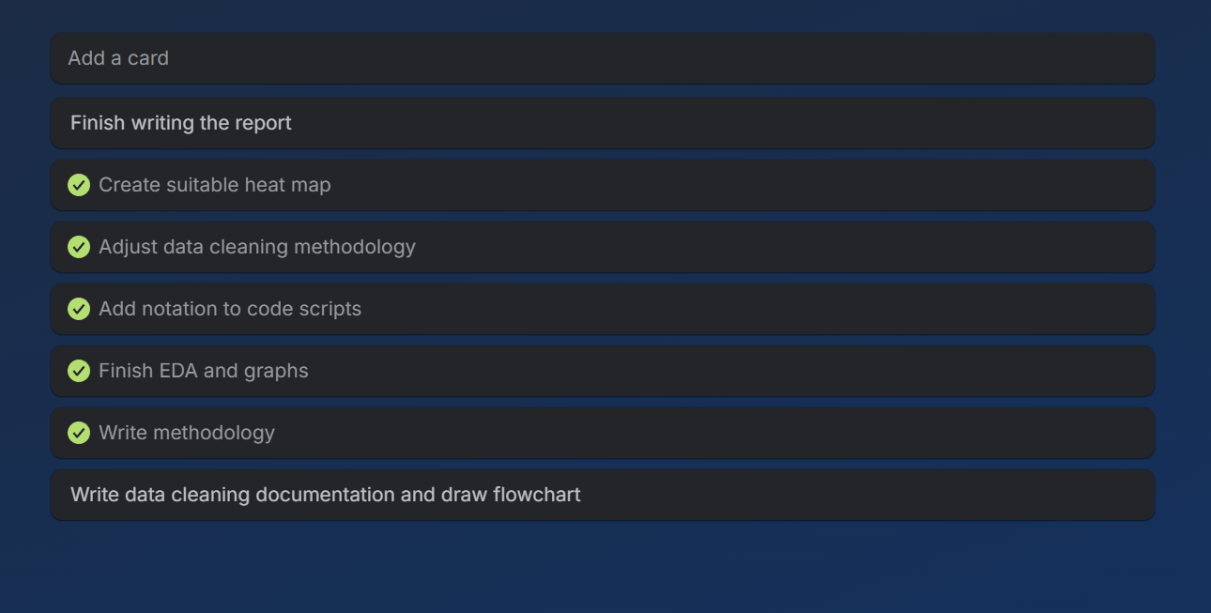
Notes:
‎10 ‎November ‎2025, ‏‎19:22:20

Slide 16
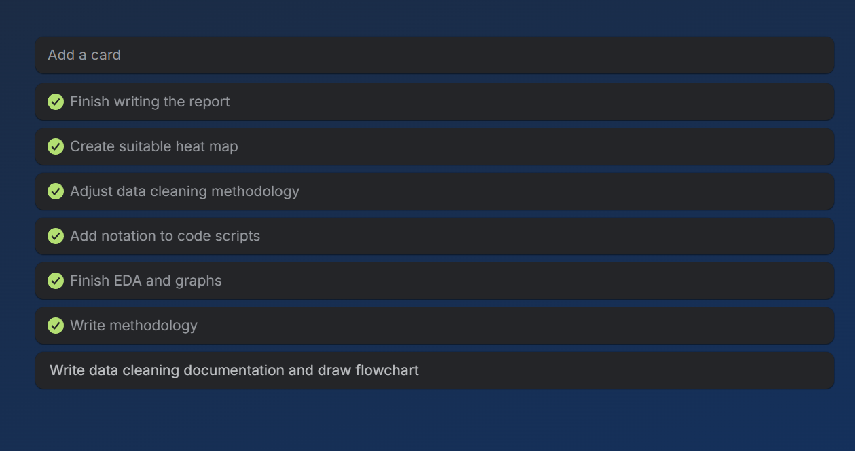
Notes:
‎10 ‎November ‎2025, ‏‎22:25:19

Slide 17
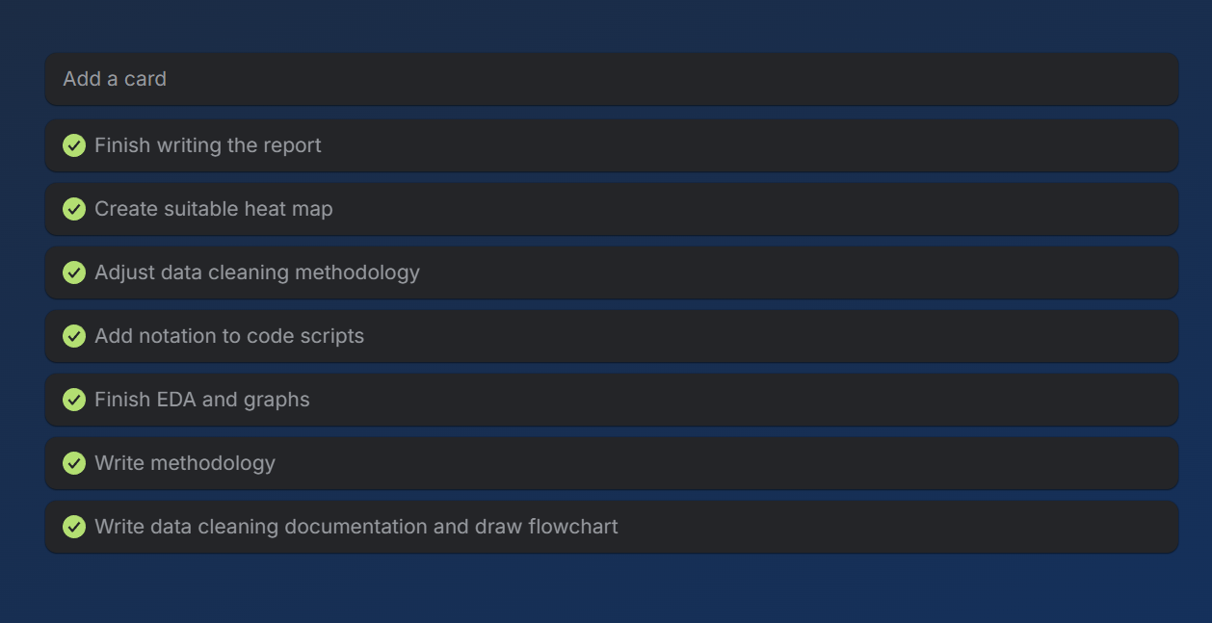
Notes:
‎10 ‎November ‎2025, ‏‎23:11:33

