Slide 1
SEG UFP Project 2 Trainee: Antara Rahman Project Start/ End date: September 11th,2024 to October 15th,2024 Mentor: Jordan Cantillano
Notes:
-Welcome
-presenting on first project for new hire training

Slide 2
Agenda
Project Overview
Test Block Overview
Test Process and Data log Results
Test Analysis – Test Time Report and Repeatability
Challenges
Project Schedule – Excepted vs. Actual
Skill Assessment – Before vs. After
Effectiveness of Project 2
Thank you!
Q&A
Notes:
No more than an hour of your time
Agenda points
-brief overview of project and test block
-process and results for each test
-how I went about analyzing the results
-challenges and effectiveness of the project
I want to leave some time for a q&A and get feedback
Pressing questions? Don’t hesitate to interrupt me

Slide 3
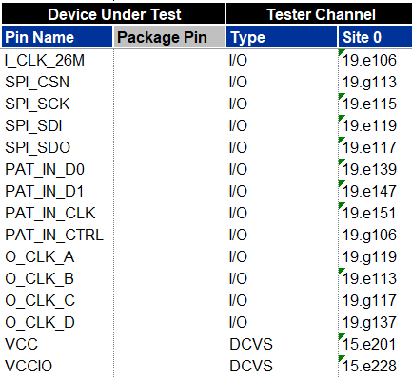
Project Overview
Background Knowledge:
The FPGA used for this project is the same as the first mini project, but with a different setup to account for 3 different modes
SPI: Serial Peripheral Interface
IDD: checking the current in power pins under unique conditions
PLL: Phase-Locked Loop
Notes:
-FPGA set to i8243 mode
-to simulate a device previously used for digital programming training
Main thing to remember is
-input/output expander
2 control pins (prog and chip select)
2 power pins (vcc and vccio), need to drive both to power up device
SPI: Serial Peripheral Interface. It’s a synchronous serial communication protocol used for short-distance communication, primarily in embedded systems1.
IDD: Intellectual and Developmental Disabilities. This term refers to a group of conditions that begin during the developmental period and typically continue throughout a person’s life2.
PLL: Phase-Locked Loop. It’s a control system that generates an output signal whose phase is related to the phase of an input signal, commonly used in radio, telecommunications, and other electronic applications

Slide 4
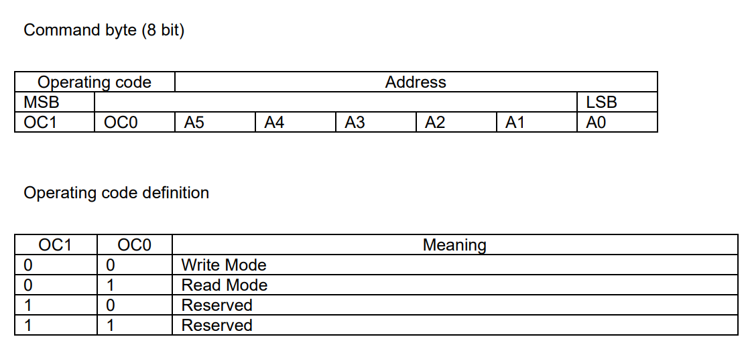
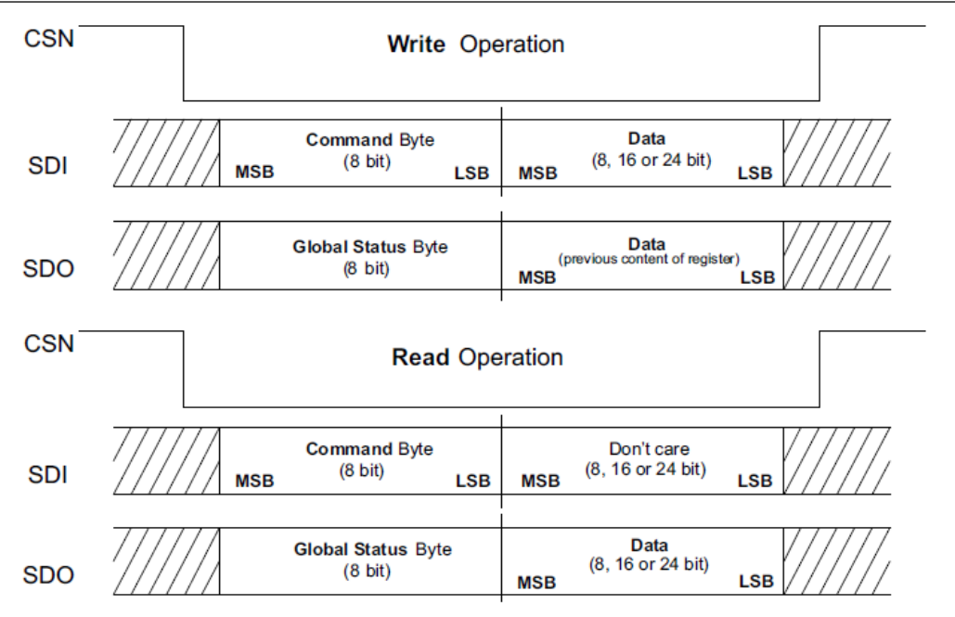
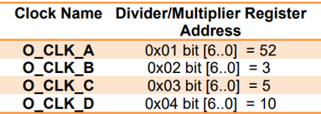
Test Block Introduction
Power Requirements: The simulated Intel 8243 requires two power supplies: VCC = 1.8V and VCCIO = 3.3V. A select few tests require VCCIO to be 3 V.
Write Mode: To write to the SPI output pin SDO, the operation code (op-code) for “write mode” should be placed in the Most Significant Bit (MSB) of the command byte, followed by the address of the register to be modified.
Read Mode: Similarly, the (op-code) for “read mode” should be placed in the MSB of the command byte, followed by the register adress. During this process, the “data” field can be filled with “don’t cares (X)” since no data is being written.
SPI for Data Transmission: For SPI data transmission, SDI and SDO handle data input and output, while CSN (Chip Select) must be low to enable communication.
SPI Communication for PLL Tests: The device features a test mode that enables four PLL output clocks to fan out to pins which helps with frequency measurements and trimming. This mode is controlled via the test mode register at address 0x0B.
Notes:
-some crucial diagrams and tables from the datasheet
-command bytes are 8 bits
-for both read/write operations, we also need to have a clock which isn’t shown here
-op codes and the registers we will use to access the PLL output clocks
Points to note
-both vcc and vccio needs to be driven,for IDD tests we use 3V for VCCIO
-Additionally, SCLK (Serial Clock) provides the necessary synchronous clock signal for timing. This setup ensures efficient data exchange
-For both read and write, It is crucial to monitor the values of CSN and SCLK
-Access to the output clocks will be achieved through the SPI pins to allow for modifications and frequency tests.

Slide 5
Test Process and Data log Results
For each mode, we will over the process and expected results. The tests discussed today are as follows:
SPI tests
SPI fixed pattern reading
SPI full read using DSSC
SPI full read (nWire)
SPI write DSSC
SPI write nWire
IDD tests
Sleep IDD
IDD Profile
Static IDD
IDDQ
Dynamic IDD
PLL tests
PLL CLK Meas (Freq Counter)
PLL CLK Meas (DSSC)
PLL Freq trim

Slide 6
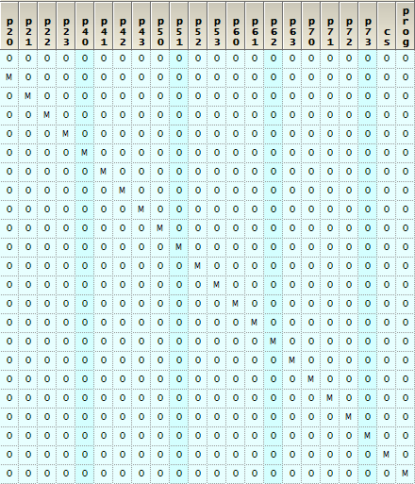
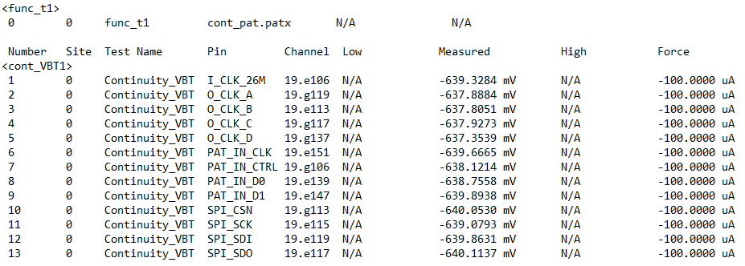
Test Process and Data log Results Continuity Test Time Follow Up
Example of Pattern
Continuity Test w Pattern | Parametric Continuity Test
1. Ground all pins and sequentially set each test pin to a high-impedance (Hi-Z) state using the pattern. | 1. Force 0V through power pins and set PinPMU current value to -100µA.
2. Program dynamic loads and test current for all pins. | 2. Set a current range and test current flowing through all pins.
3. Assess time required for both tests to draw conclusion on efficiency.
Sequentially setting each pin to Hi-Z using M to compare midband
Conclusion: No significant difference in test time was observed for continuity tests, although a longer more complex pattern may results in longer test time.
Notes:
-pin under test set to M for Hi-Z state and comparing purposes
-all the other pins grounded
-however, it is understood that a longer pattern will result in extended test durations.

Slide 7
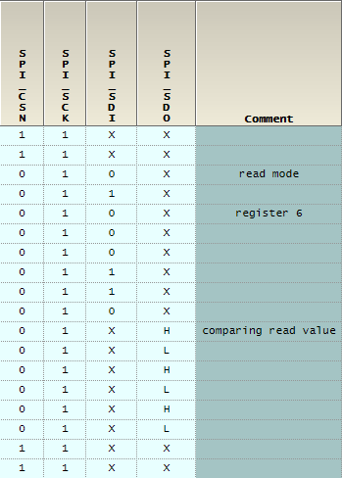
Test Process and Data log Results SPI Test: SPI Fixed Read Test The functional test uses a fixed pattern and uses SPI pins to read default value from register 0x06.
Setting read mode using 01
Writing register 0x06 in Binary
Comparing expected values using L/H compares

Slide 8
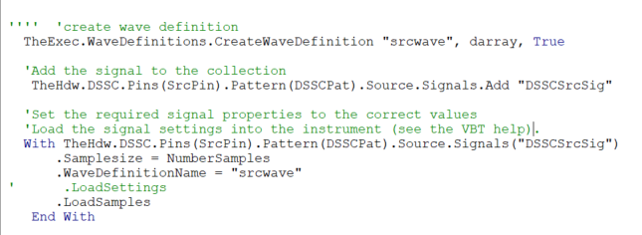
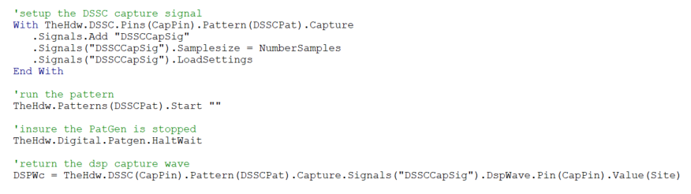
Test Process and Data log Results SPI Test: DSSC Read and Write To use the Digital Signal Source and Capture (DSSC) instrument for reading and writing from our device, a source waveform and a capture signal will be created.
Creating DSSC Source signals using the values read from the registers
Setting up DSSC Capture signal to record the expected results using a local DSPwave.

Slide 9
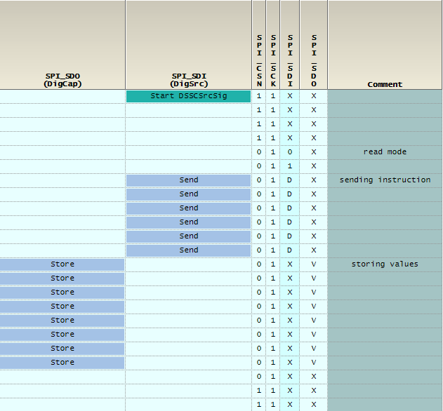
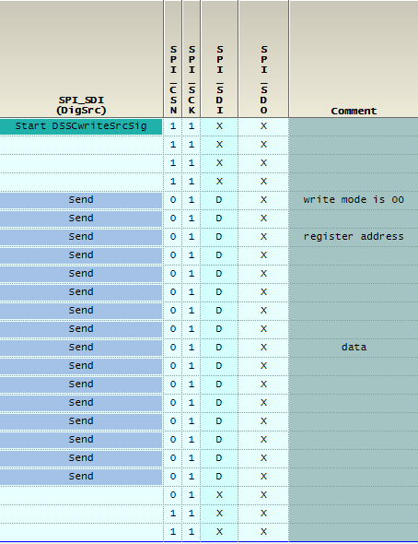
Test Process and Data log Results SPI Test: DSSC Read vs. Write Patterns
For DSSC read, instruction is sent and values are captured.
For DSSC write, both instruction and data will be sent.

Slide 10
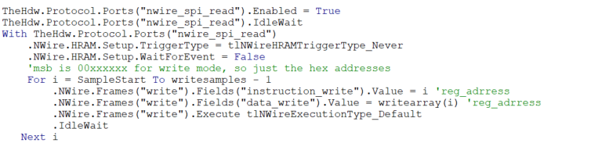
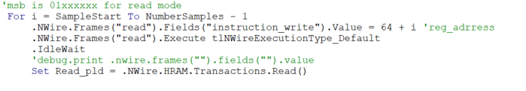
Test Process and Data log Results SPI Test: nwire Protocol Aware(PA) Read and Write To use the Protocol Aware method for SPI tests, a PA file along with required VBT code will be used for reading and writing from our device.
PA will use the frames and the fields from our .PA file to write instructions to SDI pins.
Similarly for reading data, PA will use the frames and the fields from our .PA file.

Slide 11
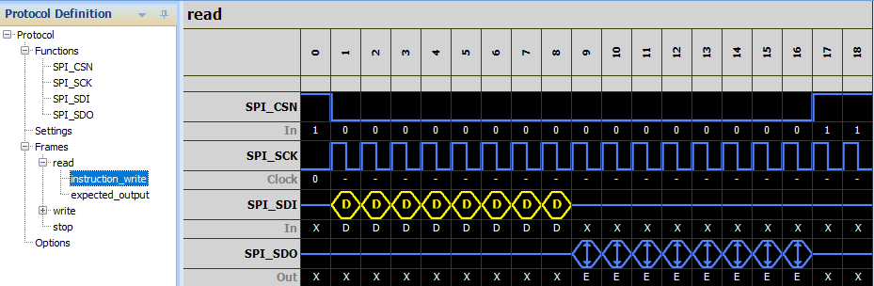
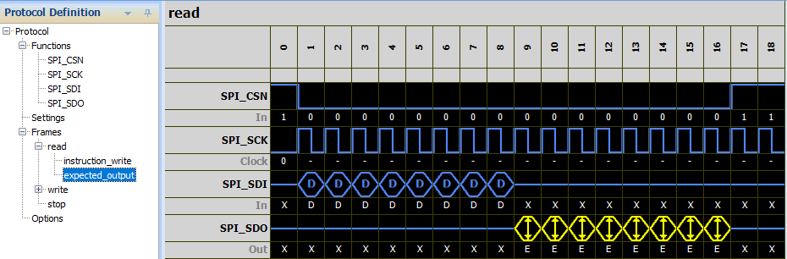
Test Process and Data log Results SPI Test: PA Read frames and fields
For PA read, instruction is sent using D and values are captured using E.

Slide 12
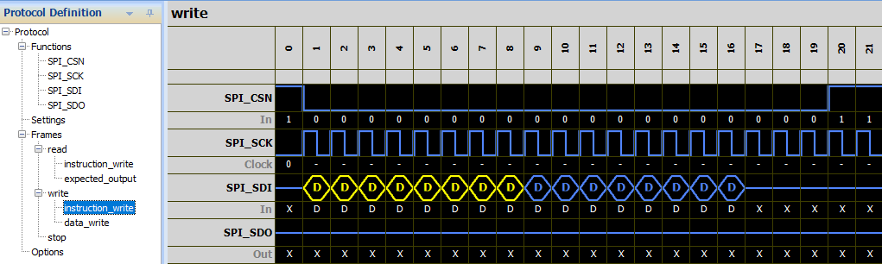
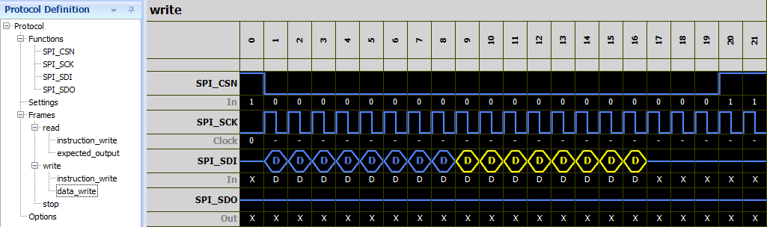
Test Process and Data log Results SPI Test: PA Write frames and fields
For PA write, both instruction and data is sent using D as we only write values.

Slide 13
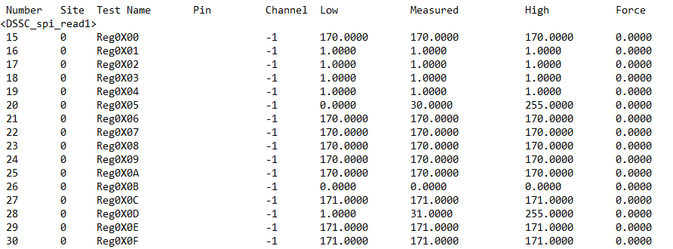
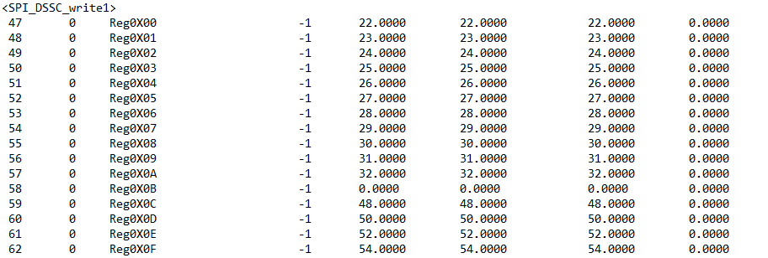
Test Process and Data log Results SPI Test: DSSC Read and Write Results

Slide 14
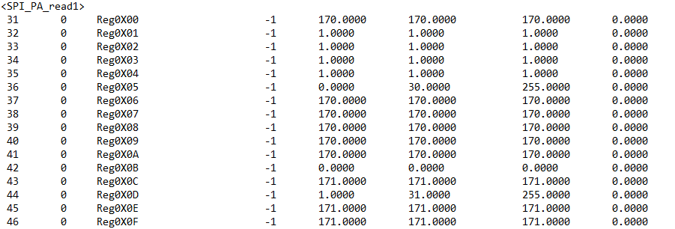
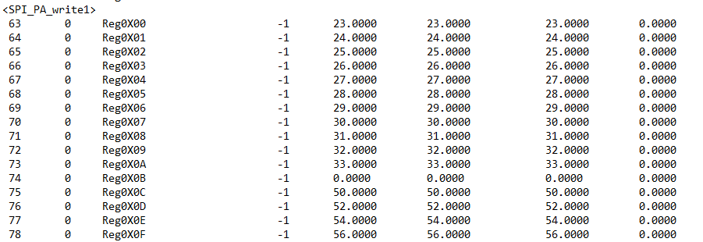
Test Process and Data log Results SPI Test: nwire PA Read and Write Results

Slide 15
Test Process and Data log Results IDD Tests
While the IDD tests are programmed in a similar way and test the same power pins (VCC and VCCIO), each will test the current flow for unique conditions: 1. Sleep IDD 2. Static IDD 3. IDDQ 4. Dynamic IDD
Notes:
-current on power pin during static state and then during dynamic state
-for static, we simply max out the voltage to power on and measure current on vcc
-for dynamic state, use functional test pattern and loop through it to measure vcc current

Slide 16
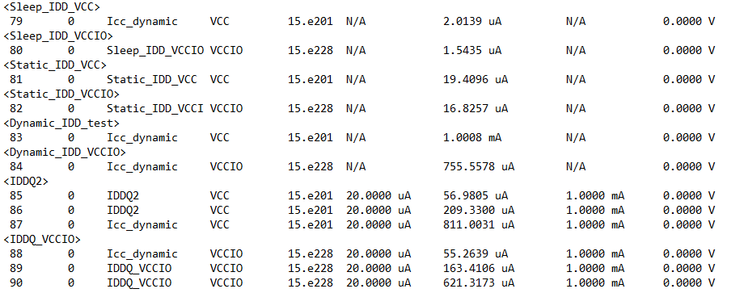
Test Process and Data log Results IDD Tests
Results
Notes:
-While dynamic ICC current is expected to be higher than the static ICC, the above measured values can be explained by the nature of the Device Under Test (DUT).

Slide 17
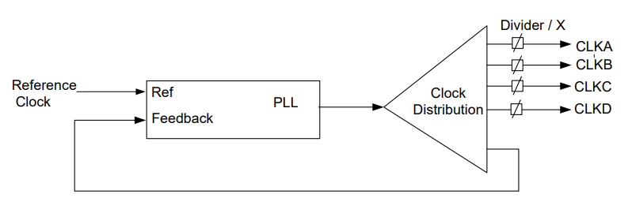
Test Process and Data log Results PLL Frequency Counter Tests
For the purposes of this project, the Phase-Locked Loop (PLL) is used for clock distribution. It takes an external clock input and divides or multiplies this reference frequency to generate several clocks with different frequencies for various internal modules. The clocks are described as follows:
Input Clock Pin: I_CLK_26M (26 MHz reference clock)
Output Clock Pins:
O_CLK_A: Divider clock with 500 kHz target frequency
O_CLK_B: Divider clock with 8.6 MHz target frequency
O_CLK_C: Multiplier clock with 130 MHz target frequency
O_CLK_D: Multiplier clock with 260 MHz target frequency
Notes:
-measuring at what time the 10% and 90% voltages occur
-first find vol and voh using waveform display
-create a new pattern and new pin levels sheet with a formula
-use characterization and interpose functions to calculate rise and fall time

Slide 18
Test Process and Data log Results PLL Frequency Counter Tests
Three tests are conducted for the PLL modes, they are briefly described below:
PLL CLK Meas (Freq Counter) | PLL CLK Meas (DSSC) | PLL Freq trim
1. Set register 0x0B to 0010 to enable PLL test mode and ensure lock indicator (MSB) is 1. | 1. Set register 0x0B to 0010 to enable PLL test mode. | 1. Set register 0x0B to 0010 to enable PLL test mode and ensure lock indicator (MSB) is 1.
2.Set the output clocks to provided values using register 0x01-0x04 and SPI pins (nwire PA method is used to set these pins). | 2.Set the output clock CLKA to provided value using register 0x01. | 2.Set the output clock CLKB to provided value using register 0x02.
3. Generate a 26MHz clock for the input reference clock and a PA file to read and write to the registers. | 3. Run a pattern and use DSSC to capture two cycles of CLKA. | 3. Create a loop to increment register 0x05 from 0x00 to 0x3F and measure the frequency of CLKB.
4.Set necessary levels and timing along with the test limits. | 4.Set necessary levels and timing along with the test limits. | 4.Set necessary levels and timing along with the test limits.
5.Use the frequency counter to measure frequency of output clocks and compare to target frequency. | 4.Use the frequency counter to measure frequency of output clock and compare to target frequency. | 4.Conitnue looping until frequency values is close to 1MHz, record the frequency measured as well as register 0x05 value.
Notes:
-measuring at what time the 10% and 90% voltages occur
-first find vol and voh using waveform display
-create a new pattern and new pin levels sheet with a formula
-use characterization and interpose functions to calculate rise and fall time

Slide 19
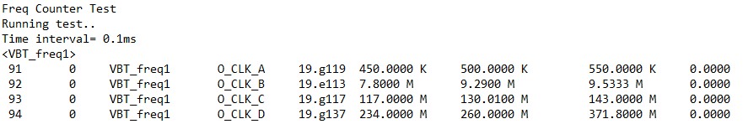
Test Process and Data log Results PLL Tests
Results

Slide 20
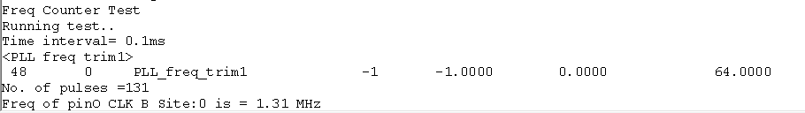
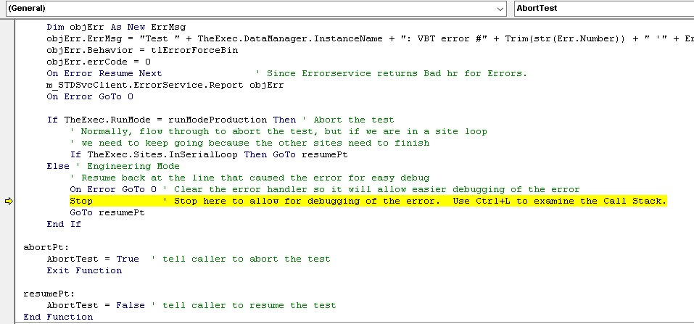
Test Process and Data log Results PLL Tests Limitations
Due to some tester maintenance issues and debugging delays, some PLL tests and data analysis aspects remain incomplete. The below tests were attempted but debugging was unsuccessful:
PLL frequency trim
PLL DSSC frequency counter test
The expected trim code is 30/31 whereas the program find a value close to 1MHz in the first attempt.
When running the test without stepping through or breakpoints, the workbook stops here during validation.
These tests will be investigated and a follow up will be sent to the audience by EOD tomorrow(10/15)

Slide 21
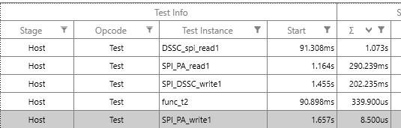
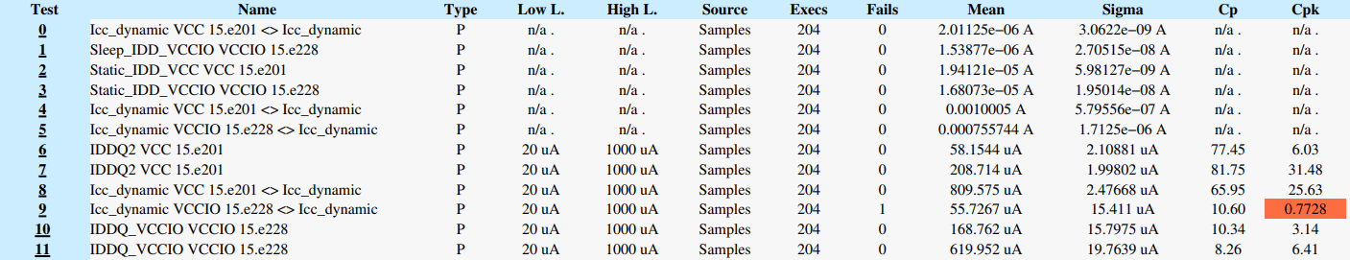
Test Program Results – Test Time Analysis
Using Timelines, Test Time Analysis is performed to observe the timing difference between each method of executing the SPI tests:
Using Galaxy, Repeatability test is performed to observe cp and cpk the IDD tests:
The discrepancies will be investigated and improved upon for a follow up, which will be sent to the audience by EOD tomorrow(10/15).
Notes:
Read out from slides

Slide 22
Project Challenges
Initial tests caused significant scheduling delays due to their complexity, making it challenging to understand and execute them efficiently.
Balanced seeking help with independent debugging efforts, which required careful consideration to ensure timely progress without over-relying on external assistance.
Tester maintenance and contact issues hindered ability to complete final test. This ultimately made it hard to draw comparisons between DSSC vs. PA frequency counters tests.
Steep learning curve in navigating MyInfo and eKnowledge resources, which made it difficult to quickly find the necessary information and tools for the project.

Slide 23
Project Schedule – Excepted vs. Actual
 |  | WW38 | WW38 | WW38 | WW38 | WW38 | WW39 | WW39 | WW39 | WW39 | WW39 | WW40 | WW40 | WW40 | WW40 | WW40 | WW41 | WW41 | WW41 | WW41
TASKS |  | 16-Sep | 17-Sep | 18-Sep | 19-Sep | 20-Sep | 23-Sep | 24-Sep | 25-Sep | 26-Sep | 27-Sep | 30-Sep | 1-Oct | 2-Oct | 3-Oct | 4-Oct | 7-Oct | 8-Oct | 9-Oct | 10-Oct
Schedule (PMP)
Personal Skills Assessment ( Before start SEP )
GIT setup
Review schedule with Mentor
Test lists
Mid Term review meeting with Mentor
Final review meeting with Mentor
Continuity Test
SPI Fixed Read
SPI DSSC Read
SPI nWire PA Read
SPI DSSC Write
SPI nWire PA Write
PLL Frequency Measurement - Frequency Counter
PLL Frequency Measurement - DSSC
PLL Frequency Trim
Sleep IDD
Static IDD
IDD Profile
Dynamic IDD
IDDQ
Major delays with first DSSC/PA test
PLL tests are still ongoing
Planned
Actual
Notes:
Some delays

Slide 24
Skill Assessment – Before vs. After Test Concept
The purpose of each test, as well as its corresponding pin levels, limits and binning are rated between 1(Very Low) and 5(Very High)
Items | Before |  |  |  |  | After
Test Concept | Do not have any knowledge on the particular topic |  | Have good knowledge of the topic but is not sure of how to apply in practice |  | Have good understanding of the topic and knows how to apply in practice | Do not have any knowledge on the particular topic |  | Have good knowledge of the topic but is not sure of how to apply in practice |  | Have good understanding of the topic and knows how to apply in practice
 | 1 | 2 | 3 | 4 | 5 | 1 | 2 | 3 | 4 | 5
Understanding of Device Data Sheets |  |  | √ |  |  |  |  |  | √
Translating from Data Sheets to Test Plans
Includes :-
Tests to be performed |  |  |  | √ |  |  |  |  |  | √
Test Specifications |  |  | √ |  |  |  |  |  | √
Instrument setups |  |  | √ |  |  |  |  |  | √
Test Limits |  |  |  | √ |  |  |  |  |  | √
Test Binning |  |  |  |  | √ |  |  |  |  | √
Understanding Timing Diagrams |  |  |  | √ |  |  |  |  |  | √
Specifying Pin Levels |  |  |  |  | √ |  |  |  |  | √
Continuity Test |  |  |  |  | √ |  |  |  |  | √
SPI Fixed Read |  |  | √ |  |  |  |  |  | √
SPI DSSC Read |  |  | √ |  |  |  |  |  | √
SPI nWire PA Read |  |  | √ |  |  |  |  |  | √
SPI DSSC Write |  |  | √ |  |  |  |  |  | √
SI nWire PA Write |  |  |  | √ |  |  |  |  |  | √
PLL Frequency Measurement - Frequency Counter |  |  | √ |  |  |  |  |  | √
PLL Frequency Measurement - DSSC |  |  | √ |  |  |  |  |  | √
PLL Frequency Trim |  | √ |  |  |  |  |  |  | √
Sleep IDD |  |  | √ |  |  |  |  |  | √
Static IDD |  |  |  | √ |  |  |  |  |  | √
IDD Profile |  |  | √ |  |  |  |  |  | √
Dynamic IDD |  |  |  | √ |  |  |  |  |  | √
IDDQ |  | √ |  |  |  |  |  |  | √
Conclusions: Significantly improved understanding of the purpose of each tests and setup methods.
Notes:
-read conclusions

Slide 25
Skill Assessment – Before vs. After Software Programming
The set up of each test, understanding of the program structure and use of IG-XL functions are rated between 1(Very Low) and 5(Very High)
Software Programming & Debugging | Do not have any knowledge on the particular item |  | Have good knowledge of the particular item but is not sure of how to apply in practice |  | Have good understanding of the particular item and knows how to apply in practice | Do not have any knowledge on the particular item |  | Have good knowledge of the particular item but is not sure of how to apply in practice |  | Have good understanding of the particular item and knows how to apply in practice
Test Program Development | 1 | 2 | 3 | 4 | 5 | 1 | 2 | 3 | 4 | 5
Test List:
Continuity Test |  |  |  | √ |  |  |  |  |  | √
SPI Fixed Read |  |  | √ |  |  |  |  |  |  | √
SPI DSSC Read |  |  | √ |  |  |  |  |  | √
SPI nWire PA Read |  |  | √ |  |  |  |  |  | √
SPI DSSC Write |  |  | √ |  |  |  |  |  | √
SI nWire PA Write |  |  | √ |  |  |  |  |  | √
PLL Frequency Measurement - Frequency Counter |  |  | √ |  |  |  |  |  | √
PLL Frequency Measurement - DSSC |  |  | √ |  |  |  |  |  | √
PLL Frequency Trim |  | √ |  |  |  |  |  |  | √
Sleep IDD |  |  | √ |  |  |  |  |  | √
Static IDD |  |  | √ |  |  |  |  |  | √
IDD Profile |  |  | √ |  |  |  |  |  | √
Dynamic IDD |  |  | √ |  |  |  |  |  | √
IDDQ |  | √ |  |  |  |  |  |  | √
Test Program Debugging
Basic Debug
Ability to set and run to trap |  |  |  |  | √ |  |  |  |  | √
Ability to debug using debug tool |  |  |  | √ |  |  |  |  | √
Continuity
Ability to debug using PPMU |  |  |  | √ |  |  |  |  | √
Protocol Studio
Ability to read write on PA Studio |  | √ |  |  |  |  |  | √
Frequency Counter
Ability to use frequency counter tool. |  | √ |  |  |  |  |  | √
Digital Debug
Ability to debug using Pattern tool |  |  |  | √ |  |  |  |  |  | √
Ability to debug using HRAM Display |  |  | √ |  |  |  |  |  | √
Plot Actual Device Waveform using Waveform Display |  |  |  | √ |  |  |  |  |  | √
Conclusions: Significantly improved understanding of all test program set ups, as well as how to create test programs for DSSC and Protocol Aware.
Notes:
-read conclusions

Slide 26
Effectiveness of Project 2
Provided a clear baseline of how to use DSSC and nwire PA for test programs.
Encouraged more independent learning for advanced digital concepts like DSSC, SCAN and PA.
Provided valuable context into the lectures on aforementioned topics as well as utilizing SPI and PLL pins for testing.
Developed my experience on debugging problems and understanding what debug tools to use (newly learned about Protocol Studio and Frequency Counter Debug Tool).
Notes:
-great experience and good practice

Slide 27
Thank you!
Training Mentor
Training
Instructors
1-1
engineers
Notes:
Thank you!

Slide 28
Questions?
Notes:
Feedback?

Slide 29
Appendix
Notes:
Feedback?

Slide 30
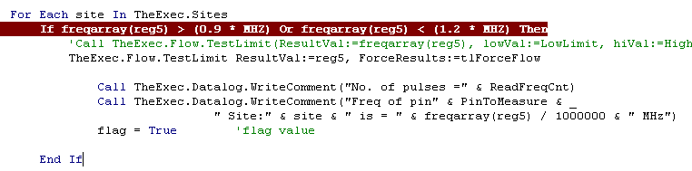
Test Process and Data log Results PLL Tests Follow Up
As mentioned during the presentation, the errors with the following two tests were investigated:
PLL frequency trim
PLL DSSC frequency counter test
PLL Frequency Trim- Before
The expected trim code is 30/31 whereas the program find a value close to 1MHz in the first attempt.
Upon investigation, stepping through the following loop unveils the reason for this result:
The OR statement made it so if the frequency was greater 0.99 MH OR less than 1.2 MHz, the trim code is recorded.

Slide 31
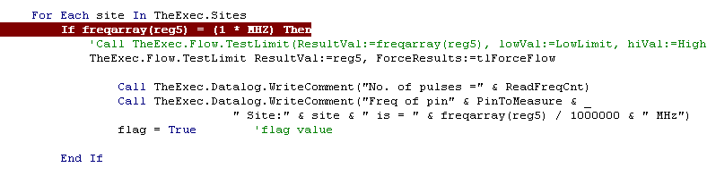
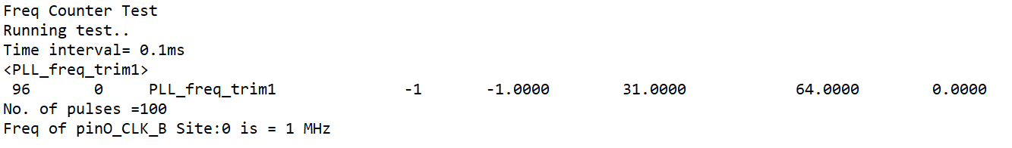
Test Process and Data log Results PLL Tests Follow Up
The easiest change would be to replace OR logic with an AND logic statement, to correctly find frequencies in the 0.9-1.2MHz range. However, the most accuracy is aschieved when the following approach is used:
Instead, the frequency is directly compared to whether it is exactly 1MHz to isolate the exact trim code.
PLL Frequency Trim- After
The expected trim code is 30/31 whereas the program find a value close to 1MHz in the first attempt.

Slide 32
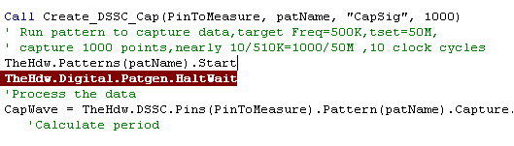
Test Process and Data log Results PLL Tests Follow Up
PLL DSSC frequency counter test- Before
When running the test without stepping through or breakpoints, the workbook stops here during validation.
It was observed that there was a wait time between the pattern starting and the “halt” in previous tests. Assuming this might be a fix, a wait time was added (next slide)

Slide 33
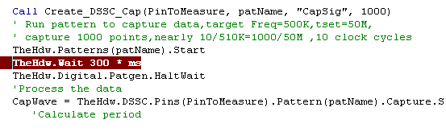
Test Process and Data log Results PLL Tests Follow Up
PLL DSSC frequency counter test- After
Upon adding a wait time of 300ms between the two lines as seen below, the issue is resolved:
A wait time of 300ms is used for stability.
The program successfully validates and no longer stops.

