Slide 1
SEG UFP Project 2 Trainee: Antara Rahman Project Start/ End date: September 11th,2024 to October 15th,2024 Mentor: Jordan Cantillano
Notes:
-Welcome
-presenting on first project for new hire training

Slide 2
Agenda
Project Overview (done or no? )
Test Block Overview
Test Process and Data log Results
Test Analysis – Test Time Report and Repeatability
Challenges
Project Schedule – Excepted vs. Actual
Skill Assessment – Before vs. After
Effectiveness of Project 2
Thank you!
Q&A
Notes:
No more than an hour of your time
Agenda points
-brief overview of project and test block
-process and results for each test
-how I went about analyzing the results
-challenges and effectiveness of the project
I want to leave some time for a q&A and get feedback
Pressing questions? Don’t hesitate to interrupt me

Slide 3
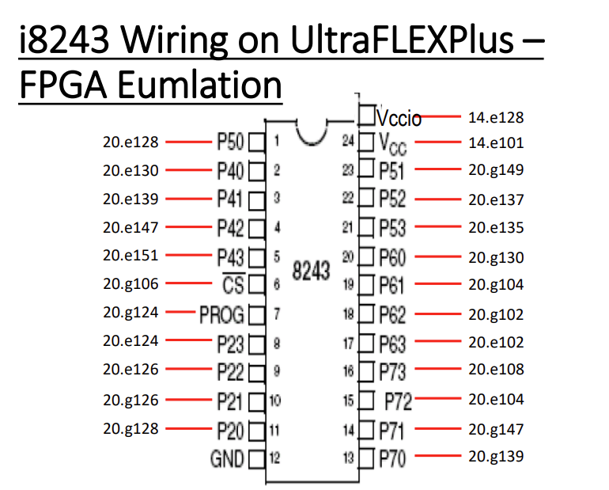
Project Overview
Background Knowledge:
I8243 Model Device is used as the first mini project in IGXL family digital programming basic training. The FPGA training kit is set to I8243 mode to simulate the device’s function.
Allows users to complete the I8243 mini project without standard lab hardware.
Feature and Description:
Intel I8243 Device is an input/output expander where Port 2 is used as an input and ports 4-7 are used as an output.
Notes:
-FPGA set to i8243 mode
-to simulate a device previously used for digital programming training
Main thing to remember is
-input/output expander
2 control pins (prog and chip select)
2 power pins (vcc and vccio), need to drive both to power up device

Slide 4
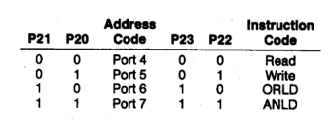
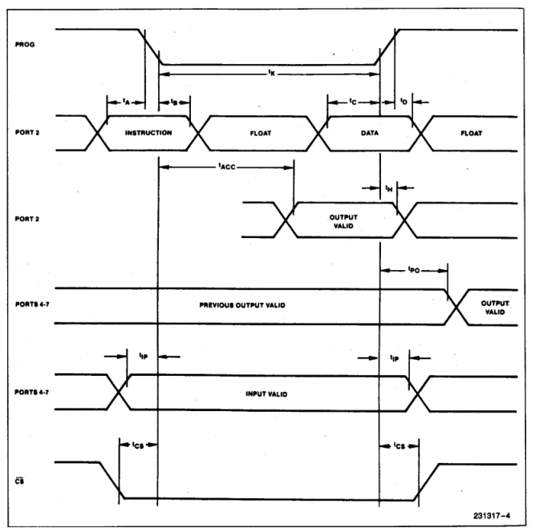
Test Block Introduction
Power-On Initialization: Initial application of power forces I/O pins 4, 5, 6, & 7 to tri-state and port 2 to input mode.
Write Modes: The device supports three write modes: MOVD,ORLD and ANLD. To write to an output port, we program the Operation code (op-code) and the port address to port 2 during high-to-low transitions on CS and PROG.
Read Mode: The device has one read mode. We program the Op-code and the port address to port 2 during high-to-low transitions on CS and PROG.
Power Requirements: The simulated Intel 8243 requires two power supplies: VCC = 1.8V and VCCIO = 3.3V.
Timing Performance: The timing performance is deciphered from the datasheet waveform. The I/O port 2 is used to send instructions and write data when PROG and CS pins are transitioning.
Notes:
-some crucial diagrams and tables from the datasheet
-one being opcodes (write to outputs using address and instruction codes)
-other being the waveform (using port 2, every time we send instruction, float, send data and float again)
Points to note
-power on sets tristate
-both vcc and vccio needs to be driven
-3 write modes and one read mode, which depend on the transitions of our control pins

Slide 5
Test Overview and Results – Data log
For each test, we will go over the process and data log results. The tests discussed today are as follows:
1.Continuity (with Pattern and PPMU)
2. Input/Output Leakage
3. Static and Dynamic ICC
4.Functional Test
5.Rise & Fall Time

Slide 6
Test Overview and Results – Data log Continuity Tests Four Continuity tests are performed: 1. Continuity Test Using Dynamic Load 2. Shorts Test Using Dynamic Loads 3.Open Test Using Dynamic Loads 4. Parametric Continuity Test
Process
Open/Short/Continuity Test w Pattern | Parametric Continuity Test
1. Ground all pins, including VCC/VCCIO and sequentially set each test pin to a high-impedance (Hi-Z) state using the pattern. | 1. Force 0V through power pins VCC and VCCIO
2. Program dynamic loads to -100µA. | 2. Use PinPMU current value to -100µA.
3. Test all input pins and bidirectional I/O ports sequentially for continuity, open and shorts using the pattern. | 3. Set a current range of 2mA.
 | 4. Test all digital pins i.e. all input pins and bidirectional I/O ports serially.
Notes:
-first did open/short/cont test using a pattern to test each pin one by one
-then used the PinPMU tool to execute the same test

Slide 7
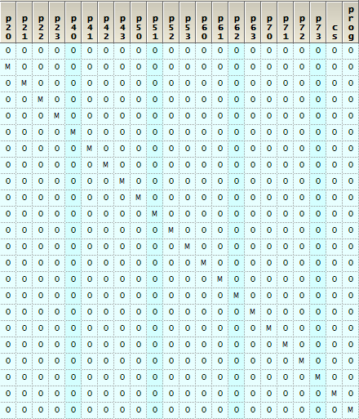
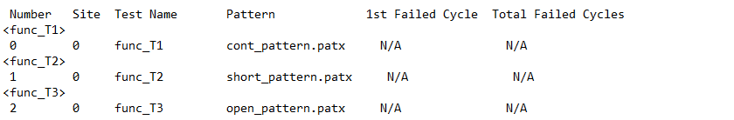
Test Overview and Results – Data log Continuity Tests
Example of Pattern
Initial state where all pins are forced to 0V
Sequentially setting each pin to Hi-Z using M to compare midband
All pins except pin-under test set to 0
Pin under test set to M
Results - Continuity Tests with Pattern
Test PASS limits are as follows:
-Continuity with pattern: Between -0.8V and -0.2V (M compare)
-Short Test: Less than -0.2 V (L compare)
-Open Test: More than -0.8V (H compare)
Notes:
-example pattern to show the setup
-pin under test set to L/H/M for Hi-Z state and comparing purposes
-all the other pins grounded
-simple functional test, with the required limits

Slide 8
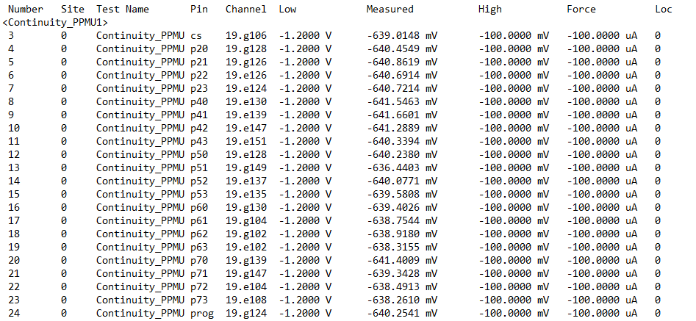
Test Overview and Results – Data log Continuity Tests
Results – PinPMU Continuity Test
Test PASS limits are as follows:
Low Limit: -1.2V
High Limit: -0.1V
Notes:
-force -100uA and ensure the value is in between our set limits

Slide 9
Test Overview and Results – Data log Leakage Tests Two leakage tests are performed: 1. Input Leakage 2. Output tristate leakage
Input Leakage | Output tristate leakage
1.Force 0V to VCC/VCCIO pins | 1.Force 1.8V to VCC and 3V to VCCIO pins.
2.Set the appropriate voltage levels and timing parameters. | 2.Set the appropriate voltage levels and timing parameters.
3.Force -400mV through input port 2 and 0V through controls pins (PROG,CS) | 3.Use a pattern to set ports 4-7 to READ mode, after which these ports will go to tri-state.
4.Measure current on the control pins and each pin of the input port 2 sequentially. | 4.Force a high voltage of 2.7V and low voltage of 0V through the output ports 4-7
 | 5.Measure current on each pin of the output ports 4-7 sequentially.
Notes:
-checking current leakage on input and output pins sequentially
Some things to note:
-for input leakage, we force -400mV to get a stable results (this is device specific)
-for output leakage two things
--instead of 3.3V we use 3V for VCCIO
--to ensure outputs are at tristate, we use a pattern to set them to read mode

Slide 10
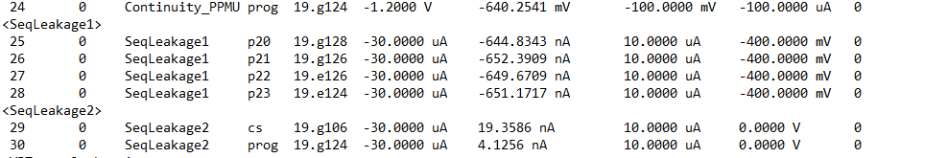
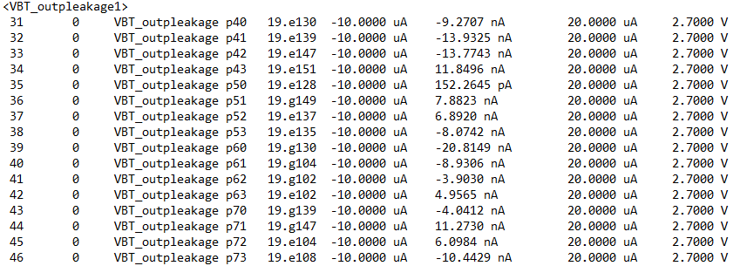
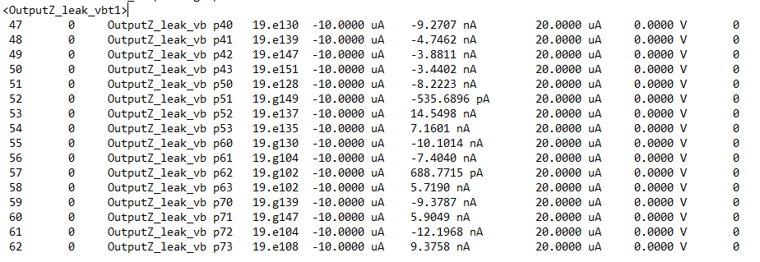
Test Overview and Results – Data log Leakage Tests
Results
1. Input Leakage
Test PASS limits are as follows:
Low Limit: -30uA
High Limit: 10uA
2.(Output tristate leakage)
Test PASS limits are as follows:
Low Limit: -10uA
High Limit: 20uA
Notes:
-we do not want too much leakage current on our inputs/outputs, so these values make sense

Slide 11
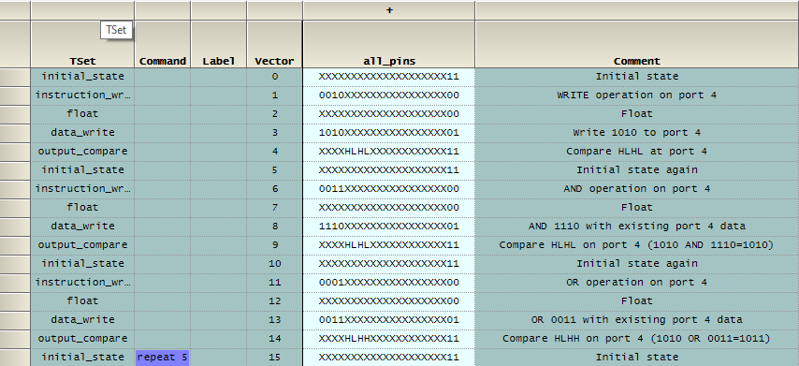
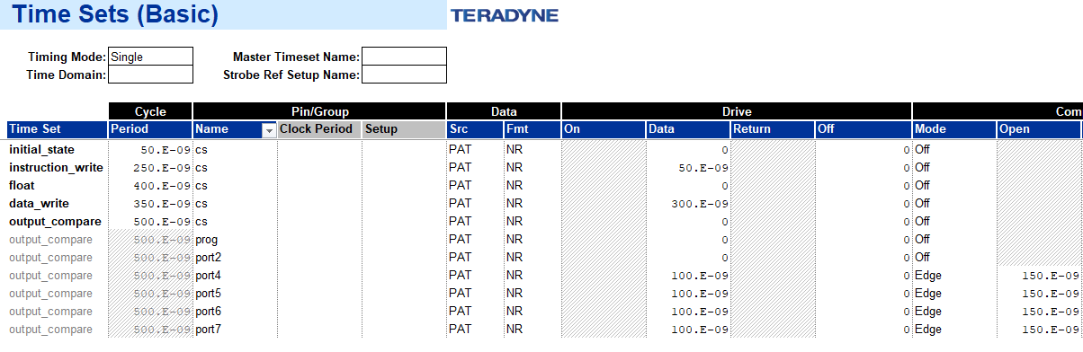
Test Overview and Results – Data log Functional Test The functional test has 3 main steps: -use write instruction for 1010 on port 4-7 -use AND instruction for port 4-7 to get 1110 AND existing data -use OR instruction for port 4-7 to get 0011 OR existing data
Process
Executing WRITE mode on port 4 and write data to port 4
Executing AND operation on port 4 (existing data AND New Data)
Executing OR operation on port 4 (existing data OR New Data)
Time sets are named based on each step on the Pattern Tool.
Based on Datasheet waveform and timing parameters, a Time Sets (Basic) sheet is created on IG-XL.
Notes:
Discuss main steps
Pattern example,time sets are named based on the instruction
Time Set sheet created according to the AC parameters

Slide 12
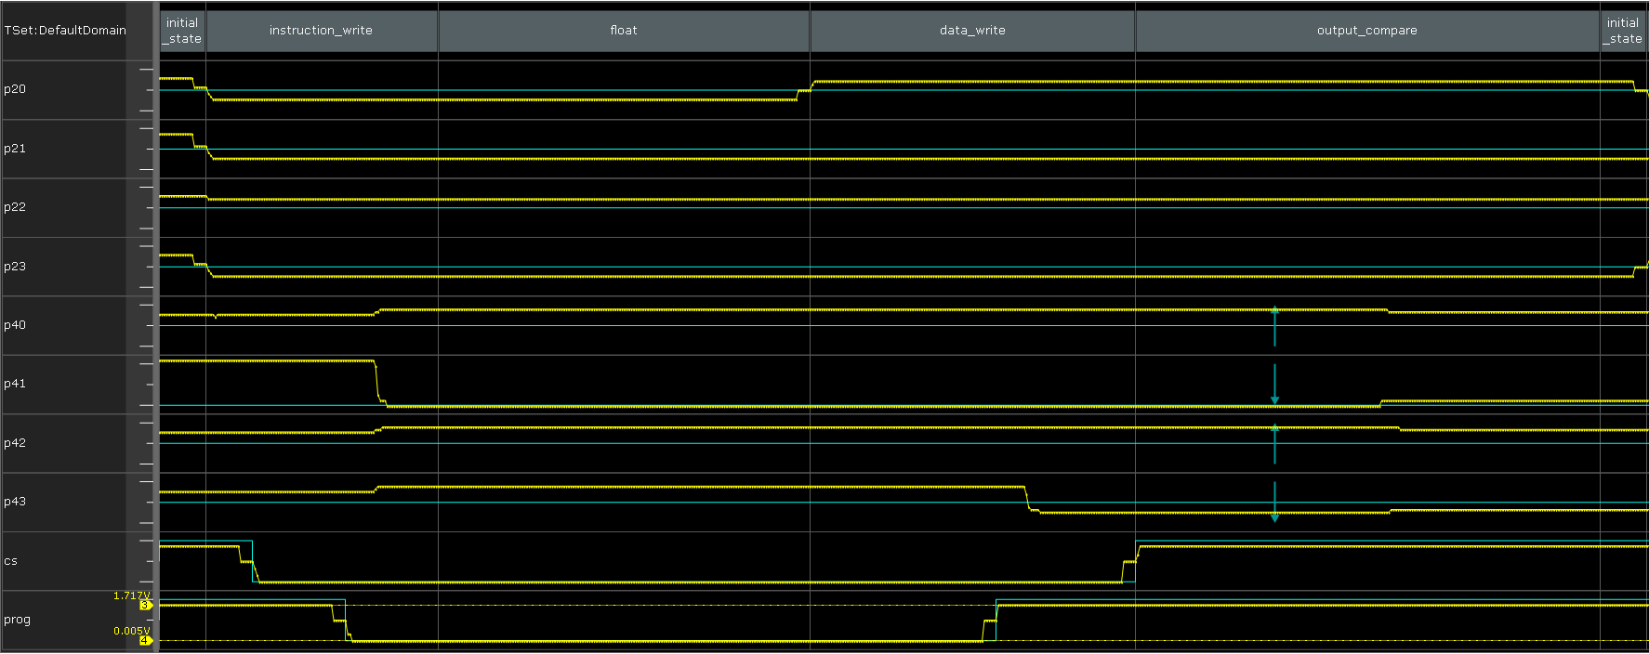
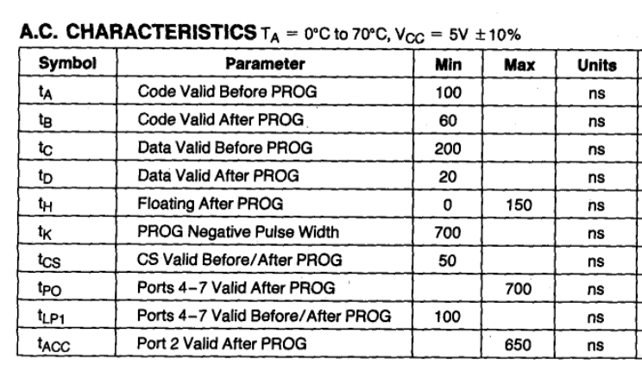
Test Overview and Results – Data log Functional Test
Results (Waveform)
tA=150ns
tB=100ns
tC=200ns
tD=150ns
tpo=300ns
tcs=100ns
tk=700ns
Results (Datalog)
Notes:
-functional test run in actual mode with the parameters labelled
-main things is during prog and cs transitions, we execute the instructions

Slide 13
Test Overview and Results – Data log ICC Tests Two ICC tests are performed: 1. Static ICC 2. Dynamic ICC
Process
Static ICC | Dynamic ICC
1. Force maximum voltage to the power pins: 1.8V to VCC and 3.3V to VCCIO pins. | 1. Force maximum voltage to the power pins: 1.8V to VCC and 3.3V to VCCIO pins.
2.Set the appropriate voltage levels and timing parameters. | 2.Set the appropriate voltage levels and timing parameters.
3.Measure the current value of VCC pin. | 3. Use Pattern OpCodes to loop functional pattern to set the device to a dynamic state
 | 4. Measure the current value of VCC pin.
Notes:
-current on power pin during static state and then during dynamic state
-for static, we simply max out the voltage to power on and measure current on vcc
-for dynamic state, use functional test pattern and loop through it to measure vcc current

Slide 14
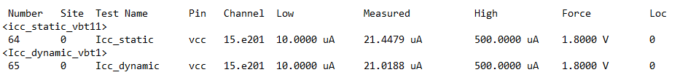
Test Overview and Results – Data log ICC Tests
Results
NOTE: Due to the DUT being an FPGA in i8243 mode for this project, the static ICC and dynamic ICC results are atypical.
Test PASS limits are as follows:
Low Limit: 10uA
High Limit: 500uA
Notes:
-While dynamic ICC current is expected to be higher than the static ICC, the above measured values can be explained by the nature of the Device Under Test (DUT).

Slide 15
Test Overview and Results – Data log Rise/Fall time Tests Using a pattern and Characterization studio, the following tests are performed: 1. Rise Time Test 2. Fall Time Test
Process
Rise Time | Fall Time
1. Apply power and set the appropriate voltage levels and timing parameters. | 1. Apply power and set the appropriate voltage levels and timing parameters.
2.Run a functional pattern with low to high transition on P50 to find VOL and VOH. | 2.Run a functional pattern with low to high transition on P53 to find VOH and VOL.
3.Run a new functional pattern with the same low to high transition and an M compare to find midband on P50. | 3.Run a new functional pattern with the same high to low transition and an M compare to find midband on P53.
4.Create a new Pin Levels sheet to find 10% (start point) and 90% voltage time (end point). | 4.Create a new Pin Levels sheet to find 90% (start point) and 10% voltage time (end point).
5.Use Characterization Studio and Interpose functions to measure the rise time i.e. time when voltage on P50 rises from 10% to 90%. | 5.Use Characterization Studio and Interpose functions to measure the fall time i.e. time when voltage on P53 drops from 90% to 10%.
Notes:
-measuring at what time the 10% and 90% voltages occur
-first find vol and voh using waveform display
-create a new pattern and new pin levels sheet with a formula
-use characterization and interpose functions to calculate rise and fall time

Slide 16
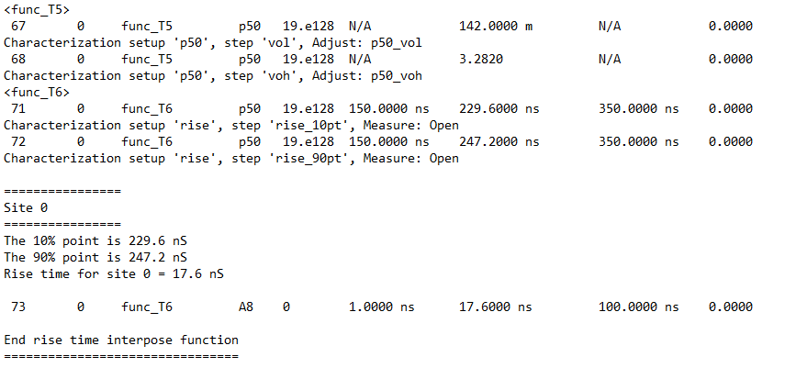
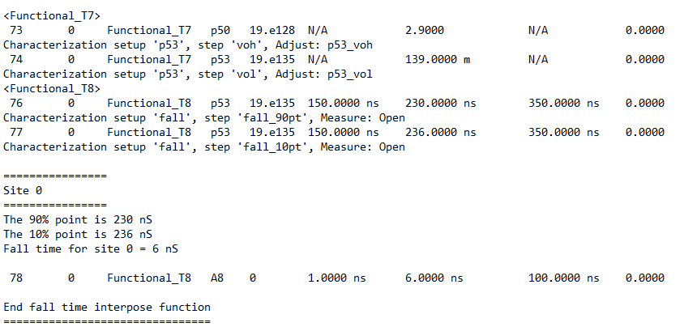
Test Overview and Results – Data log Rise/Fall time Tests
Results - Rise Time
Results- Fall Time
Notes:
-Voh and vol
-when the transition for rise and fall time is happening
-using interpose function to calculate the rise time and fall time

Slide 17
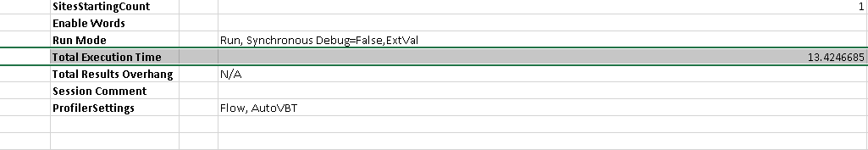
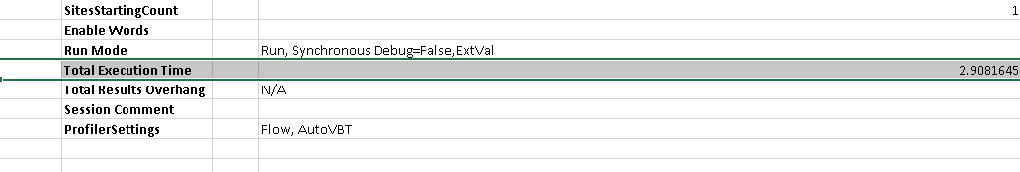
Test Program Results – Test Time Analysis
Using the IG-XL Profiler Options, a Test Time Analysis is performed to report the Total Execution Time to be 13.42s.
It was found that the rise and fall time tests were taking the longest. After multiple rounds of trial and error to reduce the step size in the Characterization Studio, the Total Execution Time was reduced to 2.908s.
Notes:
Read out from slides

Slide 18
Test Program Results – Repeatability
Initial Results
Cp/Cpk values lesser than 2
Although having a narrow voltage range as well as lower step size for the rise and fall test can reduce the total execution time to a low as 2.08s, it will also affect the Cp/Cpk values due to increased inconsistencies.
Final Results
Cp/Cpk values greater than 2
After tweaking some aspects of the rise and fall time test, the final analysis is seen using Galaxy Examinator.
Notes:
Execute the test sequence 50 times using IG-XL to ensure consistency and reliability.
Export an STDF file from the Repeatability test using IG-XL.
Import the STDF file into the Galaxy Examinator platform for detailed analysis and a Cp/Cpk output greater than 2.

Slide 19
Project Challenges
Developing a comprehensive test plan and understanding the impact of different pin levels on the test program was crucial.
Interesting challenges with output leakage and functional test, a big reminder is to keep in mind the differences in testing from one device to the other.
Test delays and scheduling conflicts were also significant challenges and often led to setbacks in the timeline.
Characterization presented its own set of hurdles in assessing the Cp/Cpk values which was addressed to ensure accurate and reliable results.

Slide 20
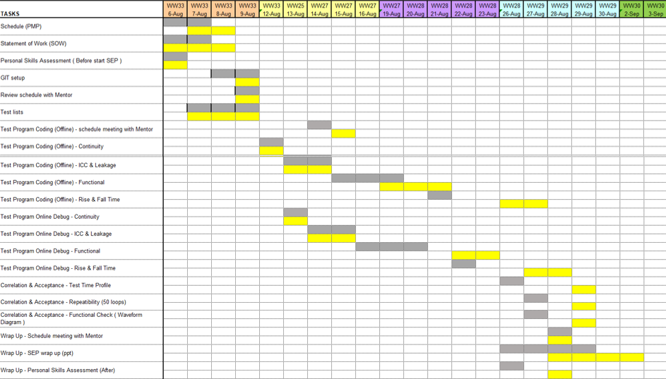
Project Schedule – Excepted vs. Actual
Delay with functional test
Extra day for Rise/Fall Test Debug
Planned
Actual
Notes:
Some delays

Slide 21
Skill Assessment – Before vs. After Test Concept
The purpose of each test, as well as its corresponding pin levels, limits and binning are rated between 1(Very Low) and 5(Very High)
Items | Before |  |  |  |  | After
Test Concept | Do not have any knowledge on the particular topic |  | Have good knowledge of the topic but is not sure of how to apply in practice |  | Have good understanding of the topic and knows how to apply in practice | Do not have any knowledge on the particular topic |  | Have good knowledge of the topic but is not sure of how to apply in practice |  | Have good understanding of the topic and knows how to apply in practice
 | 1 | 2 | 3 | 4 | 5 | 1 | 2 | 3 | 4 | 5
Understanding of Device Data Sheets |  |  |  | √ |  |  |  |  |  | √
Translating from Data Sheets to Test Plans
Includes :-
Tests to be performed |  |  | √ |  |  |  |  | √
Test Specifications |  |  | √ |  |  |  |  |  | √
Instrument setups |  |  | √ |  |  |  |  | √
Test Limits |  |  | √ |  |  |  |  |  | √
Test Binning |  | √ |  |  |  |  |  |  | √
Understanding Timing Diagrams |  | √ |  |  |  |  |  |  |  | √
Specifying Pin Levels |  | √ |  |  |  |  |  |  |  | √
Continuity Test |  |  |  | √ |  |  |  |  |  | √
Functional Test |  | √ |  |  |  |  |  |  |  | √
Supply Current ICC Test |  | √ |  |  |  |  |  |  | √
Leakage Test | √ |  |  |  |  |  |  |  |  | √
Functional Test | √ |  |  |  |  |  |  |  |  | √
Rise/ Fall Time Test |  |  |  | √ |  |  |  |  |  | √
Conclusions: Significantly improved understanding of timing diagrams and how to apply waveform information in datasheets to functional test. Also improved understanding of the purpose of each tests and setup methods.
Notes:
-read conclusions

Slide 22
Skill Assessment – Before vs. After Software Programming
The set up of each test, understanding of the program structure and use of IG-XL functions are rated between 1(Very Low) and 5(Very High)
Items | Before |  |  |  |  | After
Software Programming | Do not have any knowledge on the particular item |  | Have good knowledge of the particular item but is not sure of how to apply in practice |  | Have good understanding of the particular item and knows how to apply in practice | Do not have any knowledge on the particular item |  | Have good knowledge of the particular item but is not sure of how to apply in practice |  | Have good understanding of the particular item and knows how to apply in practice
Test Program Development | 1 | 2 | 3 | 4 | 5 | 1 | 2 | 3 | 4 | 5
Test List:
Continuity using Dynamic Loads |  | √ |  |  |  |  |  |  |  | √
Parametric Continuity Test |  |  | √ |  |  |  |  |  |  | √
Static ICC Test |  |  | √ |  |  |  |  |  | √
Dynamic ICC Test |  |  | √ |  |  |  |  |  | √
IIL Leakage Test |  | √ |  |  |  |  |  |  |  | √
IOZ Leakage Test |  | √ |  |  |  |  |  |  |  | √
Functional Test |  | √ |  |  |  |  |  |  |  | √
Rise/ Fall Time Test |  |  | √ |  |  |  |  |  | √
Program Structure:
Site-Aware Environment | √ |  |  |  |  | √
Error Handling |  | √ |  |  |  |  | √
IG-XL Functions:
IG-XL Help |  | √ |  |  |  |  |  |  | √
IG-XL Pinlistdata Object | √ |  |  |  |  | √
Conclusions: Significantly improved understanding of all test program set ups, as well as how to create patterns and time set sheets from scratch. Also successfully utilized IG-XL help and MyInfo for guidance on test program setup.
Notes:
-read conclusions

Slide 23
Skill Assessment – Before vs. After Test Debugging
Debugging skills using various IG-XL instruments are rated between 1(Very Low) and 5(Very High)
Items | Before |  |  |  |  | After
Test Debugging | Do not have any knowledge on the particular item |  | Have good knowledge of the particular item but is not sure of how to apply in practice |  | Have good understanding of the particular item and knows how to apply in practice | Do not have any knowledge on the particular item |  | Have good knowledge of the particular item but is not sure of how to apply in practice |  | Have good understanding of the particular item and knows how to apply in practice
Test Program Debugging
Basic Debug
Ability to set and run to trap |  |  | √ |  |  |  |  |  |  | √
Ability to debug using debug tool |  | √ |  |  |  |  |  |  |  | √
Continuity
Ability to debug using PPMU |  | √ |  |  |  |  |  |  | √
DCVI Debug
Ability to debug using DCVI |  | √ |  |  |  |  | √
Characterization
Ability to obtain Vil, Vih, Vol, Voh, Iol, Ioh from Characterization |  | √ |  |  |  |  |  |  | √
Digital Debug
Ability to debug using Pattern tool | √ |  |  |  |  |  |  |  |  | √
Ability to debug using HRAM Display |  | √ |  |  |  |  | √
Plot Actual Device Waveform using Waveform Display | √ |  |  |  |  |  |  |  |  | √
Conclusions: Much more accustomed to IG-XL instruments for debugging compared to before the project. Learned how to use Debug tool and step through programs, Waveform display to assess functional test failures, and finally, the characterization studio for rise and fall time tests.
Notes:
-read conclusions

Slide 24
Effectiveness of Project
Provided valuable context into the labs that were conducted for ULTRAFLEXplus fundamentals.
Encouraged questioning of previously unconsidered aspects, leading to a better understanding of IGXL and related tools.
Provided a clear baseline for each test and how to set them up
Developed a better approach to debugging problems and understanding what debug tools to use.
Notes:
-great experience and good practice

Slide 25
Thank you!
Training Mentor
Training
Instructors
1-1
engineers
Notes:
Thank you!

Slide 26
Questions?
Notes:
Feedback?

Slide 27
Appendix

Slide 28
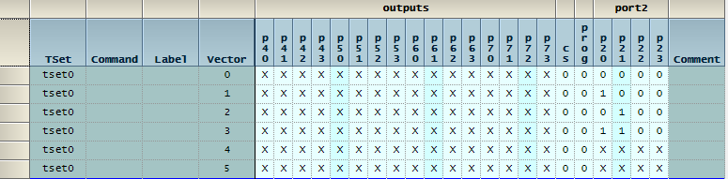
Output Leakage Test Pattern

Slide 29
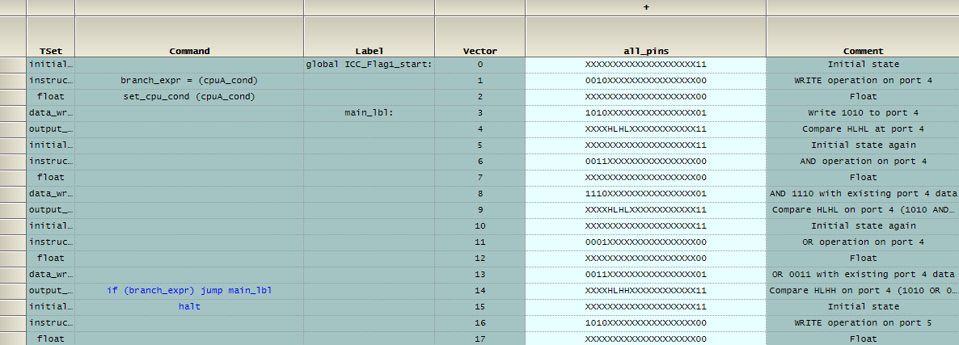
Dynamic ICC Test Pattern

Slide 30
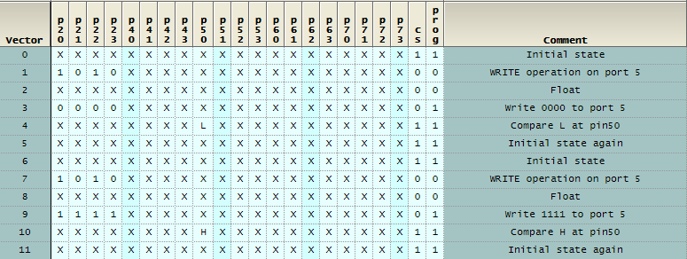
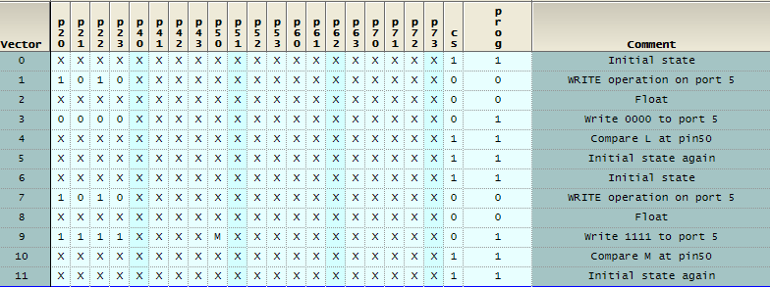
Test Overview and Results – Data log Rise/Fall time Tests Using a pattern and Characterization studio, the following tests are performed: 1. Rise Time Test 2. Fall Time Test
Process – Rise Time
Creating a Low to High Transition on P50
And using L/H compare to verify output
Using M compare and new levels sheet to determine Rise time on P50

Slide 31
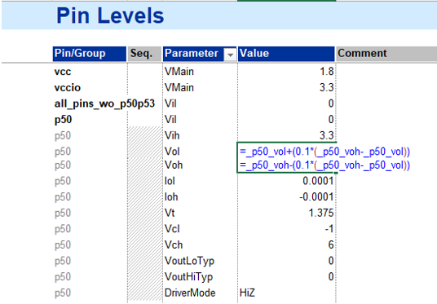
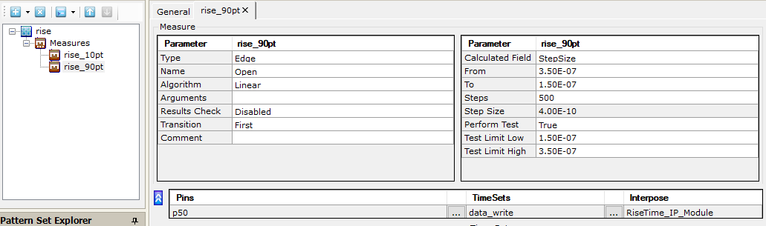
Test Overview and Results – Data log Rise/Fall time Tests
Process – Rise Time (Contd.)
Excel formula to find 10% voltage time
Excel formula to find 90% voltage time

Slide 32
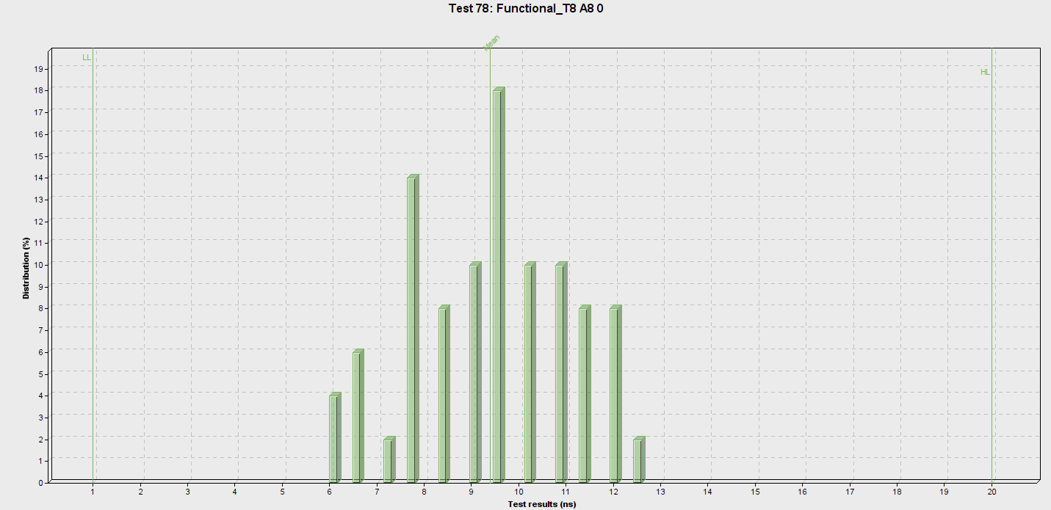
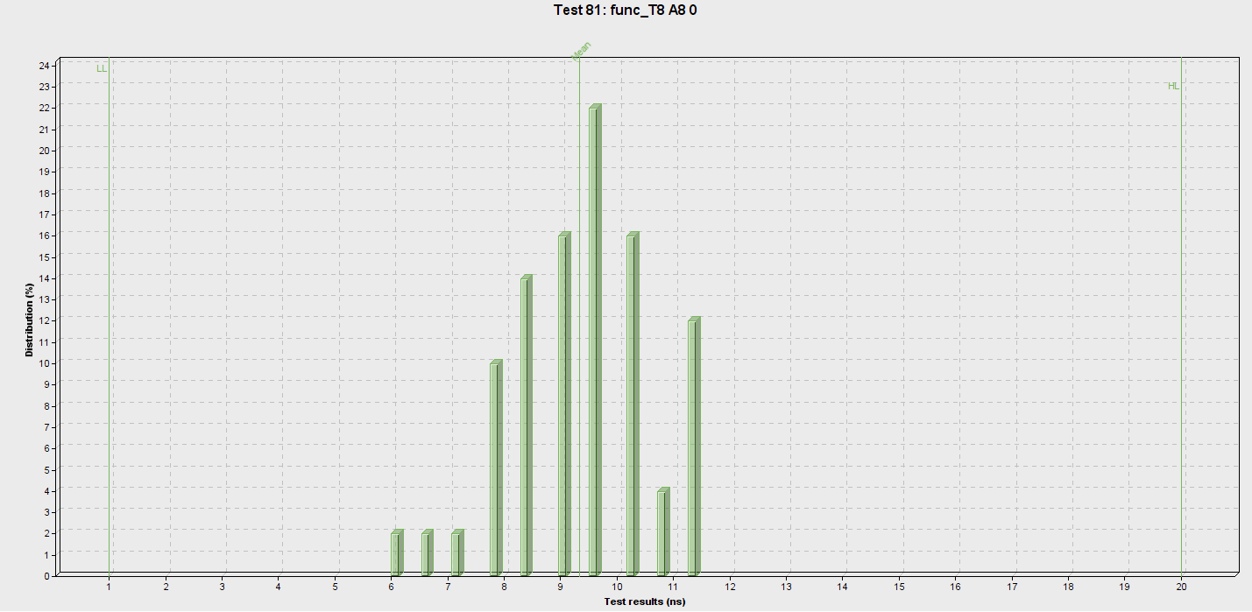
Test Program Results – Repeatability

