Slide 1

Security and Cryptography
13.05.2024
Abdurrahman Çoban

Slide 2
Project Overview: Encryption Methods
Symmetric-key algorithms
AES
ChaCha20
Asymmetric-key algorithms
Rsa

Slide 3
AES: Algorithm Explanation
Overview of AES Encryption Code (Key Functions)
KeyExpansion: Generates the round keys from the initial encryption key.
AddRoundKey: XORs the state with the round key.
SubBytes: Applies a non-linear substitution step using the S-box.
ShiftRows: hifts the rows of the state cyclically.
MixColumns: Mixes the columns of the state to provide diffusion.
Cipher: The main function that performs the AES encryption.

Slide 4
AES: Algorithm Explanation
Overview of AES Decryption Code (Key Functions)
InvSubBytes: Applies the inverse of the SubBytes step.
InvShiftRows: Applies the inverse of the ShiftRows step.
InvMixColumns: Applies the inverse of the MixColumns step.
InvCipher: The main function that performs the AES decryption.
Supporting Functions:
pad: Pads the input to ensure it is a multiple of the block size.
unpad: Removes padding after decryption to retrieve the original message.

Slide 5

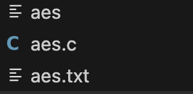
AES: How to Run the Code ?
There are two files at the beginning:
Run this line of code to generate an exec file >> gcc -o aes aes.c

Slide 6
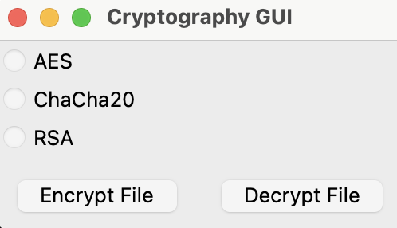
AES: How to Run the Code ?
Run this line of code to start the GUI
>> python3 crypto_gui.py
Select AES,
Click encrypt button,
Choose the aes.txt file,
Enter the key 16 char long,
Check the aes.txt file, content has changed.
Apply the same steps for decryption on the same file.

Slide 7
ChaCha20: Algorithm Explanation
Overview of ChaCha20 Encryption Code (Key Functions)
chacha20_keysetup: Initializes the state matrix with the key, nonce, and constants.
chacha20_block: Generates a 64-byte keystream block.
rotate: Rotates a 32-bit integer left by a specified number of bits.
chacha20_encrypt: Encrypts or decrypts data using the keystream generated by ChaCha20.
process_file: Reads the input file, processes it with ChaCha20, and writes the output.
Main: Handles command-line arguments and calls process_file.

Slide 8

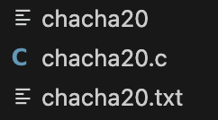
ChaCha20: How to Run the Code ?
There are two files at the beginning: Image: Right-top
Run this line of code to generate an exec file >> gcc -o chacha20 chacha20.c
Image: Right-bottom

Slide 9
ChaCha20: How to Run the Code ?
Run this line of code to start the GUI
>> python3 crypto_gui.py
Select ChaCha20,
Click encrypt button,
Choose the chacha20.txt file,
Enter two keys first 32 long char then 8 char long.
To decrypt, apply the same steps, click de Decrypt File and use the same keys.

Slide 10
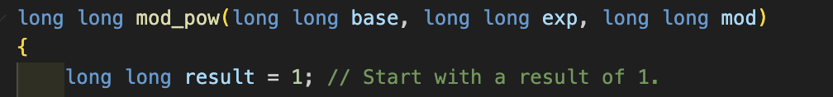
Rsa: Algorithm Explanation
mod_pow: This function performs modular exponentiation,
which is crucial for the RSA encryption and decryption
processes. It calculates 𝑏𝑎𝑠𝑒^{𝑒𝑥𝑝} mod 𝑚𝑜𝑑 efficiently, even
for large numbers.
2.main: The entry point for the program, which handles the
command-line arguments and controls the flow of data for
encryption or decryption using RSA.

Slide 11
Rsa: Algorithm Explanation
Functionality:
Command-Line Arguments: It takes four arguments: the file name containing the number to be encrypted/decrypted, the modulus 𝑛, the exponent (which could be e for encryption or d for decryption), and the mode (either "encrypt" or "decrypt").
File Operations: The program reads an integer from a file, processes it using the RSA algorithm (either encrypting or decrypting), and then writes the result back to the same file.

Slide 12
Rsa: Algorithm Explanation
In the RSA algorithm, the numbers 𝑛, 𝑒, and 𝑑 are crucial components of the cryptographic process.
𝑛 (Modulus):
Definition: 𝑛 is the product of two prime numbers, typically denoted as 𝑝 and 𝑞. It is a part of both the public and private keys in the RSA algorithm.
Role in RSA: 𝑛 serves as the modulus in the modular arithmetic operations of RSA. It determines the key length and the size of the ciphertext space.
e (Public Exponent): e is used during the encryption process. It is relatively small and often chosen for its properties to make encryption efficient. Common values for 𝑒e are 33, 1717, or 65537 (which is 2¹⁶+1).
𝑑 (Private Exponent): d is used during the decryption process. It essentially reverses the encryption process applied by 𝑒e and is computed to specifically work with the values of 𝑒e and 𝑛n used during encryption.

Slide 13
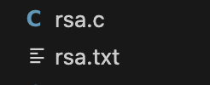
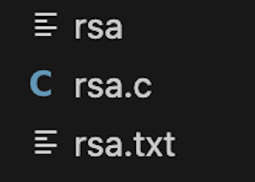
Rsa: How to Run the Code ?
There are two files at the beginning:
Run this line of code to generate an exec file >> gcc -o rsa rsa.c

Slide 14
Rsa: How to Run the Code ?
Run this line of code to start the GUI
>> python3 crypto_gui.py
Select RSA,
Click encrypt button,
Choose the rsa.txt file,
Enter the keys for encryption(3233,17)
To decrypt, apply the same steps on the same file, keys:3233,2753

Slide 15
Rsa: How to Run the Code ?
During Encryption: Choose to encrypt using RSA in the GUI:
𝑛 and 𝑒 are requested because they define how the data will be encrypted. The public key consists of 𝑛 and 𝑒, and they transform the plaintext into ciphertext using the formula 𝑐=𝑚^{𝑒} mod 𝑛 where 𝑚 is the plaintext message.
During Decryption: Choose to decrypt:
𝑛 and 𝑑 are needed because they allow the reversal of the encryption process. The private key, which consists of 𝑛 and 𝑑, is used to convert the ciphertext back to plaintext using the formula 𝑚=𝑐^{𝑑} mod 𝑛.
To test, use this numbers n=3233, 𝑒=17, 𝑑=2753

Slide 16
How to Run the App via Terminal?
Compile each one using gcc (creating exec files)
gcc -o aes aes.c
gcc -o chacha20 chacha20.c
gcc -o rsa rsa.c

Slide 17
How to Run the App via Terminal?
AES
./aes aes.txt 1234567890abcdef encrypt
./aes aes.txt 1234567890abcdef decrypt
ChaCha20
./chacha20 chacha20.txt 12345678901234567890123456789012 12345678 encrypt
./chacha20 chacha20.txt 12345678901234567890123456789012 12345678 decrypt
RSA
./rsa rsa.txt 3233 17 encrypt
./rsa rsa.txt 3233 2753 decrypt

Slide 18

West University of Timisoara
This task has been prepared in the scope of Security and Cryptography lab. The task has been prepared by Abdurrahman Çoban
13.05.2024

