Slide 1
CN6035 — MOBILE AND DISTRIBUTED SYSTEMS
HMS DApp
A Hybrid Hospital Management Decentralised Application
Task 2 — Video Presentation
Solidity · Node.js · React 19 · Ganache
Notes:
Welcome. I'm presenting HMS DApp — a Hybrid Hospital Management Decentralised Application built for CN6035 Mobile and Distributed Systems. Over the next ten minutes I'll walk you through what the system does, how it's built, specifically how it interacts with the blockchain, and critically evaluate the design choices I made and where the system could be pushed further.

Slide 2
01 — OVERVIEW
Project Overview
ADMIN
DOCTOR
• Analytics dashboard with recharts
• Manage users, departments & beds
• Approve doctor registrations
• Blockchain verification page
• Full audit log viewer
• Manage appointment slots
• View booked patients
• Create prescriptions (hash on-chain)
• View billing for own patients
PATIENT
RECEPTIONIST
• Browse doctors & book appointments
• View bills — pay off-chain or via MetaMask
• View prescriptions & notifications
• PDF export of bills & prescriptions
• Manage bed assignments
• Manage department allocations
Notes:
HMS DApp is a full-stack hospital platform that extends a traditional Node.js backend with a React frontend, a Solidity smart contract, and MetaMask wallet integration. The system supports four distinct user roles: Admin, Doctor, Patient, and Receptionist. The core value proposition is a tamper-proof audit layer — every booking, payment, and prescription is mirrored onto an Ethereum-compatible blockchain, so the backend alone cannot silently alter medical or financial records.

Slide 3
02 — ARCHITECTURE
System Architecture
React SPA
Node / Express API
Ganache Chain
User Interface
localhost:3000
Business Logic + MongoDB
localhost:8000
Immutable Audit Layer
localhost:7545
web3.js / RPC
REST / JWT
React 19
Router
recharts
JSON + Bearer token
Express 4
Mongoose
signed tx + receipt
Solidity 0.8.19
Truffle v5
MetaMask
jsPDF
JWT/bcrypt
web3.js
Chain ID 5777
node-cron
Every booking, payment and prescription is mirrored on-chain — the tx hash is stored on the MongoDB document for independent verification.
Notes:
The architecture is a three-tier hybrid. React 19 talks to a Node.js Express API via JWT-authenticated REST calls. Express owns business logic, writes to MongoDB for persistent storage, and dispatches web3.js calls to a local Ganache chain. Crucially, the React frontend can also bypass the backend and talk directly to MetaMask via window.ethereum for on-chain payments. Every mutating action therefore produces both a MongoDB write and an on-chain transaction, with the transaction hash stored back on the Mongo document so the two stores can be cross-verified.

Slide 4
03 — TECHNOLOGIES
Technology Stack
FRONTEND
BACKEND
BLOCKCHAIN
PRESENTATION LAYER
APPLICATION · PERSISTENCE
CONSENSUS LAYER
React 19 + Router v6
Node.js + Express 4
Solidity 0.8.19
SPA with role-based route protection
REST API, 12 route groups, Swagger UI
HospitalRecords smart contract
recharts
MongoDB + Mongoose
Truffle v5
Admin analytics: revenue, diagnoses, on-chain coverage
10 schemas + blockchainStatus audit fields
Compilation, migration, testing framework
jsPDF
JWT + bcryptjs
Ganache
Exportable bill & prescription PDFs
Auth + doctor approval workflow
Local Ethereum chain — Chain ID 5777, :7545
web3.js + MetaMask
web3.js + node-cron
MetaMask
window.ethereum — on-chain bill payment
Contract calls & scheduled slot cleanup
Injected wallet for patient on-chain payments
Notes:
On the technology choices — React 19 with Router for role-based SPA routing, recharts for the admin analytics dashboards, jsPDF for exportable bills and prescriptions. The backend is Express 4 with Mongoose schemas, JWT plus bcrypt for auth, node-cron for scheduled slot cleanup, and web3.js for contract calls. Blockchain is Solidity 0.8.19 deployed with Truffle onto Ganache at chain ID 5777. Each tier maps to a distinct architectural layer — Presentation, Application, Persistence, and Consensus — which is how I reasoned about cross-cutting concerns like auth and audit.

Slide 5
04 — BLOCKCHAIN
Smart Contract Design
DATA STRUCTURES & CORE FUNCTIONS
HospitalRecords.sol · payBillOnChain
PatientRecord
dataHash + timestamp + exists
function payBillOnChain(
AppointmentRecord
string memory _billId,
patientId · doctorId · status
string memory _patientId
BillingRecord
amount (wei) · status · paidBy
) public payable {
PrescriptionRecord
medicineHash (SHA-256)
require(msg.value > 0, "Must send ETH");
billingRecords[_billId].status = "paid";
KEY FUNCTIONS
billingRecords[_billId].paidBy = msg.sender;
logAppointment(id, pat, dr, status)
onlyOwner
payable(owner).transfer(msg.value);
logBilling(id, pat, amount, status)
onlyOwner
emit PaymentReceived(
logPrescription(id, pat, dr, hash)
onlyOwner
_billId, msg.sender, msg.value, block.timestamp
payBillOnChain(billId, patientId)
payable
);
get*(id) — direct chain read
public view
}
Patient → MetaMask → contract. No backend custody.
msg.value is forwarded to owner; status flips inside the EVM.
Notes:
The smart contract HospitalRecords defines four structs — PatientRecord, AppointmentRecord, BillingRecord, PrescriptionRecord — each keyed by a MongoDB ObjectId string. Writes are gated by an onlyOwner modifier so only the backend's deployer account can append records; this is the centralisation I'll critique later. The exception is payBillOnChain, which is payable — a patient sends ETH directly via MetaMask, the contract marks the bill paid, forwards the ETH to the owner, and emits a PaymentReceived event. This is shown in the Solidity snippet on the right.

Slide 6
05 — INTERACTIONS
Blockchain Interaction Flow
Example: Patient books an appointment — on-chain trail across five lanes
PATIENT
REACT UI
EXPRESS
MONGODB
GANACHE
1
Fills booking
form
2
JWT-auth'd
request
POST /api/
appointments
Bearer token
verified
3
Creates
Appointment
4
Document
persisted
Mongoose schema write
ObjectId
returned
5
logAppointment()
6
Tx mined,
hash returned
web3.send
signed tx
block.timestamp
recorded
8
Notification
polled (30s)
7
txHash +
status='logged'
bell icon
flashes
back on
Mongo doc
Notes:
Here's the end-to-end flow across the stack. A patient POSTs to /api/appointments. Express authenticates the JWT, writes the Appointment document to MongoDB, then calls logAppointment on the contract via web3.js. Ganache mines the transaction and returns a hash — we persist that hash plus a blockchainStatus of 'logged' back onto the Mongo document. If the send fails we now persist a 'failed' status instead of swallowing the error, which I'll come back to on the evaluation slide. Finally a Notification is dispatched to the patient and the Admin Blockchain Verification page can independently call getAppointment on the contract to re-prove the record.

Slide 7
06 — PAYMENT PATHS
Off-Chain vs On-Chain Payment
Two payment flows coexist — the right path is what makes this a DApp
Backend-Mediated
MetaMask On-Chain
TRUSTS BACKEND
TRUSTLESS · DApp
1
Patient clicks 'Pay'
1
Patient clicks 'Pay with MetaMask'
REST call to /api/bills/:id/pay
window.ethereum.request
2
Express marks bill paid in MongoDB
2
MetaMask prompts to sign tx
bill.status = 'paid'
gas estimate shown, patient approves
3
Backend calls logBilling()
3
payBillOnChain() executes in EVM
web3.send from DEPLOYER_ACCOUNT
ETH flows patient → contract → owner
4
Tx hash stored on Mongo doc
4
Contract flips status, emits event
blockchainStatus = 'logged'
PaymentReceived + BillingLogged
5
Audit middleware writes AuditLog
5
Backend never holds patient funds
who/what/when — off-chain
attack surface removed
Notes:
Payment is where the hybrid design really matters. The standard path — left side — is backend-mediated: the patient clicks Pay, the backend marks the bill paid in Mongo, then logBilling writes a status record on chain. The trust assumption is that the backend is honest. The on-chain path — right side — uses payBillOnChain: the patient signs a transaction in MetaMask, ETH goes from their wallet into the contract, the contract itself flips the bill status and forwards funds to the owner. No backend custody, no backend write. If the backend were compromised it still couldn't forge a payment here. That's what 'fully decentralised payment' actually means in the submission.

Slide 8
07 — FEATURES
Role-Based Features
★
⚕
♥
◈
ADMIN
DOCTOR
PATIENT
RECEPTIONIST
Analytics Dashboard
✓
—
—
—
Blockchain Verification
✓
—
—
—
Manage Appointments
✓ all
✓ own
Book/Cancel
—
Prescriptions
✓ view all
✓ create
View own
—
Billing & Payment
✓ view all
View own
✓ pay
—
MetaMask On-Chain Pay
—
—
✓
—
Beds & Departments
✓ manage
—
—
✓ assign
Audit Log
✓
—
—
—
PDF Export
✓
✓
✓
—
Notes:
This table summarises what each role can do. Admin is broadest — analytics, blockchain verification, audit log. Doctor manages their own slots and writes prescriptions. Patient books, pays, and reads. Receptionist handles beds and department allocation. Notice that MetaMask on-chain payment is patient-exclusive — because it's the patient's wallet signing. All roles see in-app notifications polled every thirty seconds, and PDF export is available to everyone who needs to archive a record externally.

Slide 9
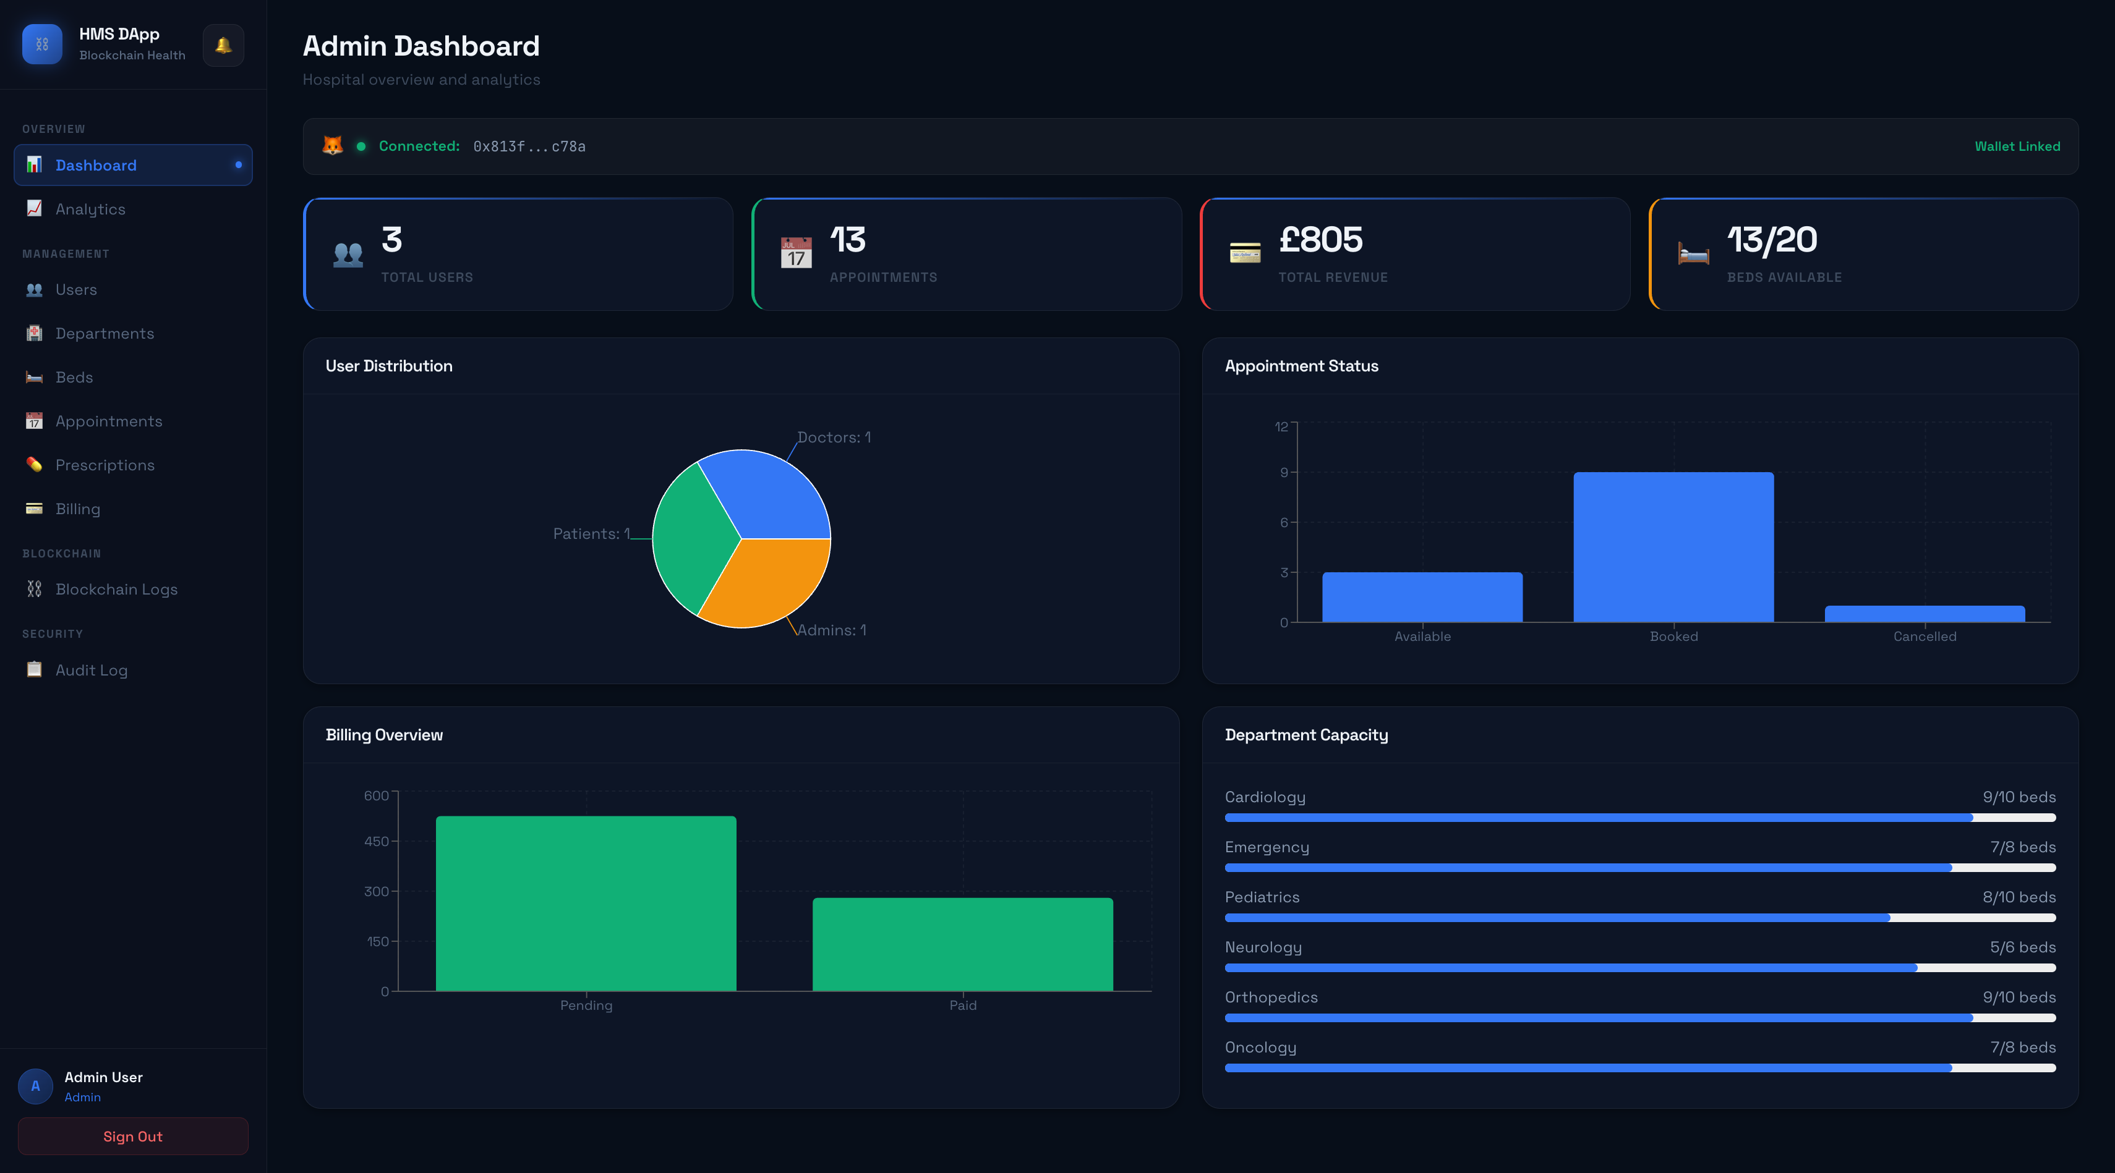
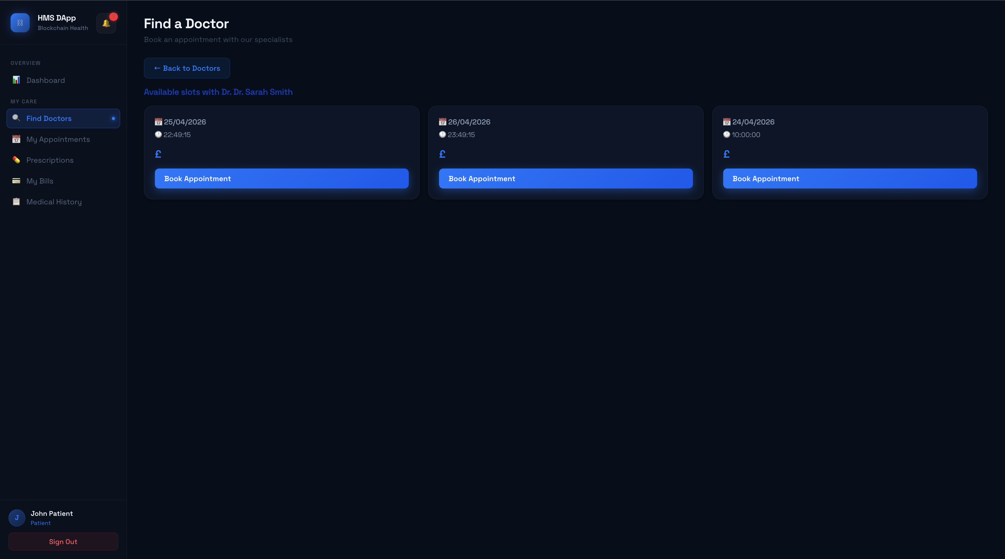
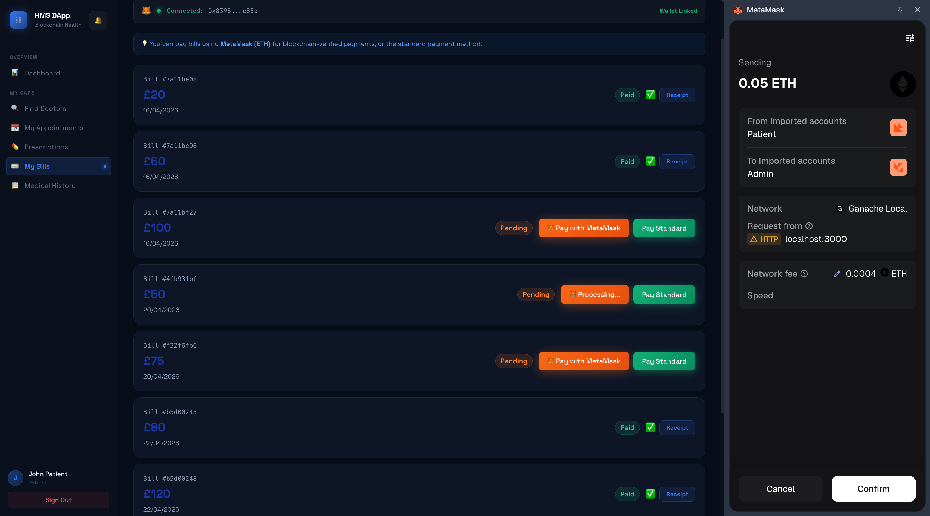
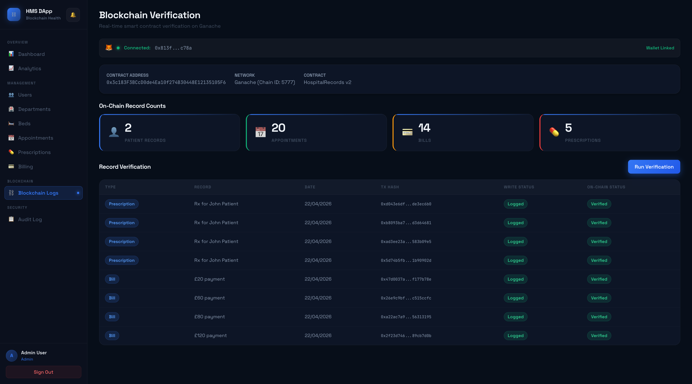
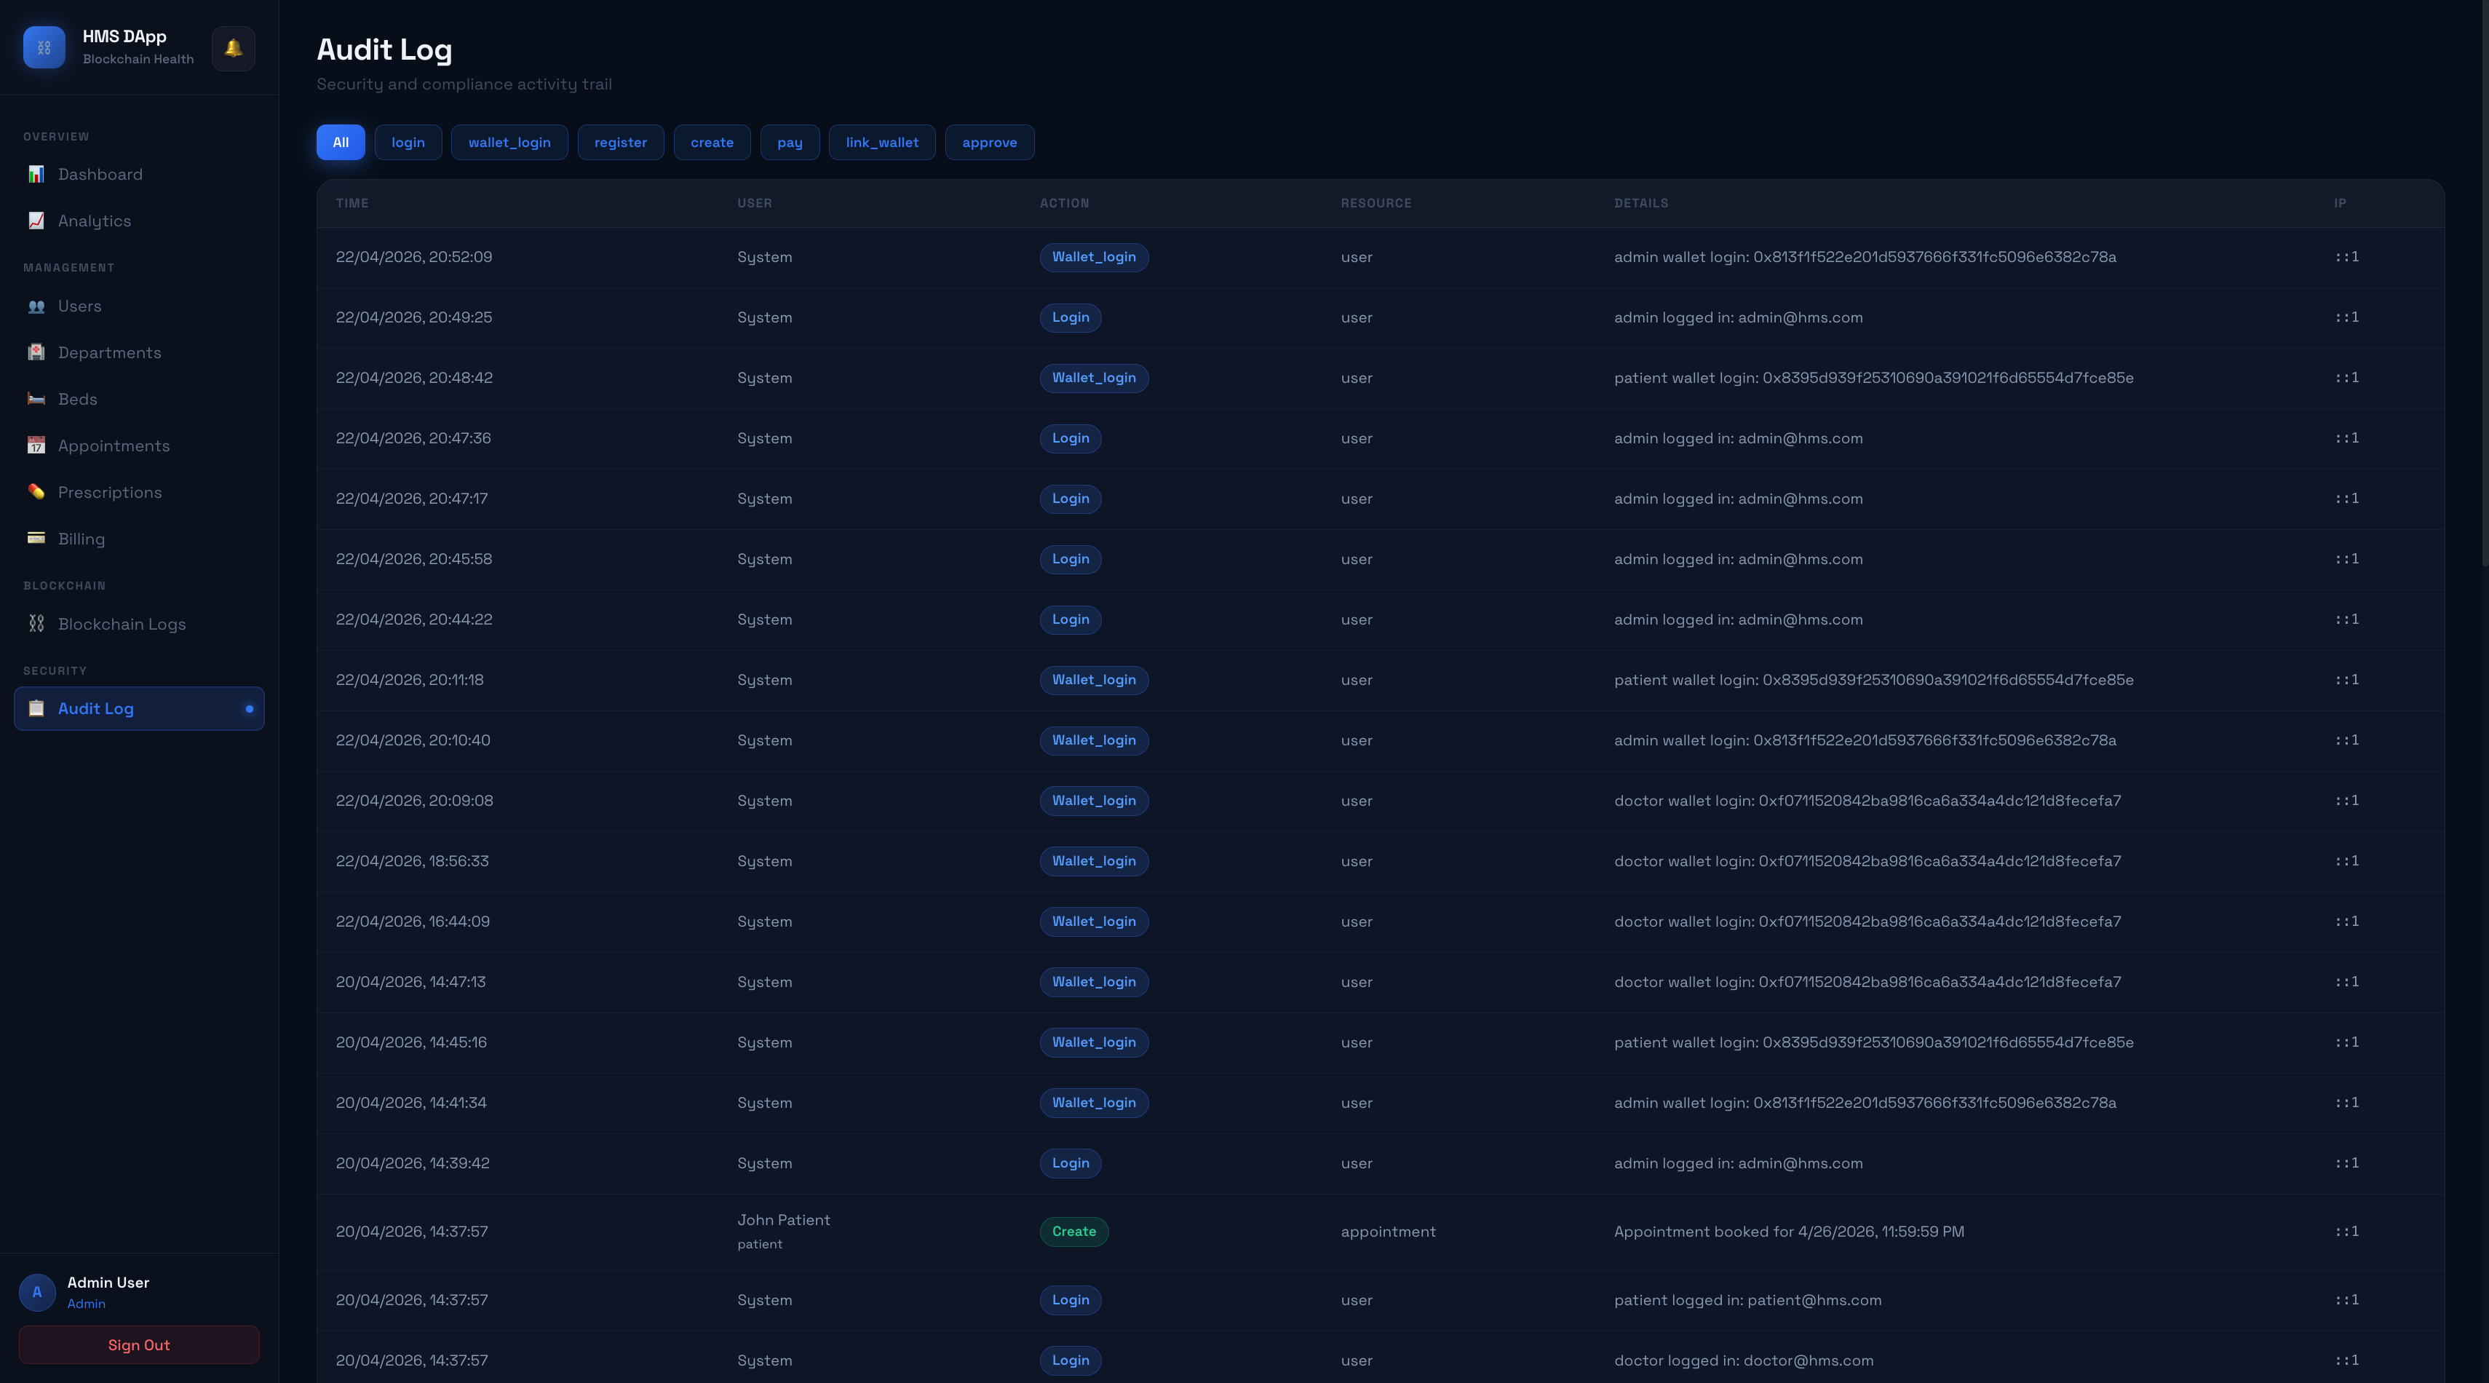
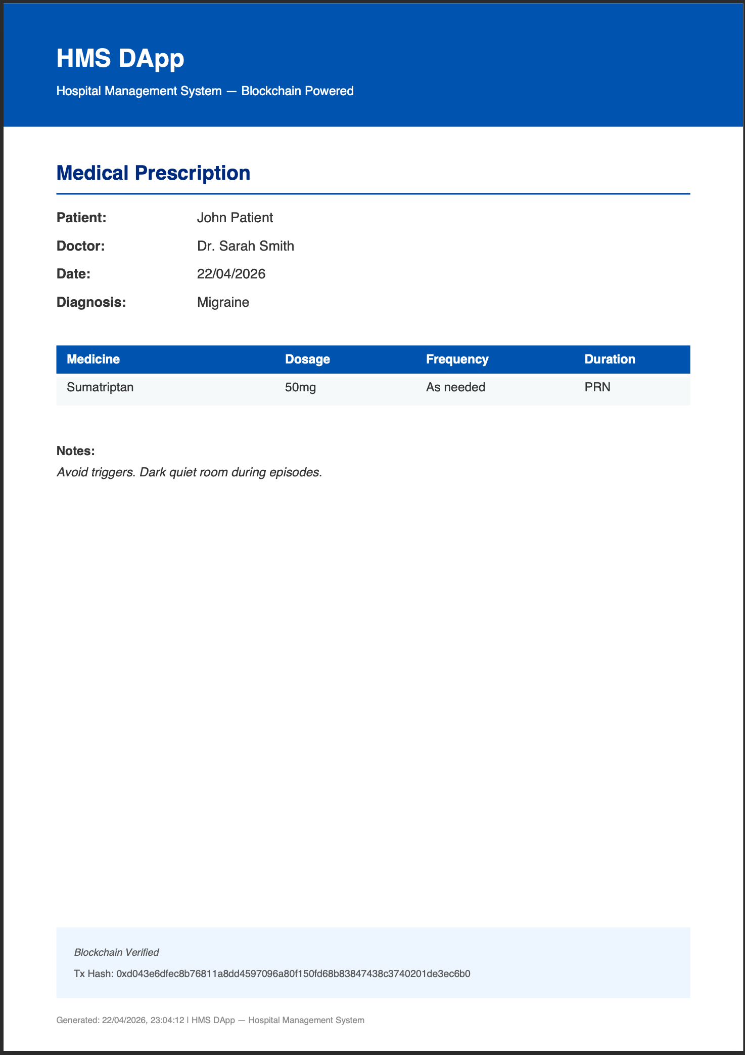
08 — THE RUNNING APP
Live Screenshots
Admin — overview + recharts analytics
Patient — booking flow
MetaMask — payBillOnChain signature
Admin — on-chain verification
Admin — audit trail
jsPDF — portable record
Notes:
These are captures from the running system. Top-left is the admin overview with recharts-powered analytics for revenue, per-doctor load, diagnosis distribution, and on-chain coverage. Top-centre shows the patient booking a slot. Top-right is MetaMask mid-confirmation during an on-chain bill payment. Bottom-left is the Blockchain Verification page where the admin clicks Run Verification and cross-checks the tx hashes stored in Mongo against getAppointment and getBilling reads directly from Ganache. Bottom-centre is the audit log middleware output. Bottom-right is a jsPDF prescription export, which carries the tx hash in the footer so a paper copy is still verifiable.

Slide 10
09 — CROSS-CUTTING
Key Cross-Cutting Features
Tamper-Proof Audit Trail
Audit Middleware
MetaMask Wallet Integration
Every appointment, billing, and prescription is mirrored on-chain. The tx hash is persisted on the Mongo document; admins re-verify by reading directly from Ganache.
An Express middleware intercepts every mutating HTTP request and writes a timestamped AuditLog entry — who, what, when — independent of the blockchain trail.
The MetaMask bar detects window.ethereum, shows account + ETH balance. Patients call payBillOnChain directly — backend never holds their funds.
Real-Time Notifications
PDF Exports via jsPDF
JWT Auth + Doctor Approval
In-app bell polls the API every 30 s. Events fire on booking confirmation, payment success, and prescription issuance — no page refresh required.
Bills and prescriptions exported from patient and doctor dashboards, with the tx hash embedded in the footer so paper records remain verifiable.
Doctor registrations enter a 'pending' state requiring admin approval. bcryptjs + JWT secure every endpoint; role middleware enforces access boundaries.
Notes:
Several cross-cutting capabilities tie the system together. Every mutating HTTP request passes through audit middleware that writes an AuditLog entry independently of the blockchain. Notifications fire on booking, payment, and prescription events. jsPDF exports bills and prescriptions. The MetaMask bar at the top of every page detects window.ethereum, shows the connected address and balance, and is the entry point for on-chain payments. JWT with bcrypt and a doctor-approval workflow secures every endpoint, and there's a seed script pre-wiring admin, doctor, and patient accounts to specific Ganache wallets so demos reproduce cleanly.

Slide 11
10 — CRITICAL ANALYSIS
Design Rationale & Evaluation
WHY THESE CHOICES
TRADE-OFFS & LIMITATIONS
FUTURE WORK
Ganache over Sepolia
onlyOwner centralisation
Migrate to Sepolia testnet
Zero-cost, instant feedback loop during development — no faucet or block-time delay.
A single deployer account signs every write — reintroduces trust the chain was meant to remove.
Public verifiability + Etherscan integration for tx audit.
Mongoose over raw driver
Ganache is local
TheGraph event indexer
Schema validation + middleware hooks enabled audit logging with zero controller noise.
Tutors cannot inspect the chain on a public explorer; demo-only, not production-ready.
Scalable historical queries and real-time dashboards.
Hybrid, not fully on-chain
No event indexer
Multi-sig deployer
Storing full records on-chain is prohibitively expensive; we anchor hashes + status only.
Historical queries iterate mappings — won't scale past thousands of records.
Decentralise write authority across hospital stakeholders.
JWT over sessions
Silent errors fixed, but incomplete
Expand Jest + add E2E
Stateless auth scales better and matches the SPA model — no server-side session store.
We now persist 'failed' status; a retry queue would be the next step.
Coverage beyond the 3 coursework suites — Cypress for the React flows.
Notes:
Now the critical analysis — what I chose and why, where it falls short, and what I would do next. I chose Ganache over Sepolia because the development feedback loop is essentially free — no faucet, no block time — but this means my submission cannot be verified by a tutor on a public explorer; that's a trade-off. The onlyOwner modifier keeps write authority centralised on a single deployer account, which simplifies authentication but reintroduces the trust assumption the blockchain was meant to remove. I don't have an event indexer — so querying historical records at scale means iterating through mappings. Future work: migrate to Sepolia, index events via TheGraph, expand the Jest suite beyond the three coursework-critical paths, introduce a multi-sig deployer, and add input validation middleware using express-validator. These are the concrete next steps, not aspirational bullet points.

Slide 12
11 — SCOPE OF CONTRIBUTION
Baseline vs Extension
MASTER BRANCH — BASELINE
MAIN BRANCH — SUBMISSION
Node.js + Express API
React 19 SPA
Auth, appointments, bills — REST only.
Role-based dashboards for admin / doctor / patient / receptionist.
MongoDB + Mongoose
HospitalRecords.sol
Schemas for User, Appointment, Bill, Prescription.
Solidity 0.8.19 contract — 4 structs, payBillOnChain payable.
JWT + bcrypt auth
web3.js + Ganache pipeline
Role-agnostic, no doctor-approval flow.
Every mutating write mirrored on-chain; tx hash persisted to Mongo.
Swagger docs + seed script
MetaMask integration
Basic Postman-style API surface.
Fully decentralised patient payments via window.ethereum.
No frontend
recharts analytics + jsPDF
Backend-only — no UI, no dashboards.
Admin charts, revenue trends, exportable bill/rx PDFs.
No blockchain
Audit log, notifications, tests
All trust on the API layer.
Mutation middleware, bell polling, Jest suites, RBAC fixes.
REPO LINKS
Submission (main): github.com/rahmane001/hospital-system/tree/main
Baseline (master): github.com/rahmane001/hospital-system/tree/master · Diff: github.com/rahmane001/hospital-system/compare/master...main
Notes:
This slide makes the scope of my contribution explicit for the marker. The master branch is the pristine upstream baseline — a backend-only Node, Express, and MongoDB CRUD application with no blockchain, no React frontend, and no role-aware UI. The main branch is the submission: I layered a React 19 single-page app, a Solidity smart contract deployed to Ganache, web3.js integration, MetaMask payments, recharts analytics, jsPDF exports, audit middleware, notifications, and the entire Task 2 presentation bundle on top. The two branches live on the same GitHub repo so the tutor can diff them directly using the compare URL at the bottom of the slide. 112 files changed, roughly 59-thousand lines added.

Slide 13
12 — DEMONSTRATION
Video Demonstration
MS STREAM RECORDING
[ Insert MS Stream link here ]
Access has been granted to all lab tutors.
The recording covers login as each role · appointment booking · on-chain transaction logging · MetaMask bill payment · blockchain verification.
Notes:
This slide contains the MS Stream link to the recorded demonstration. Access has been granted to all lab tutors. The recording walks through each of the four roles, an end-to-end booking with the transaction hash appearing live in the Blockchain Verification page, a MetaMask-signed payment, and the audit log.

Slide 14
13 — REFERENCES
References
[1]
Antonopoulos, A.M. and Wood, G. (2018) Mastering Ethereum: Building Smart Contracts and DApps. Sebastopol, CA: O'Reilly Media.
[2]
Tanenbaum, A.S. and Van Steen, M. (2017) Distributed Systems: Principles and Paradigms. 3rd edn. CreateSpace.
[3]
Wood, G. (2014) Ethereum: A Secure Decentralised Generalised Transaction Ledger (Yellow Paper). Available at: https://ethereum.github.io/yellowpaper/paper.pdf [Accessed: April 2026].
[4]
Ethereum Foundation (2024) Solidity Documentation v0.8.19. Available at: https://docs.soliditylang.org/en/v0.8.19/ [Accessed: April 2026].
[5]
Truffle Suite (2024) Truffle Documentation. Available at: https://trufflesuite.com/docs/ [Accessed: April 2026].
[6]
web3.js Contributors (2024) web3.js Documentation. Available at: https://docs.web3js.org/ [Accessed: April 2026].
[7]
Nakamoto, S. (2008) 'Bitcoin: A Peer-to-Peer Electronic Cash System.' bitcoin.org. Available at: https://bitcoin.org/bitcoin.pdf [Accessed: April 2026].
[8]
MongoDB, Inc. (2024) Mongoose ODM Documentation. Available at: https://mongoosejs.com/docs/ [Accessed: April 2026].
Notes:
In summary, HMS DApp extends a traditional CRUD application into a hybrid DApp by anchoring critical records to an immutable ledger without sacrificing usability. Here are the references used in designing and evaluating the system, in Harvard format. Thank you.

