Slide 1

No One Left Behind

Slide 2
Filming Availability: Should your team be selected as the winner, indicate if and when you are able to return to the Opera House between 1-4PM on 10/21 to film a team pitch of your project.
Project Sharing: Mark “yes” if you are OK with us sharing what you built with your team at work.
Share With: If “yes” to the above, is there anyone specific you’d like us to share it with at work? Provide email(s).
NAME | EMAIL | PHONE | FILMING AVAILABILITY | PROJECT SHARING | SHARE WITH
Julian Diaz | juliand.odiaz@gmail.com | Confirm with team | Confirm with team | Yes — public repo | Team collaborators
Hossein Rahmani | rahmani.hossein1380@gmail.com | Confirm with team | Confirm with team | Yes — public repo | Team collaborators
Himanshu Jha | himanshu2007jha@gmail.com | Confirm with team | Confirm with team | Yes — public repo | Team collaborators
Frontend Lead | student-01-b08d8ba1c5d4@qwiklabs.net | Confirm with team | Confirm with team | Yes — public repo | Team collaborators
Team role | Product / story | Agent / backend | Data / validation | UI / testing | Shared repo
Project | Florida Adaptive Evacuation Readiness | Lee County, FL | Agents for Impact 2026 | Public repo | GitHub link
Video | Under 3 minutes | Screen share | Team recording | Submit with deck | Qwiklabs link
Status | Ready to confirm | Phone: confirm | Availability: confirm | Repo sharing: yes | Contacts above

Slide 3
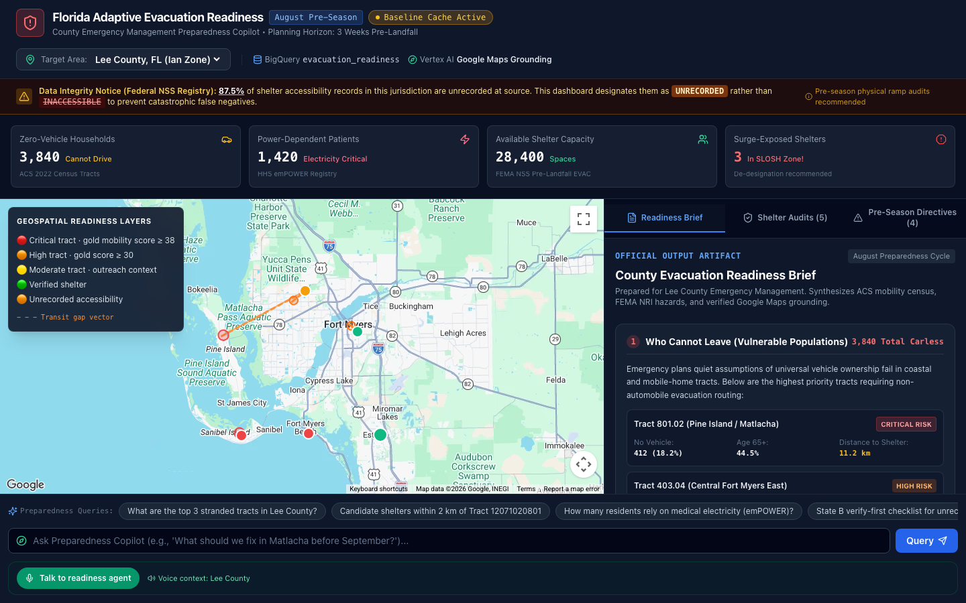
Challenge Overview
Lee County needs a pre-landfall plan for residents who cannot self-evacuate.
Ian’s median age of death was in the seventies. 3,840 households lack a vehicle; 1,420 residents depend on medical power.
The county and its community partners need one shared plan.

Slide 4
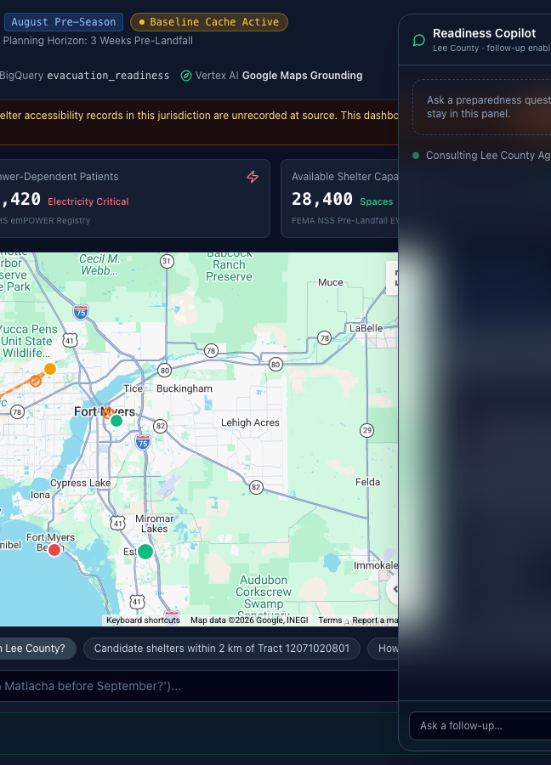
Our Agent
The planner asks which areas are hardest to evacuate. The agent ranks risk from BigQuery gold tables, finds nearby outreach hubs, grounds shelter places with Google Maps, and creates a human validation task for what the data cannot confirm.
Positive outcome
A county brief that names the next partner conversation, the right destination, the right backup, and the peer network needed to reach residents before landfall.

Slide 5
Sources
BigQuery gold tables: vulnerability, shelters, power dependence, hazard exposure.
Google Maps grounding: places and routing check whether a registered facility still exists.
Community partners validate accessibility and operations in person.
The agent keeps recorded, derived, grounded, and unknown facts distinct.

Slide 6
(
(
Prototype Architecture
Emergency manager → React command center → ADK agent with Gemini 3.x
BigQuery ranks risk and shelter options. Google Maps grounds places and routes. Community partners recruit peers and validate unknowns. The agent produces the Readiness Brief.

