Slide 1
Enhancing Wave Energy Efficiency
INTRODUCTION OF DATA SCIENCE
Presentation on
Through Optimized Wave Energy Converter Placement
Project Group-14
Name | UH ID
Md Moshiur Rahman | 2400991
Divya Sai Sree Pilli | 2404251
Tanushree Mukherjee | 2413888
Jayaprakash Yadav Guntumani | 2391724

Slide 2
Dataset Overview
Dataset Characteristics | Multivariate
Subject Area | Renewable Energy, Engineering, Costal City: Adelaide
Associated Tasks | Regression, Optimization
Feature Type | Real
Number of Instances | 71,999
Number of Features | 49 (including WEC positions, absorbed power, and total power output)
Data Collection | Dataset: https://archive.ics.uci.edu/dataset/494/wave+energy+converters
Importance: Maximizing energy capture through optimal WEC placement.

Slide 3
Data Cleaning and Preprocessing
Rename Column;
Handel Missing Values;
Analyzing Zero Values;
Outlier Detection;
EDA correlation check;
Distribution Analysis and Skewness Check;
Split Dataset and Scaling Features;

Slide 4
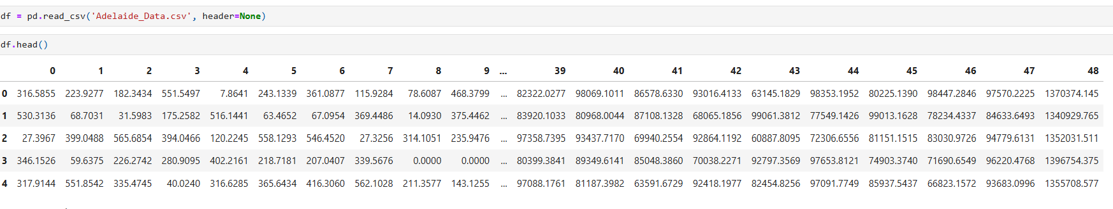
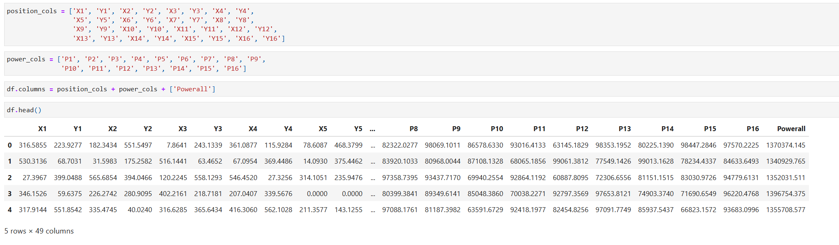
Data Cleaning and Preprocessing (Rename Column)
Original Data
Rename Column: Using Data Description

Slide 5
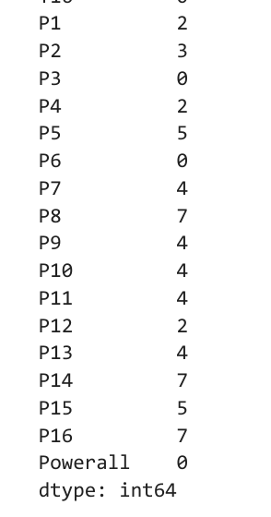
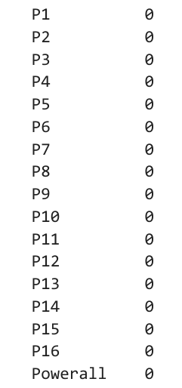
Data Cleaning and Preprocessing
Implemented Mean imputation technique to handle missing values
Before handling missing Value
After handling missing Value

Slide 6
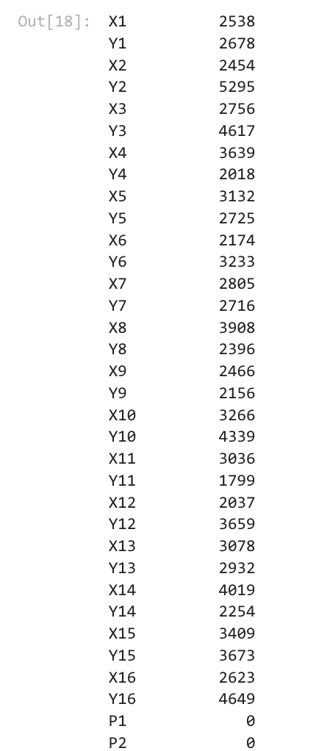
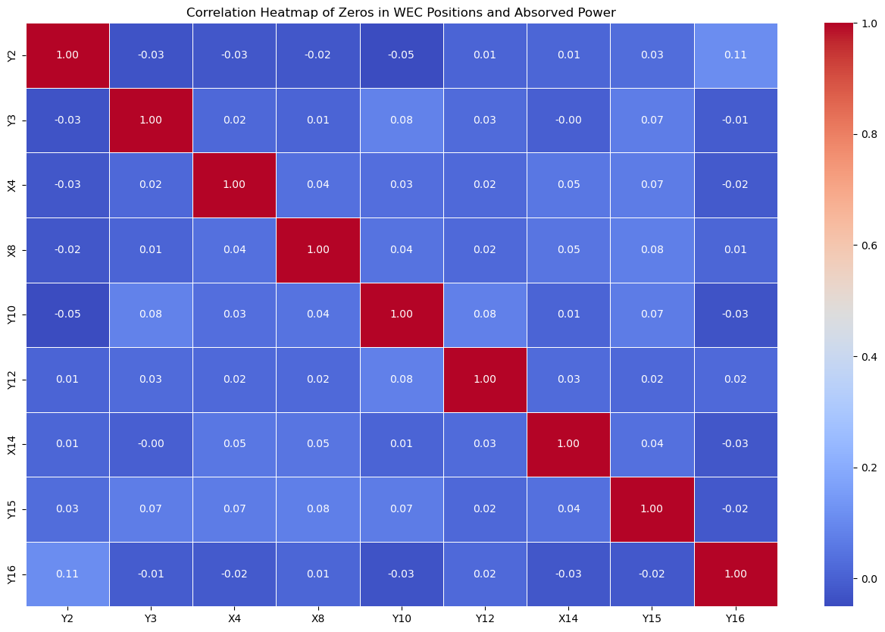
Data Cleaning and Preprocessing (Analyzing Zero Values)
If zeros in one feature have high correlation with another feature, it could indicate that the zeros are systematic and represent a real pattern. In such cases, they may be valid data points that highlight dependencies between variables.

Slide 7
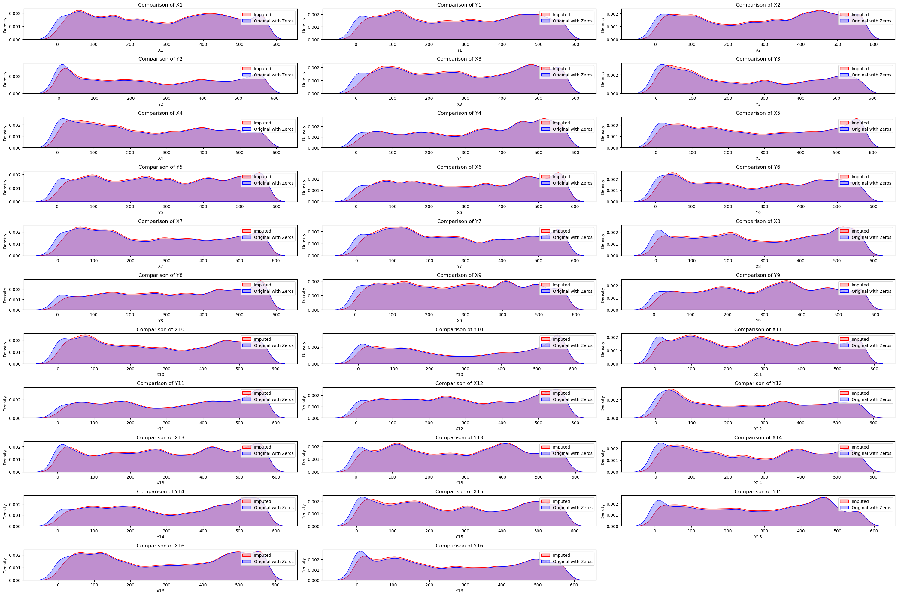
Data Cleaning and Preprocessing (Analyzing Zero Values)
We use K-Nearest Neighbors (KNN) Imputation: Because spatial relationships between WEC positions, making the imputed values more realistic.

Slide 8
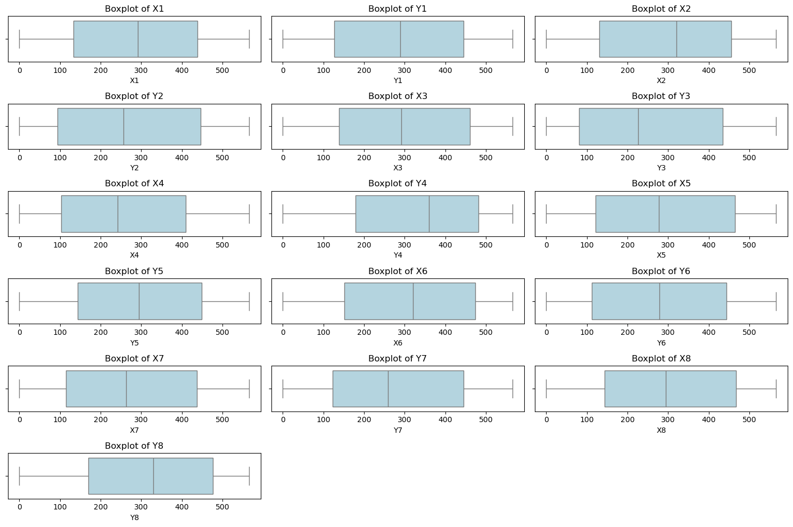
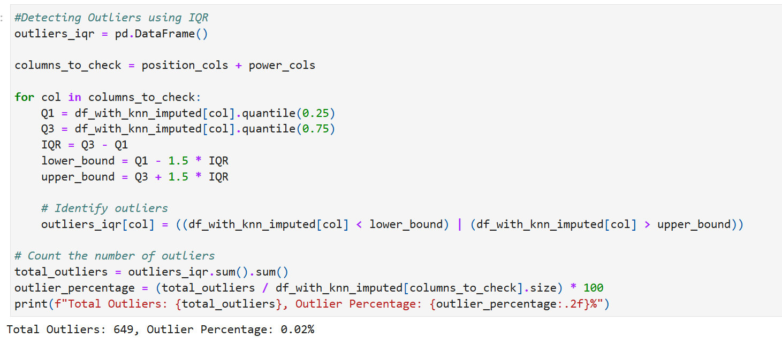
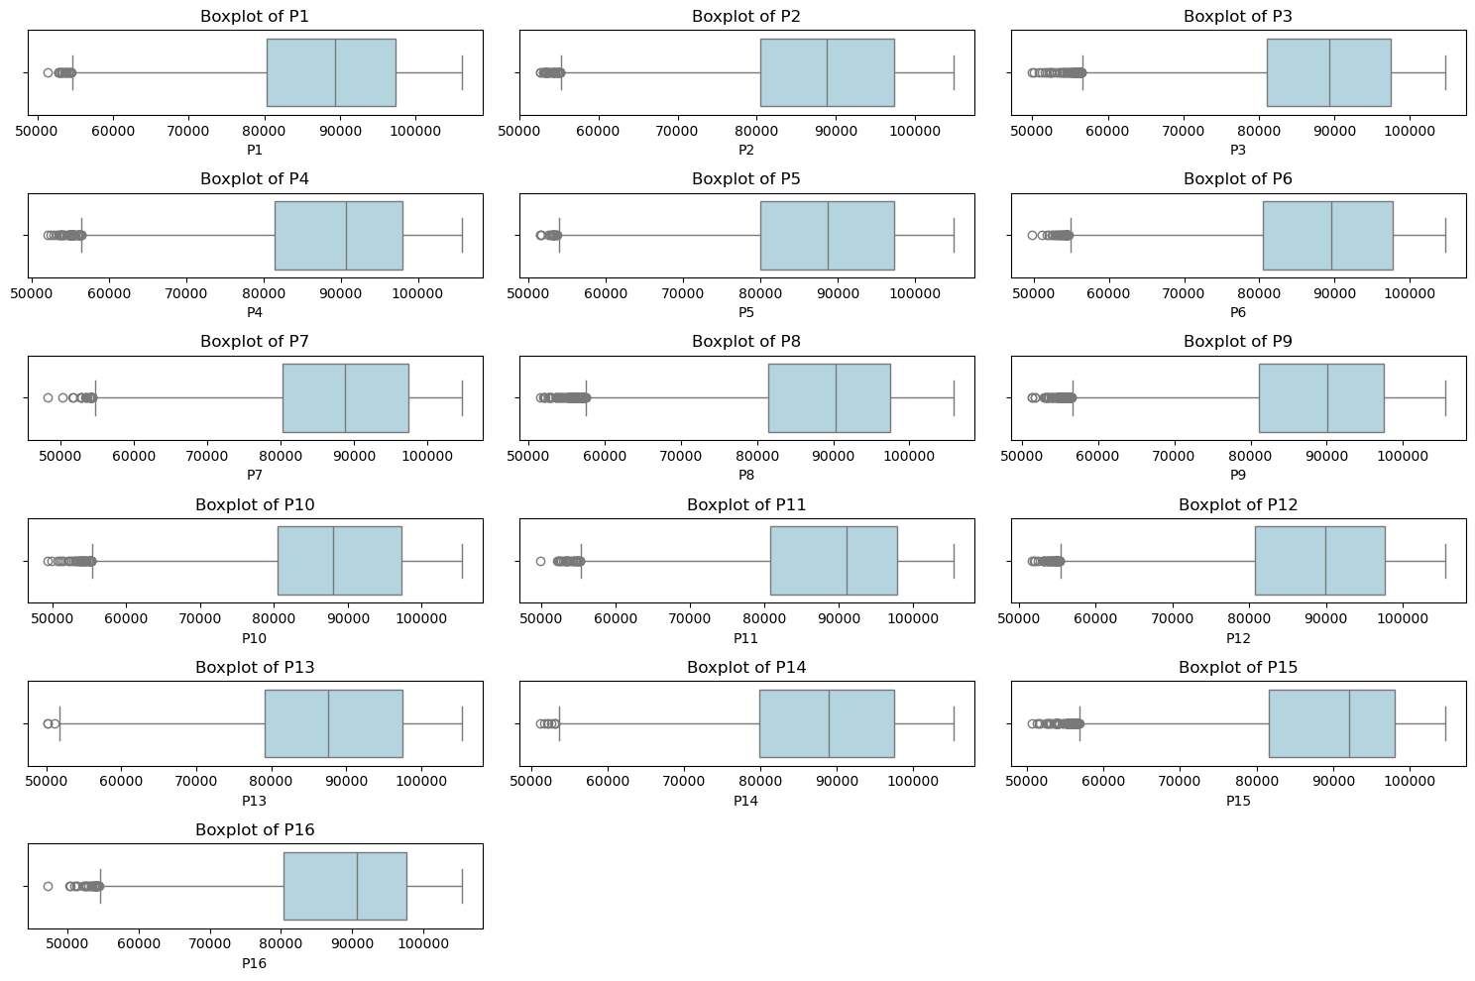
Data Cleaning and Preprocessing (Outlier Detection using IQR with Boxplot)
Handling Outliers:
Since Outliers is less than 5% we delete row contain outliers and
if it was more than 5% than we will replace the outliers value with mean of range of Q1 and Q3 data

Slide 9
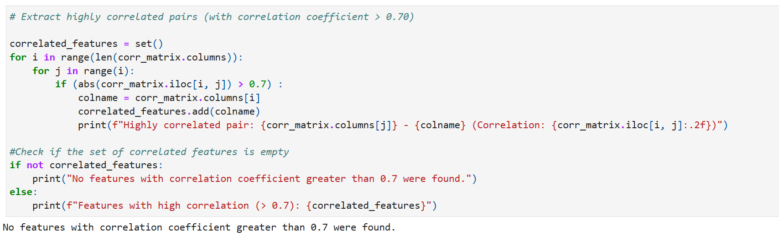
Data Cleaning and Preprocessing (Correlation checking)

Slide 10
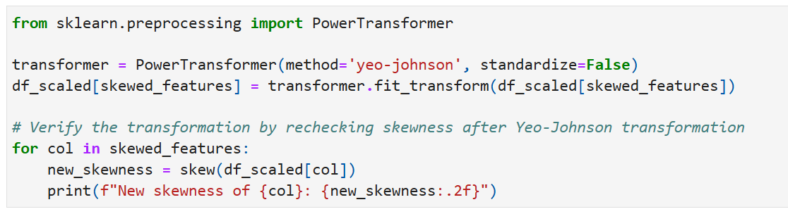
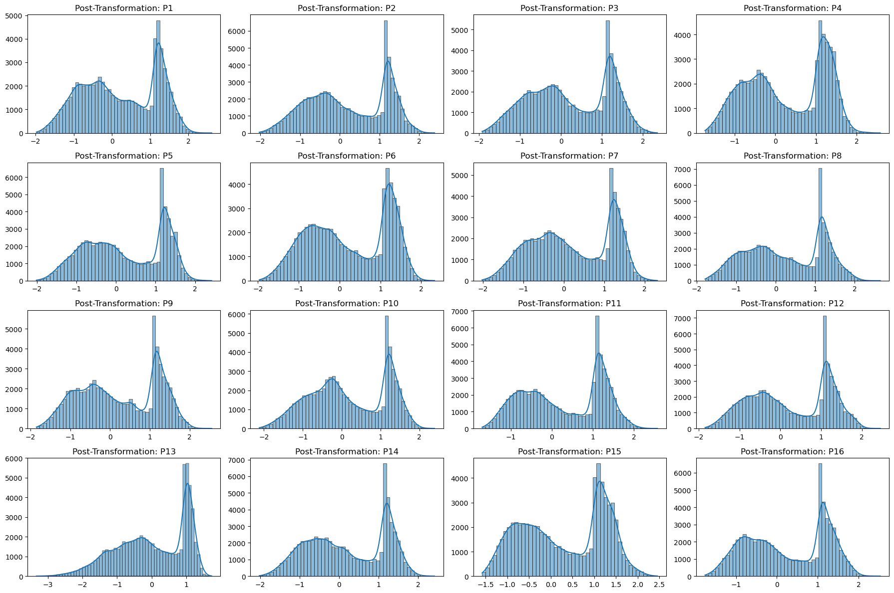
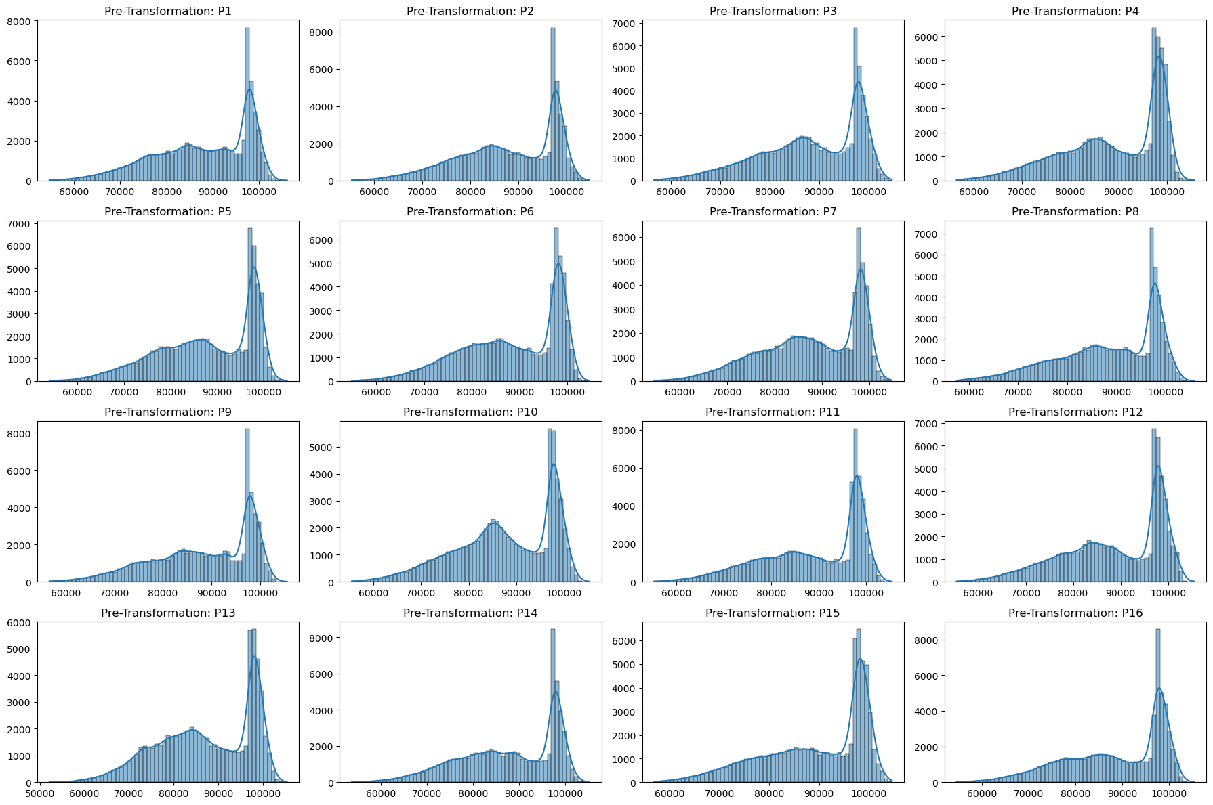
Data Cleaning and Preprocessing (Distribution Analysis and Skewness Check)
Final Dataset of Power columns

Slide 11
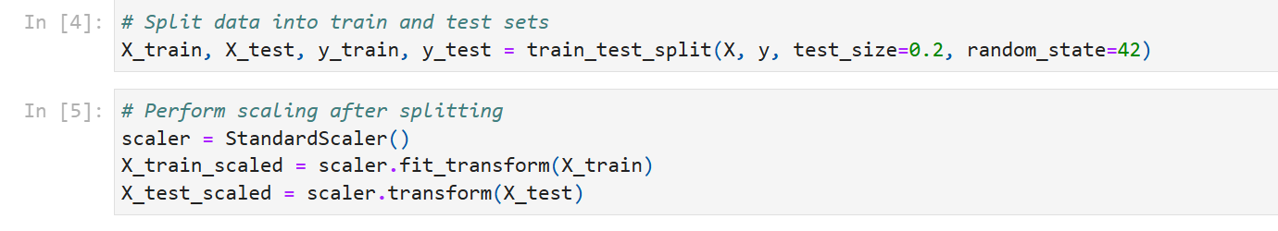
Data Cleaning and Preprocessing (Split and Scaling Dataset)
Split the dataset into Train and Test sets
Scaled data using Standard Scaling

Slide 12
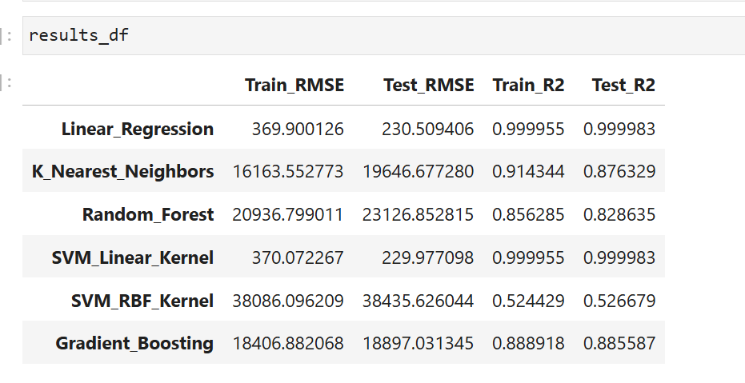
Model Building
Models: Linear Regression, Random Forest, Gradient Boosting, KNN, SVR(Linear), SVR(rbf)

Slide 13
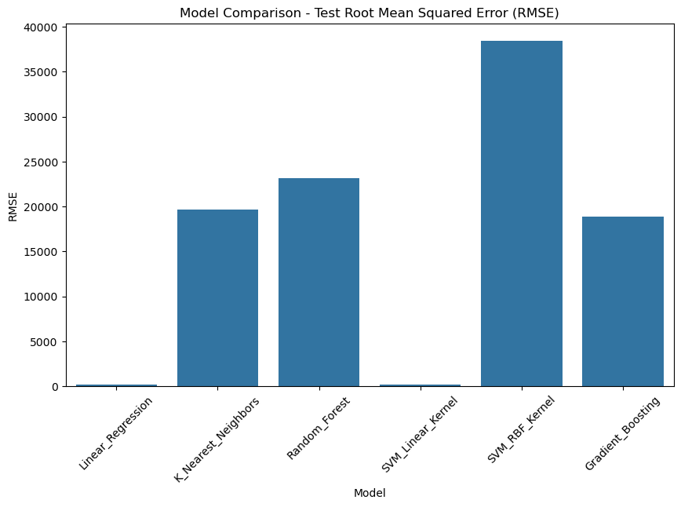
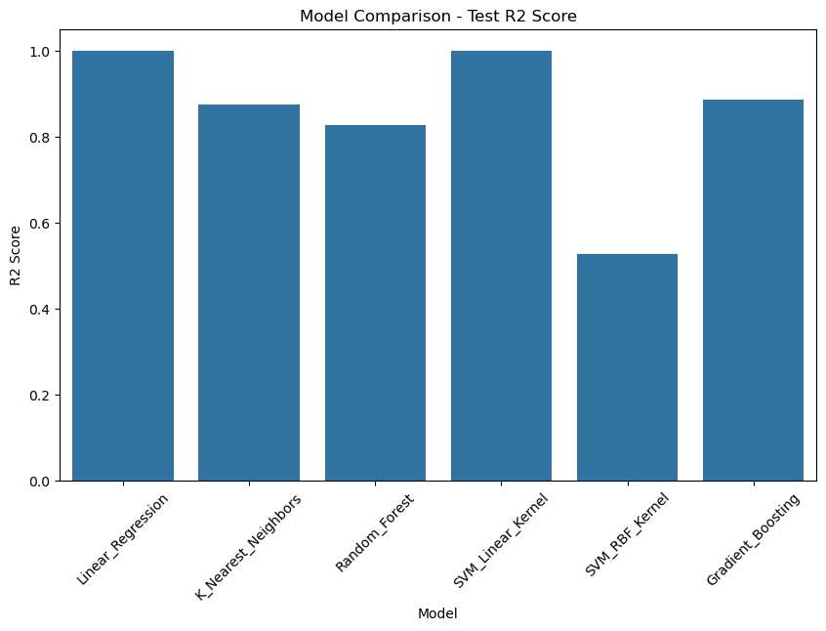
Model Evaluation (RMSE and R2 score Comparison of all model)
Best Performing Models:
Linear Regression (R²: ~1.0)
SVM (Linear Kernel, R²: ~1.0)

Slide 14
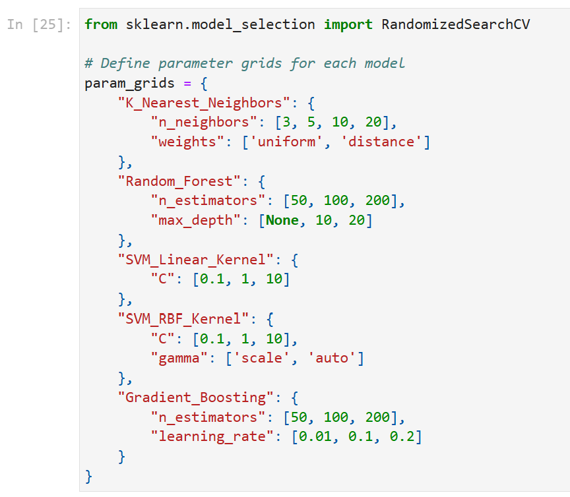
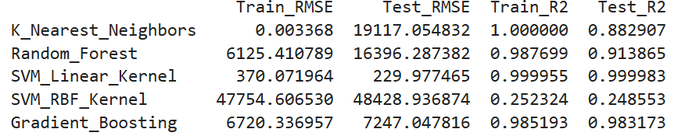
Hyperparameter Tuning
Hyperparameter tune model Result

Slide 15
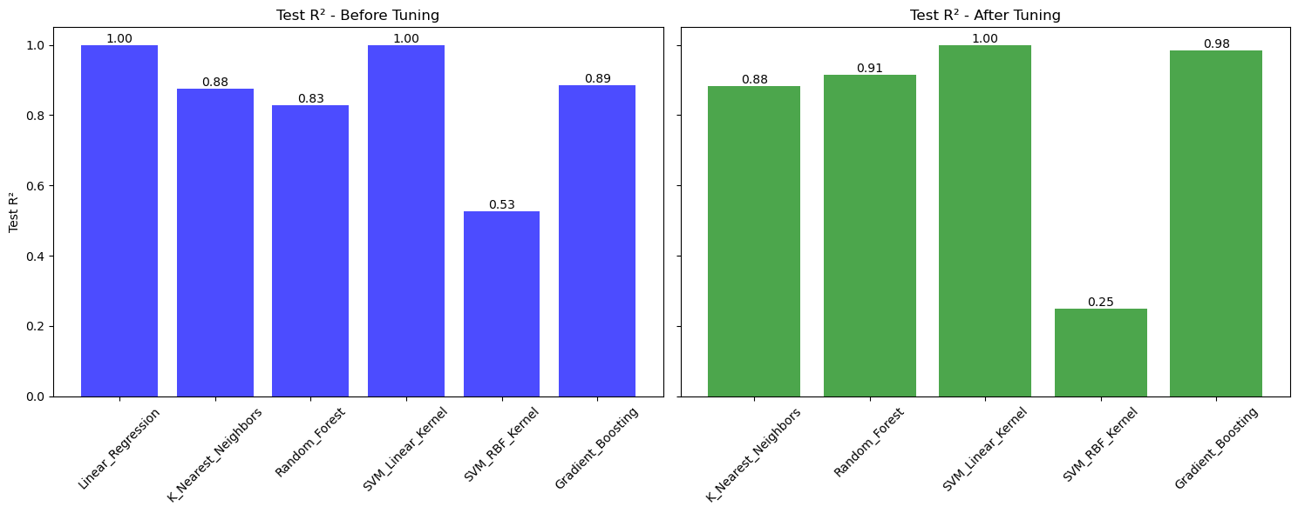
Hyperparameter Tuning (R2 Score Comparison)

Slide 16
Why Feature Selection using Lasso Regression?
1. Characteristics:
Handles large datasets with many features.
Addresses multicollinearity effectively.
Simple, computationally efficient, and interpretable.
2. Selected Features:
['P1', 'P2', 'P3', 'P4', 'P5', 'P6', 'P7', 'P8', 'P9', 'P10', 'P11', 'P12', 'P13', 'P14', 'P15', 'P16']

Slide 17
Feature Selection using Bidirectional Elimination
1. Characteristics:
Iteratively adds and removes features to find the optimal subset.
Useful for identifying features that maximize prediction accuracy.
2. Selected Features:
['Y3', 'Y4', 'X7', 'X12', 'Y12', 'X14', 'Y15', 'X16', 'P1', 'P2', 'P3', 'P4', 'P5', 'P6', 'P7', 'P8', 'P9', 'P10', 'P11', 'P12', 'P13', 'P14', 'P15', 'P16’]

Slide 18
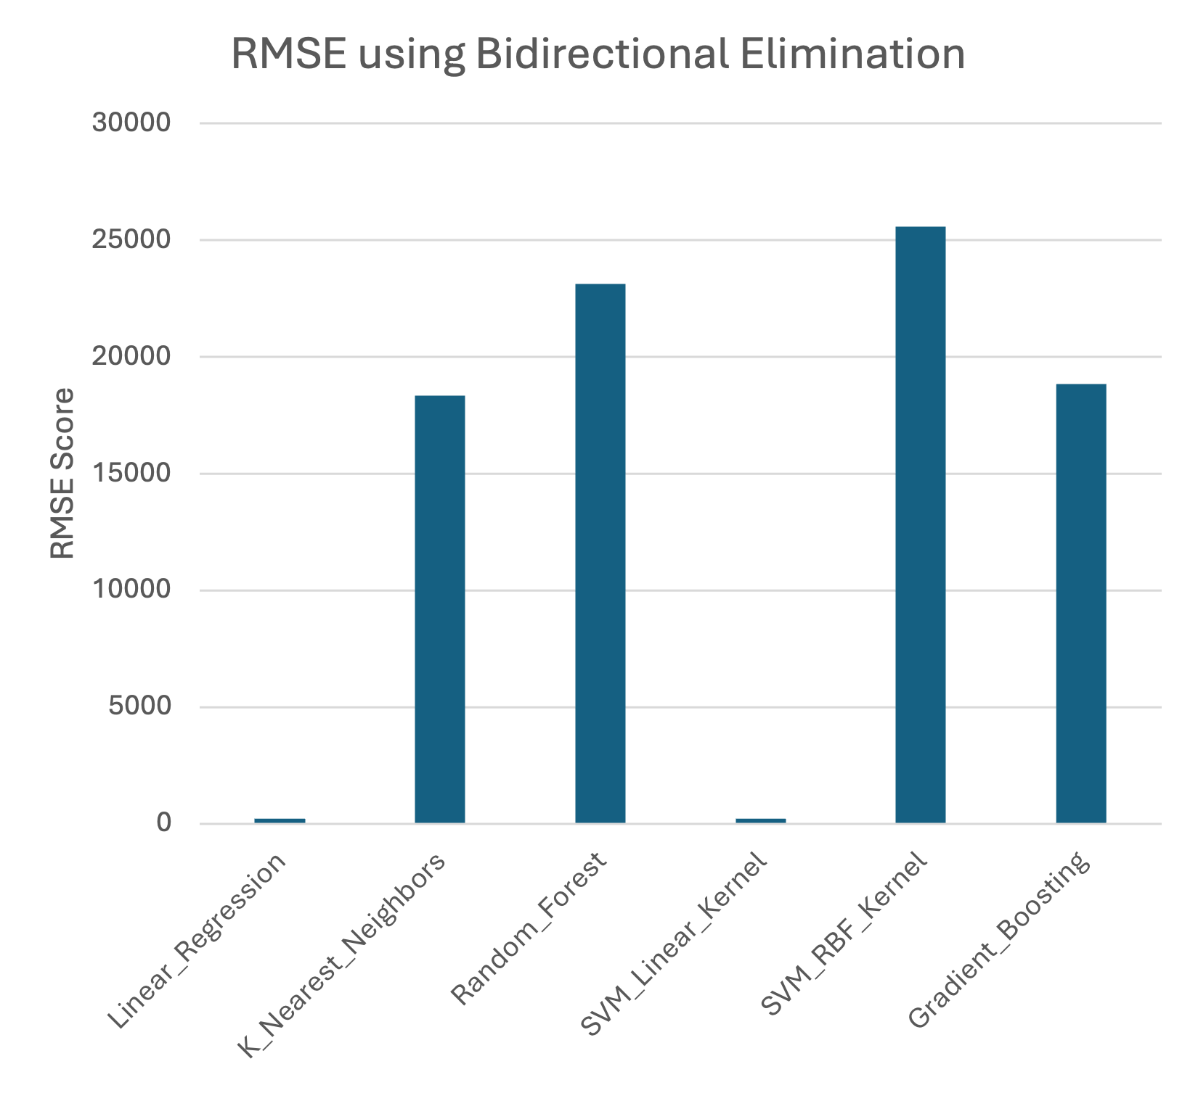
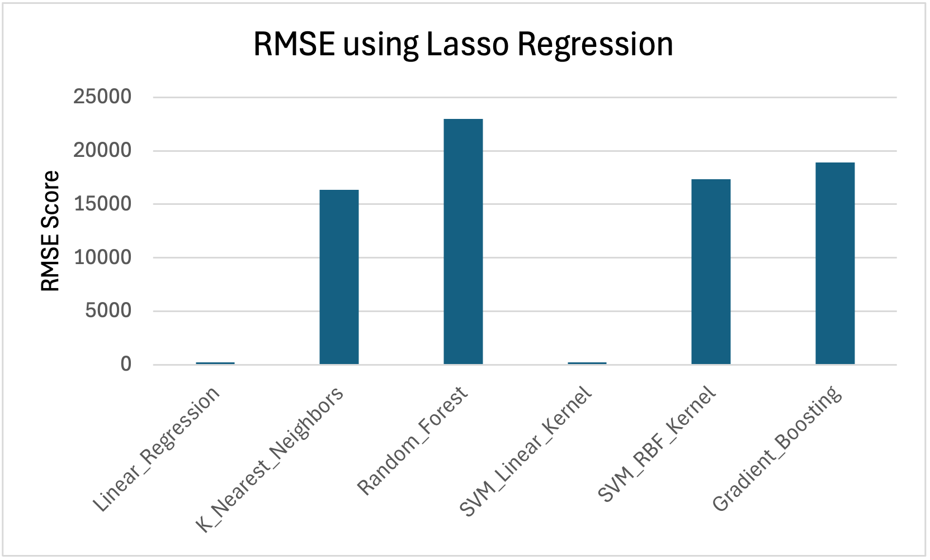
Lasso Regression vs Bidirectional Elimination
Why Lasso Regression Works Better for Us?
1. Handles multicollinearity, which is present in our data.
2. Computationally efficient, saving time with large datasets.
3. Produces a model with lower RMSE, indicating better predictive performance.

Slide 19
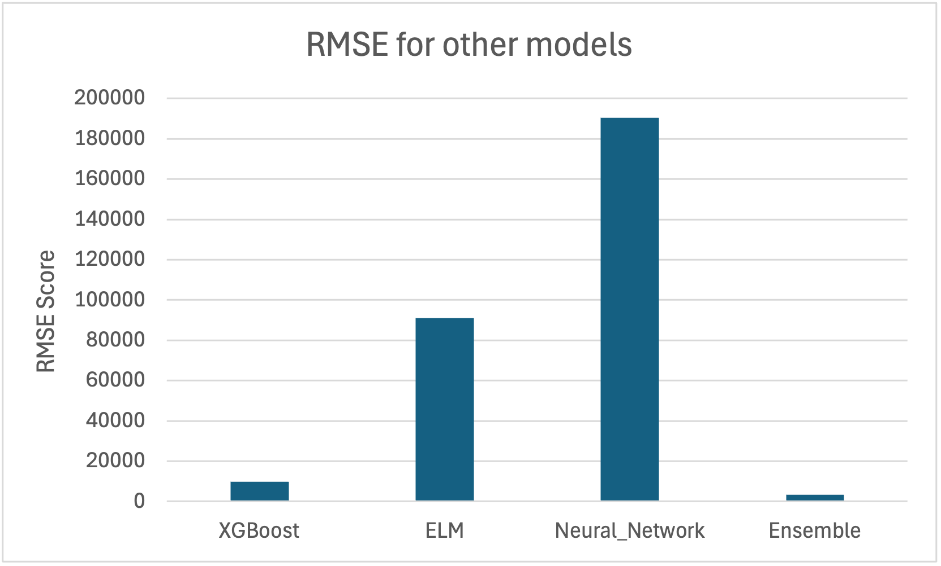
Other Models build after feature selection
Ensemble model is build using Linear Regression, SVM (Linear Kernel), and XGBoost which are the top-performing models for this dataset.

Slide 20
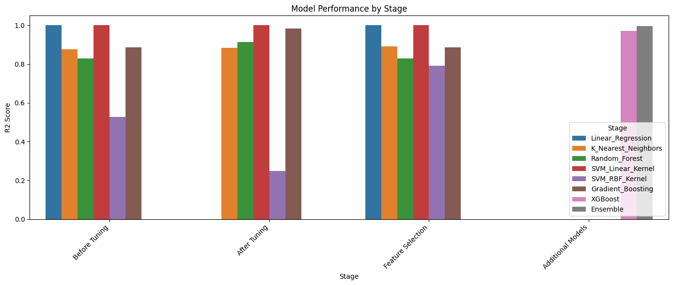



All model performances

Slide 21
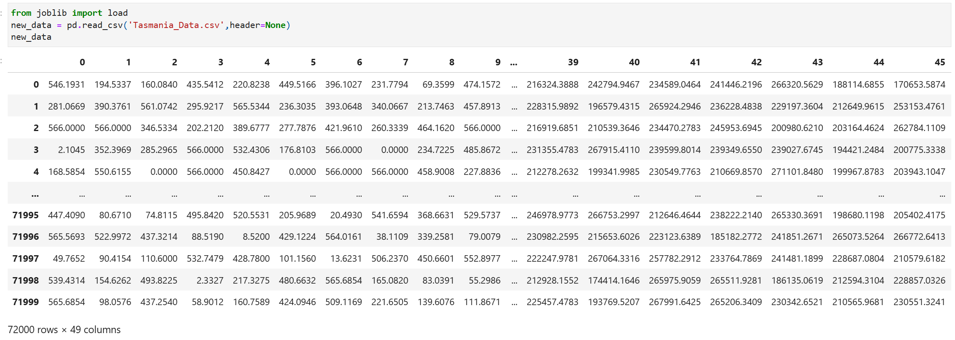
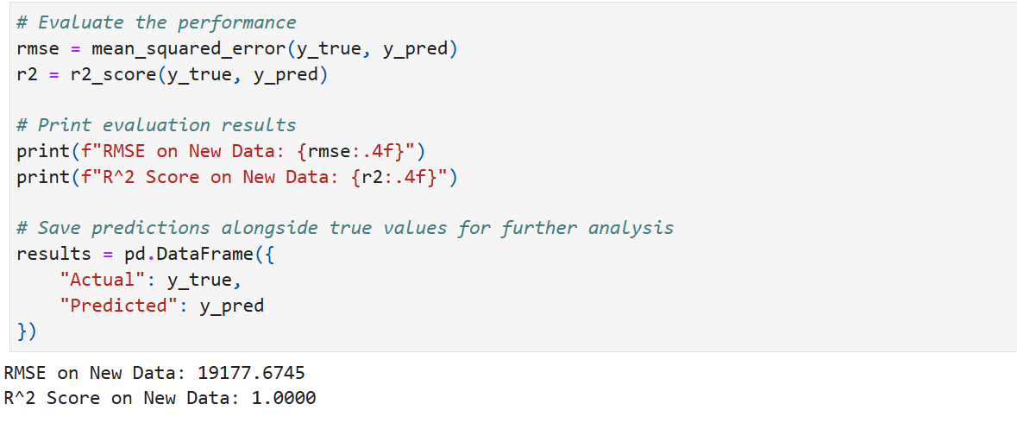
New Data Prediction and Accuracy

Slide 22
Conclusions
For inference – Linear Regression
Ideal for analyzing which machine contributes the most to overall power.
Helps determine whether the positioning of machines impacts their contribution to overall power.
For predictions – SVM Linear Kernel
The SVM Linear Kernel model achieved the lowest Test RMSE (229.98), with an almost perfect R² score of 1 on both training and testing sets.

Slide 23

Q&A
Thank you

