Slide 1
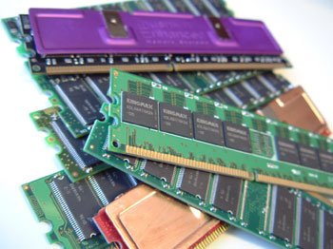
memory
Basic overview

Slide 2
agenda
Memory
Memory units
Types of memory
Ram
Types of ram
Rom
Types of rom

Slide 3
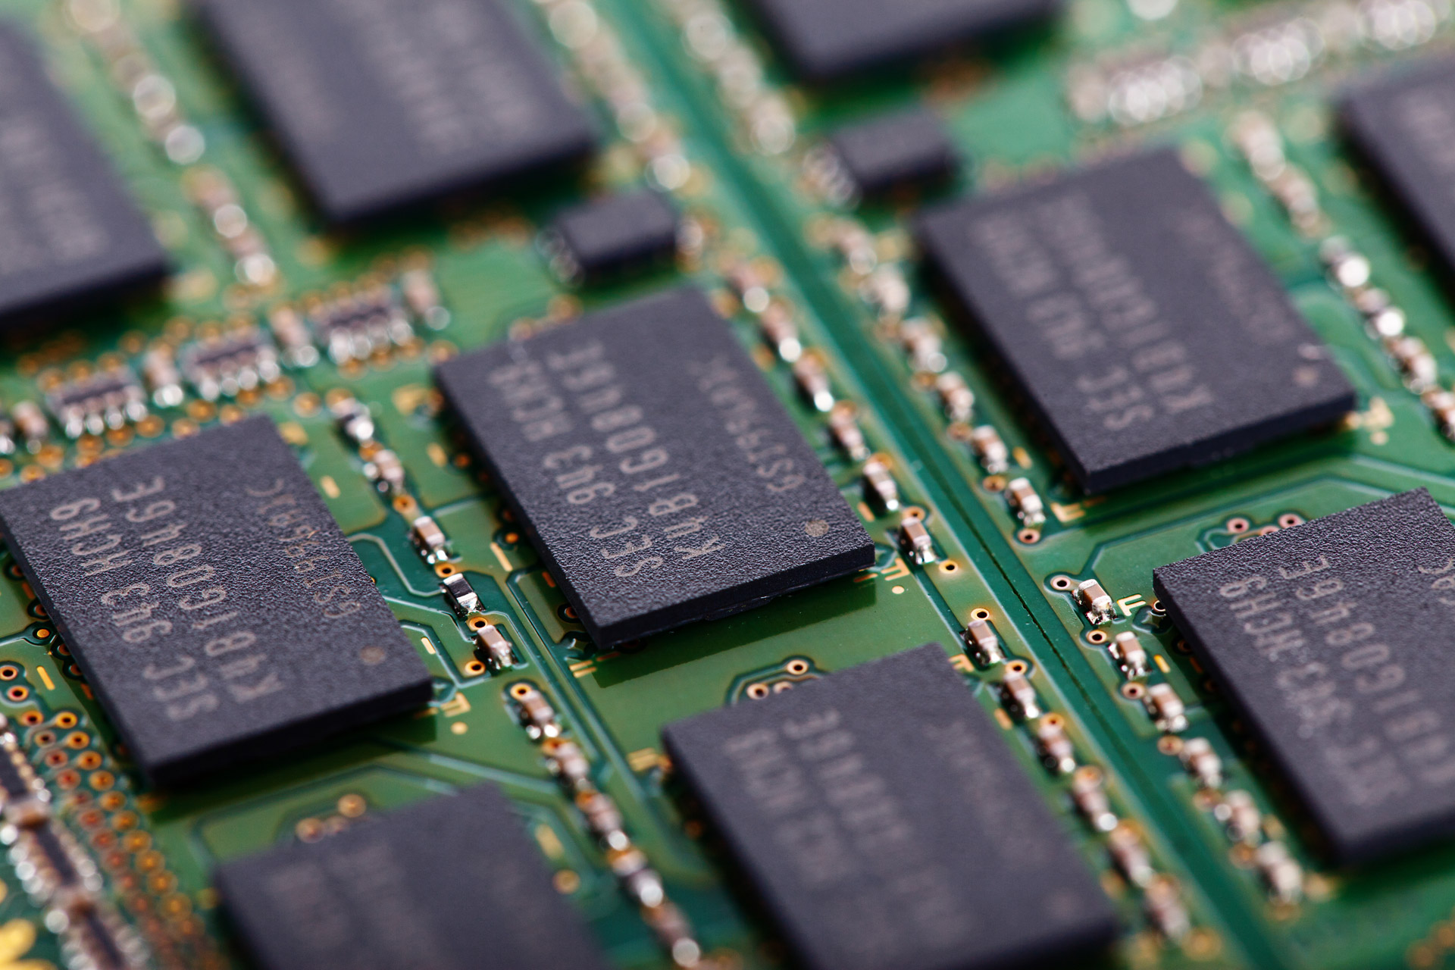
memory
A memory is just like a human brain. It is used to store data and instructions. Computer memory is the storage space in the computer, where data is to be processed and instructions required for processing are stored.

Slide 4
Memory units
Memory unit is the amount of data that can be stored in the storage unit
Bit (Binary Digit)
Nibble
Byte

Slide 5
units
Kilobyte (KB) [1 KB = 1024 Bytes]
Megabyte (MB) [1 MB = 1024 KB]
GigaByte (GB) [1 GB = 1024 MB]
TeraByte (TB) [1 TB = 1024 GB]

Slide 6
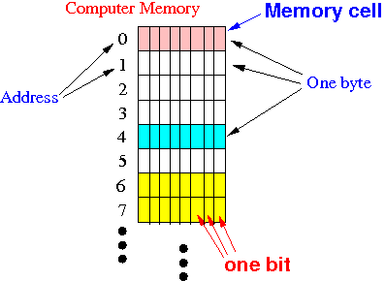
Sub points
The memory is divided into large number of small parts called cells.
Each location or cell has a unique address.

Slide 7
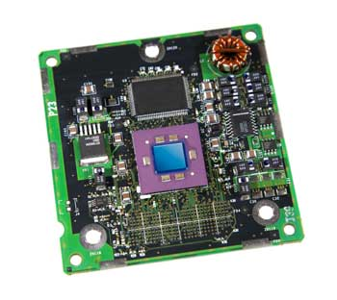
Cache Memory
Cache memory is a very high speed semiconductor memory which can speed up the CPU.
It holds frequently requested data and instructions so that they are immediately available to the CPU when needed.

Slide 8
advantages
Cache memory is faster than main memory.
It consumes less access time as compared to main memory.
It stores the program that can be executed within a short period of time.
It stores data for temporary use.

Slide 9
disadvantages
Cache memory has limited capacity.
It is very expensive

Slide 10
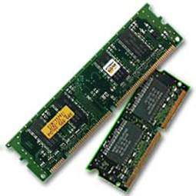
Primary Memory
Primary memory holds only those data and instructions on which the computer is currently working. It has a limited capacity and data is lost when power is switched off. It is generally made up of semiconductor device.
The data and instruction required to be processed resides in the main memory. It is divided into two subcategories RAM and ROM.

Slide 11
Characteristics of primary memory
It is known as the main memory.
Usually volatile memory.
Data is lost in case power is switched off.
Faster than secondary memories.
A computer cannot run without the primary memory.

Slide 12
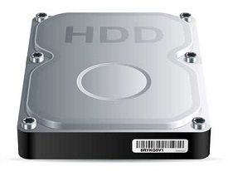
Secondary Memory
This type of memory is also known as external memory or non-volatile. It is slower than the main memory. These are used for storing data/information permanently.

Slide 13
Characteristics of secondary memory
It is known as the backup memory.
It is a non-volatile memory.
Data is permanently stored even if power is switched off.
It is used for storage of data in a computer.
Computer may run without the secondary memory.

Slide 14
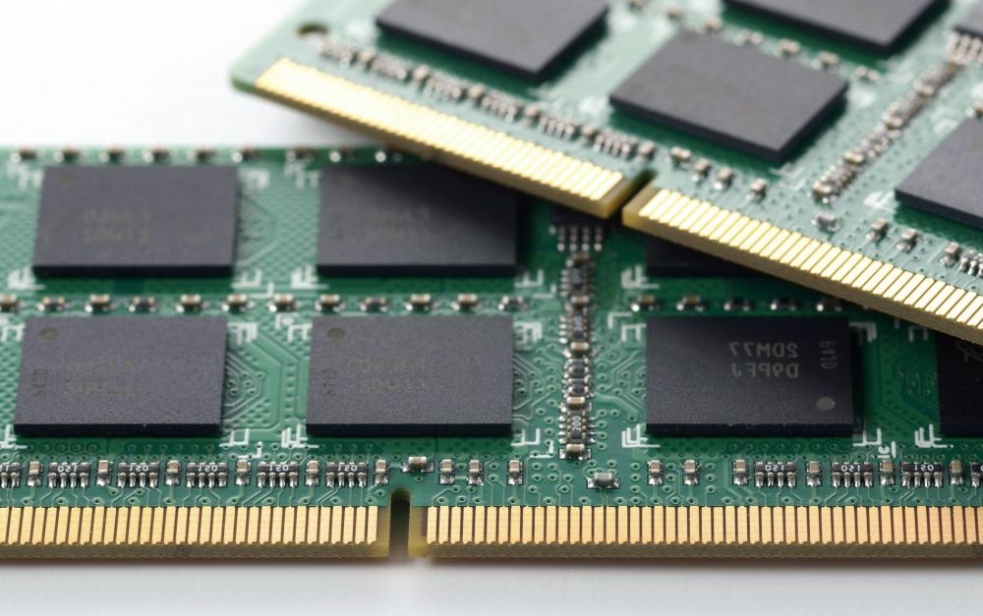
Random access memory - ram
RAM (Random Access Memory) is the internal memory of the CPU for storing data, program, and program result. It is a read/write memory which stores data until the machine is working. As soon as the machine is switched off, data is erased.
Types:
SRAM
DRAM

Slide 15
Static RAM – [sram]
Long life
No need to refresh
Faster
Used as cache memory
Expensive
High power consumption

Slide 16
Dynamic RAM (DRAM)
DRAM, must be continually refreshed in order to maintain the data.
Short data lifetime
Slower as compared to SRAM
Smaller in size
Less expensive
Less power consumption

Slide 17
Read only memory
The memory from which we can only read but cannot write on it. This type of memory is non-volatile. The information is stored permanently in such memories during manufacture.
A ROM stores such instructions that are required to start a computer.
ROM chips are not only used in the computer but also in other electronic items like washing machine and microwave oven.

Slide 18
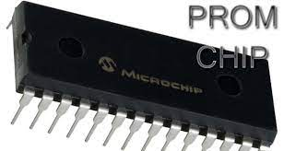
PROM
PROM is read-only memory that can be modified only once by a user. The user buys a blank PROM and enters the desired contents using a PROM program.

Slide 19
EPROM
EPROM can be erased by exposing it to ultra-violet light for a duration of up to 40 minutes. Usually, an EPROM eraser achieves this function.

Slide 20
EEPROM
EEPROM is programmed and erased electrically. It can be erased and reprogrammed about ten thousand times. Both erasing and programming take about 4 to 10 ms (millisecond).

Slide 21
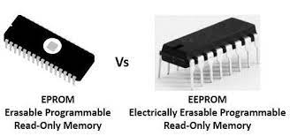

Slide 22
THANK YOU

