Slide 1
Basics of networking
MOHAMED RAHMAN SHAREFF S

Slide 2
Agenda:
Computer, Computing and Programming
Network [Internet, Intranet & Extranet]
Protocols
TCP and UDP Concept
Ports & Ethernets
Server vs Client Concept
Networking Devices [NIC, Hub, Switch, Routers etc,.]
OSI Layers

Slide 3
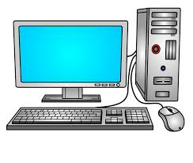
COMPUTER
A MACHINE THAT CAN BE INSTRUCTED TO CARRY OUT SEQUENCES OF ARITHMETIC OR LOGICAL OPERATORS AUTOMATICALLY VIA COMPUTER PROGRAMMING.
FACT :
The First Computer Weighed More Than 27 Tons

Slide 4


COMPUTING :
The use of operations of computer. It may be arithmetical and logical…..
PROGRAMMING :
It is the process of creating a set of instructions that tells a computer how to performs a task….

Slide 5
Network [Intranet, Extranet & Internet]
Two or more computers that are linked in order to share resources, exchange files or electronic communications
Internet : A selected Internetworking , consists of a worldwide interconnection of governmental or public
Intranet : It can be defined as a private network.
Extranet : Controlled private network

Slide 6
PROTOCOLS
Set of rules that allow electronic devices to communicate with each other
1. TCP/IP
2. UDP
3. DNS
4. DHCP

Slide 7
TCP – Transmission Control Protocol
It will always check if the recipient is available or not.
It will always expect and acknowledge from the recipient
Will be slow
No data loss
It is called heavy weighted protocol

Slide 8
UDP - User Datagram Protocol
It will not check
Will not expect
Will be fast
Data loss will be occur
It is called light weighted protocol

Slide 9
PORTS:
Every protocols will have a port number assigned to it.
It’s an communication entry point or end point
Ethernet:
It is most commonly used in wired LAN technology
It can be used Co-axial Cable or Twisted Pair Cable

Slide 10
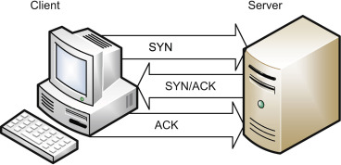
Three way handshake

Slide 11
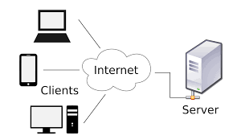
Server and Client Concepts
Server :
It may be a piece of hardware and software that provides data or information to another computer or client over the internet
Client :
It may be a piece of hardware that access a service made by a server

Slide 12
NETWORK DEVICES
HUB :
A network hardware device for connecting multiple ethernet devices together and making them act as a single network segment
SWITCH :
A network hardware that connects devices on a computer network by using packet switching to receive and forward data to the destination devices
ROUTER :
It connects computers and other devices to the internet. It chooses a best path for your information travel. It decides which computer’s get priority over others

Slide 13
Open System Interconnect - OSI LAYERS
Away
Pizza
Sausage
Throw
Not
Do
Please
How data is transferred from source to destination.
OSI – 7 layers and each layer has a device placed

Slide 14
Application Layer – HTTP, SMTP
Presentation Layer – JPEG, AVI
Session Layer – SESSION MANAGEMENT
Transport Layer – TCP, UDP
Network Layer – ROUTER, IP ADDRESSING
Data Link Layer – SWITCH, MAC ADDRESSING
Physical Layer - CABLES HUB, NIC

Slide 15
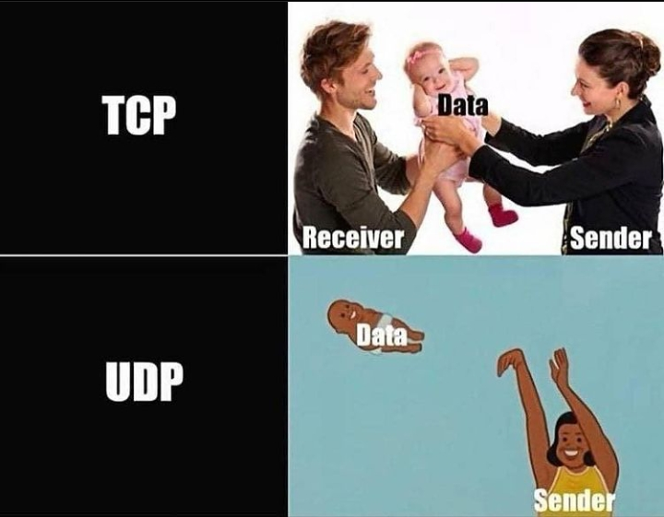

Slide 16
THANK YOU

