Slide 1
CCCS 425 – Web Services Module 1 – Introduction to Web Services

Slide 2

Acknowledgement
The following materials are produced from various online sources. Links to the original materials have been provided.

Slide 3
Session Learning Outcomes
Explain how HTTP protocol works and how it may be used to deliver web-services
Identify and explain the Server Components
Create, understand, and use XML documents

Slide 4
Session Overview
Introduction
Understanding Web and HTTP
HTTP Headers, Requests and Responses
Understanding Web Services

Slide 5
Introduction

Slide 6
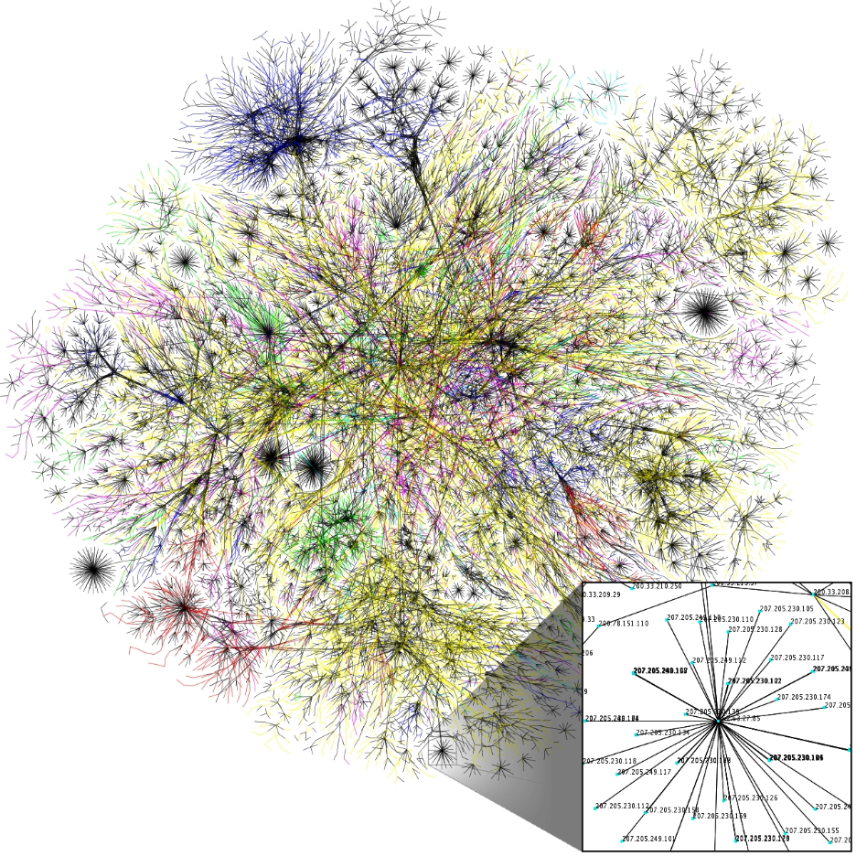
The Internet
The Internet is the global system of interconnected computer networks that uses the Internet protocol suite (TCP/IP) to communicate between networks and devices.
It is a network of networks that consists of private, public, academic, business, and government networks of local to global scope, linked by a broad array of electronic, wireless, and optical networking technologies.
The Internet carries a vast range of information resources and services, such as the inter-linked hypertext documents and applications of the World Wide Web (WWW), electronic mail, telephony, and file sharing.
https://en.wikipedia.org/wiki/Internet

Slide 7
Components of a Web Application
A Client and Server computer may interact with each other though an internet connection

Slide 8
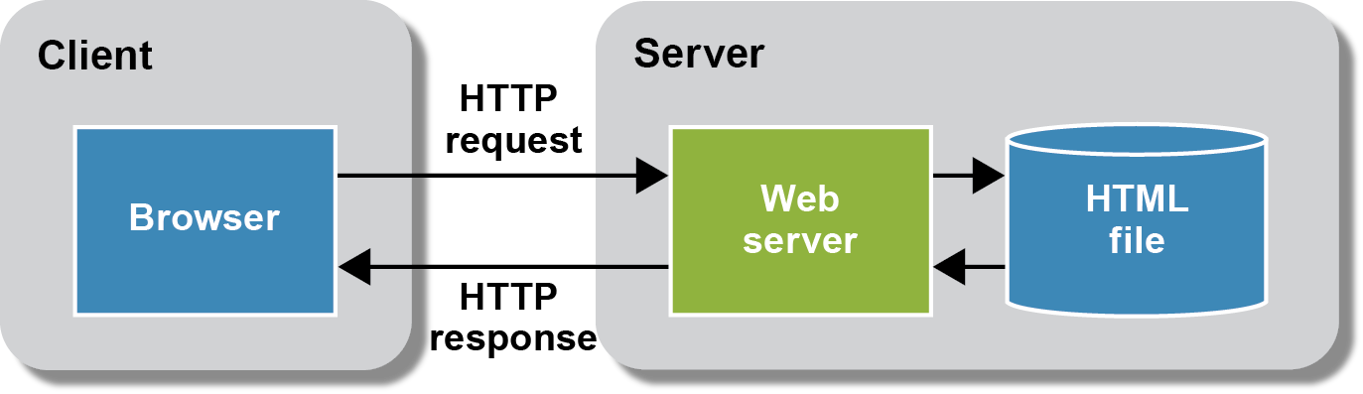
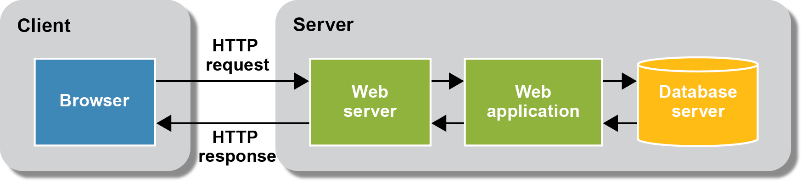
Static vs. Dynamic Pages
A Server may serve the client through static or dynamically generated content

Slide 9
What is a Web Service?
The World Wide Web Consortium (W3C) organization, which establishes the standards for Web services, defines them as follows:
“A Web service is a software system identified by a URI whose public interfaces and bindings are defined and described using XML.”

Slide 10
Benefits of Web Services
Interoperability in a heterogeneous environment
Business Services through the Web
Integration with existing systems
Freedom of choice
Support more client types
Programming productivity

Slide 11
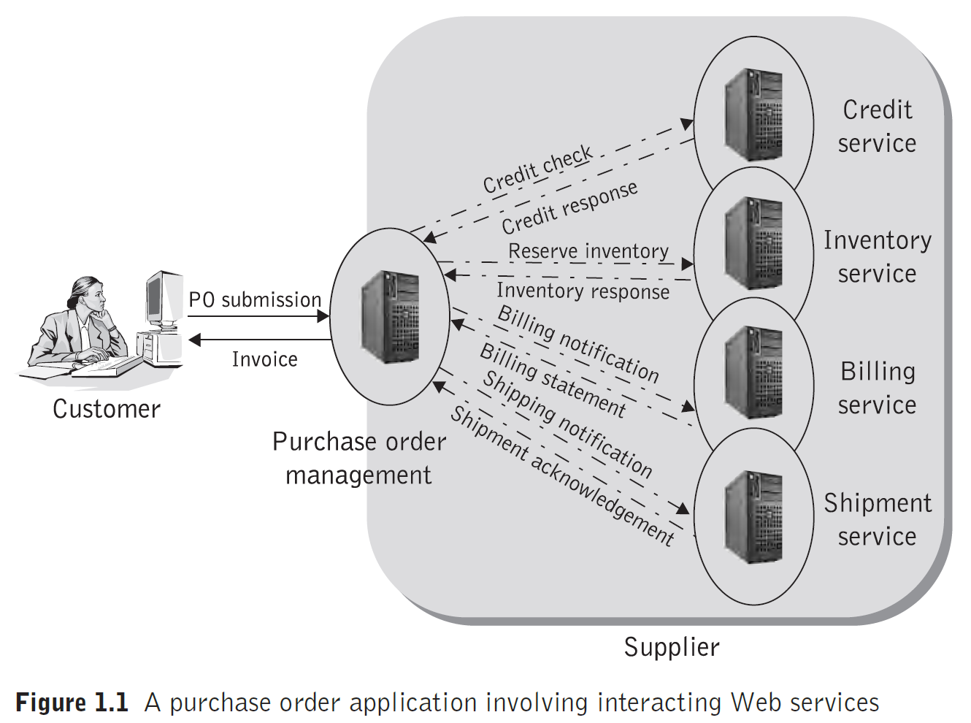
A Web Service Example
Web Services & SOA: Principles and Technology

Slide 12
Understanding Web Services

Slide 13
What is Service Oriented Architecture?
Service-oriented architecture (SOA) is a style of software design where services are provided to the other components by application components, through a communication protocol over a network.
The basic principles of service-oriented architecture are independent of vendors, products and technologies.
A service is a discrete unit of functionality that can be accessed remotely and acted upon and updated independently, such as retrieving a credit card statement online.

Slide 14
Examples of SOA
Web services i.e. WSDL and SOAP
Messaging
RESTful HTTP, with Representational state transfer (REST) constituting its own constraints-based architectural style
WCF (Microsoft's implementation of Web services, forming a part of WCF)
And many others…

Slide 15
Microservices
Microservices are a modern interpretation of service-oriented architectures used to build distributed software systems.
Services in a microservice architecture are processes that communicate with each other over the network in order to fulfill a goal.

Slide 16
Web Service Standards
Common markup language for communication: Web services use eXtensible Markup Language (XML) for the common markup language.
Common message format for exchanging information: Simple Object Access Protocol (SOAP) provides a common message format for Web services.
Common service specification formats: Web Services Description Language (WSDL) provides Web services with common specification formats.
Common means for service lookup: Universal Description, Discovery, and Integration (UDDI) specification defines a common means for looking up Web services.

Slide 17
Web Services Characteristics
Web services are XML-based.
Web services are loosely coupled.
Web services are designed in a coarse-grained fashion.
Web services may be implemented / consumed synchronously as well as asynchronously.
They support Remote Procedure Calls (RPCs).
They Document Exchange.

Slide 18
Elements, Roles, and Operations in Web Services
Service or Service Provider is the service interface / component that is typically hosted on a web server and makes the service available on the internet.
Client or Service Requestor is the consumer of the service.
Service Implementation is the physical implementation of the service.

Slide 19
Elements, Roles, and Operations in Web Services
Service Definition describes the public interface to a specific web service.
Service Processing is referred to the process of the execution of the service and returning the result to the client.
Stub is referred to a piece of code that converts parameters passed between client and server during a service call.

Slide 20
Elements, Roles, and Operations in Web Services
Service Transport is the layer responsible for transporting messages between the client and the server. HTTP/HTTPS
Service Registry is a logically centralized directory of services. The registry is a central point where service developers publish new services or find existing ones.
Service Discovery is the process of finding and locating a particular service.

Slide 21
Elements, Roles, and Operations in Web Services
XML Messaging is responsible for encoding messages in a common XML format so that messages can be understood at either end. Currently used in SOAP and XML-RPC.

Slide 22
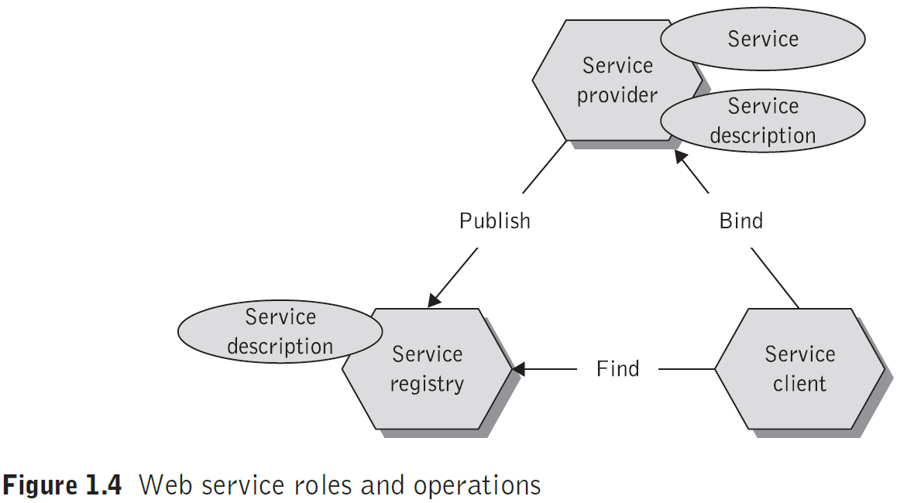
Operations in SOA
Web Services & SOA: Principles and Technology

Slide 23
Operations in SOA /cont.
Publishing a Web service, so that other users or applications can find it, actually consists of two important operations.
The first operation is describing the Web service itself;
The other is the actual registration of the Web service.
Finding Web services is also a two-fold operation:
First discovering the services in the registry of the discovery agency and then
Selecting the desired Web service(s) from the search results.

Slide 24
Operations in SOA /cont.
Invocating the Web service is the final operation in the Web services architecture.
During the binding operation, the service requestor invokes or initiates an interaction at run-time using the binding details in the service description to locate and contract to the service.
It uses the technical information entered in the registry by the Web services provider.

Slide 25
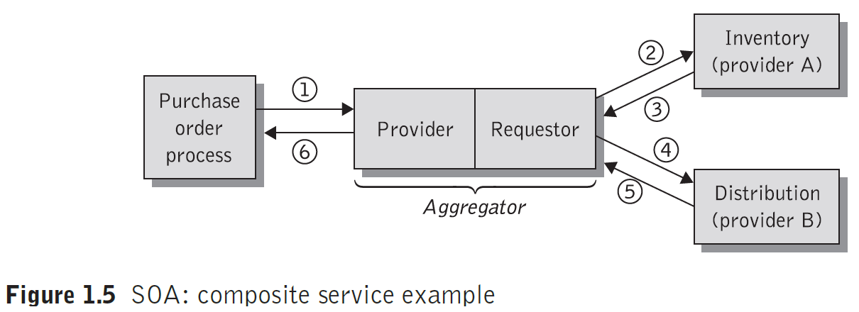
A Composite Service Example
A Composite service example is illustrated in the following diagram:
Web Services & SOA: Principles and Technology

Slide 27
Understanding Web and HTTP

Slide 28
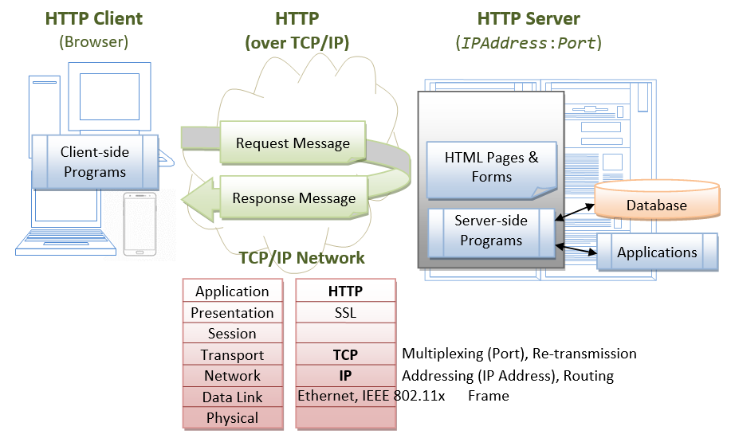
HTTP Client & Server
The HTTP protocol, the conversation between the client and the server and the TCP/IP network model:
https://www.ntu.edu.sg/home/ehchua/programming/java/JavaServlets.html

Slide 29
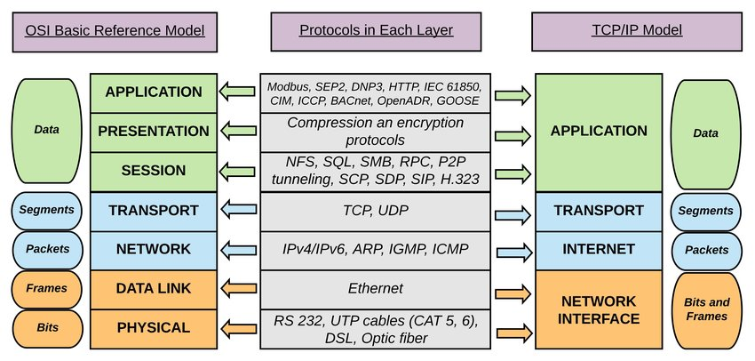
The TCP/IP
TCP/IP , OSI, The Layers and Protocols
https://www.researchgate.net/figure/The-logical-mapping-between-OSI-basic-reference-model-and-the-TCP-IP-stack_fig2_327483011

Slide 30
GET vs POST
 | GET | POST
History | Parameters remain in browser history because they are part of the URL | Parameters are not saved in browser history.
Bookmarked | Can be bookmarked. | Can not be bookmarked.
BACK button/re-submit behaviour | GET requests are re-executed but may not be re-submitted to server if the HTML is stored in the browser cache. | The browser usually alerts the user that data will need to be re-submitted.
Encoding type (enctype attribute) | application/x-www-form-urlencoded | multipart/form-data or application/x-www-form-urlencoded Use multipart encoding for binary data.
Parameters | can send but the parameter data is limited to what we can stuff into the request line (URL). Safest to use less than 2K of parameters, some servers handle up to 64K | Can send parameters, including uploading files, to the server.
Hacked | Easier to hack for script kiddies | More difficult to hack
Restrictions | Yes, only ASCII characters allowed. | No restrictions. Binary data is also allowed.
Security | GET is less secure compared to POST because data sent is part of the URL. So it's saved in browser history and server logs in plaintext. | POST is a little safer than GET because the parameters are not stored in browser history or in web-server logs.
Restrictions on form data length | Yes, since form data is in the URL and URL length is restricted. A safe URL length limit is often 2048 characters but varies by browser and web server. | No restrictions
Usability | GET method should not be used when sending passwords or other sensitive information. | POST method used when sending passwords or other sensitive information.
Visibility | GET method is visible to everyone (it will be displayed in the browser's address bar) and has limits on the amount of information to send. | POST method variables are not displayed in the URL.
Cached | Can be cached | Not cached
https://www.diffen.com/difference/GET-vs-POST-HTTP-Requests

Slide 31
HTTP Verbs (Request Methods)
GET
HEAD
POST
PUT
DELETE
TRACE
OPTIONS
CONNECT
PATCH
GET
Provides a read only access to a resource / page.
POST
Used to send data to a resource / page.
Used to create a new resource / page.
DELETE
Used to remove a resource / page.
PUT
Used to update an existing / create a new resource / page.
More info on https://en.wikipedia.org/wiki/Hypertext_Transfer_Protocol

Slide 32
Web Clients
A web client is typically a web browser that connects to a web server and retrieves a web page for display.
A web service is a program that is invoked by a URL and returns a response to the web client, via a transport protocol (i.e. HTTP).
Server software in an enterprise application sees both requests and sessions from two angles, as the server from the client and as the client to other systems.

Slide 33
Other Web Clients
Other forms of software / desktop tools may be used as on the client component to communicate with the server and consume a web service. These may include:
Command Line Applications (e.g. curl),
Desktop Applications / Service Tools (e.g. SoapUI or Postman),
Browsers Developer Tools (available in most browsers), or a
Network Programming Component (e.g. AJAX, WebSocket, Java HTTPURLConnection, or Apache HttpClient, …).

Slide 34
HTTP Headers, Requests and Responses

Slide 35
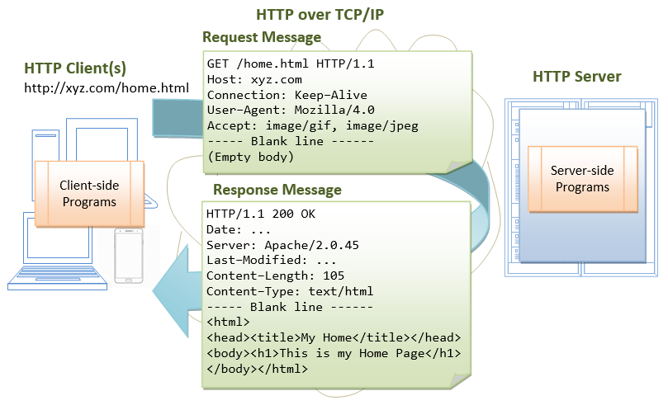
HTTP Headers, Requests and Responses
The Request and Response Headers provide additional information to the server and the client, respectively
https://www.ntu.edu.sg/home/ehchua/programming/java/JavaServlets.html

Slide 36
HTTP Headers
Some Request Headers
Accept
Authorization
Content-Length
Cookie
Referrer
Some Response Headers
Age
Accept
Content-Length
Content-Type
Expires
Location
Content-Disposition
Example of Non-Standard* Request Header
X-Forwarded-Host
Example of Non-Standard* Response Header
X-XSS-Protection
More info on https://en.wikipedia.org/wiki/List_of_HTTP_header_fields

Slide 38
Software NetBeans / IntelliJ IDEA

Slide 39
Lab Activity
Using NetBeans
Using IntelliJ IDEA

Slide 40
Session Summary
Web Services and SOA Architecture
Hypertext Transfer Protocol
Server Components
Using IntelliJ IDEA

Slide 41
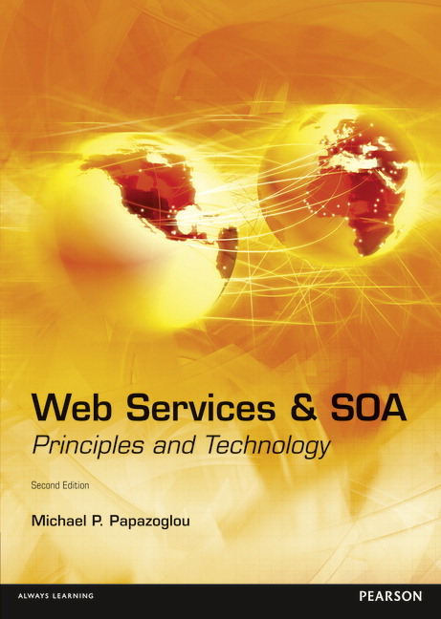
Acknowledgements
Web Services & SOA, Principles and Technology, Michael P. Papazoglou, Pearson Canada, 2nd Edition, 2012, ISBN: 978-0273732167
Additional online resources:
https://www.tutorialspoint.com/webservices/web_services_characteristics.htm
https://en.wikipedia.org/wiki/Hypertext_Transfer_Protocol
https://www.javatpoint.com/xml-tutorial
https://www.w3schools.com/xml/default.asp

Slide 42
Further Reading
https://www.tutorialspoint.com/webservices/

Slide 43
Next - Java Web and Servlets

