Slide 1
CCCS 425 – Web Services Module 2 – Java Web and Servlets

Slide 2

Acknowledgement
The following materials are produced from various online sources. Links to the original materials have been provided.

Slide 3
Session Learning Outcomes
Explain Java Web Application Architecture
Explain how servlets work
Learn how to develop a servlet
Explain HTTP Headers, Requests and Responses
Use CURL and WGET to perform HTTP actions

Slide 4
Session Overview
XML Essentials
Java Web Technology
Java Servlets
The Servlet Interface
Using Curl

Slide 5
XML Essentials

Slide 6
What is XML?
What is XML?
Xml (eXtensible Markup Language) is a markup language.
XML is designed to store and transport data.
XML is platform independent and language independent.
XML tags are not predefined. You must define your own tags.
Example:
<?xml version="1.0" encoding="ISO-8859-1"?>
<note>
<to>Tove</to>
<from>Jani</from>
<heading>Reminder</heading>
<body>Don't forget me this weekend!</body>
</note>

Slide 7
HTML vs XML
HTML is used to display data and focuses on how data looks whereas XML provides a framework to define markup languages.
XML is case sensitive.
In HTML, it is not necessary to use a closing tag. XML makes it mandatory to use a closing tag.
XML preserves whitespaces. HTML does not preserve whitespaces.

Slide 8
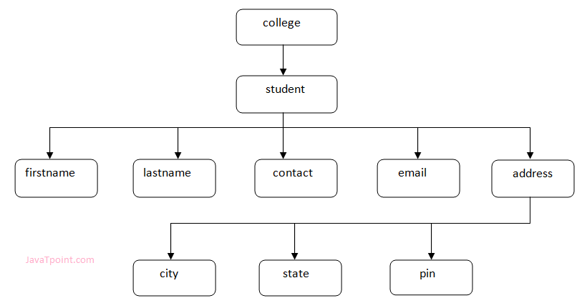
XML Document
Example:
<?xml version="1.0"?>
<college>
<student>
<firstname>Tamanna</firstname>
<lastname>Bhatia</lastname>
<contact>09990449935</contact>
<email>tammanabhatia@abc.com</email>
<address>
<city>Ghaziabad</city>
<state>Uttar Pradesh</state>
<pin>201007</pin>
</address>
</student>
</college>

Slide 9
Components of an XML Document
XML has a Root and optional header
Attributes vs. Elements
XML Comments
<?xml version="1.0"?>
<root>
.
.
.
</root>
<book publisher="Tata McGraw Hill"></book>
<book category="computer">
<author> A & B </author>
</book>
<!-- Write your comment -->

Slide 10
Components of an XML Document
XML CDATA
Example:
<![CDATA[
characters with markup
]]>
<element>
<![CDATA[
<message> Welcome to TutorialsPoint </message>
]] >
</element>

Slide 11
XML Namespaces
XML namespaces are used for providing uniquely named elements and attributes in an XML document. They are defined in a W3C recommendation.
Consider the following two tables (one in HTML, and one describing a coffee table in xml):
vs.
<table>
<tr>
<td>Apples</td>
<td>Bananas</td>
</tr>
</table>
<table>
<name>African Coffee Table</name>
<width>80</width>
<length>120</length>
</table>

Slide 12
XML Namespaces
Using XML namespaces, the previous examples may be revised as in the following:
<root xmlns:h=http://www.w3.org/TR/html4/
xmlns:f="https://www.w3schools.com/furniture">
<h:table>
<h:tr>
<h:td>Apples</h:td>
<h:td>Bananas</h:td>
</h:tr>
</h:table>
<f:table>
<f:name>African Coffee Table</f:name>
<f:width>80</f:width>
<f:length>120</f:length>
</f:table>
</root>

Slide 13
XML Namespaces
An XML namespace is declared using the reserved XML attribute xmlns or xmlns:prefix, the value of which must be a valid namespace name.
For example, the following declaration maps the "xhtml:" prefix to the XHTML namespace:
As such, any element or attribute whose name starts with the prefix "xhtml:" is considered to be in the XHTML namespace.
xmlns:xhtml="http://www.w3.org/1999/xhtml"

Slide 14
Default Namespace
A default namespace may be declared for the whole document. As a result, all subsequent elements inherit the namespace by default.
<table xmlns="http://www.w3.org/TR/html4/"> <tr> <td>Apples</td> <td>Bananas</td> </tr> </table>

Slide 15
XML Schema
An XML schema is a description of a type of XML document, typically expressed in terms of constraints on the structure and content of documents of that type, above and beyond the basic syntactical constraints imposed by XML itself.
These constraints are generally expressed using some combination of grammatical rules governing the order of elements, Boolean predicates that the content must satisfy, data types governing the content of elements and attributes, and more specialized rules such as uniqueness and referential integrity constraints.
Some common XML Schema languages:
DTD
XSD
And many more…

Slide 16
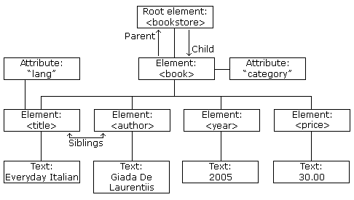
XML Processing
The most common way to process XML documents is through DOM.
The XML DOM defines a standard way for accessing and manipulating XML documents. It presents an XML document as a tree-structure:
Example: java support for XML DOM via
javax.xml.parsers.DocumentBuilderFactory

Slide 17
XPATH (XML Path)
XPATH (XML Path), defined by W3C, is a query language for selecting nodes from an XML document.
It can be used to navigate through elements and attributes in an XML document.
It may be used to compute values from the content of an XML document.
XPath is a major element in the XSLT standard.
Examples:
/bookstore/book[1]
/bookstore/book[last()]
//title[@lang='en']
/bookstore/book[price>35.00]/title
<?xml version="1.0" encoding="UTF-8"?>
<bookstore>
<book category="web">
<title lang="en">XQuery Kick Start</title>
<author>James McGovern</author>
<author>Per Bothner</author>
<author>Kurt Cagle</author>
<author>James Linn</author>
<author>Vaidyanathan Nagarajan</author>
<year>2003</year>
<price>49.99</price>
</book>
...
</bookstore>

Slide 18
XPATH (XML Path)
XPath uses path expressions to select nodes or node-sets in an XML document. These path expressions look very much like the expressions you see when you work with a traditional computer file system.
XPath Expression | Result
/bookstore/book[1] | Selects the first book element that is the child of the bookstore element
/bookstore/book[last()] | Selects the last book element that is the child of the bookstore element
/bookstore/book[last()-1] | Selects the last but one book element that is the child of the bookstore element
/bookstore/book[position()<3] | Selects the first two book elements that are children of the bookstore element
//title[@lang] | Selects all the title elements that have an attribute named lang
//title[@lang='en'] | Selects all the title elements that have a "lang" attribute with a value of "en"
/bookstore/book[price>35.00] | Selects all the book elements of the bookstore element that have a price element with a value greater than 35.00
/bookstore/book[price>35.00]/title | Selects all the title elements of the book elements of the bookstore element that have a price element with a value greater than 35.00

Slide 19
Java Web Technology

Slide 20
Jakarta Servlet
A Jakarta Servlet (formerly Java Servlet) is a Java software component that extends the capabilities of a server.
Although servlets can respond to many types of requests, they most commonly implement web containers for hosting web applications on web servers and thus qualify as a server-side servlet web API.
Such web servlets are the Java counterpart to other dynamic web content technologies such as PHP and ASP.NET.
Jakarta Server Pages (JSP; formerly JavaServer Pages) is a collection of technologies that helps software developers create dynamically generated web pages based on HTML, XML, SOAP, or other document types. Released in 1999 by Sun Microsystems, JSP is similar to PHP and ASP, but uses the Java programming language.
https://docs.oracle.com/javaee/5/tutorial/doc/bnafe.html

Slide 21
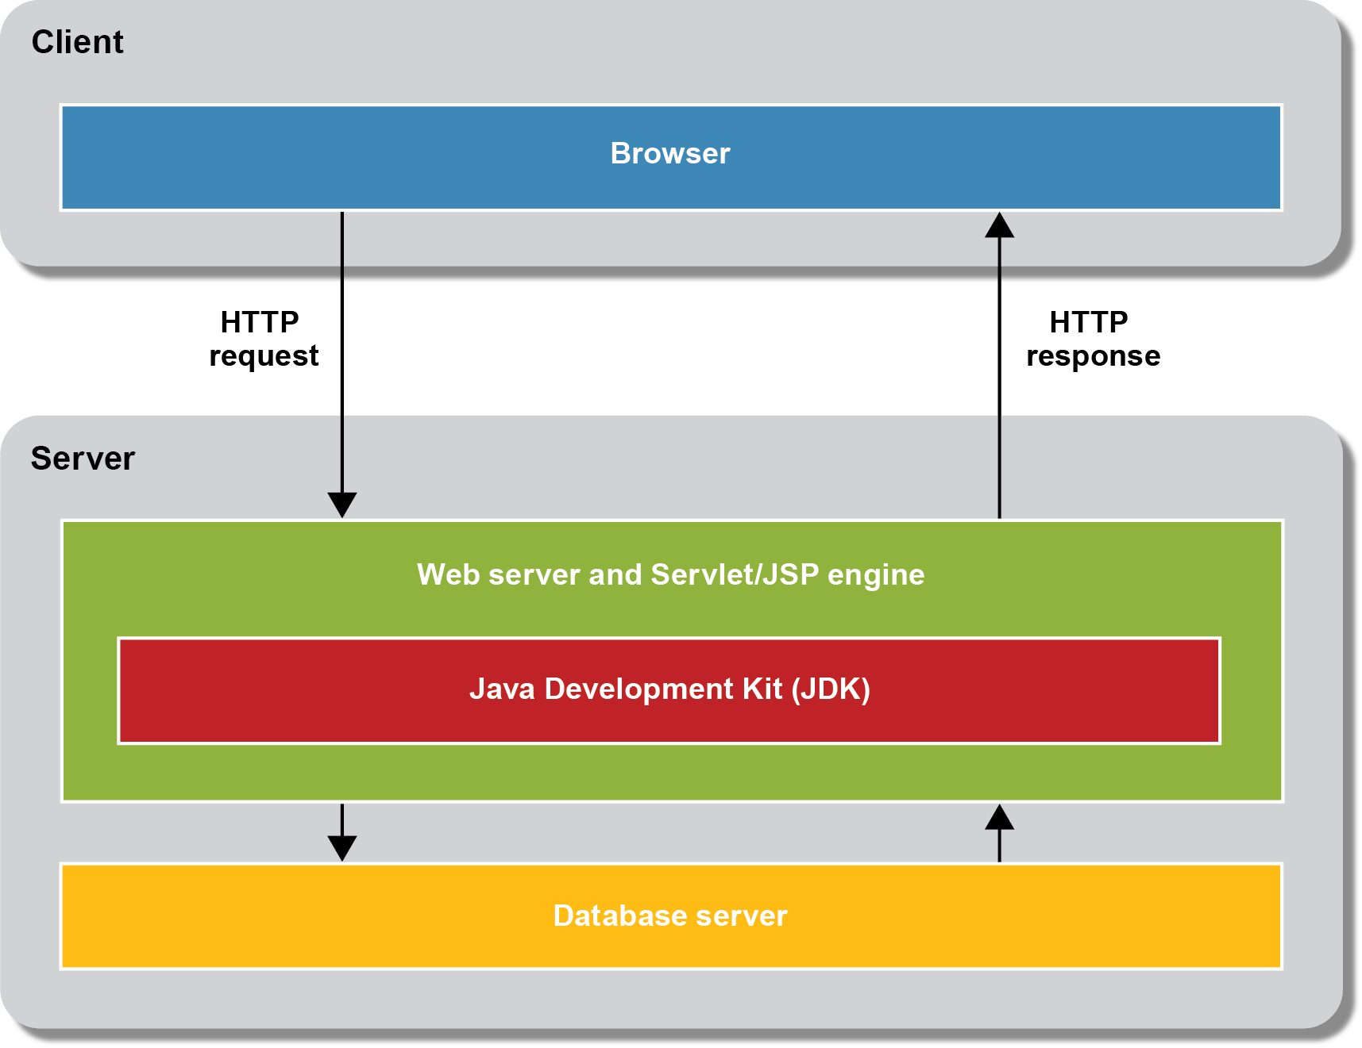
Servlet/JSP

Slide 22
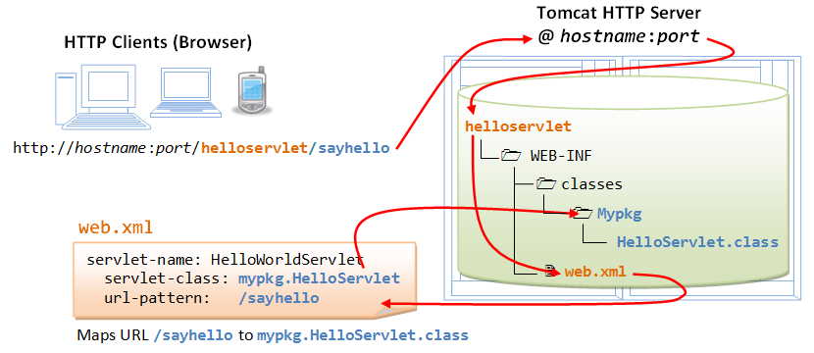
The File Structure of Web Applications

Slide 23
J2EE Web Services
Java APIs for XML Processing: Java APIs for XML Processing (JAXP) is a vendor-neutral set of lightweight APIs for parsing or processing XML documents.
Java API for XML-Based RPC: Java API for XML-based RPC (JAX-RPC) supports XML-based RPC for Java and J2EE platforms. It enables a traditional client-server remote procedure call (RPC) mechanism using an XML-based protocol.
Java API for XML Registries: Java API for XML Registries (JAXR), a Java API for accessing business registries, has a flexible architecture that supports UDDI, and other registry specifications (such as ebXML).
SOAP with Attachments API for Java: SOAP with Attachments API for Java (SAAJ), which enables developers to produce and consume messages conforming to the SOAP 1.1 specification and SOAP with Attachments note, provides an abstraction for handling SOAP messages with attachments.
The Integrated Platform for Web Services in J2EE Platform: Using a JAX-RPC service endpoint or an EJB service endpoint.
Support for WS-I (the Web Services Interoperability Organization) Basic Profile: Messaging standards (such as SOAP), Description and discovery standards (such as UDDI), and Security
https://docs.oracle.com/javaee/5/tutorial/doc/bnafe.html

Slide 24
Java Servlets

Slide 25
What is a servlet?
A servlet is a Java programming language class that is used to extend the capabilities of servers that host applications accessed by means of a request-response programming model.
Although servlets can respond to any type of request, they are commonly used to extend the applications hosted by web servers. For such applications, Java Servlet technology defines HTTP-specific servlet classes.
https://docs.oracle.com/javaee/5/tutorial/doc/bnafe.html

Slide 26
Developing Java Web Apps
Examples of some approaches for developing Java Web Apps
Servlet/JSP (Java Server Pages)
lower-level API that does less work for the programmer
high degree of control over the HTML/CSS/JavaScript that’s returned to the browser
JSF (Java Server Faces)
higher-level API that does more work for the programmer
Makes it more difficult to control the HTML/CSS/JavaScript that’s returned to the browser
Spring Framework
higher-level API that does more work for the programmer
provides a high degree of control over the HTML/CSS/JavaScript that’s returned to the browser

Slide 27
What is a servlet?
Servlet is a technology which is used to create a web application.
Servlet is an API that provides many interfaces and classes including documentation.
Servlet is an interface that must be implemented for creating any Servlet.
Servlet is a class that extends the capabilities of the servers and responds to the incoming requests. It can respond to any requests.
Servlet is a web component that is deployed on the server to create a dynamic web page.

Slide 28
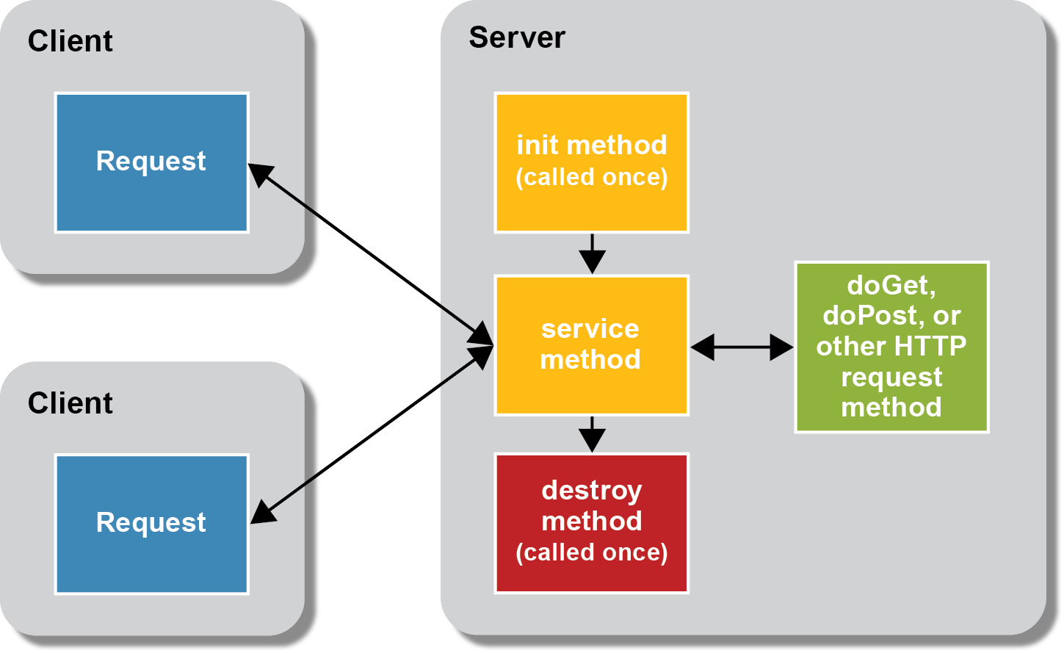
Servlets and their life cycle

Slide 29
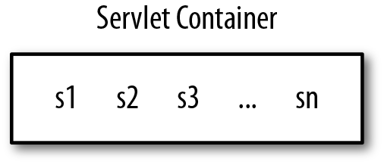
Servlets and Containers
Servlets execute in a servlet container, which is middleware that mediates between the application code of the servlet and the web server

Slide 30
Servlets and Synchronization
A web server such as Tomcat can arbitrarily instantiate many instances of a servlet, although the number is typically small (e.g., 1 through 4). The web server itself makes the decision.
For example, Tomcat by default loads one instance of a servlet to begin but may load more instances thereafter if simultaneous requests for the servlet are sufficient in number.
The one-thread-per-request model poses challenges for the servlet/JSP programmer, in particular the challenge of thread coordination or synchronization.
For example, if there are a dozen concurrent requests against the servlet, then each of these requests is implemented as a thread that executes the appropriate do-method in the servlet.

Slide 31
The Servlet Interface

Slide 32
The Servlet Interface
A servlet is a body of Java code that is loaded into and runs inside a servlet engine, such as a web server. It receives and responds to requests from clients.
All servlets implement the servlet interface. This interface is for developing servlets.
Servlet writers typically do this by subclassing either GenericServlet, which implements the Servlet interface, or by subclassing GenericServlet's descendent, HttpServlet.

Slide 33
The Servlet Interface methods
The Servlet Interface methods are summarized in the following table:
Method | Description
public void init(ServletConfig config) | initializes the servlet. It is the life cycle method of servlet and invoked by the web container only once.
public void service(ServletRequest request,ServletResponse response) | provides response for the incoming request. It is invoked at each request by the web container.
public void destroy() | is invoked only once and indicates that servlet is being destroyed.
public ServletConfig getServletConfig() | returns the object of ServletConfig.
public String getServletInfo() | returns information about servlet such as writer, copyright, version etc.

Slide 34
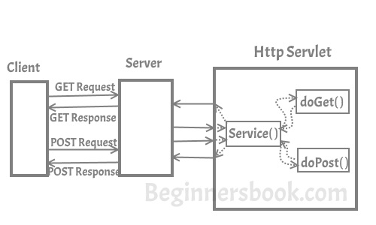
HttpServlet, How it works
The following figure summarizes the how the HttpServlet class is used during the interaction between the client and the server:

Slide 35
The HttpServlet methods
The HttpServlet class includes the methods by which the servlet developer implements appropriate do methods.
public void service(ServletRequest req,ServletResponse res) dispatches the request to the protected service method by converting the request and response object into http type.
protected void service(HttpServletRequest req, HttpServletResponse res) receives the request from the service method, and dispatches the request to the doXXX() method depending on the incoming http request type.
protected void doGet(HttpServletRequest req, HttpServletResponse res) handles the GET request. It is invoked by the web container.
protected void doPost(HttpServletRequest req, HttpServletResponse res) handles the POST request. It is invoked by the web container.
protected void doHead(HttpServletRequest req, HttpServletResponse res) handles the HEAD request. It is invoked by the web container.
protected void doOptions(HttpServletRequest req, HttpServletResponse res) handles the OPTIONS request. It is invoked by the web container.
protected void doPut(HttpServletRequest req, HttpServletResponse res) handles the PUT request. It is invoked by the web container.
protected void doTrace(HttpServletRequest req, HttpServletResponse res) handles the TRACE request. It is invoked by the web container.
protected void doDelete(HttpServletRequest req, HttpServletResponse res) handles the DELETE request. It is invoked by the web container.
protected long getLastModified(HttpServletRequest req) returns the time when HttpServletRequest was last modified since midnight January 1, 1970 GMT.

Slide 36
A Servlet Example
The following code demonstrates a sample servlet that responds to a GET request.
import java.io.*;
import javax.servlet.*;
import javax.servlet.http.*;
// Creating Http Servlet by Extending HttpServlet class
public class ExampleHttpServlet extends HttpServlet {
private String mymsg;
public void init() throws ServletException {
mymsg = "Http Servlet Demo";
}
public void doGet(HttpServletRequest request, HttpServletResponse response)
throws ServletException, IOException {
// Setting up the content type of web page
response.setContentType("text/html");
// Writing the message on the web page
PrintWriter out = response.getWriter();
out.println("<h1>" + mymsg + "</h1>"); // BAD Practice!
out.println("<p>" + "Hello Friends!" + "</p>"); // BAD Practice!
}
public void destroy() {
// Leaving empty. Use this if you want to perform
//something at the end of Servlet life cycle.
}
}

Slide 37
The Query String
A query string is a part of a URL that assigns values to specified parameters.
A query string commonly includes fields added to a base URL by a Web browser during the HTML form submission.
https://example.com/path/there?name=ferret

Slide 38
The Query String and Parameters in Servlets
For HTTP servlets, parameters are contained in the query string or posted form data.
Use the following methods to access query string in both GET and POST.
public String ServletRequest.getQueryString()
public String ServletRequest.getParameter(String name)
public String[] ServletRequest.getParameterValues(String name)
See also:
public java.util.Enumeration<String> req.getParameterNames()
Http Servlet Request and Response reference:
https://docs.oracle.com/javaee/6/api/javax/servlet/http/HttpServletRequest.html
https://docs.oracle.com/javaee/6/api/javax/servlet/http/HttpServletResponse.html

Slide 39
Servlet, web.xml, and annotations
A sample server mapping in web.xml
<!-- the definitions for the servlets -->
<servlet>
<servlet-name>EmailListServlet</servlet-name>
<servlet-class>murach.email.EmailListServlet</servlet-class>
</servlet>
<servlet>
<servlet-name>TestServlet</servlet-name>
<servlet-class>murach.email.TestServlet</servlet-class>
</servlet>
<!-- the mapping for the servlets -->
<servlet-mapping>
<servlet-name>EmailListServlet</servlet-name>
<url-pattern>/emailList</url-pattern>
</servlet-mapping>
<servlet-mapping>
<servlet-name>EmailListServlet</servlet-name>
<url-pattern>/email/*</url-pattern>
</servlet-mapping>
<servlet-mapping>
<servlet-name>TestServlet</servlet-name>
<url-pattern>/test</url-pattern>
</servlet-mapping>
url with pattern

Slide 40
Servlet, web.xml, and annotations
Alternatively, a servlet can be also deployed without using web.xml. An alternative approach is to use annotations:
import java.io.IOException;
import java.io.PrintWriter;
import javax.servlet.ServletException;
import javax.servlet.annotation.WebServlet;
import javax.servlet.http.HttpServlet;
import javax.servlet.http.HttpServletRequest;
import javax.servlet.http.HttpServletResponse;
@WebServlet("/test")
public class TestServlet extends HttpServlet {
...
...

Slide 41
Servlet, web.xml, and annotations
WebServlet annotation may receive additional parameters, which can be passed by name. i.e.:
Specifiying multiple url patterns:
Specifying internal name
More information may be found here:
https://tomcat.apache.org/tomcat-7.0-doc/servletapi/javax/servlet/annotation/WebServlet.html
@WebServlet(urlPatterns={"/emailList", "/email/*"})
@WebServlet(name="MurachTestServlet", urlPatterns={"/test"})

Slide 43

Using Curl

Slide 44
CURL (Client URL Request Library)
cURL is a computer software project providing a library (libcurl) and command-line tool (curl) for transferring data using various protocols.
It was first released in 1997. The name stands for "Client URL". The original author and lead developer is the Swedish developer Daniel Stenberg.
cURL for Windows may be downloaded using the following link:
https://curl.haxx.se/windows/

Slide 45
Using CURL
curl http://www.example.org:1234/ (GET)
curl -u user:password http://example.org/ (GET with authentication)
curl "http://www.hotmail.com/when/junk.cgi?birthyear=1905&press=OK" (GET with query string)
curl http://url1.example.com http://url2.example.com (multiple GETs)
curl --data name=curl http://url1.example.com (POST)
curl --data-urlencode "name=I am Daniel" http://www.example.com (POST with urlencode)
curl --referer http://www.example.come http://www.example.com (headers)
curl --location http://www.example.com (follow redirects)
curl --cert mycert.pem https://secure.example.com (HTTPS)
curl -X PUT -d 'name=mkyong&email=abc@gmail.com' http://localhost:8080/user/100 (PUT)
curl --form upload=@localfile http://localhost:8080/form-submit (POST with file upload)
A complete tutorial may be found here:
https://curl.haxx.se/docs/httpscripting.html

Slide 47
Lab Activity

Slide 48
Lab Activity
Creating Hello World Servlet.
Optional: Create a calculator servlet

Slide 49
Session Summary
XML and XML components
XML namespaces
Java Servlets
The Servlet Interface
Request and Response Objects
GET, POST, PUT, and DELETE verbs
Client URL (cURL) Application

Slide 50
Acknowledgements
https://www.javatpoint.com/servlet-tutorial

Slide 51
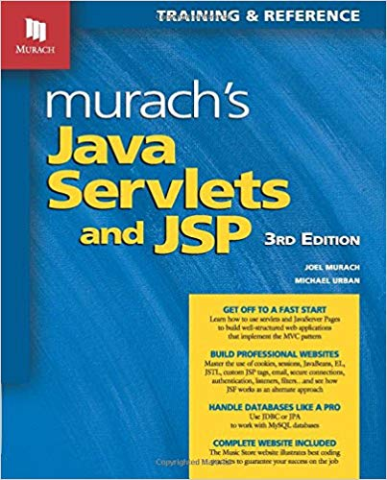
Further Reading
Murach's Java Servlets and JSP, 3rd Edition, Mike Murach & Associates, 2014, ISBN-10: 1890774782, ISBN-13: 978-1890774783
Chapter 3: How to work with NetBeans and Tomcat

Slide 52
Next - RESTful Web Services

