Slide 1
CCCS 425 – Web Services Module 4 – REST, The Client Side

Slide 2

Acknowledgement
The following materials are produced from various online sources. Links to the original materials have been provided.

Slide 3
Session Learning Outcomes
Use web clients to consume a RESTful web service

Slide 4
Session Learning Outcomes
Use web clients to consume a RESTful web service

Slide 5
Session Overview
Web Application Description Language (WADL)
Generic Clients
Client Support in Java
The JAX-RS Client API

Slide 6
Web Application Description Language (WADL)

Slide 7
Recall: Wed Service Definition
The World Wide Web Consortium (W3C) organization, which establishes the standards for web services, defines them as follows:
“A Web service is a software system identified by a URI whose public interfaces and bindings are defined and described using XML”

Slide 8
Web Application Description Language
Web Application Description Language (WADL) is a machine-readable XML description of HTTP-based web services.
WADL models the resources provided by a service and the relationships between them.
WADL is intended to simplify the reuse of web services, based on the existing HTTP architecture.
It is a platform and language-independent.
https://en.wikipedia.org/wiki/Web_Application_Description_Language

Slide 9
Web Application Description Language /cont.
WADL has NOT been standardized by W3C. It is the “REST equivalent” of SOAP's WSDL, which can also be used to describe REST web services.
Neither WSDL2.0 nor WADL has been adopted by the industry, citing poor human readability of both and WADL being actually unable to fully describe a RESTful API.
https://en.wikipedia.org/wiki/Overview_of_RESTful_API_Description_Languages

Slide 10
WADL Auto Generation at Runtime
WADLs are often generated automatically during runtime.
Using JAX-RS, the WADL may be obtained by appending “/application.wadl” to the resource URL.
Example:
http://…your-app-path…/webresources/usersrepository/users
web-app
resource-base
resource-service
method-path
http://…your-app-path…/webresources/application.wadl

Slide 11
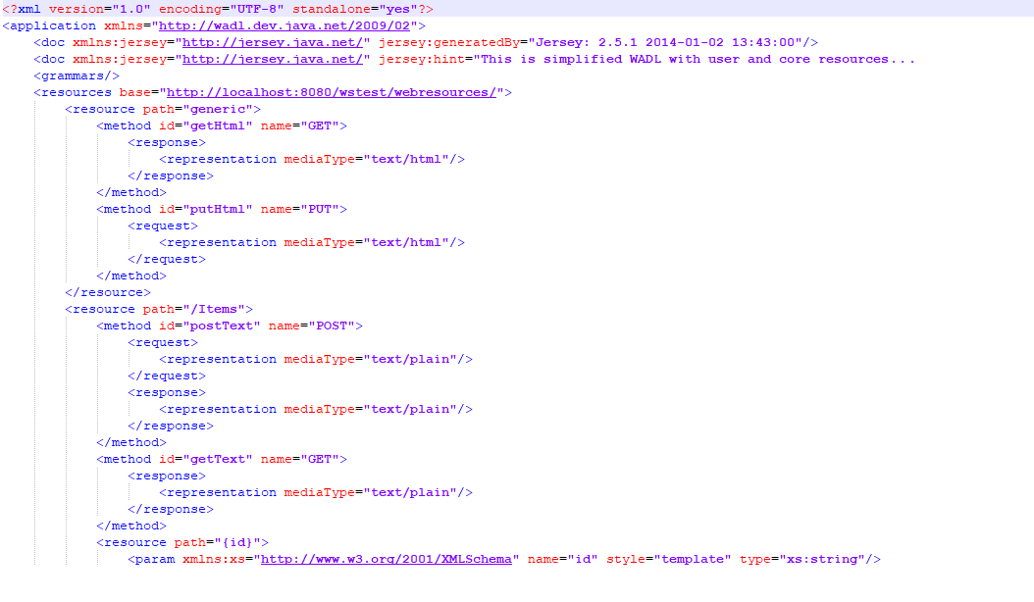
WADL Example
Below is a sample WADL file that is automatically generated by JAX-RS:
http://localhost:8080/wstest/webresources/application.wadl

Slide 12
Using WADL
The WADL file provides the service information regardless of the implementation platform.
WADLs may be saved and used offline.
WADL files may be used to generate REST Clients, automatically.
There are various tools / plugins that may be used to generate java code from an existing WADL.
Examples:
Apache CXF
JAX-RS RESTful Web Services (Jersey)

Slide 13
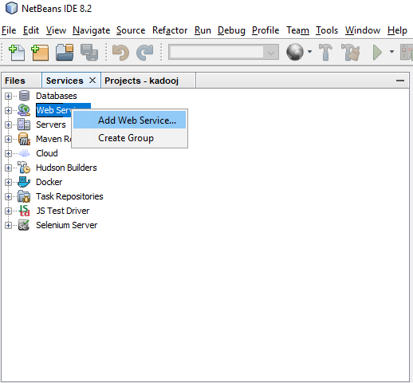
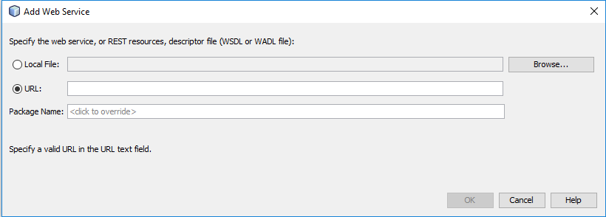
Generating REST Clients
Method 1: Adding a Web Reference (widely used in SOAP)

Slide 14
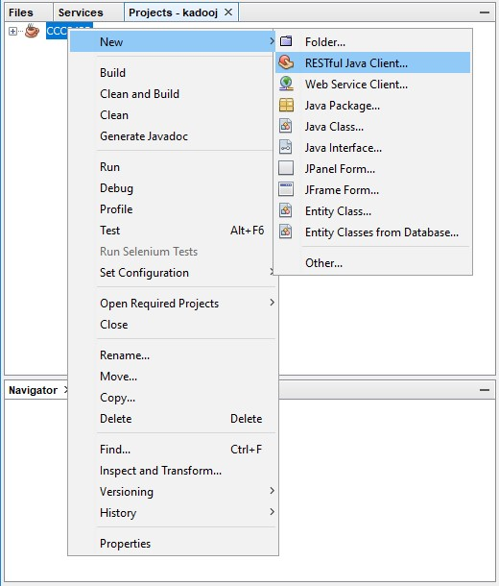
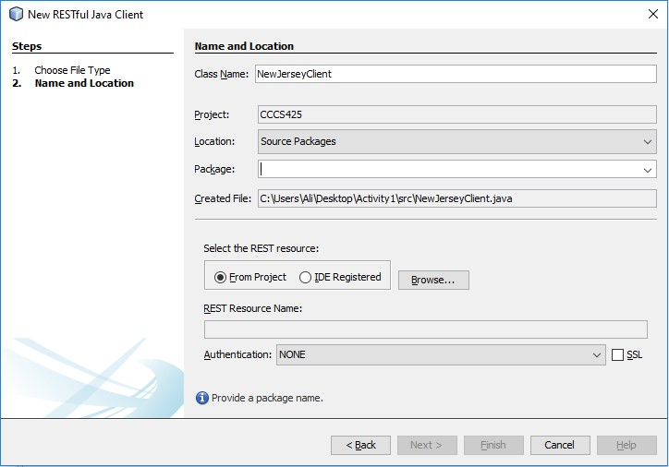
Generating REST Clients /cont.
Method 2: Generating a Jersey Client

Slide 15
CLI Tools and Plugins
Additional utilities are often provided as CLI (Command Line Interface) Tools and/or plugins.
For instance, Apache CXF provides both java2wadl command line too to generate WADL file form java code as well as provides a wadl2java maven plugin to create a REST client from a WADL file.
For more information see:
https://cxf.apache.org/docs/jaxrs-services-description.html

Slide 16
Generic Clients

Slide 17
Web Clients
A web client is typically a web browser that connects to a web server and retrieves a web page for display.
A web service is a program that is invoked by a URL and returns a response to the web client, via a transport protocol (i.e. HTTP).
Server software in an enterprise application sees both requests and sessions from two angles, as the server from the client and as the client to other systems.

Slide 18
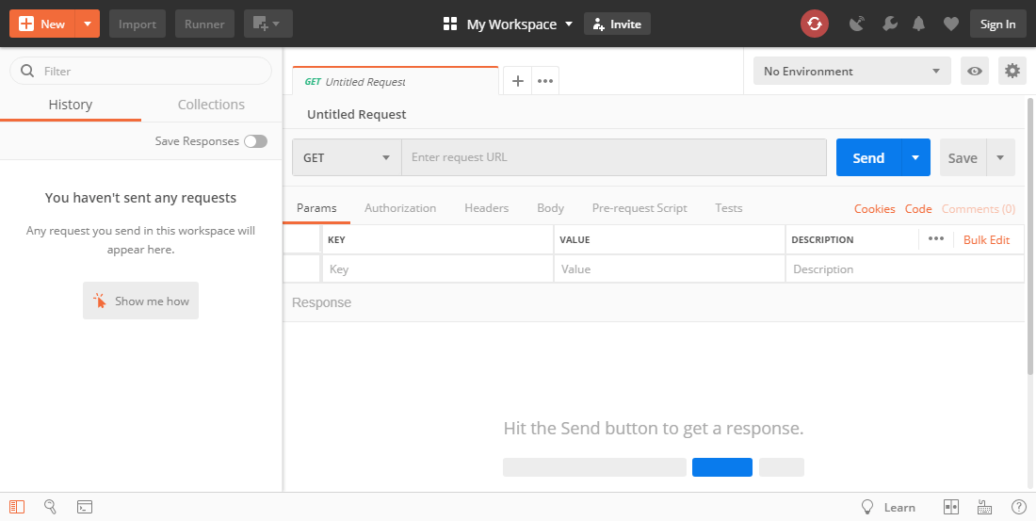
Using Postman
Postman is a scalable API Testing Tool that quickly integrates into CI/CD pipeline (Continuous Integration Continuous Delivery). Typically used in REST.
A quick tutorial:
https://www.guru99.com/postman-tutorial.html

Slide 19
Using Non-Java Clients
Note that the client and the server communication is purely over HTTP and there is no dependency between the client and the server code.
While the previous examples, demonstrated sharing “interfaces”, no assumption may made on the client platform.
The following demonstrates consuming a REST json service using jQuery AJAX:
$(document).ready(function() {
$.ajax({
url: "http://rest-service.guides.spring.io/greeting"
}).then(function(data) {
$('.greeting-id').append(data.id);
$('.greeting-content').append(data.content);
});
});

Slide 20
Using XMLHttpRequest
See also in JavaScript:
https://developer.mozilla.org/en-US/docs/Web/API/XMLHttpRequest/Using_XMLHttpRequest
function reqListener () {
console.log(this.responseText);
}
var oReq = new XMLHttpRequest();
oReq.addEventListener("load", reqListener);
oReq.open("GET", "http://www.example.org/example.txt");
oReq.send();

Slide 21
Client Support in Java

Slide 22
Using HttpURLConnection
The HttpURLConnection class, available in java.net, provides basic support for HTTP-specific features.
It supports GET and POST.
HttpsURLConnection is a subclass that supports HTTPS-specific features.

Slide 23
A HttpURLConnection Example
import java.io.*;
import java.net.*;
private void sendGet() throws Exception
{
URL url = new URL("http://www.google.com/search?q=mkyong");
HttpURLConnection con = (HttpURLConnection) url.openConnection();
con.setRequestMethod("GET"); // optional default is GET
//add request header
con.setRequestProperty("User-Agent", "Mozilla/5.0");
int responseCode = con.getResponseCode();
System.out.println("\nSending 'GET' request to URL : " + url. toString());
System.out.println("Response Code : " + responseCode);
BufferedReader in = new BufferedReader(new InputStreamReader(con.getInputStream()));
String inputLine;
StringBuffer response = new StringBuffer();
while ((inputLine = in.readLine()) != null)
{
response.append(inputLine);
}
in.close();
//print result
System.out.println(response.toString());
}

Slide 24
A HttpURLConnection Example /cont.
import javax.net.ssl.HttpsURLConnection;
private void sendPost() throws Exception {
URL url = new URL("https://selfsolve.apple.com/wcResults.do");
HttpsURLConnection con = (HttpsURLConnection) url.openConnection();
//add reuqest header
con.setRequestMethod("POST");
con.setRequestProperty("User-Agent", "Mozilla/5.0");
con.setRequestProperty("Accept-Language", "en-US,en;q=0.5");
String urlParameters = "sn=C02G8416DRJM&cn=&locale=&caller=&num=12345";
// Send post request
con.setDoOutput(true);
DataOutputStream wr = new DataOutputStream(con.getOutputStream());
wr.writeBytes(urlParameters);
wr.flush();
wr.close();
int responseCode = con.getResponseCode();
System.out.println("\nSending 'POST' request to URL : " + url.toString());
System.out.println("Post parameters : " + urlParameters);
System.out.println("Response Code : " + responseCode);
BufferedReader in = new BufferedReader(new InputStreamReader(con.getInputStream()));
String inputLine;
StringBuffer response = new StringBuffer();
while ((inputLine = in.readLine()) != null)
response.append(inputLine);
in.close();
//print result
System.out.println(response.toString());
}

Slide 25
Using Apache HttpClient
The java.net package provides basic functionality for accessing resources via HTTP, and does NOT provide the full flexibility or functionality needed by many applications.
HttpClient seeks to fill this void by providing an efficient, up-to-date, and feature-rich package implementing the client side of the most recent HTTP standards and recommendations.

Slide 26
Using Apache HttpClient /cont.
Apache HttpClient provides alternative and simpler approach for performing GET and POST, as well as other verbs.
import org.apache.http.HttpResponse;
import org.apache.http.NameValuePair;
import org.apache.http.client.HttpClient;
import org.apache.http.client.entity.UrlEncodedFormEntity;
import org.apache.http.client.methods.HttpGet;
import org.apache.http.client.methods.HttpPost;
import org.apache.http.impl.client.DefaultHttpClient;
import org.apache.http.message.BasicNameValuePair;

Slide 27
Using Apache HttpClient Example
private void sendGet() throws Exception {
HttpClient client = new DefaultHttpClient();
HttpGet request = new HttpGet("http://www.google.com/search?q=developer");
// add request header
request.addHeader("User-Agent", "Mozilla/5.0");
HttpResponse response = client.execute(request);
System.out.println("\nSending 'GET' request to URL");
System.out.println("Response Code : " +
response.getStatusLine().getStatusCode());
BufferedReader rd = new BufferedReader(
new InputStreamReader(response.getEntity().getContent()));
StringBuffer result = new StringBuffer();
String line = "";
while ((line = rd.readLine()) != null)
result.append(line);
System.out.println(result.toString());
}

Slide 28
Using Apache HttpClient Example /cont.
private void sendPost() throws Exception {
HttpClient client = new DefaultHttpClient();
HttpPost post = new HttpPost("https://selfsolve.apple.com/wcResults.do");
// add header
post.setHeader("User-Agent", "Mozilla/5.0");
List<NameValuePair> urlParameters = new ArrayList<NameValuePair>();
urlParameters.add(new BasicNameValuePair("sn", "C02G8416DRJM"));
urlParameters.add(new BasicNameValuePair("cn", ""));
urlParameters.add(new BasicNameValuePair("locale", ""));
urlParameters.add(new BasicNameValuePair("caller", ""));
urlParameters.add(new BasicNameValuePair("num", "12345"));
post.setEntity(new UrlEncodedFormEntity(urlParameters));

Slide 29
Using Apache HttpClient Example /cont.
See also:
PUT: https://memorynotfound.com/apache-httpclient-http-put-request-method-example/
DELETE: https://memorynotfound.com/apache-httpclient-http-delete-request-method-example/
HttpResponse response = client.execute(post);
System.out.println("\nSending 'POST' request to URL");
System.out.println("Post parameters : " + post.getEntity());
System.out.println("Response Code : " +
response.getStatusLine().getStatusCode());
BufferedReader rd = new BufferedReader(
new InputStreamReader(response.getEntity().getContent()));
StringBuffer result = new StringBuffer();
String line = "";
while ((line = rd.readLine()) != null)
result.append(line);
System.out.println(result.toString());
}

Slide 31
The JAX-RS Client API

Slide 32
The JAX-RS Client API
The JAX-RS client API is provided under javax.ws.rs.client.
An automatically generated code uses the above API to perform REST calls on the client.
A request to the server is passed via a WebClient object.

Slide 33
The JAX-RS Client Example
The following code dynamically binds to the remote service and performs a REST call, using Apache CXF:
Client client = ClientBuilder.newBuilder().newClient();
WebTarget target = client.target("http://localhost:8080/rs");
target = target.path("service").queryParam("a", "avalue");
Invocation.Builder builder = target.request();
Response response = builder.get();
Book book = builder.get(Book.class);
(Apache CXF)
<dependency>
<groupId>org.apache.cxf</groupId>
<artifactId>cxf-rt-rs-client</artifactId>
<version>3.0.15</version>
</dependency>
http://cxf.apache.org/docs/jax-rs-client-api.html

Slide 34
Proxy-based API
With the proxy-based API, one can reuse on the client side the interfaces or even the resource classes which have already been designed for processing the HTTP requests on the server side.
When reused on the client side, they simply act as remote proxies.
http://cxf.apache.org/docs/jax-rs-client-api.html

Slide 35
Proxy-based API Example
Consider the following implementation on the server:
@Path("/bookstore")
public interface BookStore {
@GET
Books getAllBooks();
@Path("{id}")
BookResource getBookSubresource(@PathParam("id") long id) throws NoBookFoundException;
}
public class BookStoreImpl implements BookStore {
public Books getAllBooks() {}
public BookResource getBookSubresource(long id) throws NoBookFoundException {}
}
public interface BookResource {
@GET
Book getBook();
}
public class BookResourceImpl implements BookResource {
Book getBook() {}
}
http://cxf.apache.org/docs/jax-rs-client-api.html

Slide 36
Proxy-based API Example
The interfaces may be reused on the client side as thin remote proxies:
@Path("/bookstore")
public interface BookStore {
@GET
Books getAllBooks();
@Path("{id}")
BookResource getBookSubresource(@PathParam("id") long id) throws NoBookFoundException;
}
public interface BookResource {
@GET
Book getBook();
}
BookStore store = JAXRSClientFactory.create("http://bookstore.com", BookStore.class);
// (1) remote GET call to http://bookstore.com/bookstore
Books books = store.getAllBooks();
// (2) no remote call
BookResource subresource = store.getBookSubresource(1);
// {3} remote GET call to http://bookstore.com/bookstore/1
Book b = subresource.getBook();
http://cxf.apache.org/docs/jax-rs-client-api.html

Slide 38
Lab Activity

Slide 39
Lab Activity
Using Postman.
Creating a REST client Application.

Slide 40
Session Summary
JAX-RS The Client Side
Jersey Client
Endpoint
Web Application Description Language (WADL)
Using WebClient
Using XMLHttpRequest

Slide 41
Acknowledgements
https://en.wikipedia.org/wiki/Web_Application_Description_Language
https://howtodoinjava.com/resteasy/restful-webservices-client-using-java-net-package/
https://howtodoinjava.com/library/jaxrs-client-httpclient-get-post/
http://cxf.apache.org/docs/jax-rs-client-api.html
https://en.wikipedia.org/wiki/Overview_of_RESTful_API_Description_Languages
Further Reading:
https://www.baeldung.com/jersey-jax-rs-client

Slide 42
Next - Understanding XML and JSON Data Types

