Slide 1
CCCS 425 – Web Services Module 6 – SOAP Web Services

Slide 2

Acknowledgement
The following materials are produced from various online sources. Links to the original materials have been provided.

Slide 3
Session Learning Outcomes
Design and implement a SOAP-based web service
Explain SOAP web-services and their key components
Explain and Use Web Service Definition (WSDL) files

Slide 4
Session Overview
Introduction to SOAP
Web Service Description Language (WSDL)
A SOAP Hello World
The SOAP Client

Slide 5
Introduction to SOAP

Slide 6
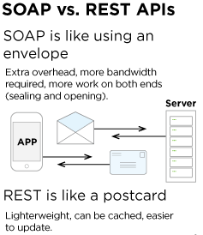
What is SOAP?
SOAP stands for Simple Object Access Protocol. It is a XML-based protocol for accessing web services.
SOAP is a W3C recommendation for communication between two applications.
SOAP is XML based protocol. It is platform independent and language independent. By using SOAP, you will be able to interact with other programming language applications.

Slide 7
Advantages and Disadvantages
SOAP’s standard HTTP protocol makes it easier for it to operate across firewalls and proxies without modifications to the SOAP protocol itself.
Sometimes designing SOAP services can actually be less complex compared to REST.
SOAP is highly extensible through other protocols and technologies.
SOAP is slow. SOAP uses XML format that must be parsed to be read. It defines many standards that must be followed while developing the SOAP applications. So it is slow and consumes more bandwidth and resource.
WSDL dependency: SOAP uses WSDL and doesn't have any other mechanism to discover the service.

Slide 8
SOAP vs REST
SOAP | REST
SOAP is a protocol. | REST is an architectural style.
SOAP stands for Simple Object Access Protocol. | REST stands for REpresentational State Transfer.
SOAP can't use REST because it is a protocol. | REST can use SOAP web services because it is a concept and can use any protocol like HTTP, SOAP.
SOAP uses services interfaces to expose the business logic. | REST uses URI to expose business logic.
JAX-WS is the java API for SOAP web services. | JAX-RS is the java API for RESTful web services.
SOAP defines standards to be strictly followed. | REST does not define too much standards like SOAP.
SOAP requires more bandwidth and resource than REST. | REST requires less bandwidth and resource than SOAP.
SOAP defines its own security. | RESTful web services inherits security measures from the underlying transport.
SOAP permits XML data format only. | REST permits different data format such as Plain text, HTML, XML, JSON etc.
SOAP is less preferred than REST. | REST more preferred than SOAP.

Slide 9
JAX-WS
The Java API for XML Web Services (JAX-WS) is a Java programming language API for creating web services, particularly SOAP services.
JAX-WS is one of the Java XML programming APIs. It is part of the Java EE platform.

Slide 10
JAX-WS Packages
Package | Description
javax.xml.ws | Has the Core JAX-WS APIs
javax.xml.ws.http | Has APIs specific to XML/HTTP Binding
javax.xml.ws.soap | Has APIs specific to SOAP/HTTP Binding
javax.xml.ws.handler | Has APIs for message handlers
javax.xml.ws.spi | defines SPIs for JAX-WS
javax.xml.ws.spi.http | Provides HTTP SPI that is used for portable deployment of JAX-WS in containers
javax.xml.ws.wsaddressing | Has APIs related to WS-Addressing
javax.jws | Has APIs specific to Java to WSDL mapping annotations
javax.jws.soap | Has APIs for mapping the Web Service onto the SOAP protocol

Slide 11
Acknowledgement and Further Reading
https://www.javatpoint.com/soap-web-services
https://en.wikipedia.org/wiki/Java_API_for_XML_Web_Services
https://dzone.com/articles/comprehensive-guide-rest-vs-soap

Slide 13
Web Service Description Language (WSDL)

Slide 14
Web Service Description Language (WSDL)
The Web Services Description Language (WSDL /ˈwɪz dəl/) is an XML-based interface description language that is used for describing the functionality offered by a web service.
The acronym is also used for any specific WSDL description of a web service (also referred to as a WSDL file), which provides a machine-readable description of
How the service can be called
What parameters it expects
What data structures it returns
Its purpose is roughly similar to that of a type signature in a programming language.

Slide 15
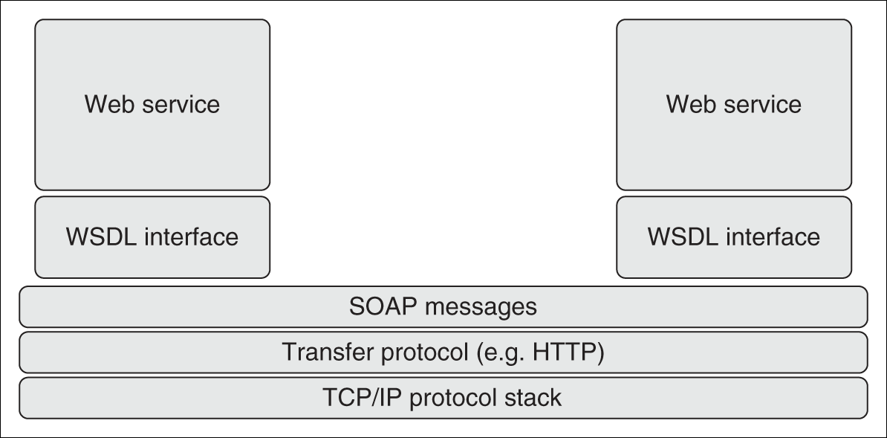
SOAP as a Messaging Protocol / cont.
Figure 4.1 The Web services communication and messaging network
Web Services & SOA: Principles and Technology

Slide 16
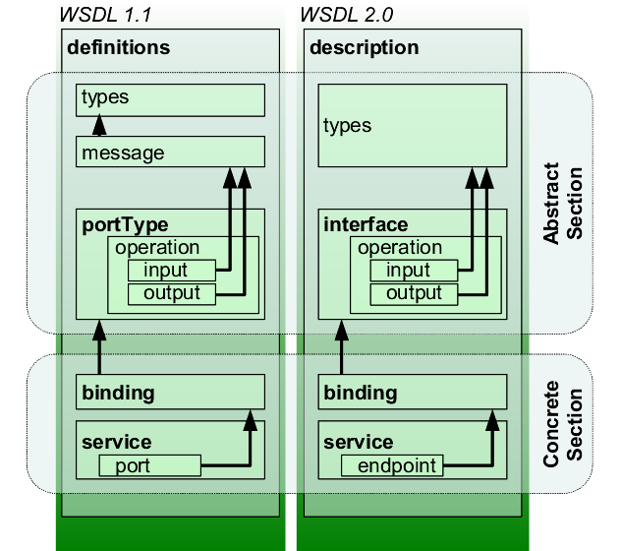
Web Service Description Language (WSDL)
WSDL
WSDL 1.1 | WSDL 2.0 | Description
Service | Service | Contains a set of system functions that have been exposed to the Web-based protocols.
Port | Endpoint | Defines the address or connection point to a Web service. It is typically represented by a simple HTTP URL string.
Binding | Binding | Specifies the interface and defines the SOAP binding style (RPC/Document) and transport (SOAP Protocol). The binding section also defines the operations.
PortType | Interface | Defines a Web service, the operations that can be performed, and the messages that are used to perform the operation.
Operation | Operation | Defines the SOAP actions and the way the message is encoded, for example, "literal." An operation is like a method or function call in a traditional programming language.
Message | n/a | Typically, a message corresponds to an operation. Each message is made up of one or more logical parts. Each part is associated with a message-typing attribute. The message name attribute provides a unique name among all messages. The part name attribute provides a unique name among all the parts of the enclosing message. A part may represent a parameter in the message; Messages were removed in WSDL 2.0, in which XML schema types for defining bodies of inputs, outputs and faults are referred to simply and directly.
Types | Types | Describes the data. The XML Schema language (also known as XSD) is used (inline or referenced) for this purpose.

Slide 17
WSDL Example
<?xml version="1.0" encoding="UTF-8"?>
<description xmlns="http://www.w3.org/ns/wsdl" xmlns:tns="http://www.tmsws.com/wsdl20sample" xmlns:whttp="http://schemas.xmlsoap.org/wsdl/http/" xmlns:wsoap="http://schemas.xmlsoap.org/wsdl/soap/" targetNamespace="http://www.tmsws.com/wsdl20sample">
<documentation> This is a sample WSDL 2.0 document. </documentation>
<!-- Abstract type -->
<types>
<xs:schema xmlns:xs="http://www.w3.org/2001/XMLSchema" xmlns="http://www.tmsws.com/wsdl20sample" targetNamespace="http://www.example.com/wsdl20sample">
<xs:element name="request"> ... </xs:element>
<xs:element name="response"> ... </xs:element>
</xs:schema>
</types>
<!-- Abstract interfaces -->
<interface name="Interface1">
.
.
.

Slide 18
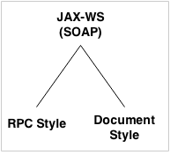
RPC Style vs Document Style
RPC style web services use method name and parameters to generate XML structure.
The generated WSDL is difficult to be validated against schema.
In RPC style, SOAP message is sent as many elements.
RPC style message is tightly coupled.
In RPC style, SOAP message keeps the operation name.
In RPC style, parameters are sent as discrete values.
In Document Style the data is passed as XML.
The advantage of using a Document style model is that you can structure the SOAP body any way you want it as long as the content of the SOAP message body is any arbitrary XML instance. The Document style is also referred to as Message-Oriented style.

Slide 19
RPC Style vs Document Style
RPC Style Example
Soap Message
<message name="getHelloWorldAsString">
<part name="arg0" type="xsd:string"/>
</message>
<message name="getHelloWorldAsStringResponse">
<part name="return" type="xsd:string"/>
</message>
<binding name="HelloWorldImplPortBinding" type="tns:HelloWorld">
<soap:binding transport="http://schemas.xmlsoap.org/soap/http"
style="rpc"/>
<operation name="getHelloWorldAsString">
<soap:operation soapAction=""/>
<input>
<soap:body use="literal" namespace="http://javatpoint.com/"/>
</input>
<output>
<soap:body use="literal" namespace="http://javatpoint.com/"/>
</output>
</operation>
</binding>

Slide 20
RPC Style vs Document Style
Document Style Example
Soap Message
<message name="getHelloWorldAsString">
<part name="parameters"
element="tns:getHelloWorldAsString"/>
</message>
<message name="getHelloWorldAsStringResponse">
<part name="parameters“ element=
"tns:getHelloWorldAsStringResponse"/>
</message>
<binding name="HelloWorldImplPortBinding" type="tns:HelloWorld">
<soap:binding transport=http://schemas.xmlsoap.org/soap/http
style="document"/>
<operation name="getHelloWorldAsString">
<soap:operation soapAction=""/>
<input>
<soap:body use="literal"/>
</input>
<output>
<soap:body use="literal"/>
</output>
</operation>
</binding>

Slide 21
JAX-WS, JAX-WS RI, and METRO
Metro is a high-performance, extensible, easy-to-use web service stack. It is a one-stop shop for all your web service needs, from the simplest hello world web service to reliable, secured, and transacted web service.
JAX-WS RI is a Web Services framework that provides tools and infrastructure to develop Web Services solutions for the end users and middleware developers.

Slide 22
Acknowledgement and Further Reading
https://en.wikipedia.org/wiki/Web_Services_Description_Language
https://javaee.github.io/metro/

Slide 25
A SOAP Hello World

Slide 26
A SOAP Hello World
Making a class as well as its methods available across web
public class HelloWorld {
public String getHelloWorldAsString(String name) {
return "Hello " + name;
}
}

Slide 27
A SOAP Hello World
First abstraction, the interface:
public interface HelloWorld{
String getHelloWorldAsString(String name);
}

Slide 28
A SOAP Hello World
Adding annotations
import javax.jws.WebMethod;
import javax.jws.WebService;
import javax.jws.soap.SOAPBinding;
import javax.jws.soap.SOAPBinding.Style;
//Service Endpoint Interface
@WebService
@SOAPBinding(style = Style.RPC)
public interface HelloWorld{
@WebMethod String getHelloWorldAsString(
@WebParam(name = "name") String name);
}

Slide 29
A SOAP Hello World
Defining Service Implementation
import javax.jws.WebService;
//Service Implementation
@WebService(endpointInterface = "com.javatpoint.HelloWorld")
public class HelloWorldImpl implements HelloWorld{
@Override
public String getHelloWorldAsString(String name) {
return "Hello World JAX-WS " + name;
}
}

Slide 30
Using NetBeans
Using NetBeans, you may choose Add New “Web Service” and follow the wizard to create your web services.

Slide 31
Publishing Hello World
Apart from hosting the Web service on the web server, web services may also be hosted in console (server) applications using EndPoint
import javax.xml.ws.Endpoint;
public class HelloWorldPublisher{
public static void main(String[] args) {
Endpoint.publish("http://localhost:7779/ws/hello", new HelloWorldImpl());
}
}

Slide 32
Testing the WSDL file
The WSDL file is automatically generated by appending “wsdl” as the query string to the end of the web service url
i.e. http://localhost:7779/ws/hello?wsdl

Slide 34
The SOAP Client

Slide 35
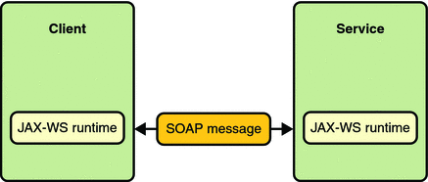
The SOAP Client
In order consume a SOAP service we must send SOAP message to the web service with regards to the WSDL file.

Slide 36
The SOAP Client
Alternatively, a client stub may be created.
Common practices:
Generic method (using JAX-WS)
Using stub generators
Using IDEs

Slide 37
The SOAP Client
Generic Method
import java.net.URL;
import javax.xml.namespace.QName;
import javax.xml.ws.Service;
public class HelloWorldClient{
public static void main(String[] args) throws Exception {
URL url = new URL("http://localhost:7779/ws/hello?wsdl");
//1st argument service URI, refer to wsdl document above
//2nd argument is service name, refer to wsdl document above
QName qname = new QName("http://javatpoint.com/", "HelloWorldImplService");
Service service = Service.create(url, qname);
HelloWorld hello = service.getPort(HelloWorld.class);
System.out.println(hello.getHelloWorldAsString("javatpoint rpc"));
}
}

Slide 38
The SOAP Client
In NetBeans, this can be done, very similar to generating REST client, but using WSDL file. Simply right click on the project and add new “Web Service Client…”
Once the reference is created, simply browse to the Web Service References and drag the method you want to call into the code file and the method call will be generated.

Slide 39
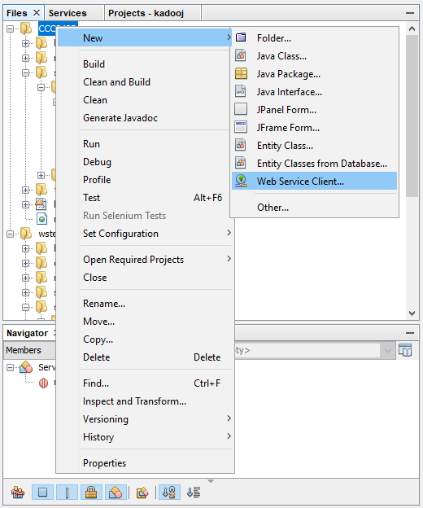
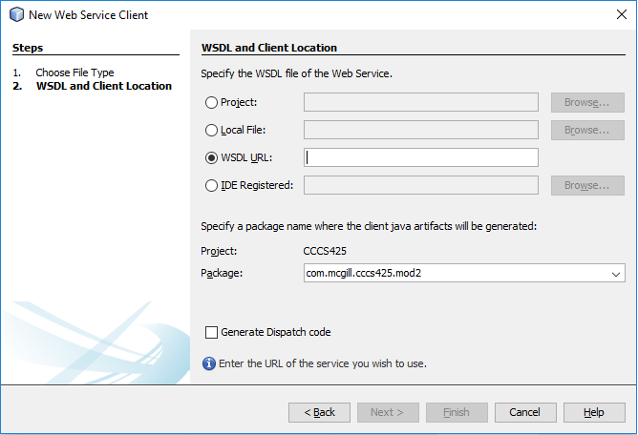
The SOAP Client
Generating Web Client using “New Web Service Client”

Slide 40
Lab Activity

Slide 41
Lab Activity
Creating a simple SOAP Service and consuming it using SOAP-UI

Slide 42
Session Summary
Simple Object Access Protocol (SOAP)
Web Service Definition Language (WSDL)
JAX-WS and SOAP
JAX-WS and METRO
RPC vs Document Style
Web Service Hello World
The Soap Client
SOAP API
Publishing using EndPoint

Slide 43
Acknowledgements
https://www.javatpoint.com/soap-web-services
https://en.wikipedia.org/wiki/Java_API_for_XML_Web_Services
https://dzone.com/articles/comprehensive-guide-rest-vs-soap
https://en.wikipedia.org/wiki/Web_Services_Description_Language
See also:
https://javaee.github.io/metro/

Slide 44
Next - Understanding SOAP Messages

