Slide 1
CCCS 425 – Web Services Module7 – Understanding SOAP Messages

Slide 2

Acknowledgement
The following materials are produced from various online sources. Links to the original materials have been provided.

Slide 3
Session Learning Outcomes
Explain SOAP messages
Use Java API to send SOAP messages
Explain SOAP Faults
Handle Exceptions using SOAP Faults
Explain the difference between HTTP Exceptions and SOAP Faults

Slide 4
Session Overview
SOAP Messaging
SOAP Faults
Using SOAP API

Slide 5
SOAP Messaging

Slide 6
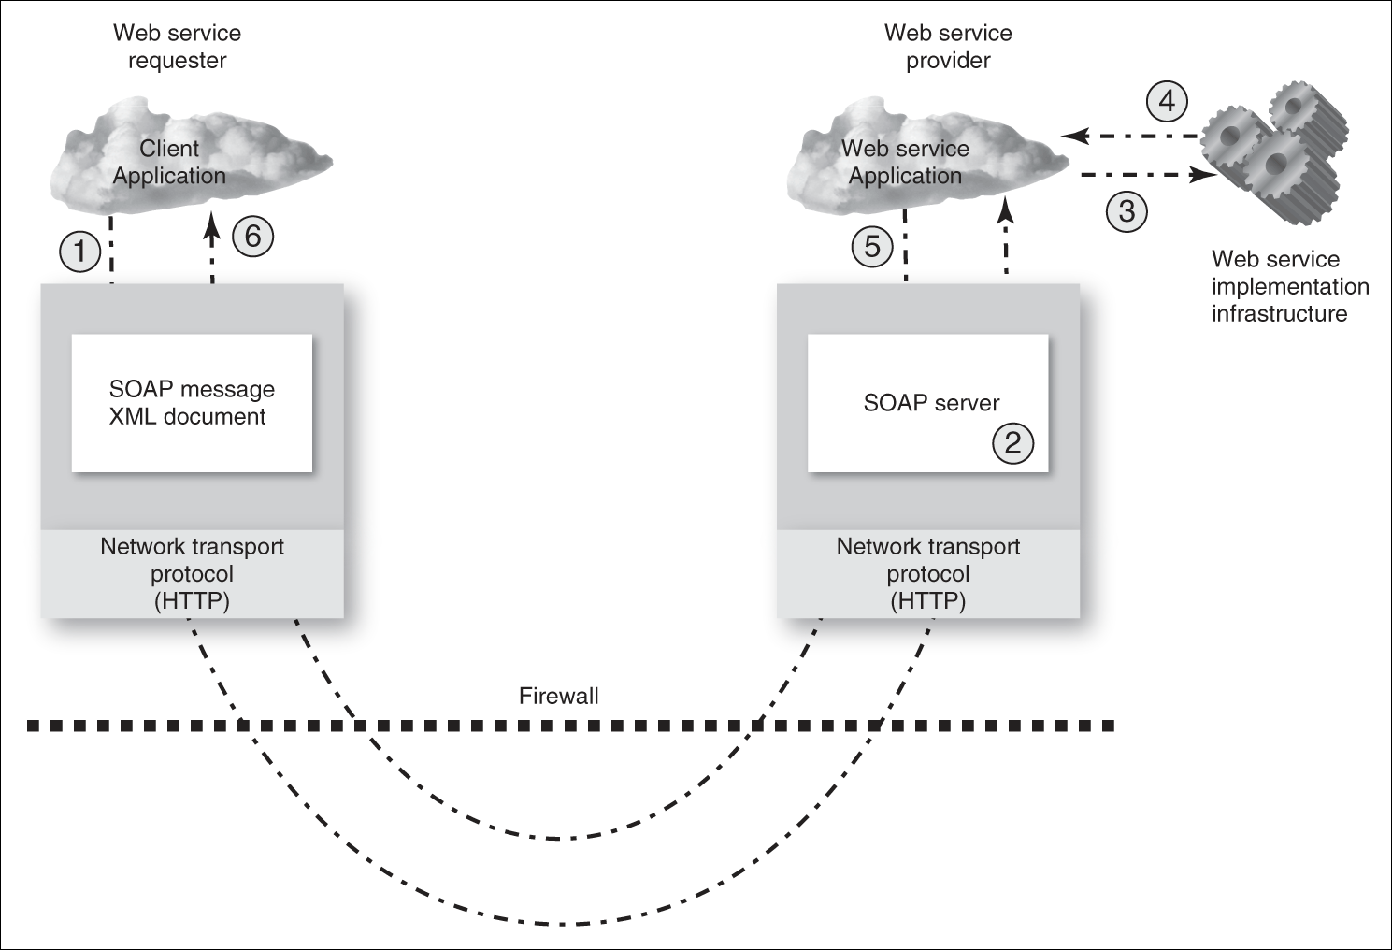
SOAP as a Messaging Protocol
Web Services & SOA: Principles and Technology

Slide 7
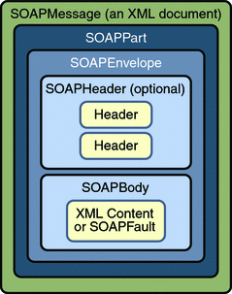
Understanding SOAP Messages
Structure of a SOAP message
A SOAP XML document has a hierarchical structure made up of elements, subelements, subsubelements, and so on.

Slide 8
Understanding SOAP Messages
A closer look at SOAP protocol
Consider the following service
package com.mcgill.cccs425.soap;
@WebService(serviceName = "MyService")
public class MyService {
@WebMethod(operationName = "hello")
public String hello(@WebParam(name = "name") String name)
{
return "hello " + name + "!";
}
}

Slide 9
Understanding SOAP Messages
A closer look at SOAP protocol
The SOAP Request over HTTP:
protocol
POST /cccs425.web/MyService HTTP/1.1
Host: localhost:8080
Content-Type: Content-Type: text/xml;charset=UTF-8
Content-Length: length
<?xml version="1.0" encoding="utf-8"?>
<soapenv:Envelope
xmlns:soapenv="http://schemas.xmlsoap.org/soap/envelope/"
xmlns:att="http://com.mcgill.cccs425.soap/">
<soapenv:Header/>
<soapenv:Body>
<att:hello>
<name>me</name>
</att:hello>
</soapenv:Body>
</soapenv:Envelope>
headers
data

Slide 10
Understanding SOAP Messages
A closer look at SOAP protocol
The SOAP Response:
status
HTTP/1.1 200 OK
Content-Type: application/soap+xml; charset=utf-8
Content-Length: length
<?xml version="1.0" encoding="utf-8"?>
<S:Envelope xmlns:S="http://schemas.xmlsoap.org/soap/envelope/">
<S:Body>
<ns2:helloResponse xmlns:ns2="http://com.cccs425.mcgill.soap/">
<return>hello me!</return>
</ns2:envTestResponse>
</S:Body>
headers
data

Slide 11
Understanding SOAP Messages
Invoking SOAP
You may also try SOAPUI: https://www.soapui.org/downloads/soapui.html
curl -H "Content-Type: text/xml;charset=UTF-8" -H "SOAPAction:"
-d @envelope.xml http://localhost:8080/cccs425.web/MyService?wsdl
<?xml version="1.0" encoding="utf-8"?>
<soapenv:Envelope
xmlns:soapenv="http://schemas.xmlsoap.org/soap/envelope/">
<soapenv:Header/>
<soapenv:Body>
<hello xmlns="http://com.mcgill.cccs425.soap/">
<name>me</name>
</hello>
</soapenv:Body>
</soapenv:Envelope>

Slide 13
SOAP Faults

Slide 14
SOAP Faults
Understanding SOAP Faults
A SOAP fault is an error in a SOAP communication resulting from various sources of problems (i.e. incorrect message format, header-processing problems, or incompatibility between applications, etc.)
When a SOAP fault occurs, a special message is generated
The message contains data indicating where the error originated and what caused it.
This data is called a fault element.

Slide 15
SOAP Faults
A SOAP Fault Example
<?xml version = '1.0' encoding = 'UTF-8'?>
<SOAP-ENV:Envelope
xmlns:SOAP-ENV = "http://schemas.xmlsoap.org/soap/envelope/"
xmlns:xsi = "http://www.w3.org/1999/XMLSchema-instance"
xmlns:xsd = "http://www.w3.org/1999/XMLSchema">
<SOAP-ENV:Body>
<SOAP-ENV:Fault>
<faultcode xsi:type = "xsd:string">SOAP-ENV:Client</faultcode>
<faultstring xsi:type = "xsd:string">
Failed to locate method (ValidateCreditCard) in class (examplesCreditCard) at
/usr/local/ActivePerl-5.6/lib/site_perl/5.6.0/SOAP/Lite.pm line 1555.
</faultstring>
</SOAP-ENV:Fault>
</SOAP-ENV:Body>
</SOAP-ENV:Envelope>

Slide 16
SOAP Faults
JAX-WS and Faults
@WebFault(name="MySOAPFault", targetNamespace="http://www.example.com")
public class MySOAPFault extends Exception {
public MySOAPFault(String message) {
super(message);
}
public MySOAPFault(String message, Throwable cause) {
super(message, cause);
}
}

Slide 17
SOAP Faults
JAX-WS and Faults
@WebService(serviceName = "FooSvc")
public class FooService {
public String sayHello(String name) throws MySOAPFault {
if (name.isEmpty()) {
Throwable t = new IllegalArgumentException("Empty name");
throw new MySOAPFault("There is one error", t);
}
return "Hello, " + name;
}
}

Slide 18
SOAP Faults
A Sample Output
<S:Envelope xmlns:S="http://schemas.xmlsoap.org/soap/envelope/">
<S:Body>
<S:Fault xmlns:ns4="http://www.w3.org/2003/05/soap-envelope">
<faultcode>S:Server</faultcode>
<faultstring>There is one error</faultstring>
<detail>
<ns2:MySOAPFault xmlns:ns2="http://ws.pkg/">
<message>There is one error</message>
</ns2:MySOAPFault>
</detail>
</S:Fault>
</S:Body>
</S:Envelope>

Slide 21
Using SOAP API

Slide 22
Using SOAP API
Imports
Necessary classes may be found under java.xml.soap pacakage
import javax.xml.soap.SOAPConnectionFactory;
import javax.xml.soap.SOAPConnection;
import javax.xml.soap.SOAPFactory;
import javax.xml.soap.MessageFactory;
import javax.xml.soap.SOAPMessage;
import javax.xml.soap.SOAPHeader;
import javax.xml.soap.SOAPBody;
import javax.xml.soap.SOAPBodyElement;
import javax.xml.soap.SOAPElement;
import javax.xml.soap.Name;

Slide 23
Using SOAP API
Constructing the message
SOAPConnectionFactory conFactory = SOAPConnectionFactory.newInstance();
SOAPConnection conn = conFactory.createConnection();
SOAPFactory soapFactory = SOAPFactory.newInstance();
MessageFactory mfactory = MessageFactory.newInstance();
SOAPMessage message = mfactory.createMessage();
SOAPBody body = message.getSOAPBody();
Name envTestName = soapFactory.createName(
"hello", "myns", "http://com.mcgill.cccs425.soap/");
SOAPBodyElement hellomethod = body.addBodyElement(envTestName);
SOAPElement nameparam = hellomethod.addChildElement("name");
SOAPElement val = nameElement.addTextNode("me");

Slide 24
Using SOAP API
Performing the SOAP Call and retrieving the response
URL endpoint = new URL("http://localhost:8080/cccs425.web/MyService");
SOAPMessage response = conn.call(message, endpoint);

Slide 25
Using SOAP API
Processing the Response
System.out.println(
response.getSOAPBody().getChildNodes().item(0).
getChildNodes().item(0).
getChildNodes().item(0).getNodeValue());
<S:Envelope xmlns:S="http://schemas.xmlsoap.org/soap/envelope/">
<S:Body>
<ns2:helloResponse xmlns:ns2="http://com.cccs425.mcgill.soap/">
<return>hello me!</return>
</ns2:envTestResponse>
</S:Body>

Slide 27
JAX RPC

Slide 28
JAX RPC
What is JAX RPC
JAX-RPC stands for Java API for XML-based RPC.
It's an API for building Web services and clients that used remote procedure calls (RPC) and XML.

Slide 29
JAX RPC
JAX RPC is now obsolete
JAX-RPC is an older version of SOAP implementation which is now replaced by JAX-WS and is deprecated.
It is based on java 1.4 and do not support new standards. Therefore, it is no longer supported.
It is based on java Remote Method Invocation (RMI) framework.

Slide 30
JAX RPC
JAX-WS vs JAX-RPC
Similarities:
Both support SOAP 1.1 and HTTP 1.1
Differences:
JAX-WS support SOAP 1.2
JAX-RPC is based on java 1.4 while JAX-WS uses java 5
JAX-RPC uses its own object model and supports certain java data types
JAX-WS uses JAXB
JAX-WS support new features such i.e. async functionality

Slide 31
JAX RPC
JAX-RPC supported types
java.lang.Boolean
java.lang.Byte
java.lang.Double
java.lang.Float
java.lang.Integer
java.lang.Long
java.lang.Short
java.lang.String
java.math.BigDecimal
java.math.BigInteger
java.util.Calendar
java.util.Date

Slide 32
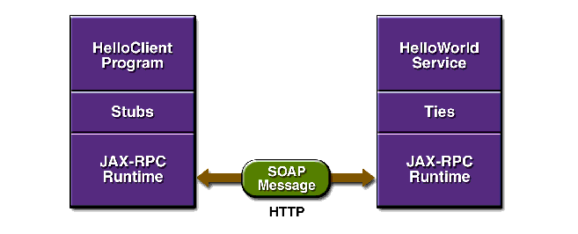
JAX RPC
THE RPC Model

Slide 33
JAX RPC
JAX RPC Components
Layer | Source
Client Service (interface and implementation class) | Provided by the application developer
Stubs | Generated by the wscompile tool, which is run by the application developer
Ties | Generated by the wsdeploy tool, which is run by the application developer
JAX-RPC Runtime System | Included with the Java WSDP (Java Web Services Development Pack)

Slide 34
JAX RPC
Service Interface
package hello;
import java.rmi.Remote;
import java.rmi.RemoteException;
public interface HelloIF extends Remote {
public String sayHello(String s) throws RemoteException;
}

Slide 35
JAX RPC
The Implementation Class
package hello;
public class HelloImpl implements HelloIF {
public String message ="Hello";
public String sayHello(String s) {
return message + s;
}
}

Slide 36
JAX RPC
The jaxrpc-ri.xml file
<?xml version="1.0" encoding="UTF-8"?>
<webServices xmlns="http://java.sun.com/xml/ns/jax-rpc/ri/dd" version="1.0"
targetNamespaceBase="http://com.test/wsdl"
typeNamespaceBase="http://com.test/types" urlPatternBase="/ws">
<endpoint name="MyHello" displayName="HelloWorld Service"
description="A simple web service"
interface="hello.HelloIF" implementation="hello.HelloImpl"/>
<endpointMapping endpointName="MyHello" urlPattern="/hello"/>
</webServices>

Slide 37
JAX RPC
The Client Code
package hello;
import javax.xml.rpc.Stub;
public class HelloClient {
public static void main(String[] args) {
try {
Stub stub = createProxy();
HelloIF hello = (HelloIF)stub;
System.out.println(hello.sayHello("Duke!"));
}
catch (Exception ex) {
ex.printStackTrace();
}
}
private static Stub createProxy() {
// Note: MyHello_Impl is implementation-specific.
return (Stub)(new MyHello_Impl().getHelloIFPort());
}
}

Slide 38
JAX RPC
The Dynamic Code
public class HelloClient {
public static void main(String[] args) {
try {
String UrlString = "http://localhost:8080/ProxyHelloWorld.wsdl";
String nameSpaceUri = "http://proxy.org/wsdl";
String serviceName = "HelloWorld";
String portName = "HelloIFPort";
URL helloWsdlUrl = new URL(UrlString);
ServiceFactory serviceFactory = ServiceFactory.newInstance();
Service helloService = serviceFactory.createService(helloWsdlUrl, new QName(nameSpaceUri, serviceName));
HelloIF myProxy = (HelloIF) helloService.getPort(new QName(nameSpaceUri, portName), proxy.HelloIF.class);
System.out.println(myProxy.sayHello("Buzz"));
}
catch (Exception ex) {
ex.printStackTrace();
}
}
}
import java.net.URL;
import javax.xml.rpc.Service;
import javax.xml.rpc.JAXRPCException;
import javax.xml.namespace.QName;
import javax.xml.rpc.ServiceFactory;

Slide 39
Lab Activity

Slide 40
Lab Activity
Generating SOAP Faults, Consuming Services that may generate Faults

Slide 41
Session Summary
SOAP API
SOAP Faults
HTTP Exceptions
JAX-RPC features and concepts
JAX-RPC vs. JAX-WS
JAX-RPC client

Slide 42
Acknowledgements
http://lia.deis.unibo.it/Courses/TecnologieWeb0708/materiale/laboratorio/guide/j2ee14tutorial7/JAXRPC3.html
https://examples.javacodegeeks.com/enterprise-java/jws/jax-ws-vs-jax-rpc-comparison-differences/
See also:
https://www.w3schools.com/xml/xml_soap.asp
https://www.tutorialspoint.com/soap/soap_fault.htm
https://docs.oracle.com/cd/E24329_01/web.1211/e24965/faults.htm
https://www.w3schools.com/xml/xml_soap.asp
http://www.inf.fu-berlin.de/lehre/SS03/19560-P/Docs/JWSDP/tutorial/doc/JAXRPC.html

Slide 43
Next - SOAP Attachments

