Slide 1
CCCS 425 – Web Services Module 8 – SOAP Attachments

Slide 2

Acknowledgement
The following materials are produced from various online sources. Links to the original materials have been provided.

Slide 3
Session Learning Outcomes
Explain SOAP attachment
Upload files onto a server using SOAP
Download a file from a SOAP web service
Explain and Activate MTOM (Message Transmission Optimization Mechanism)
Explain and Use Content Marshaling
Use Java Properties

Slide 4
Session Overview
SOAP with Attachments API for Java
Using SAAJ
Message Transmission Optimization Mechanism (MTOM)
Content Marshalling

Slide 5
SOAP with Attachments API for Java (SAAJ)

Slide 6
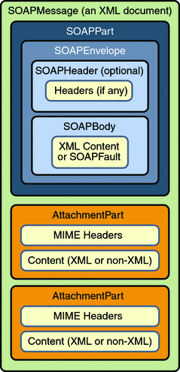
SOAP with Attachments
SOAP with Attachments API for Java (SAAJ)
SOAP with attachment is very similar to a regular SOAP message and consists of multi-parts. In other words, it is a “multipart” massage.

Slide 7
SOAP with Attachments
A multipart SOAP Message
POST /propertyListing HTTP/1.1
Host: www.realproperties.com
Content-Type: Multipart/Related; boundary=MIME_boundary; type=text/xml; start="<property1234@realhouses.com>"
Content-Length: NNNN
--MIME_boundary
Content-Type: text/xml; charset=UTF-8
Content-Transfer-Encoding: 8bit
Content-ID: <property1234.xml@realhouses.com>
<?xml version='1.0'?>
<SOAP-ENV:Envelope xmlns:SOAP-ENV="http://schemas.xmlsoap.org/soap/envelope/">
<SOAP-ENV:Body>
<realProperty:propertyListing id="property_432"
xmlns:realProperty="http://schemas.realhouses.com/listingSubmission">
<listingAgency>Really Nice Homes, Inc.</listingAgency>
<listingType>Add</listingType>
<propertyAddress>
<street>1234 Main St</street>
<city>Pleasantville</city>
<state>CA</state>
<zip>94323</zip>
</propertyAddress>

Slide 8
SOAP with Attachments
A multipart SOAP Message
<listPrice>
250000
</listPrice>
<frontImage href="property1234_front.jpeg@realhouses.com"/>
<interiorImage href="property1234_interior.jpeg@realhouses.com"/>
</realProperty:propertyListing>
</SOAP-ENV: Body>
</SOAP-ENV: Envelope>
--MIME_boundary
Content-Type: image/jpeg
Content-ID: <property1234_front.jpeg@realhouses.com>
....JPEG DATA .....
--MIME_boundary
Content-Type: image/jpeg
Content-ID: <property1234_interior.jpeg@realhouses.com>
....JPEG DATA .....
--MIME_boundary--

Slide 10
Using SAAJ

Slide 11
Using SAAJ
JAX-WS and attachments
import java.io.*;
import javax.activation.DataHandler;
@WebService(serviceName = "FileWebService")
public class FileWebService {
@WebMethod(operationName = "hello")
public String hello(@WebParam(name = "name") String txt,
@WebParam(name = "file") DataHandler file) {
int total = 0;
try (InputStream input = file.getInputStream()) {
byte[] b = new byte[100000];
int bytesRead = 0;
while ((bytesRead = input.read(b)) != -1) {
// TODO process data
total += bytesRead;
}
} catch (Exception e) {
return e.getMessage();
}
return "Total " + total + " bytes received";
}
}

Slide 12
Using SAAJ
JAX-WS and returning files
import java.io.*;
import javax.activation.DataHandler;
@WebService(serviceName = "FileWebService")
public class FileWebService {
@WebMethod
public @XmlMimeType("application/octet-stream")
DataHandler downloadFile() {
DataSource dataSource = new FileDataSource(new File("... ");
return new DataHandler(dataSource);
}
}

Slide 13
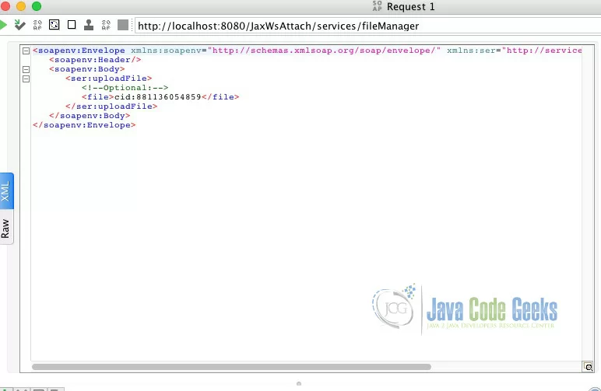
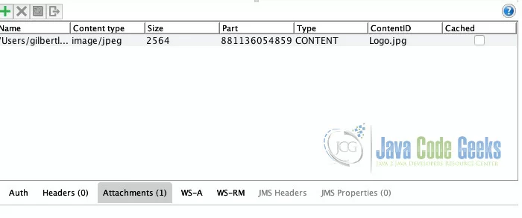
Using SAAJ
Using SOAP UI

Slide 14
Using SAAJ
Using SAAJ
import java.io.*;
import javax.activation.DataHandler;
import javax.xml.soap.AttachmentPart;
URL url = new URL("file:///export/files/pic1.jpg");
DataHandler dataHandler = new DataHandler(url);
AttachmentPart att = message.createAttachmentPart(dataHandler);
att.setContentId("cid:....");
message.addAttachmentPart(att);

Slide 15
Using SAAJ
The Client Side and Downloading Files
import java.io.FileOutputStream;
public class FileClient{
public static void main(String[] args) throws Exception {
FileWebService service = new FileWebService();
FileDownload server = service.getFileWebServicePort();
byte[] bytes = server.downloadFile();
FileOutputStream fos = new
FileOutputStream("D:/DownloadTest/save/downloadTest.docx");
fos.write(bytes);
fos.flush();
fos.close();
System.out.println("Download Completed");
}
}

Slide 18
Message Transmission Optimization Mechanism (MTOM)

Slide 19
Message Transmission Optimization Mechanism (MTOM)
What is MTOM?
MTOM is the W3C Message Transmission Optimization Mechanism, a method of efficiently sending binary data to and from Web services.
MTOM is usually used with the XOP (XML-binary Optimized Packaging).
XML-binary Optimized Packaging (XOP) is a mechanism defined for the serialization of XML Information Sets (infosets) that contain binary data, as well as deserialization back into the XML Information Set.
MIME-Version: 1.0
Content-Type: Multipart/Related;boundary=MIME_boundary;
...
--MIME_boundary
Content-Type: application/xop+xml;
...
<soap:Envelope> ...
<soap:Body> ...
<m:photo xmlmime:contentType="image/png">
<xop:Include xmlns:xop="http://www.w3.org/2004/08/xop/include"
href="cid:http://example.org/me.png"/></m:photo>
...
--MIME_boundary
Content-Type: image/png
Content-Transfer-Encoding: binary
Content-ID: <http://example.org/me.png>

Slide 20
Message Transmission Optimization Mechanism (MTOM)
A Web Service returning binary data
import java.awt.Image;
import javax.jws.WebMethod;
import javax.jws.WebService;
import javax.jws.soap.SOAPBinding;
import javax.jws.soap.SOAPBinding.Style;
@WebService
@SOAPBinding(style=Style.RPC)
public interface ImageService {
//Download image from server
@WebMethod
Image downloadImage(String imageName);
}

Slide 21
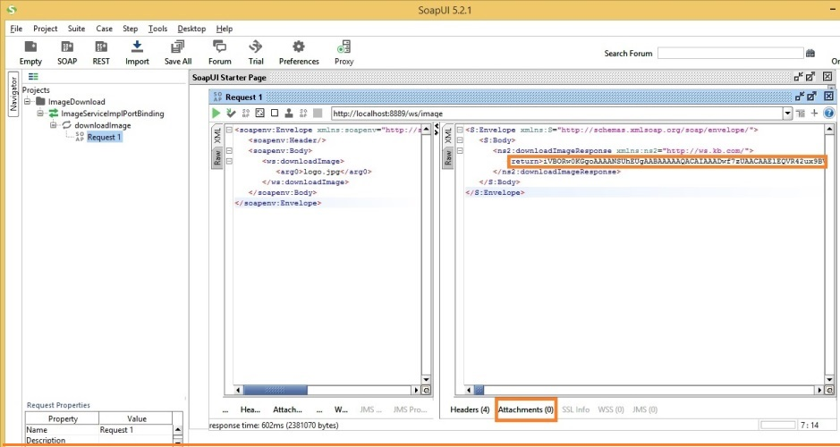
Message Transmission Optimization Mechanism (MTOM)
A Web Service returning binary data

Slide 22
Message Transmission Optimization Mechanism (MTOM)
Enabling MTOM
@WebService(endpointInterface="com.kb.ws.MtomImageService")
@MTOM(threshold=10)
public class MtomImageServiceImpl implements MtomImageService{
@Override
public Image downloadImage(String imageName) {
File image = new File("...");
try {
return ImageIO.read(image);
} catch (IOException e) {
e.printStackTrace();
}
return null;
}
}
When MTOM is enabled, binary data above the threshold size in bytes will be XOP encoded or sent as attachment. The value of this property MUST always be >= 0. Default value is 0.

Slide 23
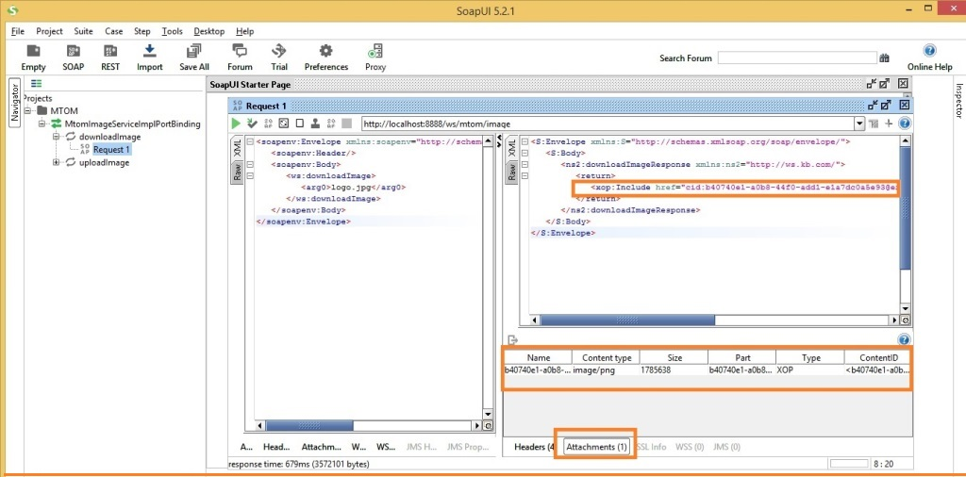
Message Transmission Optimization Mechanism (MTOM)
Web Service output with MTOM enabled

Slide 25
Content Marshaling

Slide 26
Content Marshaling
Jax-RS and Marshaling
JAX-RS has a bunch of built-in handlers that can marshal to and from a few different specific Java types. While most are low-level conversions, they can still be useful to your JAX-RS classes.

Slide 27
Content Marshaling
InputStream
@Path("/")
public class MyService {
@PUT
@Path("/stuff")
public void putStuff(InputStream is) {
. . .
}

Slide 28
Content Marshaling
Byte[]
@Path("/")
public class MyService {
@GET
@Produces("text/plain")
public byte[] get() {
return "hello world".getBytes();
}
@POST
@Consumes("text/plain")
public void post(byte[] bytes) {
System.out.println(new String(bytes));
}
}

Slide 29
Content Marshaling
OutputStream
package javax.ws.rs.core;
public interface StreamingOutput {
public void write(OutputStream os) throws IOException, WebApplicationException;
}
@Path("/myservice")
public class MyService {
@GET
@Produces("text/plain")
StreamingOutput get() {
return new StreamingOutput() {
public void write(OutputStream output) throws IOException, WebApplicationException {
output.write("hello world".getBytes());
}
};
}

Slide 30
Content Marshaling
File
@Path("/file")
public class FileService {
private static final String basePath = "...";
@GET
@Path("{filepath: .*}")
@Produces("text/plain")
public File getFile(@PathParam("filepath") String path) {
return new File(basePath + path);
}

Slide 31
Content Marshaling
MultivaluedMap
@Path("/")
public class MyService {
@POST
@Consumes("application/x-www-form-urlencoded")
@Produces("application/x-www-form-urlencoded")
public MultivaluedMap<String,String> post(
MultivaluedMap<String, String> form) {
return form;
}
}

Slide 33
Java Properties

Slide 34
Java Properties
Properties class in Java
The Properties class represents a persistent set of properties. The Properties can be saved to a stream or loaded from a stream
Properties are configuration values managed as key/value pairs.
Properties is a subclass of Hashtable.
The key and value are both String values.
One may specify a default property that will be returned if no value is associated with a certain key.
Multiple thread can share a single properties object without the need of external synchronization.

Slide 35
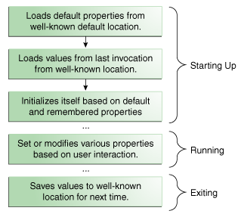
Java Properties
Properties life cycle

Slide 36
Java Properties
Example
import java.util.*;
public class PropDemo {
public static void main(String args[]) {
Properties capitals = new Properties();
Set states; String str;
capitals.put("Illinois", "Springfield");
capitals.put("Missouri", "Jefferson City");
capitals.put("Washington", "Olympia");
capitals.put("California", "Sacramento");
capitals.put("Indiana", "Indianapolis");
// Show all states and capitals in hashtable.
states = capitals.keySet();
// get set-view of keys
Iterator itr = states.iterator();
while(itr.hasNext()) {
str = (String) itr.next();
System.out.println("The capital of " + str + " is " + capitals.getProperty(str) + ".");
}
System.out.println();
// look for state not in list -- specify default
str = capitals.getProperty("Florida", "Not Found");
System.out.println("The capital of Florida is " + str + ".");
}
}
The capital of Missouri is Jefferson City.
The capital of Illinois is Springfield.
The capital of Indiana is Indianapolis.
The capital of California is Sacramento.
The capital of Washington is Olympia.
The capital of Florida is Not Found.

Slide 37
Java Properties
Loading from properties file
import java.io.FileInputStream;
import java.io.IOException;
import java.io.InputStream;
import java.util.Properties;
public class App2 {
public static void main(String[] args) {
try (InputStream input = new FileInputStream("path/to/config.properties")) {
Properties prop = new Properties();
// load a properties file
prop.load(input);
// get the property value and print it out
System.out.println(prop.getProperty("db.url"));
System.out.println(prop.getProperty("db.user"));
System.out.println(prop.getProperty("db.password"));
} catch (IOException ex) {
ex.printStackTrace();
}
}
}

Slide 38
Java Properties
Loading from properties file
import java.io.FileOutputStream;
import java.io.IOException;
import java.io.OutputStream;
import java.util.Properties;
public class App1 {
public static void main(String[] args) {
try (OutputStream output = new FileOutputStream("path/to/config.properties")) {
Properties prop = new Properties();
// set the properties value
prop.setProperty("db.url", "localhost");
prop.setProperty("db.user", "mkyong");
prop.setProperty("db.password", "password");
// save properties to project root folder
prop.store(output, null);
System.out.println(prop);
} catch (IOException io) {
io.printStackTrace();
}
}
}

Slide 39
Java Properties
Load a properties file from classpath
public class MyApplication {
public static void main(String[] args) {
try (InputStream input = MyApplication.class.getClassLoader().getResourceAsStream("config.properties")) {
Properties prop = new Properties();
if (input == null) {
System.out.println("Sorry, unable to find config.properties");
return;
}
//load a properties file from class path, inside static method
prop.load(input);
.
.
.

Slide 41
Lab Activity

Slide 42
Lab Activity
File Download / Upload using SOAP and using MTOM.
Content Marshalling using JAX-RS

Slide 43
Session Summary
SOAP Attachments
SOAP with Attachments API for Java (SAAJ)
Message Transmission Optimization Mechanism (MTOM)
Content Marshaling
Java Properties

Slide 44
Acknowledgements
https://www.javaworld.com/article/2073735/soa-saaj-no-strings-attached.html
https://examples.javacodegeeks.com/enterprise-java/jws/jax-ws-attachment-example/
https://www.concretepage.com/webservices/download-file-using-jax-ws-web-service-in-java
https://dennis-xlc.gitbooks.io/restful-java-with-jax-rs-2-0-en/cn/part1/chapter6/built_in_content_marshalling.html
https://www.mkyong.com/java/java-properties-file-examples/ https://www.tutorialspoint.com/java/java_properties_class
https://docs.oracle.com/javase/tutorial/essential/environment/properties.html
https://www.geeksforgeeks.org/java-util-properties-class-java/
See also:
https://docs.oracle.com/javaee/5/tutorial/doc/bnbhr.html

Slide 45
Next - Micro-services

