Slide 1
CCCS 425 – Web Services Lecture 9 – Micro-Services

Slide 2

Acknowledgement
The following materials are produced from various online sources. Links to the original materials have been provided.

Slide 3
Session Learning Outcomes
Explain Service Oriented Architecture
Explain Micro Services Architecture
Create and Deploy Micro Services

Slide 4
Session Overview
Service Oriented Architecture
Micro-Service Architecture
A Micro-Service Example
Service Deployment

Slide 5
Service Oriented Architecture

Slide 6
What is Service Oriented Architecture?
Recall
Service-oriented architecture (SOA) is a style of software design where services are provided to the other components by application components, through a communication protocol over a network.
The basic principles of service-oriented architecture are independent of vendors, products and technologies.
A service is a discrete unit of functionality that can be accessed remotely and acted upon and updated independently, such as retrieving a credit card statement online.

Slide 7
Service-Oriented Architecture (SOA)
SOA services are maintained in the organization by a registry which acts as a directory listing. Applications need to look up the services in the registry and invoke the service.
SOA is just like an orchestra where each artist is performing with their instrument while the music director gives instructions to all.

Slide 8
SOA and Enterprise Systems
Building distributed software systems involves fitting together resources and systems from diverse organizations.
In other words: “business functions” are enumerated as services, organized into logical domains, and somehow managed over their lifetimes.
All functions in an SOA are defined as services
All services are independent of each other
Service interfaces are invokable

Slide 9
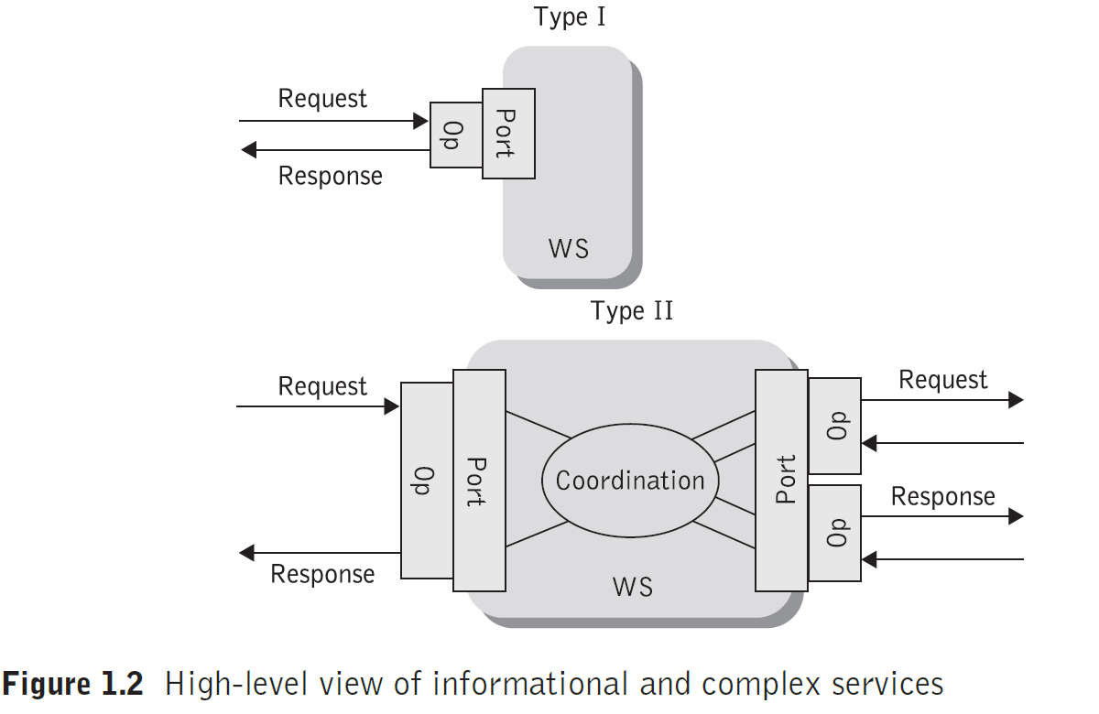
(Topologically) Types of Web Services
Topologically, Web services can come in two flavors
Type I: support only simple request / response operations; they wait for a request; process it and respond.
Complex, or type II: implement some form of coordination between inbound and outbound operations

Slide 10
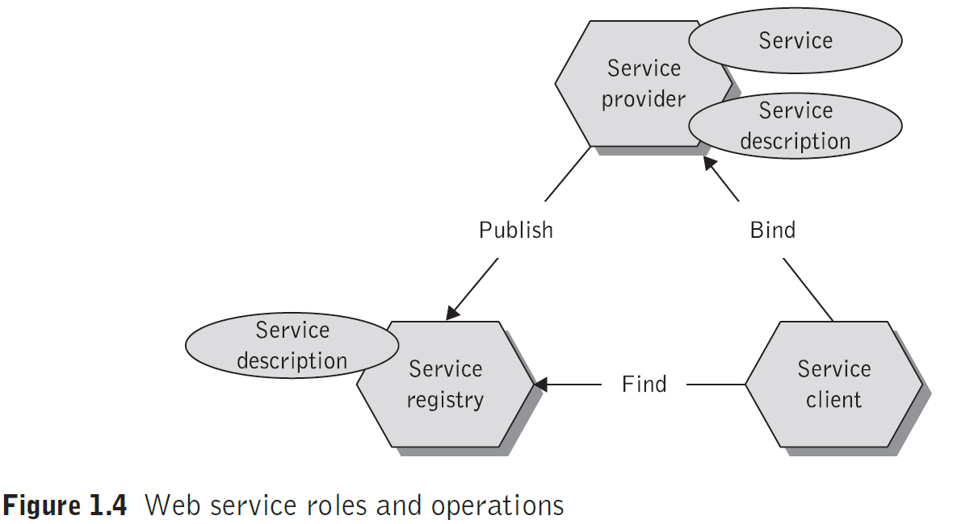
Operations in SOA

Slide 11
Operations in SOA /cont.
Publishing a Web service, so that other users or applications can find it, actually consists of two important operations.
The first operation is describing the Web service itself;
The other is the actual registration of the Web service.
Finding Web services is also a two-fold operation:
First discovering the services in the registry of the discovery agency and then;
Selecting the desired Web service(s) from the search results.

Slide 12
Operations in SOA /cont.
Invocating the Web service is the final operation in the Web services architecture.
During the binding operation, the service requestor invokes or initiates an interaction at run-time using the binding details in the service description to locate and contract to the service.
It uses the technical information entered in the registry by the Web services provider.

Slide 13
Service Roles in SOA
A service container provides deployment and a run-time support environment that makes a web service highly distributed.
A service container is the physical manifestation of the abstract service endpoint and provides the implementation of the service interface.
Web Services & SOA: Principles and Technology

Slide 14
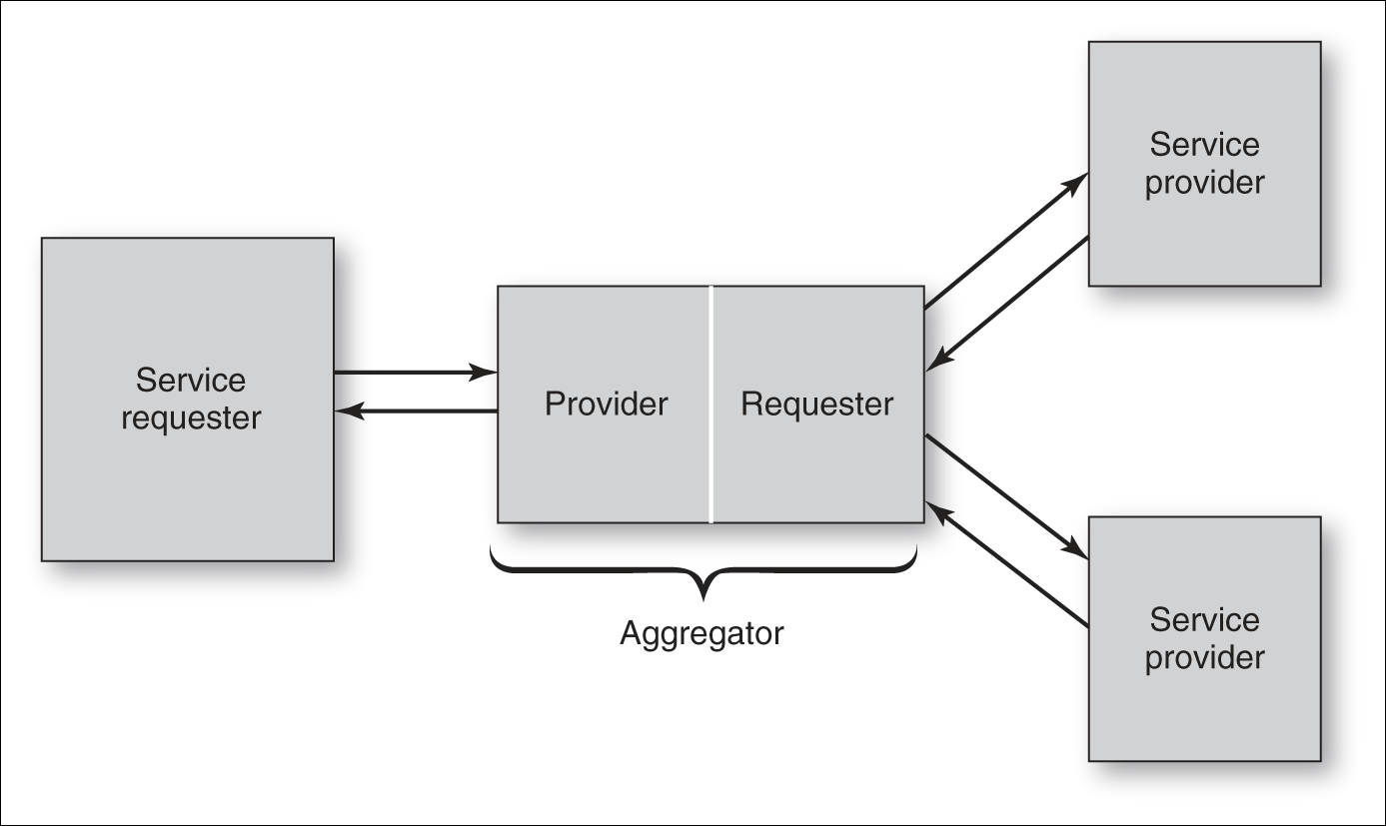
Service Roles in SOA / cont.
A Composite service example is illustrated in the following diagram:
The service aggregator performs a dual role:
acts as an application service provider
acts as a service requestor as it may need to request and reserve services from other service providers.

Slide 15
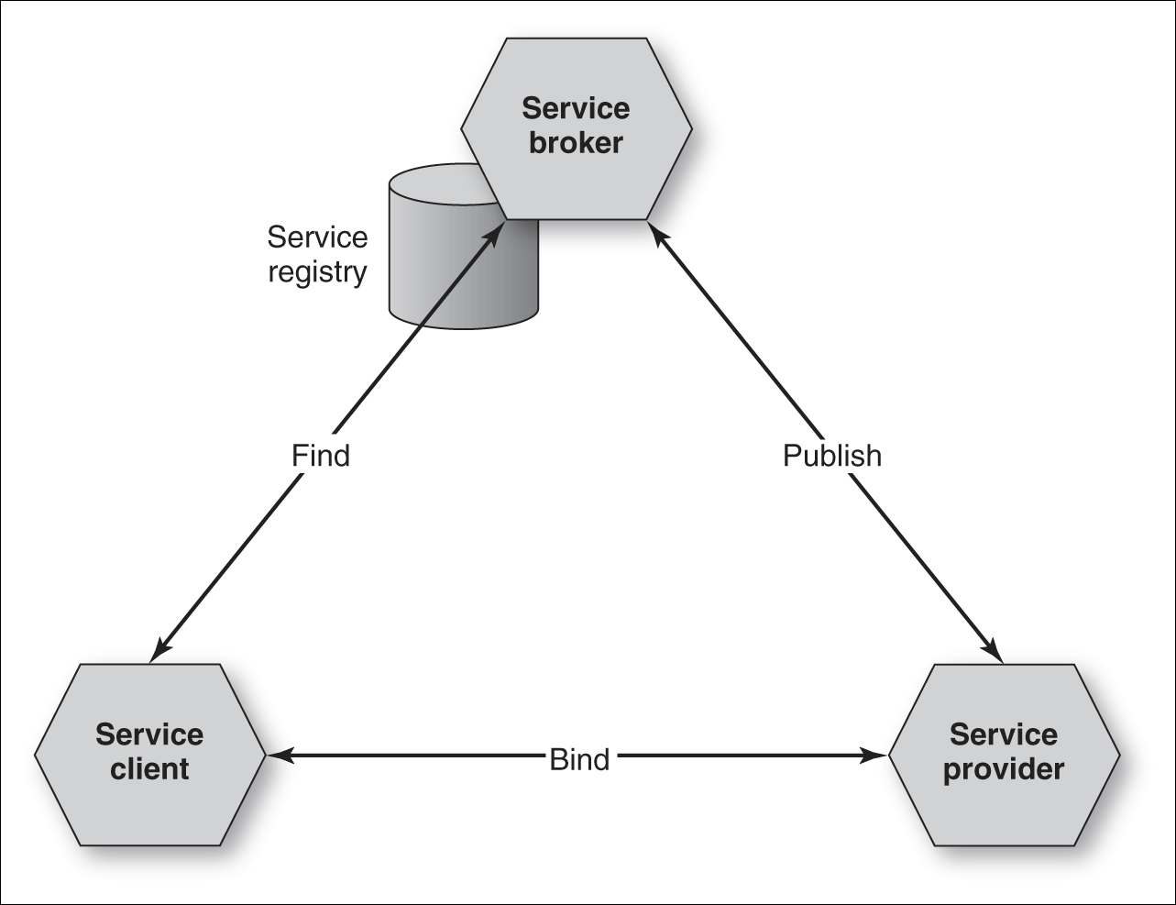
Service Roles in SOA / cont.
Service brokers (also known as certification authorities) are trusted parties that force service providers to adhere to information practices that comply with privacy laws and regulations, or, in the absence of such laws, industry best practices.

Slide 17
Micro-Service Architecture

Slide 18
Microservices
Microservices are a modern interpretation of service-oriented architectures used to build distributed software systems.
Services in a microservice architecture are processes that communicate with each other over the network in order to fulfill a goal.

Slide 19
Microservices
Microservice Architecture is a special design pattern of Service-Oriented Architecture.
In this type of service architecture, all the processes will communicate with each other with the smallest granularity to implement a big system or service.

Slide 20
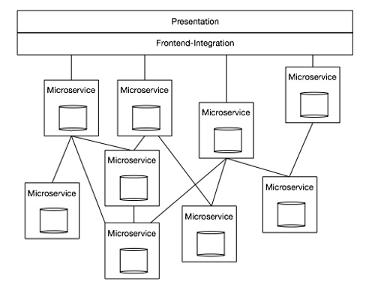
Microservices Characteristics
Independent − Each microservice should be independently deployable.
Coupling − All microservices should be loosely coupled with one another so that changes in one will not affect the other.
Business Goal − Each service unit of the entire application should be the smallest and capable of delivering one specific business goal.

Slide 21
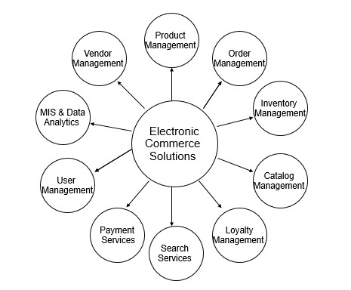
A Microservice Implementation Example
The following figure shows how an Electronic Commerce Solutions System may be implemented using a micro-service architecture:

Slide 22
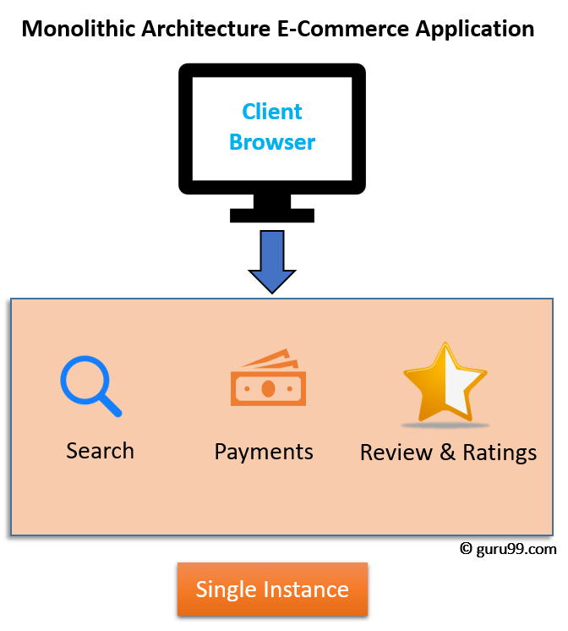
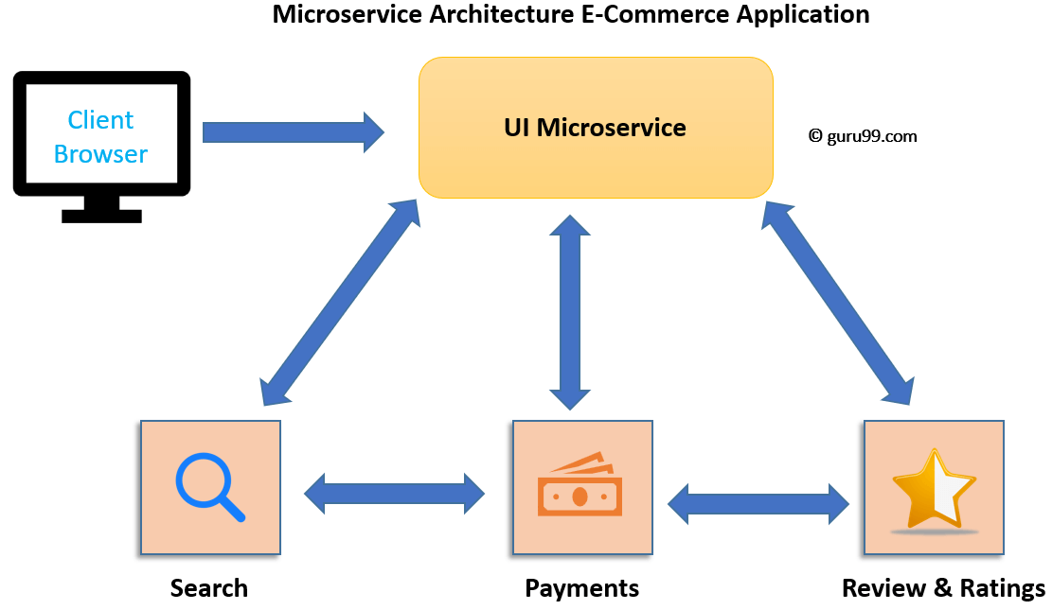
Microservice vs. Monolith
The following diagrams illustrate the architectural difference between a monolith and a microservice:

Slide 23
Advantages and Disadvantages
The advantages and disadvantages of using microservices architecture are summarized in the following:
Advantages | Disadvantages
Small in size Focused Autonomous Technology heterogeneity Resilience Ease of deployment | Distributed system different technologies are used Cost possibly maintaining different servers Enterprise readiness

Slide 24
SOA and Microservices
Parameter | SOA | Microservices
Design type | In SOA, software components are exposed to the outer world for usage in the form of services. | Micro Service is a part of SOA. It is an implementation of SOA.
Dependency | Business units are dependent. | They are independent of each other.
Size of the Software | Software size is larger than any conventional software | The size of the Software is always small in Microservices
Technology Stack | The technology stack is lower compared to Microservice. | Microservice technology stack could be very large
Nature of the application | Monolithic in nature | Full stack in nature
Independent and Focus | SOA applications are built to perform multiple business tasks. | They are built to perform a single business task.
Deployment | The deployment process is time- consuming. | Deployment is straightforward and less time-consuming.
Cost - effectiveness | More cost-effective. | Less cost-effective.
Scalability | Less compared to Microservices. | Highly scalable.
Business logic | Business logic components are stored inside of single service domain Simple wire protocols(HTTP with XML JSON) API is driven with SDKs/Clients | Business logic can live across domains enterprise Service Bus like layers between services Middleware

Slide 25
APIs and Microservices
It is important to not confuse a microservice with an API.
API (Application Programming Interface): A set of subroutine definitions, communication protocols, and tools for building software. In general terms, it is a set of clearly defined methods of communication between various components.
Microservice: a software development technique — a variant of the service-oriented architecture (SOA) architectural style that structures an application as a collection of loosely coupled services. In a microservices architecture, services are fine-grained and the protocols are lightweight.
One can say that an API is usually a portion of a microservice, allowing for interaction with the microservice itself.

Slide 26
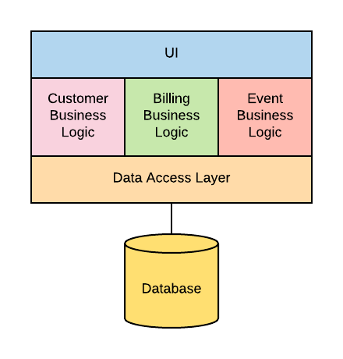
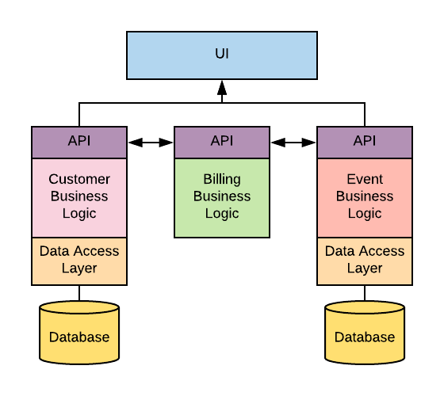
APIs and Microservices / cont.
In microservice architecture, the APIs in microservices provide the access to the micro-“businesses” to the UI.
Monolith
Microservice

Slide 29
A Micro-Service Example

Slide 30
Spring Boot
Spring Boot is an open-source Java-based framework used to create a Micro-Service.
Why using Spring Boot?
Spring boot has gained popularity over years.
Many registry services are implemented using spring boot.
A quick tutorial on spring boot may be found here:
https://www.tutorialspoint.com/spring_boot/spring_boot_introduction.htm

Slide 31
An Entity Class
The following shows an entity class (in JPA):
@Entity class Employee {
private @Id @GeneratedValue Long id;
private String name;
private String role;
Employee() {}
Employee(String name, String role) {
this.name = name; this.role = role;
}
. . .

Slide 32
The Spring Boot Application
A Spring boot application is implemented by executing a run() method:
@SpringBootApplication
public class PayrollApplication {
public static void main(String... args) {
SpringApplication.run(PayrollApplication.class, args);
}
}

Slide 33
REST Controllers
A sample Rest Controller may be implemented as in the following:
@RestController
class EmployeeController {
private final EmployeeRepository repository;
EmployeeController(EmployeeRepository repository) {
this.repository = repository;
}
@GetMapping("/employees")
List<Employee> all() {
return repository.findAll();
}

Slide 34
REST Controllers / cont.
@PostMapping("/employees")
Employee newEmployee(@RequestBody Employee newEmployee) {
return repository.save(newEmployee);
}
@GetMapping("/employees/{id}")
Employee one(@PathVariable Long id) {
return repository.findById(id).orElseThrow(() -> new EmployeeNotFoundException(id));
}
@PutMapping("/employees/{id}")
Employee replaceEmployee(@RequestBody Employee newEmployee, @PathVariable Long id) {
. . .
}
. . .
}

Slide 35
Micro Services and Service Registry
Clients of a service use either Client-side discovery or Server-side discovery to determine the location of a service instance to which to send requests.
Netflix Eureka is an example of a service registry that is implemented as Spring Boot Application.
The service Registry and Discovery will be covered in the next module.
@SpringBootApplication
@EnableEurekaServer
public class EurekaServer {
public static void main(String[] args) {
new SpringApplicationBuilder(EurekaServer.class).web(true).run(args);
}
}

Slide 37
Service Deployment

Slide 38
Web Archives
Web applications are deployed within a standalone servlet container, like Apache Tomcat, Jetty, JBossWeb, or the servlet container of your favorite application server, like JBoss, Wildfly, Weblogic, Websphere, or Glassfish.
Servlet-based applications are organized in deployment units called Web ARchives (WAR). A WAR is a JAR-based packaging format that contains the Java classes and libraries used by the deployment as well as static content like images and HTML files that the web server will publish.
IMPORTANT: Any files outside and above the WEB-INF/ directory of the archive are published and available directly through HTTP.
<any static content>
WEB-INF/
web.xml
classes/
lib/

Slide 39
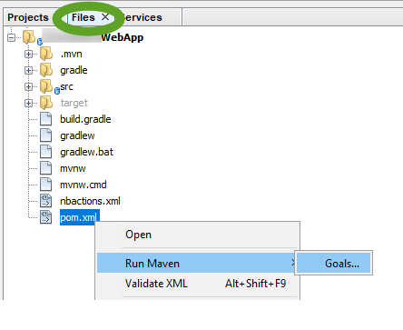
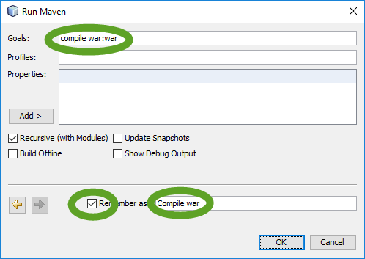
Creating Web Archives in NetBeans
Upon Build, the war archive will be created under the dist folder.
In case of using Maven, the war file may be created by right-clicking on the pom.xml and running the maven goal “compile war:war”

Slide 40
Deploying WAR files
Deployment via IDE:
The deploy option is available through the IDE (NetBeans, IntelliJ IDEA, Eclipse, …)
Deployment via Web Server Manager / Dashboard
i.e. using the dashboard, provide full url to the war file.
OK - Deployed application at context path /myapp
INFO: Deployment of web application archive \path\to\deployed_war has finished in 4,833 ms

Slide 41
Self Containing Web Applications
Self-Containing Web Applications may be released as JARs.
A JAR (Java Archive) is a package file format typically used to aggregate many Java class files and associated metadata and resources (text, images, etc.) into one file for distribution.
Java Applications containing self-hosted web servers
i.e. JAX-RS services using Java HttpServer
or JAX-WS services using EndPoint

Slide 42
Web Services Deployment
JAX-RS using Java HttpServer
import java.net.InetSocketAddress;
import javax.ws.rs.ext.RuntimeDelegate;
import com.sun.net.httpserver.HttpHandler;
import com.sun.net.httpserver.HttpServer;
final int port = 8080;
final String uri = "/rs-resource-path";
final String url = "http://localhost:" + port + uri;
final int backlog = 8;
HttpServer server = HttpServer.create(new InetSocketAddress("localhost", port), backlog);
HttpHandler handler = RuntimeDelegate.getInstance().createEndpoint(new RestfulClass(), HttpHandler.class);
server.createContext(uri, handler);
server.start();
. . .

Slide 43
Web Services Deployment
JAX-WS using Java WS EndPoint
import javax.xml.ws.Endpoint;
final int port = 8080;
final String uri = "/ws-service-path";
final String url = "http://localhost:" + port + uri;
Endpoint ep = Endpoint.publish(url, new ServiceImpClass());

Slide 44
Web Services Deployment
Jersey ServletContainer and web.xml
<web-app>
<display-name>Archetype Created Web Application</display-name>
<servlet>
<servlet-name>jersey-serlvet</servlet-name>
<servlet-class>org.glassfish.jersey.servlet.ServletContainer</servlet-class>
<init-param>
<param-name>javax.ws.rs.Application</param-name>
<param-value>com.myapp.jersey.MyApplication</param-value>
</init-param>
<load-on-startup>1</load-on-startup>
</servlet>
<servlet-mapping>
<servlet-name>jersey-serlvet</servlet-name>
<url-pattern>/my-app-rest/*</url-pattern>
</servlet-mapping>
</web-app>

Slide 46
Lab Activity

Slide 47
Lab Activity
Create a sample micro service in Spring Boot

Slide 48
Session Summary
Service Oriented Architecture (SOA)
Micro Service Architecture
Microservices vs. SOA vs. Monolithic
Building RESTful Services using Spring Boot
Building Micro-services
Service Deployment

Slide 49
Acknowledgements
https://www.tutorialspoint.com/microservice_architecture/
https://www.guru99.com/microservices-tutorial.html
https://www.scalyr.com/blog/api-vs-microservices
https://stackify.com/what-are-microservices/
See also:
https://microservices.io/

Slide 50
Next - Service Discovery

