Slide 1
CCCS 425 – Web Services Lecture 10 – Service Discovery

Slide 2

Acknowledgement
The following materials are produced from various online sources. Links to the original materials have been provided.

Slide 3
Session Learning Outcomes
Explain common Service Discovery processes
Explain Universal Description, Discovery, and Integration (UDDI)
Create a Discoverable Service using Netflix Eureka
Discover and use an external Service using Netflix Eureka

Slide 4
Session Overview
Service Registry and Discovery
Universal Description, Discovery, and Integration (UDDI)
Service Registry using Netflix Eureka
A Registry Example using Eureka
JAX-RS and Eureka

Slide 5
Service Registry and Discovery

Slide 6
Service Registries
Problem Statement:
Clients want to choose a service among a large collection of services and providers.
The client does not necessarily need to know which provider provides the service.

Slide 7
Service Registries / cont.
Service Registries are used for two equally important operations: describing and registering web service.
Compare/Contrast with URLs
Publication of a service requires proper description of a Web service in terms of business, service, and technical information.
Registration deals with persistently storing the web service descriptions in the Web services registry.

Slide 8
Service Registries / cont.
The following illustrates an example of a discovery process by a service requestor (see steps 2-6).
(2)
Query for all
(3)
Discovery
Service
Registry
matching services in
results
registry
the
registry
(1)
Registration
request for
service description
(4)
Request
for selected
(5)
Service
service information
information of
PUBLISH
selected service
SEARCH
(6)
Invocation request
including possible inputs
Service
E
INVOKE
-
service
Service provider
provider
provider
Service
(7)
Invocation resu
Service requester
lts
requestor
Web Services & SOA: Principles and Technology

Slide 9
Benefits of Service Registries
A service registry keeps track of what services an organization has and the characteristics of those services.
Organizations discover each other, make their needs and capabilities known, and compose web services from diverse organizations into new services and business processes.
Service registries are all about visibility and control.

Slide 10
Benefits of Service Registries / cont.
Maximizes web services reuse and encourages broad usage by all potential users in an SOA solution.
Creates a management and governance structure to grow and sustain a successful SOA implementation.
Contains all the metadata about web services and their associated objects. It also contains information about service providers, consumers, and their relationships.
Provides general- and special-purpose interfaces that address the needs of providers, consumers, administrators, and operators.
Ensures that the evolving SOA can handle the growing number of services and service consumers and quickly adapt to changing business requirements.

Slide 11
Two Types of Service Registries
The document-based registry: enables its clients to publish information, i.e. by storing XML-based service documents such as business profiles or technical specifications (including WSDL descriptions of the service).
The metadata-based service registry: captures the essence of the submitted document.

Slide 12
Service Discovery
Service discovery is the process of locating web service providers, and retrieving web service descriptions that have been previously published.
Service discovery is an important element of an SOA.

Slide 13
Service Discovery / cont.
Interrogating services involve querying the service registry for web services matching the needs of a service requestor.
A query consists of search criteria such as:
the type of the desired service, preferred price and maximum number of returned results,
and is executed against service information published by service provider.

Slide 14
Service Discovery / cont.
Discovering Web services is a process that is also dependent on the architecture of the service registry.
After the discovery process is complete, the service developer or client application should know the exact location of a web service (URI), its capabilities, and how to interface with it.

Slide 15
Types of Service Discovery
Static
The service implementation details are bound at design time and a service retrieval is performed on a service registry.
The results of the retrieval operation are examined usually by a human designer and the service description returned by the retrieval.
Dynamic
The service implementation details are left unbound at design time so that they can be determined at run-time.
The web service requestor has to specify preferences to enable the application to infer/reason which web service(s) the requester is most likely to want to invoke.
Based on application logic quality of service considerations such as best price, performance, security certificates, and so on, the application chooses the most appropriate service, binds to it, and invokes it.

Slide 16
Failover Systems
In network computing, failover is referred to switching to a redundant or standby computer server, system, hardware component or network upon the failure or abnormal termination of the previously active application, server, system, hardware component, or network.
Failover and switchover are essentially the same operations, except that failover is automatic and usually operates without warning, while switchover requires human intervention.

Slide 17
Failover Automation
Systems designers usually provide failover capability in servers, systems or networks requiring near-continuous availability and a high degree of reliability.
Failover automation usually uses a "heartbeat" system that connects two servers. As long as a regular "pulse" or "heartbeat" continues between the two servers, the second server will not bring its systems online.
The use of virtualization software has allowed failover practices to become less reliant on physical hardware.

Slide 19
Universal Description, Discovery, and Integration (UDDI)

Slide 20
Universal Description, Discovery, and Integration
Universal Description, Discovery, and Integration (UDDI) is a cross-industry initiative to create a registry standard for web service description and discovery together with a registry facility that supports the publishing and discovery processes.
The UDDI specifications take advantage of World Wide Web Consortium (W3C) and Internet Engineering Task Force (IETF) standards such as XML, HTTP, and Domain Name System (DNS) protocols.
UDDI is deprecated!

Slide 21
History of UDDI
UDDI was written in 2000, with a vision of a world in which consumers of web services would be linked up with providers through a public or private dynamic brokerage system, with publicly operated UDDI nodes.
UDDI was included in the Web Services Interoperability (WS-I) standard as a central pillar of Web services infrastructure, and the UDDI specifications supported a publicly accessible Universal Business Registry in which a naming system was built around the UDDI-driven service broker.
https://en.wikipedia.org/wiki/Web_Services_Discovery#History_of_UDDI

Slide 22
History of UDDI / cont.
UDDI has not been as widely adopted as its designers had hoped. IBM, Microsoft, and SAP announced they were closing their public UDDI nodes in 2006.
The group defining UDDI, the OASIS Universal Description, Discovery, and Integration (UDDI) Specification Technical Committee voted to complete its work in late 2007 and has been closed.
In September 2010, Microsoft announced they were removing UDDI services from future versions of the Windows Server operating system. Instead, this capability would be moved to BizTalk Server.
https://en.wikipedia.org/wiki/Web_Services_Discovery#History_of_UDDI

Slide 23
History of UDDI / cont.
In 2013, Microsoft further announced the deprecation of UDDI Services in BizTalk Server and in 2016, removed UDDI Services from BizTalk Server.
UDDI systems are most commonly found inside companies, where they are used to dynamically bind client systems to implementations. However, much of the search metadata permitted in UDDI is not used for this relatively simple role.
https://en.wikipedia.org/wiki/Web_Services_Discovery#History_of_UDDI

Slide 24
The UDDI Business Model
UDDI enables a business to:
describe its business and its services;
discover other businesses that offer desired services;
integrate (interoperate) with these other businesses.

Slide 25
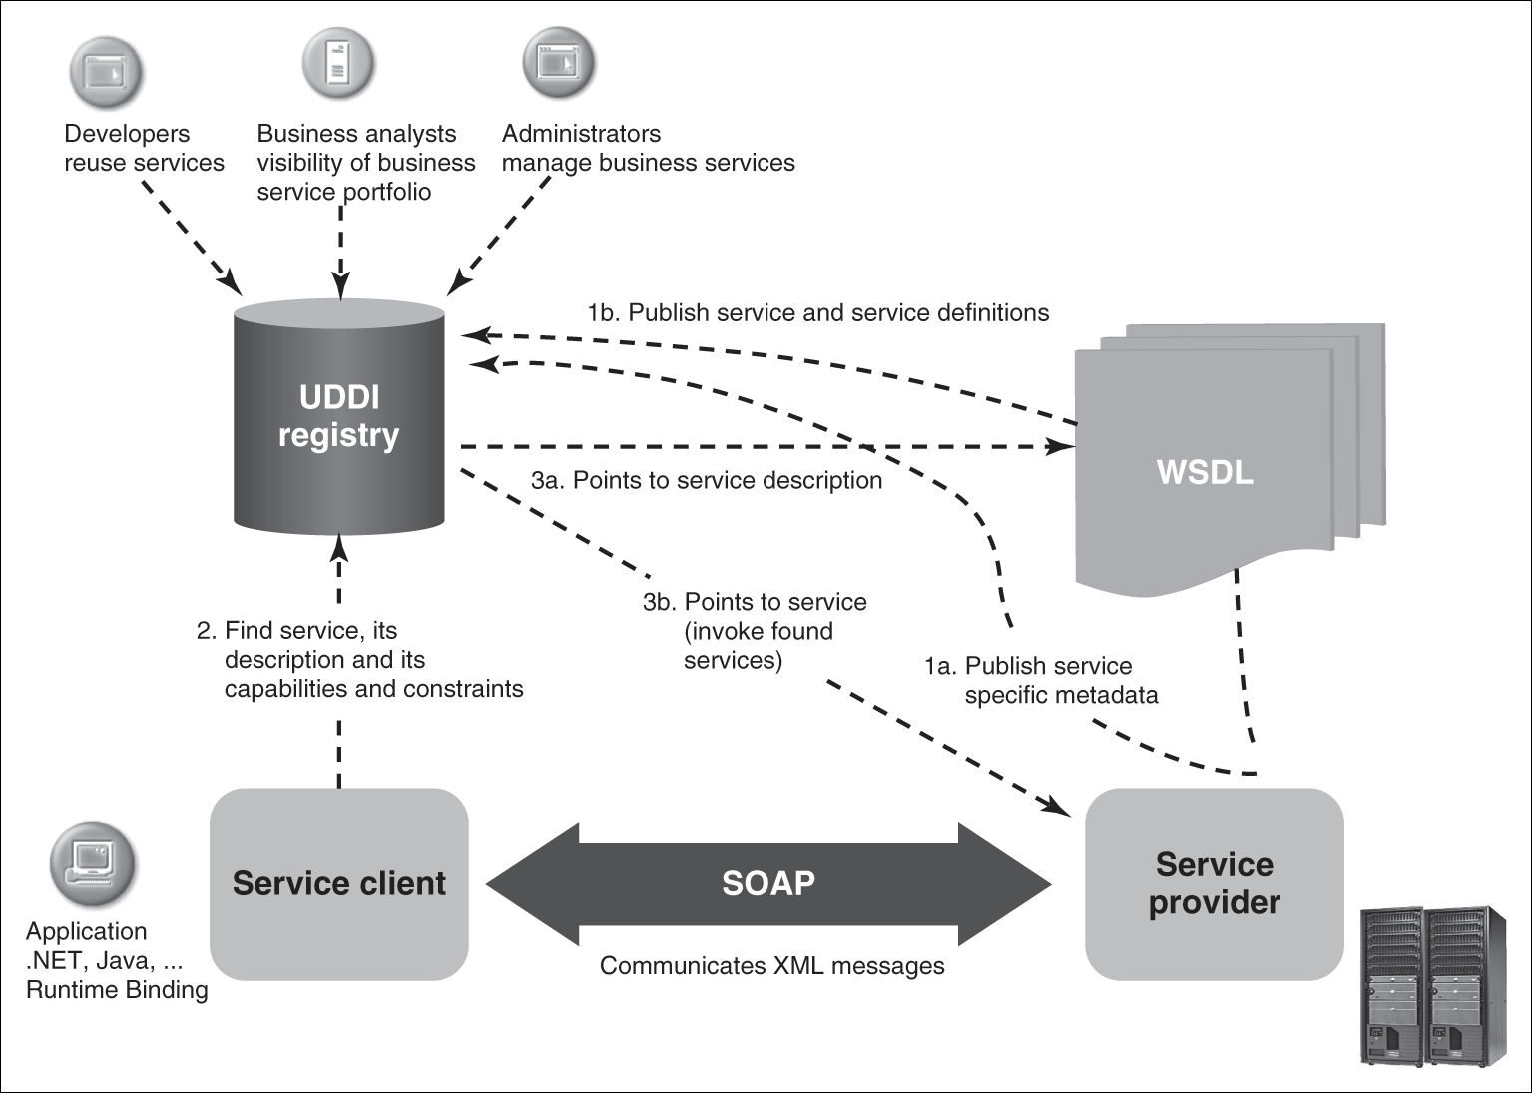
The UDDI Business Model / cont.
The UDDI model has been illustrated in the following:
Figure 6.1 The UDDI usage model
Web Services & SOA: Principles and Technology

Slide 26
The UDDI Business Model / cont.
An enterprise may set up multiple private UDDI registries in-house to support intranet and eBusiness operations.
Public UDDI registries can be set up by customers and business partners of an enterprise.
Services must be published in a public UDDI registry so that potential clients and service developers can discover them.

Slide 27
UDDI Queries
Find web services implementations that are based on a common abstract interface definition.
Find web service providers that are classified according to a known classification scheme or identifier system.
Issue a search for services based on a general keyword.
Determine the security and transport protocols supported by a given web service.
Cache the technical information about a web service and then update that information at run-time.

Slide 28
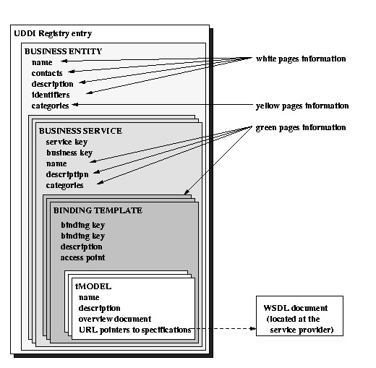
UDDI Structure
A UDDI business registration consists of three components:
White Pages — address, contact, and known identifiers;
Yellow Pages — industrial categorizations based on standard taxonomies;
Green Pages — technical information about services exposed by the business.
Web Services & SOA: Principles and Technology

Slide 31
Service Registry using Netflix Eureka

Slide 32
Jakarta XML Registries (JAXR)
Support for UDDI in Java is provided by JAXR.
Jakarta XML Registries (JAXR) defines a standard API for Jakarta EE applications to access and programmatically interact with various kinds of metadata registries. It provides a uniform and standard Java API for accessing different kinds of XML-based metadata registry.
JAXR supports ebXML Registry version 2.0 (sponsored by OASIS), and UDDI version 2.0.
JAXR, too, is deprecated!

Slide 33
Other Registries
Apache ZooKeeper is a high-performance coordination service for distributed applications.
It exposes common services - such as naming, configuration management, synchronization, and group services - in a simple interface so you don't have to write them from scratch.
More info at:
https://zookeeper.apache.org/doc/r3.3.3/index.html
https://www.tutorialspoint.com/zookeeper/index.htm
https://www.baeldung.com/java-zookeeper

Slide 34
Other Registries / cont.
Netflix Eureka is a REST based service that is primarily used in the AWS cloud for locating services for the purpose of load balancing and failover of middle-tier servers.
Spring Cloud Eureka allows clients to register to it, maintains a heartbeat with registered clients, and maps service names to hostnames for clients that lookup services by service name.
More info at:
https://github.com/Netflix/eureka/wiki/Eureka-at-a-glance
https://www.baeldung.com/spring-cloud-netflix-eureka (tutorial)

Slide 35
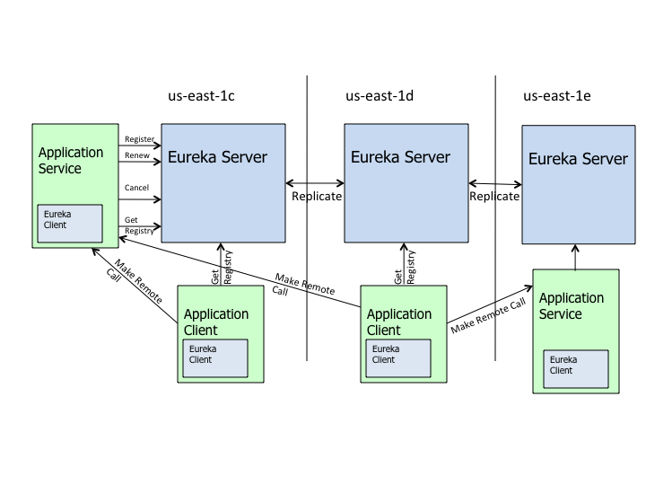
Other Registries / cont.
The following diagram illustrates using Netflix Eureka server in an enterprise environment.

Slide 37
A Registry Example using Eureka

Slide 38
Before we begin
Note that a service discovery may simply be implemented using a REST service.
For instance, a ServiceResigtry itself may be implemented using REST API.
This, however, may lead into non-standard implementations.
Netflix Eureka provides standard as well as configurable registry implementation using annotations.
In this section, we will use Eureka registry that is implemented using Spring Boot.

Slide 39
Project Setup, How it works.
Firstly, we'll create a new Maven project and put the dependencies into it.
The server application is a maven project that hosts the discoverable service.
The client application is a eureka client that discovers and invokes the service.

Slide 40
The Server Configuration
We import spring-cloud-starter-parent to all projects.
<dependency>
<groupId>org.springframework.cloud</groupId>
<artifactId>spring-cloud-starter-netflix-eureka-server</artifactId> </dependency>
<dependencyManagement>
<dependencies>
<dependency>
<groupId>org.springframework.cloud</groupId>
<artifactId>spring-cloud-starter-parent</artifactId>
<version>Greenwich.RELEASE</version>
<type>pom</type>
<scope>import</scope>
</dependency>
</dependencies>
</dependencyManagement>

Slide 41
The Server Application
The server application may be defined as follows:
@SpringBootApplication
@EnableEurekaServer
public class MyEurekaServerApplication {
public static void main(String[] args) {
SpringApplication.run(
MyEurekaServerApplication.class, args); }
. . .
}

Slide 42
The Server Configuration
We need to configure the application by adding the properties in YAML format
(application.yml will be our configuration file)
server:
port: 8761
eureka:
client:
registerWithEureka: false
fetchRegistry: false

Slide 43
The Eureka Client
A sample Eureka client implementation is given in the following:
@SpringBootApplication
@RestController
public class EurekaClientApplication implements GreetingController {
@Autowired @Lazy
private EurekaClient eurekaClient;
@Value("${spring.application.name}")
private String appName;
public static void main(String[] args) {
SpringApplication.run(EurekaClientApplication.class, args); }
@Override public String greeting() {
return String.format( "Hello from '%s’!”,
eurekaClient.getApplication(appName).getName()); }
}

Slide 44
The Client Maven Configuration
The following maven dependency is added to the client project:
<dependency>
<groupId>org.springframework.cloud</groupId>
<artifactId>spring-cloud-starter-netflix-eureka-starter</artifactId>
</dependency>
<dependency>
<groupId>org.springframework.boot</groupId>
<artifactId>spring-boot-starter-web</artifactId> </dependency>

Slide 45
The Client Configuration
The following configuration is added to the client project:
spring:
application:
name: spring-cloud-eureka-client
server:
port: 0
eureka:
client:
serviceUrl:
defaultZone: ${EUREKA_URI:http://localhost:8761/eureka}
instance:
preferIpAddress: true

Slide 46
JAX-RS and Eureka

Slide 47
Enabling Service Discovery / cont.
A JAX-RS service may also be discoverable using Eureka.
To do so, an application class as well as a configuration class must be implemented.
An Example is provided in the next sides.

Slide 48
A JAX-RS Discoverable Service
The following shows how to make a JAX-RS service discoverable using in Eureka:
// The @EnableDiscoveryClient tag helps register the service on the Eureka registry @SpringBootApplication @EnableDiscoveryClient public class MyEurekaServerApplication extends SpringBootServletInitializer { @Override protected SpringApplicationBuilder configure(SpringApplicationBuilder builder) { return builder.sources(MyRestService.class); } @Bean public ServletContextInitializer servletInitializer() { return new ServletContextInitializer() { @Override public void onStartup(ServletContext servletContext) throws ServletException { final ServletRegistration.Dynamic appServlet = servletContext.addServlet("jersey-servlet", new SpringServlet()); Map<String, String> filterParameters = new HashMap<>(); // Discovery Parameters filterParameters.put("MyRestService", "com.mcgill.myrestservice"); appServlet.setInitParameters(filterParameters); appServlet.setLoadOnStartup(2); appServlet.addMapping("/myrestservice/*"); } }; } public static void main(String[] args) { SpringApplication.run(MyRestService.class, args); } }

Slide 49
A JAX-RS Discoverable Service / cont.
In case the service is implement in JAX-RS, the following configuration will do the trick:
@ApplicationPath("/") public class MyRestConfig extends PackagesResourceConfig { public MyRestConfig() { super(getparams()); }
private static final Map<String, Object> getparams() { Map<String, Object> result = new HashMap<>(); result.put(PackagesResourceConfig.PROPERTY_PACKAGES,
"com.mcgill.myrestservice"); // forwarding non-Jersey paths to servlet container to Spring Boot actuator result.put("com.sun.jersey.config.feature.FilterForwardOn404", "true"); result.put(JSONConfiguration.FEATURE_POJO_MAPPING, "true"); return result; } }

Slide 51
Lab Activity

Slide 52
Lab Activity
Create Service Registry in Eureka
Discover and invoke the service on the client side (Optional)

Slide 53
Session Summary
Service Discovery using UDDI
REST based service discovery
Netflix Eureka
Microservices
Eureka Client and Eureka Server Applications
JAX-RS and Eureka

Slide 54
Acknowledgements
https://en.wikipedia.org/wiki/Web_Services_Discovery
https://en.wikipedia.org/wiki/Microservices
https://en.wikipedia.org/wiki/Jakarta_XML_Registries
https://en.wikipedia.org/wiki/EbXML
https://docs.oracle.com/cd/E13214_01/wli/docs70/b2bsampl/ebxml.htm
https://github.com/Netflix/eureka/wiki/Eureka-at-a-glance
https://zookeeper.apache.org/doc/r3.3.3/index.html
https://docs.oracle.com/cd/E17802_01/webservices/webservices/docs/1.6/tutorial/doc/JAXR-ebXML2.html
https://en.wikipedia.org/wiki/Failover
Further Reading:
https://www.baeldung.com/spring-cloud-netflix-eureka
https://spring.io/guides/gs/service-registration-and-discovery/
https://medium.com/swlh/spring-cloud-service-discovery-with-eureka-16f32068e5c7

Slide 55
Next - Web Services Security

