Slide 1
CCCS 425 – Web Services Lecture 11 – Web Services Security

Slide 2

Acknowledgement
The following materials are produced from various online sources. Links to the original materials have been provided.

Slide 3
Session Learning Outcomes
Explain Web Services Security (WSS)
Explain various web authentication methods, especially on using web services
Implement a secure web service
Use a secure web service
Explain Application, Network, and Wire level Security

Slide 4
Session Overview
Wire-level Security
User Authentication and Authorization
WS-Security (WSS)
Tomcat tomcat-users.xml configuration
Accessing HTTP Headers

Slide 5
Wire-level Security

Slide 6
Wire-level Security
Securing Web Services
Transport-level security:
HTTP Basic/Digest and SSL
Message-level / Application-level security:
WS-Security, XML digital signature, XML Encryption, XKMS (XML Key Management Specification), XACML (eXtensible Access Control Markup Language), SAML (Secure Assertion Markup Language), …

Slide 7
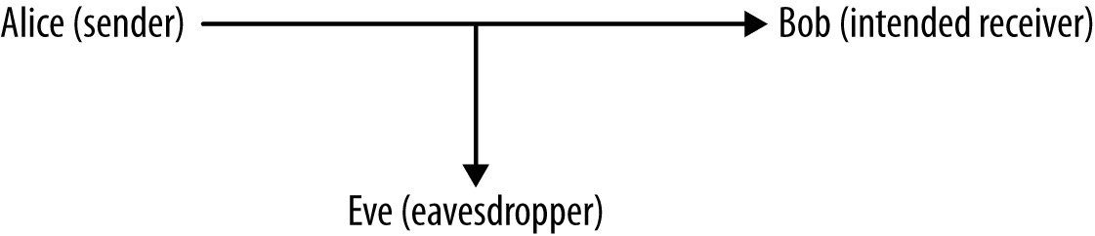
Wire-level Security
The Man In The Middle (MITM) Problem

Slide 8
Wire-level Security
The Three Critical Security Services
Peer authentication
Confidentiality
Integrity

Slide 9
Wire-level Security
Man In The Middle (MITM)
Peer authentication
Alice needs Bob to authenticate himself so that she is sure about who is on the receiving end before she sends the secret message.
Bob, too, needs Alice to authenticate herself so that he knows that the secret message is from her rather than an impostor such as Eve.
AKA mutual authentication or mutual challenge
Confidentiality
Integrity

Slide 10
Wire-level Security
Man In The Middle (MITM)
Peer authentication
Confidentiality
Once Alice and Bob have authenticated each other, Alice needs to encrypt the secret message in such a way that only Bob can decrypt it.
Even if Eve intercepts the encrypted message, Eve should not be able to decrypt the message, because doing so requires enormous computational power or incredibly good luck.
Integrity

Slide 11
Wire-level Security
Man In The Middle (MITM)
Peer authentication
Confidentiality
Integrity
The message that Alice sends should be identical to the one that Bob receives. If not, an error condition should be raised.
The received message might differ from the sent one for various reasons; for instance, noise in the communications channel or deliberate tampering on Eve’s part.
Any difference between the sent and the received message should be detected.

Slide 12
Wire-level Security
Hashing vs. Encryption vs. Encoding
Encoding: text-to-bin / bin-to-text, not encrypted
Text Encoding: ASCII, UTF8, ISO-8859-1, …
Binary Encoding: Base64, BinHex, MIME, Quoted-Printable, UUEncode
See also: Terminal escape codes: i.e. ANSI, …
Hashing: one-way
MD5, SHA1, HMAC
Encryption: two-way (reversible)
3DES, SSL, AES, BlowFish, IDEA, RSA

Slide 13
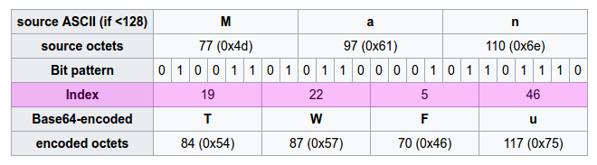
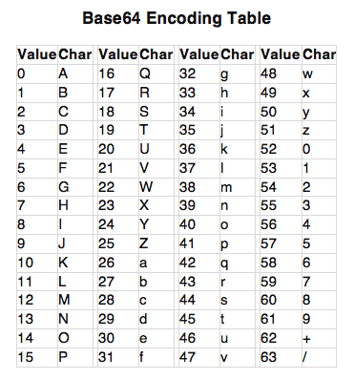
Wire-level Security
Encoding Example (Base64)
Text: Web Services
Base64: V2ViIFNlcnZpY2Vz

Slide 14
Wire-level Security
Base64 Example
import java.util.Base64;
import java.io.UnsupportedEncodingException;
String string = "TutorialsPoint?java8";
// Encode
String base64encodedString = Base64.getEncoder().encodeToString(string.getBytes("utf-8"));
System.out.println("Base64 Encoded String (Basic) :" + base64encodedString);
// Decode
byte[] base64decodedBytes = Base64.getDecoder().decode(base64encodedString);
System.out.println(new String(base64decodedBytes, "utf-8"));

Slide 15
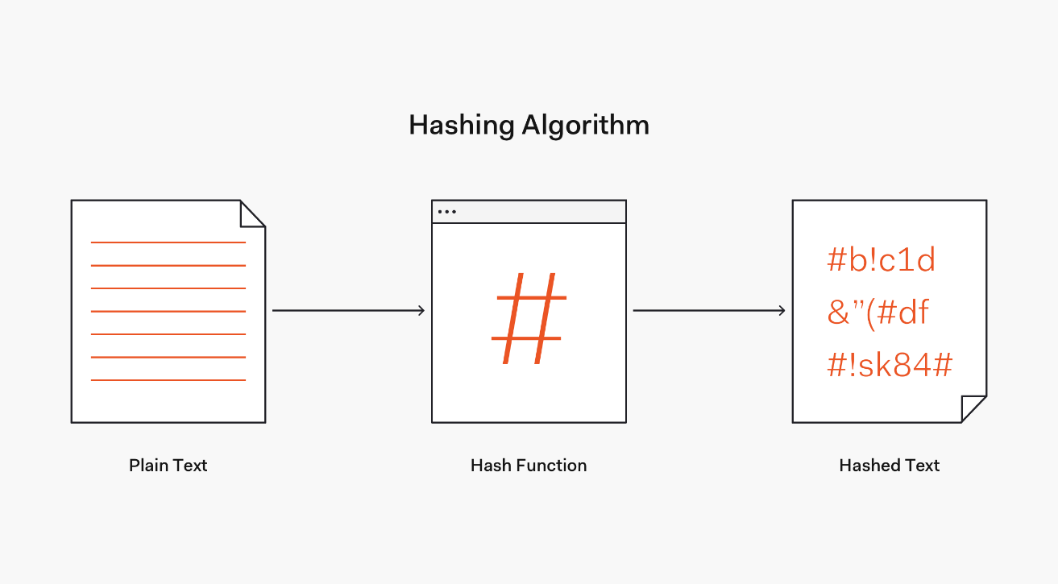
Wire-level Security
Hashing Example
Text: Web Services
MD5 (in hex): 2c10282d2a9ce8be1576d7af8091d09e

Slide 16
Wire-level Security
MD5 Example
import java.security.MessageDigest;
import javax.xml.bind.DatatypeConverter;
String password = "ILoveJava";
MessageDigest md = MessageDigest.getInstance("MD5");
md.update(password.getBytes());
byte[] digest = md.digest();
String myHash =
DatatypeConverter.printHexBinary(digest).toUpperCase();
System.out.println(myHash);

Slide 17
Wire-level Security
Java Cipher
For more info on Java cipher check:
http://tutorials.jenkov.com/java-cryptography/cipher.html

Slide 18
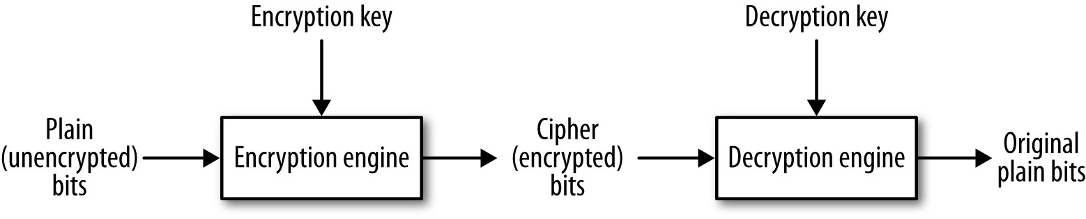
Wire-level Security
Symmetric and Asymmetric Encryption/Decryption
The encrypted bits are the cipher bits. If the input bits represent text, then they are the plaintext and the output bits are the ciphertext.

Slide 19
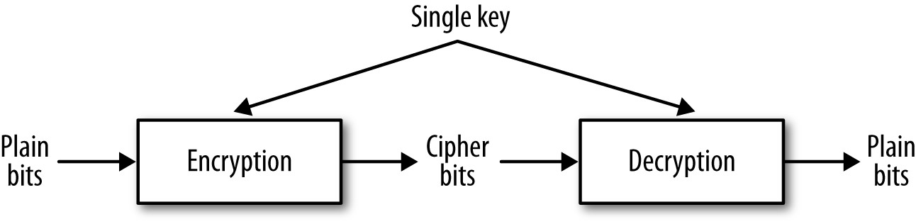
Wire-level Security
Symmetric and Asymmetric Encryption/Decryption
Single Key Encryption (Symmetric):

Slide 20
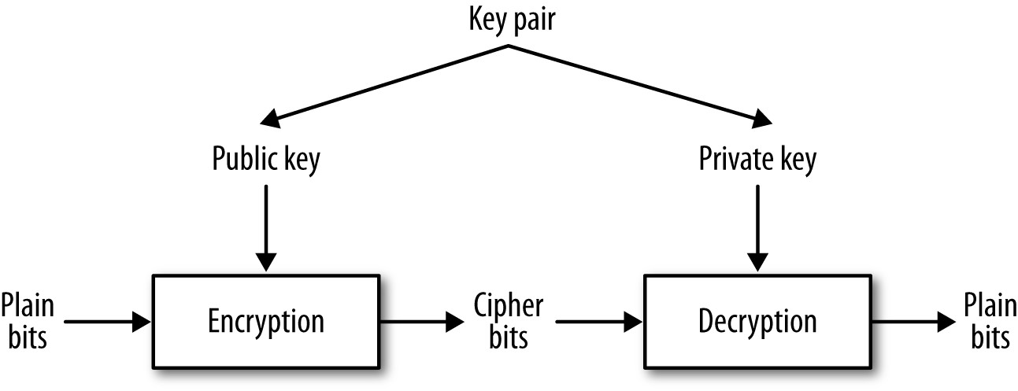
Wire-level Security
Symmetric and Asymmetric Encryption/Decryption
Public Key Encryption (Asymmetric):

Slide 21
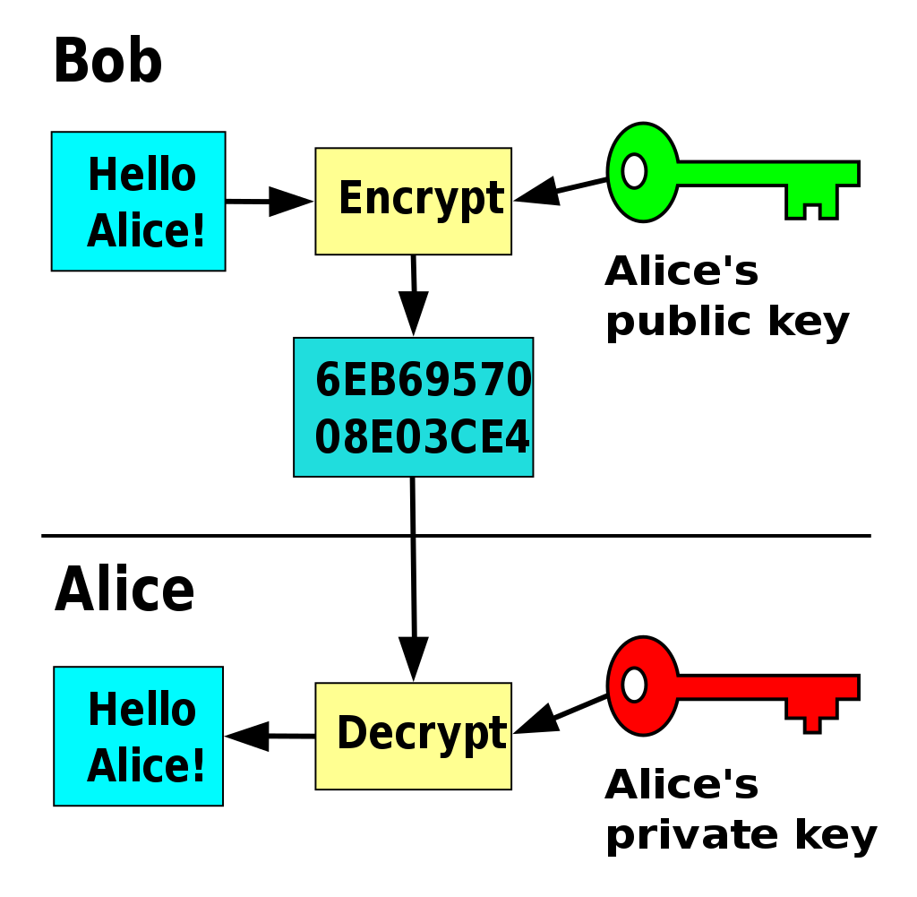
Wire-level Security
Symmetric and Asymmetric Encryption/Decryption
Public Key Encryption (Asymmetric):

Slide 22
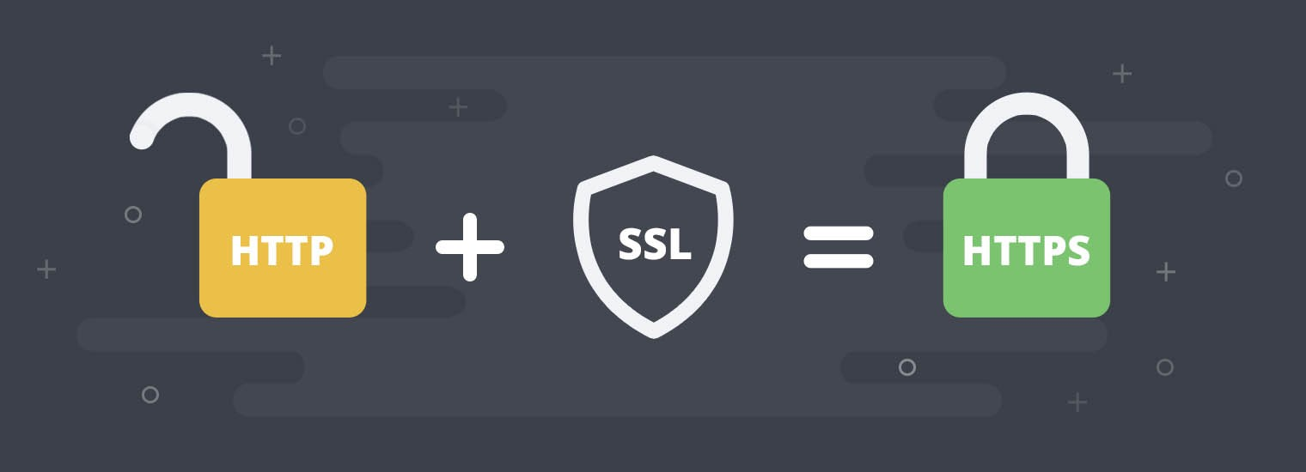
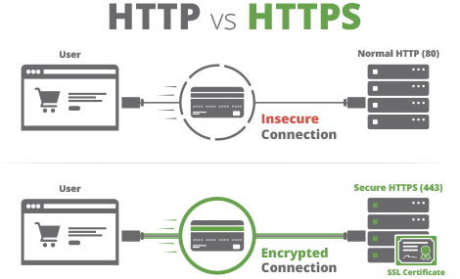
Wire-level Security
HTTPS

Slide 23
Wire-level Security
HTTPS
HTTPS is easily the most popular among the secure versions of HTTP. HTTPS provides three critical security services over and above the transport services that HTTP provides.
HTTPS Handshake:
relies on digital certificates (public key cryptography)

Slide 24
Wire-level Security
HTTPS Handshake
The client challenges the web server, which sends one or more digital certificates as authentication
An X.509 certificate is a public key certificate that serves as an identity certificate by binding the public key from a key pair to an identity such as a person (for instance, Alice) or an organization (for instance, Bob’s employer). The certificate contains the digital signature of a CA such as VeriSign, although certificates can be self-signed for testing purposes.
The client can determine whether to accept the server’s digital certificates by checking these against its truststore.

Slide 25
Wire-level Security
HTTPS Handshake
The server has the option of challenging the client. For a website, such a challenge is unusual.
Once the challenge phase is over, the client begins the process of generating a secret key. The process begins with the client’s generation of a pre-master secret, a string that is shared with the server.
The pre-master is then used on each side to generate the same master secret key, which is used to encrypt and decrypt the traffic between the client and the server. At issue here is how the pre-master secret is sent securely from the client to the server.

Slide 26
Wire-level Security
HTTPS Handshake
In a common scenario, the client encrypts a 48-bit pre-master secret with the server’s public key, available on the server’s digital certificate downloaded during the peer authentication phase. The encrypted pre-master secret is sent to the server, which decrypts the secret. If everything is still in order, each side confirms that encryption of traffic between them is to begin. The public key/private key pair is thus critical in solving the key distribution problem for secret keys.
At any point, either the client or the server may insist on starting the entire process all over again. For example, if either Alice or Bob suspects that Eve is up to no good, either Alice or Bob can restart the handshake process.

Slide 27
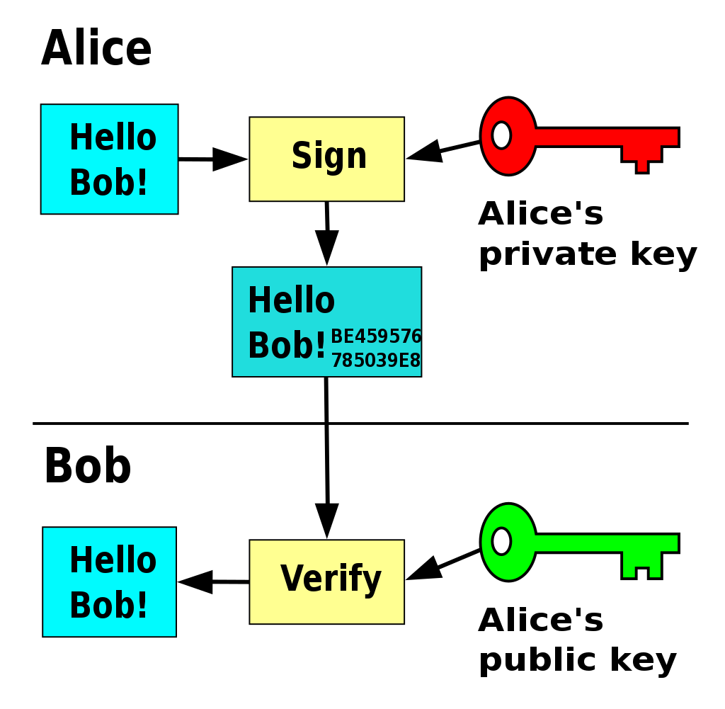
Wire-level Security
HTTPS Handshake

Slide 28
Wire-level Security
The HttpsURLConnection Class
HttpsURLConnection conn = (HttpsURLConnection) url.openConnection();
. . .
conn.connect()
. . .
print("Status code: " + conn.getResponseCode());
print("Cipher suite: " + conn.getCipherSuite());
Certificate[ ] certs = conn.getServerCertificates();
for (Certificate cert : certs) {
System.out.println ("\tCert. type: " + cert.getType());
System.out.println ("\tHash code: " + cert.hashCode())
System.out.println ("\tAlgorithm: " + cert.getPublicKey().getAlgorithm());
System.out.println ("\tFormat: " + cert.getPublicKey().getFormat());
System.out.println("");
}

Slide 29
Wire-level Security
The HttpsURLConnection Class
Sample output:
Status code: 200
Cipher suite: TLS_ECDHE_RSA_WITH_RC4_128_SHA
Cert. type: X.509
Hash code: 12584213
Algorithm: RSA
Format: X.509
Cert. type: X.509
Hash code: 2815543
Algorithm: RSA
Format: X.509

Slide 30
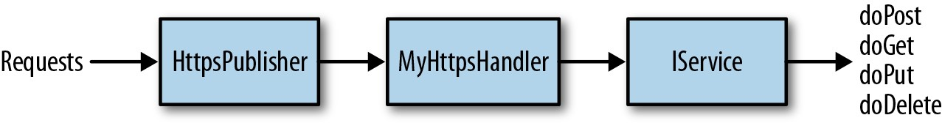
Wire-level Security
Publishing HTTPS Services
Web Services supporting SSL
i.e. OpenSSL + Apache
Programmatically
i.e. using HttpsServer and SSLContext
Check ch.6 of the book.

Slide 32
User Authentication and Authorization

Slide 33
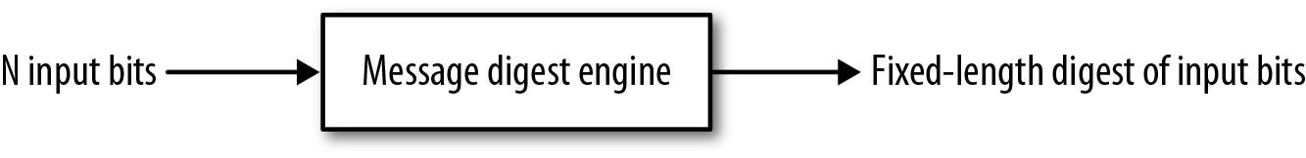
User Authentication and Authorization
HTTP and Authentication
Uses HMAC (Hash Message Authentication Code)
Example: Amazon AWS
The signature is added to the request in the HTTP 1.1 Authorization header (or the query string)
Upon receipt of the request, the server validates the signature and then honors the request only if the validation succeeds.

Slide 34
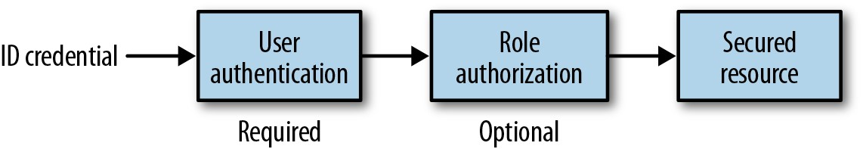
User Authentication and Authorization
Users / Roles Security
This picture shows the User authentication process. An optional role authorization may be executed after the user authentication in order to provide a secure access to the resource.

Slide 35
User Authentication and Authorization
Enforcing Authentication
Using SecurityContext
Using Annotations
Using Container-Managed Security (web.xml)
https://docs.oracle.com/cd/E24329_01/web.1211/e24983/secure.htm#RESTF252

Slide 36
User Authentication and Authorization
Using SecurityContext
import javax.ws.rs.core.SecurityContext;
import javax.ws.rs.core.Context;
@Path("/secureserv")
public class MyService {
@GET
@Produces("text/plain;charset=UTF-8")
@Path("/hello")
public String sayHello(@Context SecurityContext sc) {
if (sc.isUserInRole("admin"))
return "Hello World!";
throw new SecurityException("User is unauthorized.");
}

Slide 37
User Authentication and Authorization
Using Annotations
import javax.annotation.Security.RolesAllowed;
@Path("/helloworld")
@RolesAllowed({"ADMIN", "ORG1"})
public class helloWorld {
@GET
@Path("sayHello")
@Produces("text/plain")
@RolesAllows("ADMIN")
public String sayHello() {
return "Hello World!";
}
}

Slide 38
User Authentication and Authorization
Using Container-Managed Security (web.xml)
A RESTful service can be augmented with container-managed security and without any change to the code.
<web-app>
<servlet>
<servlet-name>mysevlet</servlet-name>
<servlet-class>com.mcgill.example.MyServlet</servlet-class>
</servlet>
<security-role>
<role-name>bigshot</role-name>
<!-- other roles as needed -->
</security-role>
<security-constraint>
<web-resource-collection>
<url-pattern>/*</url-pattern>
</web-resource-collection>
<auth-constraint>
<role-name>bigshot</role-name>
</auth-constraint>
<user-data-constraint>
<transport-guarantee>CONFIDENTIAL</transport-guarantee>
</user-data-constraint>
</security-constraint>
<login-config>
<auth-method>BASIC</auth-method>
</login-config>
<servlet-mapping>
<servlet-name>predictor</servlet-name>
<url-pattern>/*</url-pattern>
</servlet-mapping>
</web-app>

Slide 39
User Authentication and Authorization
Authentication Methods
BASIC
FORM
DIGEST
CLIENT-CERT
The BASIC and FORM types require that the username and the password be stored on the server side because the server needs to compare the submitted username/password pair against the server’s own copies of these.

Slide 40
User Authentication and Authorization
Authentication Methods
BASIC
FORM
DIGEST
CLIENT-CERT
The DIGEST type meets this challenge by sending a digest (hash value) of the password rather than the password itself.

Slide 41
User Authentication and Authorization
Authentication Methods
BASIC
FORM
DIGEST
CLIENT-CERT
The CLIENT-CERT type uses a digital certificate instead of a username/password or username/password-digest pair for authentication. For user access to websites, this approach may be impractical because a user may wish to hit a website from a device that does not have a copy of the user’s digital certificate.

Slide 42
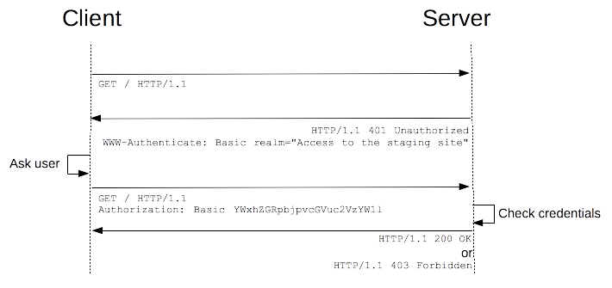
User Authentication and Authorization
Basic Authentication

Slide 43
User Authentication and Authorization
Basic Authentication
The browser makes a request to some URL
The server sends back a response with an HTTP status code of 401 (meaning “Not authorized”), plus a header describing the types of authentication it will accept. For example:
WWW-Authenticate: Basic
This makes the browser display a login prompt, but it doesn’t display any other text that’s in the response.
When the user enters some credentials, the browser resubmits the same request to the same URL, plus it also adds this extra header:
Authorization: Basic username:password
The server parses the username and password from the request and decides whether the credentials are valid or not. If they are valid, the server lets the user continue; If they are invalid, it returns a 401 again (i.e., goes back to step 2).
If the user enters the same incorrect credentials twice in a row, the browser normally won’t bother resubmitting them and will just give up.

Slide 44
User Authentication and Authorization
Basic Authentication
.htaccess
https://httpd.apache.org/docs/2.4/howto/htaccess.html
Apache
https://httpd.apache.org/docs/2.4/howto/auth.html
Also check <tomcat-users>

Slide 45
User Authentication and Authorization
Basic Authentication (A Closer Look)
private HttpsURLConnection getConnection(URL url, String verb, String uname, String passwd) {
try {
HttpsURLConnection conn = (HttpsURLConnection) url.openConnection();
conn.setDoInput(true); conn.setDoOutput(true); conn.setRequestMethod(verb);
// authentication (although header name is Authorization)
String userpass = uname + ":" + passwd;
String basicAuth = "Basic " + new String(new Base64().encode(userpass.getBytes()));
conn.setRequestProperty ("Authorization", basicAuth);
conn.setHostnameVerifier(new HostnameVerifier() {
public boolean verify(String host, SSLSession session) {
return host.equals("localhost"); // for development
}
});
return conn;
}
catch(Exception e) { throw new RuntimeException(e); }
}

Slide 46
Kerberos Authentication
Kerberos was developed to provide a range of authentication and security facilities for computing networks including single sign-on and use of public-key cryptography.
The goal of Kerberos is to provide authentication in an insecure distributed environment.
Kerberos is a third trusted party authentication protocol that deals with two kinds of security objects:
a Ticket
An authentication token (pieces of information used for authentication or authorization that can be added to a SOAP header) called a ticket is issued by the Kerberos ticket-granting service for presentation to a particular server, verifying that the client has recently been authenticated by Kerberos.
Tickets include an expiry time and a newly generated session key for use by the client and the server.
a Session Key
A session key is a secret key randomly generated by Kerberos and issued to a client for use when communicating with a particular server.
Client processes must possess a ticket and a session key for each server that they use.

Slide 47
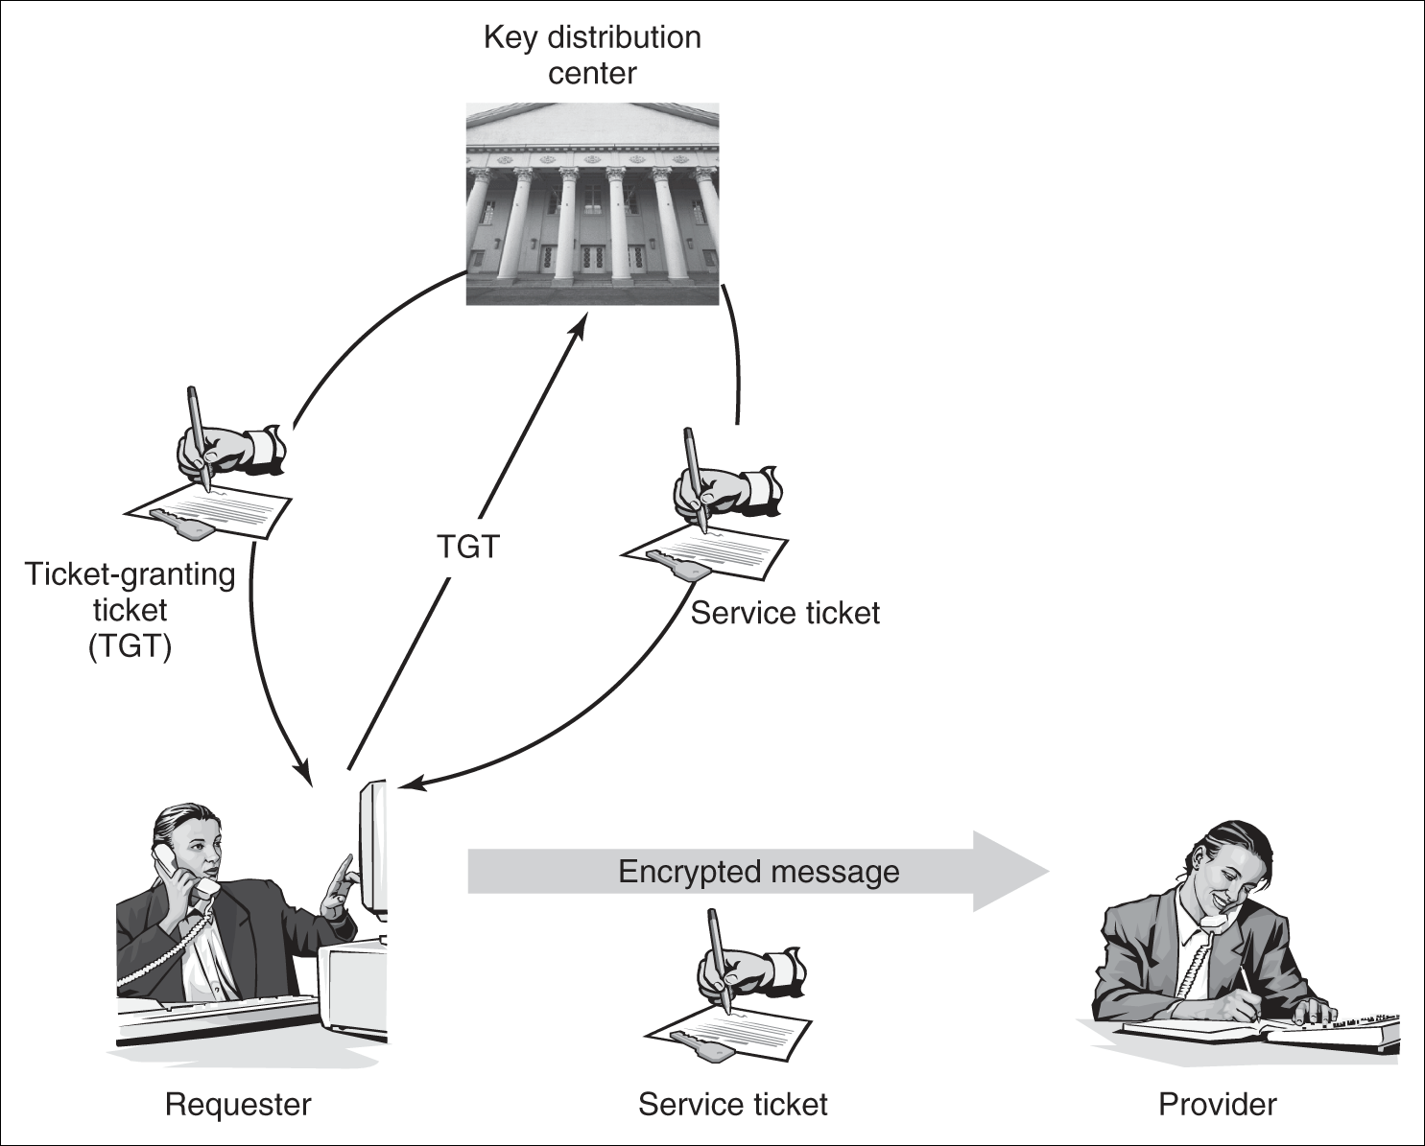
Kerberos Authentication / cont.
The following figure illustrates the ticket-granting mechanism of Kerberos for a client accessing a Web service.
A key distribution center (KDC) maintains the principal’s credentials.
It first offers an authentication service that accepts the requestor’s credentials (typically login and password) from a client process, and
It subsequently sends back a credential called a ticket-granting ticket (TGT) to the requestor.
The TGT contains a temporary secret session key that can be persisted during the session to prevent having to use the permanent credentials.

Slide 48
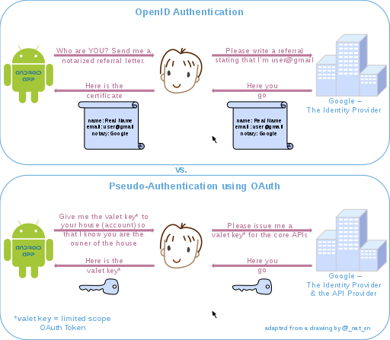
OAuth
OAuth is an open standard for access delegation, commonly used as a way for Internet users to grant websites or applications access to their information on other websites but without giving them the passwords.
This mechanism is used by companies such as Amazon, Google, Facebook, Microsoft and Twitter to permit the users to share information about their accounts with third party applications or websites.
Current version: OAuth2

Slide 49
SSO and Federated Authentication
Single sign-on (SSO) is an authentication scheme that allows a user to log in with a single ID and password to any of several related, yet independent, software systems.
A federated identity is the means of linking a person's electronic identity and attributes, stored across multiple distinct identity management systems.
Federated identity is related to single sign-on (SSO), in which a user's single authentication ticket, or token, is trusted across multiple IT systems or even organizations. SSO is a subset of federated identity management, as it relates only to authentication and is understood on the level of technical interoperability. It would not be possible without some sort of federation.
Federated Authentication is referred to the process that implements the sign-in process using the above authentication token.

Slide 52
WS-Security

Slide 53
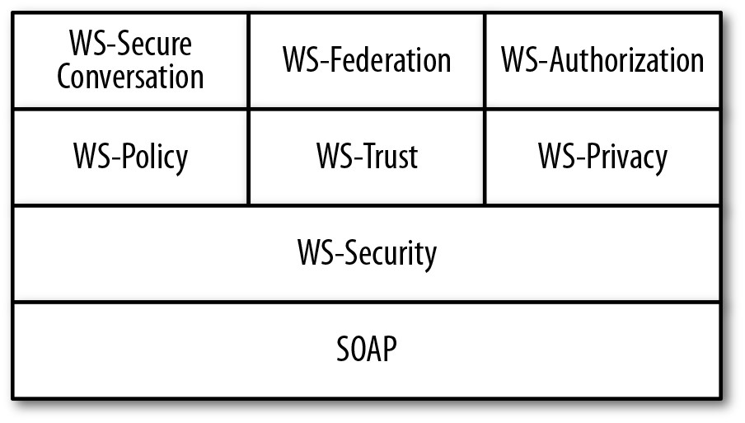
WS-Security
The WS-Security Specification
WS-Policy
This specification describes general security capabilities, constraints, and policies. For example, a WS-Policy assertion could stipulate that a message requires security tokens or that a particular encryption algorithm be used.
WS-Trust
This specification deals primarily with how security tokens are to be issued, renewed, and validated.

Slide 54
WS-Security
The WS-Security Specification
WS-Privacy
This specification explains how services can state and enforce privacy policies.
WS-SecureConversation
how a security context is created and how security keys are derived and exchanged.
WS-Federation
managing security identities across different platforms and organizations.
WS-Authorization
management of authorization data such as security tokens and underlying policies for granting access to secured resources.

Slide 55
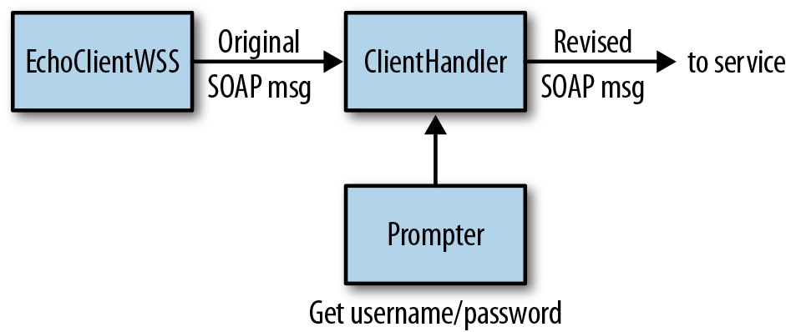
WS-Security
The Client Side Architecture

Slide 56
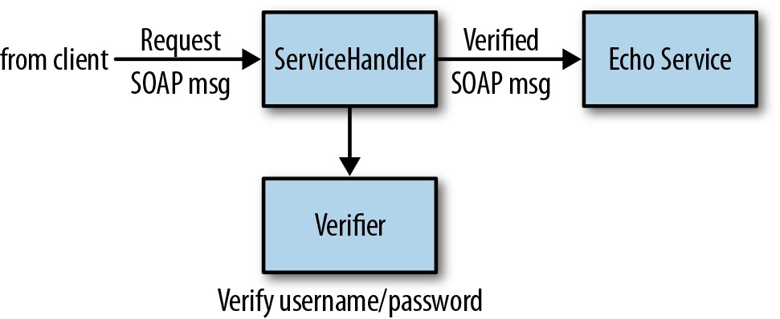
WS-Security
The Server-Side Architecture

Slide 58
Tomcat tomcat-users.xml configuration

Slide 59
Tomcat tomcat-users.xml configuration
The tomcat-users.xml File
<?xml version='1.0' encoding='utf-8'?>
<tomcat-users>
<role rolename="tomcat"/>
<role rolename="role1"/>
<user username="tomcat" password="tomcat" roles="tomcat"/>
<user username="both" password="tomcat" roles="tomcat,role1"/>
<user username="role1" password="tomcat" roles="role1"/>
</tomcat-users>

Slide 60
Tomcat tomcat-users.xml configuration
Web Application Security Concepts
Authentication
Authorization
Realm
Container Managed Security

Slide 61
Tomcat tomcat-users.xml configuration
Web Application Security Concepts
Authentication
To access a restricted resource on the server, Tomcat challenges a user to produce user details to confirm that they are who they say they are.
Authorization
Realm
Container Managed Security

Slide 62
Tomcat tomcat-users.xml configuration
Web Application Security Concepts
Authentication
Authorization
Once a user is authenticated, the server determines whether this user is authorized to access the restricted resource requested.
Realm
Container Managed Security

Slide 63
Tomcat tomcat-users.xml configuration
Web Application Security Concepts
Authentication
Authorization
Realm
A realm is a repository of user information; it is an abstraction of the data store – text file, JDBC database or a JNDI resource. This has the following information: username, password and the roles which are assigned to the users.
Container Managed Security

Slide 64
Tomcat tomcat-users.xml configuration
Web Application Security Concepts
Authentication
Authorization
Realm
Container Managed Security
Container managed security provides enforcing and implementing security policies on the web server Also known as declarative security (for authentication and authorization)

Slide 65
The tomcat-users.xml File
For more info (especially on realms) see:
https://examples.javacodegeeks.com/enterprise-java/tomcat/tomcat-users-xml-configuration-example/

Slide 67
Accessing HTTP Headers

Slide 68
Accessing HTTP Headers
Accessing HTTP Headers via Service Context
JAX-WS:
Using @Resource and WebServiceContext
@Resource
WebServiceContext webServiceContext;
MessageContext messageContext = webServiceContext.getMessageContext();
// get request headers
Map<?,?> requestHeaders = (Map<?,?>) messageContext.get(MessageContext.HTTP_REQUEST_HEADERS);
List<?> usernameList = (List<?>) requestHeaders.get("username"); // custom plain-text username header
List<?> passwordList = (List<?>) requestHeaders.get("password"); // custom plain-text password header

Slide 69
Accessing HTTP Headers
Accessing HTTP Headers
JAX-WS Example
@WebService(endpointInterface = "com.javacodegeeks.jaxws.CalculatorI")
public class CalculatorImplAppManagedAuth implements CalculatorI {
@Resource
WebServiceContext context;
@Override
public int add(int a, int b) {
if (isAuthenticated())
return a + b;
else
throw new HTTPException(401);
}

Slide 70
Accessing HTTP Headers
Accessing HTTP Headers
JAX-WS Example
private boolean isAuthenticated() {
MessageContext messageContext = context.getMessageContext();
Map httpHeaders = (Map) messageContext.get(MessageContext.HTTP_REQUEST_HEADERS);
List userNameList = (List) httpHeaders.get("uname");
List passwordList = (List) httpHeaders.get("pass");
if (userNameList.contains("saurabh") && passwordList.contains(“********"))
return true;
else
return false;
}

Slide 71
Accessing HTTP Headers
The Client Side
JAX-WS
URL wsdlUrl = new URL("http://localhost:8888/webservice/helloworld?wsdl");
QName qname = new QName("http://ws.enterprise.javacodegeeks.com/", "WebServiceImplService");
Service service = Service.create(wsdlUrl, qname);
WebServiceInterface sayHello = service.getPort(WebServiceInterface.class);
Map<String, Object> requestContext = ((BindingProvider)sayHello).getRequestContext();
requestContext.put(BindingProvider.ENDPOINT_ADDRESS_PROPERTY, "http://localhost:8888/webservice/helloworld?wsdl");
Map<String, List<String>> requestHeaders = new HashMap<String, List<String>>();
requestHeaders.put("username", Collections.singletonList("nikos"));
requestHeaders.put("Password", Collections.singletonList("superpassword"));
requestContext.put(MessageContext.HTTP_REQUEST_HEADERS, requestHeaders);
String result = sayHello.getHelloWorldAsString(“….");

Slide 72
Accessing HTTP Headers
Accessing HTTP Headers via Service Context
JAX-RS:
Using @Context and HttpHeaders
@Path("/users")
public class UserService {
@GET @Path("/get")
public Response addUser(@Context HttpHeaders headers) {
String header = headers.getRequestHeader("...").get(0);
. . .
}
}

Slide 73
Accessing HTTP Headers
Accessing HTTP Headers via Service Context
JAX-RS:
Using @HeaderParam (i.e. HTTP Basic Authentication)
@GET
@Path("/order/{orderId}")
@Produces(MediaType.APPLICATION_JSON)
public User getUserById(@PathParam("orderId") Integer orderId,
@HeaderParam("authorization") String authString){
if(!isUserAuthenticated(authString)){
return "{\"error\":\"User not authenticated\"}";
}
. . .
return user;
}

Slide 74
Accessing HTTP Headers
Accessing HTTP Headers via Service Context
JAX-RS:
Full context accessible via @Context and ServletContext
See also HttpServletRequest, HttpServletResponse, …
@Context
ServletContext ctx;
// example
ctx.getRealPath("/") // returns the real path to the root of the web app

Slide 75
Accessing HTTP Headers
Accessing HTTP Headers via Service Context
JAX-RS (HTTP Basic Authentication):
authorization: basic ***<base64-encoded-user-:-password>***
private boolean isUserAuthenticated(String authString){
String decodedAuth = ""; // basic auth (authorization header)
String[] authParts = authString.split("\\s+");
String authInfo = authParts[1];
byte[] bytes = null; // base64 decode
try {
bytes = new BASE64Decoder().decodeBuffer(authInfo);
} catch (IOException e) {
e.printStackTrace();
}
decodedAuth = new String(bytes);
System.out.println(decodedAuth);
// your validation code goes here....
return true;
}
String name = "java2novice";
String password = "*******";
String authString = name + ":" + password;

Slide 76
Accessing HTTP Headers
Accessing HTTP Headers via Service Context
The Client Side:
String url = "http://localhost:8080/RestfulWebServices/orders/order/1016";
String name = "java2novice";
String password = "Simple4u!";
String authString = name + ":" + password;
String authStringEnc = new BASE64Encoder().encode(authString.getBytes());
System.out.println("Base64 encoded auth string: " + authStringEnc);
Client restClient = Client.create();
WebResource webResource = restClient.resource(url);
ClientResponse resp = webResource.accept("application/json")
.header("Authorization", "Basic " + authStringEnc)
.get(ClientResponse.class);
if(resp.getStatus() != 200){
System.err.println("Unable to connect to the server");
}
String output = resp.getEntity(String.class);
System.out.println("response: "+output);

Slide 78
Lab Activity

Slide 79
Lab Activity
Secure the service you implemented in module 3 by checking the authorization header in the service. In case the user is not authorized, generate proper HTTP response / message.
See also the activity in the next module.

Slide 80
Session Summary
HTTPS
Encryption and Digital Certificates
Authentication Methods: Basic, Digest, and Kerberos
Federated Authentication
OAuth

Slide 81
Acknowledgements
https://www.baeldung.com/java-md5
https://www.tutorialspoint.com/java8/java8_base64.htm
https://docs.oracle.com/cd/E24329_01/web.1211/e24983/secure.htm
https://www.mkyong.com/webservices/jax-ws/application-authentication-with-jax-ws/
https://examples.javacodegeeks.com/enterprise-java/jws/jax-ws-security-example/
https://www.mkyong.com/webservices/jax-rs/get-http-header-in-jax-rs/
http://www.java2novice.com/restful-web-services/http-basic-authentication/
https://examples.javacodegeeks.com/enterprise-java/tomcat/tomcat-users-xml-configuration-example/

Slide 82
Next - Filters and Interceptors

