Slide 1
CCCS 425 – Web Services Lecture 12 – Filters and Interceptors

Slide 2

Acknowledgement
The following materials are produced from various online sources. Links to the original materials have been provided.

Slide 3
Session Learning Outcomes
Explain Web Filters
Implement and use Jersey Filters
Implement and use Jersey Interceptors
Implement and use SOAP Handlers

Slide 4
Session Overview
Introduction
Filters and Interceptors
A JAX-RS Filter Example
SOAP Handlers
Some Tips on Context Resources

Slide 5
Introduction

Slide 6
Overview
Web filters are normally associated with content control and content filtering.
Content-Control software, commonly referred to as an Internet Filter, is software that restricts or controls the content an Internet user is capable to access, especially when utilized to restrict material delivered over the Internet via the Web, e-mail, or other means.
Content-control software determines what content will be available or be blocked. Utilizing a filter that is overly zealous at filtering content, or mislabels content not intended to be censored can result in over blocking, or over-censoring.

Slide 7
Applications and Implementation
While ethical aspects of the content filtering must be addressed, in this lecture, we are concerned about the technical aspect of the implementation and its application to authorization, access control, and/or content modification, with respect to web applications and services.

Slide 8
Filters vs. Interceptors
Internet filters may additionally be used by enterprise web applications for content transformation.
In the context of web applications and services, filtering modules are categorized into two classes: filters and interceptors.
A filter may be used when you want to modify any request or response parameters i.e. headers.
While filters are primarily intended to manipulate request and response parameters such as headers, URIs, HTTP methods, interceptors are intended to manipulate entities, via input/output streams.

Slide 9
Web Server Implementation
Most web services provide SDK to implement web filters
See: Apache Filters, ISAPI Filters (Microsoft IIS), etc.
https://www.codejava.net/java-ee/servlet/how-to-create-java-servlet-filter
In the context of web services, both JAX-RS and JAX-WS frameworks provide built in support.
JAX-RS provides implementing JAX-RS Filters and Interceptors. They are also known as Jersey Filters.
In JAX-WS, filters are referred to as SOAP Handlers.
They are covered in the next sections.

Slide 11
JAX-RS Filters and Interceptors

Slide 12
JAX-RS Filters
A JAX-RS 2.0 filter is a type of plug-in that gives a developer access to all of the JAX-RS messages passing through a CXF client or server.
Including HTTP headers, query parameters, media type, and other metadata.
Filters have the capability to abort a message invocation.
Multiple filters may be installed at each extension point, in which case the filters are executed in a chain.
The order of execution is undefined, however, unless the priority value is specified for each installed filter.
Apache CXF is an open-sourceframework that was originated as the combination of two
open-source projects: Celtix and XFire.

Slide 13

JAX-RS Filters
JAX RS Filter
Original Request
Modify
Server
Altered Request
Modify
Altered Response
Original Response

Slide 14
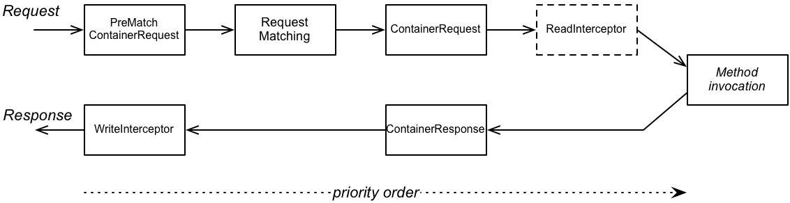
JAX-RS Filters and Interceptors
JAX-RS Server Processing Pipeline

Slide 15
JAX-RS Filters and Interceptors
JAX-RS Extension Points
PreMatchContainerRequest filter
ContainerRequest filter
ReadInterceptor
ContainerResponse filter
WriteInterceptor

Slide 16
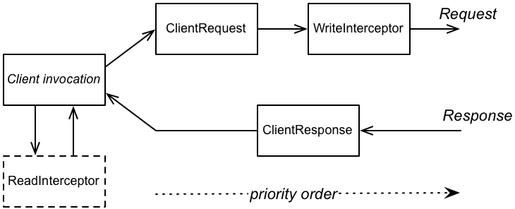
JAX-RS Filters and Interceptors
JAX-RS Client processing pipeline

Slide 17
JAX-RS Filters and Interceptors
JAX-RS Client Extension Points
ClientRequest filter
WriteInterceptor
ClientResponse filter
ReadInterceptor

Slide 18
JAX-RS Filters and Interceptors
Filter Classes
Interceptor Classes
javax.ws.rs.container.ContainerRequestFilter
javax.ws.rs.container.ContainerResponseFilter
javax.ws.rs.client.ClientRequestFilter
javax.ws.rs.client.ClientResponseFilter
javax.ws.rs.ext.ReaderInterceptor
javax.ws.rs.ext.WriterInterceptor

Slide 20
A JAX-RS Filter Example

Slide 21
A JAX-RS Filter Example
REST API Security Example
We will be using ContainerRequestFilter interface. In this filter, we will get the details of the method that request is trying to access.
We will find-out all security related configuration on that method, and verify everything here in this filter e.g. annotation like:
@PermitAll
@DenyAll
@RolesAllowed

Slide 22
A JAX-RS Filter Example
Secure REST API
@Path("/...")
public class MyRestService
{
@RolesAllowed("ADMIN")
@GET
@Produces(MediaType.APPLICATION_JSON)
@Consumes(MediaType.APPLICATION_JSON)
public String getMethod()
{
return . . .
}
}

Slide 23
A JAX-RS Filter Example
Create RequestAuthenticationFilter
import javax.annotation.security.DenyAll;
import javax.annotation.security.PermitAll;
import javax.annotation.security.RolesAllowed;
import javax.ws.rs.container.ContainerRequestContext;
import javax.ws.rs.container.ResourceInfo;
import javax.ws.rs.core.Context;
import javax.ws.rs.core.MultivaluedMap;
import javax.ws.rs.core.Response;
import javax.ws.rs.ext.Provider;
@Provider
public class RequestAuthenticationFilter implements javax.ws.rs.container.ContainerRequestFilter
{
@Context
private ResourceInfo resourceInfo;
private static final String AUTHORIZATION_PROPERTY = "Authorization";
private static final String AUTHENTICATION_SCHEME = "Basic";

Slide 24
A JAX-RS Filter Example
Create RequestAuthenticationFilter
@Override
public void filter(ContainerRequestContext requestContext)
{
Method method = resourceInfo.getResourceMethod();
if(!method.isAnnotationPresent(PermitAll.class)) // Access allowed for all
{
if(method.isAnnotationPresent(DenyAll.class)) //Access denied for all
{
requestContext.abortWith(Response.status(Response.Status.FORBIDDEN)
.entity("Access blocked for all users !!").build());
return;
}
//Get request headers
final MultivaluedMap<String, String> headers = requestContext.getHeaders();
//Fetch authorization header
final List<String> authorization = headers.get(AUTHORIZATION_PROPERTY);
//If no authorization information present; block access
if(authorization == null || authorization.isEmpty())
{
requestContext.abortWith(Response.status(Response.Status.UNAUTHORIZED)
.entity("You cannot access this resource").build());
return;
}

Slide 25
A JAX-RS Filter Example
Create RequestAuthenticationFilter
//Get encoded username and password
final String encodedUserPassword = authorization.get(0).replaceFirst(AUTHENTICATION_SCHEME + " ", "");
//Decode username and password
String usernameAndPassword = new String(Base64.decode(encodedUserPassword.getBytes()));;
//Split username and password tokens
final StringTokenizer tokenizer = new StringTokenizer(usernameAndPassword, ":");
final String username = tokenizer.nextToken();
final String password = tokenizer.nextToken();
//Verify user access
if(method.isAnnotationPresent(RolesAllowed.class))
{
RolesAllowed rolesAnnotation = method.getAnnotation(RolesAllowed.class);
Set<String> rolesSet = new HashSet<String>(Arrays.asList(rolesAnnotation.value()));
//Is user valid?
if(!isUserAllowed(username, password, rolesSet))
{
requestContext.abortWith(Response.status(Response.Status.UNAUTHORIZED)
.entity("You cannot access this resource").build();
return;
}
}
}
}

Slide 26
A JAX-RS Filter Example
Create RequestAuthenticationFilter
private boolean isUserAllowed(final String username, final String password, final Set<String> rolesSet)
{
boolean isAllowed = false;
//Step 1. Fetch password from database and match with password in argument
//If both match then get the defined role for user from database and continue; else return isAllowed [false]
//Access the database and do this part yourself
//String userRole = userMgr.getUserRole(username);
if(username.equals("howtodoinjava") && password.equals("password")) // TODO: Step 1.1
{
String userRole = "ADMIN"; // TODO: Step 1.2
//Step 2. Verify user role
if(rolesSet.contains(userRole))
{
isAllowed = true;
}
}
return isAllowed;
}
}

Slide 27
A JAX-RS Filter Example
Registering RequestAuthenticationFilter
@javax.ws.rs.ApplicationPath("/...")
public class CustomApplication extends Application
{
@Override
public Set<Class<?>> getClasses()
{
Set<Class<?>> resources = new java.util.HashSet<>();
addRestResourceClasses(resources);
resources.add(RequestAuthenticationFilter.class);
return resources;
}
}

Slide 28
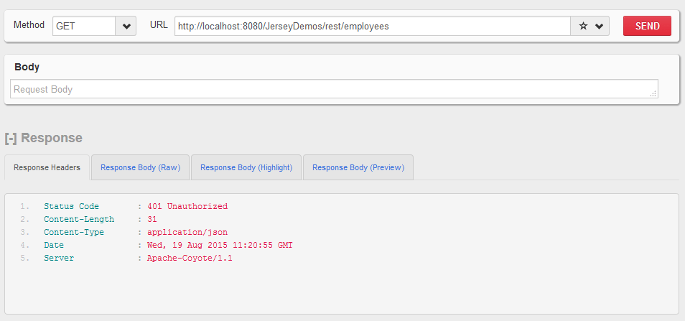
A JAX-RS Filter Example
Testing

Slide 29
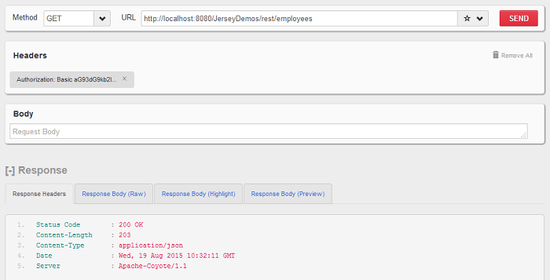
A JAX-RS Filter Example
Testing

Slide 32
SOAP Handlers

Slide 33
SOAP Handlers
What is a SOAP Handler?
SOAP handler is a SOAP message interceptor, which is able to intercept incoming or outgoing SOAP message and manipulate its values.
Example:
Checking which computer is allowed to access the published service by using MAC addresses:
Attach a SOAP handler in client side, which will inject client’s computer MAC address into the SOAP header block for every outgoing SOAP message that is send by the client.
In the server side, attach another SOAP handler, to retrieve back the client’s MAC address in SOAP header block from every incoming SOAP message.

Slide 34
SOAP Handlers
Review
https://www.mkyong.com/webservices/jax-ws/jax-ws-soap-handler-in-server-side/
https://www.mkyong.com/webservices/jax-ws/jax-ws-soap-handler-in-client-side/

Slide 36
Some Tips on Context Resources

Slide 37
Context Resources - Case Studies: Tomcat vs. Jetty
Accessing Context Resources
REST
Using @Context (attributes as well as method parameters)
Example: @Context ServletContext ctx, @Context UriInfo uinfo
unifo.getRequestUri() // returns the requested uri (logical)
ctx.getRealPath("/") // returns the real (physical) path to the root context (web root of the application)
SOAP
Using @Resource (attribute only)
Example: @Resource private ServletContext ctx;
ctx.getRealPath("/")

Slide 38
Context Resources - Case Studies: Tomcat vs. Jetty
Accessing Context Resources
Note that the webserver automatically injects the context variables to the service classes upon availability.
In some cases they may not be available (c.f. the code samples using Jetty)
Possible checks:
ctx is null
Root Cause: the injection is not supported by the web server (i.e. Jetty Server)
ctx is not null, but the return value of the function call is null (i.e. ctx.getRealPath(“myfile"))
Root Cause: invalid resource path, or resource not found

Slide 39
Context Resources - Case Studies: Tomcat vs. Jetty
Accessing Context Resources
Possible solution:
Use the class resource instead
Example: this.getClass().getResource("/")
An example of safely getting the web application context path:
String base = ctx != null? ctx.getRealPath("/") :
this.getClass().getResource("/").toExternalForm();

Slide 40
Context Resources - Case Studies: Tomcat vs. Jetty
Navigating outside the context path
For security reasons, accessing resources outside the context path is restricted.
It is highly recommended that you do not provide such access.
However, if there are files that are located outside the web folder, they may be accessed using their physical address, i.e.:
String base = ctx == null? this.getClass().getResource("/").toExternalForm() : ctx.getRealPath("/");
String fullpath = (new URI(base)).resolve(relativepath).toString();

Slide 41
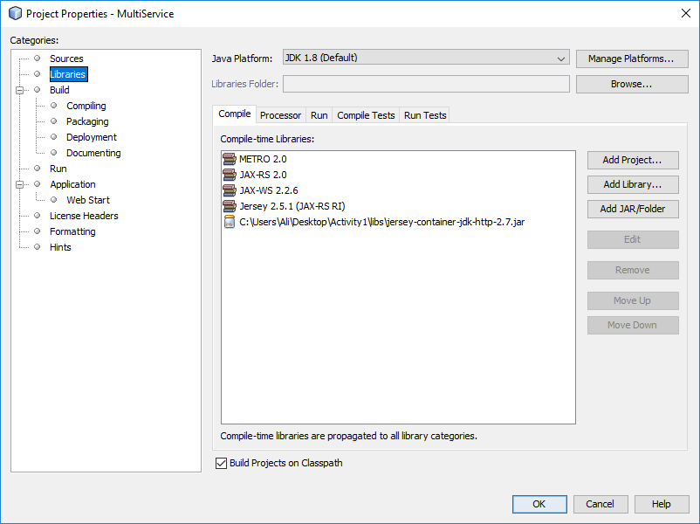
Useful Tips
Common References
JAX-WS Reference Implementation (JAX-WS RI)
Java HTTP (Web) server and Java Servlet container (Jetty)
If missing
Jul 24, 2019 3:31:40 PM org.glassfish.jersey.server.ApplicationHandler initialize
INFO: Initiating Jersey application, version Jersey: 2.5.1 2014-01-02 13:43:00...
java.lang.IllegalArgumentException: No container provider supports the type interface com.sun.net.httpserver.HttpHandler
at org.glassfish.jersey.server.ContainerFactory.createContainer(ContainerFactory.java:96)
at org.glassfish.jersey.server.internal.RuntimeDelegateImpl.createEndpoint(RuntimeDelegateImpl.java:71)

Slide 42
Useful Tips
Common Errors
Common Error when publishing services using HttpServer
No container provider supports the type interface com.sun.net.httpserver.HttpHandler
Cause: Missing jersey Container
Solution: Download and add jersey-container-jdk-http jar
org.glassfish.jersey.server.ApplicationHandler initialize
INFO: Initiating Jersey application, version Jersey: 2.5.1 2014-01-02 13:43:00...
java.lang.IllegalArgumentException: No container provider supports the type interface com.sun.net.httpserver.HttpHandler
at org.glassfish.jersey.server.ContainerFactory.createContainer(ContainerFactory.java:96)
at org.glassfish.jersey.server.internal.RuntimeDelegateImpl.createEndpoint(RuntimeDelegateImpl.java:71)

Slide 43
Useful Tips
Common Errors
Common Error when publishing services using HttpServer
java.lang.AbstractMethodError: org.glassfish.jersey.jdkhttp.JdkHttpHandlerContainerProvider.createContainer(Ljava/lang/Class;Lorg/glassfish/jersey/server/ApplicationHandler;)Ljava/lang/Object;
Cause: Wrong version of Jersey Container
Solution: Check for compatible version of the jersey-container-jdk-http jar, download and replace the jar
Exception in thread "main" java.lang.AbstractMethodError: org.glassfish.jersey.jdkhttp.JdkHttpHandlerContainerProvider.createContainer(Ljava/lang/Class;Lorg/glassfish/jersey/server/ApplicationHandler;)Ljava/lang/Object;
at org.glassfish.jersey.server.ContainerFactory.createContainer(ContainerFactory.java:90)
at org.glassfish.jersey.server.internal.RuntimeDelegateImpl.createEndpoint(RuntimeDelegateImpl.java:71)

Slide 44
Useful Tips
Common Errors
Common Error when publishing web services with Soap Faults using EndPoint
Unable to create JAXBContext
Caused by: java.security.PrivilegedActionException: com.sun.xml.bind.v2.runtime.IllegalAnnotationsException: 1 counts of IllegalAnnotationExceptions
java.lang.StackTraceElement does not have a no-arg default constructor.
Cause: Exception class cannot be serialized
Solution: Add @XmlType(propOrder = {"message"}) annotation to your Exception class.
Or use HttpException instead
javax.xml.ws.WebServiceException: Unable to create JAXBContext
at com.sun.xml.ws.model.AbstractSEIModelImpl.createJAXBContext(AbstractSEIModelImpl.java:166)
at com.sun.xml.ws.model.AbstractSEIModelImpl.postProcess(AbstractSEIModelImpl.java:94)
at com.sun.xml.ws.model.RuntimeModeler.buildRuntimeModel(RuntimeModeler.java:258)
at com.sun.xml.ws.server.EndpointFactory.createSEIModel(EndpointFactory.java:338)
at com.sun.xml.ws.server.EndpointFactory.createEndpoint(EndpointFactory.java:201)
at com.sun.xml.ws.api.server.WSEndpoint.create(WSEndpoint.java:505)
at com.sun.xml.ws.transport.http.server.EndpointImpl.createEndpoint(EndpointImpl.java:257)
at com.sun.xml.ws.transport.http.server.EndpointImpl.publish(EndpointImpl.java:181)
at com.mcgill.cccs425.multiserv.MultiServiceApp.main(MultiServiceApp.java:38)
Caused by: java.security.PrivilegedActionException: com.sun.xml.bind.v2.runtime.IllegalAnnotationsException: 1 counts of IllegalAnnotationExceptions
java.lang.StackTraceElement does not have a no-arg default constructor.

Slide 46
Lab Activity

Slide 47
Lab Activity
Secure the service you implemented in module 3 by installing a JAX-RS filter that checks the authorization header in the service. In case the user is not authorized, generate proper HTTP response / message.
See also the activity in the previous module.

Slide 48
Session Summary
JAX-WS (SOAP) Handlers
JAX-RS / Jersey Filters
JAX-RS / Jersey Interceptors
Context Resources

Slide 49
Acknowledgements
https://access.redhat.com/documentation/en-us/red_hat_jboss_fuse/6.2/html/apache_cxf_development_guide/jaxrs20filters
https://howtodoinjava.com/jersey/jersey-rest-security/
See also:
https://jersey.github.io/documentation/latest/filters-and-interceptors.html
https://www.logicbig.com/tutorials/java-ee-tutorial/jax-rs/interceptors.html

Slide 50
Next - Advanced Concepts in Web Services

