Slide 1
CCCS 425 – Web Services Lecture 13 – Advanced Concepts in Web Services

Slide 2

Acknowledgement
The following materials are produced from various online sources. Links to the original materials have been provided.

Slide 3
Session Learning Outcomes
Explain system integration using web services
Explain Workflow system
Implement a workflow system using Camunda

Slide 4
Session Overview
Workflow Management Systems
Camunda Workflow System
Camunda Resources

Slide 5
Workflow Management Systems

Slide 6
Workflow Management Systems
A Workflow Management System (WFMS) provides an infrastructure for the set-up, performance and monitoring of a defined sequence of tasks, arranged as a workflow application
WFMS may control automated processes in addition to replacing paperwork
They may appear in distributed IT environments
Used in order to manage the execution of various processes that may belong to the same application. In many cases they are used as a means to guarantee the offered quality of service (QoS).

Slide 7
Workflow Management Systems / cont.
WFMS may also be enhanced by using existing enterprise infrastructure (software apps).
Based on their functionalities, WFMS systems may be classified into several categories. The following are two main categories:
Integration-centric workflow systems
Human task-centric workflow systems
WFMS often comes with a workflow designer, a GUI that enables a process engineer to design and implement a workflow on the WFMS system.

Slide 8
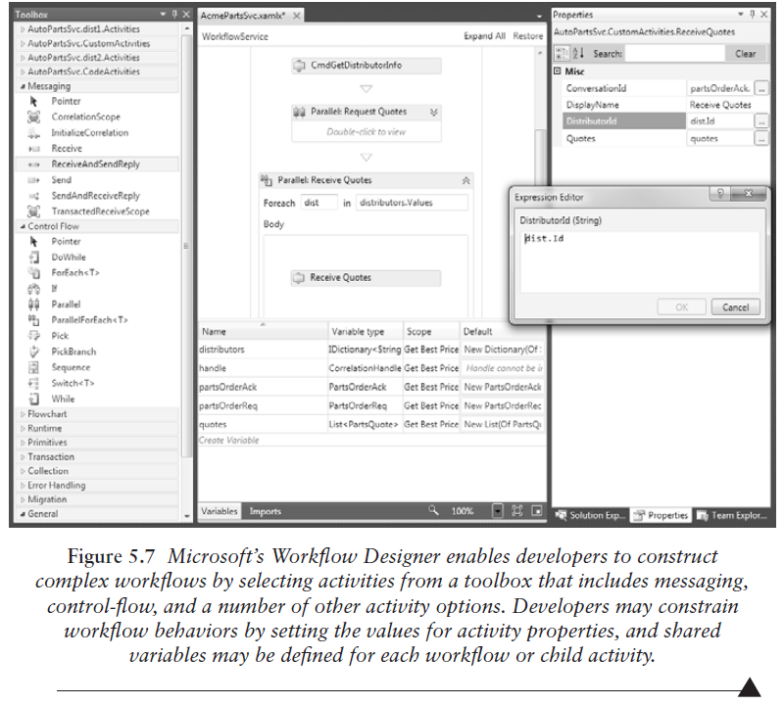
A Workflow Designer Example

Slide 9
A Workflow Example

Slide 10
Workflow System Characteristics
Process Complexity
Best for large scale processes
Variety of choices
Flexible for different use cases
The bests are very expensive
Ease of use
Hides complexity instead of reducing it
Process definition changes are much simpler to change

Slide 11
Camunda Workflow System

Slide 12
Camunda Software
Camunda is an open-source workflow engine and modeler. It provides process automation with a standards-based, highly scalable and collaborative approach for business and IT.

Slide 13
Process Orchestration in Camunda
Processes are complex and include many different steps, components, and endpoints across different technologies.
The Workflow Engine orchestrates processes that span APIs, microservices, business decisions and rules, human work, IoT devices, RPA bots, and more, so you have complete control and visibility for your most critical business processes.

Slide 14
Camunda Software
Workflow System (download and instructions):
https://camunda.com/download/
Modeler Application (download and instructions):
https://camunda.com/download/modeler/

Slide 15
Camunda Process Model
A workflow process may be modelled in Camunda workflow designer. An example is provided in the following:

Slide 16
Camunda Workflow Components
The following components may be used in a process:
Service Task
User Task
Data-based Exclusive Gateway
Inclusive Gateway
Parallel Gateway

Slide 17
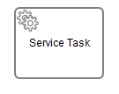
Service Task
A Service Task is used to invoke services. In Camunda this is done by calling Java code or providing a work item for an external worker to complete asynchronously or invoking a logic which is implemented in form of webservices.

Slide 18
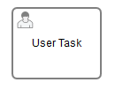
User Task
A User Task is used to model work that needs to be done by a human actor. When the process execution arrives at such a User Task, a new task is created in the task list of the user(s) or group(s) assigned to that task.

Slide 19
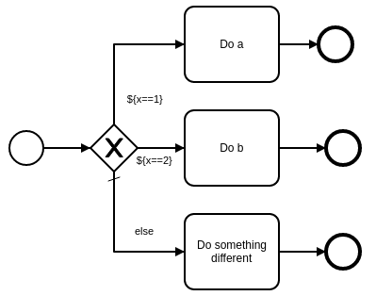
Data-based Exclusive Gateway
Provides branching based on value checks

Slide 20
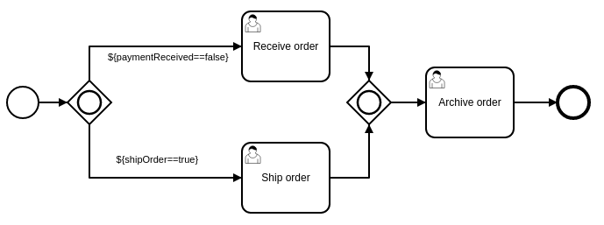
Inclusive Gateway
Provides a join

Slide 21
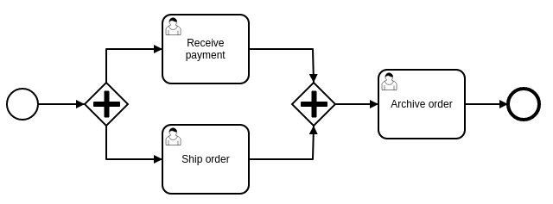
Parallel Gateway
Provides a parallel fork

Slide 23
Camunda Resources

Slide 24
Maven Dependency
In order to use Camunda, the following maven dependency must be added to your project:
<dependency>
<groupId>org.camunda.bpm</groupId>
<artifactId>camunda-external-task-client</artifactId>
<version>1.4.1</version>
</dependency>
<dependency>
<groupId>com.sun.xml.bind</groupId>
<artifactId>jaxb-impl</artifactId>
<version>2.2.4</version>
</dependency>

Slide 25
Resources
Camunda Examples:
https://github.com/camunda/camunda-bpm-examples
Camunda Rest API:
https://docs.camunda.org/manual/latest/reference/rest/
JavaScript Task Client:
https://github.com/camunda/camunda-external-task-client-js
Java Task Client:
https://github.com/camunda/camunda-external-task-client-java
Task Types:
https://docs.camunda.org/manual/7.14/reference/bpmn20/tasks/
Gateway Types:
https://docs.camunda.org/manual/7.14/reference/bpmn20/gateways/

Slide 26
Tutorial Videos
Getting Started:
https://www.youtube.com/watch?v=2XeTJQfz_YQ
Camunda in Java:
https://www.youtube.com/watch?v=HxtZf5VD6lQ
Distributed System:
https://www.youtube.com/watch?v=l6pMXr8Jf6k
REST API:
https://www.youtube.com/watch?v=ypX90aQScOQ
Advanced Topics:
https://www.youtube.com/watch?v=gFY1UuiCVl4

Slide 29
Lab Activity

Slide 30
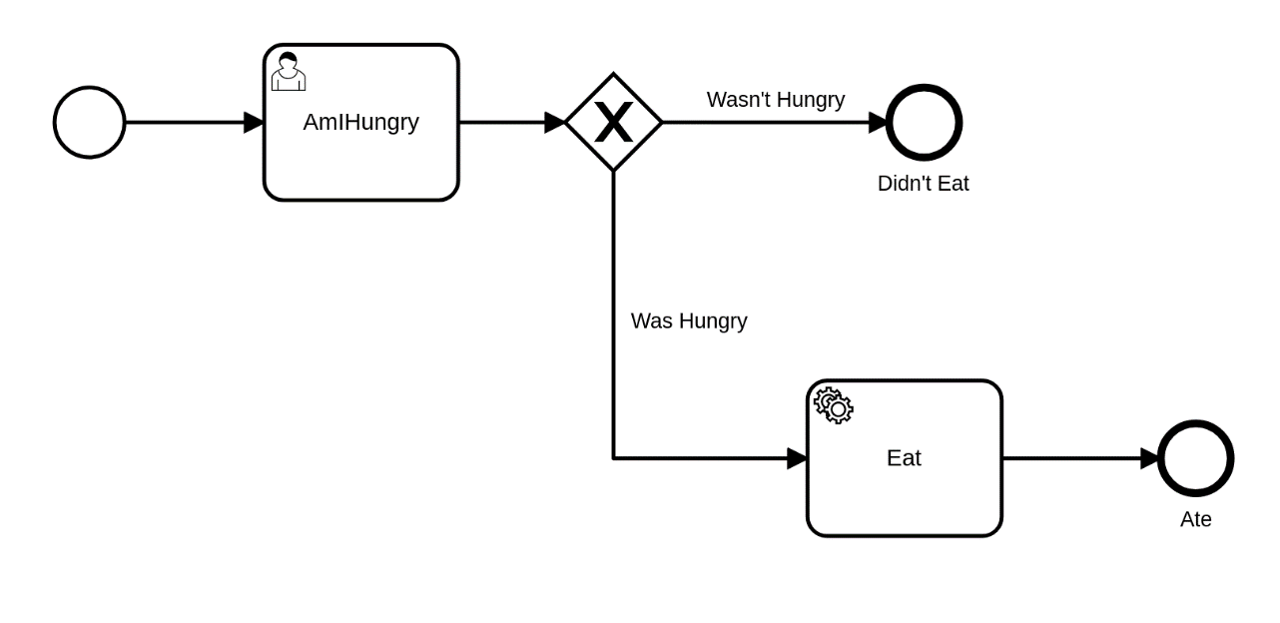
Lab Activity
Implement the following process in Camunda.
Create a use task called “AmIHungry”. This user tasks provide the variable indicating whether the user is hungry or not.
If the user was indeed hungry, the service task “Eat” will be executed.
AmIHungry: Create a console app. This console prompt the user and asks whether the user is hungry or not. It then starts the processby passing a variable to the workflow engine.
Eat: This is done though a worker app. The worker app is subscribed to the service task eat and prints out the work "EATING", when the service task is being executed.

Slide 31
Session Summary
System integration using web services
Service Infrastructures and Workflow systems

Slide 32
Acknowledgements
Camunda Workflow Tutorial, by Nicholas Nagy, https://github.com/SOEN487/T09

Slide 33
Congratulations, you finished the course!

