Slide 1
The RSA Algorithm
JooSeok Song
2007. 11. 13. Tue

Slide 2
Private-Key Cryptography
traditional private/secret/single key cryptography uses one key
shared by both sender and receiver
if this key is disclosed communications are compromised
also is symmetric, parties are equal
hence does not protect sender from receiver forging a message & claiming is sent by sender
Notes:
<number>

Slide 3
Public-Key Cryptography
probably most significant advance in the 3000 year history of cryptography
uses two keys – a public & a private key
asymmetric since parties are not equal
uses clever application of number theoretic concepts to function
complements rather than replaces private key crypto
Notes:
<number>

Slide 4
Public-Key Cryptography
public-key/two-key/asymmetric cryptography involves the use of two keys:
a public-key, which may be known by anybody, and can be used to encrypt messages, and verify signatures
a private-key, known only to the recipient, used to decrypt messages, and sign (create) signatures
is asymmetric because
those who encrypt messages or verify signatures cannot decrypt messages or create signatures

Slide 5
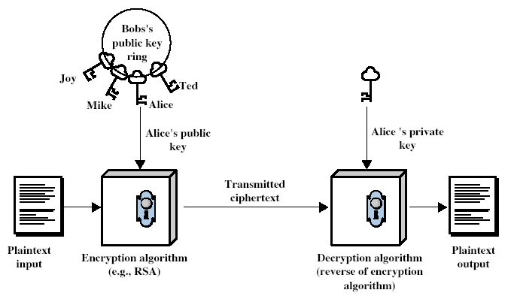
Public-Key Cryptography
Notes:
<number>

Slide 6
Why Public-Key Cryptography?
developed to address two key issues:
key distribution – how to have secure communications in general without having to trust a KDC with your key
digital signatures – how to verify a message comes intact from the claimed sender
public invention due to Whitfield Diffie & Martin Hellman at Stanford Uni in 1976
known earlier in classified community
Notes:
<number>

Slide 7
Public-Key Characteristics
Public-Key algorithms rely on two keys with the characteristics that it is:
computationally infeasible to find decryption key knowing only algorithm & encryption key
computationally easy to en/decrypt messages when the relevant (en/decrypt) key is known
either of the two related keys can be used for encryption, with the other used for decryption (in some schemes)
Notes:
<number>

Slide 8
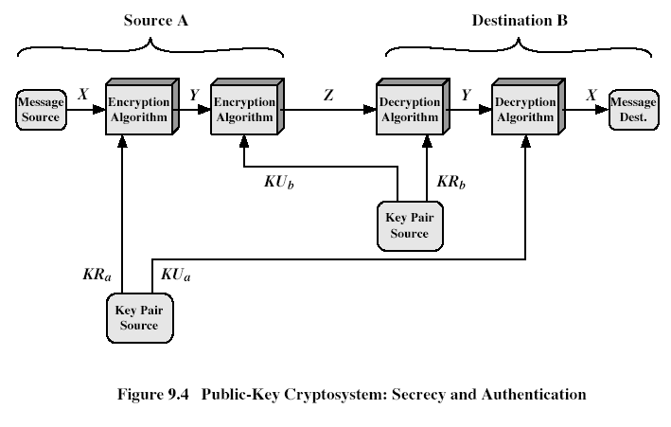
Public-Key Cryptosystems
Notes:
<number>

Slide 9
Public-Key Applications
can classify uses into 3 categories:
encryption/decryption (provide secrecy)
digital signatures (provide authentication)
key exchange (of session keys)
some algorithms are suitable for all uses, others are specific to one

Slide 10
Security of Public Key Schemes
like private key schemes brute force exhaustive search attack is always theoretically possible
but keys used are too large (>512bits)
security relies on a large enough difference in difficulty between easy (en/decrypt) and hard (cryptanalyse) problems
more generally the hard problem is known, its just made too hard to do in practise
requires the use of very large numbers
hence is slow compared to private key schemes
Notes:
<number>

Slide 11
RSA
by Rivest, Shamir & Adleman of MIT in 1977
best known & widely used public-key scheme
based on exponentiation in a finite (Galois) field over integers modulo a prime
nb. exponentiation takes O((log n)³) operations (easy)
uses large integers (eg. 1024 bits)
security due to cost of factoring large numbers
nb. factorization takes O(e ^{log n log log n}) operations (hard)
Notes:
<number>

Slide 12
RSA Key Setup
each user generates a public/private key pair by:
selecting two large primes at random - p, q
computing their system modulus N=p.q
note ø(N)=(p-1)(q-1)
selecting at random the encryption key e
where 1<e<ø(N), gcd(e,ø(N))=1
solve following equation to find decryption key d
e.d=1 mod ø(N) and 0≤d≤N
publish their public encryption key: KU={e,N}
keep secret private decryption key: KR={d,p,q}
Notes:
<number>

Slide 13
RSA Use
to encrypt a message M the sender:
obtains public key of recipient KU={e,N}
computes: C=Me mod N, where 0≤M<N
to decrypt the ciphertext C the owner:
uses their private key KR={d,p,q}
computes: M=C^{d} mod N
note that the message M must be smaller than the modulus N (block if needed)

Slide 14
Prime Numbers
prime numbers only have divisors of 1 and self
they cannot be written as a product of other numbers
note: 1 is prime, but is generally not of interest
eg. 2,3,5,7 are prime, 4,6,8,9,10 are not
prime numbers are central to number theory
list of prime number less than 200 is:
2 3 5 7 11 13 17 19 23 29 31 37 41 43 47 53 59 61 67 71 73 79 83 89 97 101 103 107 109 113 127 131 137 139 149 151 157 163 167 173 179 181 191 193 197 199

Slide 15

Prime Factorisation
to factor a number n is to write it as a product of other numbers: n=a × b × c
note that factoring a number is relatively hard compared to multiplying the factors together to generate the number
the prime factorisation of a number n is when its written as a product of primes
eg. 91=7×13 ; 3600=2⁴×3²×5²
Notes:
<number>

Slide 16
Relatively Prime Numbers & GCD
two numbers a, b are relatively prime if have no common divisors apart from 1
eg. 8 & 15 are relatively prime since factors of 8 are 1,2,4,8 and of 15 are 1,3,5,15 and 1 is the only common factor
conversely can determine the greatest common divisor by comparing their prime factorizations and using least powers
eg. 300=2¹×3¹×5² 18=2¹×3² hence GCD(18,300)=2¹×3¹×5⁰=6

Slide 17
Fermat's Theorem
a^{p-1} mod p = 1
where p is prime and gcd(a,p)=1
also known as Fermat’s Little Theorem
useful in public key and primality testing

Slide 18
Euler Totient Function ø(n)
when doing arithmetic modulo n
complete set of residues is: 0..n-1
reduced set of residues is those numbers (residues) which are relatively prime to n
eg for n=10,
complete set of residues is {0,1,2,3,4,5,6,7,8,9}
reduced set of residues is {1,3,7,9}
number of elements in reduced set of residues is called the Euler Totient Function ø(n)

Slide 19
Euler Totient Function ø(n)
to compute ø(n) need to count number of elements to be excluded
in general need prime factorization, but
for p (p prime) ø(p) = p-1
for p.q (p,q prime) ø(p.q) = (p-1)(q-1)
eg.
ø(37) = 36
ø(21) = (3–1)×(7–1) = 2×6 = 12

Slide 20
Euler's Theorem
a generalisation of Fermat's Theorem
a^{ø(n)}mod N = 1
where gcd(a,N)=1
eg.
a=3;n=10; ø(10)=4;
hence 3⁴ = 81 = 1 mod 10
a=2;n=11; ø(11)=10;
hence 2¹⁰ = 1024 = 1 mod 11

Slide 21
Why RSA Works
because of Euler's Theorem:
a^{ø(n)}mod N = 1
where gcd(a,N)=1
in RSA have:
N=p.q
ø(N)=(p-1)(q-1)
carefully chosen e & d to be inverses mod ø(N)
hence e.d=1+k.ø(N) for some k
hence : C^{d} = (Me)^{d} = M^{1+k.ø(N)} = M¹.(M^{ø(N)})^{q} = M¹.(1)^{q} = M¹ = M mod N
Notes:
<number>

Slide 22
RSA Example
Select primes: p=17 & q=11
Compute n = pq =17×11=187
Compute ø(n)=(p–1)(q-1)=16×10=160
Select e : gcd(e,160)=1; choose e=7
Determine d: de=1 mod 160 and d < 160 Value is d=23 since 23×7=161= 10×160+1
Publish public key KU={7,187}
Keep secret private key KR={23,17,11}
Notes:
<number>

Slide 23
RSA Example cont
sample RSA encryption/decryption is:
given message M = 88 (nb. 88<187)
encryption:
C = 88⁷ mod 187 = 11
decryption:
M = 11²³ mod 187 = 88
Notes:
<number>

Slide 24
Exponentiation
can use the Square and Multiply Algorithm
a fast, efficient algorithm for exponentiation
concept is based on repeatedly squaring base
and multiplying in the ones that are needed to compute the result
look at binary representation of exponent
only takes O(log₂ n) multiples for number n
eg. 7⁵ = 7⁴.7¹ = 3.7 = 10 mod 11
eg. 3¹²⁹ = 3¹²⁸.3¹ = 5.3 = 4 mod 11

Slide 25
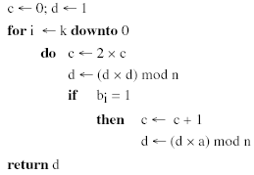
Exponentiation

Slide 26
RSA Key Generation
users of RSA must:
determine two primes at random - p, q
select either e or d and compute the other
primes p,q must not be easily derived from modulus N=p.q
means must be sufficiently large
typically guess and use probabilistic test
exponents e, d are inverses, so use Inverse algorithm to compute the other
Notes:
<number>

Slide 27
RSA Security
three approaches to attacking RSA:
brute force key search (infeasible given size of numbers)
mathematical attacks (based on difficulty of computing ø(N), by factoring modulus N)
timing attacks (on running of decryption)

Slide 28
Factoring Problem
mathematical approach takes 3 forms:
factor N=p.q, hence find ø(N) and then d
determine ø(N) directly and find d
find d directly
currently believe all equivalent to factoring
have seen slow improvements over the years
as of Aug-99 best is 130 decimal digits (512) bit with GNFS
biggest improvement comes from improved algorithm
cf “Quadratic Sieve” to “Generalized Number Field Sieve”
barring dramatic breakthrough 1024+ bit RSA secure
ensure p, q of similar size and matching other constraints
Notes:
<number>

Slide 29
Timing Attacks
developed in mid-1990’s
exploit timing variations in operations
eg. multiplying by small vs large number
or IF's varying which instructions executed
infer operand size based on time taken
RSA exploits time taken in exponentiation
countermeasures
use constant exponentiation time
add random delays
blind values used in calculations

Slide 30
Summary
have considered:
prime numbers
Fermat’s and Euler’s Theorems
Primality Testing
Chinese Remainder Theorem
Discrete Logarithms
principles of public-key cryptography
RSA algorithm, implementation, security

Slide 31
Assignments
Perform encryption and decryption using RSA algorithm, as in Figure 1, for the following:
p = 3; q = 11, e = 7; M = 5
p = 5; q = 11, e = 3; M = 9
In a public-key system using RSA, you intercept the ciphertext C = 10 sent to a user whose public key is e = 5, n = 35. What is the plaintext M?
Encryption
Decryption
Ciphertext
Plaintext
7
11
23
Plaintext
88
88
mod
187
=
11
11
mod
187
=
88
88
KU
=
7
,
187
KR
=
23
,
187
Figure
1
.
Example of RSA Algorithm
<number>

