Slide 1
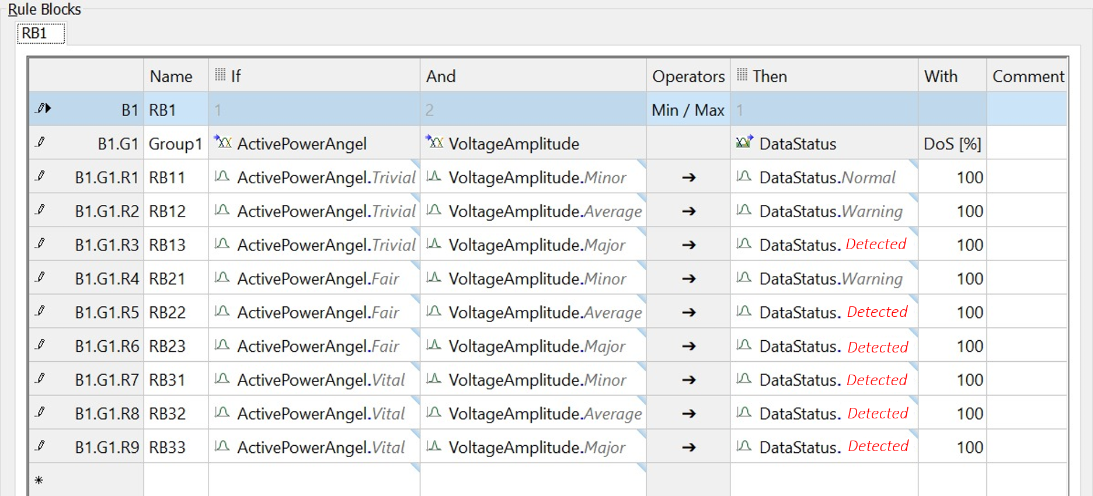
Active Power Angel (Δ δ)
Voltage Amplitude (ΔV) |  | Trivial | Fair | Vital
 | Minor | Normal | Warning | DETECT
 | Average | Warning | DETECT | DETECT
 | Major | DETECT | DETECT | DETECT
B
A
Rule Specification
Rule Matrix

