Slide 1
Introduction

Slide 2
Course Objectives
After completing this course, you should be able to do the following:
  Identify the components and architecture of
  Java 2, Enterprise Edition (J2EE), based on the needs of specific applications
  Describe the Model View Controller (MVC) architecture and create development plans for J2EE applications
  Build a Web-based database application by using J2EE components: servlets, JavaServer Pages (JSP)
Notes:
Course Objectives
Many businesses rely on the Internet and Web applications for their daily business. Oracle provides several tools that you can use to easily develop and deploy these applications. The purpose of this course is to teach you how to develop applications by using the J2EE components. These components include servlets, JSP, and EJB. Additionally, you should be able to create applications that adhere to the MVC architecture, which provides easily maintainable components.

Slide 3
Course Objectives
  Test J2EE components by using Web and Java clients
  Provide versatile access to applications through Web services, and use a published Web service in an application
  Deploy J2EE applications to Oracle Application Server 10g
  Manage transactions in EJB
  Implement J2EE security in applications
Notes:
Course Objectives (continued)
Additionally, you should be able to describe how to develop client applications for your J2EE components, and how to create Web services from your applications. This course also explains how to deploy J2EE applications to Oracle Application Server 10g, and also addresses the handling of security issues when deploying J2EE applications. Further, declaratively and programmatically managing transactions when using EJB is also described in detail.

Slide 4
Course Overview
  Lesson 1: Course Overview
  Lesson 2: J2EE Overview
  Lesson 3: Design considerations for building J2EE applications
  Lesson 4: Introduction to servlets
  Lesson 5: Using JDBC to access the database from servlets
  Lesson 6: Advanced servlet topics
  Lesson 7: Maintaining sessions in servlets
  Lesson 8: Introduction to JavaServer Pages (JSP)
  Lesson 9: Utilizing custom tags in JSP

Slide 5
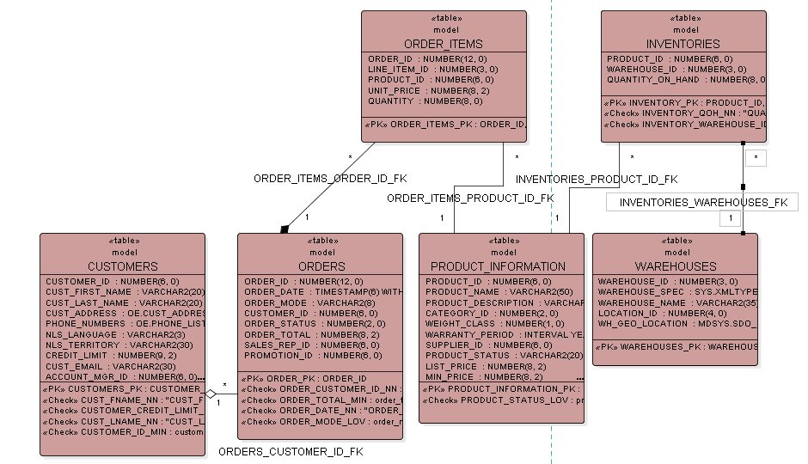
Order Entry Schema
ORDER_ITEMS_ORDER_ID_FK
INVENTORIES_PRODUCT_ID_FK
ORDER_ITEMS_PRODUCT_ID_FK
INVENTORIES_WAREHOUSES_FK
ORDERS_CUSTOMER_ID_FK
Notes:
Order Entry Schema
In the company’s order entry records, each customer has a unique ID. A customer might have orders that are detailed in the ORDER_ITEMS table. These orders contain products that are office supply products.
The company is global and has several warehouses containing inventories of various products. Some products have photos stored in the product media schema, which is not used in this course.
This slide and the next show a brief description of the tables in the schema; Appendix B contains a full description of each table used in the course.

Slide 6
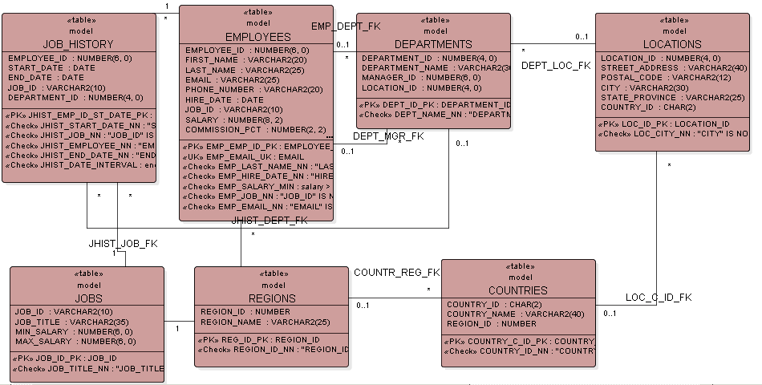
Human Resources (HR) Schema
EMP_DEPT_FK
DEPT_LOC_FK
DEPT_MGR_FK
*
JHIST_DEPT_FK
JHIST_JOB_FK
COUNTR_REG_FK
LOC_C_ID_FK
Notes:
Human Resources (HR) Schema
In the company’s human resource records, each employee has a unique identification number, e-mail address, job identification number, salary, and manager.
The company also tracks information about jobs within the organization. Each job has an identification number, job title, and a minimum and maximum salary range for the job.
The sample company is regionally diverse, so it tracks the locations of not only its warehouses but also of its departments. Each of the company’s employees is assigned to a department. Each department is identified by a unique department code and a short name. Each department is associated with one location. Each location has a full address that includes the street address, postal code, city, state or province, and country code.
For each country where it has facilities, the company records the country name, currency symbol, currency name, and the region where the country is geographically located.

Slide 7
HR Application Flow Diagram
Employee entity
No
View
employees
process
Process
log in
Administrator?
Yes
Insert
employees
process
Notes:
HR Application Flow Diagram
In this course, you will build an application for both an Order Entry and a Human Resources business scenario. The Order Entry scenario is discussed in detail in later lessons. The slide above shows a general flow diagram for the Human Resources scenario.
Employees can log in to an application to view the details of the employees in their department. If the employee who logged in to the application is an HR administrator, then he or she may insert new employees into the application.

Slide 8
Summary
After completing this course, you should be able to:
  Create J2EE components by using best practices
  Develop J2EE applications by using servlets, JSPs, and EJBs
  Test J2EE components by using Web and Java clients
  Implement J2EE security in applications
  Deploy J2EE applications to JBOSS EAP 7.x
  Develop Web services, and provide access to them
Notes:
Summary
In this course, you learn how to create J2EE applications by using servlets, JSP, EJB, and Web services. You learn how to design and develop J2EE applications by using Oracle JDeveloper 10g, and make decisions about when to use the various J2EE components. Additionally, the applications that you create are deployed to Oracle Application Server 10g.

