Slide 1
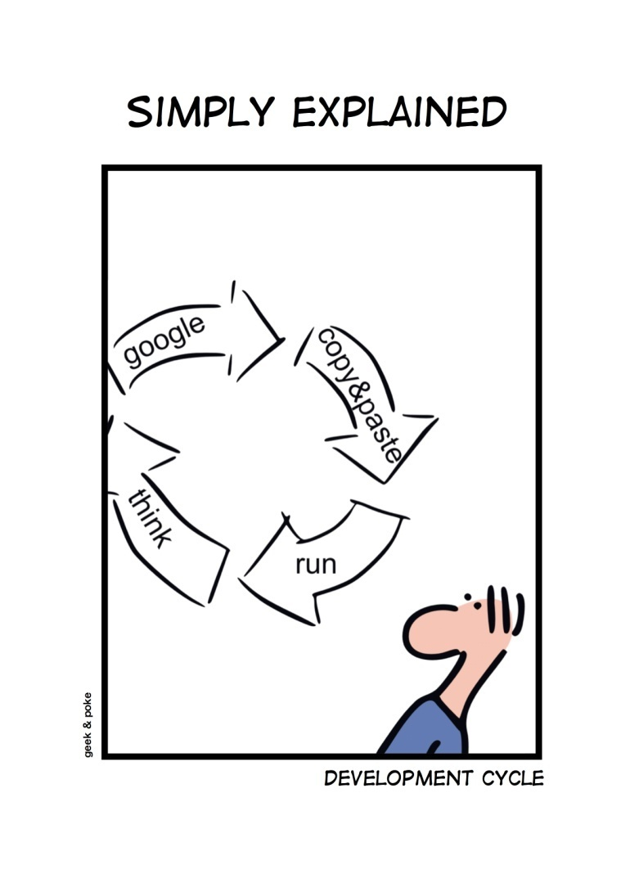
Software Engineering www.cs.uoi.gr/~zarras/http://www.cs.uoi.gr/~zarras/se.htm
Slides material sources:
Software Engineering - Theory & Practice, S. L. Pfleeger
Introduction to Software Engineering, I. Sommerville
SWEBOK v3: IEEE Software Engineering Body of Knowledge

Slide 2
What are the objectives & expected outcomes?

Slide 3
What are the objectives & expected outcomes?
The study and application of systematic processes, methods and techniques for software design, implementation and testing.
Learn how to:
Specify requirements for a large-scale software system.
Specify the architecture of the system based on the requirements specification.
Design and implement the subsystems of the system’s architecture.
Test the system in a principled way that guarantees the quality of the result.
Organize the delivery of the system and the user’s training.
Notes:
The study and application of systematic processes, methods and techniques for software design, implementation and testing. The main outcomes of the course is that the students will be capable to:
Elicit, analyze and specify requirements for a large scale software system.
Specify the architecture of the system based on the requirements specification.
Design and implement the subsystems of the system’s architecture.
Test the system in a principled way that guarantees the quality of the result.
Organize the delivery of the system and the user’s training.
Literature and Study Material
The main textbooks for the course are:
Software Engineering - Theory & Practice, S. L. Pfleeger, ISBN 978-960-461-477-6
Software Engineering, I. Sommerville, ISBN 978-960-461-220-8
Apart from the above textbooks you can download the course's lecture notes here.Project
The project is developed by groups of 2 students. The project consists of different phases (requirements specification, design, implementation, testing, delivery) each one of which has a corresponding deliverable.

Slide 4
Literature and study material
The main textbooks for the course are:
Software Engineering - Theory & Practice, S. L. Pfleeger, ISBN 978-960-461-477 6
Software Engineering, I. Sommerville, ISBN 978-960-461-220-8
Apart from the above textbooks you can download the course's lecture notes.
SWEBOK v3: IEEE Software Engineering Body of Knowledge
Lethbridge and Laganiere, Object-Oriented Software Engineering Practical Software Development using UML and Java, 2005
R.C. Martin, Agile Software Development, Principles, Patterns, and Practices, 2003
GoF, Design Patterns: Elements of Reusable OO Software, 1995
M. Fowler. Patterns for Enterprise Application Architecture, https://martinfowler.com/books/eaa.html
Software Testing – A Craftsman’s Approach, P Jorgensen
G. Meszaros. xUnit Test Patterns, https://martinfowler.com/books/meszaros.html
Notes:
The study and application of systematic processes, methods and techniques for software design, implementation and testing. The main outcomes of the course is that the students will be capable to:
Elicit, analyze and specify requirements for a large scale software system.
Specify the architecture of the system based on the requirements specification.
Design and implement the subsystems of the system’s architecture.
Test the system in a principled way that guarantees the quality of the result.
Organize the delivery of the system and the user’s training.
Literature and Study Material
The main textbooks for the course are:
Software Engineering - Theory & Practice, S. L. Pfleeger, ISBN 978-960-461-477-6
Software Engineering, I. Sommerville, ISBN 978-960-461-220-8
Apart from the above textbooks you can download the course's lecture notes here.Project
The project is developed by groups of 2 students. The project consists of different phases (requirements specification, design, implementation, testing, delivery) each one of which has a corresponding deliverable.

Slide 5
Project, Labs, Related Technologies
The project is developed by groups of 2-3 students.
Final deliverables:
Source code
Report
We will have a LAB in I5 where we will discuss the project and related technologies like Spring, Thymeleaf, Bootstrap, JPA, Hibernate, MySQL, JUnit, Mockito, Maven etc.

Slide 6
Grades and exams
There will also be a final written exam at the end of the semester.
If FinalExamGrade >=5 and ProjectGrade >= 5
  Overall grade = 0.6 * FinalExamGrade + 0.4 * ProjectGrade
Else
  Overall grade = min(FinalExamGrade, ProjectGrade)

