Slide 1
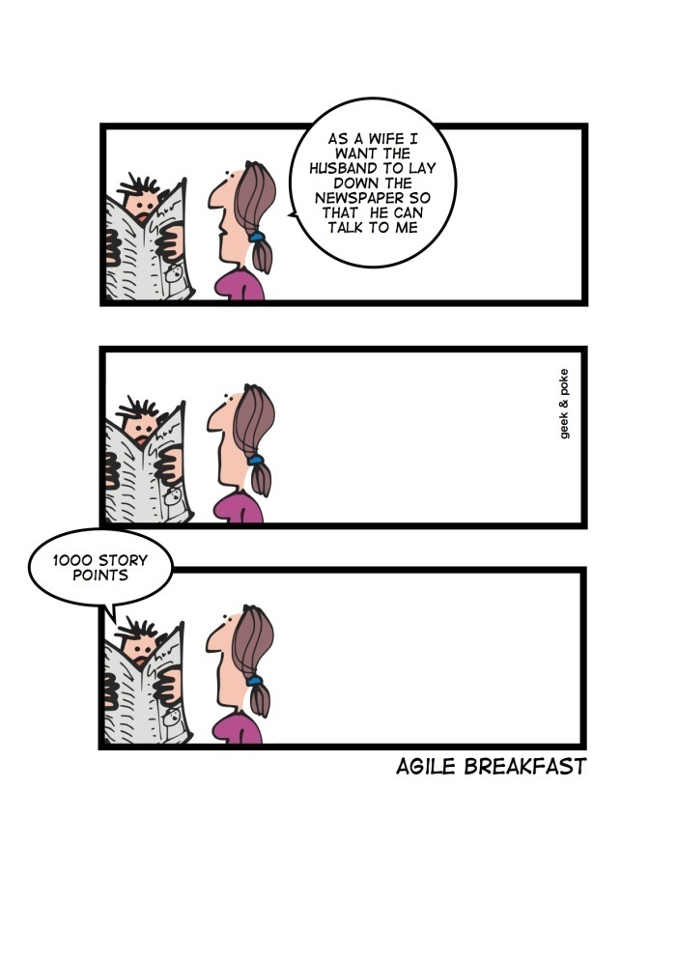
Software Requirements www.cs.uoi.gr/~zarras/http://www.cs.uoi.gr/~zarras/se.htm
Slides material sources:
Software Engineering - Theory & Practice, S. L. Pfleeger
Introduction to Software Engineering, I. Sommerville
SWEBOK v3: IEEE Software Engineering Body of Knowledge
IEEE Recommended Practice for Software Requirements Specifications

Slide 2
Software requirements fundamentals

Slide 3
What is a software requirement?

Slide 4
What is a requirement?
At its most basic, a requirement is a property that must be exhibited by a software in order to solve some problem in the real world.
SWEBOK v3: IEEE Software Engineering Body of Knowledge
It may range from a high-level abstract statement of a service or of a system constraint to a detailed mathematical functional specification.

Slide 5
How can we classify requirements?

Slide 6
How can we classify requirements?
Product / Process requirements
Functional / Non-functional requirements
System / Software requirements

Slide 7
What makes them so important?

Slide 8
What makes them so important?
According to a large scale empirical study (> 8000 projects) done by Standish in 1995 they are amongst the top factors that cause a project to fail.
  Incomplete requirements (13.1%)
  Lack of user involvement (12.4%)
  Unrealistic expectations (9.9%)
  Lack of executive support (9.3%)
  Changing requirements and specifications (8.7 %)
  Lack of planning (8.1%)
  System no longer needed (7.5%)

Slide 9
What is a functional requirement?

Slide 10
What is a functional requirement?
A functional requirement describes a function/service that the software is to execute/provide.
Sometimes known as capability or feature.

Slide 11
What is a nonfunctional requirement?

Slide 12
What is a nonfunctional requirement?
A non-functional requirement is a constraint on the provided functions/services.
Sometimes known as constraints or quality requirements.
Can be further classified according to whether they are performance requirements, maintainability requirements, safety requirements, reliability requirements, security requirements, availability requirements, interoperability requirements…. or any other quality attribute….

Slide 13
What makes a good software requirement specification (SRS)?

Slide 14

It should be correct
IEEE Recommended Practice for Software Requirements Specifications
An SRS is correct if, and only if, every requirement stated therein is one that the software should/shall meet.
There is no tool or procedure that ensures correctness.
The SRS should be compared with any applicable superior specification, such as a system requirements specification, with other project documentation, and with other applicable standards, to ensure that it agrees.
Alternatively, the customer or user can determine if the SRS correctly reflects the actual needs.

Slide 15

It should be unambiguous
IEEE Recommended Practice for Software Requirements Specifications
An SRS is unambiguous if, and only if, every requirement stated therein has only one interpretation.
As a minimum, this requires that each concept/characteristic of the product be described using a single unique term.

Slide 16

It should be complete
IEEE Recommended Practice for Software Requirements Specifications
An SRS is complete if, and only if it includes:
All significant requirements.
Definition of the responses of the software to all realizable classes of input data in all realizable classes of situations. Note that it is important to specify the responses to both valid and invalid input values.
Full labels and references to all figures, tables, and diagrams in the SRS and definition of all terms and units of measure.

Slide 17
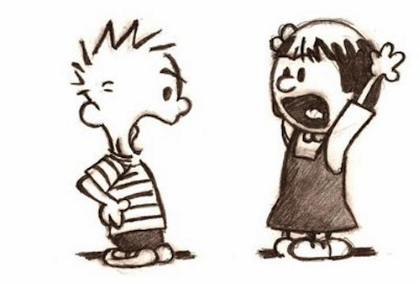
It should be consistent
IEEE Recommended Practice for Software Requirements Specifications
SRS is internally consistent if, and only if, no subset of individual requirements described in it conflict.
Consistency refers to internal consistency. If an SRS does not agree with some higher-level document, such as a system requirements specification, then it is not correct.

Slide 18
It should be consistent
IEEE Recommended Practice for Software Requirements Specifications
The specified characteristics of real-world concepts may conflict.
For example:
The format of an output report may be described in one requirement as tabular but in another as textual.
One requirement may state that all lights shall be green while another may state that all lights shall be blue.

Slide 19
It should be consistent
IEEE Recommended Practice for Software Requirements Specifications
There may be logical or temporal conflicts between two specified actions.
For example οne requirement may state that A must always follow B, while another may require that A and B occur simultaneously.

Slide 20
It should be consistent
IEEE Recommended Practice for Software Requirements Specifications
Two or more requirements may describe the same real-world object but use different terms for that object.
For example, a program’s request for a user input may be called a prompt in one requirement
and a cue in another.

Slide 21

It should be ranked for importance
IEEE Recommended Practice for Software Requirements Specifications
An SRS is ranked for importance if and only if each requirement in it has an identifier to indicate the importance of that particular requirement.
Essential - Implies that the software will not be acceptable unless these requirements are provided in an agreed manner.
Conditional - Implies that these are requirements that would enhance the software product, but would not make it unacceptable if they are absent.
Optional - Implies a class of functions that may or may not be worthwhile. This gives the supplier the opportunity to propose something that exceeds the SRS.

Slide 22

It should be ranked for stability
IEEE Recommended Practice for Software Requirements Specifications
An SRS is ranked for stability if and only if each requirement in it has an identifier to indicate the stability of that particular requirement.
Stability can be expressed in terms of the number of expected changes to any requirement based on experience or knowledge of forthcoming events that affect the organization, functions, and people supported by the software system.

Slide 23
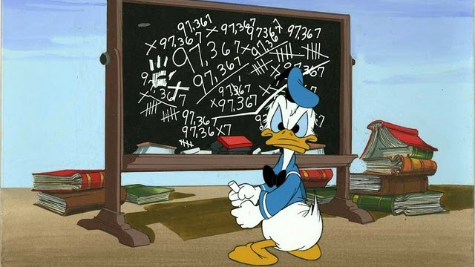
It should be verifiable
IEEE Recommended Practice for Software Requirements Specifications
An SRS is verifiable if, and only if, every requirement stated therein is verifiable.
A requirement is verifiable if, and only if, there exists some finite cost-effective process with which a person or machine can check that the software product meets the requirement.
In general any ambiguous requirement is not verifiable.

Slide 24
It should be verifiable
IEEE Recommended Practice for Software Requirements Specifications
Examples of non-verifiable requirements are statements such as:
“works well”, “good human interface” and “shall usually happen”
An example of a verifiable statement is:
Output of the program shall be produced within 20 s of event X 60% of the time; and shall be produced within 30 s of event Y 100% of the time.
This statement can be verified because it uses concrete terms and measurable quantities.

Slide 25

It should be modifiable
IEEE Recommended Practice for Software Requirements Specifications
An SRS is modifiable if, and only if, its structure and style are such that any changes to the requirements can be made easily.
SRS must have a coherent and easy-to-use organization with a table of contents, an index, and explicit cross-referencing.
Not be redundant (i.e., the same requirement should not appear in more than one place in the SRS).
Express each requirement separately, rather than intermixed with other requirements.

Slide 26
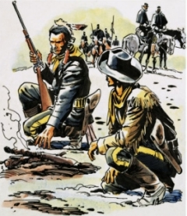
It should be traceable
IEEE Recommended Practice for Software Requirements Specifications
An SRS is traceable if the origin of each of its requirements is clear and facilitates the referencing of each requirement in future development or documentation.
Backward traceability - each requirement must explicitly reference its source in earlier documents.
Forward traceability - each requirement in the SRS must have a unique name or reference number.

Slide 27
Software requirements process & techniques

Slide 28
Where do we start from?

Slide 29
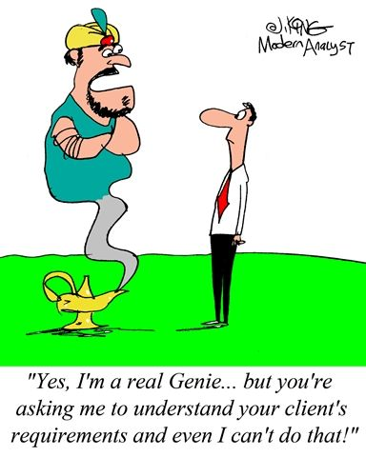
Requirements elicitation
Requirements elicitation is the first stage in building an understanding of the problem the software is required to solve.
It is fundamentally a human activity and is where the stakeholders are identified and relationships established between the development team and the customer.
It is variously termed requirements capture, requirements discovery, and requirements acquisition.

Slide 30
How do we collect requirements?

Slide 31
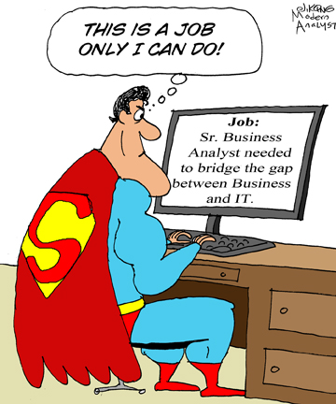
Elicitation techniques
Interviews - Interviewing stakeholders is a
“traditional” means of eliciting requirements.
Types of interviews
  Closed interviews based on pre-determined list of questions
  Open interviews where various issues are explored with stakeholders.
Effective interviewing
  Be open-minded, avoid pre-conceived ideas and be willing to listen to stakeholders.
  Prompt the interviewee using a springboard question, a requirements proposal, or by working together on a prototype system.

Slide 32
Elicitation techniques
Interviews in practice
Normally a mix of closed and open-ended interviewing.
Interviews are good for getting an overall understanding of what stakeholders do and how they might interact with the system.

Slide 33
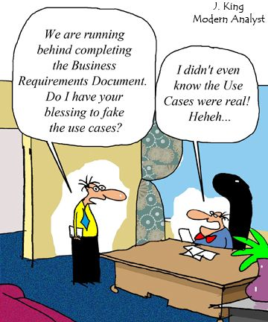
Elicitation techniques
Scenarios
Scenarios are real-life descriptions of how a system can be used.
They should include:
  A description of the starting situation;
  A description of the normal flow of events;
  A description of what can go wrong;
  A description of the state when the scenario finishes.

Slide 34
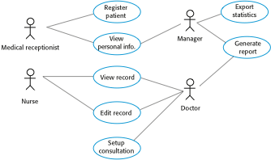
Elicitation techniques
Use-cases
A scenario based technique in UML which identify the actors in an interaction and which describe the interaction itself.
High-level graphical model supplemented by more detailed tabular description.
Sequence diagrams may be used to add detail to use-cases by showing the sequence of event processing in the system.

Slide 35
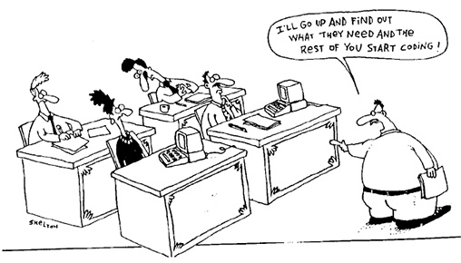
Elicitation techniques
Prototypes
This technique is a valuable tool
for clarifying ambiguous requirements and assess alternatives.
They provide users with a context within which they can better understand what information they need to provide.

Slide 36
Elicitation techniques
Prototypes
  Paper mockups
  Screen designs
  Beta-test versions
Low fidelity prototypes are often preferred to avoid stakeholder “anchoring” on minor, incidental characteristics of a higher quality prototype that can limit design flexibility in unintended ways.

Slide 37
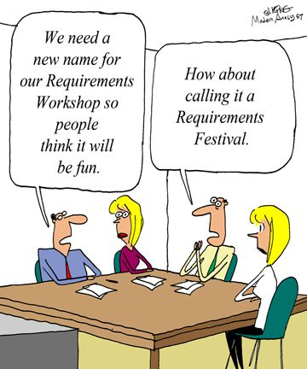
Elicitation techniques
Facilitated meetings
The purpose of these meetings is to try to achieve a summative effect, whereby a group of people can bring more insight into their software requirements than by working individually.
They can brainstorm and refine ideas that may be difficult to bring to the surface using interviews.
Another advantage is that conflicting requirements surface early on in a way that lets the stakeholders recognize where these occur.
Notes:
Facilitated meetings. The purpose of these
meetings is to try to achieve a summative
effect, whereby a group of people can bring
more insight into their software requirements
than by working individually. They
can brainstorm and refine ideas that may be
difficult to bring to the surface using interviews.
Another advantage is that conflicting
requirements surface early on in a way that
lets the stakeholders recognize where these
occur.
may result in a richer and more consistent
set of requirements than might otherwise
be achievable. However, meetings need to
be handled carefully (hence the need for a
facilitator) to prevent a situation in which
the critical abilities of the team are eroded
by group loyalty, or in which requirements
reflecting the concerns of a few outspoken
(and perhaps senior) people that are favored
to the detriment of others.

Slide 38
Elicitation techniques
Facilitated meetings
May result in a richer and more consistent set of requirements than might otherwise
be achievable.
However, meetings need to be handled carefully to prevent a situation in which the critical abilities of the team are eroded by group loyalty, or in which requirements reflecting the concerns of a few outspoken (and perhaps senior) people.

Slide 39
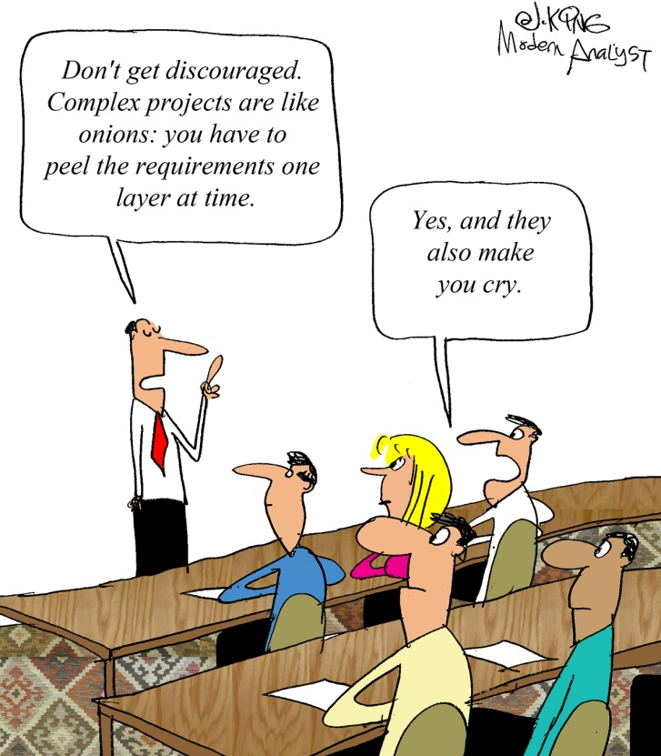
Elicitation techniques
Observation - ethnography
The importance of software context within the organizational/operational environment has led to observational techniques.
  Software engineers learn about user tasks by observing how users perform their tasks by interacting with each other and with software tools and other resources.
  These techniques are relatively expensive but also instructive because they illustrate that many user tasks and business processes are too subtle and complex for their actors to describe.
Ethnography is effective for understanding existing processes but cannot identify new features.

Slide 40
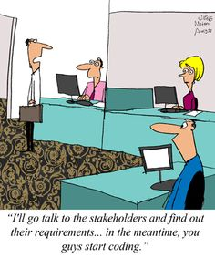
Elicitation techniques
User stories
This technique is commonly used in agile methods (esp. XP)
Refers to short, high-level descriptions of required functionality expressed in customer terms.
A typical user story has the form:
“As a <role>, I want <goal/desire> so that <benefit>.”

Slide 41
Elicitation techniques
User stories
A user story contains just enough information so that the we can produce a reasonable estimate of the effort to implement it. The details are orally discussed
Before a user story is implemented, a detailed acceptance test must be provided to determine whether the goals of the user story have been fulfilled.

Slide 42
What do we do once we have the requirements?

Slide 43
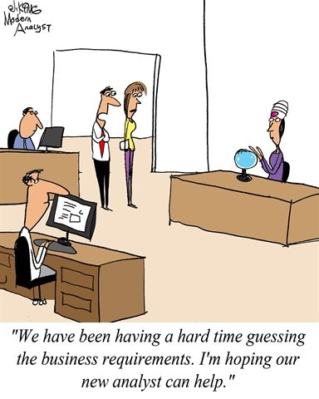
Requirements analysis
Requirements Classification
Requirements can be classified on a number of dimensions:
  Functional/Non Functional
  Product/Process
  Importance
  Stability
  Scope

Slide 44
Requirements analysis
Conceptual modeling
The development of models of a real-world problem is key to software requirements analysis.
Their purpose is to aid in understanding the situation in which the problem occurs, as well as depicting a solution.
Hence, conceptual models comprise models of entities from the problem domain, configured to reflect their real-world relationships and dependencies.

Slide 45
Requirements analysis
Conceptual modeling
Several kinds of models can be developed.
  Use case diagrams
  State models
  Process/Activity models
  Data models
  and many others…..
Many of these modeling notations are part of the Unified Modeling Language (UML).

Slide 46
Requirements analysis
Architecture design and requirements allocation
At some point, the solution architecture must
be derived. Architectural design is the point at which the requirements process overlaps with software or systems design.
The requirements allocation amounts to identifying the architecture/design components that will be responsible for satisfying the requirements.

Slide 47
Requirements analysis
Requirements negotiation
Another term commonly used for this task
is “conflict resolution.”
This concerns resolving problems with requirements where conflicts occur between stakeholders requiring mutually incompatible features, between requirements and resources, or between functional and nonfunctional requirements, for example.

Slide 48
What do we do after the analysis?

Slide 49
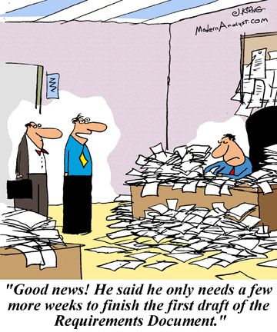
Requirements specification
Requirements specification typically refers to the production of a document that can be systematically reviewed, evaluated, and approved.
For complex systems, particularly those involving substantial non-software components, as many as three different types of documents are produced: system definition, system requirements, and software requirements.
For simple software products, only the
software requirements spec is required.

Slide 50
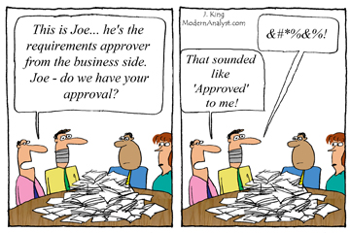
Requirements validation
The goal of this task is to check if the requirements specification is of good quality wrt required characteristics like correctness, completeness, unambiguity, traceability, verifiability, modifiability….

Slide 51
