Slide 1
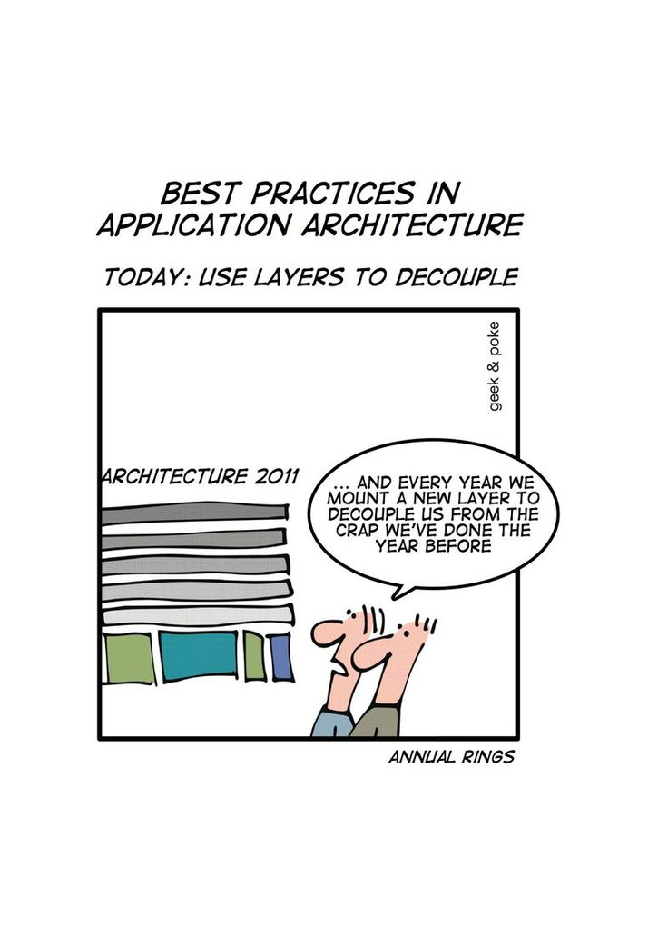
Software Design www.cs.uoi.gr/~zarras/http://www.cs.uoi.gr/~zarras/se.htm
Slides material sources:
Software Engineering - Theory & Practice, S. L. Pfleeger
Introduction to Software Engineering, I. Sommerville
SWEBOK v3: IEEE Software Engineering Body of Knowledge
R.C. Martin, Agile Software Development, Principles, Patterns, and Practices, 2003
GoF, Design Patterns: Elements of Reusable OO Software, 1995
M. Fowler. Patterns of Enterprise Application Architecture

Slide 2
Design fundamentals

Slide 3
What is software design?

Slide 4
What is software design?
In the general sense, design can be viewed as a form of a problem solving process.
In the case of software the input of the design process is the requirements.

Slide 5
What are the basic steps of the design process?

Slide 6
What are the basic steps of the design process?
Architectural design (also referred to as high level design and top-level design) describes how software is organized into components.
Detailed design describes the desired behavior of these components.

Slide 7
What is the outcome of the design process?

Slide 8
What is the outcome of the design process?
The output of these two processes is a set of models and artifacts that record the major decisions that have been taken, along with an explanation of the rationale for each nontrivial decision.
By recording the rationale, long-term maintainability of the software product is enhanced..

Slide 9
What makes a good design?

Slide 10
Modularity & Decomposition
Decomposing and modularizing means that large software is divided into a number of smaller named components having well-defined interfaces that describe component interactions.
Usually the goal is to place different functionalities and responsibilities in different components.

Slide 11
What makes a good split?

Slide 12
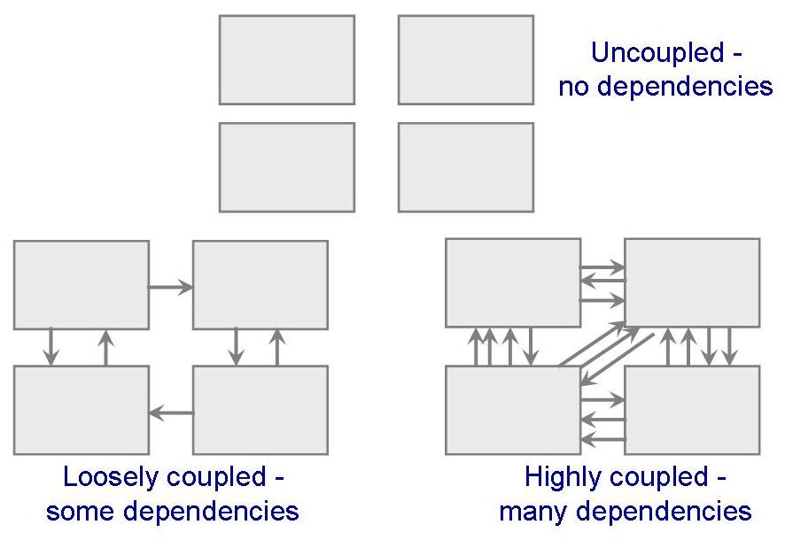
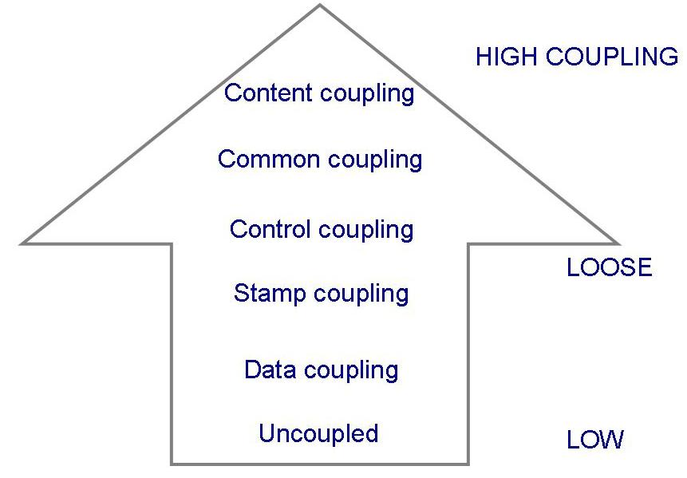
Low coupling
Coupling is a measure of the interdependence among components in a computer program.
W. P. Stevens, G. J. Myers and L. L. Constantine, Structured design, IBM Systems Journal, vol. 13, no. 2, pp. 115-139, 1974.

Slide 13
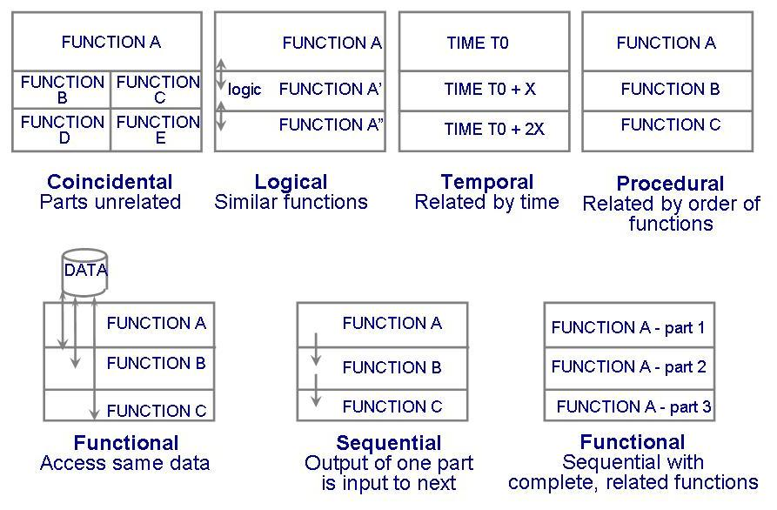
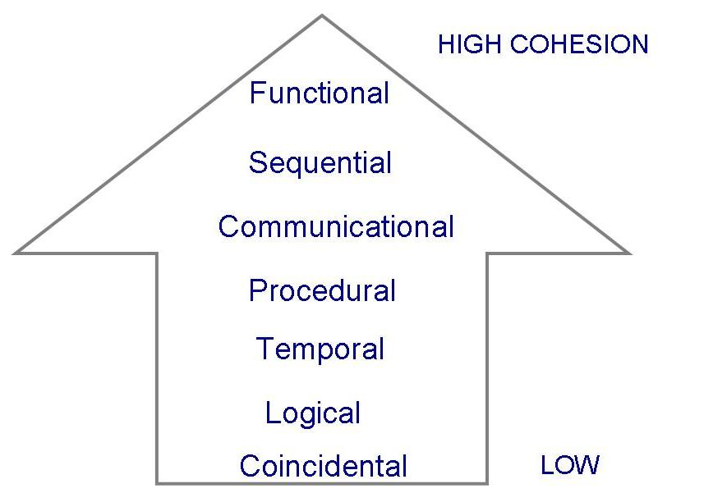
High cohesion
Cohesion is a measure of the strength of association of the elements within a component.
W. P. Stevens, G. J. Myers and L. L. Constantine, Structured design, IBM Systems Journal, vol. 13, no. 2, pp. 115-139, 1974.

Slide 14

Abstraction, encapsulation & information hiding
Abstraction is generally defined as a view of an object that focuses on the information relevant to a particular purpose and ignores the remainder of the information.
Encapsulation and information hiding means grouping and packaging the internal details of an abstraction and making those details inaccessible to external entities.
D. L. Parnas, On the Criteria To Be Used in Decomposing Systems into Modules. Communications of the ACM. 15 (12): 1053–58, 1972.

Slide 15
How do we assess the quality of a software design?

Slide 16
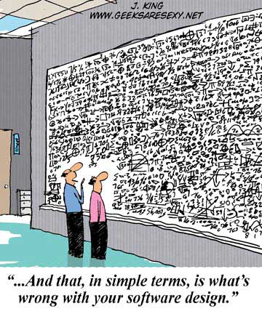
Software design quality
Software design reviews, informal or formal techniques, to determine the quality of design artifacts.
Software metrics to quantify the assessment.
The CK metrics suite is a well known set of metrics for OO software.

Slide 17
Coupling
  Coupling Between Object classes (CBO) [Chidamber & Kemerer]
  CBO(A) = number of classes used by A (inheritance is typically not counted)

Slide 18
class Controller {
private boolean alarm;
private Bell b;
private Light l;
public Controller(Bell ab, Light al){
  alarm = false;
  b = ab;
  l = al;
}
public void alarmSignal(){
  alarm = true;
}
public void cancelAlarm(){
  alarm = false;
  System.out.println("False alarm !!");
}
…………………………….
}

Slide 19
class Controller {
private boolean alarm;
private Bell b;
private Light l;
…………………………………….
public void confirmAlarm (){
  if (alarm == true) {
  if(b != null) b.ring();
  if(l!=null) l.open();
  alarm = false;
  } else
  System.out.println("False alarm !!");
}
public void stopAlarm(){
  if(b != null) b.stop();
  if(l!=null) l.close();
}
}
CBO(Controller) = 2
COF(Controller, Bell, Light) = (2+0+0)/(3*2) = 0.33

Slide 20
Cohesion
Lack of Cohesion of Methods (LCOM)
  LCOM [Chidamber & Kemerer]
      Q set contains the pairs of class methods that use common attributes
      P set contains the pairs of class methods that don’t use common attributes
    LCOM(x) = |P| – |Q| αν |P| > |Q|,
    LCOM(x) = 0 αν |P| <= |Q|

Slide 21
public class Rectangle {
private double x;
private double y;
private double width;
private double height;
public Rectangle(double ax, double ay,
double aWidth, double aHeight){
  x = ax;
  y = ay;
  width = aWidth;
  height = aHeight;
}
……………………………………
}

Slide 22
public class Rectangle {
………………………………………..
public void draw(){
  System.out.println("Drawing Rectangle at : (" +
  x + "," + y +
  ") with width = " + width + " height = " + height);
  // drawing code ....
}
public double calculateArea(){
  return width * height;
}
}
Q = 3, P = 0 => LCOM = 0

Slide 23
Cohesion
    LCOM2(x) = 1 – Sum(ma_{i})/(m*a) [Henderson-Sellers, Constantine, Graham]
    m = number of methods
    a = number of attributes
    ma_{i} = number of methods that use a_{i}, i=1, …, a
      maximum of ma_{i} is m
    LCOM2 the smaller the better…..
    LCOM2 = 1 ?
    LCOM2 = 0 ?

Slide 24
public class Rectangle {
private double x;
private double y;
private double width;
private double height;
public Rectangle(double ax, double ay,
double aWidth, double aHeight){
  x = ax;
  y = ay;
  width = aWidth;
  height = aHeight;
}
……………………………………
}

Slide 25
public class Rectangle {
………………………………………..
public void draw(){
  System.out.println("Drawing Rectangle at : (" +
  x + "," + y +
  ") with width = " + width + " height = " + height);
  // drawing code ....
}
public double calculateArea(){
  return width * height;
}
}

Slide 26
m = 3, a = 4
ma_{x} = 2
ma_{y} = 2
ma_{width} = 3
ma_{height} = 3
LCOM2 = 1 – 10/12 = 1/6 = 0.166

Slide 27
Class complexity
  Weighted Methods per Class (WMC) [Chidamber & Kemerer]
  WMC(A) = Sum(Ci), i=1, .. N methods
  Ci = method i complexity
  ➔ Ci can be measured in various ways:
    Lines of Code (LOC)
    McCabe (number of conditions +1)
      if, for, while → 1 condition
      Switch ➔ transform to if conditions first because it depends on how switch is implemented…

Slide 28
class Controller {
private boolean alarm;
private Bell b;
private Light l;
public Controller(Bell ab, Light al){
  alarm = false;
  b = ab;
  l = al;
}
public void alarmSignal(){
  alarm = true;
}
public void cancelAlarm(){
  alarm = false;
  System.out.println("False alarm !!");
}
…………………………….
}

Slide 29
class Controller {
private boolean alarm;
private Bell b;
private Light l;
…………………………………….
public void confirmAlarm (){
  if (alarm == true) {
  if(b != null) b.ring();
  if(l!=null) l.open();
  alarm = false;
  } else
  System.out.println("False alarm !!");
}
public void stopAlarm(){
  if(b != null) b.stop();
  if(l!=null) l.close();
}
}
McCabe version of WMC(Controller) = 10

Slide 30
Software Architecture

Slide 31
What do we mean by software architecture?

Slide 32
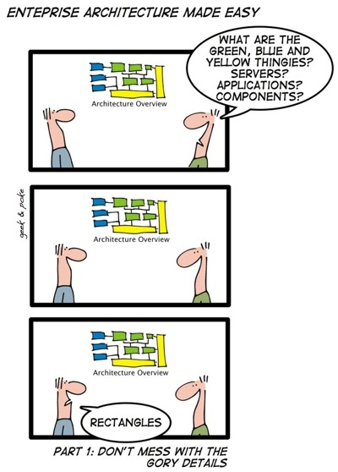
What do we mean by software architecture?
In its strict sense, a software architecture is the set of structures needed to reason about the system, which comprise software elements, relations among them, and properties of both.
P. Clements et al., Documenting Software Architectures: Views and Beyond, Pearson, 2010

Slide 33
What do we mean by software architecture?
During the mid-1990s, however, software architecture emerged as a broader discipline that involved the study of software structures and architectures in a more generic way.
This gave rise to a number of interesting concepts about software design at different levels of abstraction.
Some of these concepts can be useful during the architectural design (architectural styles) as well as during the detailed design (design patterns).
Interestingly, most of these concepts can be seen as attempts to describe, and thus reuse, design knowledge.

Slide 34
Architectural Styles

Slide 35
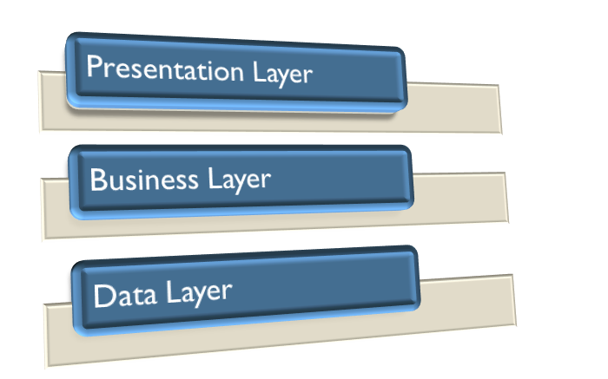
Architectural styles
Layered architectures
Components are organized in layers
Each layer depends only on the next layer
D. Garlan and M. Shaw, An Introduction to Software Architecture, Advances in Software Engineering and Knowledge Engineering, Volume I , 1993

Slide 36
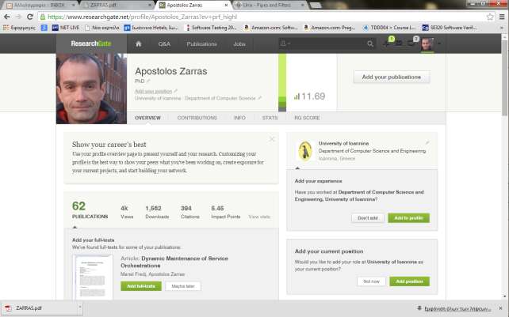
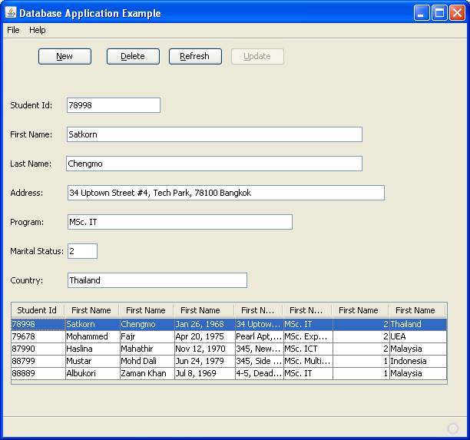
Architectural styles
Event – Based
Event producers/consumers
Producer
Producer
event distribution
register for events
consume events
Consumer
Consumer
D. Garlan and M. Shaw, An Introduction to Software Architecture, Advances in Software Engineering and Knowledge Engineering, Volume I , 1993

Slide 37
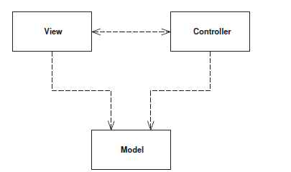
Architectural styles
Model – View – Controller (MVC)
The model represents some information about the domain.
The view represents the display of the model in the UI.
The controller takes user input, manipulates
the model, and causes the view to update appropriately.
In this way UI is a combination of the view and the controller.

Slide 38
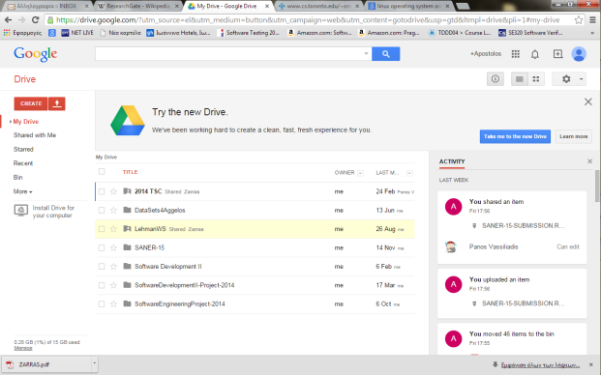
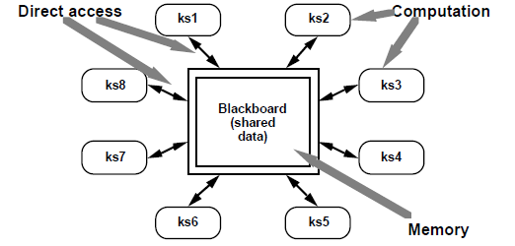
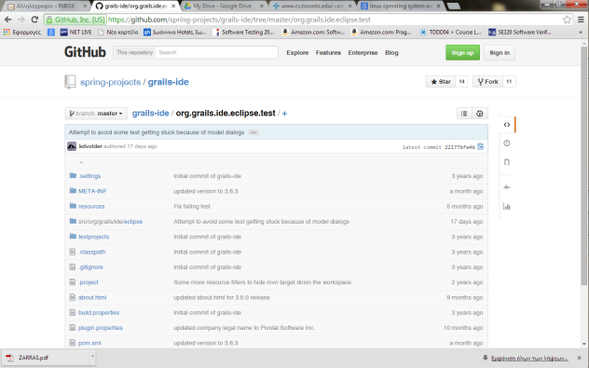
Architectural styles
Blackboard/repository
D. Garlan and M. Shaw, An Introduction to Software Architecture, Advances in Software Engineering and Knowledge Engineering, Volume I , 1993

Slide 39
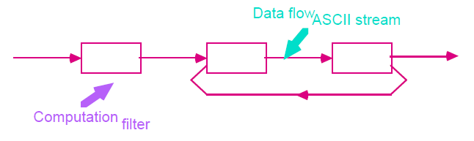
Architectural styles
$ls -l | grep "Aug"
-rw-rw-rw- 1 john doc 11008 Aug 6 14:10 ch02
-rw-rw-rw- 1 john doc 8515 Aug 6 15:30 ch07
-rw-rw-r-- 1 john doc 2488 Aug 15 10:51 intro
-rw-rw-r-- 1 carol doc 1605 Aug 23 07:35 macros $
$ls -l | grep "Aug" | sort +4n | more
-rw-rw-r-- 1 carol doc 1605 Aug 23 07:35 macros
-rw-rw-r-- 1 john doc 2488 Aug 15 10:51 intro
-rw-rw-rw- 1 john doc 8515 Aug 6 15:30 ch07
-rw-rw-r-- 1 john doc 14827 Aug 9 12:40 ch03 . . .
-rw-rw-rw- 1 john doc 16867 Aug 6 15:56 ch05
--More--(74%)
Pipes and filters
D. Garlan and M. Shaw, An Introduction to Software Architecture, Advances in Software Engineering and Knowledge Engineering, Volume I , 1993

Slide 40
Design patterns

Slide 41

Design patterns
Christopher Alexander says,
"Each pattern describes a problem which occurs over and over again in our environment, and then describes the core of the solution to that problem, in such a way that you can use this solution a million times over, without ever doing it the same way twice"

Slide 42
Gang of Four (GoF) patterns for OO design

Slide 43
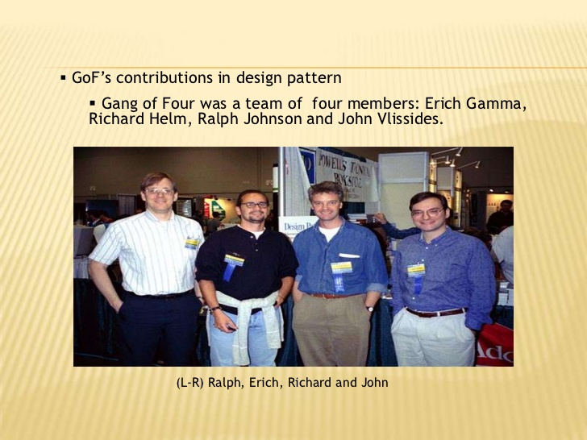
GoF Patterns
GoF say:
The design patterns are descriptions of communicating objects and classes that are customized to solve a general design problem in a particular context.
Design Patterns: Elements of Reusable Object Oriented Software,” Gamma, Helm, Johnson, Vlissides, Addison-Wesley, 1995

Slide 44
Classification of GoF patterns
Creational | Structural | Behavioral
Factory Method Abstract Factory Builder Prototype Singleton | Adapter Bridge Composite Decorator Flyweight Facade Proxy | Interpreter Template Method Chain of Responsibility Command Iterator Mediator Memento Observer State Strategy Visitor
Notes:
Creation, structure and collaboration between objects

Slide 45

Parameterized Factory

Slide 46
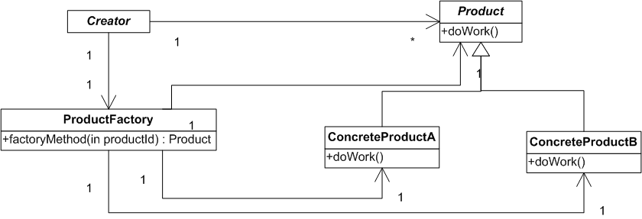
Parameterized Factory
Structure
Parameterized factory. A variation of
factory method that lets us create multiple kinds of products without depending on their concrete classes. The factory method takes a parameter that identifies the kind of object to create, creates the object and returns it to the caller.
Notes:
Separate the code that creates objects that belong to a hierarchy of classes from the code that uses them

Slide 47
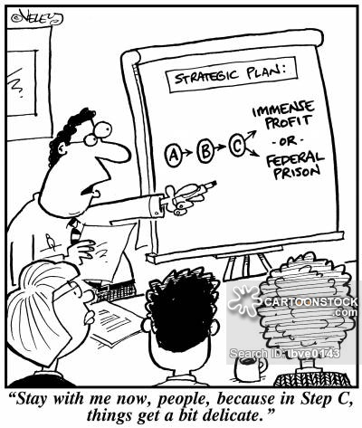
Strategy

Slide 48
Strategy
Intent
Define a family of algorithms, encapsulate each one, and make them interchangeable.
Strategy lets the algorithm vary independently from clients that use it.

Slide 49
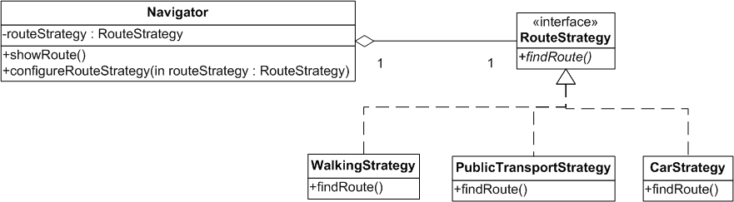
Strategy
Motivation

Slide 50
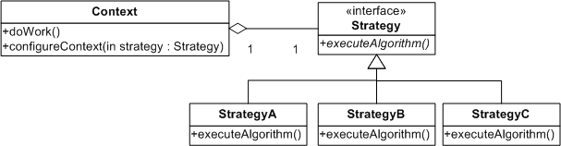
Strategy
Structure
Strategy (RouteStrategy) declares an interface common to all supported algorithms. Context uses this interface to call the algorithm defined by a ConcreteStrategy.
StrategyA, StrategyB, …. (WalkingStrategy, CarStrategy, …) implements the algorithm using the Strategy interface.
Context (Navigator) is configured with a ConcreteStrategy object. Maintains a reference to a Strategy object. May define an interface that lets Strategy access its data.
Example: https://github.com/zarras/myy803-GoF-patterns-tutorials/tree/master/Strategy

Slide 51
Strategy
Benefits
We can isolate Context from the implementation details of an algorithm.
We can add new strategies without having to change Context.
We can avoid complex conditionals that realize the alternative algorithms in Context.
We can swap algorithms used inside a Context object at runtime.
Liabilities
Specifying a common interface for different algorithms may not be easy.
Strategies increase the number of objects in an application.

Slide 52

Template Method

Slide 53
Template Method
Intent
Define the skeleton of an algorithm in an operation, deferring some steps to subclasses. Template Method lets subclasses redefine certain steps of an algorithm without changing the algorithm's structure.

Slide 54
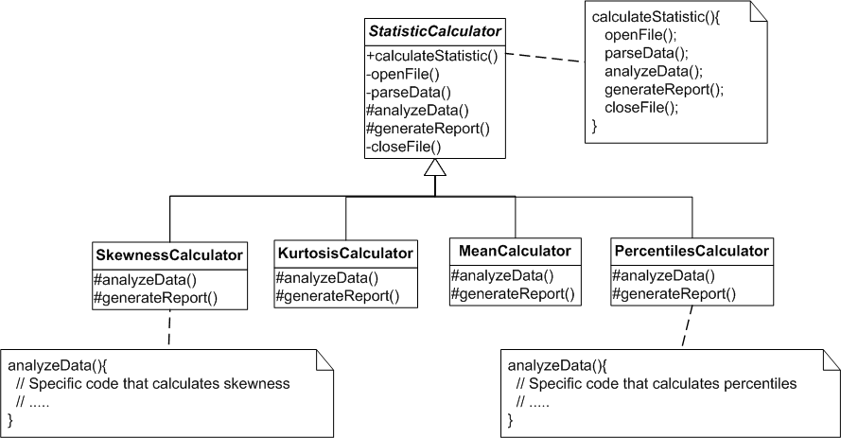
Template Method
Motivation

Slide 55
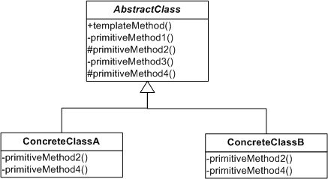
Template Method
Structure
AbstractClass (StatisticCalculator) defines abstract primitive operations that concrete subclasses define to implement steps of an algorithm. Implements a template method defining the skeleton of an algorithm.
The template method calls primitive operations as well as abstract operations defined in AbstractClass or those of other objects.
ConcreteClass (KurtosisCalculator, …) implements the primitive operations to carry out subclass-specific steps of the algorithm.
Example: https://github.com/zarras/myy803-GoF-patterns-tutorials/tree/master/TemplateMethod

Slide 56
Template Method
Benefits
Template methods are a fundamental technique for code reuse. They are particularly important in class libraries, because they are the means for factoring out common behavior and reduce duplication.
Liabilities
To reuse an abstract class effectively, subclass writers must understand which operations are designed for overriding and how this should be done.

Slide 57

Adapter

Slide 58
Adapter
Intent
Convert the interface of a class into another interface clients expect. Adapter lets classes work together that couldn't otherwise because of incompatible interfaces.

Slide 59
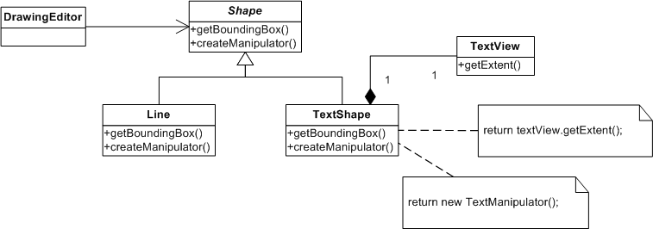
Adapter
Motivation

Slide 60
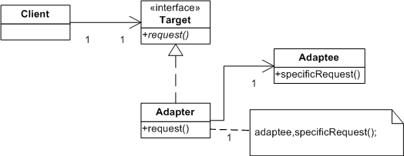
Adapter
Structure
Object Adapter
Target (Shape) defines the domain-specific interface that Client uses.
Client (DrawingEditor) collaborates with objects conforming to the Target interface.
Adaptee (TextView) defines an existing interface that needs adapting.
Adapter (TextShape) adapts the interface of Adaptee to the Target interface.
Example: https://github.com/zarras/myy803-GoF-patterns-tutorials/tree/master/Adapter

Slide 61
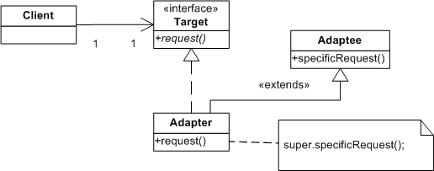
Adapter
Structure
Class Adapter
Target (Shape) defines the domain-specific interface that Client uses.
Client (DrawingEditor) collaborates with objects conforming to the Target interface.
Adaptee (TextView) defines an existing interface that needs adapting.
Adapter (TextShape) adapts the interface of Adaptee to the Target interface.

Slide 62
Adapter
Benefits
Adaptees added/used without changes to existing code.
Liabilities
The overall complexity of the code increases because we add new classes and a level of indirection.

Slide 63
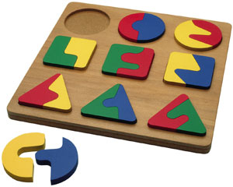
Composite

Slide 64
Composite
Intent
Compose objects into structures to represent part-whole hierarchies. Composite lets clients treat individual objects and compositions of objects uniformly.
Notes:
Files directories and - client stats counting

Slide 65
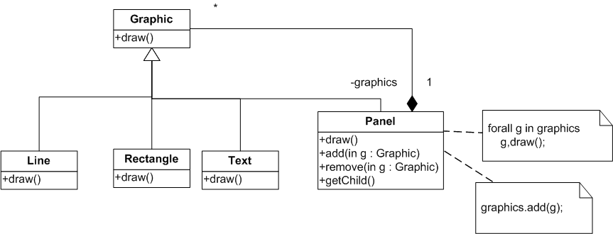
Composite
Motivation
To realize the graphics….

Slide 66
Composite
Motivation
To realize the graphics….
In some cases specifying the common methods in an interface may not be enough.
E.g. a client class has a list of Graphic and wants to add(graphic) in all the panels of this list … In this case the client has to check every list element to see if it is a composite panel ….

Slide 67
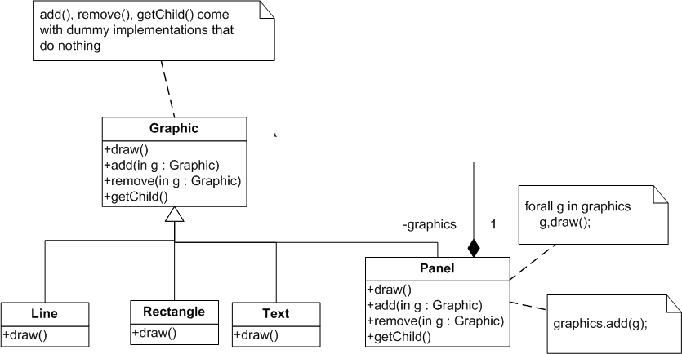
Composite
To solve this problem we can maximize the common interface of primitive and composite objects…. Make it the union of the provided methods … to avoid implementing the panel specific methods on every primitive graphic we can define dummy implementations
Motivation

Slide 68
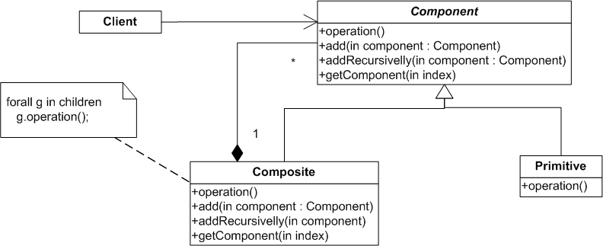
Composite
Structure
Component (Graphic) declares the interface for objects in the composition; implements default behavior for the interface common to all classes.
Primitive (Rectangle, Line, Text, etc.) represents leaf objects in the composition.
Composite (Picture) defines behavior for components having children.
Client manipulates objects in the composition through the Component interface.
Example: https://github.com/zarras/myy803-GoF-patterns-tutorials/tree/master/Composite

Slide 69
Composite
Benefits
Makes the clients simple. Clients can treat composite structures and individual objects uniformly.
Makes it easier to add new kinds of components. Newly defined Composite or Leaf subclasses work automatically with existing structures and client code.
Liabilities
Can make your design too general. The disadvantage of making it easy to add new components is that it makes it harder to restrict the components of a composite.

Slide 70
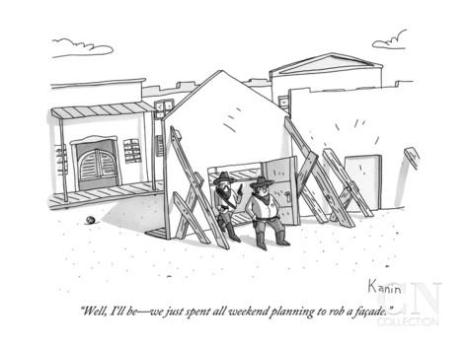
Façade

Slide 71
Façade
Intent
Provide a unified interface to a set of interfaces in a subsystem. Facade defines a higher-level interface that makes the subsystem easier to use.

Slide 72
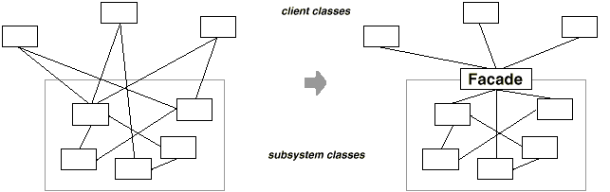
Façade
Motivation

Slide 73
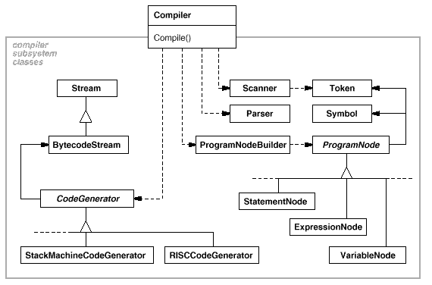
Façade
Motivation

Slide 74
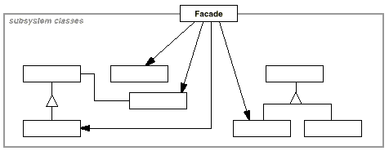
Façade
Structure
Facade (Compiler) knows which subsystem classes are responsible for a request. Delegates client requests to appropriate subsystem objects.
Subsystem classes (Scanner, Parser, ProgramNode, etc.)
implement subsystem functionality.
handle work assigned by the Facade object.
have no knowledge of the facade; that is, they keep no references to it.
Example: https://github.com/zarras/myy803-GoF-patterns-tutorials/tree/master/Facade

Slide 75
Facade
Benefits
Façade shields clients from subsystem components, thereby reducing the number of objects that clients deal with and making the subsystem easier to use.
Façade doesn't prevent applications from using subsystem classes if they need to.
Liabilities
Façade can be become a God (complex) class.

Slide 76

Command

Slide 77
Command
Intent
Encapsulate an action as an object, thereby letting you parameterize clients with different actions, queue or log actions, and support undoable/redoable actions.

Slide 78
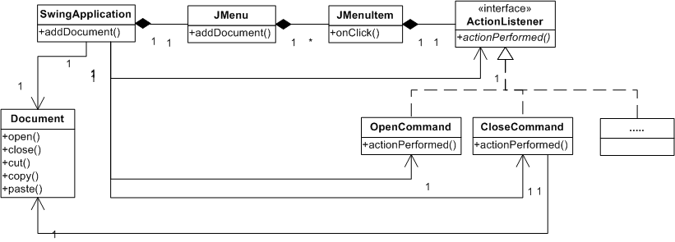
Command
Motivation
Every menu item should do a diff. action
Represents all the different actions

Slide 79
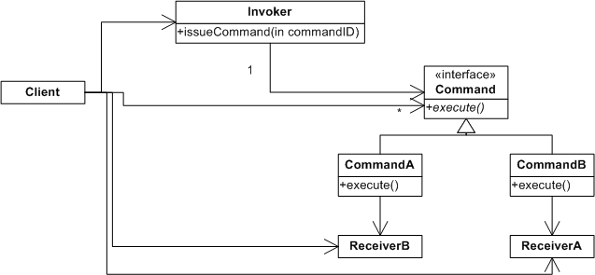
Command
Structure
Command declares an interface for executing an action.
ConcreteCommand (PasteCommand, OpenCommand) defines a binding between a Receiver object and an action. implements Execute by invoking the corresponding operation(s) on Receiver.
Client (Application) creates a ConcreteCommand object and sets its receiver.
Invoker (JMenuItem) asks the command to carry out the request.
Receiver (Document, Application) knows how to perform the operations associated with carrying out a request. Any class may serve as a Receiver.

Slide 80
Command
Benefits
Command decouples the object that invokes the operation from the one that knows how to perform it.
We can assemble commands into a composite command, queue or log commands
It's easy to add new Commands because you don't have to change existing classes.
Liabilities
The code may become more complicated since you’re introducing a new layer between invokers and receivers.
Specifying a common interface for different commands may not be easy.

Slide 81
Martin Fowler’s
Enterprise Application Architecture (EAA) Patterns

Slide 82
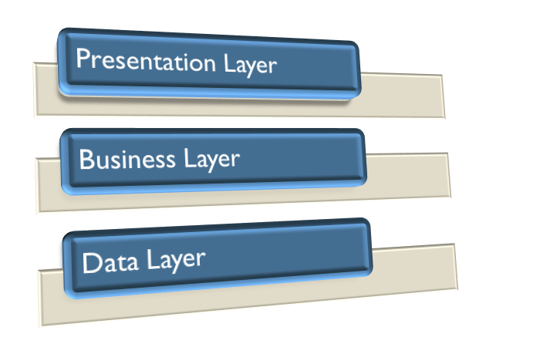
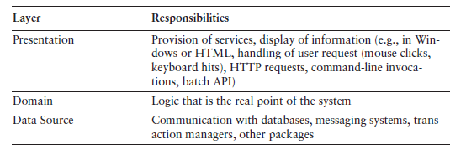
Enterprise Application Architecture
Enterprise Application Architecture

Slide 83
Business logic patterns

Slide 84
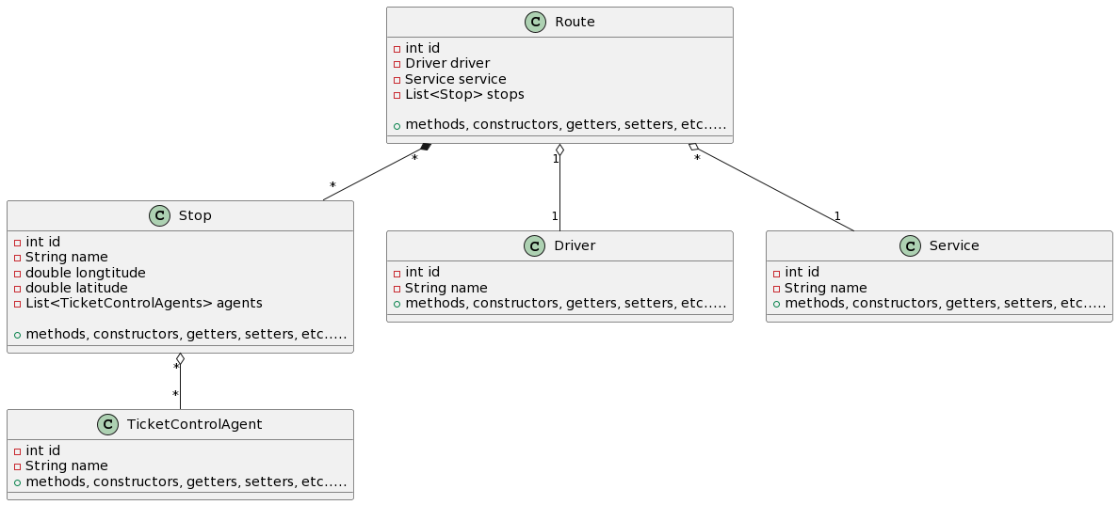
Domain Model
An object model of the domain that incorporates both behavior and data. A different object per table tuple/row …..
Example:
https://github.com/zarras/myy803-EAAP-tutorials/tree/main/domainmodel.datamapper

Slide 85
Domain Model
An object model of the domain that incorporates both behavior and data.
At its worst business logic can be very complex.
Rules and logic describe many different cases and slants of behavior, and it's this complexity that objects were designed to deal with.
A Domain Model creates a web of interconnected objects, where each object represents some meaningful concept.
Good for real world complex business logic.
Notes:
Employee calculateSalary template based on different strategies (salary, marital status)
Engineer,
Salesman

Slide 86
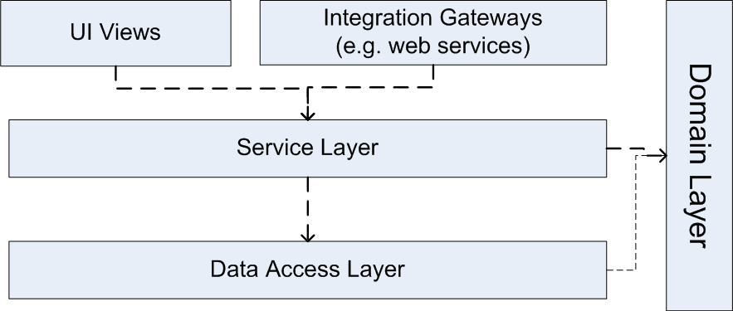
Service Layer
Defines an application's boundary with a layer of services that establishes a set of available operations and coordinates the application's response in each operation.
Enterprise applications typically require different kinds of interfaces to the data: HTML, REST, others.
Despite their different purposes, these interfaces often need common interactions with the application to access and manipulate its data and invoke its business logic.
Encoding the logic of the interactions separately in each interface causes a lot of duplication..
If an application has or will have to support different types of clients with different interfacing requirements.

Slide 87
Patterns for mapping the domain model to the database schema

Slide 88
ORM
Mapping objects to database relations and vice versa is called Object-Relational Mapping (ORM).
The KEY IDEA is that
→ we have a DB relation/table in the Data layer per class of objects in the Domain layer and
→ each object is stored as a table row

Slide 89
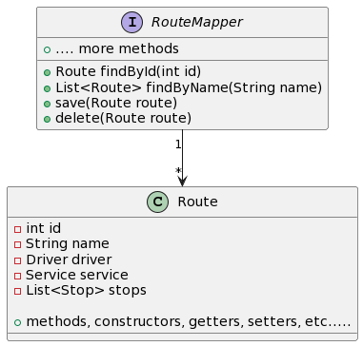
Data Mapper
A set of Mappers moves data between objects and a database while keeping them independent of each other and the mapper itself.
Example:
https://github.com/zarras/myy803-EAAP-tutorials/tree/main/domainmodel.datamapper.springboot

Slide 90
Data Mapper
Also known as Repository, Data Access Object (DAO)
A set of Mappers moves data between objects and a database while keeping them independent of each other and the mapper itself.
The Data Mapper is a layer of software that separates the in-memory objects from the database. Its responsibility is to transfer data between the two and also to isolate them from each other.
With Data Mapper the in-memory objects needn't know even that there's a database present.
Fits well with Domain Model.

Slide 91
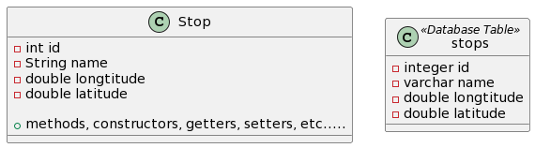
Identity Field
Saves a database ID field in an object to maintain identity between an in-memory object and a table row.
Intent
Reading data from a database is all very well, but in order to write data back you need to tie the database to the in-memory object system.
In essence, Identity Field is mind-numbingly simple. All you do is store the primary key of the relational database table in the object’s fields.
Example:
https://github.com/zarras/myy803-EAAP-tutorials/tree/main/foreignkey.mapping

Slide 92
Foreign Key Mapping
Maps an association between objects to a foreign key reference between tables.
Objects can refer to each other directly by object references.
To save these objects to a database, it’s vital to save these references.
A Foreign Key Mapping maps an object reference to a foreign key in the database.
Example:
https://github.com/zarras/myy803-EAAP-tutorials/tree/main/foreignkey.mapping

Slide 93
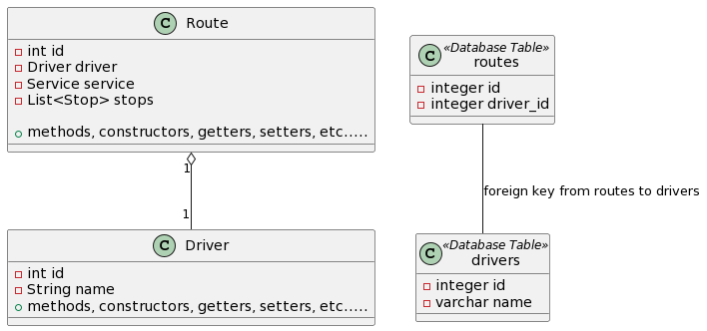
Foreign Key Mapping
Maps an association between objects to a foreign key reference between tables.
One-to-One relation – Route to Driver

Slide 94
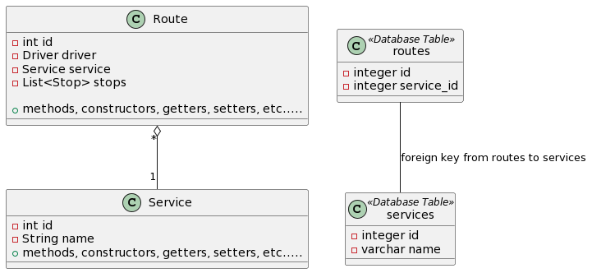
Foreign Key Mapping
Maps an association between objects to a foreign key reference between tables.
Many-to-One relation – Route to Service

Slide 95
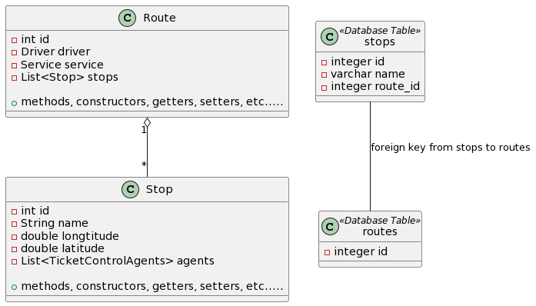
Foreign Key Mapping
Maps an association between objects to a foreign key reference between tables.
One-to-Many relation – Route to Stop
Example:
https://github.com/zarras/myy803-EAAP-tutorials/tree/main/foreignkey.mapping

Slide 96
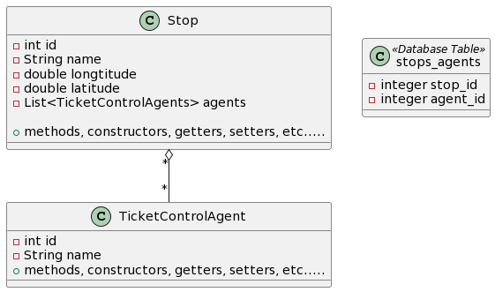
Association Table Mapping
Saves a Many-to-Many association as a table with foreign keys to the tables that are linked by the association.
Example:
https://github.com/zarras/myy803-EAAP-tutorials/tree/main/foreignkey.mapping

Slide 97
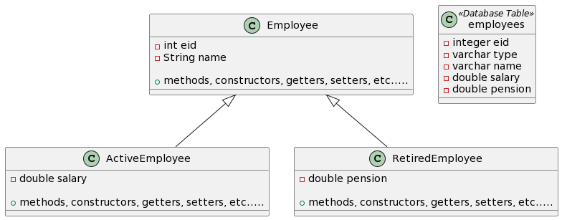
Single Table Inheritance
Represents an inheritance hierarchy of classes as a single table that has columns for all the fields of the various classes.
Example:
https://github.com/zarras/myy803-EAAP-tutorials/tree/main/singletable.inheritence

Slide 98
Single Table Inheritance
There’s only a single table to worry about on the database. There are no joins in retrieving data. Any refactoring that pushes fields up or down the hierarchy doesn’t change the DB.
Fields are sometimes relevant and sometimes not, which can be confusing. Columns used only by some subclasses lead to wasted space in the database. The single table may end up being too large.

Slide 99
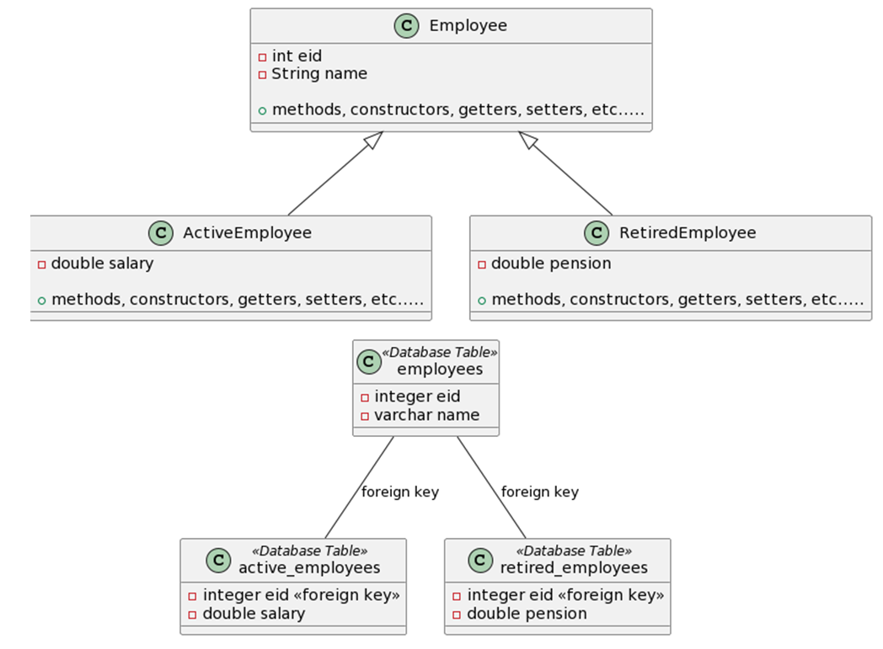
Class Table Inheritance
Represents an inheritance hierarchy of classes with one table for each class.
The linking between the tables can be done by foreign keys between the tables
Example:
https://github.com/zarras/myy803-EAAP-tutorials/tree/main/classtable.inheritence

Slide 100
Class Table Inheritance
Represents an inheritance hierarchy of classes with one table for each class.
All columns are relevant for every row so tables are easier to understand and don’t waste space.
The relationship between the domain model and the database is straightforward.
Need to touch multiple tables to load an object, which means a join or multiple queries and sewing in memory.
Any refactoring of fields up or down the hierarchy causes database changes.

Slide 101
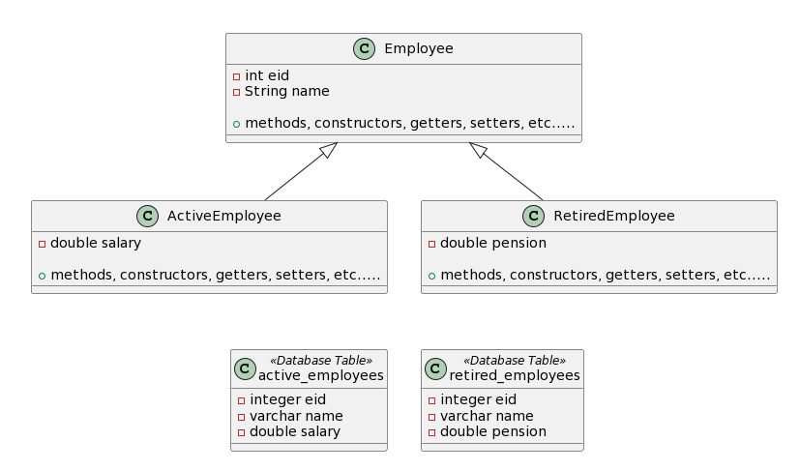
Concrete Table Inheritance
Represents an inheritance hierarchy of classes with one table per leaf class in the hierarchy with all fields in the table row.
Example:
https://github.com/zarras/myy803-EAAP-tutorials/tree/main/concretetable.inheritence

Slide 102
Concrete Table Inheritance
Represents an inheritance hierarchy of classes with one table per leaf class in the hierarchy with all fields in the table row.
Each table is self-contained and has no irrelevant fields.
There are no joins to do when reading the data from the concrete mappers.
Each table is accessed only when that class is accessed, which can spread the access load.
Redundancy in the data
With fields are pushed up or down the hierarchy, you don’t have to alter the table definitions.
If a superclass field changes, you need to change each table.

Slide 103
Presentation logic patterns

Slide 104
Model View Controller
Splits user interface interaction into three distinct roles.
The model is an object that represents some
information about the domain.
The view represents the display of the model in the UI.
The controller takes user input, manipulates
the model, and causes the view to update appropriately.
In this way UI is a combination of the view and the controller.
The separation of presentation and model is one of the most important design principles in software, and the only time we shouldn’t follow it is in very simple systems where the model has no real behavior in it anyway.
Example:
https://github.com/zarras/myy803-EAAP-tutorials/tree/main/mvc.controller.templateengine

Slide 105
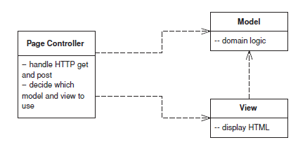
Page Controller
An object that handles a request for a specific page or action on a Web site.
The basic idea behind a Page Controller is to have one module on the Web server act as the controller for each page on the Web site.
In practice, it doesn’t work out to exactly one module per page, since you may get a different page depending on dynamic information.
More strictly, the controllers tie in to each action, which may be clicking a link or a button.
Page Controller works particularly well in a site where most of the controller navigational logic is pretty simple.

Slide 106
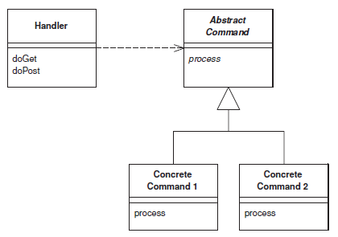
Front Controller
A controller that handles all requests for a Web site.
A Front Controller handles all calls for a Web site, and is usually structured in
two parts: A Web handler and a command hierarchy.
The Web handler is the object that actually receives post or get requests from the Web server. It pulls just enough information from the URL and the request to decide what kind of
action to initiate and then delegates to a command to carry out the action
Front Controller works particularly well in a site where the controller navigational logic is more complex.

Slide 107

Template View
Renders information into HTML by embedding markers in an HTML page.
The basic idea of Template View is to embed markers into a static HTML page
when it’s written.
When the page is used to service a request, the markers are replaced by the results of some computation, such as a database query.
The strength of Template View is that it allows you to compose the content of the page by looking at the page structure.
But they are not easy to use with complex generation logic and they are not easy to test.
Example:
https://github.com/zarras/myy803-EAAP-tutorials/tree/main/mvc.controller.templateengine

Slide 108

Transform View
A module that processes domain data element by element and transforms it into HTML.
The basic notion of Transform View is writing a program that looks at domain-oriented data and converts it to HTML.
The program walks the structure of the domain data and, as it recognizes each form of domain data, it writes out the particular piece of HTML for it.
Transform View does not mix HTML with view generation logic and is easier to test.
However, several people may prefer to have everything embedded in one module.

Slide 109
More topics on Software Design ……..

Slide 110
Cohesion
    LCOM3 = (m - Sum(ma_{i})/a) / (m – 1) [Henderson-Sellers, Constantine, Graham]
      the smaller the better…..
      = 0 perfect
      = 1 bad
      > 1 dead attributes
    LCOM3 = 0 ??
    why dead attributes if LCOM3 > 1 ?

Slide 111
public class Rectangle {
private double x;
private double y;
private double width;
private double height;
public Rectangle(double ax, double ay,
double aWidth, double aHeight){
  x = ax;
  y = ay;
  width = aWidth;
  height = aHeight;
}
……………………………………
}

Slide 112
public class Rectangle {
………………………………………..
public void draw(){
  System.out.println("Drawing Rectangle at : (" +
  x + "," + y +
  ") with width = " + width + " height = " + height);
  // drawing code ....
}
public double calculateArea(){
  return width * height;
}
}

Slide 113
m = 3, a = 4
ma_{x} = 2
ma_{y} = 2
ma_{width} = 3
ma_{height} = 3
LCOM3 = (3-10/4)/(3-1) = 0.25

Slide 114
Class complexity
  Request For a Class (RFC) [Chidamber & Kemerer]
  RFC(A) = M + R
  M = number of class methods
  R = number of methods called by the class methods (with each method counts once if called multiple times
  ➔ Usually we only count methods of the same project – we do not consider standard API calls and so on.

Slide 115
class Controller {
private boolean alarm;
private Bell b;
private Light l;
public Controller(Bell ab, Light al){
  alarm = false;
  b = ab;
  l = al;
}
public void alarmSignal(){
  alarm = true;
}
public void cancelAlarm(){
  alarm = false;
  System.out.println("False alarm !!");
}
…………………………….
}

Slide 116
class Controller {
private boolean alarm;
private Bell b;
private Light l;
…………………………………….
public void confirmAlarm (){
  if (alarm == true) {
  if(b != null) b.ring();
  if(l!=null) l.open();
  alarm = false;
  } else
  System.out.println("False alarm !!");
}
public void stopAlarm(){
  if(b != null) b.stop();
  if(l!=null) l.close();
}
}
RFC(Controller) = 5 + 4

Slide 117
Reuse vs complexity
  Depth of Inheritance Tree (DIT) [Chidamber & Kemerer]
  DIT(A) = depth of A in the tree
  Number of Children (NOC) [Chidamber & Kemerer]
  NOC(A) = number of subclasses A has

Slide 118

DIT(Student) = 0
DIT(GradStudent) = 1
NOC(Student) = 2
NOC(GradStudent) = 0

Slide 119
More GoF patterns …

Slide 120
Factory Method
(& Parameterized Factory Variant)

Slide 121
Factory Method
Intent
Factory Method lets a class defer instantiation of the objects it needs to its subclasses.

Slide 122

Factory Method
Motivation

Slide 123

Factory Method
Structure
Product (Document) defines the interface of objects the factory method creates.
ConcreteProduct (LatexDocument) implements the Product interface.
Creator (DocumentStatisticsCalculator) declares the factory method, which returns an object of type Product; may call the factory method to create a Product object.
ConcreteCreator (LatexStatisticsCalculator) overrides the factory method to return an instance of a ConcreteProduct.

Slide 124
Factory Method
Benefits
We avoid tight coupling between the Creator and the concrete Product objects.
We keep the Product object creation code in one place.
We can introduce new types of products into the program without changing Creator code.
Liabilities
We need to add several small subclasses to implement the pattern.

Slide 125

Prototype

Slide 126
Prototype
Intent
Specify the kinds of objects to create using a prototypical instance, and create new objects by copying this prototype.

Slide 127

Prototype
To realize the graphic elements…
To realize the tools…
Motivation

Slide 128

Prototype
Structure
Prototype (Graphic) declares an interface for cloning itself.
ConcretePrototype (Staff, WholeNote, HalfNote) implements an operation for cloning itself.
Client (GraphicTool) creates a new object by asking a prototype to clone itself.

Slide 129
Prototype
Benefits
We can create objects without coupling to their concrete classes. So, we can easily parameterize the creating objects with different classes of prototypical objects.
We can get rid of repeated initialization code in favor of cloning pre-built prototypes and produce complex objects more conveniently.
Liabilities
Cloning complex objects can be tricky. Shallow vs deep copies, circular dependencies, ….

Slide 130

Singleton

Slide 131
Singleton
Intent
Ensure a class only has one instance, and provide a global point of access to it.

Slide 132
Singleton
Motivation
It's important for some classes to have exactly one instance.
Although there can be many printers in a system, there should be only one printer spooler.
There should be only one file system and one window manager.
An accounting system will be dedicated to serving one company.
How do we ensure that a class has only one instance and that the instance is easily accessible?
A nice solution is to make the class itself responsible for keeping track of
its sole instance.

Slide 133

Singleton
Structure
if(uniqueInstance == null){
uniqueInstance = new Singleton();
}
return uniqueInstance;

Slide 134
Singleton
Benefits
Guarantees that a class has only a single object.
Provides a global access point to that object.
Liabilities
Mixing object management with object behavior in one class.
A global unique object can make debugging and unit testing difficult; singleton objects cannot be easily mocked.

Slide 135

Decorator

Slide 136
Decorator
Intent
Decorators provide a flexible alternative to subclassing for extending functionality.
… lets us attach new behaviors/features to objects by placing these objects inside special wrapper objects that contain the new behaviors/features.

Slide 137

Decorator
Inheritance is static: from the moment
you create an object you cannot add/remove
Functionalities/features
Motivation
With inheritance cannot add functionalities dynamically – after the object creation
Notes:
1) We could create subclasses to add border and scroll bar
2) We could add these features in the TextView class
Both solutions are problematic.

Slide 138

Decorator
Motivation
Represents all the possible extensions we would make
Overrides Draw()
to realize the extended
functionality

Slide 139
Decorator
Intent
Decorators provide a flexible alternative to subclassing for extending functionality.
Applicability
to add responsibilities to individual objects dynamically.
when extension by subclassing is impractical. Sometimes a large number of independent extensions are possible and would produce an explosion of subclasses to support every combination.
When a class definition may be hidden or otherwise unavailable for subclassing.

Slide 140

Decorator
Structure
Overrides Operation()
to realize the extended
functionality
Component (VisualComponent) defines the interface for objects that can have responsibilities added to them dynamically.
ConcreteComponent (TextView) defines a class of objects to which additional responsibilities can be attached.
Decorator maintains a reference to a Component object and defines an interface that conforms to Component's interface.
ConcreteDecorator (BorderDecorator, ScrollDecorator) adds responsibilities to the component.

Slide 141
Decorator
Benefits
More flexibility than static inheritance. The Decorator pattern provides a more flexible way to add responsibilities to objects than can be had with static (multiple) inheritance.
  With decorators, responsibilities can be added and removed at run-time simply by placing objects inside decorators.
  In contrast, inheritance requires creating a new class for each additional responsibility (and combinations of responcibilities). This gives rise to many classes and increases the complexity of a system.
Also avoids feature-laden classes high up in the hierarchy.
  Instead of trying to support all foreseeable features in a complex, customizable class, we can define a simple class and add functionality incrementally with Decorator objects.
Liabilities
Lots of small objects. Although these systems are easy to customize by those who understand them, they can be hard to learn and debug.

Slide 142

Observer

Slide 143
Observer
Intent
Define a one-to-many association between objects so that when one object changes state, all its dependents are notified and updated automatically.

Slide 144

Observer
Motivation

Slide 145

Observer
Structure
Subject knows its observers. Any number of Observer objects may observe a Subject object. Subject Provides an interface for attaching and detaching Observer objects.
Observer defines an updating interface for objects that should be notified of changes in a subject.
ConcreteSubject stores state of interest to ConcreteObserver objects. Sends a notification to its observers when its state changes.
ConcreteObserver maintains a reference to a ConcreteSubject object. Stores state that should stay consistent with the subject's. Implements the Observer updating interface to keep its state consistent with the subject's.

Slide 146
Observer
Benefits
The coupling between subjects and observers is abstract and minimal.
We can introduce new Observer classes without having to change the Subject class.
We can establish relations between objects at runtime.
Liabilities
Unexpected/unwanted notifications.

Slide 147
User interface design

Slide 148
What are the fundamental UI design principles?

Slide 149

UI design principles
Learnability.
The software should be easy to learn so that the user can rapidly start working with the software.
User familiarity.
The interface should use terms and concepts drawn from the experiences of the people who will use the software.
Consistency.
The interface should be consistent so that comparable operations are activated in the same way.
Minimal surprise.
The behavior of software should not surprise users.

Slide 150
UI modalities
Recoverability.
The interface should provide mechanisms allowing users to recover from errors.
User guidance.
The interface should give meaningful feedback when errors occur and provide context-related help to users.
User diversity.
The interface should provide appropriate interaction mechanisms for diverse types of users and for users with different capabilities (blind, poor eyesight, deaf, colorblind, etc.).

Slide 151
How should the user interact with the software?

Slide 152
UI modalities
Question-answer.
The interaction is essentially restricted to a single question-answer exchange between the user and the software.
Direct manipulation.
Users interact with objects on the computer screen. Direct manipulation often includes a pointing device (such as a mouse, trackball, or a finger on touch screens) that manipulates an object and invokes actions that specify what is to be done with that object.
Menu selection.
The user selects a command from a menu list of commands.

Slide 153
UI modalities
Form fill-in.
The user fills in the fields of a form. Sometimes fields include menus, in which case the form has action buttons for the user to initiate action.
Command language.
The user issues a command and provides related parameters to direct the software what to do.
Natural language.
The user issues a command in natural language. That is, the natural language is a front end to a command language and is parsed and translated into software commands.
Notes:
• Question-answer. The interaction is essentially
restricted to a single question-answer
exchange between the user and the software.
The user issues a question to the software,
and the software returns the answer to the
question.
• Direct manipulation. Users interact with
objects on the computer screen. Direct
manipulation often includes a pointing
device (such as a mouse, trackball, or a finger
on touch screens) that manipulates an
object and invokes actions that specify what
is to be done with that object.
• Menu selection. The user selects a command
from a menu list of commands.
• Form fill-in. The user fills in the fields of a
form. Sometimes fields include menus, in
which case the form has action buttons for
the user to initiate action.
• Command language. The user issues a command
and provides related parameters to
direct the software what to do.
• Natural language. The user issues a command
in natural language. That is, the natural
language is a front end to a command language
and is parsed and translated into software
commands.

Slide 154
How should information from the software be presented to the user?

Slide 155
UI information presentation
Limit the number of colors used.
Use color change to show the change of software status.
Use color-coding to support the user’s task.
Use color-coding in a thoughtful and consistent way.
Use colors to facilitate access for people with color blindness or color deficiency (e.g., use the change of color saturation and color brightness, try to avoid green and red combinations).
Don’t depend on color alone to convey important information to users with different capabilities.

